Slide 1
Design of bulk supply network in the southern West Bank
Prepared by: Muna Faidi
Aya Nofal

Slide 2
Introduction And General Description Of The Project
This study is concerned with the development of bulk water supply system in the southern parts of the West Bank which consist mainly of Bethlehem and Hebron governorates. The current Palestinian

Slide 3
Population in these two governorates is about 728,000 people distributed in about 137 localities.

Slide 4
Future forecasts
Population annual growth rates are estimated at about 3.5 % in the West Bank and predicted to reduce as a result of socio-economic development. This will result in doubling the population in less than 50 years. Thus, the population of the southern West Bank might exceed 1.7 million people in 50 years which will result in increasing water demands significantly and thus resulting in more severe shortages for water.

Slide 5
What we are aims to do?
To design Bulk water supply network in the southern West Bank.
Evaluate existing water resources and future demand.
Estimate additional supplies that will be needed to satisfy future demand.

Slide 6
Water recourses in Palestine
Surface Water Resources
Ground Water
1) The Shallow Aquifer System
2) The Upper Aquifer System
3) The Lower Aquifer System
4) The Deep Aquifer System

Slide 7
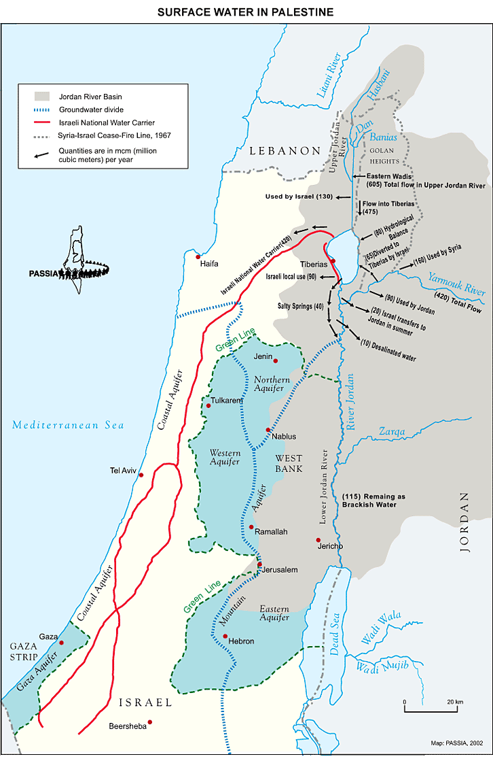

Slide 8
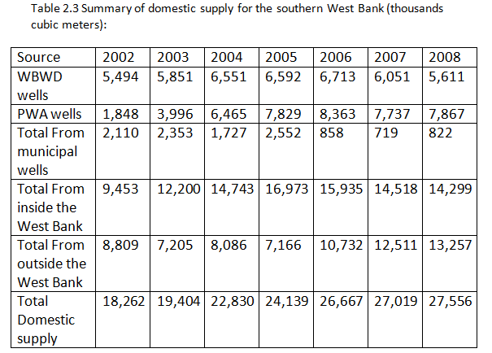

Slide 9
Locations
Bethlehem:
Bethlehem is a Palestinian city in the central West Bank, approximately 10km (6 mi) south of Jerusalem, at an altitude of about 765 m above sea level.

Slide 10
Hebron:
Hebron city , a Palestinian town located to the south of Jerusalem in the West Bank and away from Jerusalem, about 35 km, is the largest Palestinian cities in terms of population and area after the city of Gaza, the center of Hebron.

Slide 11
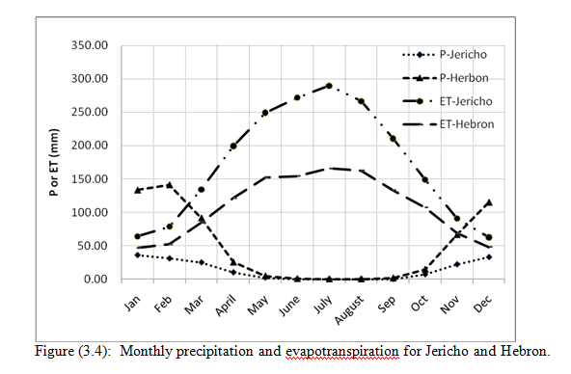
Climate Description rainfall and evaporation

Slide 12
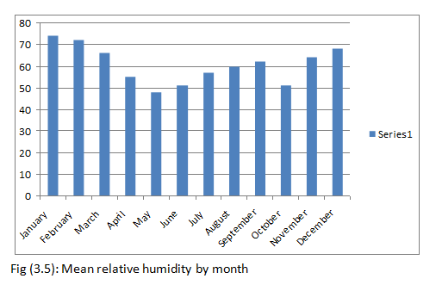
Humidity

Slide 13
Existing Water Demand
Bethlehem and Hebron consist from 137 locations as shown in table, and because of the difficulty of dealing with them we combined them in 27 .we take the elevation from Google Earth

Slide 14
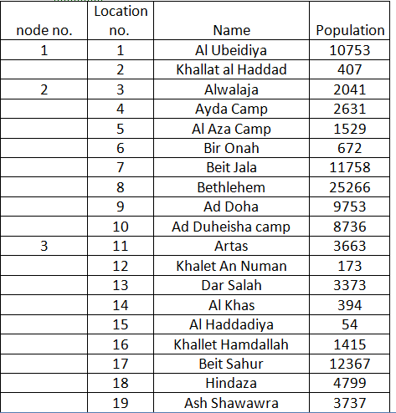
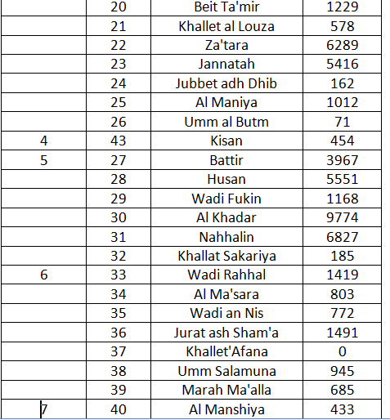

Slide 15
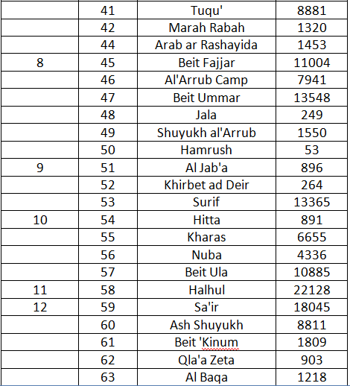
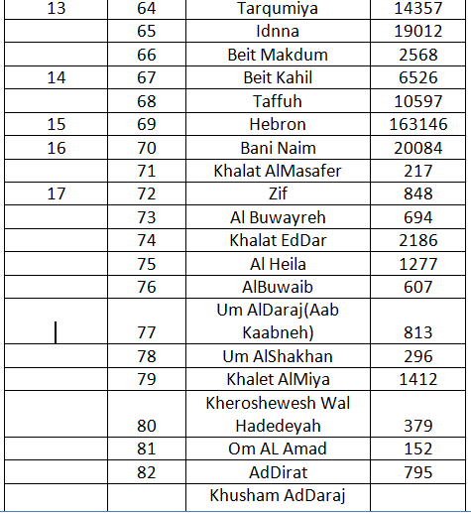

Slide 16
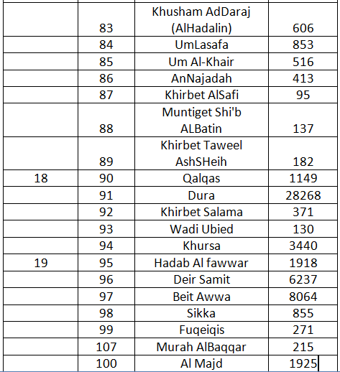
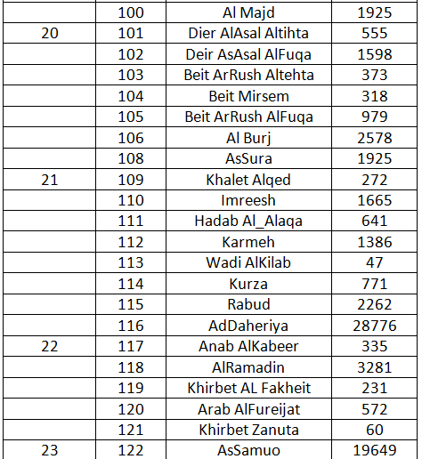

Slide 17
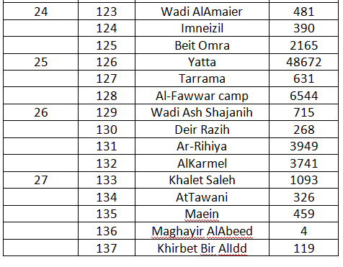

Slide 18
After that we calculate the water consumption by knowing the consumption for each person, that equals 100 l\day (36 m^3\year), it equals 2993 m^3\hr as shown in table

Slide 19
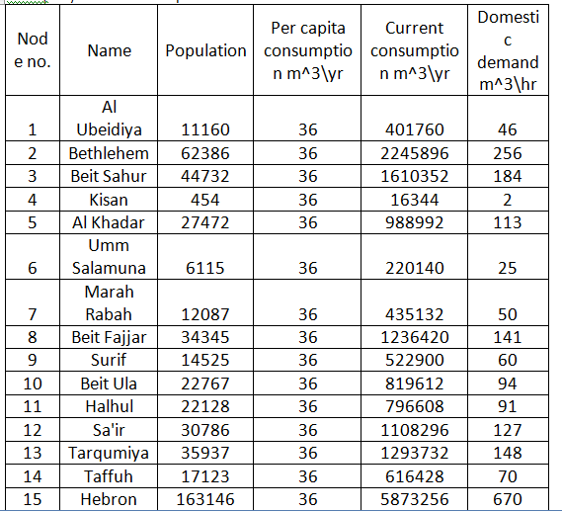

Slide 20
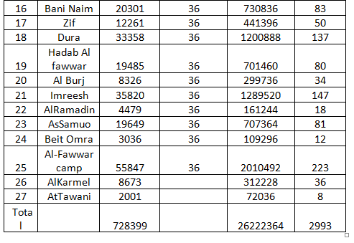

Slide 21
Future Water Demand
In future water demand, we calculate the populations in 2050 by take the rate of growth 2% it equals 1.7 million. Then we calculate the people consumption in is year, it equals 9820m^3/hr .we assume that consumption per capita day equals 140 L\day (40m^3/hr) in table .
Population Estimates:-
We have created a number of the population by the following equation:
P2050= P2007 *(1+r)^n.
N=43.
R=2%.

Slide 22
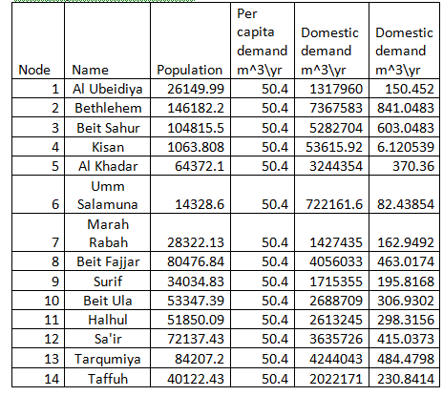

Slide 23
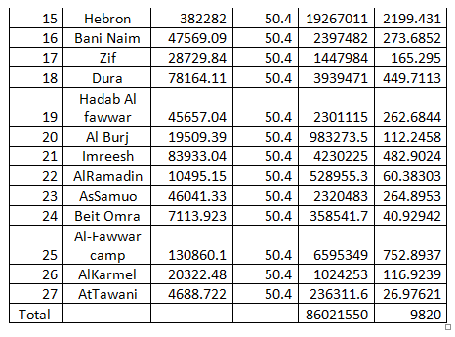

Slide 24
The total domestic demand for the southern West Bank way estimated at 9820 (m^3/hr) by year 2050.
Existing water recourses estimated at 2933 (m^3/hr).
Additional supply required to satisfy future needs for domestic demand in the southern West Bank is estimated at 6827(m^3/hr).

Slide 25
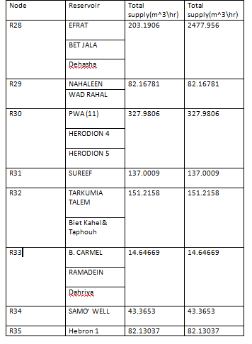

Slide 26
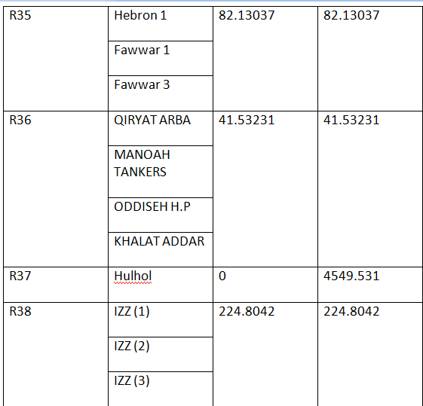

Slide 27
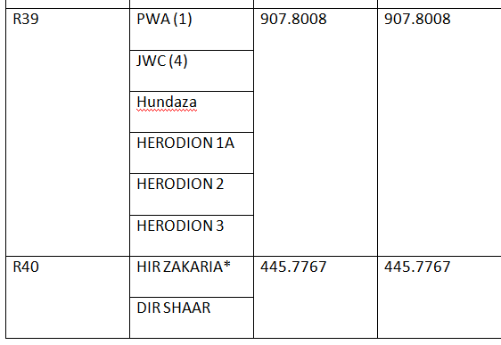

Slide 28
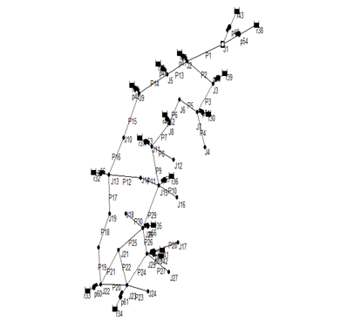
Schematic Diagram For The Area:

Slide 29
Modeling Of Bulk Supply System:
Water resources:
we uses reservoir to model
existing resources and future
resources in table

Slide 30
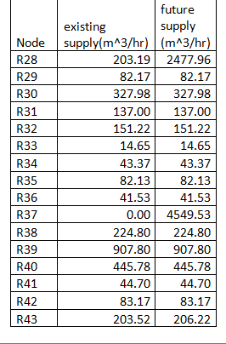

Slide 31
Reservoir with pumps
we need the estimate the pumping head at each pump.
We stared assuming heads 150 m
at each pump, we run the model.
If pressure is low at certain
node we increase the heads in table

Slide 32
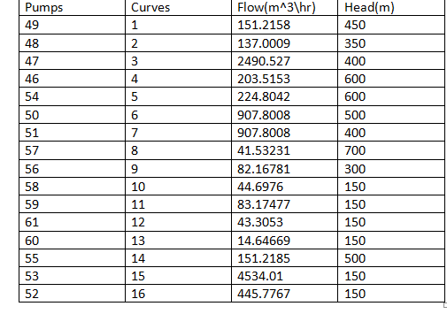

Slide 33
Modeling of pipes:
Iterative procedure:
Iterative for pipe sizes: we star with a size and run the model, estimate velocity (.3-3m/s), if velocity is high we increase the size, if velocity is too low we reduce the size. The results of the modeling as shown in table:

Slide 34
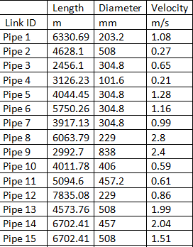

Slide 35
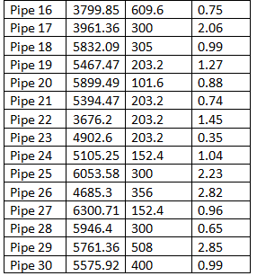

Slide 36
Thank You

