Slide 1
Graduation Project prepared by:
Muna Arda
Wafa’ Daraghmeh supervisor:
Emad Al-Qasem

Slide 2
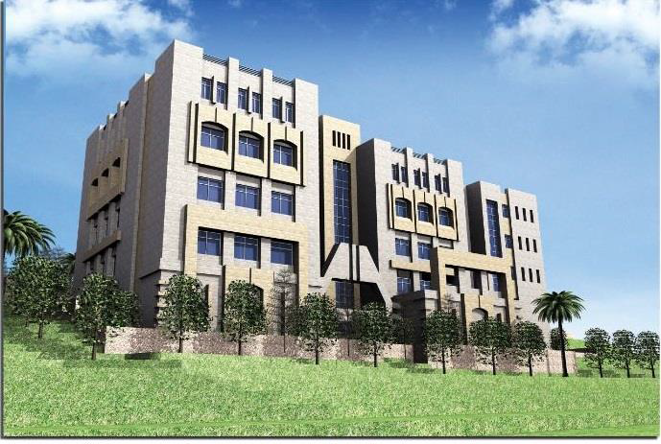
INTRUDUCTION :
  Structural Design of The Faculty of Allied Medical Sciences In Arab American University-Jenin.

Slide 3
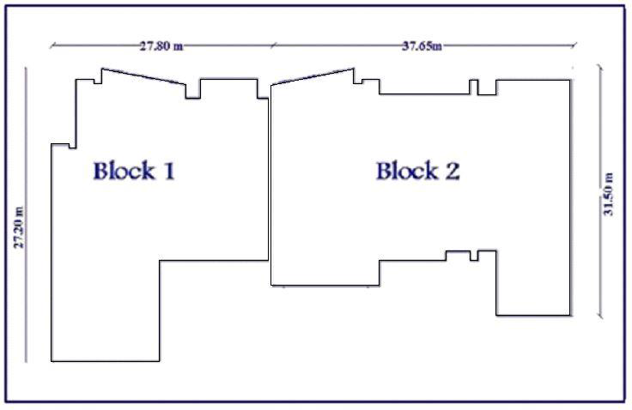
INTRUDUCTION :
  Project description:

Slide 4
INTRUDUCTION :
  design criteria:
  - Materials:
  1.Structural materials.
  2.Non-structural materials.
  -Soil properties :
  q all=350KN/m2.

Slide 5
INTRUDUCTION :
  Design criteria:
  -Codes and Standards:
  1.ACI 318-11.
  2.UBC-97 (Uniform Building Code)
  3. Jordanian National Building Code.
  -Loads :
  1. Gravity loads
  2.Lateral loads.

Slide 6
INTRUDUCTION :
Design criteria:
-Load combinations:
U = 1.4DACI318-11.
U = 1.2D + 1.6L + 0.5(Lr or S or R).
U = 1.2D + 1.6(Lr or S or R) + (1.0L or 0.5W) .
U = 1.2D + 1.0W + 1.0L + 0.5(Lr or S or R) .
U = 1.2D + 1.0E + 1.0L + 0.2S.
U = 0.9D + 1.0W.
U = 0.9D + 1.0E.

Slide 7
PRELIMINARY DESIGN.

Slide 8
PRELIMINARY DESIGN :
Slab design:
selected strips :

Slide 9


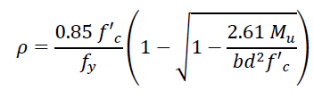
PRELIMINARY DESIGN :
Slab design:
1.laods:
2. shear check:
3.Flexure design:

Slide 10
PRELIMINARY DESIGN :
Slab design:
design results:
 | Block 1 | Block 2
Thickness: | 170 𝑚𝑚 | 150 𝑚𝑚
Reinforcement(+ve): | 5φ12 mm/m | 6φ12 mm/m

Slide 11
PRELIMINARY DESIGN :
Beam design:
Beams selected:

Slide 12
PRELIMINARY DESIGN :
Beam design:
1.laods:
2. shear check:
3.Flexure design:

Slide 13
PRELIMINARY DESIGN :
Beam design:
Design results:
 | Block 1 | Block 2
Dimensions(cm): | 60x70 | 60x50
Longitudinal reinforcement(+ve): | 8 φ 32 | 5 φ 25
Shear reinforcement: | 2 legs φ10 /10cm | 2 legs φ10 /20cm

Slide 14
SEISMIC LAODS.

Slide 15
SEISMIC LAODS :
Seismic load will be calculated depending on UBC-97.
Seismic parameters:
1.Soil type (rock)
2.seismic zone 2B .
3.zone factor is (Z= 0.2). TABLE 16-I .
4.site Soil Classification is SB, TABLE 16-J .

Slide 16
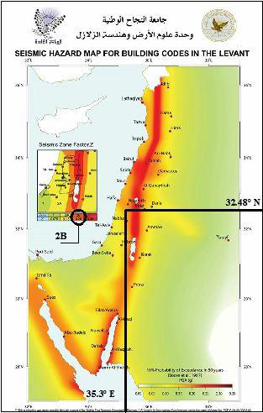
SEISMIC LAODS :
Palestine seismic map :

Slide 17

SEISMIC LAODS :
Seismic load calculations :
-structure period:
where:
ℎ𝑛=ℎ𝑒𝑖𝑔ℎ𝑡 𝑜𝑓 𝑡ℎ𝑒 𝑏𝑢𝑖𝑙𝑑𝑖𝑛𝑔=20.48 m.
Ct = 0.0488 for all other buildings.

Slide 18

SEISMIC LAODS :
Seismic load calculations :
-Determinations of base shear using static lateral force procedure:
Where:
W = the total seismic dead load.
Ie =the importance factor. TABLE 16-N
R =the response modification . TABLE 16-K
𝐶𝑣 = seismic coefficient . TABLE 16-R

Slide 19


SEISMIC LAODS :
-Determinations of base shear using static lateral force procedure:
The total design base shear need not exceed the following:-
Where: 𝐶𝑎 = seismic coefficient=0.2
The total design base shear shall not be less than the following:-

Slide 20
THREE DIMENSIONAL STRUCTURAL ANALYSIS AND DESIGN.

Slide 21
THREE DIMENSIONAL STRUCTURAL ANALYSIS AND DESIGN :
Modeling :
1. Material:
reinforced concrete ( 𝑓’𝑐= 28𝑀𝑃𝑎) .
2. Sections on sap:
columns.
Beams.
slabs.
Shear wall.

Slide 22
THREE DIMENSIONAL STRUCTURAL ANALYSIS AND DESIGN :
Modeling :
3. Loads on sap:
-Live load.
-Superimposed dead load.
- Seismic load:
A-equivalent static method
B-response spectrum and

Slide 23
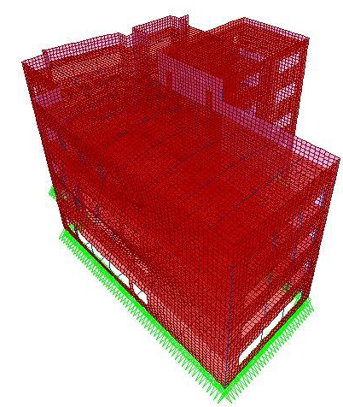
THREE DIMENSIONAL STRUCTURAL ANALYSIS AND DESIGN :
Verifications of structural analysis:
-Strength check .
-Compatibility of structural model:

Slide 24

THREE DIMENSIONAL STRUCTURAL ANALYSIS AND DESIGN :
-Period and modal participation ratio :
  Ritz vectors approach .
  Period of structure:
Where:
W: weight of each floor
F: lateral force subjected to the structure
Δ: displacement in x-direction at each floor results from Force (F) .

Slide 25
THREE DIMENSIONAL STRUCTURAL ANALYSIS AND DESIGN :
-Period and modal participation ratio :
  Period of structure:
 | T from Sap | T from the equation | % error
Block 1 | 0.2361 | 0.234 | 0.88
Block 2 | 0.1455 | 0.15 | 3.33

Slide 26
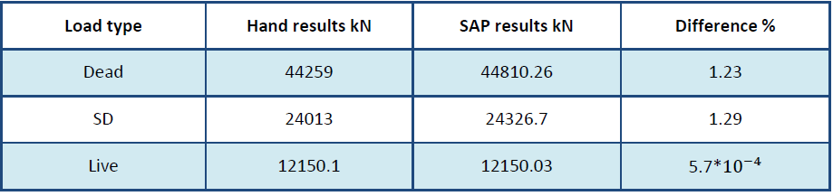
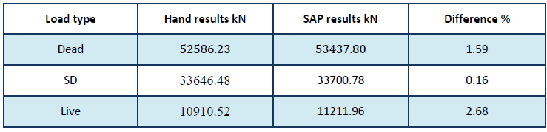
THREE DIMENSIONAL STRUCTURAL ANALYSIS AND DESIGN :
Equilibrium :
-Gravity load check for block 1:
-Gravity load check for block 2:

Slide 27
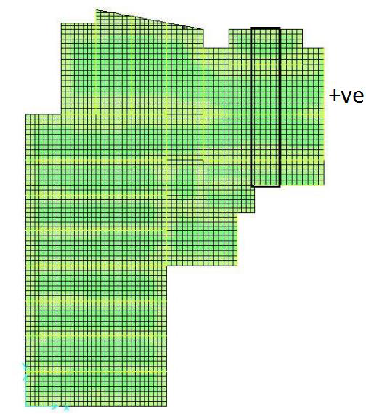
THREE DIMENSIONAL STRUCTURAL ANALYSIS AND DESIGN :
Stress Strain relationship (internal equilibrium) :
Slab moment :
BLOCK1 BLOCK2

Slide 28
THREE DIMENSIONAL STRUCTURAL ANALYSIS AND DESIGN :
Stress Strain relationship (internal equilibrium) :
All % of errors are less than 10%.
 | Moment from sap | Moment from 1D analysis | %error
Slab in bock 1 | 18.11 | 17.71 | 2.2
Slab in bock 2 | 18.88 | 18.28 | 3.17
Beam in block1 | 2500.7 | 2421.36 | 3.2
Beam in block1 | 736.1 | 683.05 | 7.2

Slide 29
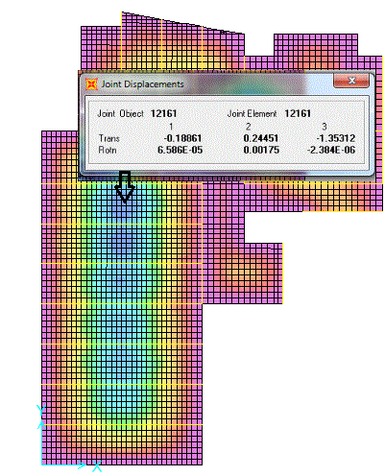
THREE DIMENSIONAL STRUCTURAL ANALYSIS AND DESIGN :
Check slab for deflection (Serviceably check):

Slide 30

THREE DIMENSIONAL STRUCTURAL ANALYSIS AND DESIGN :
Check slab for deflection (Serviceably check):
-
-The allowable deflection for all sustained load = 𝐿/240 .
-Slab deflection:
 | Δ Long term (m) | Δ Allowable (m) | result
Block1 | 0.00037 | 3.2 /240 = 0.013 | ok
Block 2 | 0.0094 | 3.2 /240 = 0.013 | ok

Slide 31
THREE DIMENSIONAL STRUCTURAL ANALYSIS AND DESIGN :
Check sap for 3D analysis :

Slide 32
THREE DIMENSIONAL STRUCTURAL ANALYSIS AND DESIGN :
Check sap for 3D analysis :
Block1:
Shear (KN) |  |  | Negative Moment (KN.m) |  |  | Positive Moment (KN.m) |  |  | Structural Element
%e | 1D | 3D | %e | 1D | 3D | %e | 1D | 3D | Model1
2.6 | 452.22 | 464.3 | - | 0 | 1.4 | 6.7 | 1447.1 | 1551.2 | Beam
 |  |  | 0.92 | 32.8 | 32.5 | 0.35 | 17.16 | 17.1 | Slab

Slide 33
THREE DIMENSIONAL STRUCTURAL ANALYSIS AND DESIGN :
Check sap for 3D analysis :
Block2:
Shear (KN) |  |  | Negative Moment (KN.m) |  |  | Positive Moment (KN.m) |  |  | Structural Element
%e | 1D | 3D | %e | 1D | 3D | %e | 1D | 3D | Model1
2.6 | 452.22 | 464.3 | 3.5 | 310.5 | 299.8 | 9.1 | 245.3 | 270.1 | Beam
 |  |  | 3.13 | 25.6 | 24.8 | 7.8 | 20.3 | 22.04 | Slab

Slide 34
COLUMNS DESIGN

Slide 35
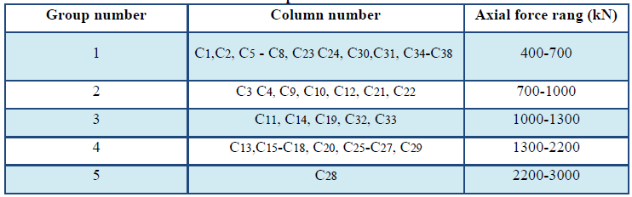
COLUMNS DESIGN :
Columns’ grouping :
-columns were classified as groups according to the range of axial load .
-the range of the axial force in all columns in block 1 were (448-2978) kN .

Slide 36
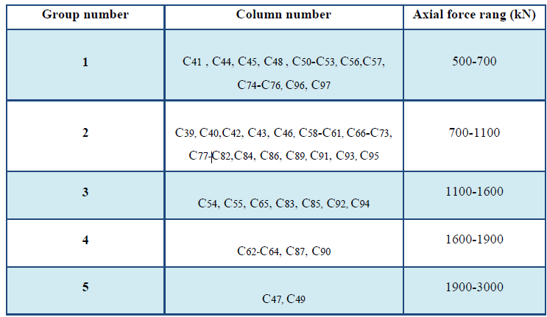
COLUMNS DESIGN :
Columns’ grouping :
The range of the axial force in all columns in block 2 were (518-2889) kN

Slide 37

COLUMNS DESIGN :
Column design :
-Check Buckling .
-Preliminary Design:

Slide 38
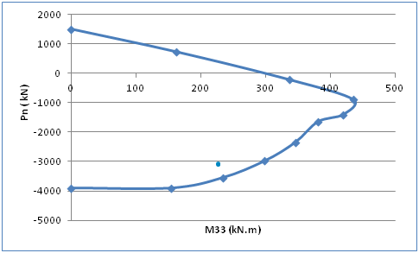
COLUMNS DESIGN :
Column design :
-Sap results:
Block 1:

Slide 39
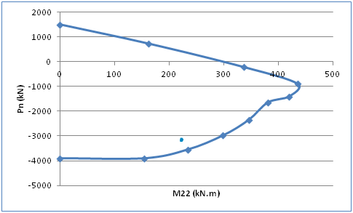
COLUMNS DESIGN :
Column design :
-Sap results:
Block 2:

Slide 40
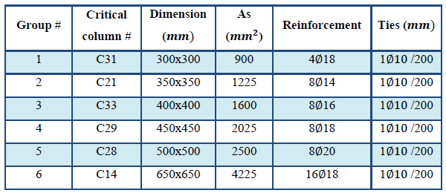
COLUMNS DESIGN :
Column design :
-Final results:
Block 1:

Slide 41
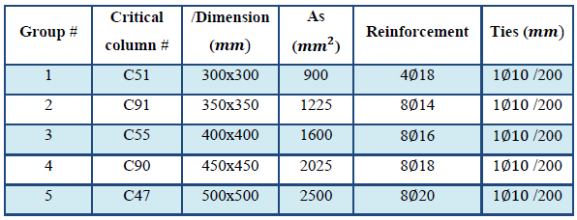
COLUMNS DESIGN :
Column design :
-Final results:
Block 2:

Slide 42
FOUNDATIONS DESIGN

Slide 43





FOUNDATIONS DESIGN:
Footings grouping.
Footings design:
1.Single footing:
-Footing dimension:
- Footing thickness based on wide beam shear.
-Check punching shear:

Slide 44


FOUNDATIONS DESIGN:
1. Single footing:
- Flexural design:
Bottom steel :
Top steel:
Use half the shrinkage steel in each direction.

Slide 45

FOUNDATIONS DESIGN:
2.combined footing:
- Footing dimension:
Sap2000 was used to check the dimension of the footing.
-Checks:
a.Bearing capacity check:

Slide 46

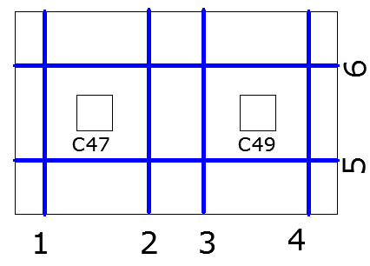
FOUNDATIONS DESIGN:
2.combined footing:
b.Check of wide beam shear:

Slide 47

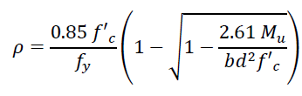
FOUNDATIONS DESIGN:
2.combined footing:
c. Check of punching shear :
-Flexural design:
Longitudinal reinforcement :

Slide 48
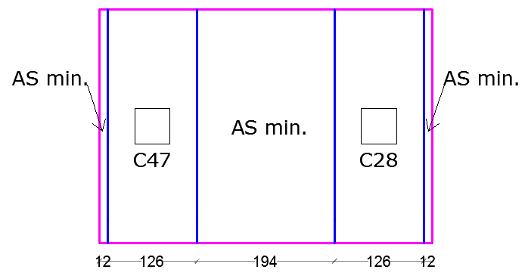
FOUNDATIONS DESIGN:
2.combined footing:
-Flexural design:
Transverse direction reinforcement

Slide 49
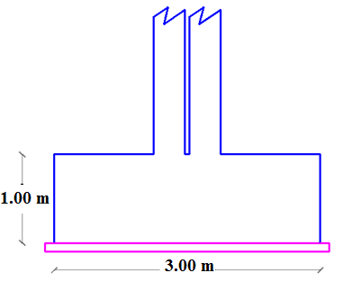
FOUNDATIONS DESIGN:
3.Mat foundation for the adjacent shear walls:

Slide 50
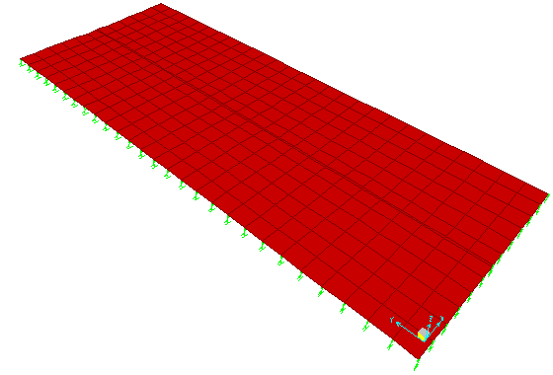
FOUNDATIONS DESIGN:
3.Mat foundation for the adjacent shear walls:
checks:
-Compatibility :

Slide 51

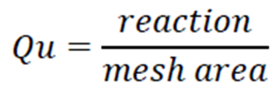
FOUNDATIONS DESIGN:
3.Mat foundation for the adjacent shear walls:
-Check deflection:
- Check stress:

Slide 52

FOUNDATIONS DESIGN:
3.Mat foundation for the adjacent shear walls:
-Flexural reinforcement :
1.For X- direction:
By displaying moment M11.
Use 10Φ20/m

Slide 53

FOUNDATIONS DESIGN:
3.Mat foundation for the adjacent shear walls:
-Flexural reinforcement :
2.For y- direction:
By displaying moment M22.
Longitudinal bars (shrinkage steel):
use (18 Φ20)

Slide 54
Any Questions???

