Slide 1
An-Najah National University
Faculaty Of Engineering
Civil Department
Construction PROJECT MANAGEMENT
Construction PROJECT MANAGEMENT
CONSTRUCTION PROJECT MANAGEMENT
Prepared by: sameh raee deiaa shaqor
yosif hamarshe ameed zawyani
Supervisor : Ins. luay dwekat

Slide 2
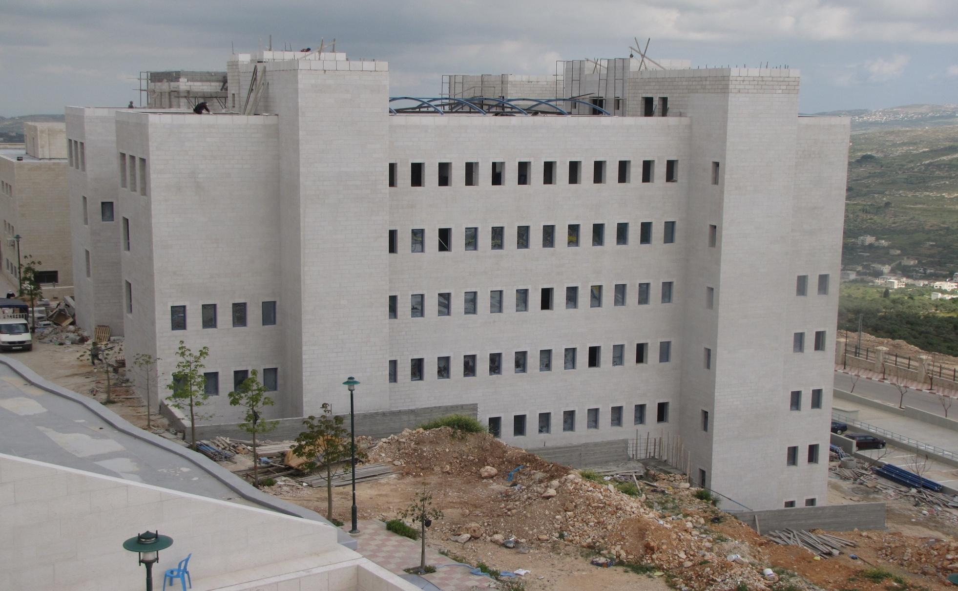
Optical and nursing college

Slide 3
Graduating project consist two parts :
The first part include preparing a theoretical research.
The second part includes the application of the principle in construction project management.

Slide 4
What is a Project?
A project is a temporary endeavor undertaken to accomplish a unique product or service with a defined start and end point and specific objectives .

Slide 5
What Project management
Project management is the application of knowledge, skills, tools, and techniques applied to project activities in order to meet or exceed stakeholder needs and expectations from a project.

Slide 6
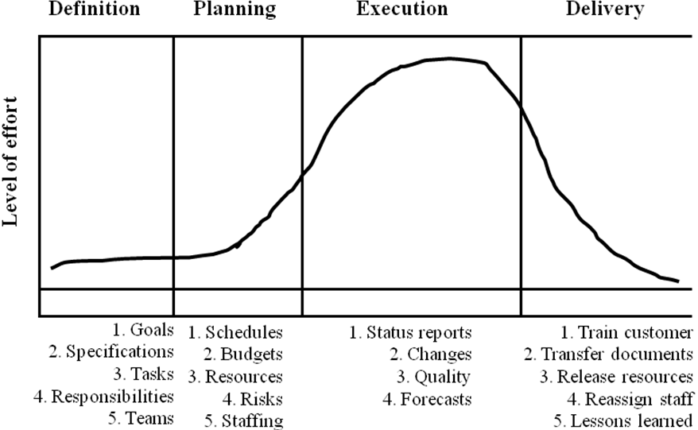
Project Life Cycles :

Slide 7
Scope of the project
Time
Cost
Quality

Slide 8
Description of the project :
optical and nursing college is one of the najah university colleges in Nablus,This college consists of seven stories and roof of total area (7021 m2).
It was designed consolidated consultant. and implemented by Al-batye office

Slide 9
method of construction:
Finishing all sub structure works and immediately begins the super structure works.
The super structure work consists of seven stories and roof that are; 3rd Basement,2nd basement,1st basement, ground, first, second and third floors and roof.
While the construction work for one story finished then begin to finishing work for that story.

Slide 10
Assumptions
Working days are all days except Fridays.
The electrical and mechanical work done by the same contractor.
All money paid by U.S Dollar ($) and the fixed value of Dollar according to local coin was (1$=3.6 NIS).

Slide 11
methodology
Step one: make work breakdown structure
Step two: activity listing and coding
Step three: relationship between activities
Step four: duration for activities and resource allocation
Step five: cost estimation and quantity surveying

Slide 12
Work Breakdown Structure (WBS)
The project was divided into four levels which are:
1st level: optical and nursing college
2nd level: earthwork, Civil, finishing, Mechanical and Electrical.
3rd level: 3rd basement, 2nd basement, 1st basement ………….
4th level: Activities.

Slide 13
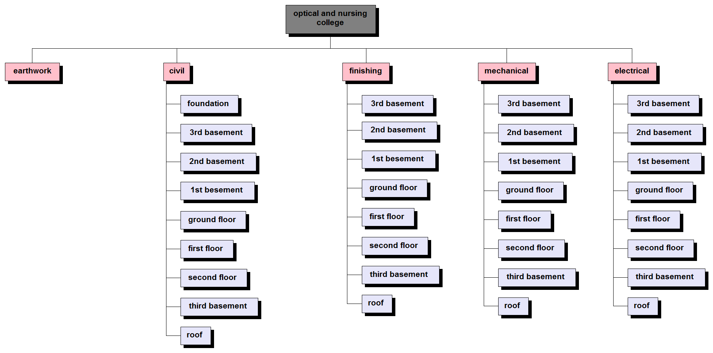
Work Breakdown Structure (WBS)

Slide 14
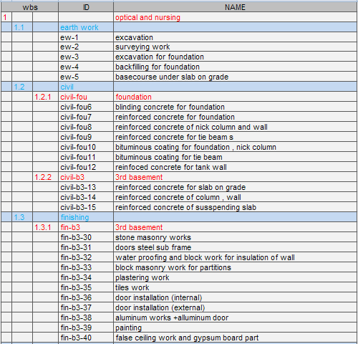
Activities List

Slide 15
relationship between activities and Resources
The relationships between activities divided to:
1. Finish to start relationship (F.S).
2. Start to Start relationship (S.S).
3. Start to finish relationship (S.F).
4. Finish to finish relationship (F.F).

Slide 16
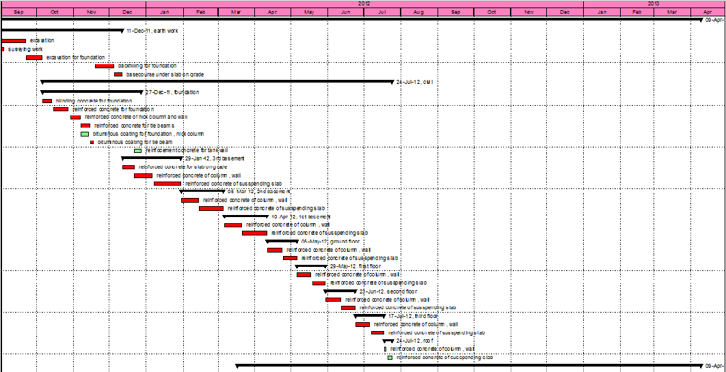
Example of Relationship using primavera

Slide 17
Duration and resource allocation
Duration = quantity of activity \ productivity
For example block Partition work:
Labor productivity equal twelve meter square for mason and helper per day.
Quantity of activity equal for example 1200 m ² .
If use one mason and helper the duration equal 1200 /12 =100 day
If use five mason and helper the duration equal 1200 /60 =20 day

Slide 18
quantity surveying and cost estimation
Fgdfyuiiokl;lkjhkjh

Slide 19
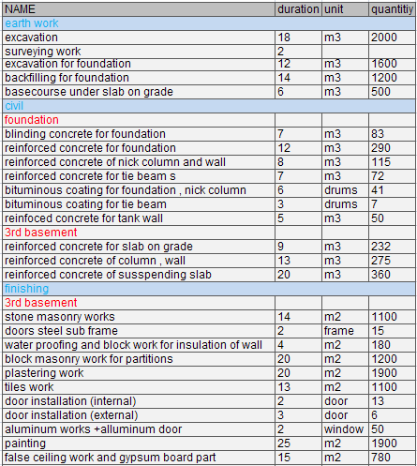
example

Slide 20
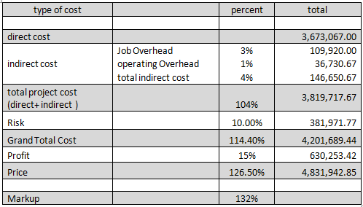
Results
The following tables shows details about cost analysis:

Slide 21
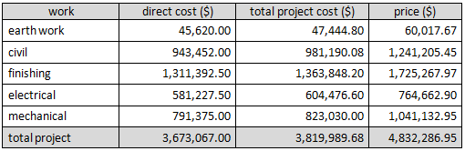
Results

Slide 22
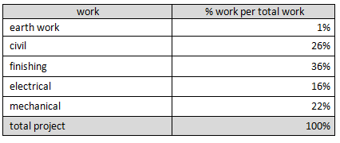
Results

Slide 23
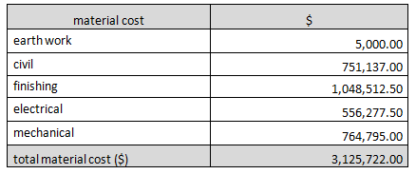
Results

Slide 24
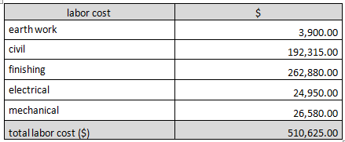
Results

Slide 25
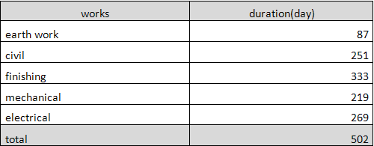
Results
The following tables shows details about duration analysis for the project:

Slide 26
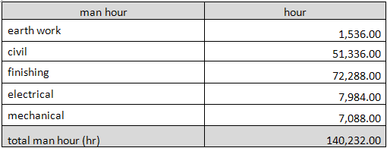
Results

Slide 27
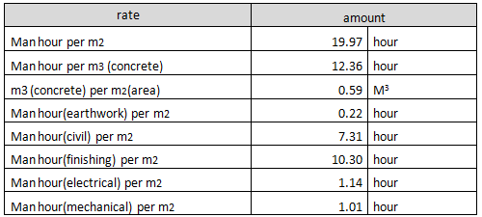
Results
The following tables show details about some items and rates:

Slide 28
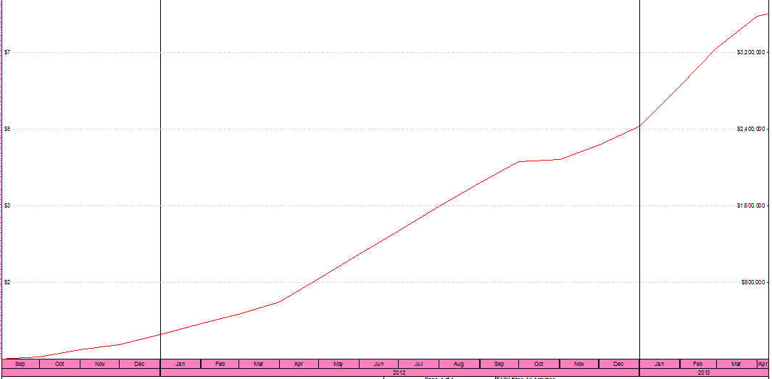
S-curve

Slide 29
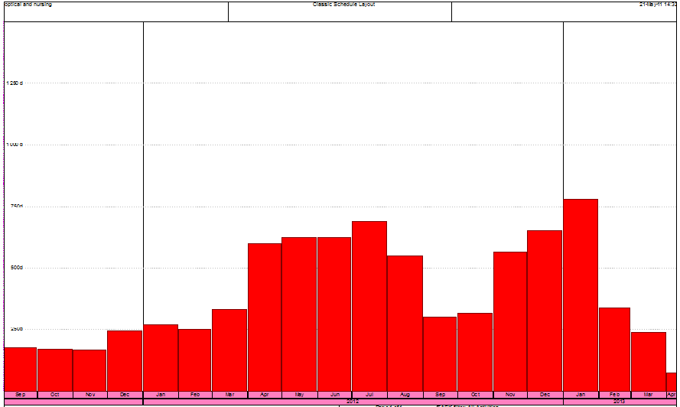
Resource profile labor

