Slide 1
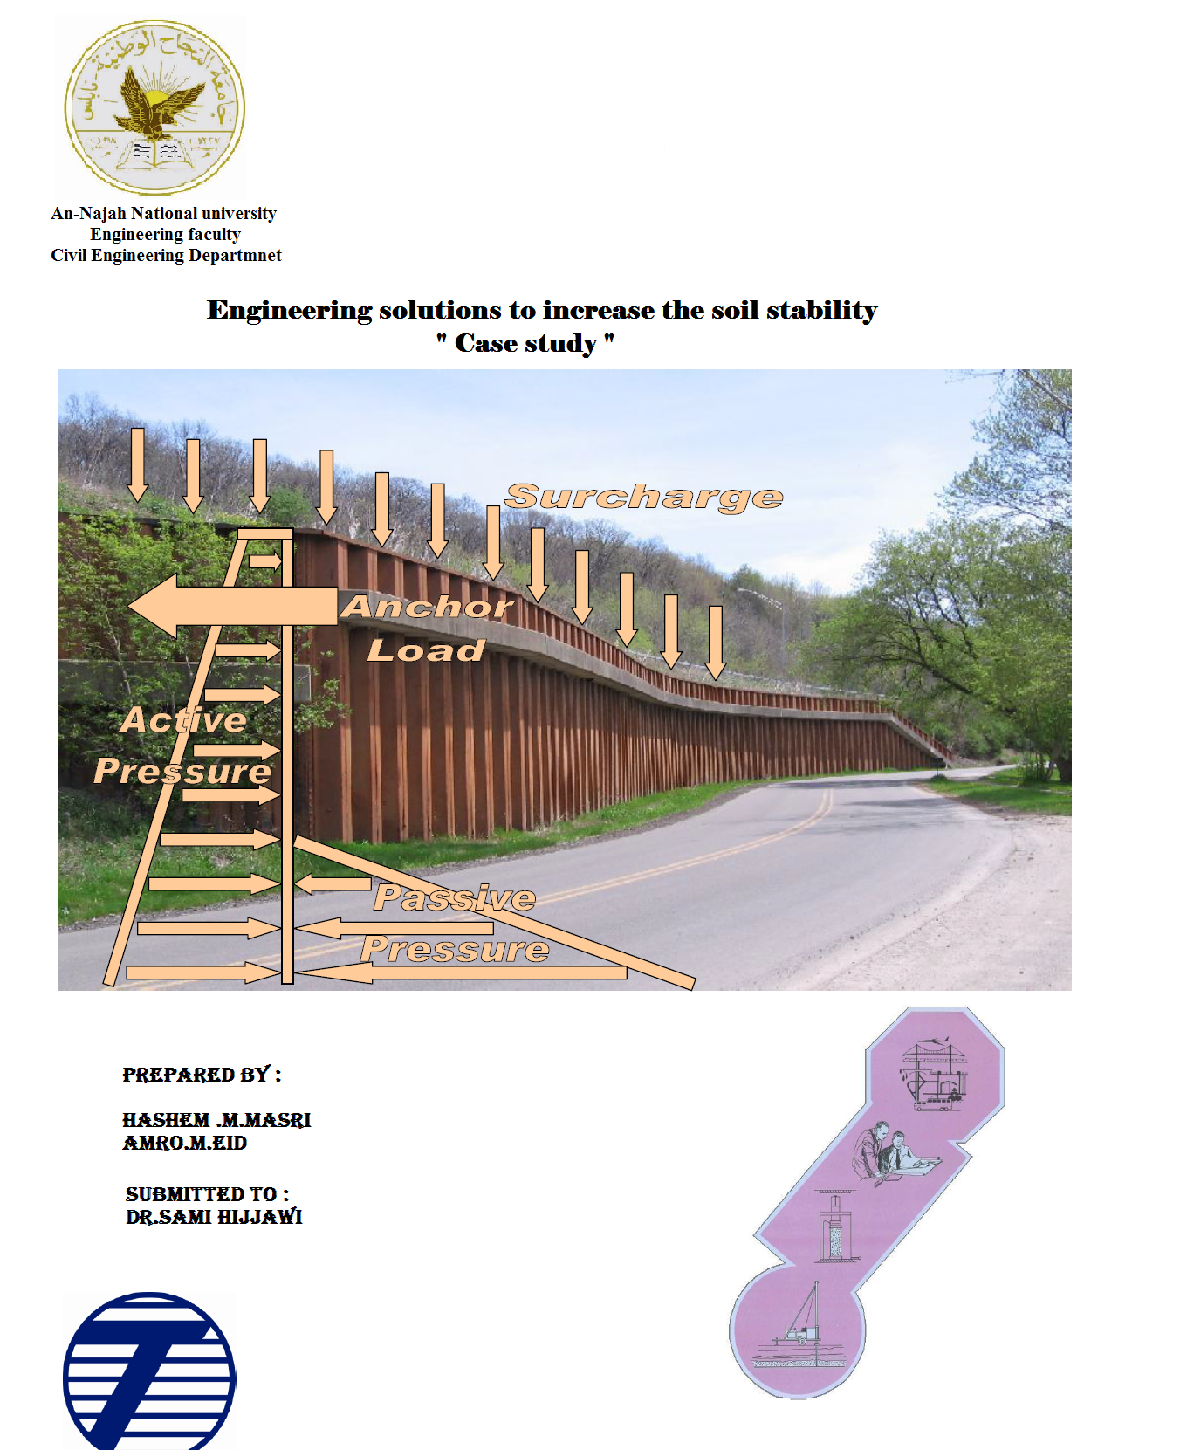

Slide 2
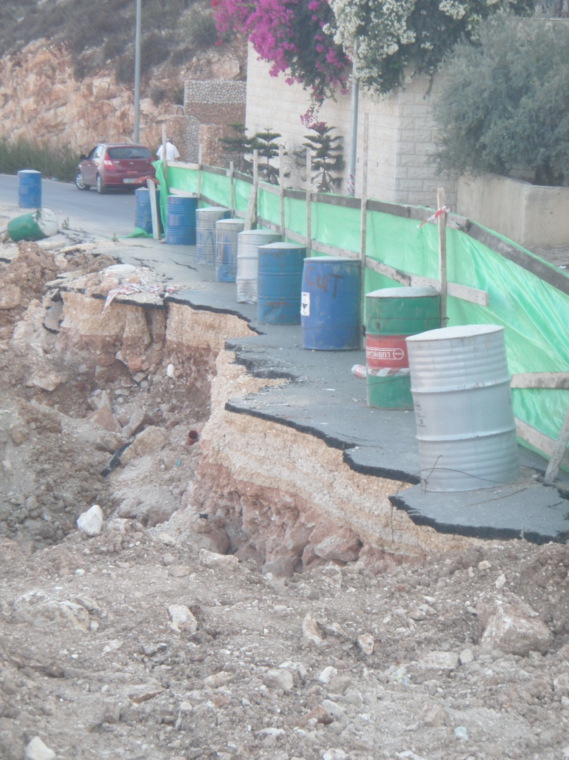
Project Purpose & Description
Problem of soil slope stability in Nablus city are very common due to the nature of the city that is located in a fault between two mountains.

Slide 3
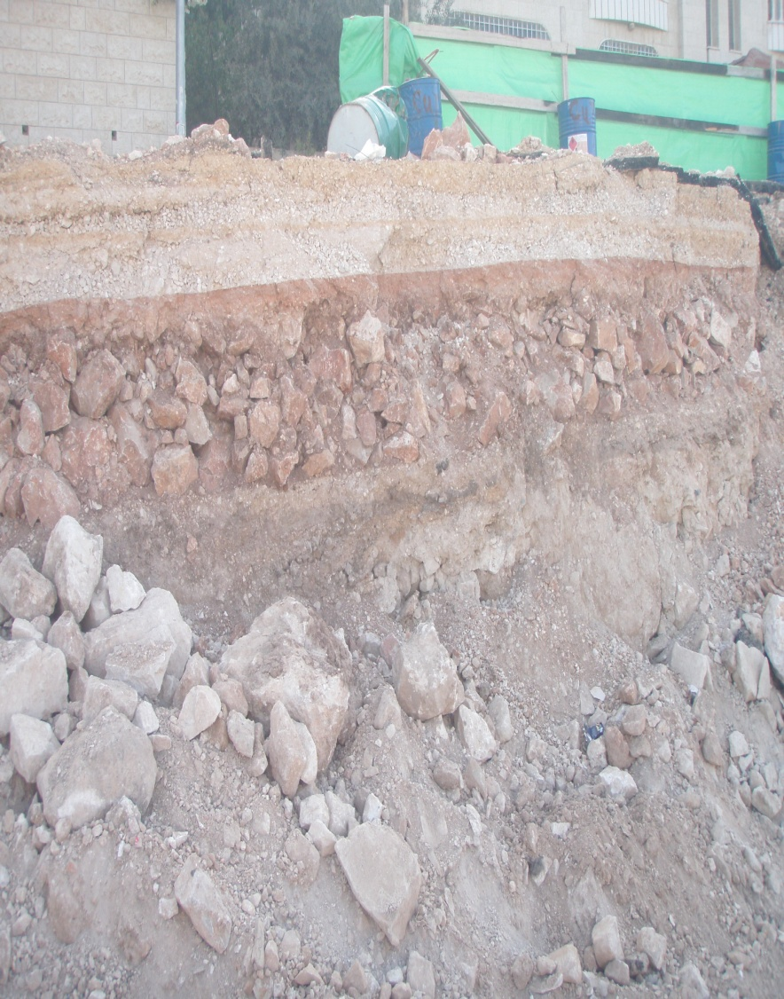
Proposed Engineering Solutions
The proposed solution based on the use of supporting system,
( retaining walls system )
Retaining walls stabilize soil and rock from down slope movement or erosion and provide support for vertical or near vertical grade change.

Slide 4
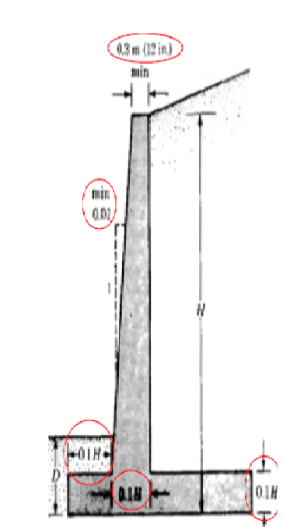
Cantilever Retaining Wall
Properties :
cast-in-place, steel-reinforced concrete.
retain the earth behind it by virtue of its internal strength and rigidity.
expensive to build.
Brittle.
“In General This Type Not Especially Attractive”

Slide 5
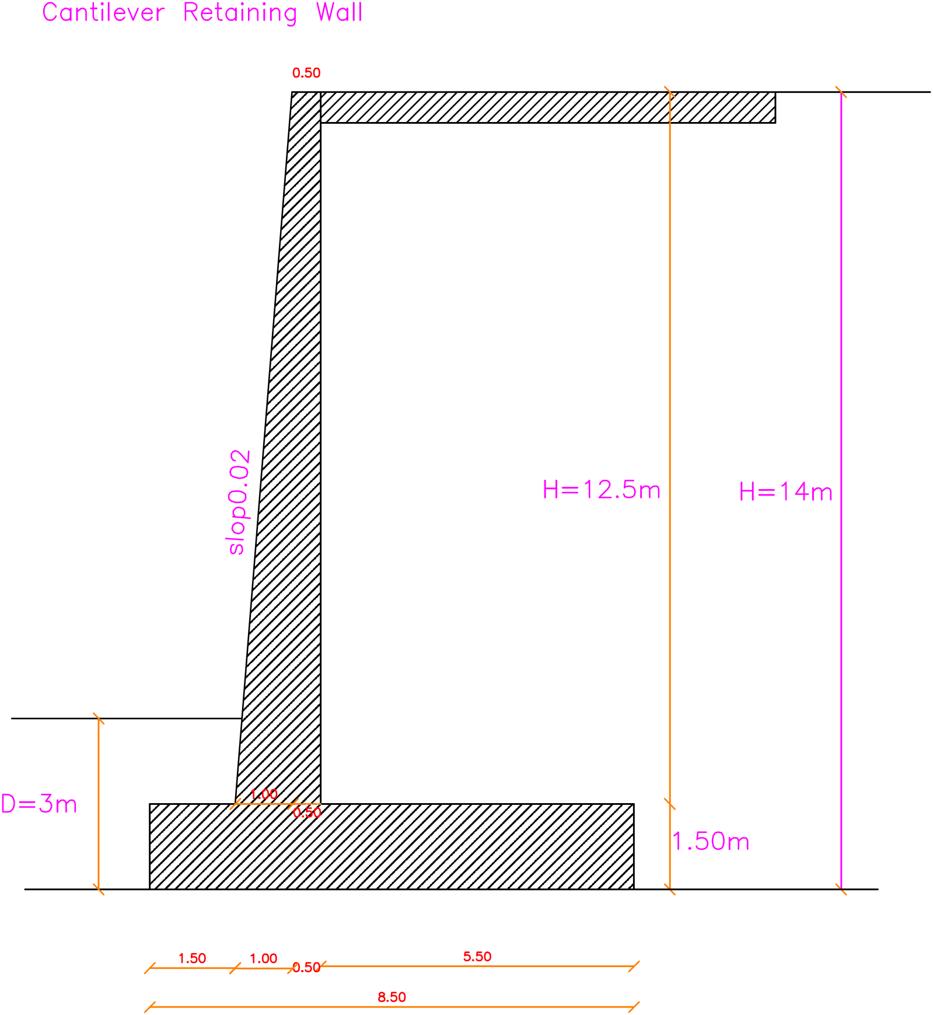

Slide 6
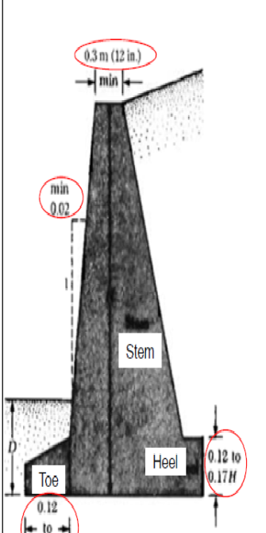
Gravity Retaining Wall
Properties :
Walls are constructed principally of soil .
to retain the earth behind it by virtue of its weight and size.
inexpensive to build .
flexibility .
“No Need To Reinforcement”

Slide 7
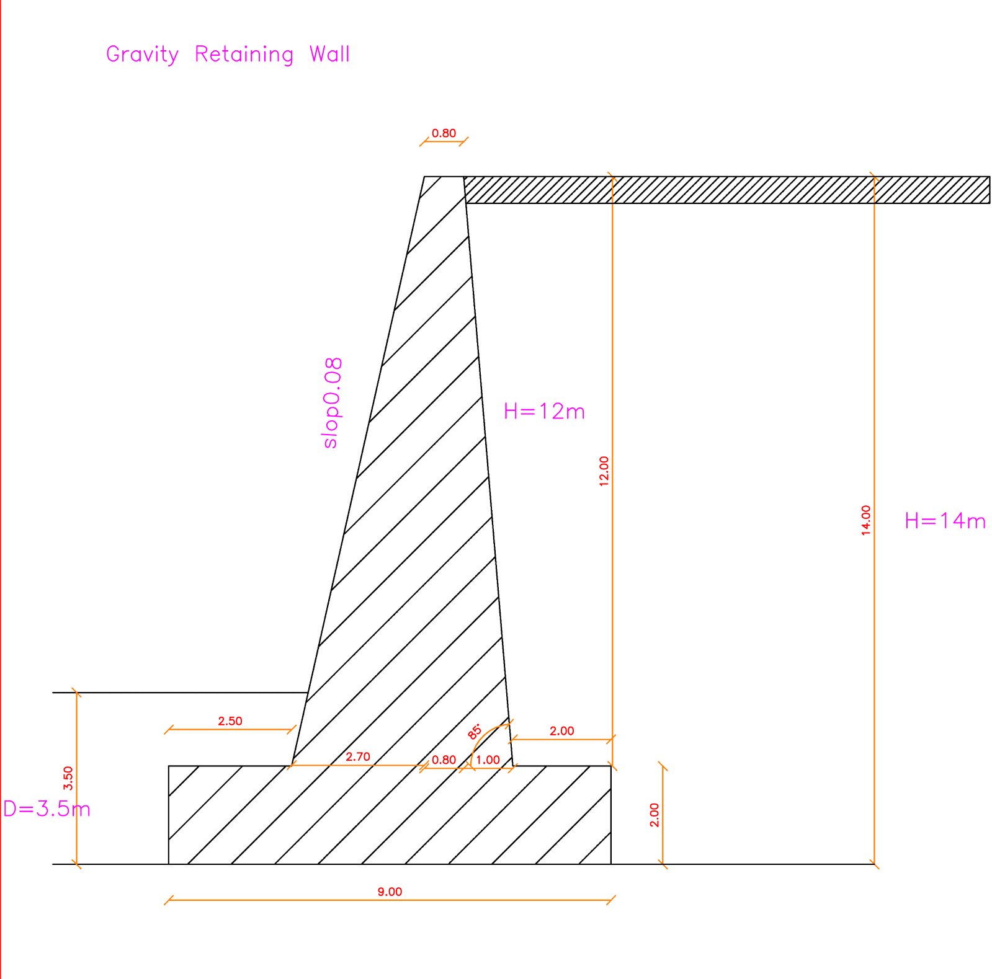

Slide 8
Piles R. W System
Properties :
a structural stilt hammered into the ground.
comprises two basic structural elements, the pile and the pile cap.
“In General This Type Considered as an advanced system”

Slide 9
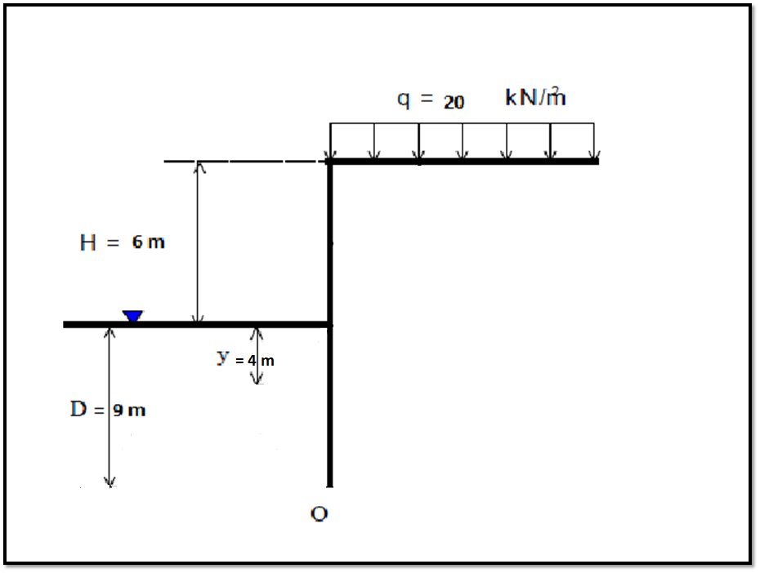

Slide 10
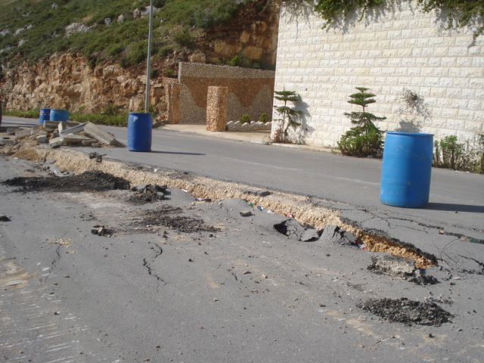
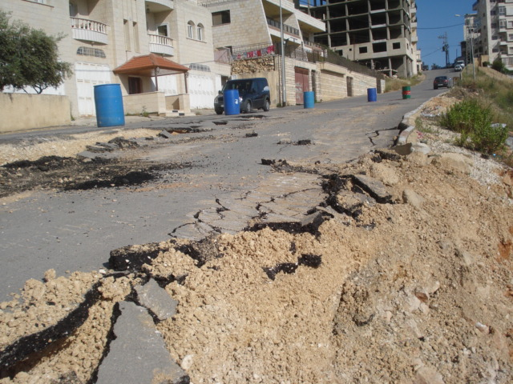
Solution Methodology, Theories And Checks Used.
Solution methodology based on the following criteria :
Site visit observations, soil tests reports & site investigations
Solution procedure & specification

Slide 11
Solution Methodology, Theories And Checks Used.
Theories applied:
According to the actual backfilling slope (street slope) which is equal to zero, we should apply” Rankine” Theory
(Active) K_{a} = (1 – sin(φ)) / (1 + sin(φ))
(Passive) K_{p} = (1 + sin(φ)) / (1 - sin(φ))
(Passive) K_{p*} = 1/ K_{p}

Slide 12
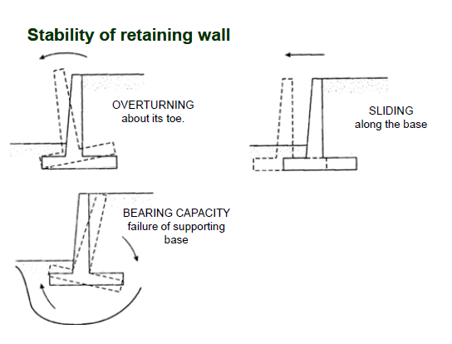
Solution Methodology, Theories And Checks Used.
Required checks applied:
Stability of retaining wall “Overturning, Sliding, And Bearing Capacity “

Slide 13
Proposed Solutions Assessment
solution capability & durability
Since we are looking for a long-term solution, we found that the solutions are durable and applicable .
Study benefits
By applying the study project we expect to reduce this risky pressure and increasing the safety at the location.
Economic feasibility
Acceptable comparing with the previous failed solutions which cost more.

Slide 14
Recommendations
cost study is performed for the proposed solutions based on the local currency and local materials, labor costs, so we recommend using piles system .

Slide 15
Let Learning Continue…

