Slide 1
Application of Discrete Event Simulation in Healthcare Facilities (Emergency Department)
Prepared By :
“Mohammad Jawad” Saleh Nedal Jamal Hoso
Presented To :
Eng. Tamer Haddad Dr. Ramiz Assaf Dr. Yahya Saleh

Slide 2
Outline
Introduction
Simulation of Healthcare System
Complexity of Healthcare System
Performance Variables
Current Situation Results
Suggested Scenarios Results
Limitation Due to Complexity
Novel Modeling Approach
Fieldwork as a Proof of Concept
Conclusions
Recommendations

Slide 3
Introduction
Problem Definition :
High patient demand and limited resources have resulted in long waiting times and long length of stay in emergency department.

Slide 4
Introduction (Cont’d.)
Objectives :
Develop a simulation model to enable the quick development and to improve quality of care at Al-Watani Hospital.

Slide 5
Simulation of Healthcare System
Simulation of healthcare systems is about the improvement of healthcare.

Slide 6
Complexity of Healthcare System
Building models of a real system to be applied in simulations requires an in-depth analysis of the system parameters.

Slide 7
Performance Variables
The key performance metrics are :
Waiting times.
Length of stay.
Resource utilization.

Slide 8
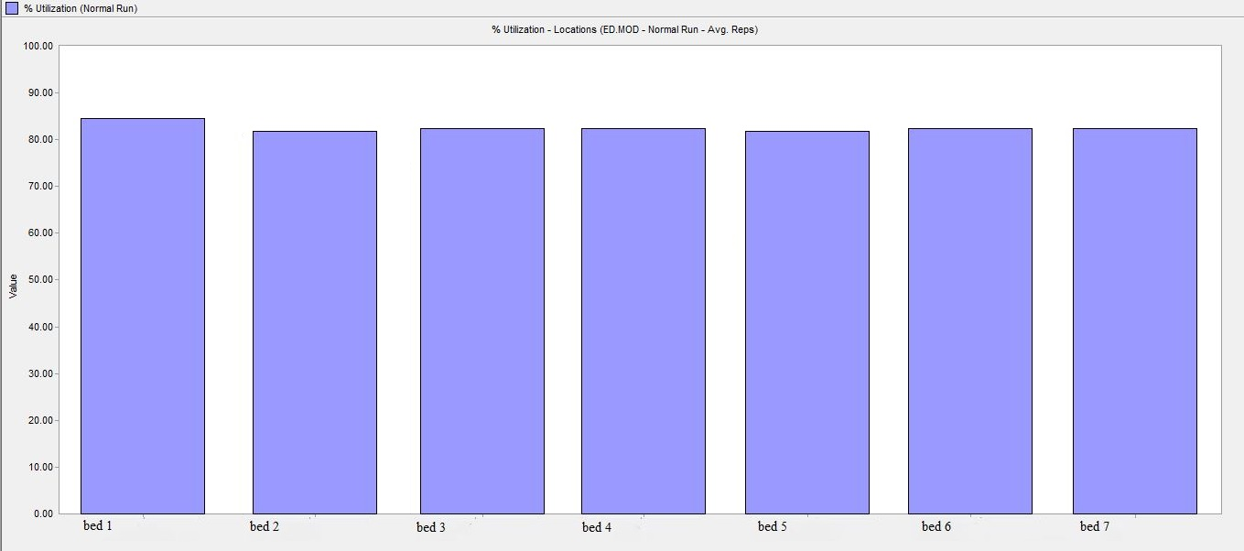
Current Situation Results
Utilization of the current model with 7 beds.

Slide 9
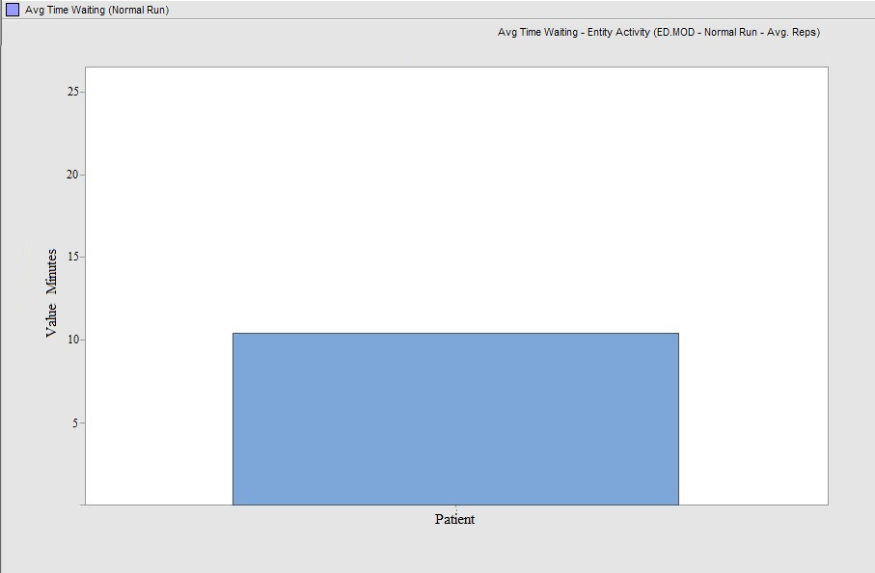
Current Situation Results (Cont’d.)
Waiting time for the current model with 7 beds.

Slide 10
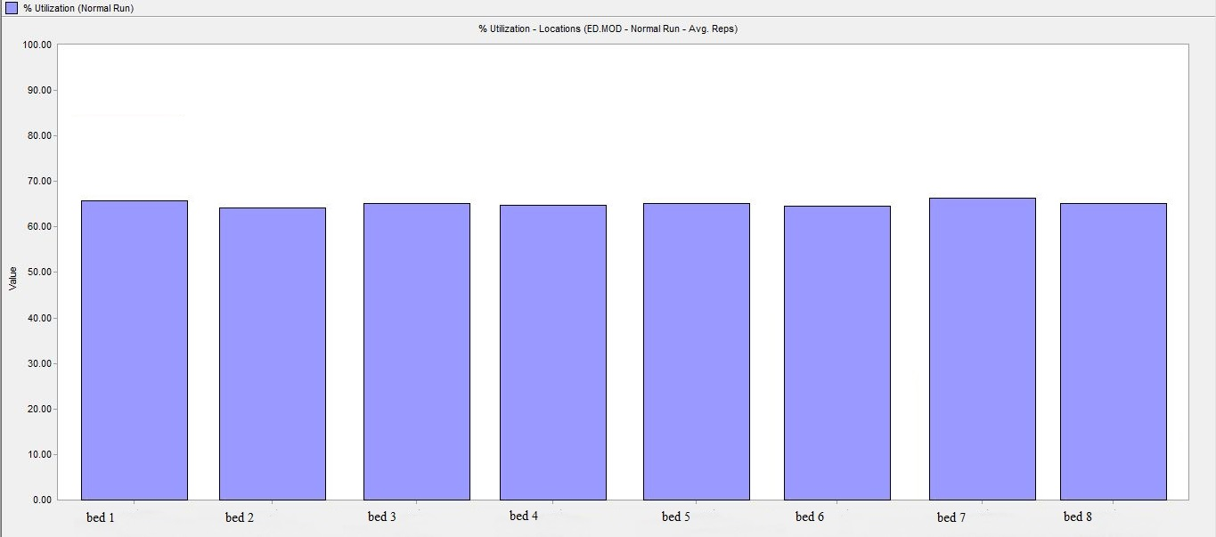
Current Situation Results (Cont’d.)
Utilization of the current model with 8 beds.

Slide 11
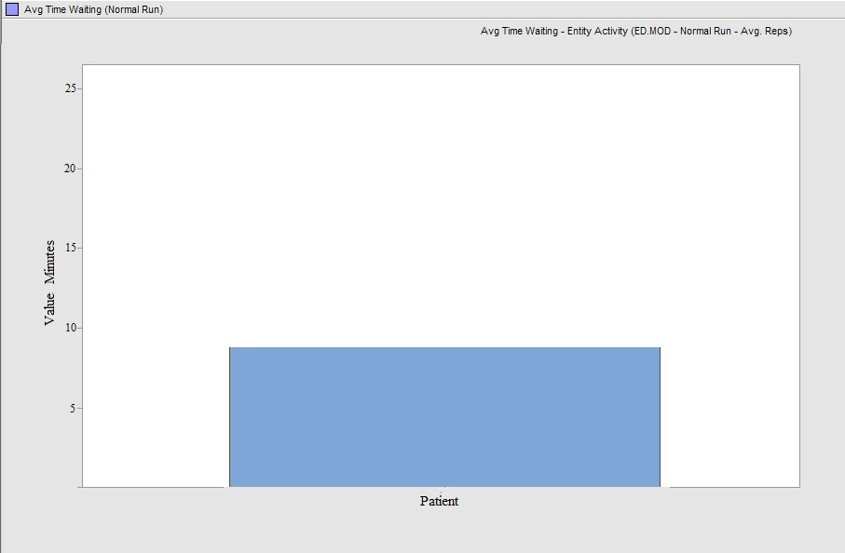
Current Situation Results (Cont’d.)
Waiting time for the current model with 8 beds.

Slide 12
Suggested Scenarios Results
There are four scenarios we suggested in our project. The following table describe each scenario.
Scenario Number | Scenario Name | Scenario Description
1 | 7 beds – increased | 7 beds with 10% increase in arrival rate
2 | 7 beds – increased | 7 beds with 25% increase in arrival rate
3 | 7 beds – increased | 7 beds with 50% increase in arrival rate
4 | 7 beds – increased | 7 beds with 100% increase in arrival rate

Slide 13
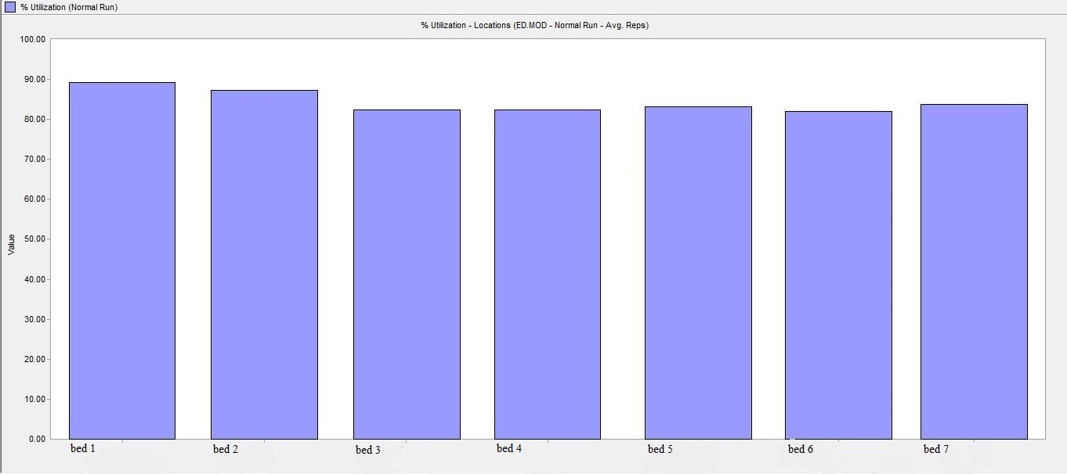
Suggested Scenarios Results (Cont’d.)
Utilization of the increased inter-arrival rate by 10% with 7 beds.

Slide 14
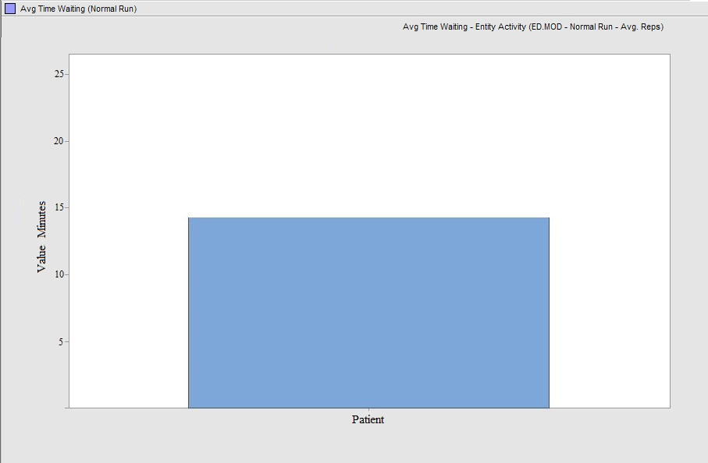
Suggested Scenarios Results (Cont’d.)
Average time waiting for the increased inter-arrival rate by 10% with 7 beds.

Slide 15
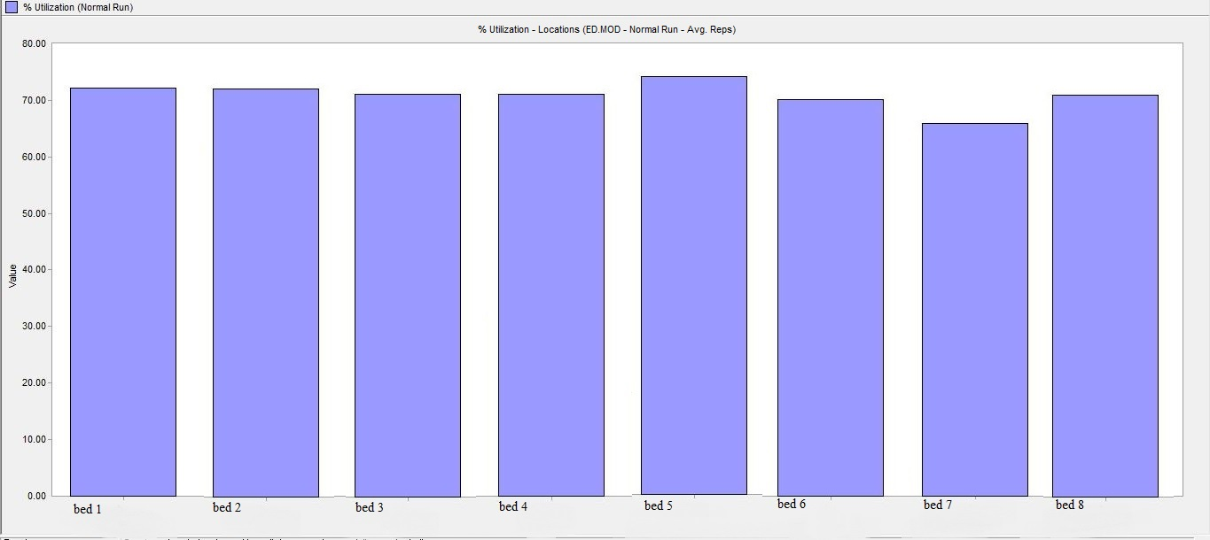
Suggested Scenarios Results (Cont’d.)
Utilization of the increased inter-arrival rate by 10% with 8 beds.

Slide 16
Suggested Scenarios Results (Cont’d.)
Average time waiting for the increased inter-arrival rate by 10% with 8 beds.

Slide 17
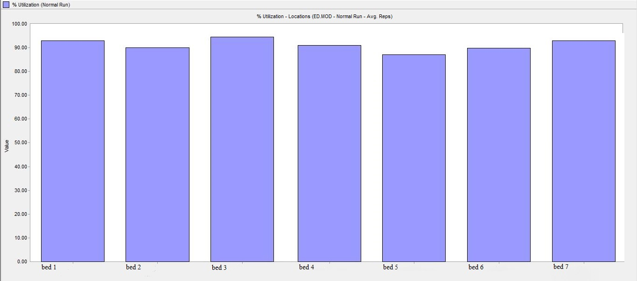
Suggested Scenarios Results (Cont’d.)
Utilization of the increased inter-arrival rate by 25% with 7 beds.

Slide 18
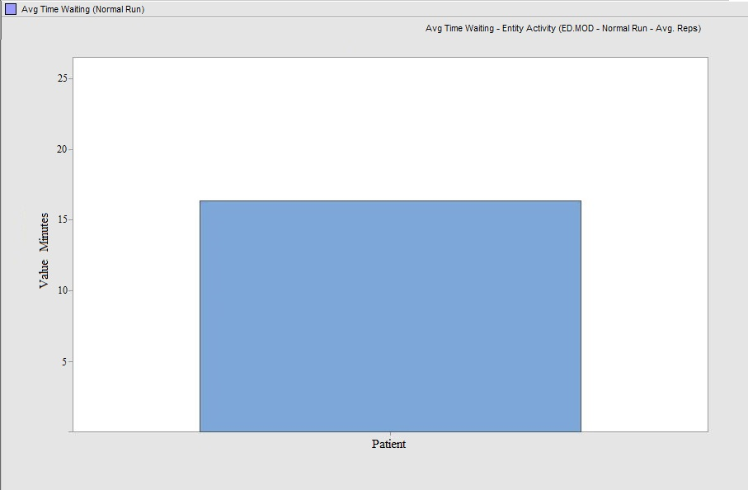
Suggested Scenarios Results (Cont’d.)
Average time waiting for the increased inter-arrival rate by 25% with 7 beds.

Slide 19
Suggested Scenarios Results (Cont’d.)
 |  |  | Utilization Maximum Value is 80%
Scenario No. | Desc-ri-ption | Avg. Time Wait | Bed 1 | Bed 2 | Bed 3 | Bed 4 | Bed 5 | Bed 6 | Bed 7 | Bed 8 | Bed 9 | Bed 10 | Bed 11 | Bed 12
1 | 7 beds | 14.76 | 89.76 | 88.32 | 81.30 | 81.30 | 82.12 | 81.30 | 83.30 | - | - | - | - | -
1 | 8 beds | 10.50 | 71.00 | 71.00 | 70.50 | 70.50 | 75.40 | 7.00 | 65.00 | 70.50 | - | - | - | -
2 | 7 beds | 16.30 | 92.31 | 90.00 | 94.80 | 90.50 | 89.20 | 90.00 | 92.31 | - | - | - | - | -
2 | 8 beds | 13.21 | 88.63 | 89.30 | 88.63 | 89.73 | 88.33 | 89.00 | 88.63 | 84.66 | - | - | - | -
2 | 9 beds | 10.20 | 79.32 | 75.10 | 75.43 | 76.63 | 74.88 | 71.53 | 72.42 | 71.53 | 74.88 | - | - | -
3 | 7 beds | 18.32 | 95.03 | 90.10 | 91.23 | 90.10 | 91.07 | 91.23 | 90.10 | - | - | - | - | -
3 | 9 beds | 15.05 | 91.20 | 90.07 | 89.96 | 90.07 | 90.20 | 90.00 | 90.09 | 91.20 | 90.07 | - | - | -
3 | 10 beds | 10.78 | 75.05 | 76.31 | 75.05 | 78.00 | 75.27 | 79.85 | 78.00 | 76.30 | 79.80 | 78.00 | - | -
4 | 7 beds | 21.00 | 93.45 | 91.42 | 93.45 | 93.45 | 93.30 | 93.45 | 91.42 | - | - | - | - | -
4 | 9 beds | 17.64 | 90.00 | 89.53 | 88.49 | 80.96 | 89.53 | 88.49 | 89.53 | 85.23 | 87.08 | - | - | -
4 | 12 beds | 12.53 | 72.14 | 75.00 | 76.13 | 74.77 | 72.14 | 76.13 | 78.26 | 78.32 | 76.13 | 76.13 | 78.32 | 76.13
The following table
shows each scenario
and its solution based
on utilization and
waiting time.

Slide 20
Limitations due to complexity
It is a common recommendation among process simulation modeler to avoid any unnecessary complexity.

Slide 21
Limitations due to complexity (Cont’d.)
Reducing complexity is a common and necessary measure in order to provide an insightful , administrable and maintainable model.

Slide 22
Novel modeling approach
Flexible resource allocation can be observed in services cape , where service are allocated to customers who are stationary .

Slide 23
Novel modeling approach (Cont’d.)
The resource , here medical staff in the ED , would walk to the cubicle where the patient is located for treatment.

Slide 24
Novel modeling approach (Cont’d.)
It is also applicable to those which program a model within a programming language.

Slide 25
Fieldwork as a Proof of Concept
In order to prove this concept it is applied in a fieldwork situation where the task is to identify the amount of documentation effort that is required for medical staff in the ED.

Slide 26
Fieldwork as a Proof of Concept (Cont’d.)
Conceptual modeling aided the modeler , especially once the resources were allocated to the treatment units and processes.

Slide 27
Fieldwork as a Proof of Concept (Cont’d.)
For the verification and validation of the model , the input data from the hospital record was compared with the result of the simulation model.

Slide 28
Conclusions
Discrete Event Simulation DES is highly appreciated as a decision aiding tool.

Slide 29
Conclusions (Cont’d.)
Flexibility of DES leads to new ideas for constructing simulation models in order to better adapt to the investigated systems.

Slide 30
Conclusions (Cont’d.)
The process flow models applied consider the process flow of the one party , the patients .

Slide 31
Recommendations
Simulation techniques are very effective tools.
Simulation could be used and applied in other hospital or any organizations.
Applying simulation on larger scale than this project needs the full version of this software.

