Slide 1

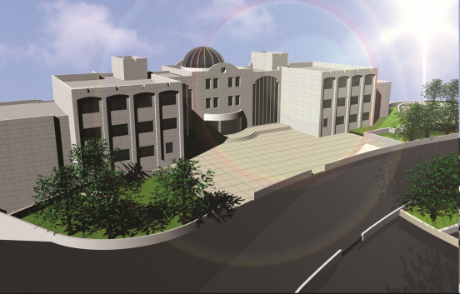



Design of Birzait Orthodox School
An-Najah National University
Faculty of Engineering
May 2011

Slide 2
Prepared By :
Mohammad Dmaidi – Mohammad Jabali
Graduation Project
Supervised By :
E. Ibrahim Arman
An-Najah National University
Faculty of Building Engineering

Slide 3


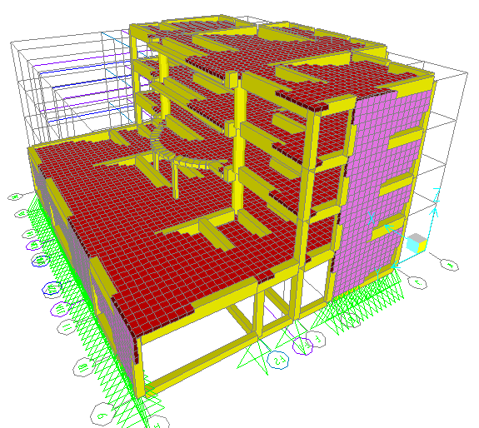
Birzait Orthodox School
Civil Engineering
Introduction
The structural design was made by SAP program
3D modeling
Graduation Project

Slide 4
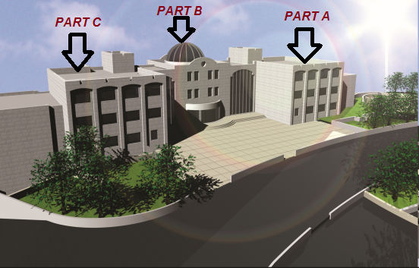
Birzait Orthodox School
Civil Engineering
Introduction
The building consists of three parts.
Graduation Project

Slide 5
Birzait Orthodox School
Civil Engineering
Introduction
Design Codes:
The structural design will be according to :
1) the American Concrete Institute code ACI 318-08 .
2) the seismic design according to UBC-97.
Design will include the following elements:
1) Slabs ( one way and two way ribbed slab).
2) Beams and ground beams.
3) Columns .
4) Shear walls.
5) Stairs.
6) Footing.
Graduation Project

Slide 6
Birzait Orthodox School
Civil Engineering
Introduction
Design data
Compressive strength of concrete (f’c)
F’c =28 MPa
2. Yielding strength of steel (f y)
steel for flexure equal f y = 420 MPa.
shear reinforcement equal f ys = 420 MPa.
3. Bearing capacity of soil= 300 KN/m².
Graduation Project

Slide 7
Birzait Orthodox School
Civil Engineering
Introduction
Loads and Load combinations
Loads:
A) Gravity loads:
1- Dead loads.
Super imposed dead load = 4.5 KN/m²
Load from external partions = 30 KN/m
2- Live loads.
Live load = 5 KN/m ²

Slide 8
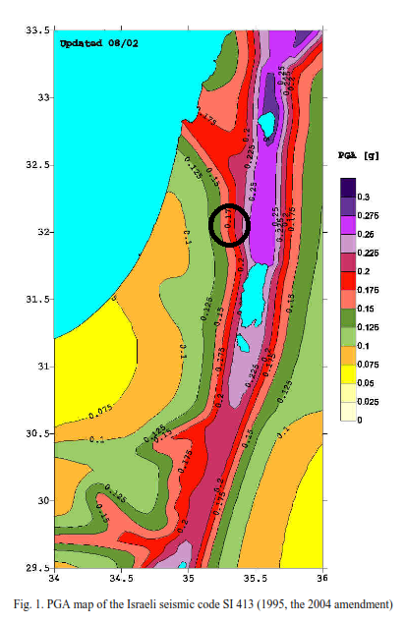
Birzait Orthodox School
Civil Engineering
Introduction
B) Lateral loads

Slide 9
Birzait Orthodox School
Civil Engineering
Introduction
Seismic zone factor (Z) = 0.2
Seismic coefficient (Cv) = 0.2
Seismic coefficient (Ca) = 0.2
The scale factor for EQ in response spectrum analysis:
9.81xI/R
where:
I: Importance factor from the Seismic importance factor table according UBC-97 code.
= 1.25
R: structure system factor from the structure system factor table according UBC-97 code.
= 5.5
Scale factor = 2.23

Slide 10
Birzait Orthodox School
Civil Engineering
Introduction
Load Combinations:
U₁ = 1.4D
U₂ = 1.2D + 1.6L + 1.6H
U₃ = 1.2D + (1.0L or 0.8W)
U₄ = 1.2D ± 1.6W + 1.0L
U₅ = 1.2D + 1.0E + 1.0L
U₆ = 0.9D ± 1.6W + 1.6H
U₇ = 0.9D + 1.0E + 1.6H
Where:
D: dead load L: live load
W: wind load E: earthquake load
H: weight and pressure load of soil

Slide 11
Birzait Orthodox School
Civil Engineering
Introduction
4. Unit weights of materials:
Material | Unit weight (KN/m³)
Reinforced concrete | 25
Blocks | 12
Masonry | 26
Tiles | 25
Mortar | 23
Plastering | 23
Selected filler (compacted base coarse) | 19
Polycarbonate | 0.4
Graduation Project

Slide 12
Birzait Orthodox School
Civil Engineering
Preliminary analysis and design of elements
Concrete Cover:
Concrete cover for reinforcement shall be:
(70mm) for foundation.
(50mm) for concrete columns.
(60 mm) for concrete beams.
(40 mm) for RIBS IN SLAB.

Slide 13
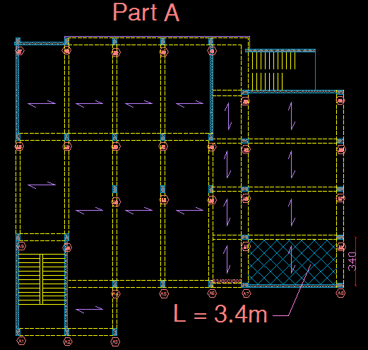
Birzait Orthodox School
Civil Engineering
Preliminary analysis and design of elements
Design of slabs:-
One way ribbed slab:

Slide 14
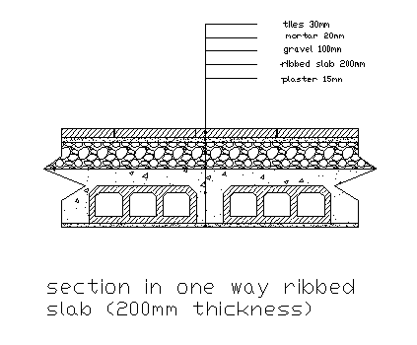
Birzait Orthodox School
Civil
Engineering
Preliminary analysis and design of elements
L (max) = 3.4 m
Slab thickness= 340/18.5 = 20 cm
Slab own weight= 3.6 KN/m²
Super imposed dead load = 4.5 KN/m²
Live load = 5 KN/m²
Ultimate load = 17.72 KN/m²
Graduation Project

Slide 15
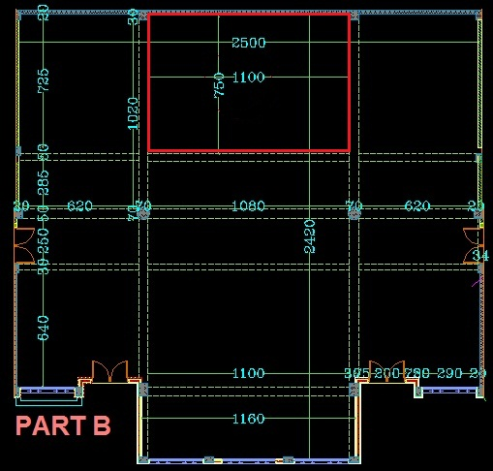
Birzait Orthodox School
Civil
Engineering
Preliminary analysis and design of elements
Two way ribbed slab:

Slide 16

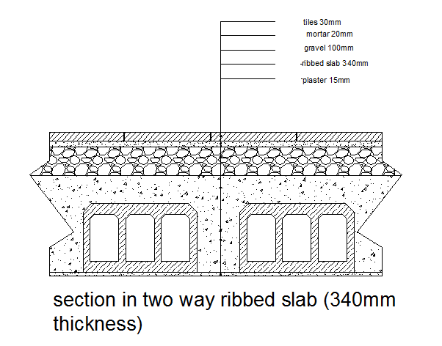
Birzait Orthodox School
Civil
Engineering
Preliminary analysis and design of elements
Since,
Equivalent ribbed Slab thickness= 34 cm
Slab own weight= 6.85 KN/m²
Super imposed dead load = 4.5 KN/m²
Live load = 5 KN/m²
Ultimate load =21.62 KN/m²

Slide 17
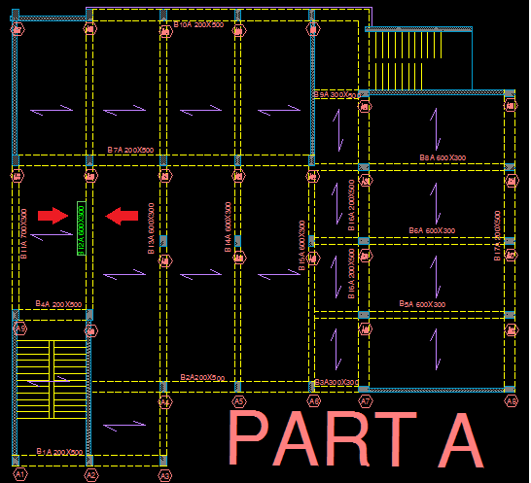
Birzait Orthodox School
Civil
Engineering
Preliminary analysis and design of elements
Beams analysis and design:-
Beam 12A in part A is taken as representive beam
Plan ground floor in part A

Slide 18
Birzait Orthodox School
Civil
Engineering
Preliminary analysis and design of elements
ACI moment – coefficients are used to analysis the beams.
Beam thickness= 710/18.5 = 384 cm
Take beam (60 cm depth, 30 cm width)
Ultimate load on beam = 65.7 KN/m
M_{u}⁻⁻_{interior} = 178.9 KN.m M_{u}⁺ = 204.4 KN.m
ρ = 0.00942 ρ = 0.005
As= 1527 mm² As= 810 mm²
Use 4 Ø25 Use 4 Ø18

Slide 19
Birzait Orthodox School
Civil
Engineering
Preliminary analysis and design of elements
Computing of stirrups:
Vu = 214 KN
Vc = 143 KN
Vs = 143 KN
(Av/S) = 0.628 mm ² /mm
Since V_{s} < 2V_{c}
S_{max} = min [d/2 , 600mm] = min [270mm , 600mm] = 270 mm
Use stirrups 1Ø10mm /200 mm

Slide 20
Birzait Orthodox School
Civil
Engineering
Preliminary analysis and design of elements
Columns analysis and design:-
Tributary area concept will be used to calculate the load on columns.
Column A3 in part A is taken as representive column
W_{u} from one way ribbed slab is equal to (17.72 KN/m²)
P_{u1} = 4 x2.89 x 17.72 = 204.8 KN
Loads from beams own weight is equal to:
P_{u2} = {1.2 [0.2 x 0.5 x1.7 + 0.3 x 0.5 x 1.7] x25} x 4 = 57.2 KN
Loads from external partition are equal to:
P_{u3} = 4 X (1.7+1.7) X 30 =408 KN.
Total load on the column is equal to
P_{u} = P_{u1} + P_{u2} + P_{u3} = 408 + 204 + 57.2 = 669.2 KN

Slide 21

Birzait Orthodox School
Civil
Engineering
Preliminary analysis and design of elements
And we assume ρ = 0.01
Ø = 0.65
669.2 x 1000 = 0.65 (0.8) (0.85 x 28(Ag – 0.01Ag) +420 x 0.01 Ag)
Ag = 46473 mm²
Take column 300 x 300 mm (Ag = 300 x 300 = 90000 mm²)

Slide 22
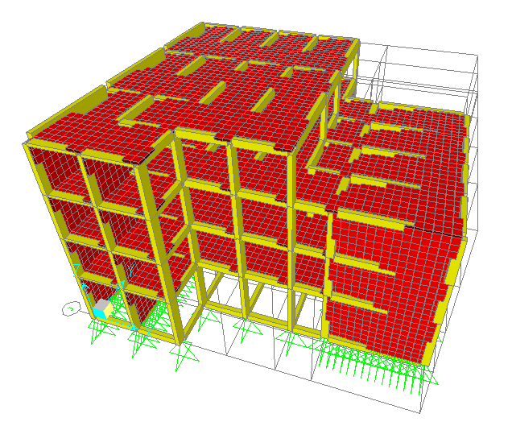
Birzait Orthodox School
Civil
Engineering
Three dimensional structural analysis and design
Modelling the building as three dimensional structures:
All the building is modeled as 3D structure on SAP program.
Part A will take as representive model
to do the requirement verifications.

Slide 23
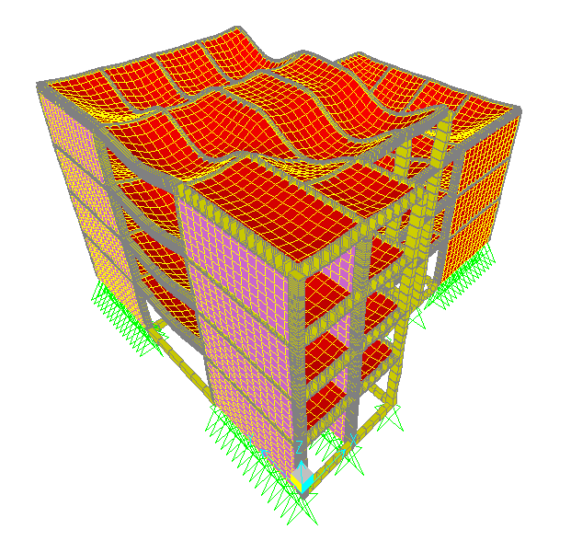
Birzait Orthodox School
Civil
Engineering
Three dimensional structural analysis and design
Checks for SAP model
Compatibility check
Graduation Project

Slide 24

Birzait Orthodox School
Civil
Engineering
Three dimensional structural analysis and design
Equilibrium
Manual total dead load = 29324.457 KN
The base reaction from dead load from SAP = 29391.787 KN
Graduation Project

Slide 25


Birzait Orthodox School
Civil Engineering
Three dimensional structural analysis and design
Check stress-strain relationship
Beam 12A in part A is taken as representive beam
WLn ²/8 = 359.217 KN.m.
Negative moment (M₁ )
Graduation Project

Slide 26


Birzait Orthodox School
Civil Engineering
Three dimensional structural analysis and design
Negative moment (M₂ )
positive moment (M )

Slide 27
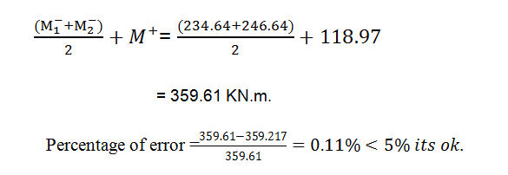
Birzait Orthodox School
Civil Engineering
Three dimensional structural analysis and design

Slide 28
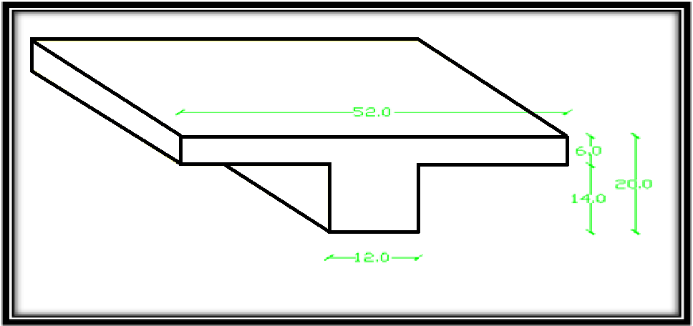
Birzait Orthodox School
Civil Engineering
Three dimensional structural analysis and design
Design of slabs
Roof slab in part A which is designed as one way ribbed slab is taken as representive slab
Thickness of slab =20cm
Graduation Project

Slide 29
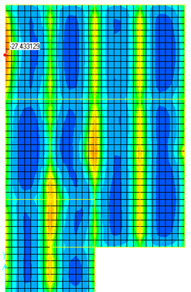
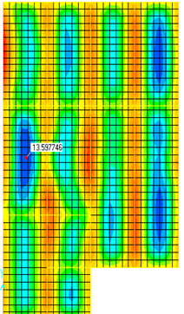
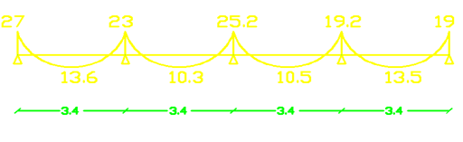
Birzait Orthodox School
Civil Engineering
Three dimensional structural analysis and design
Flexural design for slab
M11
(-ve)
for roof slab
M11
(+ve)
for roof slab
slab bending moment diagram
Graduation Project

Slide 30
Birzait Orthodox School
Civil Engineering
Three dimensional structural analysis and design
Slab reinforcement:
For Mu ⁻ = 27 KN.m
Mu/rib = 27 x 0.52 = 14.04 KN.m/rib
ρ = 0.0137
As _{min} = 0.0033 x 120 x 160 = 64 mm²
As = 264 mm² >As _{min}
Use 2Ø14mm top steel
For Mu+ = 13.6 KN.m
Mu/rib = 7.1 KN.m/rib
ρ = 0.0014265
As = 119 mm² > As min = 64 mm²
Use 2Ø10mm bottom steel
Design slab for shear:
Vu = 14.7 KN
ØVc = 12.7 KN < Vu
So, use stirrups 1Ø8 /80 mm at rib ends.

Slide 31
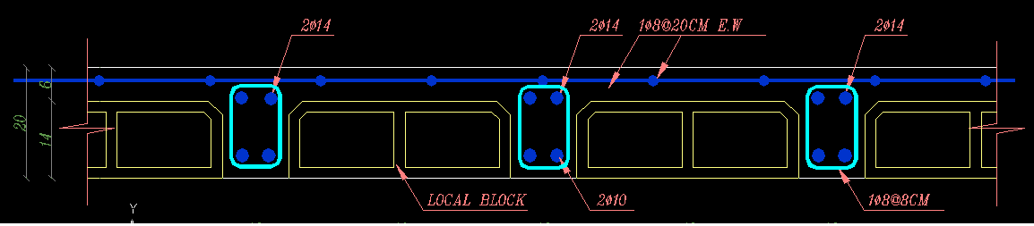
Birzait Orthodox School
Civil
Engineering
Three dimensional structural analysis and design
Cross section in slab
Section in ribbed slab
Graduation Project

Slide 32
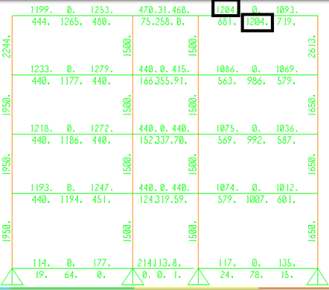
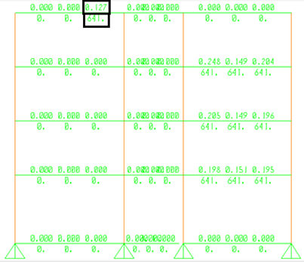
Birzait Orthodox School
Civil Engineering
Three dimensional structural analysis and design
Design of frames:
Upper beam in frame 13A as representive beam
Frame 13A- flexural reinforcement, mm²
torsion reinforcement, Al (mm²) and Av/s (mm²/mm)
Graduation Project

Slide 33
Birzait Orthodox School
Civil Engineering
Three dimensional structural analysis and design
Torsion reinforcement
Al = 641 mm²
(161 mm² in each side of beam)
Top & bottom steel:
As = 1204 mm²
As _{total} = 1204 + 161 = 1365 mm²
Use 3Ø16mm & 2Ø20mm.
Use 2Ø12mm, at left and right faces of beam section.
Graduation Project

Slide 34
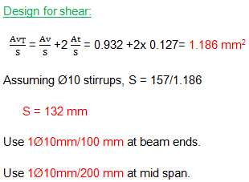
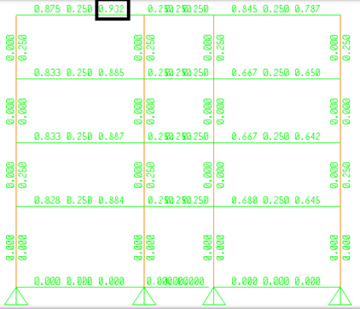
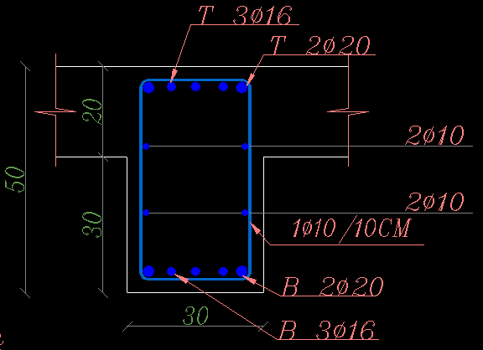
Birzait Orthodox School
Civil Engineering
Three dimensional structural analysis and design
Section in upper beam in frame 13A
Frame 13A- shear reinforcement (Av/s), mm²/mm
Graduation Project

Slide 35
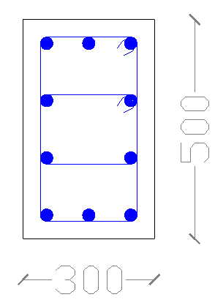
Birzait Orthodox School
Civil Engineering
Three dimensional structural analysis and design
Design of column
Column A14 in frame 13A is taken as representive column
Column dimensions ( 30 x 50)
As _{Longitudinal} = 1500 mm²
# of bars in 0.5 dir. = {(50 – 8)/15+1} = 4 bars
# of bars in 0.3 dir. = {(30 – 8)/15+1} = 3 bars
Area of one bar which must used = 1500/10 = 150 mm²
Area of (Ø14) bar = 154 mm²
So, use 10Ø14mm
use 2 Ø10mm/100 mm as hoops for a distance (1000 mm)measured from the face of beam and slab.
And outside of the length (1000 mm) use 2Ø10mm/200 mm.
Cross section in column 14A
Graduation Project

Slide 36
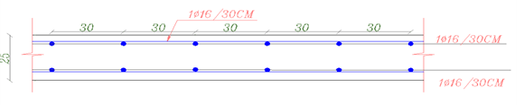
Birzait Orthodox School
Civil Engineering
Three dimensional structural analysis and design
Design of walls:
All walls in the building are modelled as 3D and the values of moments and the axial forces are taken and assigned on 1Dmodel for each wall in SAP2000 separate model
The wall in frame 6B in part B (7.2 m length, 0.3 m thickness) is taken as reprehensive wall, the vertical and horizontal reinforcing steel are shown in Figure below.
1Ø16/30cm in vertical direction, and horizontal directions
Three dimensional structural analysis and design
cross section in wall
Graduation Project

Slide 37
Birzait Orthodox School
Civil
Engineering
Three dimensional structural analysis and design
Design of stairs:
Design of flights:
Live load = 5 KN/m²
h = 400/20 = 20 cm
Dead load = 0.2 x 25 = 5 KN/m²
Super imposed dead load = 4.5 KN/m
Wu = 1.2 (4.5 + 5) + 1.6(5) = 19.4 KN/m
Mu = (Wu x L²)/8 = 38.8 KN/m for stair.
ρ=0.004155 (cover 4 cm)
As = 665 mm²/m
Use 5Ø14mm/m (8Ø14 in 1.5 m)
Design of landing:
Load on landing = landing direct load
+ load from flight
= 19.4 +19.4 (4/2)
= 58.2 KN/m
Assume this loads is resisted by 1m wide of landing, then:
M_{u} = (Wu x L²)/8 = 74.5 KN.m
ρ= 0.0083
As = 0.0083 x 1000 x 160 = 1328 mm²
Use 8Ø14/m.
Check shear in landing:
Vu = 93.12 KN
ØVc = 106 KN > Vu OK
Graduation Project

Slide 38
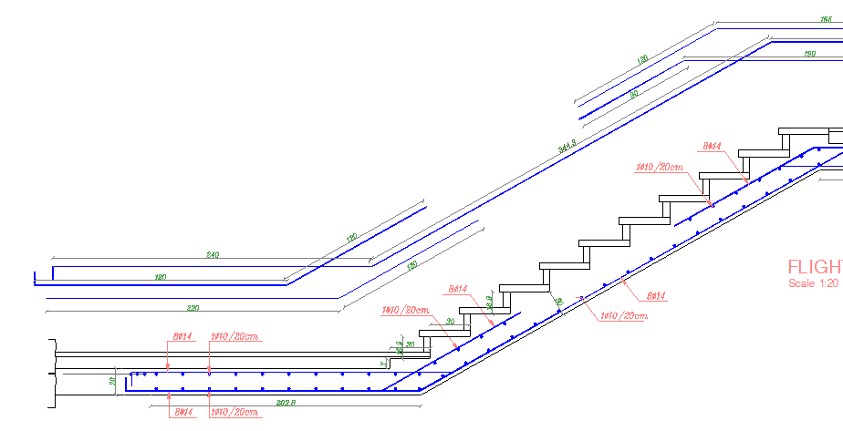
Birzait Orthodox School
Civil Engineering
Three dimensional structural analysis and design
Cross Section in stairs
Graduation Project

Slide 39
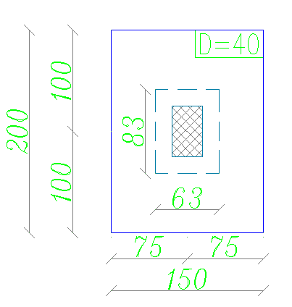
Birzait Orthodox School
Civil
Engineering
Three dimensional structural analysis and design
Design of footings:
The footing F1 which is single footing is taken to design as representive footing
Bearing capacity = 300 KN/m².
Footing area, A_{f} = (727 +156)/300 = 2.95 m²
Let B=1.5 m and L=2 m
Vu = ØVc
q_{u} x L=0.75 x (1/6) x(28) ^{0.5} x1000 x d=661.5 x d
=374 (0.75 – d)
d =0.28, take d = 0.33 m, and h = 0.4 m
Plan of footing F1
Graduation Project

Slide 40
Birzait Orthodox School
Civil
Engineering
Three dimensional structural analysis and design
Check punching shear:
ØVcp = 0.75 x (1/3) x(28) ^{0.5} x (630 + 830) x 2 x 0.33
= 1275 KN
Vup = 1122 – 374 x 0.63 x 0.83 = 195 KN
Punching is OK
Mu₁= 106 KN.m
ρ = 0.002632
A_{s} = 0.002632 x 330 x 1000 = 869 mm²
A_{S min} = .0018 x 1000 x 400 = 720 mm²
Use A_{s} = 869 mm²
A_{s} in 1.5 m = 1304 mm²
Use 9Ø14mm.
Mu₂= 67.4 KN.m
ρ = 0.001658
As = 547 mm²
A_{S min} = .0018 x 1000 x 400 = 720 mm²
Use A_{s min} = 720 mm²
A_{s} in 2 m = 1440 mm²
Use 10Ø14mm.

Slide 41
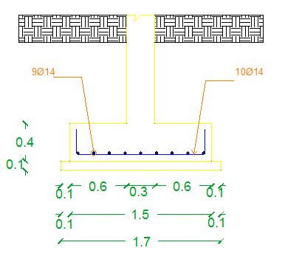
Birzait Orthodox School
Civil
Engineering
Three dimensional structural analysis and design
Cross section in footing F1

Slide 42
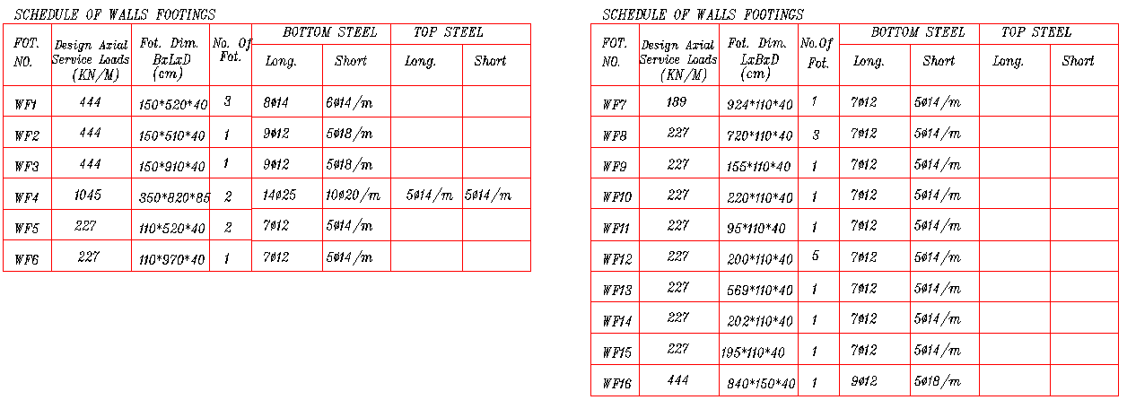
Birzait Orthodox School
Civil
Engineering
Three dimensional structural analysis and design
All footing reinforcing steel are shown Tables below

Slide 43
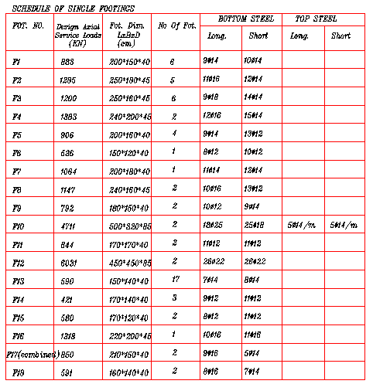
Birzait Orthodox School
Civil
Engineering
Three dimensional structural analysis and design

Slide 44
…………
Civil Engineering
Thank You
تم بحمد الله
Graduation Project

