Slide 1
Pharmacy Management System pms
Ahmad Daraghmeh and Abd Alrhman Banimatter

Slide 2
Introduction
Pharmacy Management System (PMS) is a software to manage pharmacy work contain two Apps.
First App is a desktop application designed to work in the pharmacy ,this app provides sale process , insert incoming goods ,define new products , and other processes in pharmacy.
Second App is mobile application that give alerts to manager and notifications.

Slide 3
Goal
mange ,facilitate Pharmacy work, and manage employees work ,also regulate the sale and purchase processes ,with billing system , and also provide warning system, to reduce losses by give alert about product near to be expired , and give full statistics for all aspects of work , also give tips to fresh graduate pharmacist about (how to take medicine to tell the customer , or med-position) when they make sale or search for product in pharmacy.

Slide 4
abstract
Software do all things in pharmacy like sale , insert new incoming goods , make bills , calculate taxes ,and debt , also compute employees salaries , give information about products , make different statistics as best month to sale some product via provide charts , also manage employees work.

Slide 5
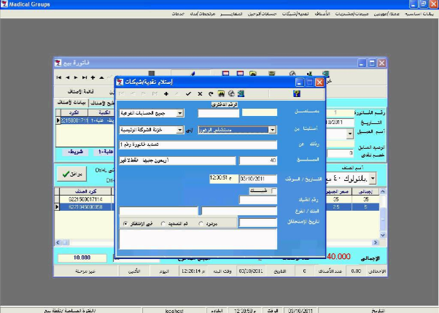
OTHER Software problems
MEDICAL GROUPS

Slide 6
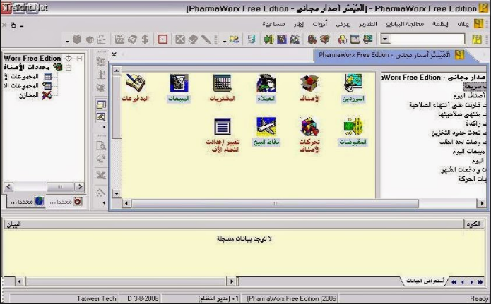
OTHER Software problems
PHARMA WORKS

Slide 7
DFD Context diagram

Slide 8
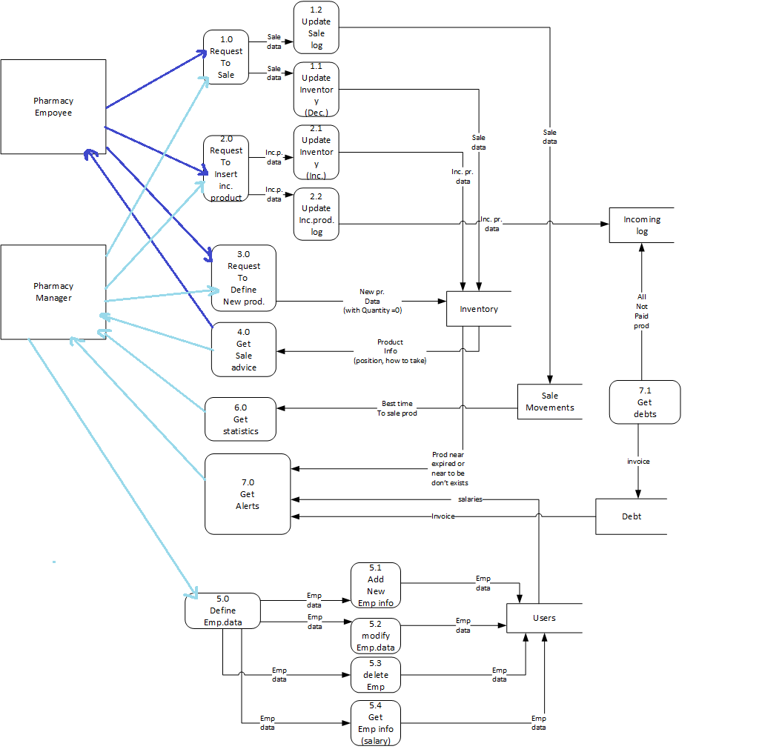

Slide 9
Use Case

Slide 10
Sequence Diagram: manager Login And Register New Employee:

Slide 11
Sequence Diagram:
Employee Login:

Slide 12
Sequence Diagram: employee Login Insert new product:

Slide 13
Sequence Diagram: employee sale and insert inc. goods:

Slide 14

Notes:
Project Icon

Slide 15
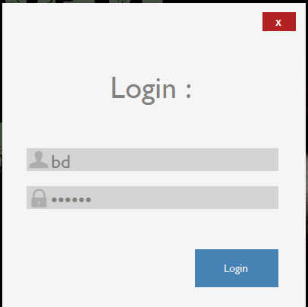
Notes:
Login

Slide 16
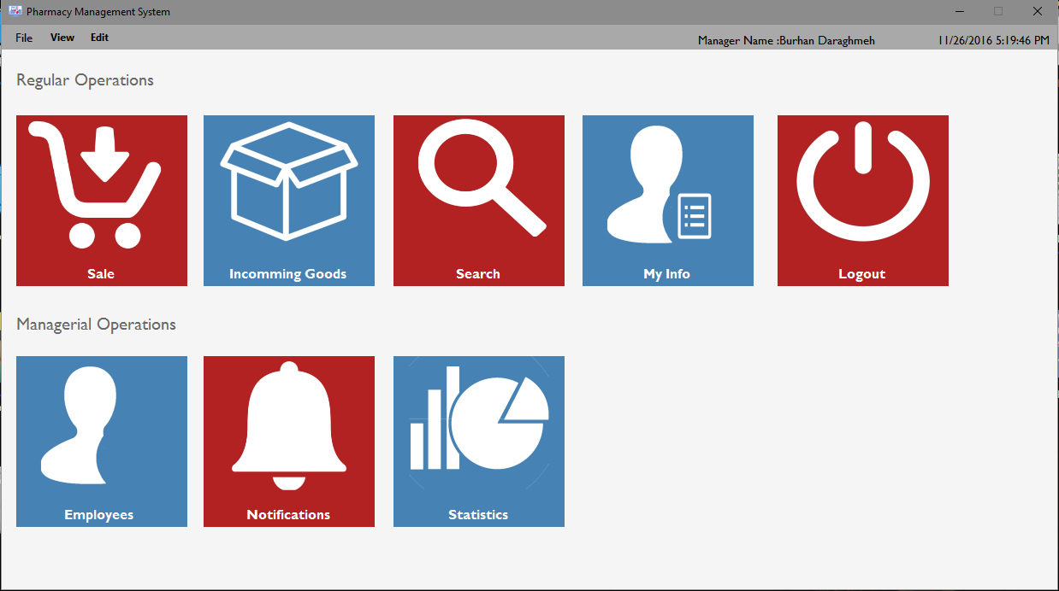
Notes:
Main Window

Slide 17
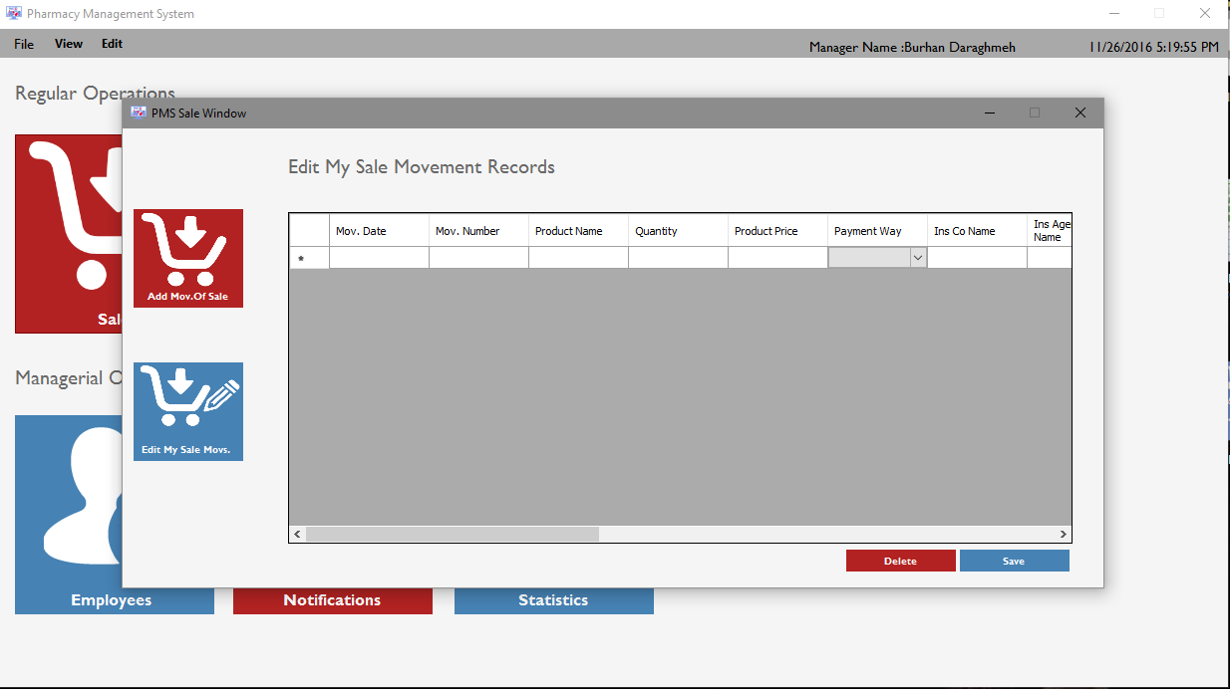
Notes:
add sale movement

Slide 18
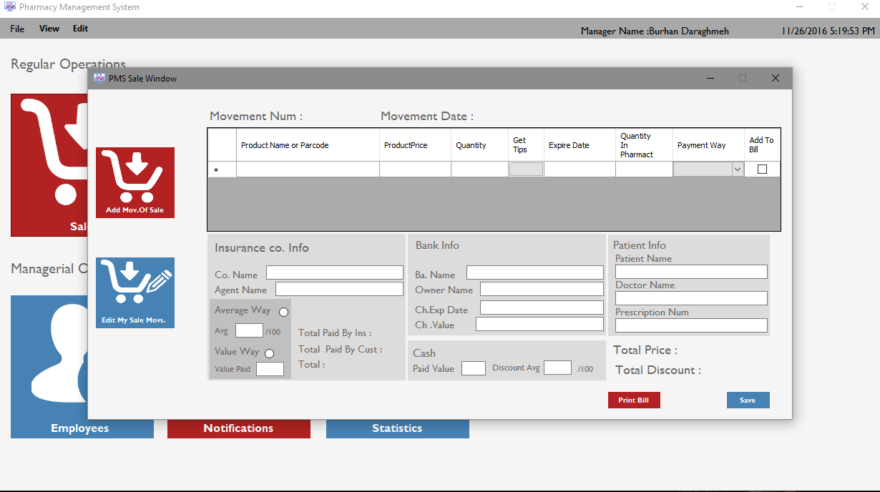
Notes:
edit my sale movement records

Slide 19
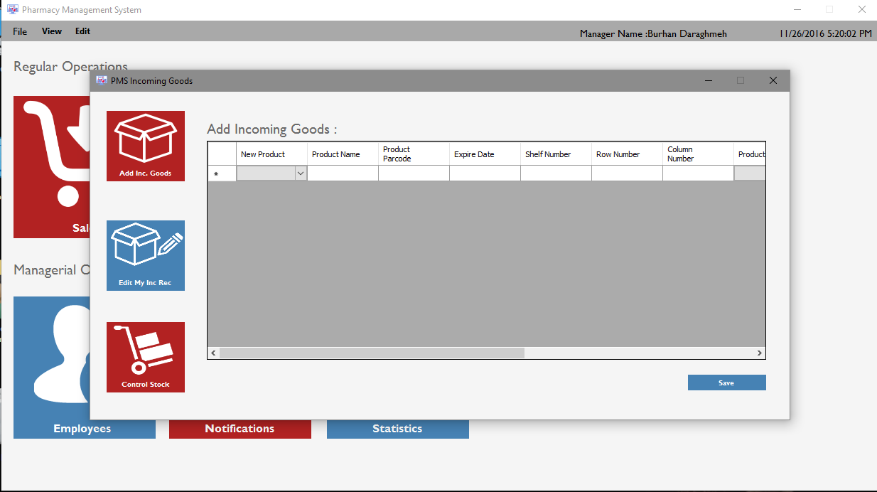
Notes:
add incoming

Slide 20
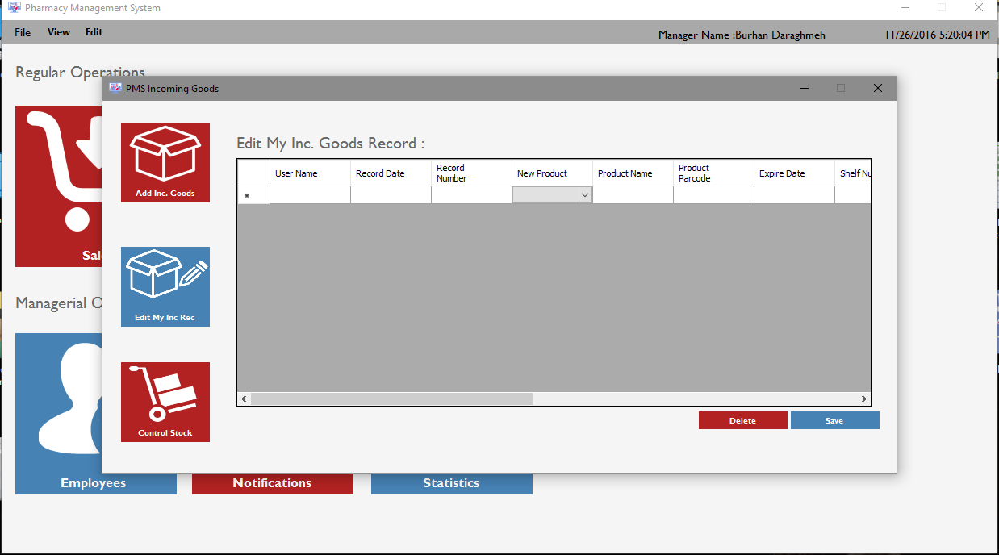
Notes:
edit my incoming goods record

Slide 21
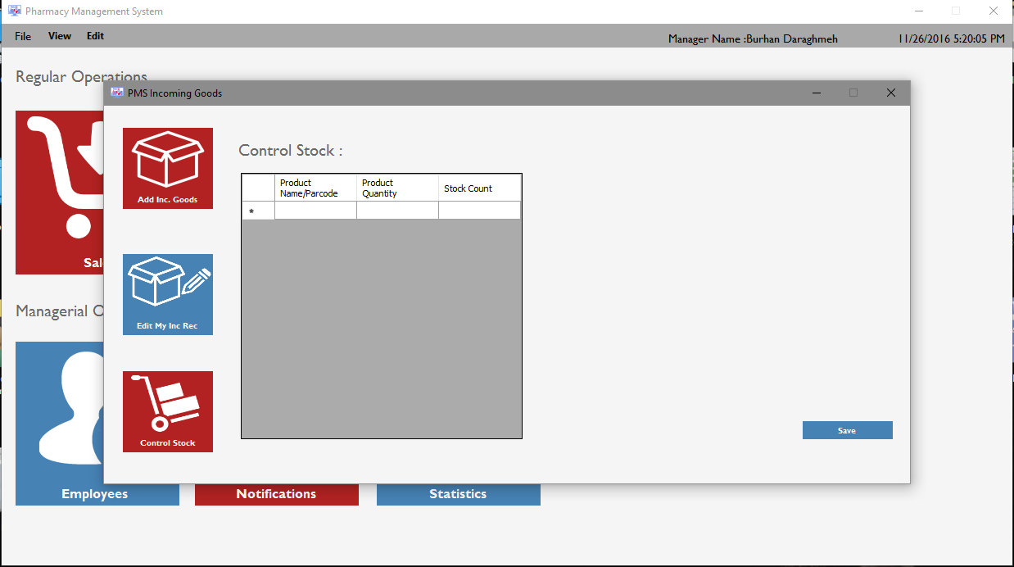
Notes:
control stock

Slide 22
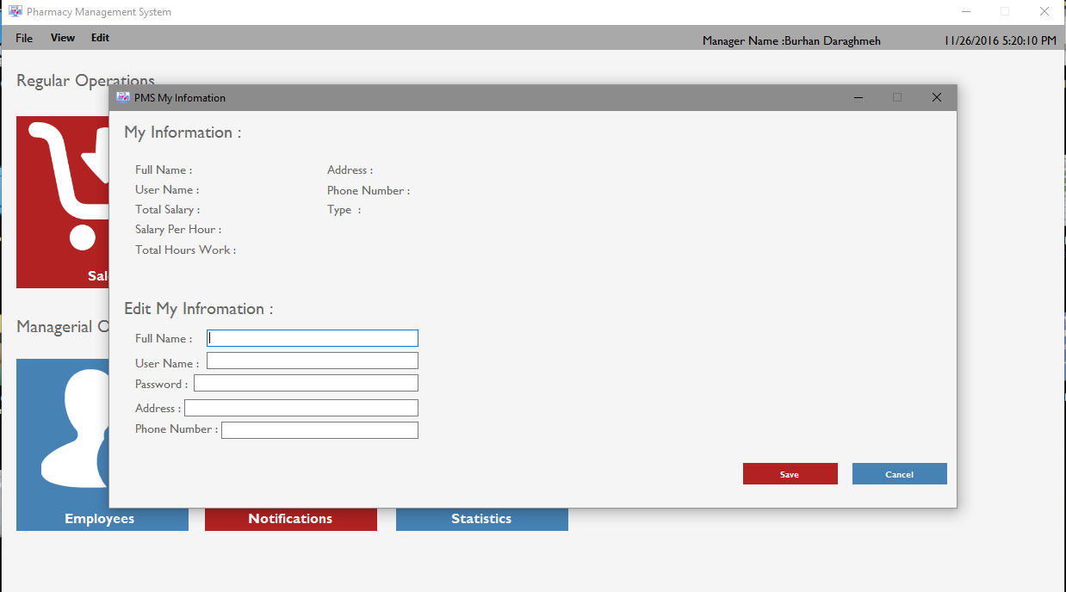
Notes:
view my information , edit my information

Slide 23
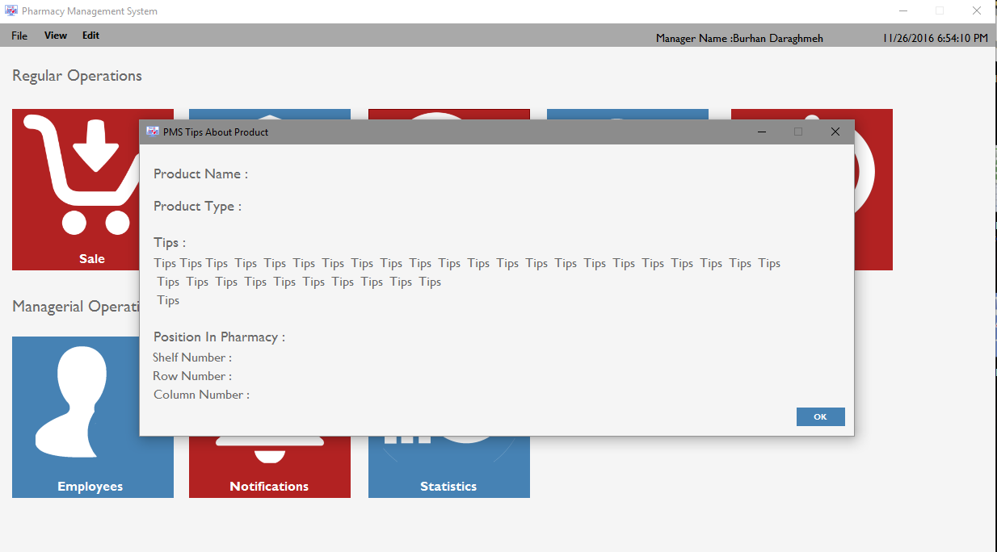
Notes:
Notifications:
Contains two processes ( View Products that near to completion , and view products that near from expire date).

Slide 24
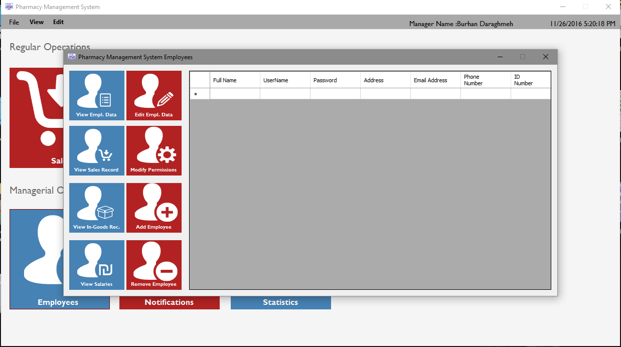
Notes:
1. view employee data

Slide 25

Notes:
2. view sale records

Slide 26
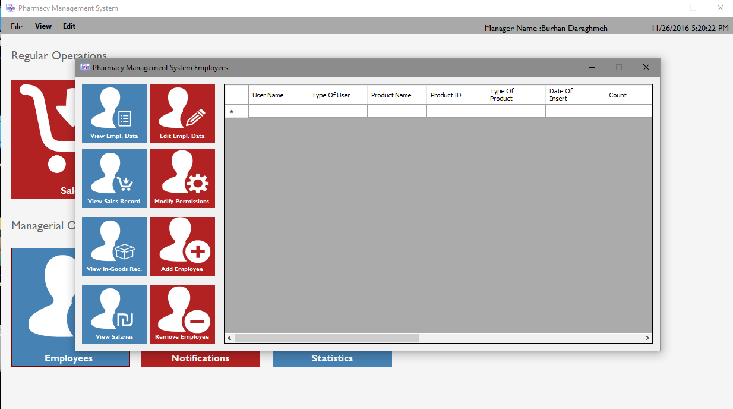
Notes:
3. view incoming goods records

Slide 27
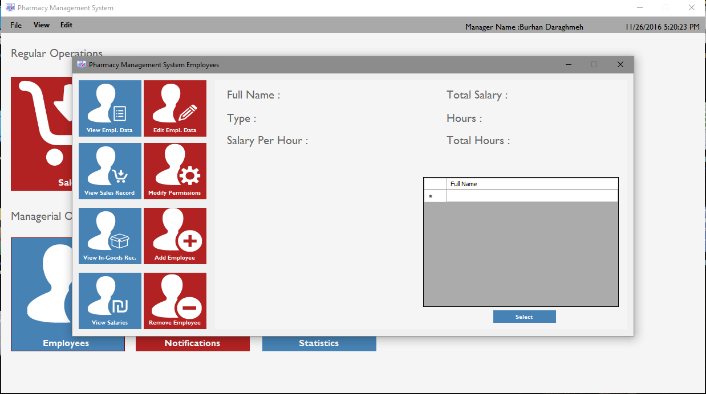
Notes:
4. view salaries

Slide 28
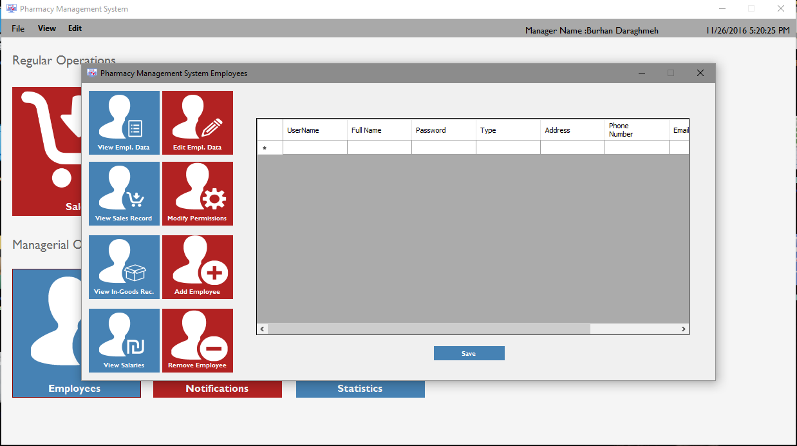
Notes:
5. edit employee data

Slide 29
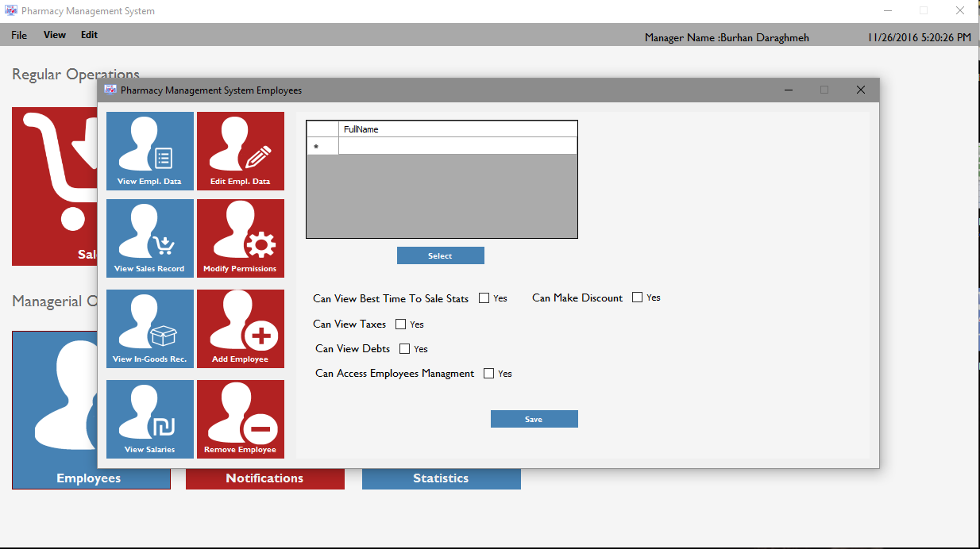
Notes:
6. modify permissions

Slide 30

Notes:
7. add employee

Slide 31

Notes:
8. remove employee

Slide 32
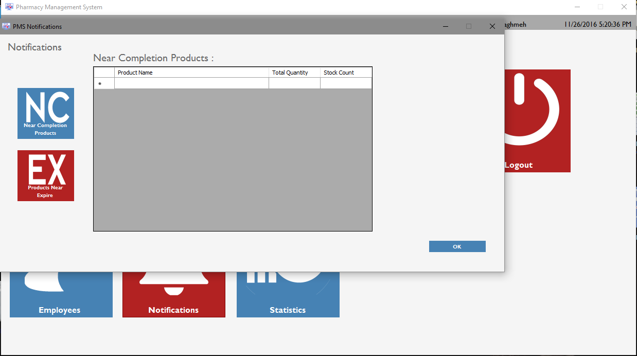
Notes:
( View Products that near to completion

Slide 33
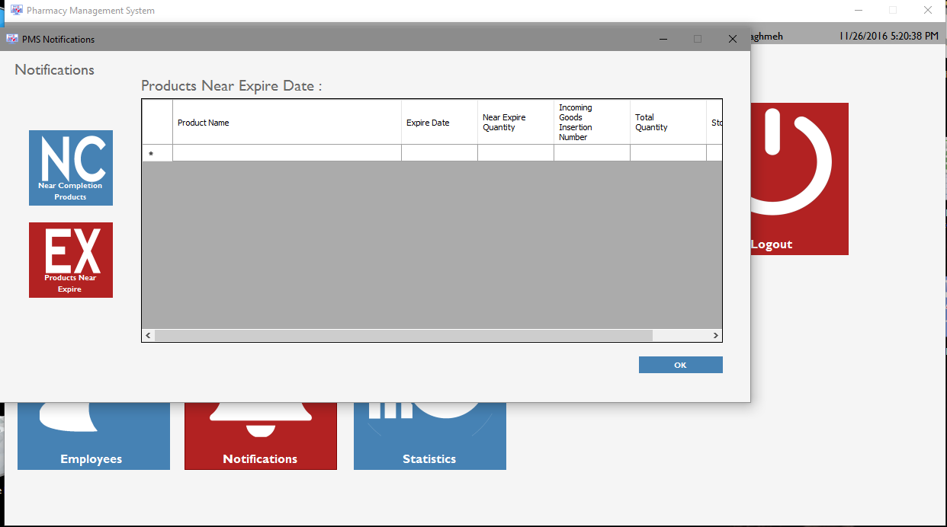
Notes:
view products that near from expire date).

Slide 34
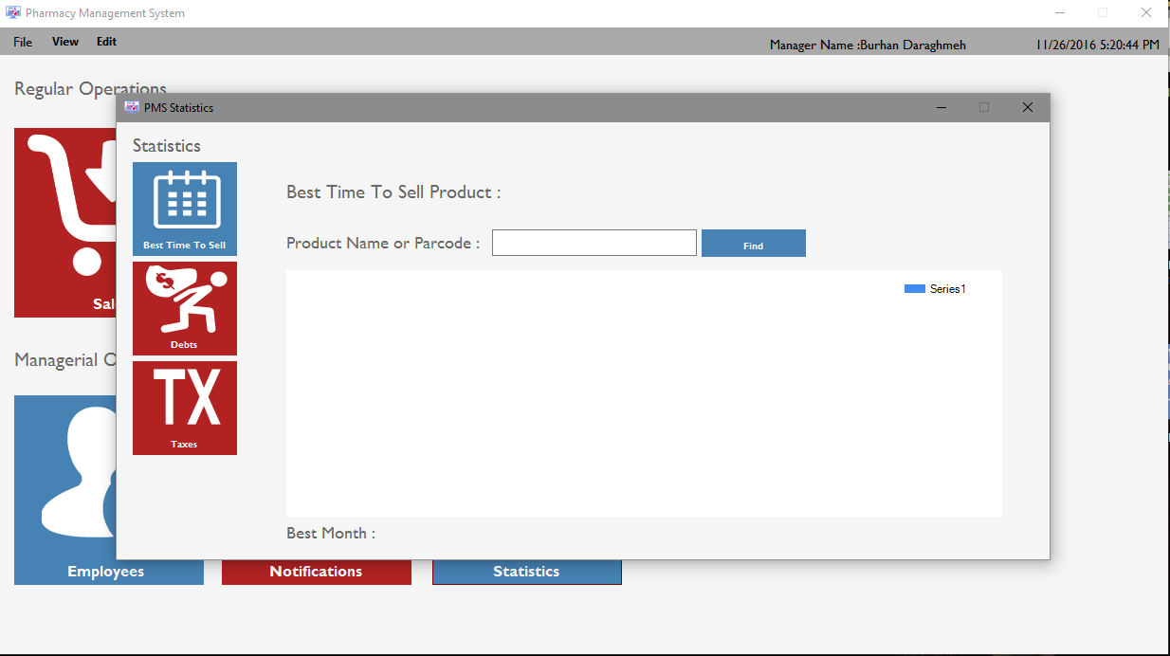
Notes:
1. view best month to sell some product

Slide 35
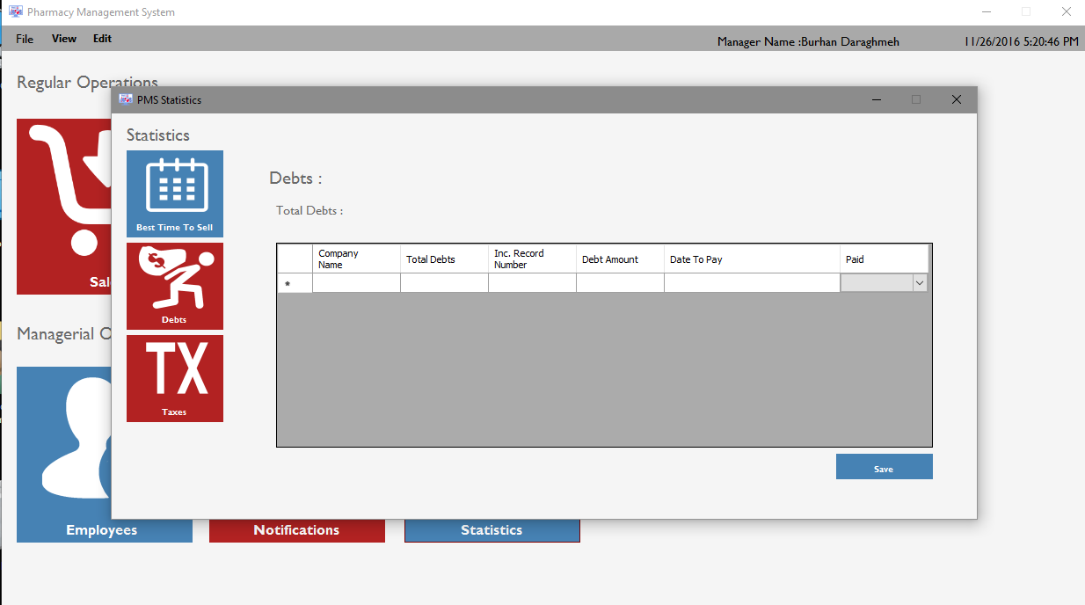
Notes:
2. view and edit debts

Slide 36
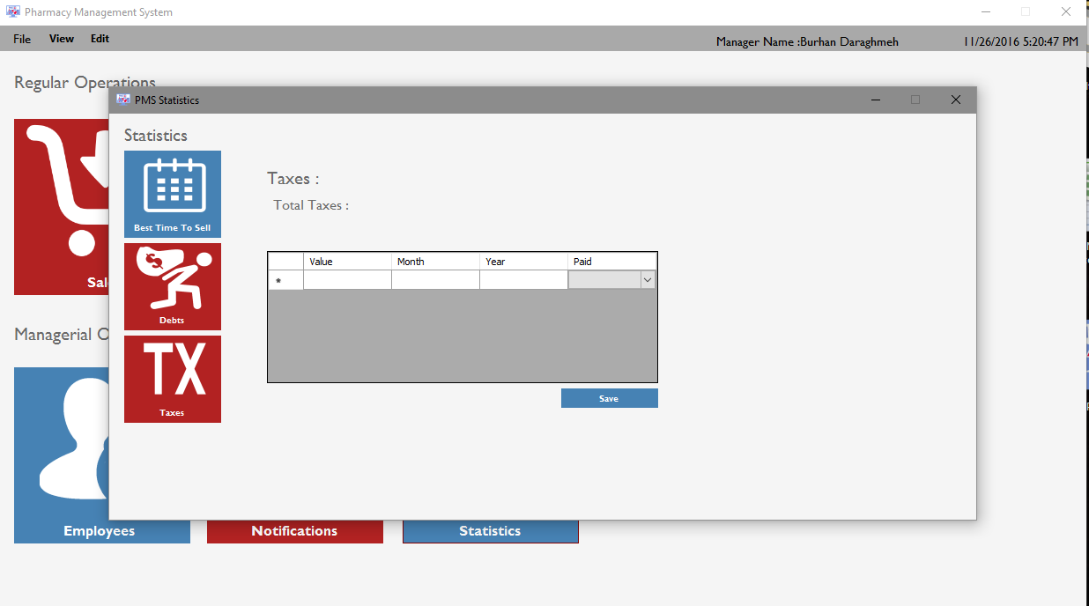
Notes:
3. view and edit taxes

