Slide 1
An-Najah National University Engineering & IT Faculty Civil Engineering Department
Structural Analysis And Design of Baitona Building
By: Anan Barahmeh (11105757)
Saleh Qundos (11212226) Galeb Daragmeh (11210069)
Under supervision of : Dr. Munther Diab

Slide 2
Outline:
Introduction.
Gravity and Lateral loads.
3D modeling using ETABS.
Design of Slab.
Design of Beams.
Design of Columns and Shear walls.
Design of Footings.

Slide 3
INTRODUCTION

Slide 4
Baitona Building
Location : Makhfia-Nablus
9 Floors.
Floor area : about 550 m²
Total Area : about 5750 m²

Slide 5
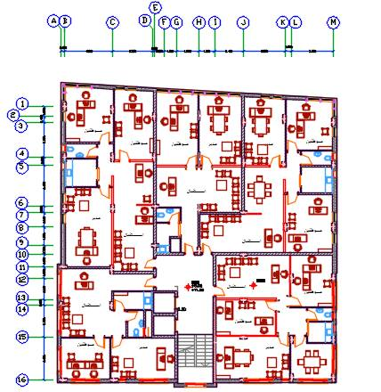
Floors consists:
Three floors is Residential.
Three floors offices.
The basement for parking the ground and the attic for storage .

Slide 6
Codes
ACI 318 (American Concrete Institute)
IBC-2012 (International Building Code)
ASCE-2010 (American Society of Civil Engineers).

Slide 7
GRAVITY & LATERAL
LOADS

Slide 8
Loads
Gravity
Lateral
Seismic
Dead
live
Superimposed

Slide 9
Preliminary Design The choice of the system for slab in the building is very important to resist the internal forces and stability.
In our project we use one way solid slab system.
As the solid slab is better for resisting seismic loads.

Slide 11
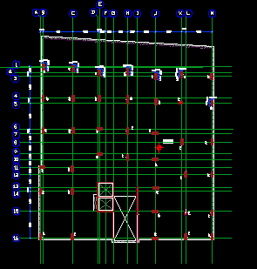
Intermediate moment resisting frame system

Slide 12
SDS=2/3*SMS
SMS= Fa * Ss
R
System
I
Fa→ site class(B), Ss
Ss= 2.5 *Z
Z→ site class(B)→ soil type
Risk category (I)
Use of Buildings and Structures

Slide 13
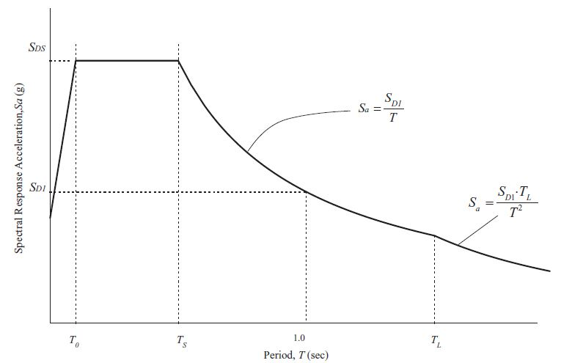
Response spectrum
A response spectrum is a plot of the maximum response amplitude (displacement, velocity, or acceleration) versus the modal period

Slide 14
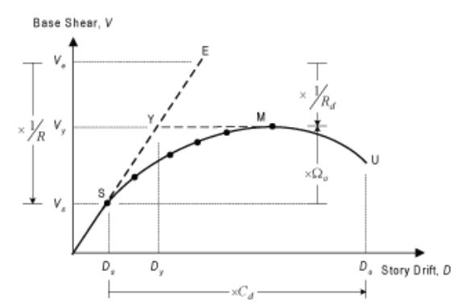
Seismic design factors
R= Modification factor

Slide 15
Code | Value of base shear (Hand Calc.)(kN)
IBC-2012 | 2769.9

Slide 16
Load combinations
U = 1.4D
U = 1.2D + 1.6L + 0.5(Lr or S or R)
U = 1.2D + 1.6(Lr or S or R) + (1.0L or 0.5W)
U = 1.2D + 1.0W + 1.0L + 0.5(Lr or S or R)
U = 1.2D + 1.0E + 1.0L + 0.2S
U = 0.9D + 1.0W
U = 0.9D + 1.0E

Slide 17
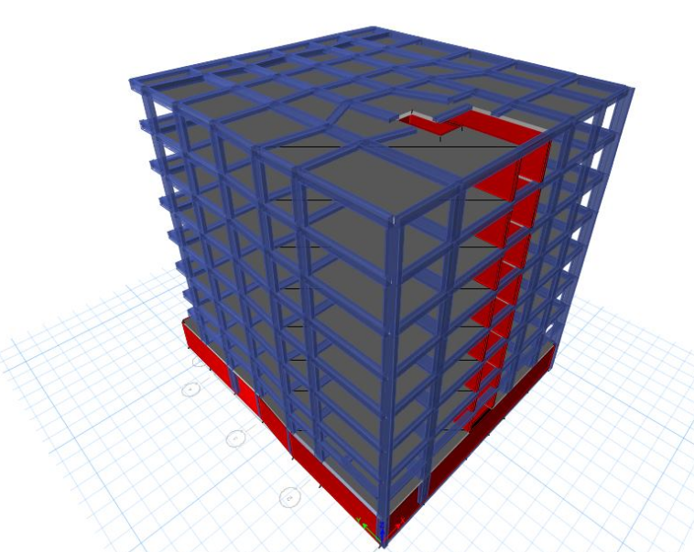
THREE DIMENSIONAL STRUCTURAL ANALYSIS

Slide 18
Modifiers for each element
Modifier | Element
0.7 | Column
0.35 | Beam
0.25 | Slab
0.7 | Shear wall

Slide 19
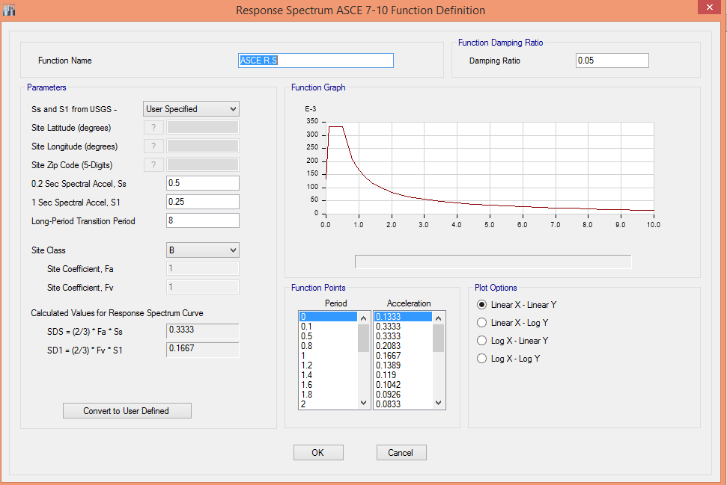

Slide 20
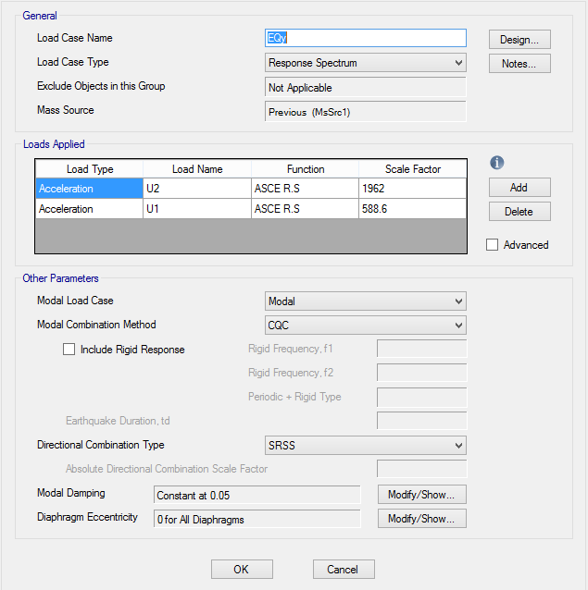

Slide 21
Strength check
Shear & torsion
No red elements
No problems
Rebar percentage
All is okay

Slide 22
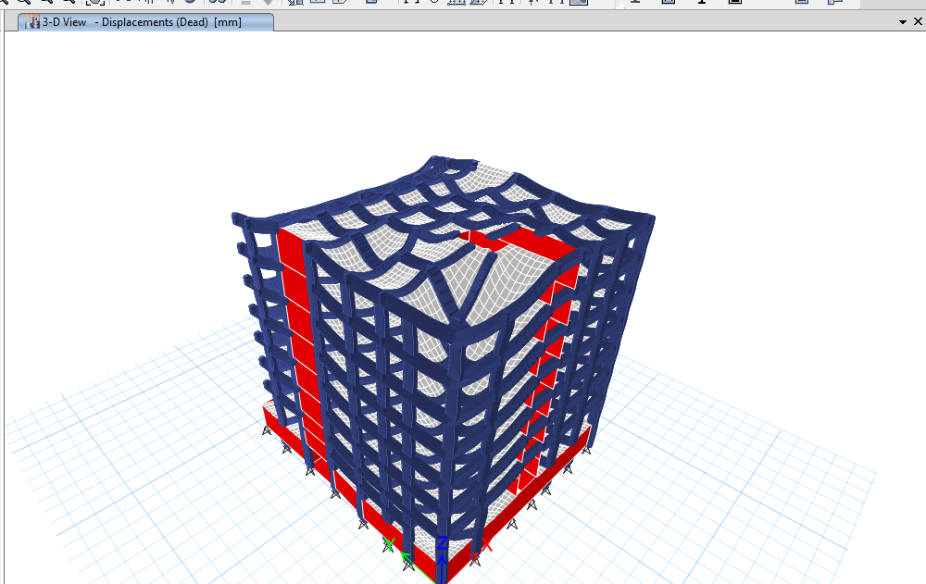
Compatibility of structural model

Slide 23
Equilibrium
Load type | Hand results kN | Etabs results kN | Difference %
Dead | 57446 | 60408 | 4.9
SD | 18844 | 21203.8 | 11
Live | 14133 | 14135 | 0

Slide 24
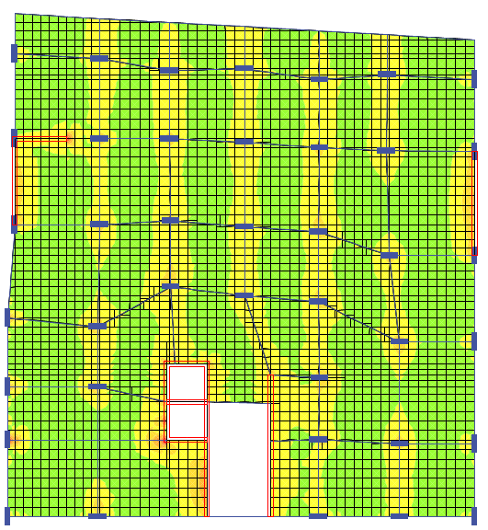
Stress Strain relationship
(internal equilibrium)
Slab moments
$\frac{4+3}{2}+2.34=5.84 KN.m$
$\frac{w_{u L^{2}}}{8}=\frac{4∗{3.88}^{2}}{8}=7.5 KN.m$
The difference percentage is 22 %, which is less than 25%, OK

Slide 25
Lateral loads check
Seismic load, IBC
Direction | Hand calculation base shear(kN) | Etabs base shear (kN)
X | 2769.9 | 2455.2

Slide 26
Period and modal participation ratio

Slide 27
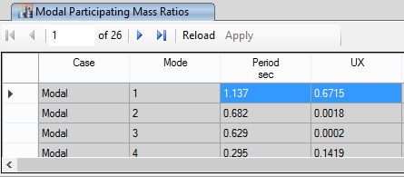

Slide 28
DESIGN OF SLAB

Slide 29
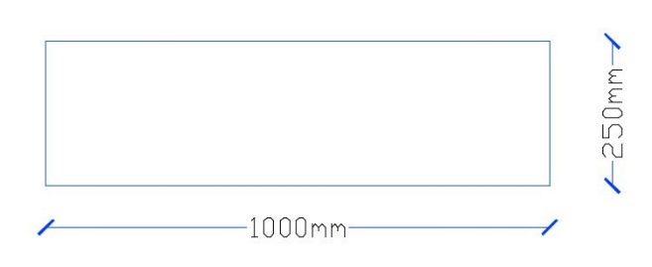
Solid slab.
Thickness = 25 cm.
Shear on slab:
Max Vu = $29.8\frac{kN}{m}$ $∅$Vc = $138.9 kN$
138.9 >29.8 so,
shear is OK

Slide 30
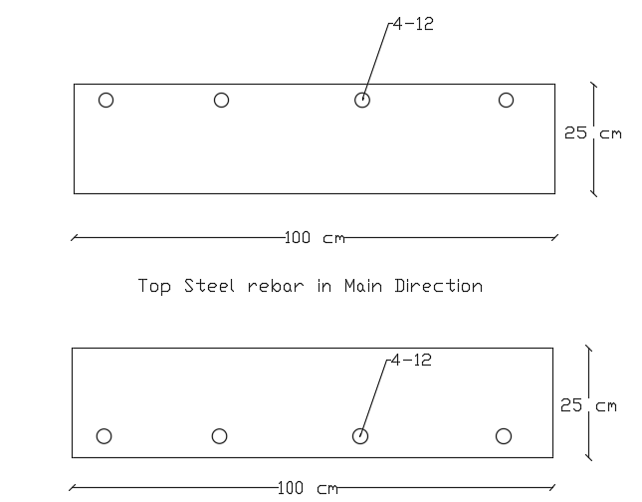
Steel reinforcement:
Using a uniform steel mesh with 4Ø12/ 1m (Top and Bottom) for all floors and roof.

Slide 31
DESIGN OF BEAMS

Slide 32
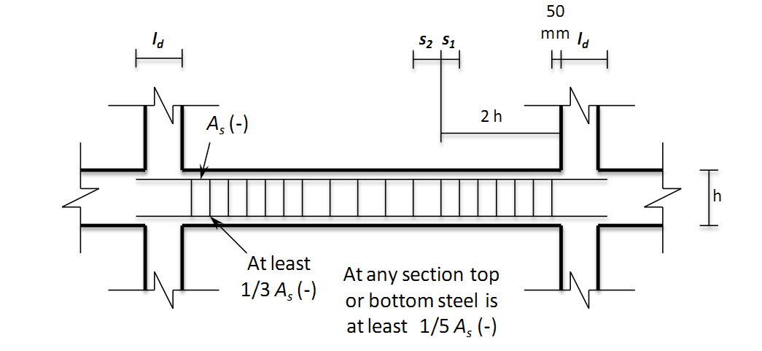
ACI318-14 Code requirements:
The value of moment and shear
computed by taking twice the
earthquake load in the load
combinations.
The first hoop shall be located not more than 50 mm from the face of a supporting member.
$S_{1}=min\left\{\begin{aligned}\frac{d}{4} \\ 8 d_{b} \\ 24ds \\ 300 mm\end{aligned}\right.$
$S_{2} =\frac{d}{2}$ .

Slide 33
Equations:
For shear and torsion |  | For flexure
$$T_{th}={\frac{1}{4}∅T}_{cr}=\frac{1}{12}λ∅\sqrt{f_{c}^{′}} \frac{A_{cp}^{2}}{P_{cp}}$$ | $V_{c}= \frac{1}{6}λ\sqrt{f_{c}^{′}}bd$ | $$ρ=\frac{0.85f_{c}^{′}}{f_{y}}\left[1−\sqrt{1−\frac{2.61 M_{u}}{bd^{2}f_{c}^{′}}}\right]$$
$$\frac{A_{t}}{S}=\frac{T_{u}}{{2A}_{°}F_{yt}}$$ | $$\frac{V_{u}}{∅}= V_{c}+ V_{s}$$ | As = ρbd
$$A_{°}=0.85A_{oh}$$
$$\sqrt{{\left(\frac{V_{u}}{bd}\right)}^{2}+ {\left(\frac{T_{u}P_{h}}{1.7A_{oh}^{2}}\right)}^{2}} ≤ ∅\frac{5}{6} \sqrt{f_{c}^{′}}$$ | $\frac{A_{v}}{S}= \frac{V_{s}}{f_{yt}d}$ | $$ρ_{min}=max\left[\frac{1.4}{f_{y}},\frac{0.25\sqrt{f_{c}^{′}}}{f_{y}}\right]$$
$$T_{th}={\frac{1}{4}∅T}_{cr}=\frac{1}{12}λ∅\sqrt{f_{c}^{′}} \frac{A_{cp}^{2}}{P_{cp}}$$
$$\sqrt{{\left(\frac{V_{u}}{bd}\right)}^{2}+ {\left(\frac{T_{u}P_{h}}{1.7A_{oh}^{2}}\right)}^{2}} ≤ ∅\frac{5}{6} \sqrt{f_{c}^{′}}$$ | $$\frac{A_{v+t}}{S}= \frac{A_{v}}{S}+2\frac{A_{t}}{S}$$
$$A_{l}=\left(\frac{A_{t}}{S}\right)P_{h}\left(\frac{f_{yt}}{f_{y}}\right)$$ | $$S= \frac{A_{v+T}}{\frac{A_{v+T}}{S}}$$
$$A_{l,min}=\frac{5\sqrt{f_{c}^{′}}}{12f_{y}} A_{cp}− \left(\frac{A_{t}}{S}\right)P_{h}\left(\frac{f_{yt}}{f_{y}}\right)$$ | $${\left(\frac{A_{v+T}}{S}\right)}_{min}=max \left\{\begin{aligned}0.062\sqrt{f_{c}^{′}}\frac{b}{f_{y}} \\ 0.35\frac{b}{f_{y}}\end{aligned}\right.$$
$${\left(\frac{A_{t}}{S}\right)}_{min}=0.175\frac{b}{f_{yt}}$$

Slide 34
Beam ID | Dimension(h/d) | Longitudinal Steel |  | transverse steel until 2h(S1) | transverse steel (S2)
B1 | (900/250) | Top | 6Ø16 | Ø8/10 cm | Ø8/10 cm
 |  | Bottom | 4Ø16
B2 | (400/250) | Top | 4Ø10 | Ø8/10 cm | Ø8/10 cm
 |  | Bottom | 4Ø10
B3 | (300/600) | Top | 4Ø16 | Ø8/10 cm | Ø8/10 cm
 |  | Bottom | 3Ø16
Tie beams | (300/500) | Top | 3Ø14 | Ø8/10 cm | Ø8/10 cm
 |  | Bottom | 3Ø14

Slide 35
DESIGN OF COLUMNS AND SHEAR WALLS

Slide 36
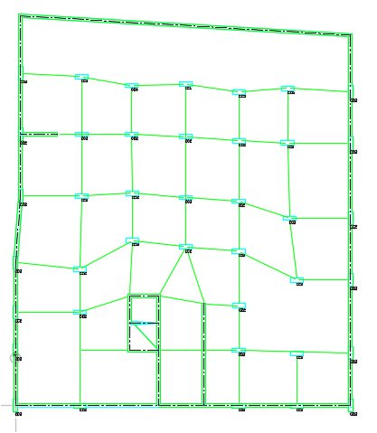

Slide 37
All columns in the building is used 90*30 cm
Design methodology:-
Using ETABS to get the axial force and moments on each column.
Choosing the proper steel ratio.
Determining the spacing between hoops.

Slide 38
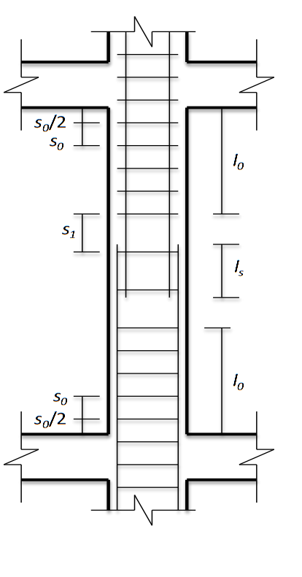
ACI318-14 code requirements:
Hoops Equations
$Sο=min \left\{\begin{aligned}\frac{least column dimension}{2} \\ 8d_{b} \\ 24d_{s} \\ 300 mm\end{aligned}\right.$
$S_{1}=min \left\{\begin{aligned}least column dimension \\ 16d_{b} \\ 48d_{s}\end{aligned}\right.$
$Lο=max \left\{\begin{aligned}clear height of column/6 \\ maximum column dimension \\ 450 mm\end{aligned}\right.$

Slide 39
For All columns Steel Ratios is used 1%
So As = 2700 mm2

Slide 40
Hoops:
For All columns: provide Ø10/10 cm at a distance of 90 cm for the whole Column
Start with hoops at a distance of 5 cm from the face of supports.
Provide a lap splice length = 50 cm.
The splicing of bars is made on the middle of columns.

Slide 41
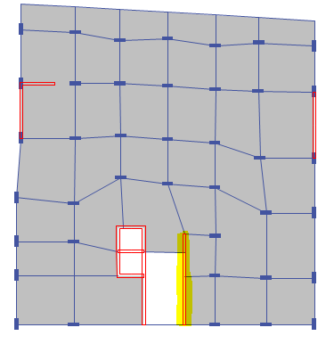
Design of shear wall :

Slide 42
Minimum reinforcement in shear walls according to ACI318-14
Minimum ratio of vertical reinforcement area, ρ shall be:
0.0015 as minimum rebar ratio with F_{y} not less than 420 MPa.
Minimum ratio of horizontal reinforcement area, ρ, shall be:
0.0025 as minimum rebar ratio with F_{y} not less than 420 MPa.
Vertical and horizontal reinforcement shall not be spaced farther apart than three times the wall thickness, nor farther apart than 450 mm.

Slide 43
Rebar for Shear walls
The design output from ETABS is 1300 mm² /meter run ➔ $7∅16/m$ for vertical rebar
For horizontal rebar use minimum steel $=0.0025×1000×250=625 mm^{2}=6∅12/m$

Slide 44
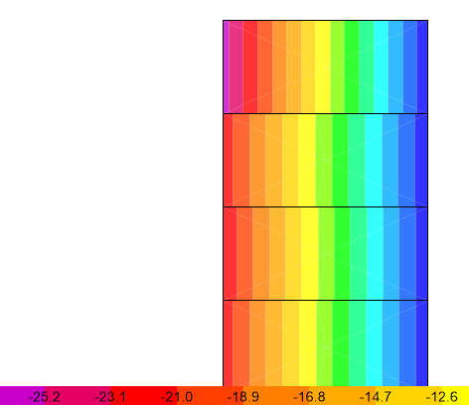
Use total cover = 40 mm.
$V_{c}=220 kN$
$Vu=25$.2 from ETABS
$V_{c}≫\frac{V_{u}}{∅}$ , therefore, there is no need for shear reinforcement

Slide 45
DESIGN OF FOOTING

Slide 46
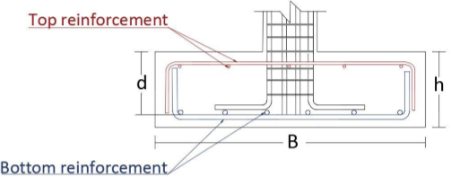
Soil type : Rock.
Allowable Bearing Capacity: 350 kN/m²

Slide 47
Group | Dim | Footing No.
F1 | 2.8*2.8*.75 | 1,2,3
F2 | 2.7*2.7*.75 | 4,5,6
F3 | 2.6*2.6*.75 | 7,8,9,10
F4 | 2.5*2.5*.75 | 11,12,13
F5 | 2.4*2.4*.75 | 14,15,16,17,18,19
F6 | 2.3*2.3*.75 | 19-24

