Slide 1
Olive waste press
Prepared by:
Mohammed Othman
Laith nedal
Amro adwan
Mammon Hamada

Slide 2
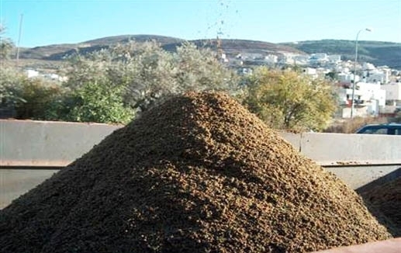
Introduction
This project was conducted to study the effects of different levels of olive pulp now we can classified the olive waste biomass renewable energy

Slide 3
Advantages of olive waste:
Generate electricity.
Thermal and heat production.
Industrial production.
Free material
Have a high specific heat

Slide 4
Disadvantages of olive waste:
Environmental risk
Only found on special region in the world
Poison material
Not solid material

Slide 5
The Aim
As result of all problem we face we decide to design a kind of press which is a machine for pressing pulverized, dried peat into briquettes. The briquettes produced have a density of 200–400 kg/m3, resulting in a high-quality fuel for domestic use, also the ability of transportation become easier and cheaper and of course the environment become healthy and more beautiful.

Slide 6
Benefits of the project
In our view the idea originated when we proceeded to convert material peat from her first to the new format, the compact and of appropriate size to use, adding that "the lack of use of the citizens of the material peat significantly as a result of reliance on modern power tools is what he paid for it."

Slide 7
Constraints
The constraint we had faced was little ,some of them was to convince the owners of olive extractor with our idea , so we visit many olive extractor before we start in jenin , nablus and tulkarem , most of the owner like the idea and welcome us in any time, another problem was the method we will use to operate the press we confuse between three method which is power screw , hydraulic press, and four bar mechanism where everyone has advantage and disadvantage , after a comparison we find that power screw Is the best for us and we will discuss why later,

Slide 8
pressing mechanism
Screw press :-
A screw press is a type of machine press in which the ram is driven up and down by a screw. The screw shaft can be driven by a handle or a wheel. It works by using a coarse screw to convert the rotation of the handle or drive-wheel into a small downward movement of greater force. The overhead handle usually incorporates balls as flyweights. The weights helps to maintain the momentum and thrust of the tool to make it easier to operate.

Slide 9
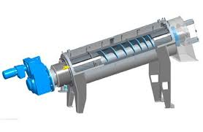
Screw press

Slide 10
The advantages of a lead screw
Large load carrying capability
2. Compact
3. Simple to design.
Easy to manufacture; no specialized machinery is required.
Large mechanical advantage.
Precise and accurate linear motion.
Smooth, quiet, and low maintenance.
Minimal number of parts.
Most are self-locking

Slide 11
pressing mechanism
Hydraulic press :-
The hydraulic press depends on Pascal's principle: the pressure throughout a closed system is constant. One part of the system is a piston acting as a pump, with a modest mechanical force acting on a small crosssectional area; the other part is a piston with a larger area which generates a correspondingly large mechanical force. Only small-diameter tubing (which more easily resists pressure) is needed if the pump is separated from the press cylinder.

Slide 12
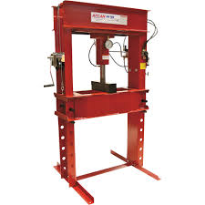
Hydraulic press

Slide 13
The advantage of hydraulic system
1. Fluid power systems are simple, easy to operate and can be controlled accurately
2. Multiplication and variation of forces.
3. Multifunction control.
4. Low-speed torque.
5. Constant force or torque.
6. Economical.
7. Low weight to power ratio.
8. Fluid power systems can be used where safety is of vital importance

Slide 14
component
Motor.
Gear box.
Pipe.
Power screw.
tank

Slide 15
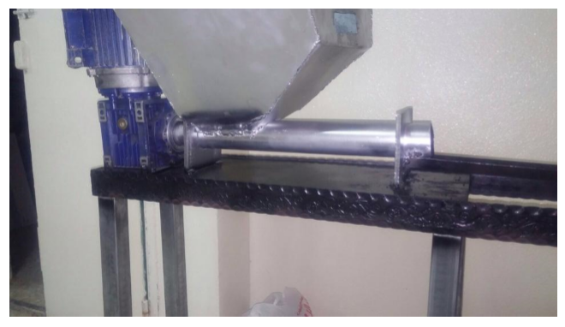
Machine component

Slide 16
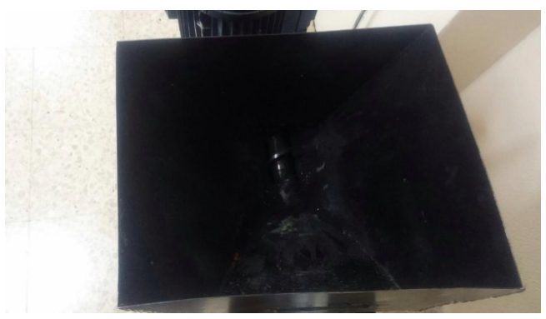
Tank

Slide 17
SINGLE SPEED ASYNCHRONOUS THREE-PHASE STANDARD MOTOR
single and two speed asynchronous three phase standard motors are noiseless, reliable, strong and versatile. The single speed motors are available from MEC 56 to MEC 180 sizes for standardized power from 0.06kW to 37kW. For the two speed motors the winding can be single or double.

Slide 18
Gear box
A gearbox is a collection of mechanical components that deliver maximum power from an engine by managing a series of gear ratios that in turn operate a transmission. These components include: a gear selector, fork, collar, dog teeth and a gear set.

Slide 19
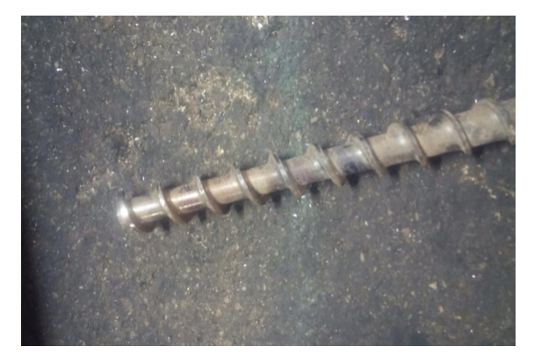
Power screw
V-threads are less suitable for leadscrews than others. Such as Acme because they have more friction between the threads. Their threads are designed to induce this friction to keep the fastener from loosening.

Slide 20
The Operation
The way to operate the press is easy by integrate all previous component at first the peat is thrown into the tank which connected by channel to the belt the peat moved along the belt to the mold which is the press ram which is automatically pressed the peat into a briquettes which then moved again into final station where a worker take the briquettes and arrange them , and after leave the peat cylinder under the sun rays for a day , after that the cylinders well be ready to move or use or even packing .

Slide 21
Safety
Safety is the important factor in all project, in this project we deal with machine (its idiot) so safety procedure must be taken in consideration for example a complete safety clothes should be warn (hat, rope, gloves and respirator, the machine should be protected by a glass shield to prevent any unexpected accident by the lake of experience for the worker.

Slide 22
Calculation
Motor three phase
Frequency 50 hertz
Power is 0.75 kw
One horse power
1.6777 ampere
Speed of motor 1500 rpm
We have ratio for gear box 60:1

Slide 23
Solution
Angular speed: 𝑤=2∗𝜋∗𝑁 60
𝑤 =
2 ∗ 𝜋 ∗ 1500 60
= 9420 60
= 157 𝑟𝑎𝑑/𝑠𝑒𝑐

Slide 24
Solution
power
𝑝𝑜𝑤𝑒𝑟 = 𝑇 ∗ 𝑤
1hp=
745.7watt 1 ∗ 745.7 = 𝑇 ∗ 157 𝑇
= 4.747 𝑁.𝑚

Slide 25
Solution
-gear box
𝑁1/ 𝑁2
𝑤2/ 𝑤1
1/ 60
𝑤2/ 157
𝑤2 = 2.6166 rad/sec

Slide 26
Solution
efficincy =Pout/ Pinp
eff = pout /750
0.9 =𝑝𝑜𝑢𝑡 /750
𝑝𝑜𝑢𝑡 = 675 𝑤𝑎𝑡𝑡
𝑃𝑜𝑢𝑡 = 𝑇2 ∗ 𝑤2
675 = 𝑇2 ∗ 2.6166 𝑇2 = 257.97 𝑁.𝑚

Slide 27
Result and Analysis
The project have been discussed completely all component have been chosen from the tank to the power screw the design approximately completed the press which we will construct will be able to deform ragged peat into briquettes which ready to use for many application like heating system and ovens, and we chose the screw press to give the perfect result and it well look like a big Chopper Weft.

Slide 28
Conclusion and Recommendation
After all the press is success to deform ragged peat into briquettes , the press will make a good profit for the user because after pressing the peat it could be sale to factory where they can use it instead of diesel , so some modification could be carried to improve the work of the press and to reduce the cost and increase the profit, conduct a large facility is a good example, also using very large press could increase the profit and decrease the cost by reducing the worker and increasing production .

