Slide 1
AN-najah National University Faculty of Engineering Civil engineering Department
Hydraulic Analysis of the Water Distribution Network of Kifl Haris using WaterCAD
Prepared by
Heba Raied Alqaq
Supervised by
Dr. Mohammad N. Almasri
May 2011

Slide 2
Introduction
Every city or village is in need to water distribution networks to satisfy the water requirements and demands
As such, the good design of a network is very important to insure that everybody will take all the needs or demands at all times
Water distribution networks (WDNs) decreases the efforts, time and make life easier than in the past time.
The efficiency of WDNs is important, and to check on this, a hydraulic analysis is carried out

Slide 3
Objectives The objectives of this project are : 1. To assess water consumption in the town of to Kifl Hares 2. To hydraulically analyze the WDN of the town of Kifl Haers using WaterCAD under three scenarios Existing steady – state. Existing Transient. Future Transient .

Slide 4
Methodology
Data collection ,maps and all information need.
Model development ,use WaterCAD ,AutoCAD ,Dxf converter,Arcv2CAD.
Evaluation of results from model output, pressure and velocity under all scenarios.
Conclusions and recommendations

Slide 5
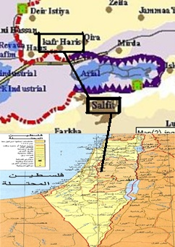
Description of study area
Kifl Hares(Arabic: كفل حارس ) is a palestinian town in the northern West Bank.located in the west of salfit .
The population of the town in 2007 was about 3206 with growth rate 3.13%.
Known as town with heavily religious monuments and graves.
Elevation from the sea level by 467m
Hares Spring

Slide 6
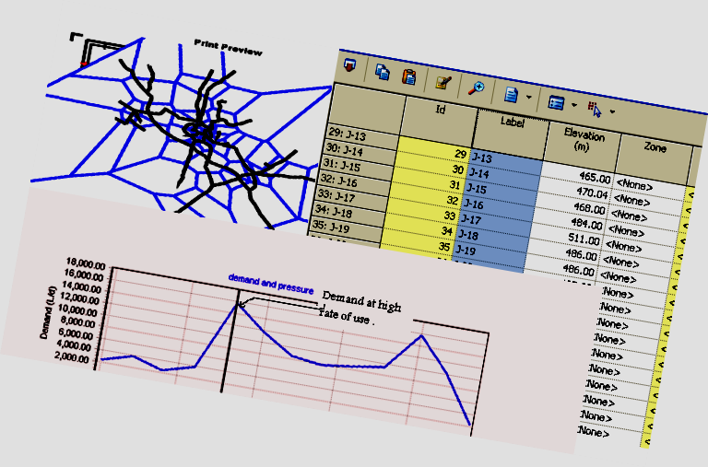
WaterCAD Program
WaterCAD is a powerful, easy-to-use program that helps civil engineers in designing and analyzing water distribution systems.
The output maybe maps ,tables ,graphs ,reports

Slide 7
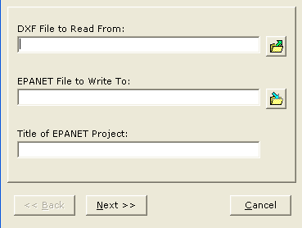
Input Data
Collecting all the data and maps needed from municipality .
Convert WDN from AutoCAD map to WaterCAD
Draw all pipes and nodes over drawing in WaterCAD

Slide 8
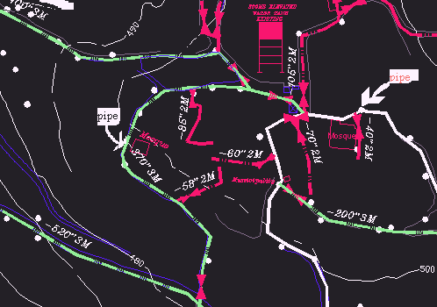
AutoCAD map

Slide 9
Insert pipe diameters manually
Elevation of nodes: the elevation automatically will be provided.
Insert value of Hazen-Williams Coeffecient which depends on type and age of pipes.
Insert demand at nodes: water consumption according to the Municipality in 2009 is ( 60 l/c/d) and daily water supply is (72 l/c/d).

Slide 10
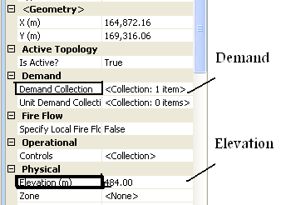
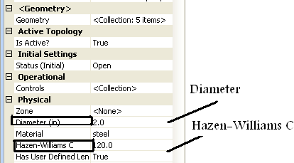
Input Data

Slide 11
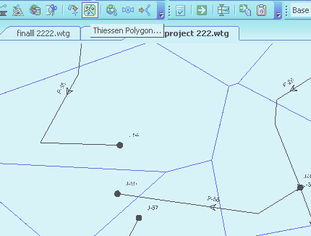
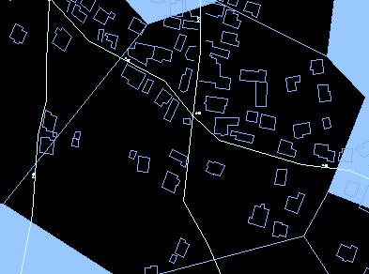
Thiessen Polygons: which are the perpendicular bisectors of the lines between all the nodes. They have unique property that each polygon contains only one node so, it can count houses for every nodes.
Insert demand pattern

Slide 12
Existing steady –state scenario
Demand
Supply =consumption/(1-%losses)
supply =60/(1-.175)=73 l/c/d.
The density =population size/number of houses
= 3401/657=5 persons /house
Results
pressure range between(3-105.7)m , there is no negative pressure but some pressure values below 20m.

Slide 13
Pressure

Slide 14
Velocity
Values of velocity range from (0.01 to 0. 6)m/s, and that mean no values of velocity above 2m/s

Slide 15
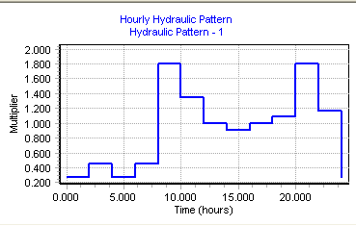
Demand pattern

Slide 16
Existing transient steady-state scenario
Pressure
In the transient condition (hour8) ,pressure range between(1.5-101)m , there is no negative pressure but some pressure values below 20m.
Velocity
Values of velocity range from (0.01 to 1.1)m/s, and that mean no values of velocity above 2m/s

Slide 17
Pressure

Slide 18
Future transient scenario
*
Demand
In this case the future analysis for the existing network after 25 year from now.
To estimate the future water demand for each node,the existing water demand will be multiplied by a factor
Factor =
*
*

Slide 19
assume the demand in the future to be 100 L/c/d
Future population=7580
Existing population in 2009=3401
Existing demand =60 L/c/d
So ,the factor is 4.5
Befor modification
Pressure
After we changed the existing demand to future demand based on the future demand factor we had negative pressure values and high velocities.

Slide 20
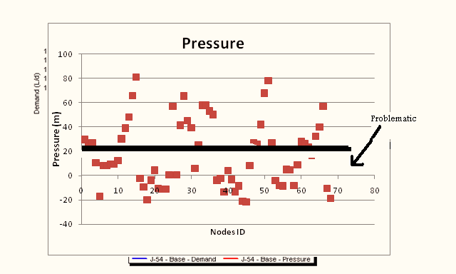
Values of future pressure before modifications
Values of future pressure before modifications

Slide 21
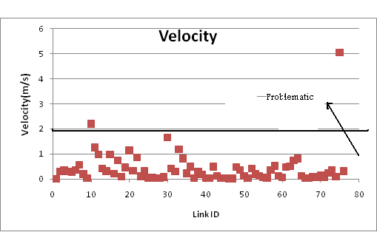
Velocity before modification

Slide 22
After modification
To reach the pressure within limitation and no negative pressure or pressure under 20m, we changed selected pipes diameter .
All values of pressure above 20m and the range of pressures between ( 24-124 )m.
Values of velocity between the range of (0.3-2)m/s.

Slide 23
After modification(Pressure)

Slide 24
After modification (Velocity)

Slide 25
Conclusions
1-percentage of losses in pipes is 17.5%.
2- Different values of velocity in the range 0.01-0.6m/s in the existing network.
3-Different values of pressure due to variation in topography and the range is between 3-105.5m .
4-WaterCAD is an efficient software to carry out a hydraulic analysis and easy to use.

Slide 26
Recommendation
All pipes in the following table should be changed in future design to satisfy the specifications for velocity and pressure.
To increase the pressure in elevated areas which has pressure less than 20m ,we must add a pump which achieves a higher head

Slide 27
Selected pipes where the diameter must be changed
Pipe name | Old diameter(in) | Recommended diameter(in)
P-9 | 3 | 4
P-25 | 3 | 4
P-26 | 3 | 4
P-32 | 3 | 4
P-40 | 3 | 4
P-53 | 3 | 4
P-55 | 3 | 4
P-62 | 3 | 4
P-21 | 3 | 4
P-36 | 3 | 4
P-45 | 3 | 6
P-46 | 3 | 4

