Slide 1

Construction project management
Submitted in partial fulfillment of construction project management for the bachelor degree in civil engineering
Fuad Qararyieh
Miqdad Nawahda
Sari Obaid

Slide 2
Graduating project consist two parts :
The first part include preparing a theoretical research.
The second part includes the application of the principle in construction project management.

Slide 3
Project Management Body of Knowledge (PMBOK)
Introduction

Slide 4
What is a Project?
A project is a temporary endeavor undertaken to accomplish a unique product or service with a defined start and end point and specific objectives .
PMBOK definition

Slide 5
What is Project Management?
Project management is the application of knowledge, skills, tools, and techniques applied to project activities in order to meet or exceed stakeholder needs and expectations from a project.
PMBOK definition

Slide 6
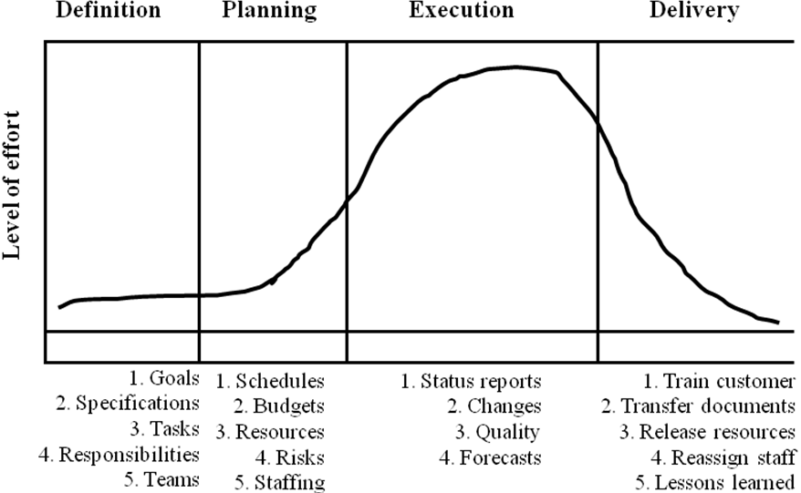
Project Phases and Life Cycle:

Slide 7
Knowledge area
9

Slide 8


Slide 9
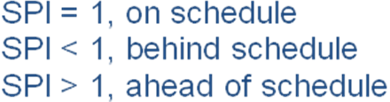
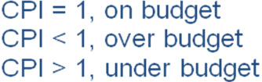
Earned Value
Earned value Reporting-Costs:
Earned value
Earned value Reporting-Schedule:
CPI
EVA
SPI
Update project

Slide 10
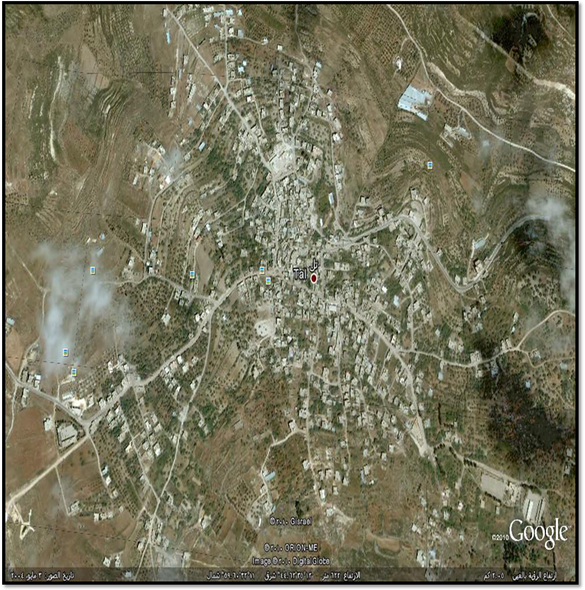
Brief Description Part

Slide 11
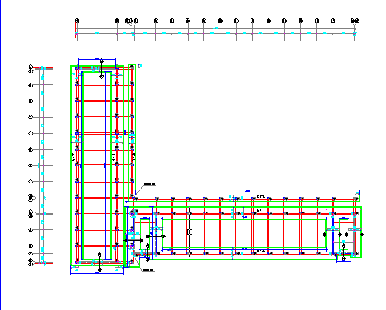
Drawing of the project

Slide 12
information of the project
1
4
2
3
Mohammed Bin rashed Al maktoum Elementary School – tell
Owner:
Palestinian National Authority . Ministry of Local Government (Till Village )
According to the contractor every day of delay will be paid 200$.
The project Consists of
1-Ground Floor 655.28 m2.
2-First floor
655.28 m2.
3- Staircase
26.16m2.
4-canteen
40.18m2
.
The project area 1377.34 m2.
Funded by : Mohammed Bin Rashed-Al Maktoum – UAE

Slide 13
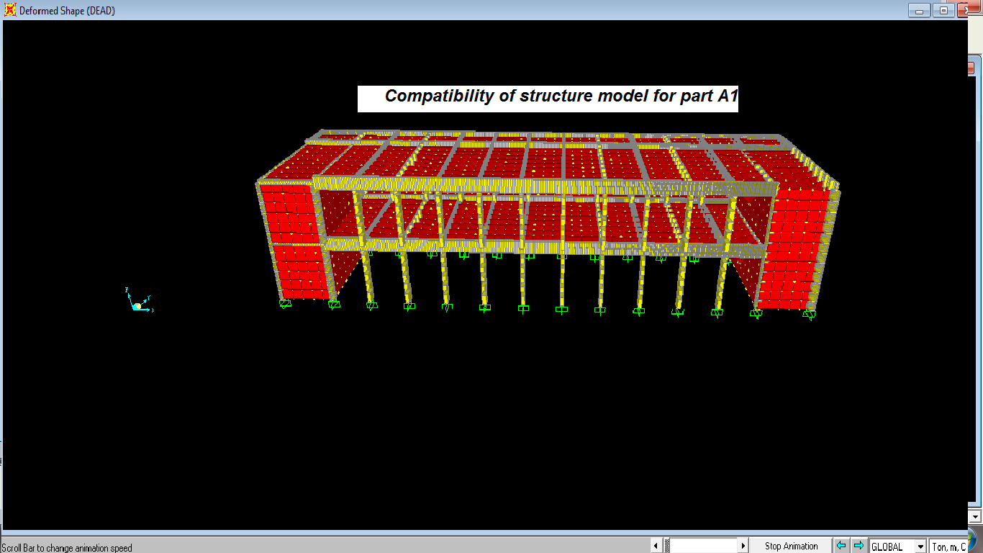
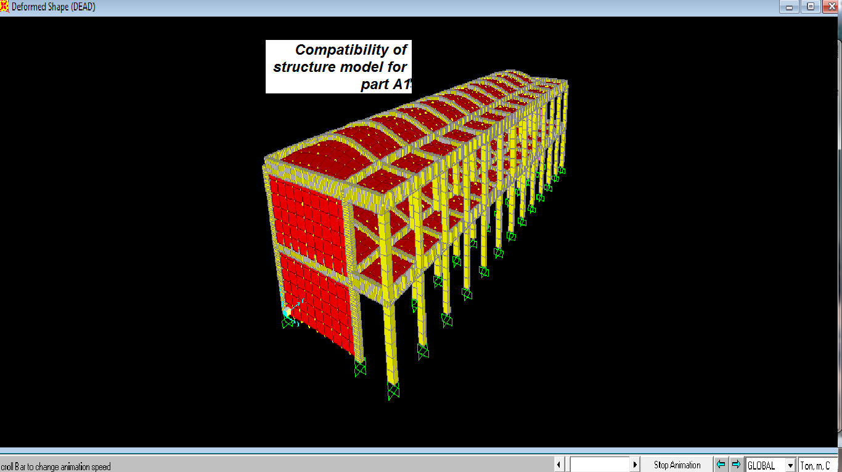
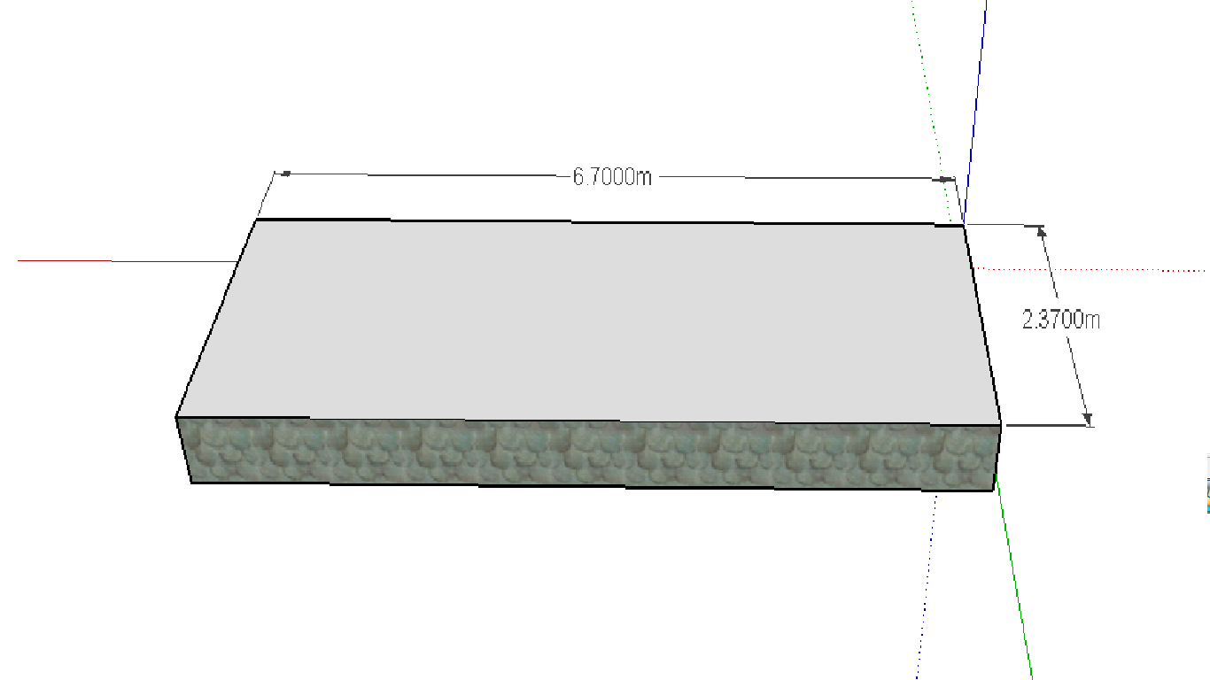
CHECK DESIGN
compatibility
Thickness of slabs

Slide 14
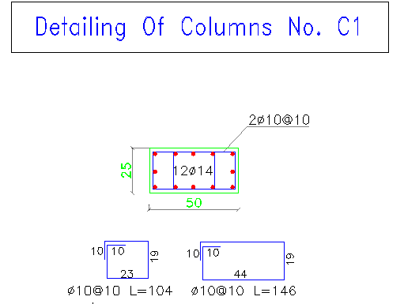
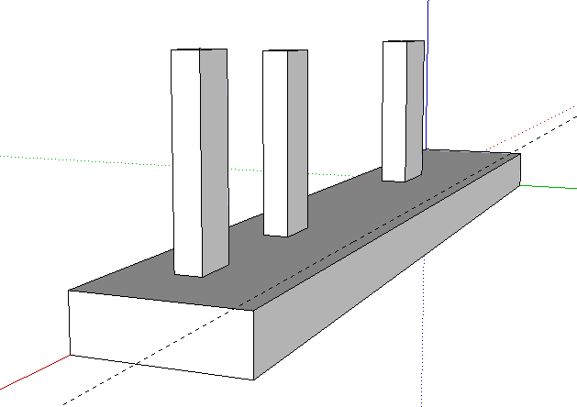
Cont….CHECK DESIGN
footings

Slide 15
Results.
Total cost of project calculated using Primavera project is (618,500 $)
(%) | Description.
(2.6%) | Excavations .
(39%) | Reinforcement.
(13%) | Blocks & Stones
(5.8%) | Plaster.
(5.5%) | Tiles.
(2.9%) | Painting.
(4.2%) | Electrical.
(3.6%) | Mechanical.
(1.3%) | Doors And windows.
(3.18%) | Roof Isolations.
(6.48%) | Steel work.
(12.30%) (100%) | External works. TOTAL

Slide 16
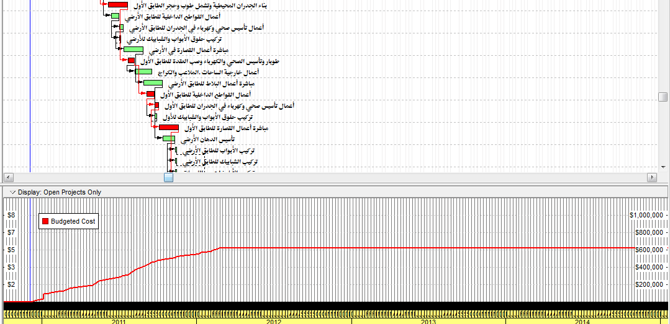
S-CURVE FOR CASE 2 Which
WE CHOOSE

Slide 17
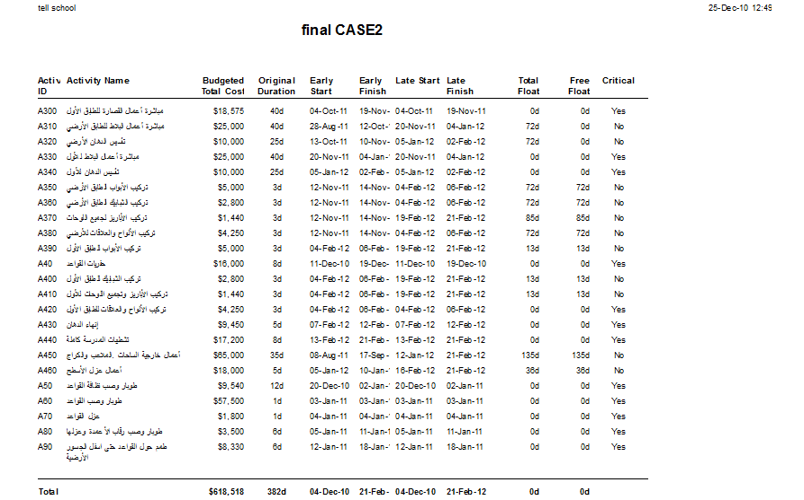

Slide 18
