Slide 1
An-Najah National University
Faculty of Engineering
Mechanical Engineering Department
Automated Capping System
( ACS )
Prepared by:
Rajab Sbaihat
Mhamad Hamza
Salah Babaa
Mhamad Zubdeh
Supervisor:
Dr. Ahmad Ramahi

Slide 2
Contents :
Abstract
Objectives
Manual Capping problems
Machine structure
Control system
Calculations
Main machine assembly
Economical Feasibility
Recommendations

Slide 3
Abstract :
Food industry is the second largest industry in Palestine with a 24% of the size market after clothing industry , vegetable oil and fats industry like Tahina have 20% of the size of the market, which has 16.8% of the rate of the participation in employment and 24 % of production rate.
Tahina companies in Palestine specially in Nablus, like Al-Molok Co. still using manual capping process which wastes time, reduces production rate and has human errors .
This project is to introduce a solution to the manual capping at Al-Molok Co. by designing, fabricating and operating an automated jar capping single station.

Slide 4
Objectives :
Increase production rate
Increase products quality
Decrease the number of workers
Reduce operation costs

Slide 5
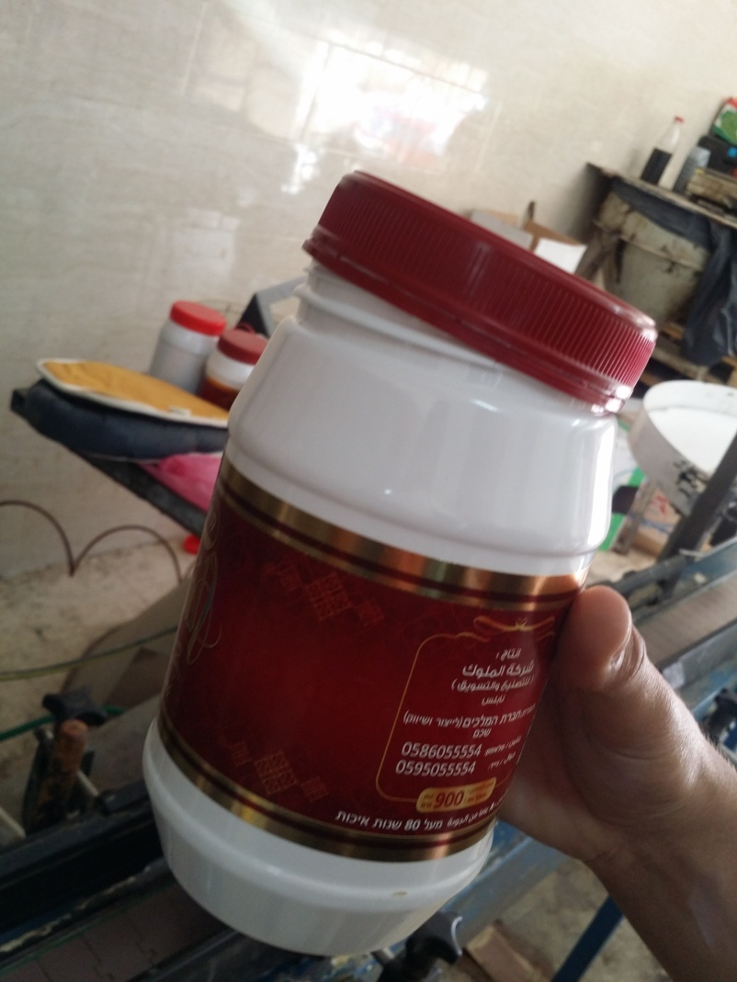
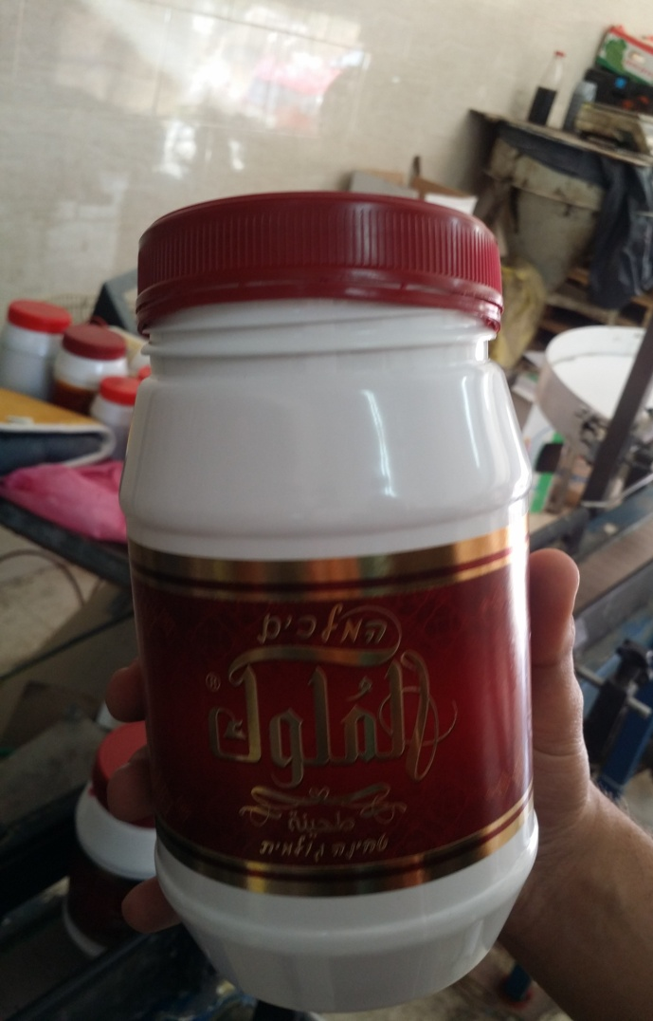
Manual Capping Problems :

Slide 6
Machine Structure :
Cap Selector
Cap Feeder
Conveyer Systems
Capping Head

Slide 7
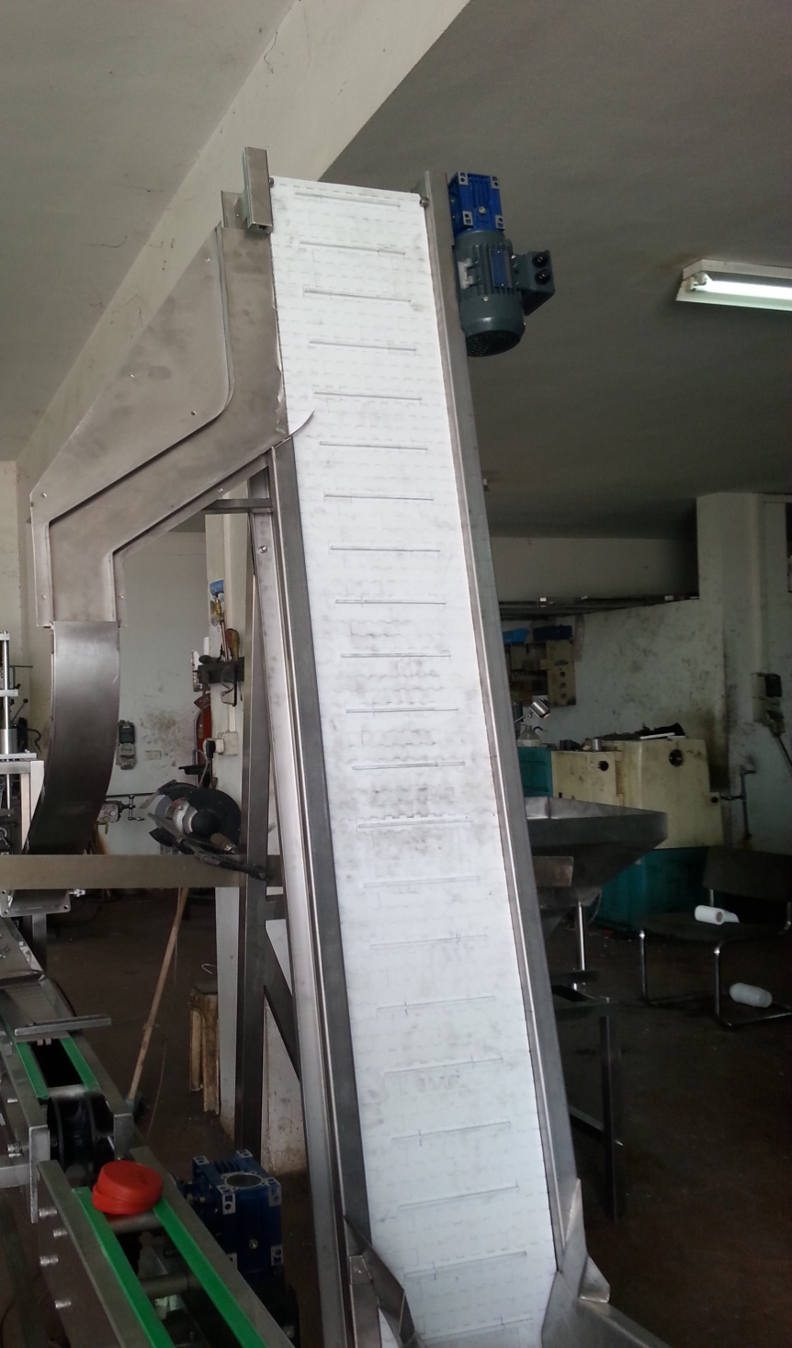
Cap Selector :
Cap elevator sorter selected with:
Motor power of 1/2 Hp
Conveyer length 8 m and 0.4 m width
Conveyer edges distributed each 10 cm
Conveyer inclination angle 15 degree
from vertical.

Slide 8
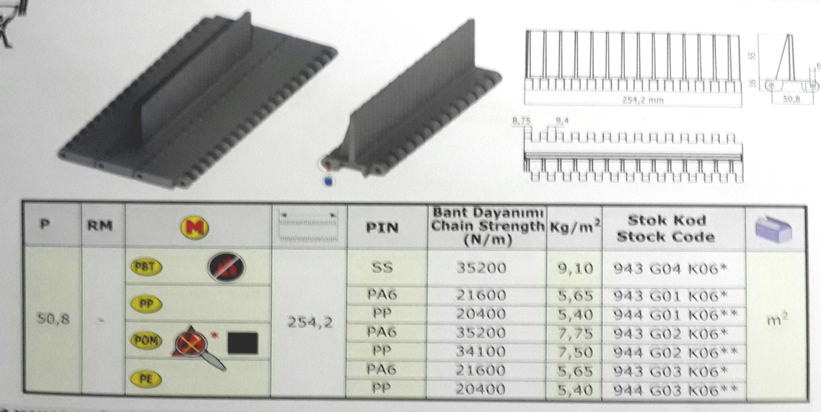
Cap Selector Conveyer
Plastic chain conveyer with fixed edges selected :
Standard plate width 254.2 mm can add length by 5 cm small parts
Plate weight 9.1 kg/ m²

Slide 9
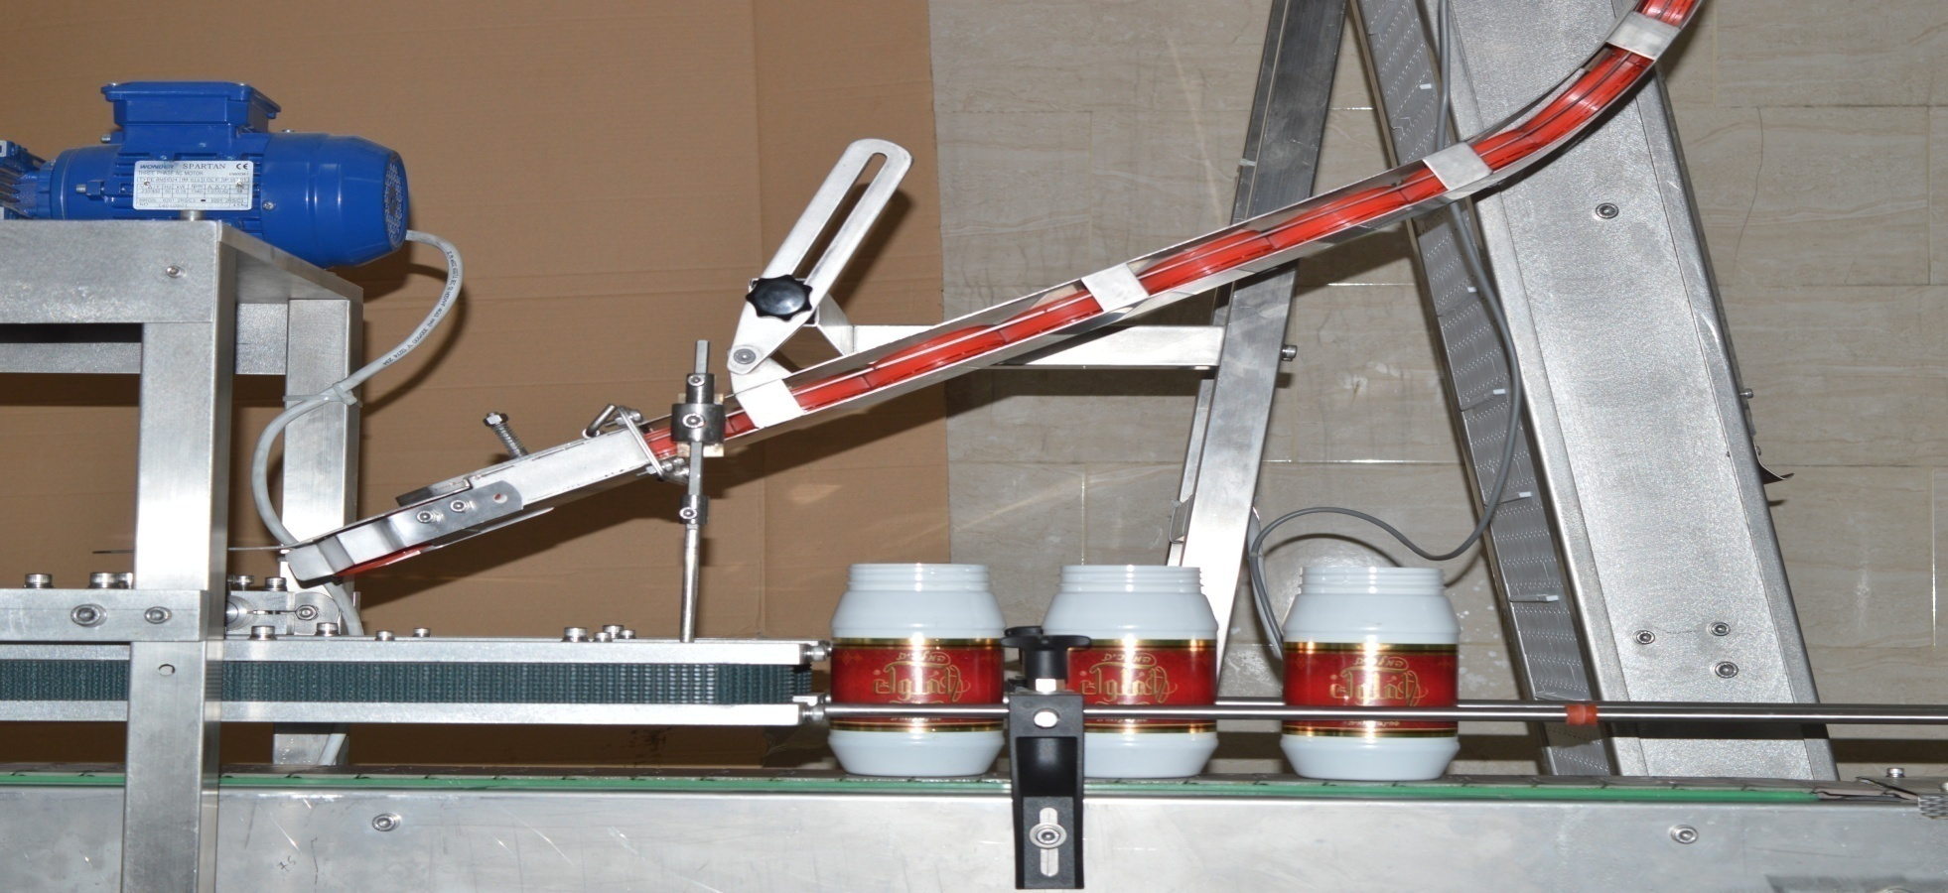
Cap Feeder :
Waterfall cap feeder selected

Slide 10
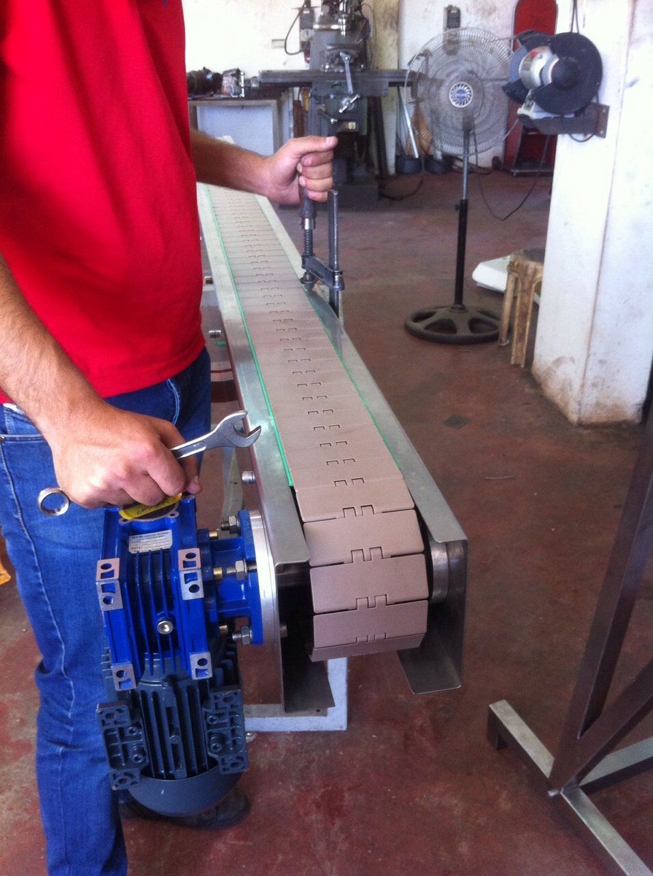
Main Conveyer :
Main conveyer selected with:
Motor power of 1/2 Hp
Conveyer Frame length 4 m.
Pair of stainless steel sides.

Slide 11
Main Conveyer chain
Plastic chain conveyer selected with:
Conveyer length 8m and 114.3 mm width
Conveyer weight 1.21 kg/m

Slide 12
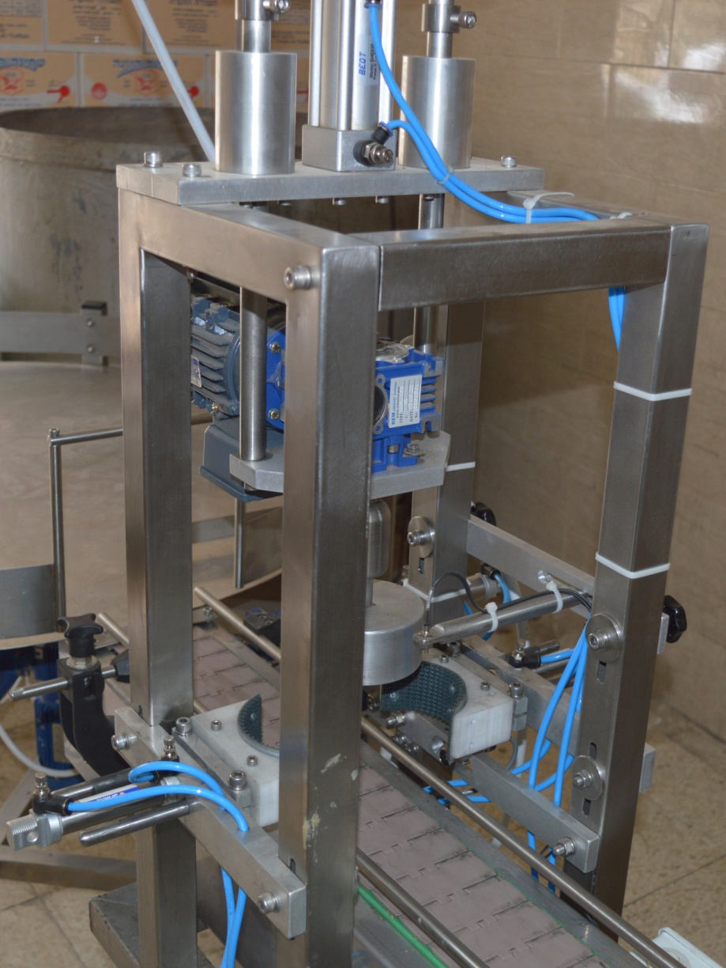
Capping Head :
Machine chuck capping head selected with:
Standard size for ½ kg tahina jar
Motor power of 1/3 Hp .

Slide 13
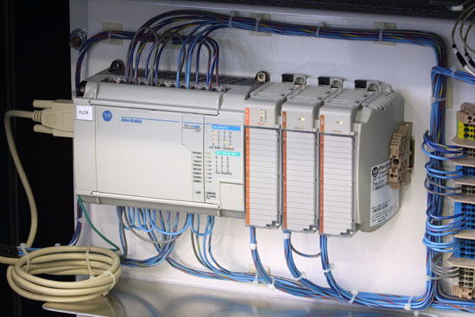
Control System :
PLC selected because it allows to insert and add commands and connect many devices together, so that filling line can be join with capping machine, to make the control of them easier by join them at the same PLC which have control program, therefore no need for timers and other independent control elements.

Slide 14
Calculations :
Motors Selection :
A) Main conveyer motor
( 30 jars with 0.5 kg ,conveyer length = 8 m , plate weight = 1.21 kg/m , Friction coefficient ( f )= 0.3 and increases to 0.7 due to dirt and tahina , max conveyer speed = 0.5 m/s )
Jars mass = 30 * 0.5 = 15 kg.
Conveyer mass = 8 * 1.21 = 9.68 ≈ 10 kg
Force = Normal Force (Tot. weight) * f = ((10+15)*9.8 ) *0.7 = 171.67 ≈ 172 N
Friction force from other elements = 20 N
 Total force = 172+20 = 192 N .
Power = Force * Velocity = 192 * 0.5 = 96 N.m/s = 96 W ≈ 100 W.
1 Hp = .745 kw
 0.1 kw = 0.134 Hp , Noting that 1 Hp = 0.745 kw
If we select 0.5 Hp motor with η = 75 % , losses from motor and gear = 30%
Actual power = 0.5 * 0.75 * 0.7 = 0.2625 Hp
 So 0.5 Hp motor is suitable to be used.

Slide 15
B) Cap selector motor
(Conveyer length 8 m and 0.4 m width, conveyer weight 9.1 kg/m² ,about 60 Edges each one weight = 0.175 Kg , friction coefficient ( f )= 0.6 , max speed = 0.5 m/s )
 Assume the case is vertical conveyer
Total mass = conveyer mass + edges mass = (8/2*0.4*9.1) + (60*0.175)= 25 Kg
Force = Tot. weight * f = (25 * 9.8 ) = 245.588 N. ≈ 246 N.
Power = Force * Velocity = 246 * 0.5 = 123 N.m/s = 123 W
1 Hp = 0.745 kw
 0.123 kw = 0.165 Hp , Noting that 1 Hp = 0.745 kw
If we select 0.5 Hp motor with η = 75 % , losses from motor and gear = 30%
Actual power = 0.5 * 0.75 * 0.7 = 0.2625 Hp
 So 0.5 Hp motor is suitable to be used.

Slide 16
C) Capping motor
( n= 210 rpm (22 rad/s) , Torque = 8 N.m )
power = T * w = 8 * 22 = 176 W = 0.176 kW = 0.236 Hp.
If we select 1/3 Hp :
Actual power = 0.75 * 1/3 = 0.25 Hp
 So 1/3 Hp motor is suitable to be used.

Slide 17
Pistons Selection :
A) Capping piston
From experience we need 10 kg press to cap the jar
From catalog :
Motor mass = 5 kg .
Machine pressure = 5 Bar = 5 Kg/cm².
D _{piston} = 3.2 cm , A _{piston} = (3.2)² *π/4 = 8.04 cm² ,
D _{rod} = 1 cm , A _{rod} = (1)² * π/4 = 0.785 cm²
 Net Area = 8.04 – 0.785 = 7.255 cm².
The maximum load on piston from 10 kg = 98 N
From catalog Square section piston the smallest square piston is 32 mm
Diameter which can press a maximum load of:
( 5 bar * (8.04-0.785) ) = 36.25 kg. = 355 N.
Note that piston load can be controlled by modifying machine pressure.

Slide 18
B) Jars handle piston
We need two pistons to catch the jar during capping each of them press approximately 5 kg
From catalog :
Machine pressure = 5 Bar = 5 Kg/cm².
D _{piston} = 2 cm , A _{piston} = (2)² *π/4 = 3.14 cm² ,
D _{rod} = 0.8 cm , A _{rod} = (0.8)² * π/4 = 0.5 cm²
 Net Area = 3.14 – 0.5 = 2.64 cm².
The maximum load on piston from 5 kg = 49 N
From catalog pen piston the smallest pen piston is 20 mm Diameter
which can press a maximum load of:
( 5 bar * (3.14 – 0.5) ) = 13.2 kg. = 129.3 N.
Note that piston load can be controlled by modifying machine pressure.

Slide 19
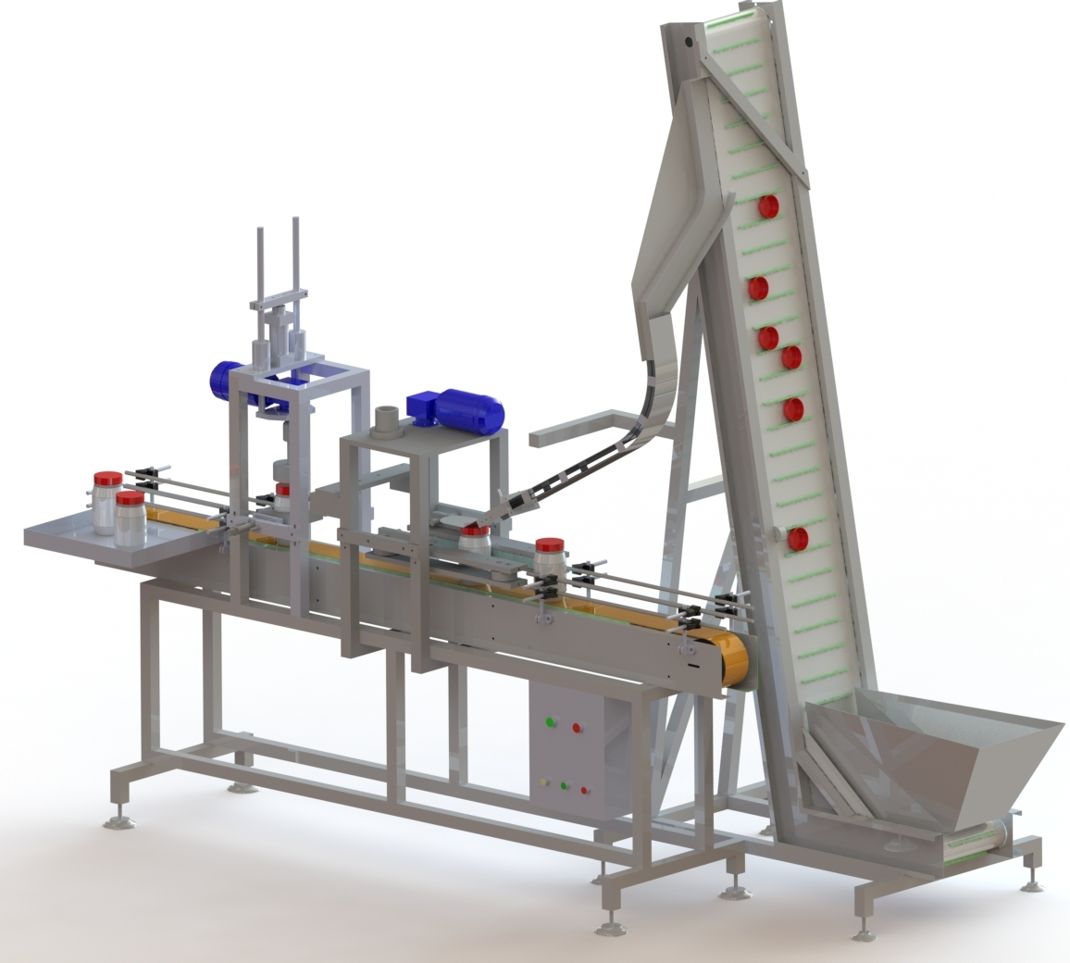
ACS ( assembly ) :

Slide 20
Economical Feasibility :
We have two workers Tot. salary = 4000 NIS per month
Now we need just one worker (salary = 2000 NIS/month)
ACS Tot. electrical power ≈ 1.5 Hp = 1.12 Kw
Operation cost = 1.12 Kw * 8 hr * 30 day * 0.7 NIS/Kw ≈ 200 NIS/month
Fixed cost = 25000 NIS ( cost of ACS )
Save money = 2000-200 = 1800 NIS/month
Recovery period = 25000/1800 = 13.8 months = One year and two months
Note Production rate depend on the rate of the filling station

Slide 21
Recommendations :
To increase the accuracy of installing the caps on the jars , a new station can be add , Such that, it has a piston that press on the top of the caps to place the cap in a more efficient position on the jar.
The ACS can be integrated with packaging machines such as cardboard package machine and nylon shrinking machine.
A labeling station can be added to the ACS as independent station after capping station and before packaging.

Slide 22
Before the end we have small videos of ACS design and manufacturing

Slide 23
Thank you for listening
Questions ?

