Slide 1
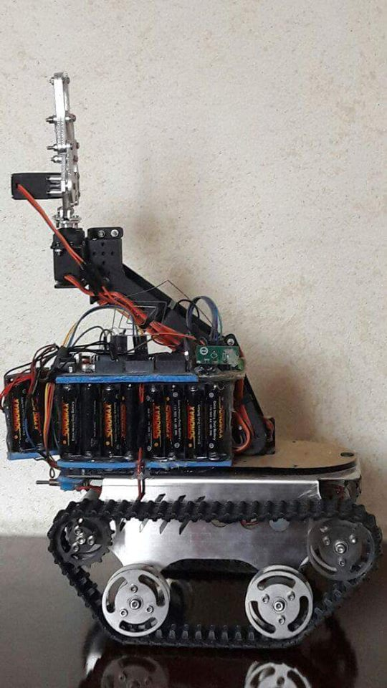
Mobile Robotic Arm

Slide 2
Contents
Objective of the Project
Introduction
Electrical Part
MechanicalPart
Software
Calculations
Conclusion

Slide 3
Objective of the Project
Design a robotic vehicle which is used to pick up an object with soft gripper.

Slide 4
Introduction
A robotic arm is a robotic manipulator, usually programmable, with similar functions to a human arm. It has about 5 degree of freedom motion.

Slide 5
Electrical Part
1. Servo Motor

Slide 6
2. DC Motor

Slide 7
3. L298N motor driver

Slide 8
4. RF Module

Slide 9
Mechanical Parts
1. Mechanical parts designed for the robot arm
2. Tank

Slide 10
Software
We used Arduino Uno

Slide 11
Calculations
We used in our Analysis Matlab program functions to obtain the desired results which are shown in our report

Slide 12
Conclusion
Robots help people with tasks that would be difficult, unsafe, or boring for a real person to do alone. These robots can learn, repeat, and can be designed to perform any desired task such as welding, gripping.

