Slide 1
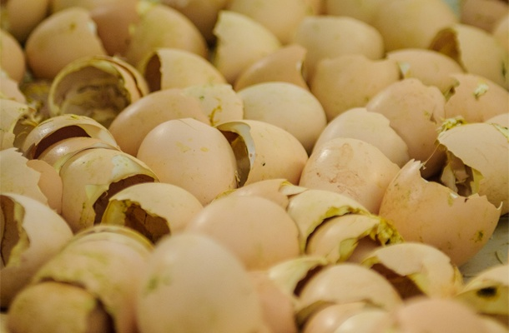
An-Najah National University
Faculty of Engineering & Information Technology
Industrial Engineering Department
Recycling eggshells in the west Bank of Palestine
Supervisor: Dr. Yahya Saleh

Slide 2
1
Introduction
2
Problem Statement
3
Objectives
4
Environmental feasibility study
Outline
5
Marketing feasibility study
6
Technical feasibility study
7
Financial feasibility study
8
Conclusion & Recommendation

Slide 3

Introduction
With the direction of the world towards a clean environment ,the recycling projects has become a of the most important issues of the day as it aims to converting waste materials into reusable objects to prevent waste of potentially useful materials and maintaining a green environment

Slide 4
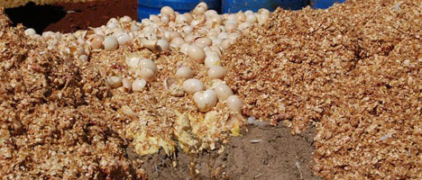

Problem statement
Environmental effects
The disposal way of large quantities of eggshells In traditional methods & disposal costs
Negative environmental effects
Lack knowledge of the importance of Eggshells
High-value components
Alternative source to some raw materials

Slide 5
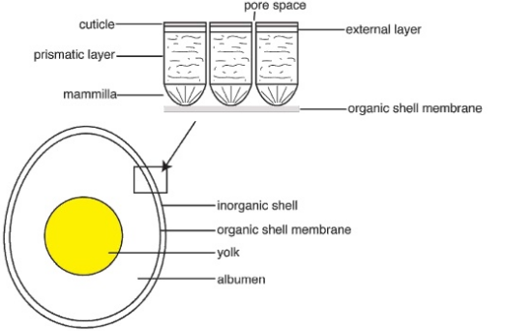

About Eggshells
Caco3
95%
Collagen & Proteins
5%
Collagen 35%
Proteins 65%
Medical uses
Cosmetics industry
Fertilizer paper
Feed Stuffs paint

Slide 6
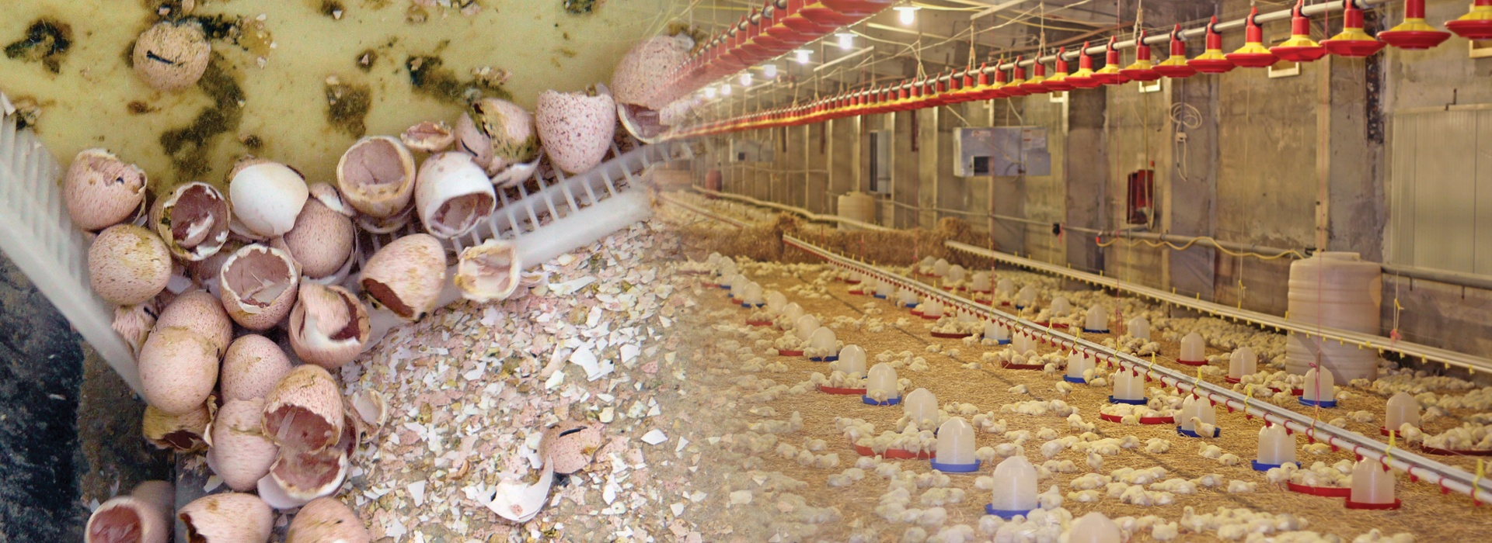

objectives
Environmental F.S
Marketing F.S
Technical F.S
Financial F.S
Environment
Nutrition
Economic

Slide 7
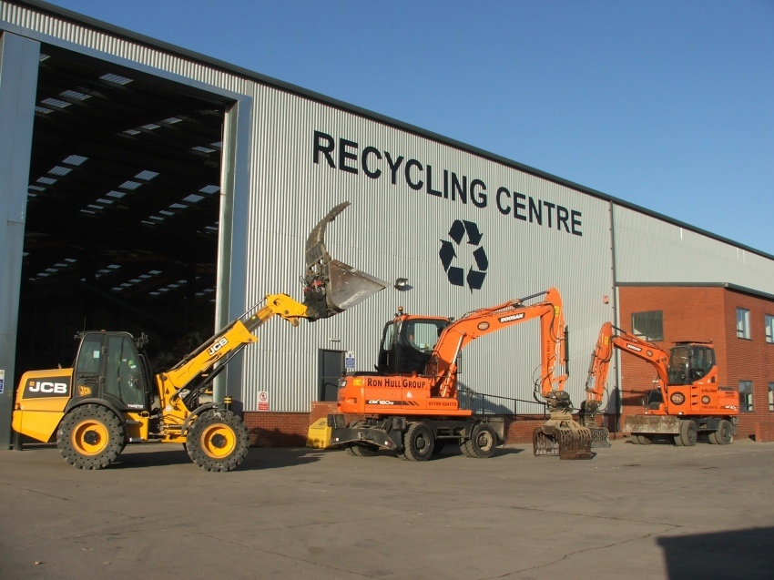


Feasibility Study
Environmental
Technical
Marketing
Financial

Slide 8
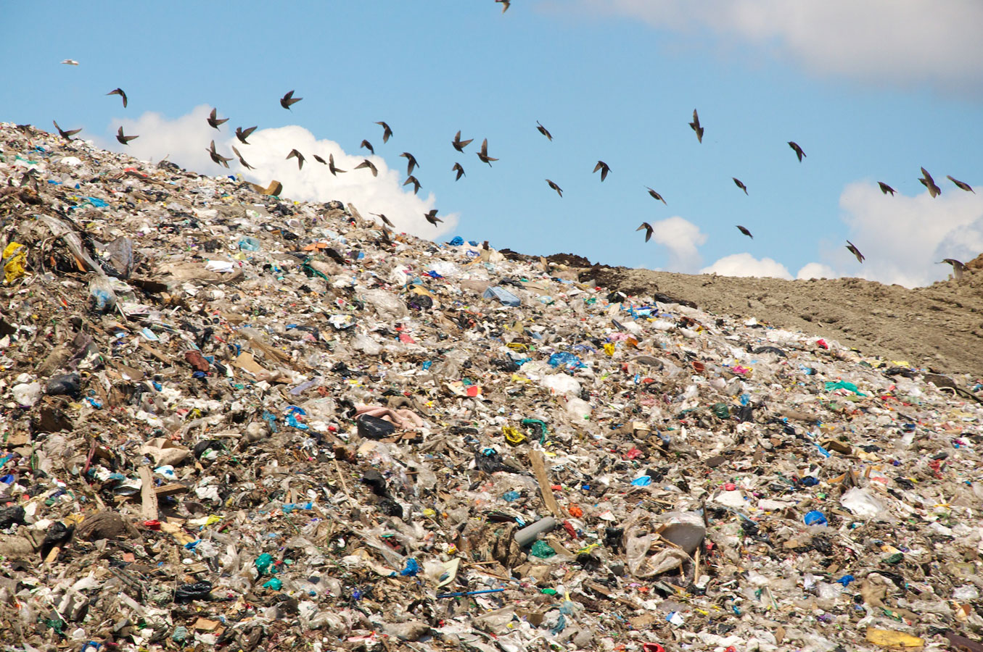
objectives
Environmental F.S
Marketing F.S
Technical F.S
Financial F.S
Conservation
of natural resources
Protection
of agricultural land
Protection
of toxic substances &
thermal emissions

Slide 9



objectives
Environmental F.S
Marketing F.S
Technical F.S
Financial F.S
Questionnaires
Awareness
Market
Analysis
Acceptance of the Project and the product
Market production of Eggs
The availability of the produced products
Competitiveness
Demand and market share
Hatcheries
Cake shops
Feedstuffs factories

Slide 10
objectives
Environmental F.S
Marketing F.S
Technical F.S
Financial F.S
Eggshells
Bio Calcium in the form of powder
Collagen and other proteins

Slide 11
Questionnaires
Hatcheries
Cake shops
The amount of eggshell waste
The extent of acceptance and
willingness to cooperate
with us in the compilation
of eggshells
Feedstuff factories
The acceptance to separate
eggshells from other waste
and put it in separate bags
so easily collect them.
The acceptance to buy
the new product resulting
from the recycling of eggshells

Slide 12
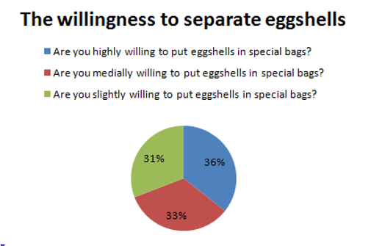
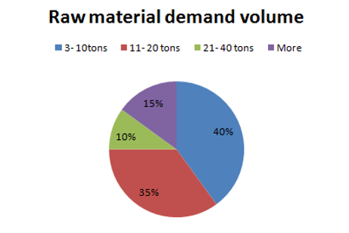
Significant results from the questionnaires

Slide 13
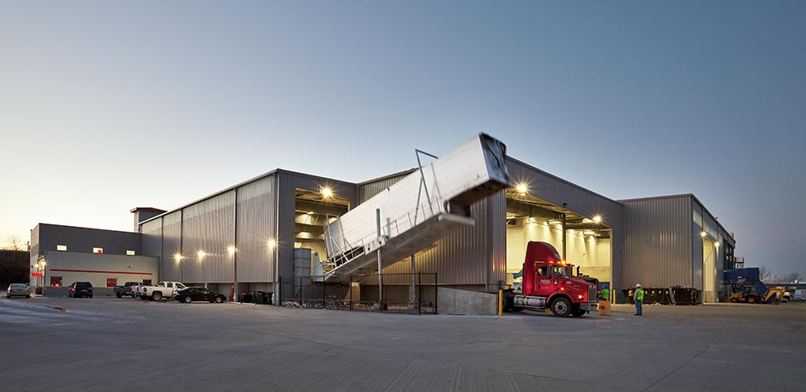
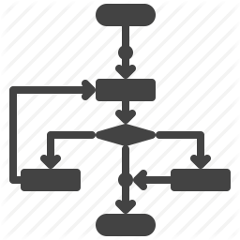
objectives
Environmental F.S
Marketing F.S
Technical F.S
Financial F.S
Location
Layout
Machines& processes

Slide 14
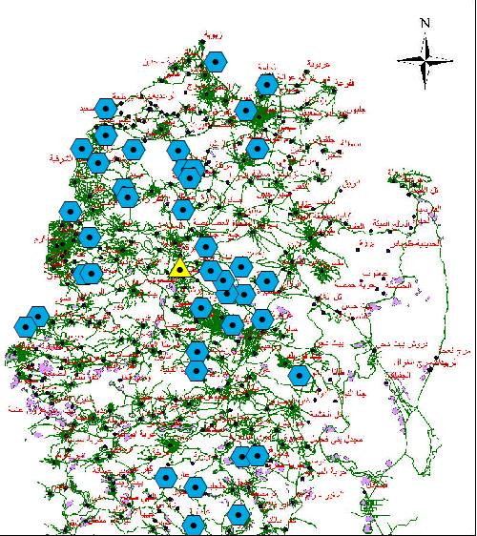
Location

Slide 15
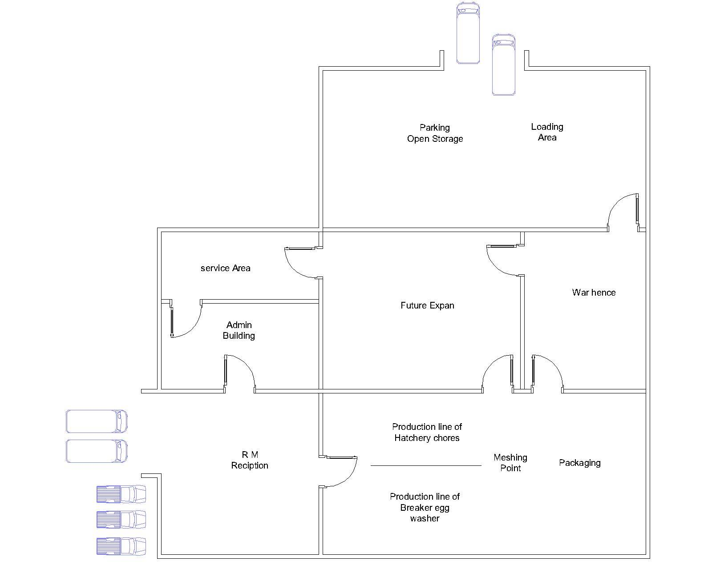
Layout

Slide 16
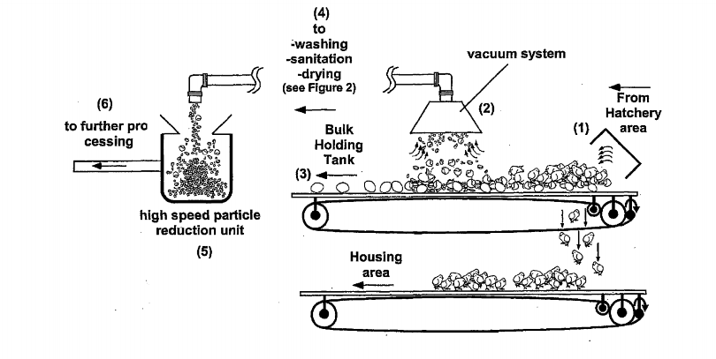
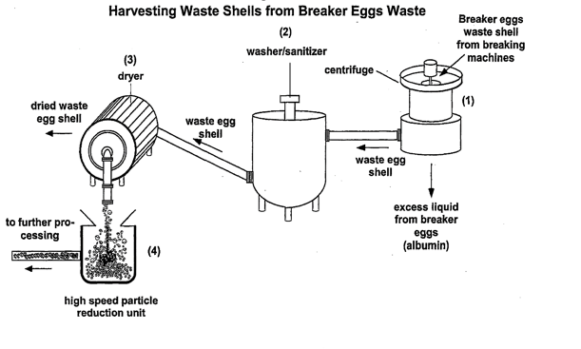
Processes

Slide 17
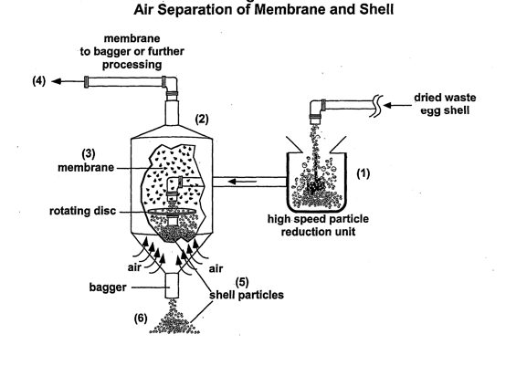
Processes

Slide 18

objectives
Environmental F.S
Marketing F.S
Technical F.S
Financial F.S
Capital investment
Operational costs

Slide 19
60,000 JD
land
96,000 JD
Construction
works
62,265 JD
Ventilation & vehicle
140,810 JD
Machines
& equipment
1,266 JD
Furniture
10,000 JD
Capital investment
370,341 JD
Contingencies

Slide 20
29,000 JD
Labor cost
20,676 JD
Material
cost
720 JD
Water consumption
Electricity
consumption
10,080 JD
Operational cost
60,876 JD

Slide 21
2% from fixed asset
7207 JD
Maintenance
Deprecation
of assets
0.75% from fixed assets
2203 JD
Machine (7%)
Infrastructure (5%)
Furniture and other equipment (2%)
10,908 JD
Insurance
fees
Overheads
Advertising expense
Administrative expense
Non-manufacturing water and electricity
2220 JD
Fixed operation cost
22,538 JD

Slide 22

Transportation
Costs

Slide 23
Production Volume & Demand
We have 34 feed stuff factories in the west bank and expected demand of feed stuffs factories from the Bio calcium according to the questionnaire is on average 10 Ton/month.
Total expected demand = 340 Tons/month.
Total expected demand >> Total production
So Sales = Total production

Slide 24
Pricing & Annual Revenues
Table(1) :-Bio calcium expected sales
Table(2) :-Collagen expected sales
Bio calcium | Expected production = Expected Sales
Unit | Ton /year
Bio calcium | 1.85*6*4*12= 533.5
Collagen & proteins | Expected production =Expected Sales
Unit | Ton /year
Collagen | 0.0975 *6*4*12= 28.08

Slide 25
Variable Production cost
Table (3) :-Variable Production cost
Variable Production cost | JD/year | Expected Sales | Variable cost /kg
Total Variable cost for Two products | 31,476
Total Variable cost For Bio calcium | 29902.2 | 533,520 Kg/year | 0.056JD/kg
Total Variable cost for Collagen | 1573.8 | 28,080 Kg/year | 0.056 JD/kg
Selling price in the market for1 Ton of lime 28 JD
so the selling price Bio Calcium 0.028 JD /kg
Selling price for collagen
& proteins unknown = X

Slide 26
Break-even point (BEP)
 | Bio calcium | Collagen and other proteins
Selling price | 0.028 JD /kg | X JD
Variable cost | 0.056JD/kg | 0.056JD/kg
Contribution margin ratio | -1 | X-0.028/X
Break-even point | -71583.8

Slide 27
Finding the approximately selling price for collagen X
NPV = -I+A1*(P/A, 10%, 20)-A2*(P/A, 10%, 20)
p2 = X = 4.98 JD/Kg

Slide 28
Conclusions & Recommendations
Environment Authority
Society
Private
sector

Slide 29
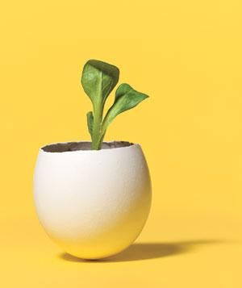
Thank You !

