Slide 1
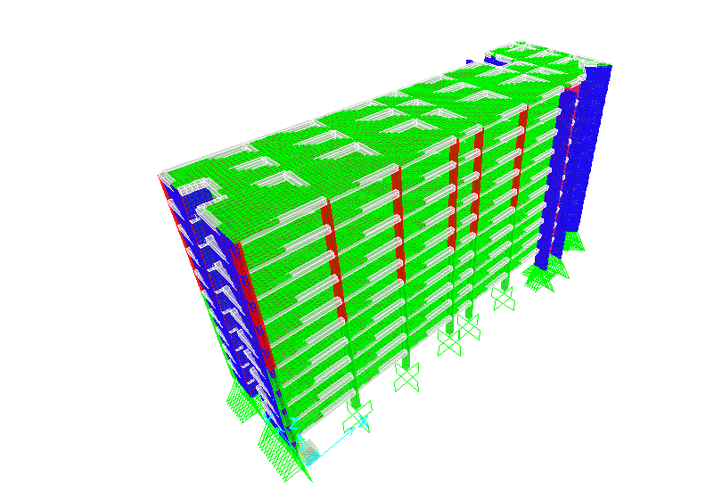
Analysis and Design of Multiple story building. Prepared by : Mohanad Shtayah Mohammad Alawneh Supervisor: Dr. Wael Abu Assab

Slide 2
Chapter One Lateral Forces Chapter Two Loads Affecting the Building Chapter Three Analysis and Design Using SAP 2000

Slide 3
Project Description
This project is a structural analysis and design for a building consists of ten storyes each story has an area of 893.5m².
Objectives :
1- Do a 3D analysis.
2-Check if the design for gravity loads is sufficient to resist EQ loads.

Slide 4
CH1 : Lateral Forces
This chapter contains the following main topics:
1- Types of lateral loads.
2- History of EQ in Palestine.
3- Lateral loads Resistant Structural Systems.

Slide 5
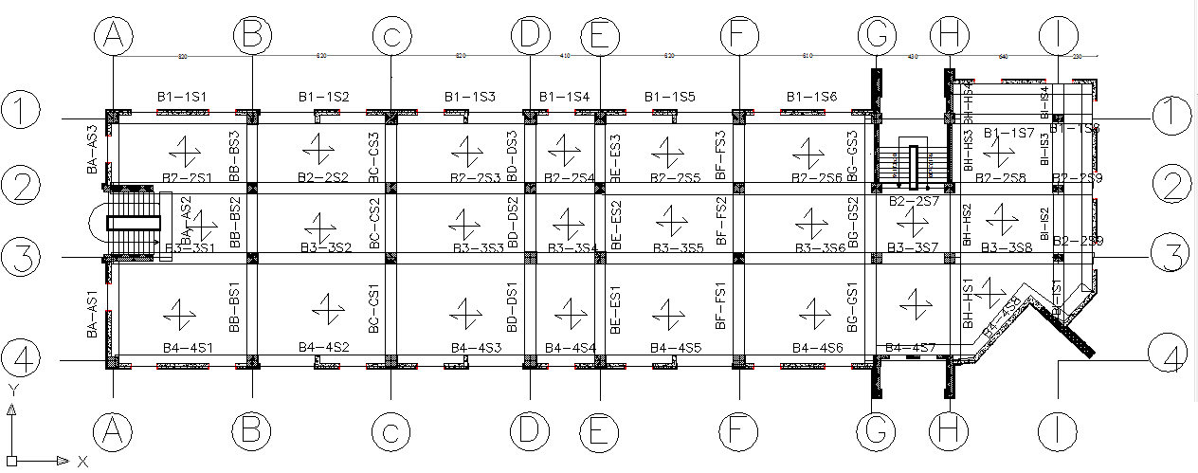
CH2 : Loads Affecting the Building
Structural Model:
Two way solid slab with drop beams. Since the structure contains long spans and to avoid large thickness for slab.

Slide 6

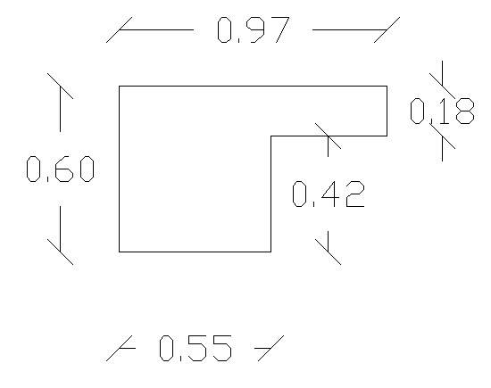
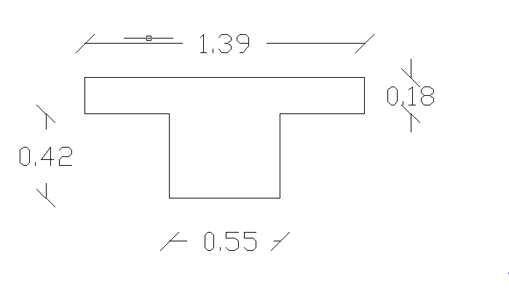
Slab Thickness
Assume α _{fm} ≥ 2
H_{min} = = 0.172 mm.
Use h = 180 mm
Beams dimensions:

Slide 7
Loads
There are two common type of loads that affecting the structure :
1) Gravity loads
2) Lateral loads:
Wind loads: ignored in the design.
Earthquake Loads.
Gravity Loads (KN/m2)
Live |  |  | Dead
Corridors | Hotel | Office | Superimposed | Own weight
5 | 2.5 | 2.5 | 4.5 | 4.5

Slide 8
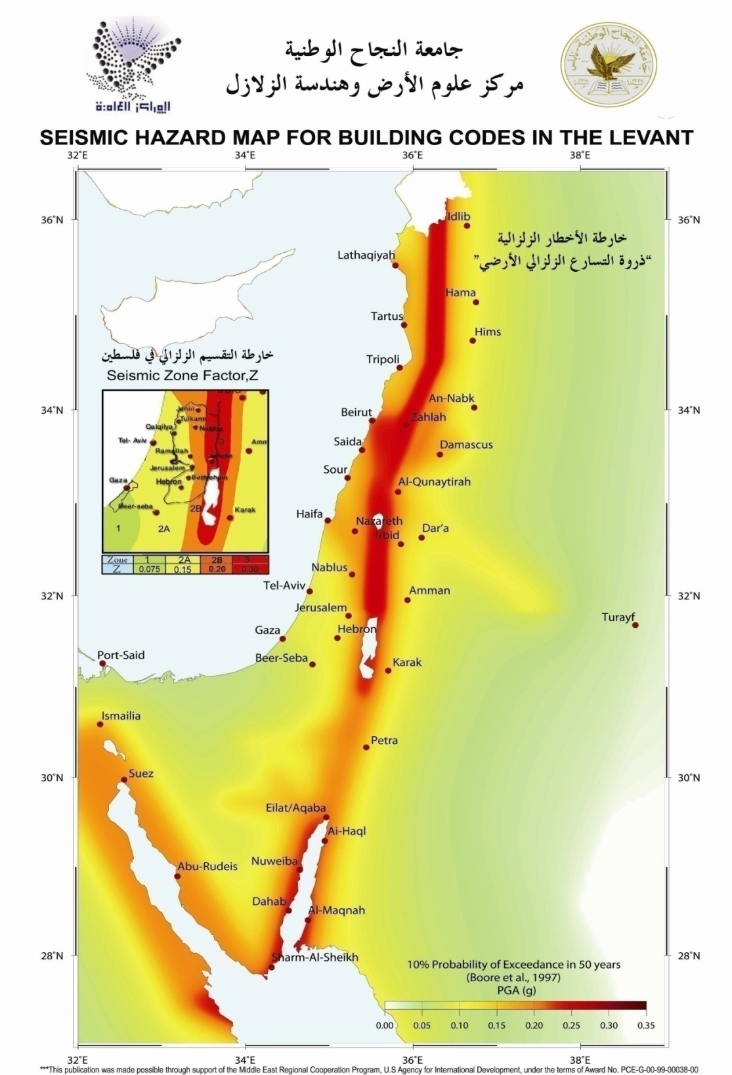
Earthquake Loads :
The design was performed
by response spectra
function using SAP2000.

Slide 9
Codes & Standards
ACI -318-08: American concrete institute for reinforce concrete structural design.
IBC - 2006: International Building code.
Load Combinations
Comb1: 1.2D+1.6L
Comb2: 0.9D-1E
Comb3: 0.9D+1E
Comb4: 1.2D+1L-1E
Comb5: 1.2D+1L+1E
Comb6:1.4D

Slide 10
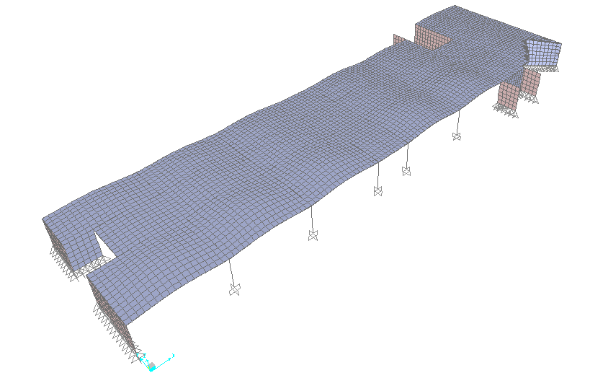
CH3 : Analysis and design Using SAP2000
After perform the model for one story three checks must be apply :
Compatibility.

Slide 11
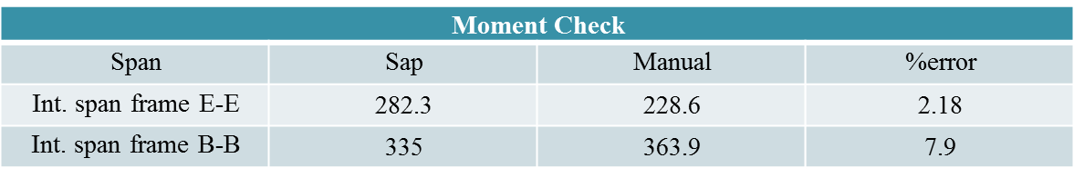
2-Equilibrium check
%Error | Manual | SAP | KN
1.6 | 13330 | 13077.5 | Dead
2.48 | 2233.8 | 2178.5 | Live
3-Stress strain relationship.

Slide 12
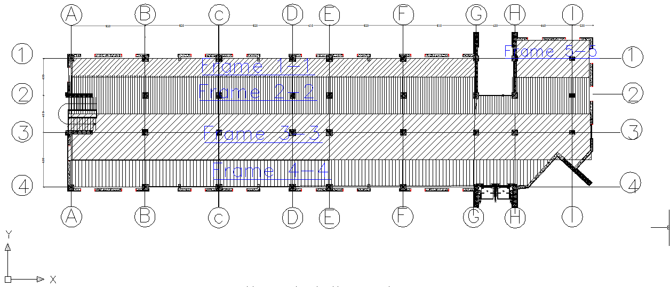
Analysis and design of slabs
Frames in x-direction
Frame | X-direction
2-2 | C.S | Top | 6Φ12
 |  | Bottom | 5Φ12
 | M.S | Top | 9 Φ10
 |  | Bottom | 9Φ10

Slide 13
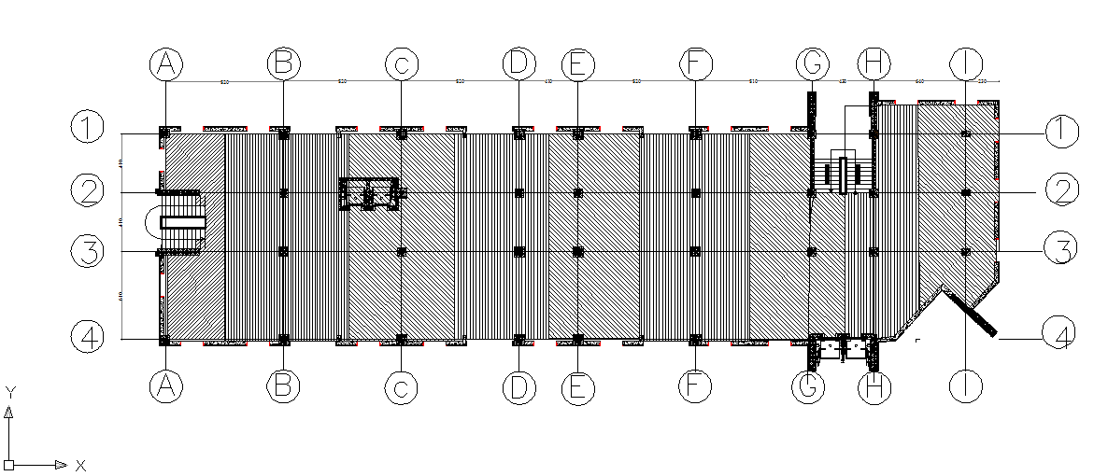
Analysis and design of slabs
Frames in y-direction
Frame | Y-direction
B-B | C.S | Top | 6Φ10
 |  | Bottom | 6Φ10
 | M.S | Top | 26Φ10
 |  | Bottom | 26Φ10

Slide 14
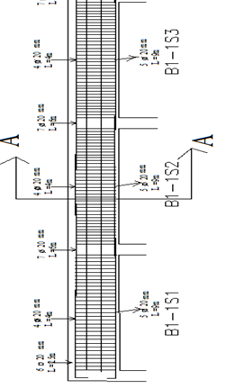
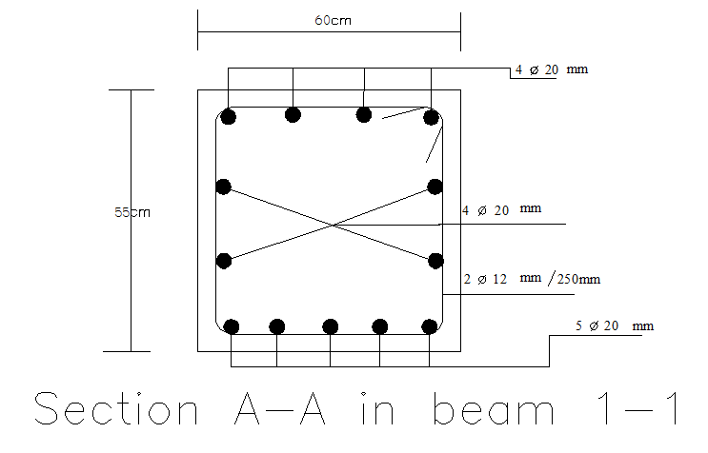
Analysis and design of beams.
Longitudinal section in beam 1-1 first floor

Slide 15
Analysis and design of columns.
The design load can be calculated using the following equation:
Pd= 𝜙Pn=𝜙*λ {0.85* f´c(Ag-As) + As*fy}
𝜙 = 0.65 for tied columns
𝜙 = 0.75 for spiral columns
λ = 0.8 for tied columns
λ = 0.85 for spiral columns
First floor
columns | dimension | # of bars
C1, C2,C3,C4 | 0.7 *0.7 | 16Φ20
C9 | 0.7*0.7 | 14Φ32

Slide 16
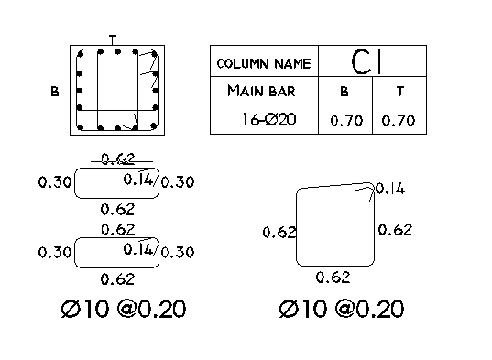
Cross section for C1

Slide 17
Analysis and design of footings.
Types of footing that been used:
1- Single footings.
2- Combined footings.
3- Wall footings.
The next slide shows the details of a single footing

Slide 18
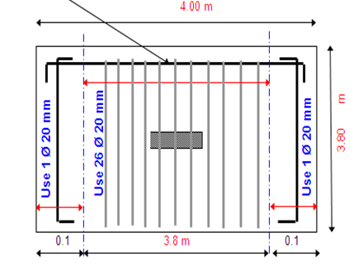
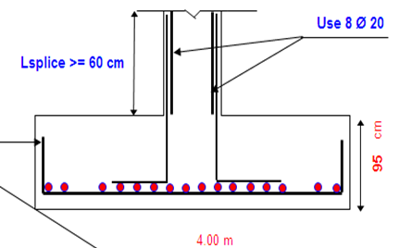
Analysis and design of footings
footing | Width (m) | Length (m) | Thickness (m) | Rein. Long direction | Rein. Short direction
F1 | 3.8 | 4 | 0.95 | 26 Φ 20 | 29 Φ 20

Slide 19
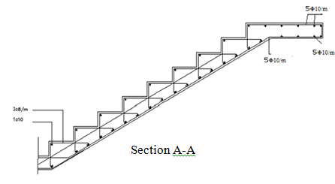
Analysis and design of Stairs.
Concrete compressive strength, f'c= 240kg/cm².
Yield Strength of steel, fy=4200kg/cm².
The thickness of stairs slab is = 0.15m
Loads
For landing part, S.I.D=2.7 KN/m²
For flight part, S.I.D = 4 KN/m²
Live load=4 KN/m² .

Slide 20
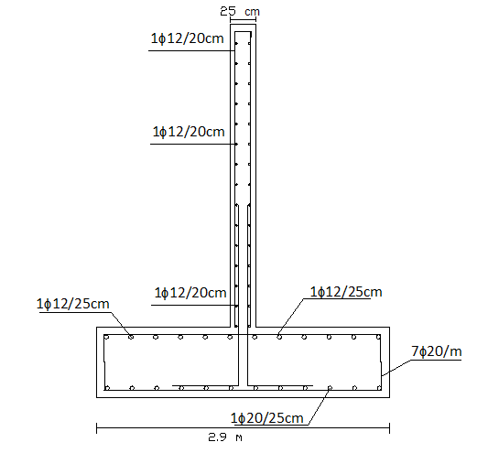
Shear wall details.

Slide 21
Earthquake design:
The structure is subjected into EQ in X and Y directions using response spectra function.
The design was performed for structural elements.
NOTE
There is no large difference between EQ and Gravity results.

Slide 22
The GOOD Design for Gravity Loads is Sufficient to resist Earthquake Loads

Slide 23
Thank You

