Slide 1
Mechanical Systems Design for Al-Bahrain Hospital
Prepared by :
Faheem Shadid
Wajdi Okal
Husam Odeh
Letham Bagdadi
Supervisor :
Dr. Iyad Assaf

Slide 2
Outline
Building Description
Heating Load calculations
Cooling load calculations
Duct design
Plumping system
Equipments selection

Slide 3
Building Description
Country: Palestine, Ramallah city
Latitude: 31.54 N
Elevation: 870 m above sea level.
Building face sits at the West orientation.

Slide 4
Second
floor
First
floor
Ground
floor
Basement
floor
which have the isolation room, patients rooms and nurse station
contains the operation room, ICU, recovery room
which contains labs, X-ray room and clinics
which contains the kitchen, laundry and the mechanical room

Slide 5
Heating & Cooling Loads
The Inside design Condition varies with respect to the application According to the ASHRAE code that refers to hospitals and clinics
Room Type | Inside heating temp. | Relative humidity in winter (%) | Inside cooling temp. | Relative humidity in summer (%)
Patient room | 24 | 30 | 24 | 50
Waiting and resting area | 22 | 30 | 23 | 30
ICU | 24 | 30 | 24 | 60
Operation room | 18 | 45 | 18 | 55
Isolation room | 22 | 45 | 22 | 55
Recovery | 24 | 45 | 24 | 55
Lab | 22 | 50 | 22 | 50
Nurse station | 24 | 30 | 24 | 30
Medical store | 22 | 50 | 22 | 50
Corridor | 22 | 50 | 22 | 30

Slide 6
Heating Load
For Example the patients room #1 in the second floor:
Parameters | Inside design condition | outside design condition
Temperature ‘ T ’ | 24°C | 4 °C
Relative Humidity ‘ Ø ’ | 30% | 71.7%
Moisture Content ‘ w ’ | 6.2 g of water/ Kg of dry air | 4 g of water/ Kg of dry air
Un-conditioning Temperature ‘ T_{un}’ | 14°C

Slide 7
Results Of Heating Calculations
Floor | Total Load [KW]
Second Floor | 88.4
First Floor | 123.8
Ground Floor | 80
Total | 292.2
Load from hot water demand:
Q= 126.8 KW
Total Heating Load = 419 KW

Slide 8
Cooling Load
For Example the patients room #1 in the second floor:
Parameters | Inside design condition | outside design condition
Temperature ‘ T ’ | 24°C | 30 °C
Relative Humidity ‘ Ø ’ | 50% | 53.7%
Moisture Content ‘ w ’ | 10.3 g of water/ Kg of dry air | 15.9 g of water/ Kg of dry air
Un-conditioning Temperature ‘ T_{un}’ | 28°C

Slide 9
Results Of cooling Calculations
Floor | Load from FCUs [Ton _{ref.}] | Load from AHUs [Ton _{ref.}] | Total
Second Floor | 34.6 | 2.6 | 37.2
First Floor | 34 | 40.8 | 74.8
Ground Floor | 43 | 0 | 43
Total | 111.6 | 43.4 | 155
We chose two chillers, one for the AHUs and the other for FCUs

Slide 10
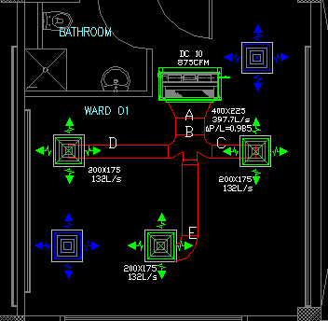
Sample of Ductwork

Slide 11
Sample of Duct Design Calculation
Section | V` [CFM] | V` [m³/s] | V [m/s] | P/L | A [m²] | D [mm] | high [mm] | width [mm]
A-B | 875 | 0.397 | 5 | 0.985 | 0.0795 | 318.2 | 400 | 225
B-C | 291.6 | 0.132 | 3.79 | 0.985 | 0.308 | 283.2 | 200 | 175
B-D | 291.6 | 0.132 | 3.79 | 0.985 | 0.308 | 283.2 | 200 | 175
B-E | 291.6 | 0.132 | 3.79 | 0.985 | 0.308 | 283.2 | 200 | 175

Slide 12
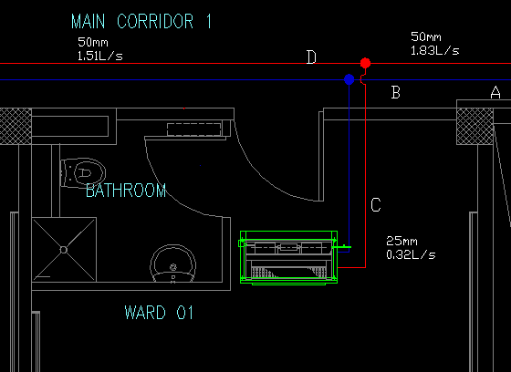
Sample of HVAC Pipes Design

Slide 13
Sample of HVAC Pipes Calculation
Section | Q [W] | m` [L/s] | P/L | D [mm]
A-B | 45962 | 1.83 | 350 | 50
B-C | 8211 | 0.327 | 350 | 25
B-D | 37751 | 1.51 | 350 | 50

Slide 14
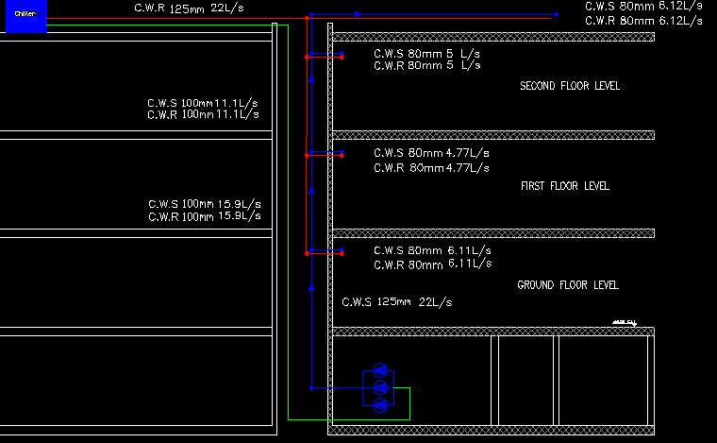
Riser Plan for HVAC Pipes

Slide 15
Domestic Water
Floor | Hot water |  | Cold water
 | # of fixture | Flow rate [L/s] | # of fixture | Flow rate [L/s]
Second | 59 | 2.02 | 243 | 4.73
First | 25 | 1.36 | 105 | 3.03
Ground | 16 | 1.14 | 129 | 3.31
Basement | 17 | 1.19 | 38 | 1.66
Total | 117 | 3.03 | 515 | 10.73

Slide 16
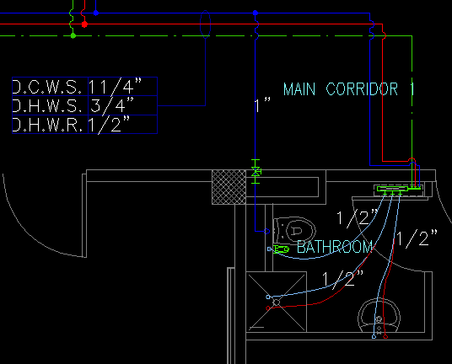
Sample of Collector Network

Slide 17
Sample of Collector Network
Application | Cold water |  | Hot water
 | # of fixture | Size [in] | # of fixture | Size [in]
Lavatory | 1.5 | 1/2” | 1.5 | 1/2”
Shower | 3 | 1/2” | 3 | 1/2”
W.C. | 10 | 1” | 0 | 0
Bidet | 1.5 | 1/2” | 0 | 0
Total | 16 | 1 1/4” | 4.5 | 3/4 “

Slide 18
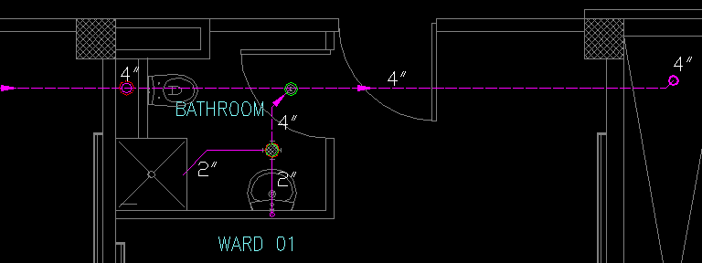
Sample of Drainage Network

Slide 19
Boiler Room
Boiler room contains
Boilers
Expansion tanks ( 2 tanks each on 1000L )
Heat Exchanger
Hot water tank
Pumps
Valves (winter/summer)
See Selections in the next slides

Slide 20
Equipment Selection
Chiller :
From PETRA Company catalogue, the suitable Chillers are:
Application | Capacity [Ton_{ref}] | Model
AHUs | 43.4 | APSa 55-1S
FCUs | 111.6 | APSa 120-2D

Slide 21
Boiler :
From De Dietrich Company catalogue, the suitable Boilers are GT 337 , two identical boilers each one has a capacity of 210 KW
Fan Coil Unit :
From PETRA Company catalogue, the suitable F.C.U for the 875 CFM is DC 10

Slide 22
Air Handling Units :
From PETRA Company catalogue, the suitable A.H.Us are:
Application | Capacity [CFM] | Model
Operation room | 2180 | PAH H B 24 C 8
Recovery | 2303 | PAH H B 32 C 8
ICU 1 | 2794 | PAH H B 32 C 6
ICU 2 | 2156 | PAH H B 24 C 8
Isolation room | 1127 | PAH H B 12 C 4

Slide 23
Fresh Air Fan :
From Rosenberg Company catalogue, the suitable fan is DHAD 560-4
Exhaust Air Fan :
From VORTICE Company catalogue, the suitable fan is ERAD355-4
HVAC Pumps:
From WILO Company catalogue, the suitable pump is IPL 80/130-0,75/4

Slide 24
THANK
YOU

