Slide 1
Measuring the Implementation of TQM Concepts in Northern West Bank Governmental Hospitals
By: Muhammad Nasser
Ibrahim Khraim
Al-Bara’ Mousa

Slide 2
Table of Contents
Quality in Health Sector in the West Bank
Quality Definition
TQM Definition
Problem Statement
Objective
Literature Review
Methodology
Hypothesis
Results
Conclusion
Recommendations

Slide 3
Quality in Health Sector in West Bank
It was started to take care of quality in Palestinian Health Sector in 1996.

Slide 4
Quality Definition
“Quality is fitness for use.” (Juran)
“the degree to which health services for individuals and populations increase the likelihood of desired health outcomes and are consistent with current professional knowledge.” (Institute of Medicine)

Slide 5
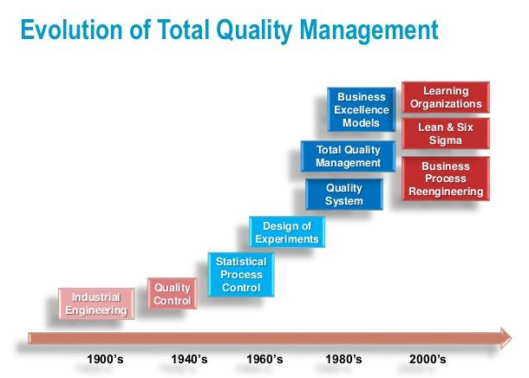
TQM Definition
TQM: Is a managerial approach and style so as to achieve customer satisfaction and global competitiveness.

Slide 6
Problem Statement
The 5D’s Indicators
Death
Disability
Disease
Dissatisfaction
Discomfort

Slide 7
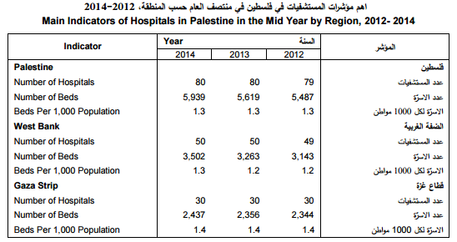

Slide 8
Objective
Evaluate the level of implementing the TQM concepts in the Palestinian hospitals from the point of view of the managers
Propose a set of recommendations that will enhance the implementation of the concepts of TQM.

Slide 9
Literature Review
The application of TQM in hospitals in Al-Riyadh City from the perspective of practitioner nursing. (B. Al-Omar -2002)
The study concluded:
There is a difference in the implementation of TQM between the studied hospitals.
There is a correlation between the ranges of implementation of TQM and the range of implementation of the continual improvement concept.

Slide 10
Evaluate the application of total quality management in the service-non-governmental institutions in the West Bank management.
(A. Abdellateef 2002)
The results showed that 82% of the studied foundations have no quality management plan, also that 60% of the studied foundations haven’t ever participated in any either training or just defining courses of the TQM.

Slide 11
Quality Management in Acute Hospitals of Selected European Countries.
(A. Pira, A. Rutz 2001)
The study concluded that all hospitals included in the study apply quality standards, but at different levels.

Slide 12
Sample size
Coordinating with hospitals
Result
Questionnaire
Analyzing Data
Previous studies
Hypothesis
Conclusion Recommendations
Methodology

Slide 13
Hypothesis
Age & Dimensions
Gender & Dimensions
Education & Dimensions
Work Level & Dimensions
Experience & Dimensions

Slide 14
Results
Cronbach’s Alfa
Primary Analysis
Associative Analysis
Profound Analysis

Slide 15
Primary Analysis

Slide 21
Dimension | Agree (Positive Response) | Disagree (Negative Response)
Commitment of upper management | 85.7% | 7.1%
Customer focused | 53.6% | 12.5%
Employee Involvement | 35.7% | 30.4%
Training | 53.6% | 19.6%
Continual Improvement | 44.6% | 12.5%
Fact Based Decision Making | 67.9% | 10.7%
Leadership | 83.9% | 8.9%
System approach | 67.9% | 17.9%

Slide 22
Associative Analysis

Slide 23
 |  | Educational level
 |  | Diploma | Bachelor | Master | PhD
Gender | Male | 6.3% | 75.0% | 9.4% | 9.4%
 | Female | 9.1% | 72.7% | 18.2% | .0%

Slide 24
 |  | Education Qualification
 |  | Diploma | Bachelor | Master | PhD
Work Level | Upper manager | 0% | 83.3% | 0% | 16.7%
 | Middle manager | 16% | 64% | 12% | 4%
 | Supervisor | 5.6% | 72.2% | 16.7% | 5.6%

Slide 25
 |  | Experience
 |  | 5 - | 6-10 | 11-15 | 16 +
Educational level | Diploma | .0% | 16.7% | 33.3% | 50.0%
 | Bachelor | 10.8% | 13.5% | 37.8% | 37.8%
 | Master | .0% | 42.9% | 57.1% | .0%
 | PhD | .0% | 33.3% | 66.7% | .0%

Slide 29
Profound Analysis

Slide 30
Hypothesis one H0 (there are no statistically significant differences for the age of respondents according to each studied dimension)

Slide 31
ANOVA
 |  | Sum of Squares | Df | Mean Square | F | Sig.
Leadership 1 | Between Groups | 8.716 | 3 | 2.905 | 2.306 | 0.088
 | Within Groups | 64.265 | 51 | 1.260
 | Total | 72.982 | 54
Leadership 2 | Between Groups | 3.221 | 3 | 1.074 | 1.034 | 0.385
 | Within Groups | 52.961 | 51 | 1.038
 | Total | 56.182 | 54
Leadership 3 | Between Groups | 9.771 | 3 | 3.257 | 3.253 | 0.029
 | Within Groups | 51.065 | 51 | 1.001
 | Total | 60.836 | 54
Leadership 4 | Between Groups | 7.887 | 3 | 2.629 | 1.743 | 0.170
 | Within Groups | 76.913 | 51 | 1.508
 | Total | 84.800 | 54
Leadership 5 | Between Groups | .770 | 3 | .257 | .229 | 0.876
 | Within Groups | 56.063 | 50 | 1.121
 | Total | 56.833 | 53

Slide 32
(I) Age |  | Mean Difference (I-J) | Std. Error | Sig. | 95% Confidence Interval
 |  |  |  |  | Lower Bound | Upper Bound
25 and lower | 26-35 | -0.95238 | 0.49793 | 0.061 | -1.9520 | 0.0473
 | 36-45 | -1.47619* | 0.49793 | 0.005 | -2.4758 | -0.4765
 | 46 and upper | -0.87500 | 0.57045 | 0.131 | -2.0202 | 0.2702
26-35 | 25 and lower | 0.95238 | 0.49793 | 0.061 | -0.0473 | 1.9520
 | 36-45 | -0.52381 | 0.30880 | 0.096 | -1.1438 | 0.0961
 | 46 and upper | 0.07738 | 0.41574 | 0.853 | -0.7573 | 0.9120
36-45 | 25 and lower | 1.47619* | 0.49793 | 0.005 | 0.4765 | 2.4758
 | 26-35 | 0.52381 | 0.30880 | 0.096 | -0.0961 | 1.1438
 | 46 and upper | 0.60119 | 0.41574 | 0.154 | -0.2334 | 1.4358
46 and upper | 25 and lower | 0.87500 | 0.57045 | 0.131 | -0.2702 | 2.0202
 | 26-35 | -0.07738 | 0.41574 | 0.853 | -0.9120 | 0.7573
 | 36-45 | -0.60119 | 0.41574 | 0.154 | -1.4358 | 0.2334

Slide 33
Hypothesis two H0 (there are no statistically significant differences for the gender of respondents according to each studied dimension)
 | F | Sig. | Result
Commitment of upper management | 0.125 | 0.725 | Accept H0
Customer focused | 0.212 | 0.647 | Accept H0
Employee Involvement | 0.443 | 0.509 | Accept H0
Training | 2.109 | 0.152 | Accept H0
Continual Improvement | 0.794 | 0.377 | Accept H0
Fact Based Decision Making | 1.240 | 0.271 | Accept H0
Leadership | 1.375 | 0.246 | Accept H0
System approach | 0.852 | 0.360 | Accept H0

Slide 34
Hypothesis Three H0 (there are no statistically significant differences for educational qualification of respondents according to each studied dimension)
 | F | Sig. | Result
Commitment of upper management | 1.916 | 0.138 | Accept H0
Customer focused | 0.981 | 0.409 | Accept H0
Employee Involvement | 2.093 | 0.112 | Accept H0
Training | 1.991 | 0.127 | Accept H0
Continual Improvement | 1.619 | 0.196 | Accept H0
Fact Based Decision Making | 0.338 | 0.798 | Accept H0
Leadership | 0.915 | 0.440 | Accept H0
System approach | 1.992 | 0.127 | Accept H0

Slide 35
Hypothesis Four H0 (there are no statistically significant differences for the work level of respondents according to each studied dimension)
 | F | Sig. | Result
Commitment of upper management | 1.723 | 0.190 | Accept H0
Customer focused | 0.487 | 0.618 | Accept H0
Employee Involvement | 0.571 | 0.569 | Accept H0
Training | 0.268 | 0.766 | Accept H0
Continual Improvement | 1.279 | 0.288 | Accept H0
Fact Based Decision Making | 0.608 | 0.549 | Accept H0
Leadership | 0.601 | 0.553 | Accept H0
System approach | 1.622 | 0.209 | Accept H0

Slide 36
Hypothesis Five H0 (there are no statistically significant differences for the years of experience of respondent according to each studied dimension)
 | F | Sig. | Result
Commitment of upper management | 1.191 | 0.323 | Accept H0
Customer focused | 0.100 | 0.959 | Accept H0
Employee Involvement | 0.281 | 0.839 | Accept H0
Training | 0.374 | 0.772 | Accept H0
Continual Improvement | 0.534 | 0.661 | Accept H0
Fact Based Decision Making | 0.220 | 0.882 | Accept H0
Leadership | 0.770 | 0.516 | Accept H0
System approach | 0.238 | 0.869 | Accept H0

Slide 37
Conclusion
In our research, we found that there is a huge percentage of the studied sample have no specialized certificates.
There is an ivory tower in the resulted data, the upper management respondents see that there is a good implementation of the studied quality dimensions, on the other hand it seems that the implementation is relatively weaker than what the upper managers see.
For the hypothesis we have assumed, there is no need to reject the null hypothesis at all except for the seventh dimension for the ANOVA test of the first hypothesis

Slide 38
Dimension | Agree (Positive Response) | Disagree (Negative Response)
Commitment of upper management | 85.7% | 7.1%
Customer focused | 53.6% | 12.5%
Employee Involvement | 35.7% | 30.4%
Training | 53.6% | 19.6%
Continual Improvement | 44.6% | 12.5%
Fact Based Decision Making | 67.9% | 10.7%
Leadership | 83.9% | 8.9%
System approach | 67.9% | 17.9%

Slide 39
Recommendations
The staff selection should be depending on the educational qualification especially for the higher levels
There should be a specialized budget for the department for quality.
There should be planned programs for increasing the awareness for the quality and the importance of quality implementation and what is the benefits of the quality that the health organization gains by implementing the quality.
Training programs should made by the ministry of health in order to build the quality culture in the health care organizations.
There should be a central quality system for all health care organizations.

Slide 40
Thank You

