Slide 2
An-Najah National University Faculty of Engineering Building Engineering Department
2015-2016
Graduation Project – 2
Design of an integrated Mall
Prepared By: Waseem Alqasem
Rezaq Shadeh
Omar Qubaa
Ashraf Zaid Project supervisor: Eng. Narmen Albarq

Slide 3
CONTENTS
Introduction
Selected Site
Architectural Design
Structural Design
Environmental Design
Electrical Design
Mechanical Design
Safety Design
Estimated Cost

Slide 4
INTRODUCTION
The main concept of our project was to design an integrated Mall, and our focus has been on Structure, Environmental, Electrical, Mechanical and Safety design to make an integrated Mall.

Slide 5
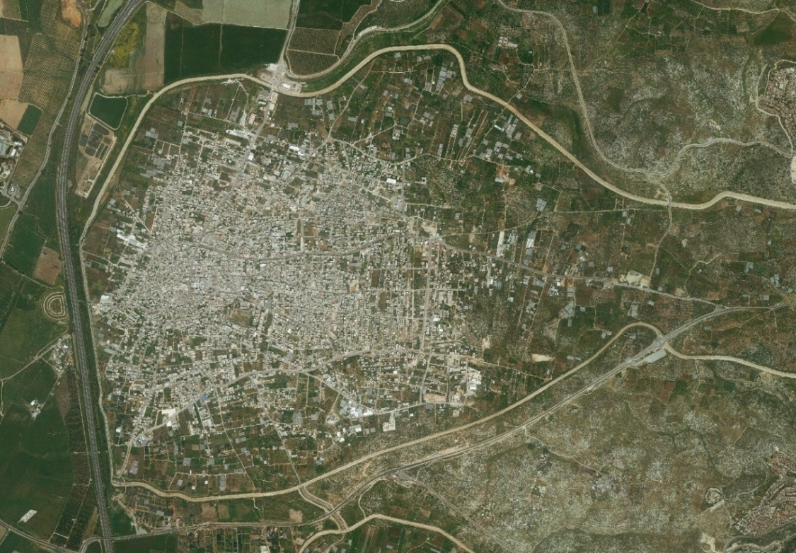
Location:
The site of the project is located in Kalkilya city
The area of land about 1050 m² .
The land has slight slope , and stands at an elevation of around 60m above Sea level.
Rebound from streets : 2 m

Slide 6
ARCHITECTURAL DESIGN

Slide 7
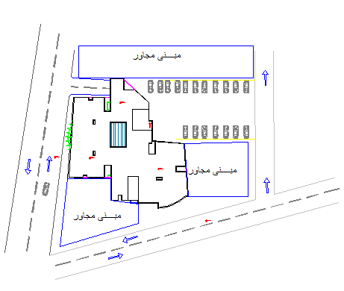
Site Plan

Slide 8
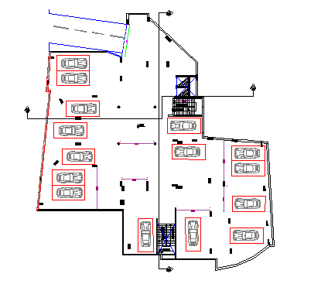
Basement Floor
Notes:
the following areas in addition to corridors, stairs and shaft.

Slide 9
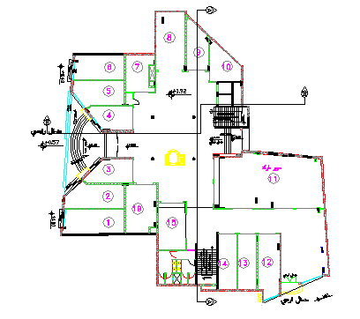
Ground Floor
Area (m2) | F.F contain :
31.05 | Shop 1
29.5 | Shop 2
21 | Shop 3
19.75 | Shop 4
25.7 | Shop 5
26.2 | Shop 6
20 | Shop 7
36.2 | Shop 8
21.5 | Shop 9
19.7 | Shop 10
120 | Super market 11
28.15 | Shop 12
21.8 | Shop 13
22.2 | Shop 14
27.36 | Shop 15
Notes:
the following areas in addition to corridors, stairs and shaft.

Slide 10
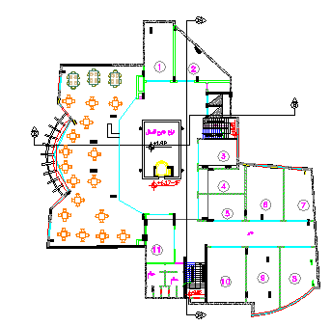
First Floor
Area(m2) | F.F contain
35.8 | Shop 1
33.6 | Shop 2
21.5 | Shop 3
23.65 | Shop 4
25.8 | Shop 5
41.8 | Shop 6
29.75 | Shop 7
43.6 | Shop 8
37.16 | Shop 9
45 | Shop 10
27.4 | Shop 11
Notes:
include the following areas in addition to corridors, stairs and shaft

Slide 11
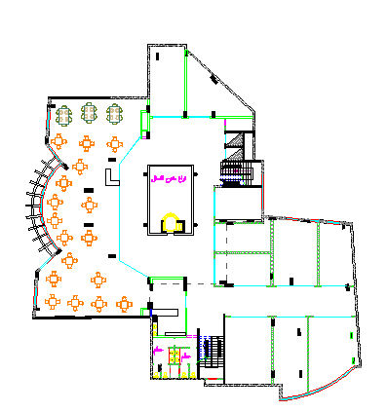
Second Floor
Area(m2) | Second Floor contain:
35.8 | Shop 1
33.6 | Shop 2
21.5 | Shop 3
23.65 | Shop 4
25.8 | Shop 5
41.8 | Shop 6
29.75 | Shop 7
43.6 | Shop 8
37.16 | Shop 9
45 | Shop 10
27.4 | Shop 11
Notes:
2nd F include the following areas in addition to corridors, stairs and shaft

Slide 12
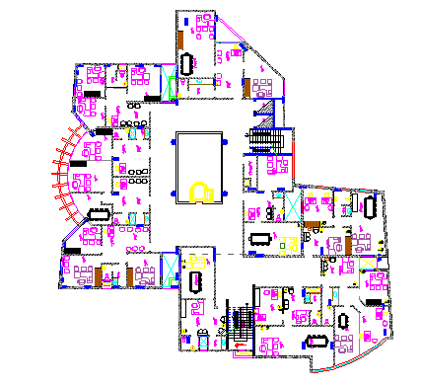
Third to fifth Floor
Area(m2) | Floor contain:
85.6 | Office 1
67.4 | Office 2
39.5 | Office 3
58.3 | Office 4
76.34 | Office 5
56 | Office 6
71 | Office 7
79 | Office 8
72.5 | Office 9
68 | Office 10
Notes:
3rd & fourth & fifth Floors include the following areas in addition to corridors ,stairs

Slide 13
West Elevation The main Entrance asserts itself through architectural design philosophy by prominent mass above it.

Slide 14
East Elevation The eastern facade represents the back of the building.

Slide 15
South Elevation High sun angles most of the day makes this facade Ideal for passive shading strategies, horizontal shelves can be installed to reduce the heat gain and eliminate glare.

Slide 16
North Elevation On this side there is no glass façade because of function issues

Slide 17
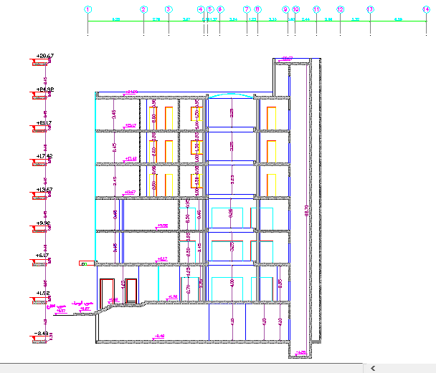
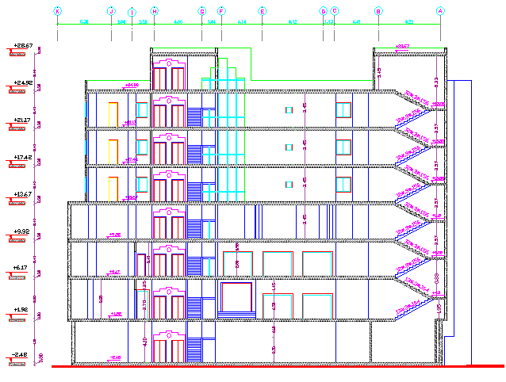
Section A-A
Section B-B

Slide 18
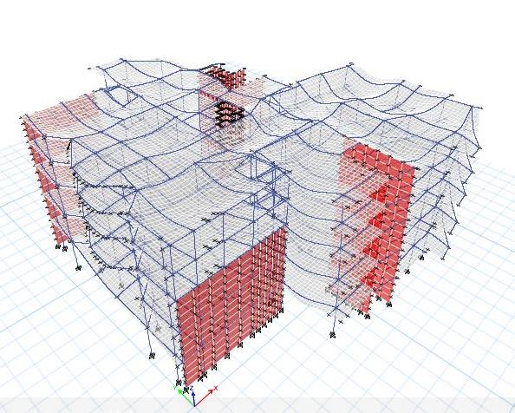
STRUCTURAL DESIGN

Slide 19
Design Codes
ACI -318-08 for reinforced concrete structural design.
ACI -350-3-06 for seismic design of soil pressure with concrete structure .
UBC -97 for earthquake load combinations.
ASCE for load combinations.

Slide 20
Material Property
Compressive strength of Concrete “f′c”.
For columns and slabs f′c = 24 Mpa
For all other elements in structure such as blinding and bracing f′c = 16 MPa
Yielding strength of steel fy = 420 MPa.
Soil Property
Soil bearing capacity = 300 KN/m2
Soil profile = Sb

Slide 21
Loads
Super Imposed dead load (SI):4.5 KN/m²
Live Load (L.L): 3.5 KN/m² (for Shops) 3 KN/m² ( for offices )
Lateral loads consider earthquake load.

Slide 22
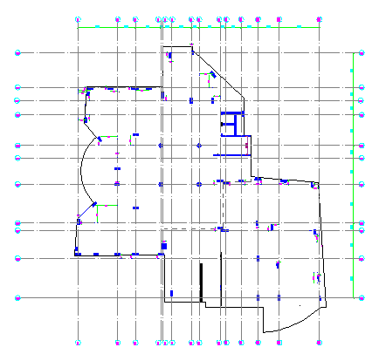
Column Center Lines Grid

Slide 23
Design and Reinforcement of Structural Elements
Slab (one way & two way rib) .
Beams ( drop) .
Columns .
Shear wall .
Stair .
Footings .

Slide 24
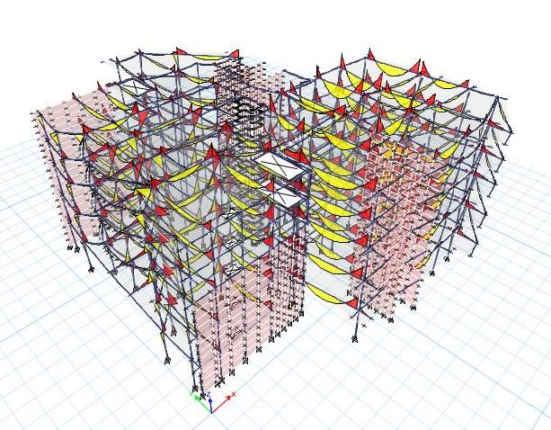
Mall 3D Model - Etabs

Slide 25
Model Checks
Compatibility
By starting animation for the MODAL deformed shape, the structure was moving as one unit. The value of factor (T =0.837) is within the acceptable range which mean that the structure is Okay.
Deflection
L/360 =7.5/360 = 0.0208m =20 mm Maximum deflection found by ETABS = 2.8 mm <20 mm

Slide 26
Model Checks
Equilibrium
Load | Manual Calc. | Etabs Calc. | Error%
Live | 11002.55 | 11002.567 | .00015
Dead | 28842.96 | 28921.0744 | 0.27

Slide 27
Model Checks
Internal Forces
Element | Ultimate Force ETAB | Ultimate Force Manual | % of Error
Beam | 281.86 KN.m | 292.8KN.m | 3.73
Slab | 25.15 KN.m/m | 26.0KN.m/m | 3.26

Slide 28
Seismic design
Cv = 0.18
Ca = 0.25
I = 1.25
R = 4.5
Soil profile S_{B}
Z = 0.15
From Etabs
Base shear ( V ) =5691.94KN
(UX = 5691.94 , UY = 5691.94)
Mass participation ratio is larger than 90% in X, Y .

Slide 29
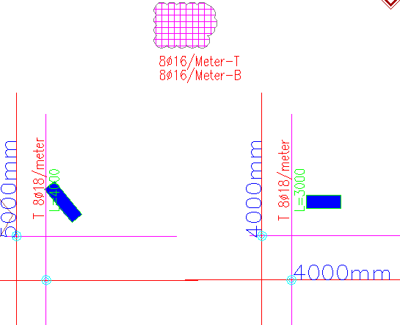
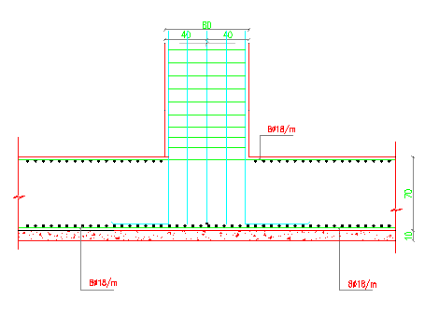
Footing Reinforcement Details
Mat Foundation

Slide 30
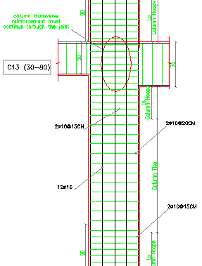
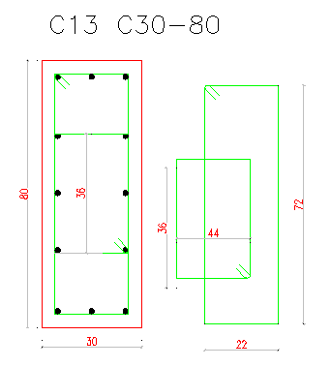
Column Reinforcement Details

Slide 31
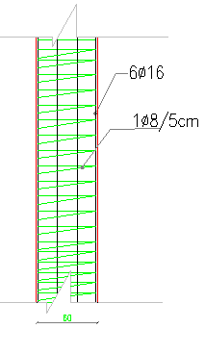
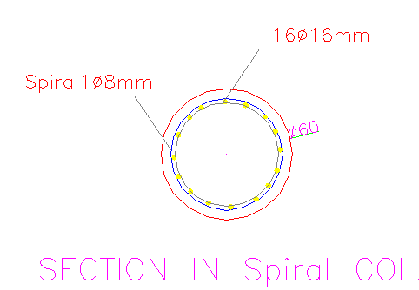
Column Reinforcement Details

Slide 32
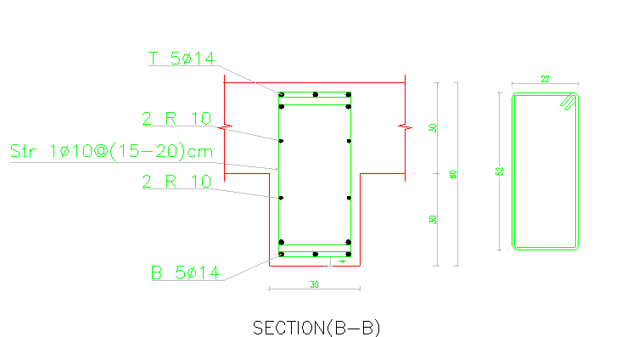
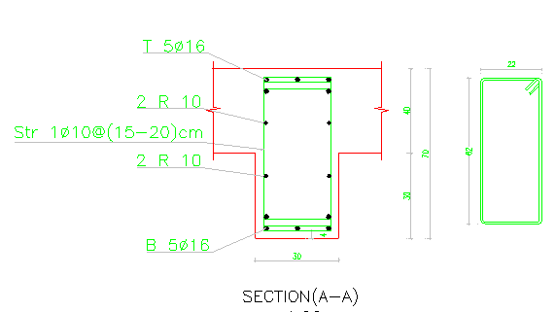
Beam Reinforcement Details

Slide 33
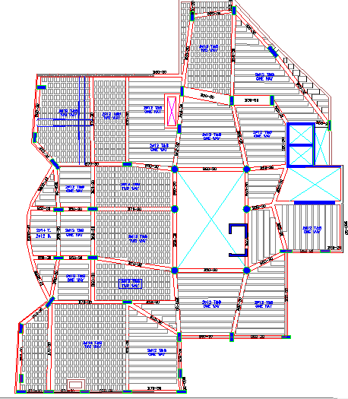
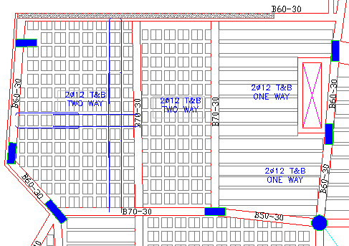
Slab Reinforcement Details

Slide 34
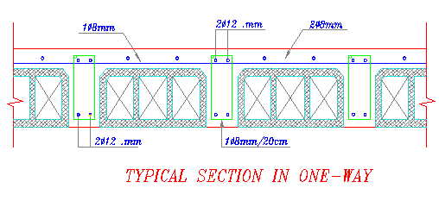
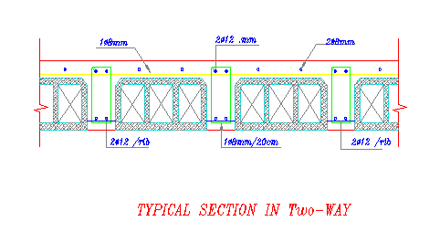
Slab Reinforcement Details

Slide 35
Shear Wall Details

Slide 36
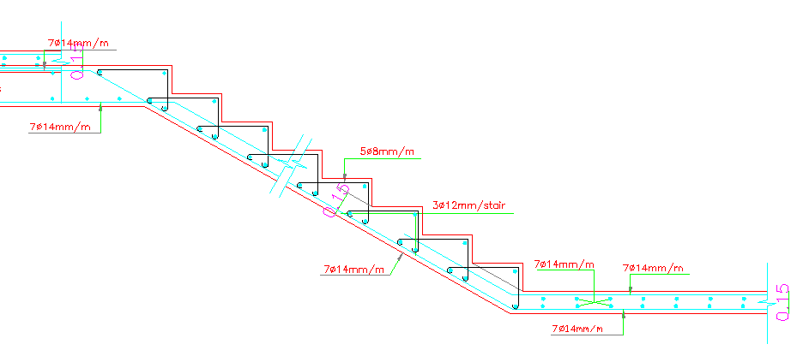
Stair Reinforcement Details

Slide 37
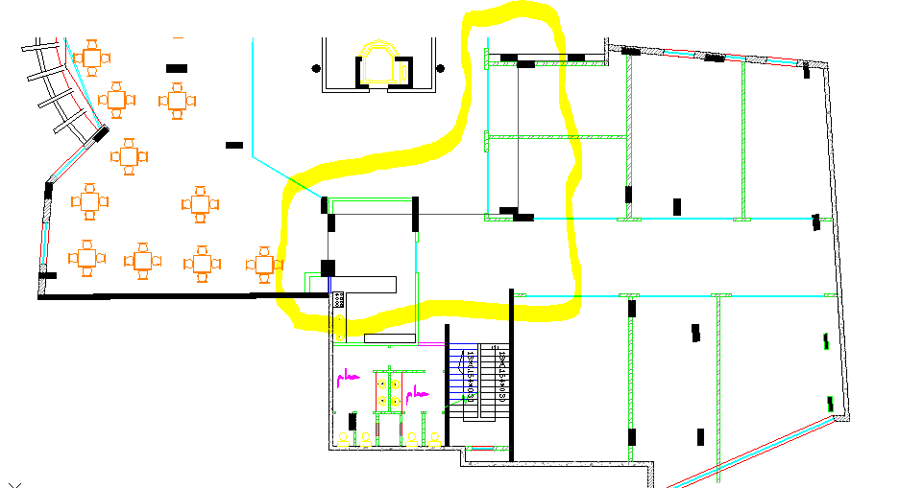
Seismic Joint

Slide 38
Environmental Design

Slide 39
Codes and specifications:
Energy Efficient Palestinian Building Code
Software:
Design builder version 4.5

Slide 40
Some Facilities Used to Achieve Environmental Design
Project have a void area in the center of the building that give Daylight and natural ventilation.
In the south there is already a building covering the area ,so we didn’t have to use shading .

Slide 41
Sun path on the building at 21 July

Slide 42
Sun path on the building at 21 January

Slide 43
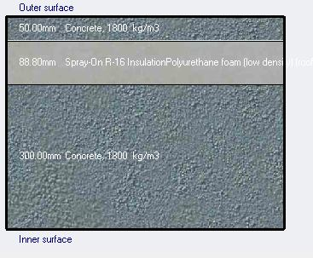
Envelope Insulation
Flat roof
(U-value = 0.390W/m².K)
Stone wall
(U-value = 0.522W/m².K

Slide 44
Glass Selection

Slide 45
Thermal Analysis
Cooling Load
Heating Load
Block | Design Capacity (kW)
GF | 50
F1 | 52.47
F2 | 52.69
F3 | 57.54
F4 | 56.24
F5 | 60.28
Block | Design Capacity (kW)
Gf | 21.68
F1 | 17.15
F2 | 16.63
F3 | 17.15
F4 | 17.59
F5 | 22.9
Heating and Cooling Loads With Insulation(63Kw/m2)

Slide 46
Thermal Analysis
Temperature and heat loss charts

Slide 47
Thermal Analysis
Temperature and heat gain charts
Energy consumption chart

Slide 48
Natural day light

Slide 49
Acoustical Analysis
We have IIC= 70 which is greater than 60... OK

Slide 50
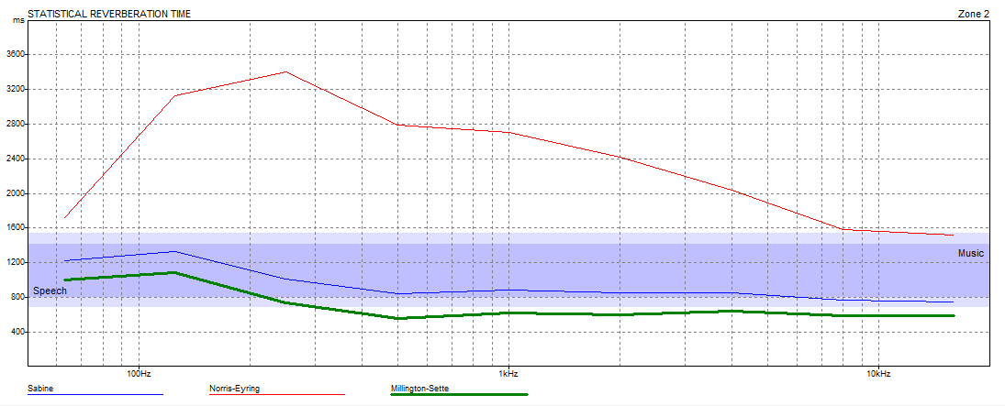
Acoustical Analysis
RT60 calculations for cafe shop:
Recommended RT60 Rating 0.7- 1.3 s

Slide 51
Acoustical Analysis
Values of RT₆₀ after improving

Slide 52
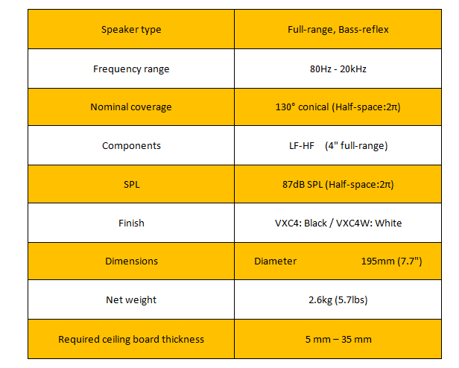
Loudspeakers design and distribution
Specifications for the speaker

Slide 53
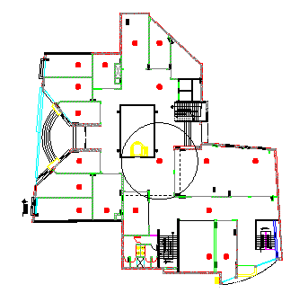
Speaker distribution

Slide 54
Electrical & Mechanical Design

Slide 55
Electrical Design 1. Artificial lighting. 2. Sockets arrangement.

Slide 56
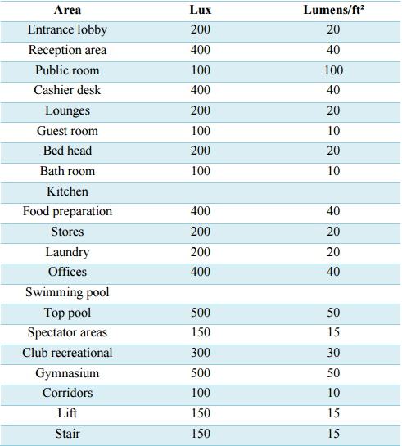
Artificial lighting

Slide 57
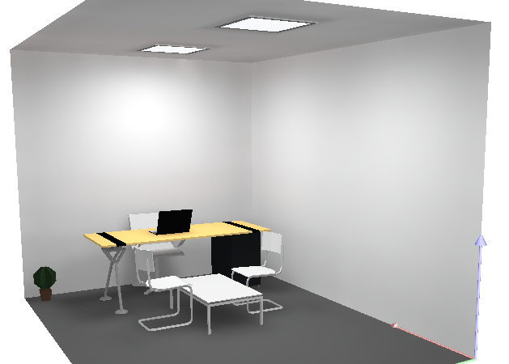
Artificial lighting Office lighting

Slide 58
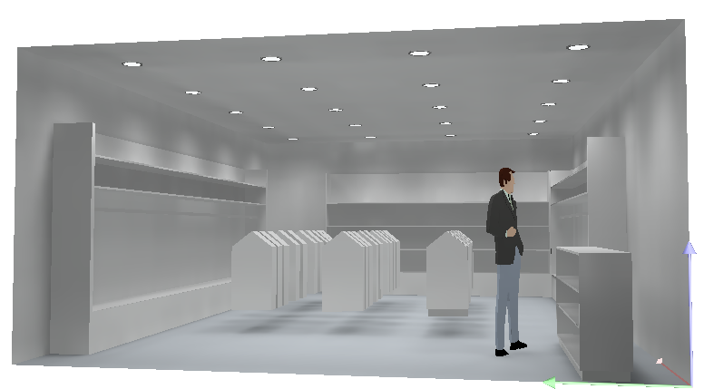
Shop lighting

Slide 59
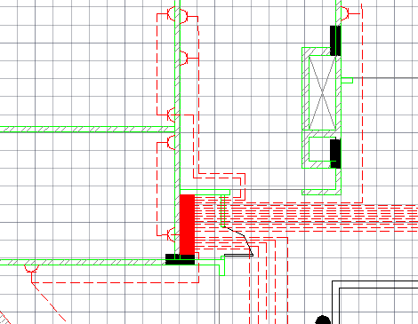
Sockets Arrangement

Slide 60
Circuit breakers (C. B.) circuit breaker 10 Amp are used for lighting and 16 Amp for sockets. for lighting use cable 1.5 mm². for sockets use cable 2.5mm².

Slide 61
Mechanical Design 1. water supply design 2. Water Drainage Design 3. Vertical Transportation (Elevator) Design 4. HVAC DESIGN

Slide 62
Water supply design Available pressure to lose by fitting = 54 - 15 = 39 psi. available pressure to lose by fitting = 39 psi >> 15.7 psi →ok

Slide 63
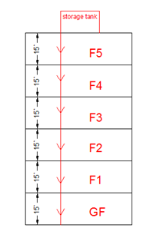
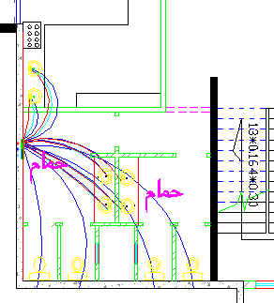
Water supply design

Slide 64
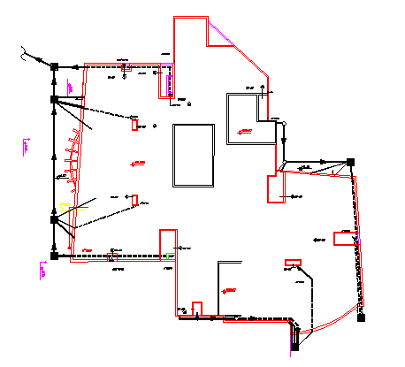
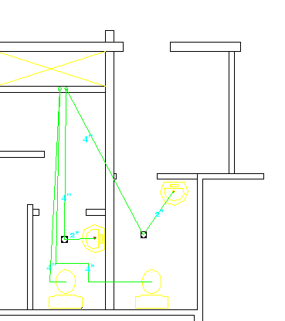
Water Drainage Design

Slide 65
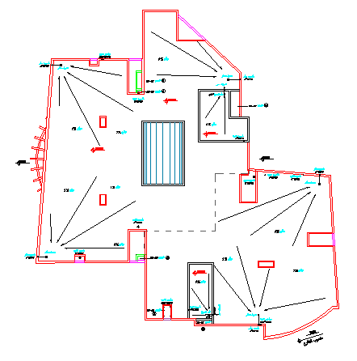
Rain Drainage System

Slide 66
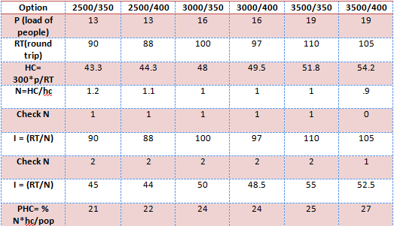
Vertical Transportation (Elevator) Design best choice : N=2 , (2500 Lb ,13 person) plus one.

Slide 67
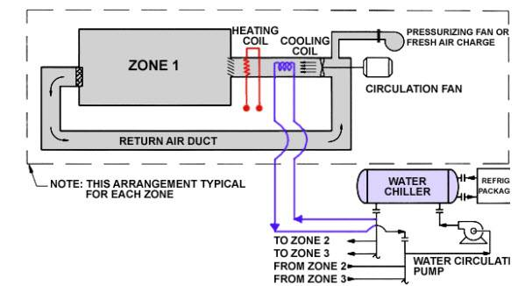
HVAC DESIGN Chilled water systems

Slide 68
HVAC DESIGN Distribution of Diffusers

Slide 69
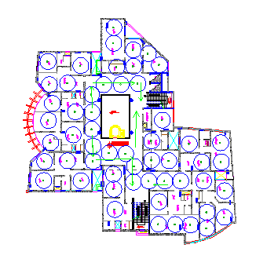
Safety Design 1. Extinguisher 2. Sprinklers 3. Egress rout

Slide 70
Estimated Cost The Total Project Cost = 3,628,000 NIS The total cost per meter square is about 600 NIS
cost | type
25000 | Excavation work
566250 | steel work
568324 | concrete work
326056 | finishes work
1243200 | stone and plaster work
900000 | labor

