Slide 1

An-Najah National University
College of Engineering
Department of Civil Engineering
Design of Some Building and Reservoirs In Nablus Waste Water Treatment Plant
Supervised by :
Eng. Ibraheem Mohammed
Prepared by
Inas Mahmood, Malak Issa, Noor Abu Kishek.

Slide 2
Main Contents
1- Identifying the project.
2- Design of Power Supply Building.
3- Design of Administration Building.
4- Design of Rectangular Aeration Tank.
.5- Design of Circular Settling Tank

Slide 3
Identifying the Project
This is a graduation project that introduces a design of some buildings and reservoirs in Nablus Waste Water Treatment Plant (WWTP).
This project will introduce the structural design of :
Power Supply Building
Administration Building
Rectangular Aeration Tank
Circular Settling Tank.

Slide 4
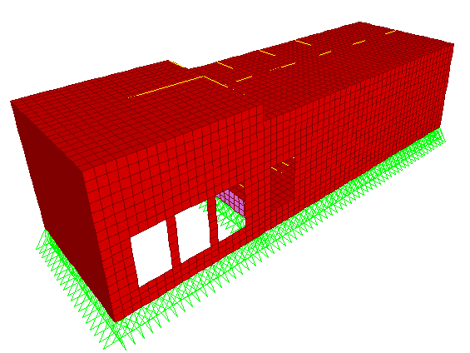
Design of Power Supply Building

Slide 5
General Description
Power Supply Building 5
Two-story building.
The floor area of building is approximately 275 m².
There are two levels of height in the same story. Story clear height is 4.42 m and 3.4 m.
The partitions are 200 mm block walls.
The perimeter walls are masonry.

Slide 6
Materials
Power Supply Building 6
Reinforced concrete for buildings: 30N/mm², f'c = 24 N/ mm²
Deformed high tensile steel bars shall have minimum yield stress of 420 N/mm², conforming to ASTM A615-Grade 60
The unit weights of materials are shown in the following table:
Table 1:unit weights of materials.
25 KN/m³ | Reinforced concrete
23 KN/m³ | Plain concrete
78.5 KN/m³ | Reinforcing steel
12 KN/m³ | Building blocks
27 KN/m³ | Masonry stone
20 KN/m³ | Fill under tiles
23 KN/m³ | Plastering

Slide 7
Loads
Power Supply Building 7
Table2: loads in power supply building .
3.6 KN/m² | Super Imposed Dead Load
5 KN/m² | Live Load in light weight stores
3 KN/m² | Live Load in steel roof

Slide 8
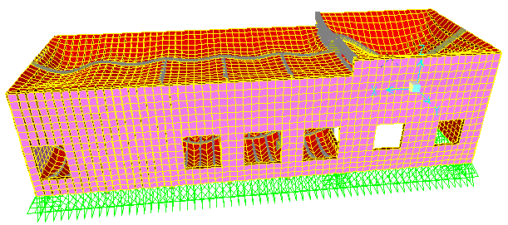
Verification of Structural Analysis
Power Supply Building 8
A) Compatibility: the structure achieves compatibility in deformations

Slide 9
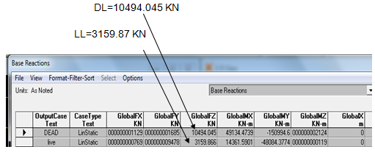
Verification of Structural Analysis Results
Power Supply Building 9
B) Equilibrium:
Total DL = 9855.45KN Total LL =3159.86KN
The results of DL and LL from SAP are:
% of error in L.L = 0%
% of error in D.L = 6.4%

Slide 10
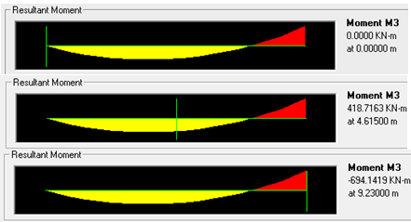
Verification of Structural Analysis Results
Power Supply Building 10
C) Stress Strain Checks:
Moment from SAP=

Slide 11
Verification of Structural Analysis Results
Power Supply Building 11
Moment from calculation:
Mu=
% of error in stress strain = 2.9%

Slide 12
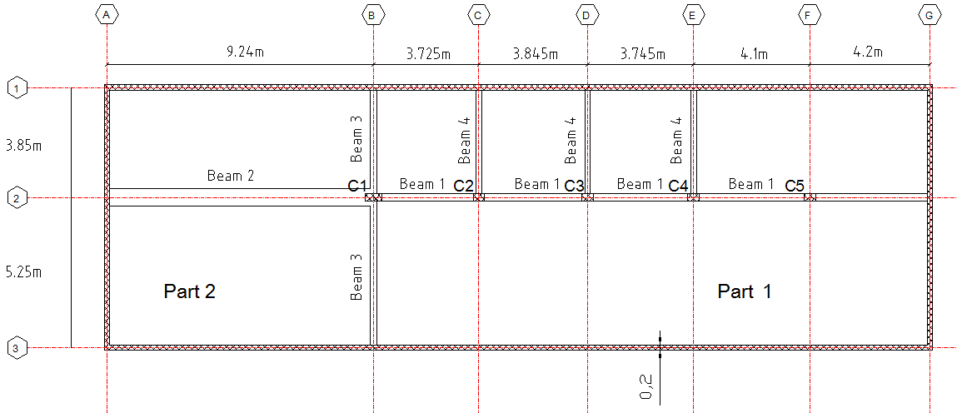
Structural Plan
Power Supply Building 12

Slide 13
Slab Design
One way solid slab in y direction
Mu= 40.4 KN.m
b=1000 mm d=180 mm
= 0.003413
As= ρbd=614.34 mm²
As min = 0.0018×b×h =396 mm²
As>As min → use As= 614.34 mm² → use 4 ɸ14
Power Supply Building 13

Slide 14
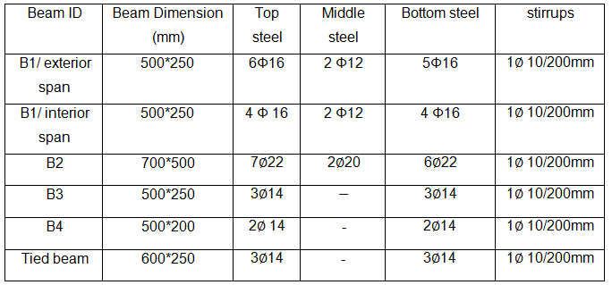
Beams Design Results
Power Supply Building 14
Table 3 :beams design results

Slide 15
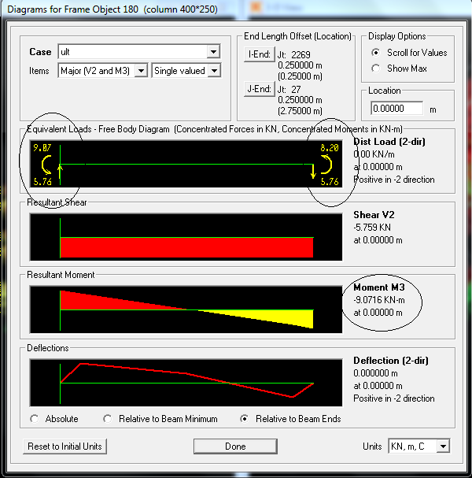
Power Supply Building 15
Column calculation
If this satisfy then column is short
C4
3 1.5 < 40 Ok
so the column is short

Slide 16
Column Calculation
Power Supply Building 16
Pu=1003KN
Assume area of column equal(400*250)
Assume steel ratio equal to 0.01→As=1000mm

Slide 17
Columns Design Results
Power Supply Building 17
Table 4:columns design results.
Columns # | Dimension (mm) | Reinforcement | Ties
1 | 800*250 | 12 Ø 25 | 10/250mm
2,3,4,5 | 400*250 | 6 Ø 16 | 10 /250mm

Slide 18
Power Supply Building 18
Single Footings design
Dimension:
for C1 ( 800 * 250 )
P _{(service)} = 743 KN P _{(ult) =} 965 KN
L = 1.85 m B= 1.3 m area of footing = 2.4 m²
Check of Wide Beam Shear :
d = 280 mm h = 350 mm
Φ V_{c} = 183.1 > Vu=133.8……… ok

Slide 19
Single Footings design
Power Supply Building 19
Check of punching shear:
Vcp=1104 KN > Vup=753.3 ………. Ok
Design Footing for Flexure:
M_{u} =71.9 KN.m
d=280 mm b=1000 ρ=0.0025
A_{s}= ρ×b×d= 700 mm² > A_{s(min)} = 0.0018×b×h = 630 mm²
Use 8φ12/m

Slide 20
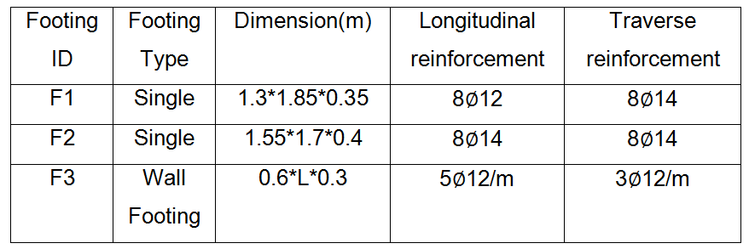
Footings Design Results
Power Supply Building 20
Table 5: footing design results.

Slide 21
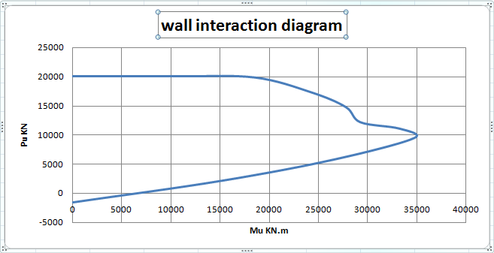
Wall Design Results
Power Supply Building 21
Using SAP2000 the wall is modeled as a column of length 9.11 m and thickness 20 mm
wall interaction diagram

Slide 22
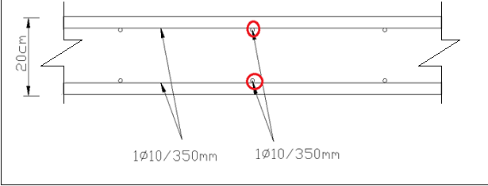
Power Supply Building 22
Wall Design Results
See the final reinforcement of the wall

Slide 23
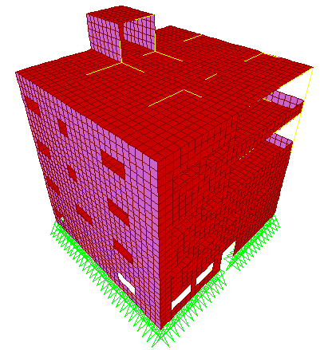
Design of Administration Building

Slide 24
General Description
Administration Building 24
Four story building.
The floor area of building is approximately 238 m².
Story height is equal to 3.4 m.
The partitions are 200 mm block walls.
The perimeter walls are masonry. The wall is consisted of 50 mm masonry stone and 200 mm concrete.

Slide 25
Materials
Administration Building 25
Reinforced concrete for buildings: 30N/mm², f'c = 24 N/ mm²
Deformed high tensile steel bars shall have minimum yield stress of 420 N/mm², conforming to ASTM A615-Grade 60
Table 6: unit weights of materials.
25 KN/m³ | Reinforced concrete
23 KN/m³ | Plain concrete
78.5 KN/m³ | Reinforcing steel
12 KN/m³ | Building blocks
27 KN/m³ | Masonry stone
20 KN/m³ | Fill under tiles
23 KN/m³ | Plastering

Slide 26
Loads
Administration Building 26
Table 7:loads in administration building.
4.6 KN/m² | Super Imposed Dead Load
2.5 KN/m² | Live Load in light weight stores
5 KN/m² | Live load in stair well

Slide 27
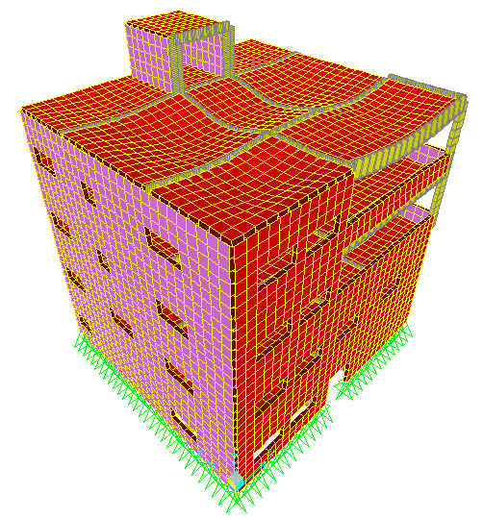
Verification of Structural Analysis
Administration Building 27
A-Compatibility…….. ok
B-Equilibrium ……….. ok
C-Stress Strain ……… ok

Slide 28
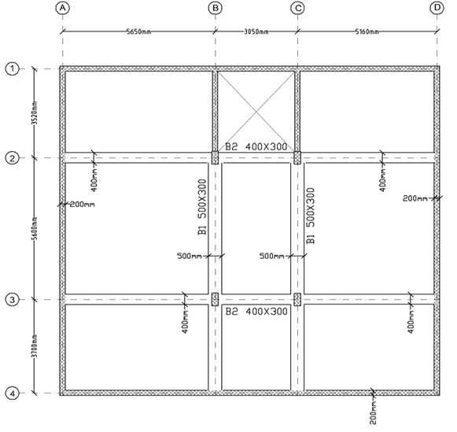
Structural Plan
Administration Building 28

Slide 29
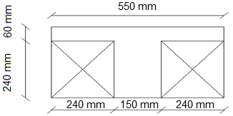
Design of slab
Administration Building 29
One Way Ribbed Slab in x direction
Slab thickness and dimensions:
Slab thickness = = 0.3m

Slide 30
Bending Moments and Reinforcing Areas for Slab
Administration Building 30
Table 8: Final Reinforcement in Slab
As used | As min mm² | As mm² | ρ | Moment/section cut length | Moment (KN.m) | Section cut #
2 ø12 | 125 | 164 | 0.00437 | 14.83 | 190.265 | 1
2 ø16 | 125 | 315 | 0.0084 | 27.4 | 351.98 | 2
2ø12 | 125 | 86.6 | 0.00063 | 8.18 | 104.967 | 3
2ø12 | 125 | 22.27 | 0.00027 | 3.52 | 45.19 | 4
2ø12 | 125 | 262 | 0.0019 | 24.33 | 312.3 | 5

Slide 31
Design of beam
Administration Building 31
Design of B4- 500*300 mm
Flexure reinforcement
Width =500mm depth=300mm ρ=0.011
Mu - = 116.05KN.m → As = 1383.6 mm²
Mu+ =77.6 KN.m → As = 884 mm²

Slide 32
Design of beam
Administration Building 32
Shear reinforcement
Vu =153.19KN
Vn = Vu/Φ = 204.25 KN.
Since, Vn >1/2 Vc then use shear reinforcement
Vs = Vn – Vc = 102.19 KN
Av/s=Vs/fy*d = 0.973

Slide 33
Design of beam
Administration Building 33
Torsion reinforcement:
Tu =4.41 KN.m
Tu >Tth so there is a need for torsion reinforcement

Slide 34
Design of beam
Administration Building 34
S=157/1.21 =130 mm
Use stirrups 1φ10/130 mm
Longitudinal steel:
AL min>AL→ Use AL min=506.5

Slide 35
Design of beam
Administration Building 35
Final reinforcement
Top steel:
As =1383.6+ 506.5/2= 1636.85mm²
Use 7ϕ 18 on the right of the span and 6ϕ18 on the left of the span.
Bottom steel:
As =884+ 506.5/2 =1137.25 mm²
Use 5 ϕ18

Slide 36


Design of beam
Administration Building 36
Reinforcement from sap 2000 result:
Top steel:
Left :
1260+478/2=1499mm² use 6φ 18
Right :
1386+478/2 =1625mm² use 7φ18
Bottom steel:
1078+478/2=1317 mm² use 6 φ18

Slide 37


Design of beam
Administration Building 37
Shear and torsion reinforcement:
Assume stirrups are φ10
Use stirrups 1φ10/145 mm

Slide 38
Comparing
Administration Building 38
As comparing between hand calculation and sap results the top steel are the same but there is a different in the bottom steel in both cases .
sap program use a pattern live load factor equal to 0.75 and this factor made increment in live load value so that there is a difference between Sap and manual calculation.

Slide 39
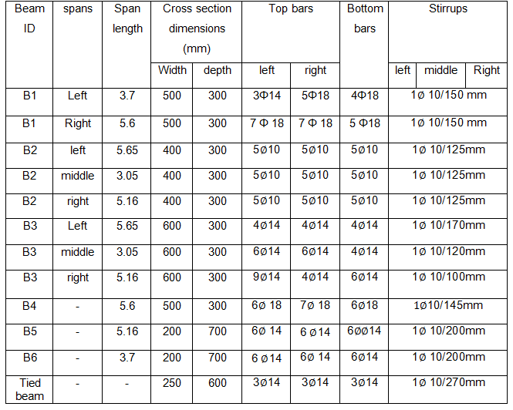
Design of Beams Results
Administration Building 39
Table 9: Final Reinforcement in beams

Slide 40
Design of Columns Results
Administration Building 40
Table 10: Final Reinforcement in column
Columns ID | cross section dimensions (mm) | Longitudinal reinforcement | Ties
C1,C2 ,C3,C4 | 250*500 | 6 Ø 18 | 10/250mm
C3 | 600*200 | 10 Ø 14 | 10 /250mm

Slide 41
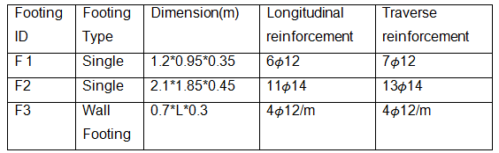
Footings Design Results
Administration Building 41
Table 11: Final Reinforcement in footings

Slide 42
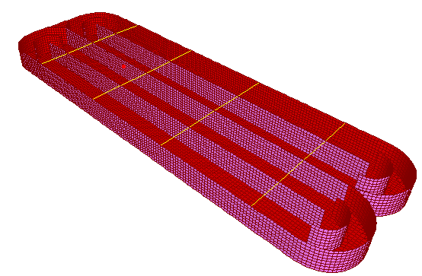
Design of Rectangular Aeration Tank
Rectangular Tank 42

Slide 43
General Description
Rectangular Tank 43
The area of rectangular aeration tank is approximately 3650 m².
Smooth curves are used at corners.
The clear height of tank is nearly 5.8 m.
The tank out-to-out dimensions are 34.5 m x 109.1 m with 5 walls in the tank long direction.
The tank is consisted of two chambers.

Slide 44
Materials
Rectangular Tank 44
Reinforced concrete for buildings: 35N/mm², f'c = 28 N/ mm²
Deformed high tensile steel bars shall have minimum yield stress of 420 N/mm², conforming to ASTM A615-Grade 60
The unit weights of materials that used are shown in the following figure.
Table 12: unit weights of materials
25 KN/m³ | Reinforced concrete
23 KN/m³ | Plain concrete
78.5 KN/m³ | Reinforcing steel

Slide 45
Loads
Rectangular Tank 45
Table 13: loads in rectangular tank
13.5 KN/m² | Live Load (from vehicles)
55.88 KN/m² | Maximum Lateral Water Pressure at the Base of the Walls
20 KN at each to span | Mechanical Load

Slide 46
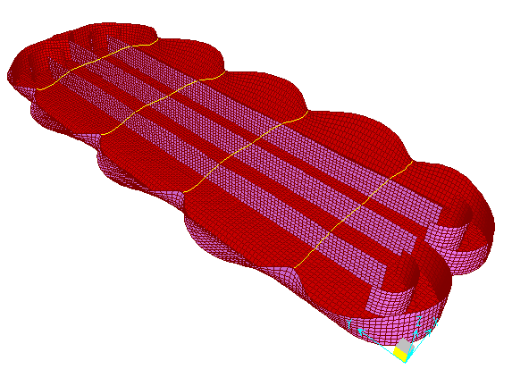
Verification of Structural Analysis Results
Rectangular Tank 46
A) Compatibility: the structure achieves compatibility in deformations.

Slide 47
Verification of Structural Analysis Results
Rectangular Tank 47
B) Equilibrium: The equilibrium law is checked by calculating the weight of the structure and comparing it with the reactions from SAP
% of error in D.L = 0.08 %
C) Stress Strain Checks:
% of error in shear = 0.0 %
% of error in moment = 0.0%

Slide 48
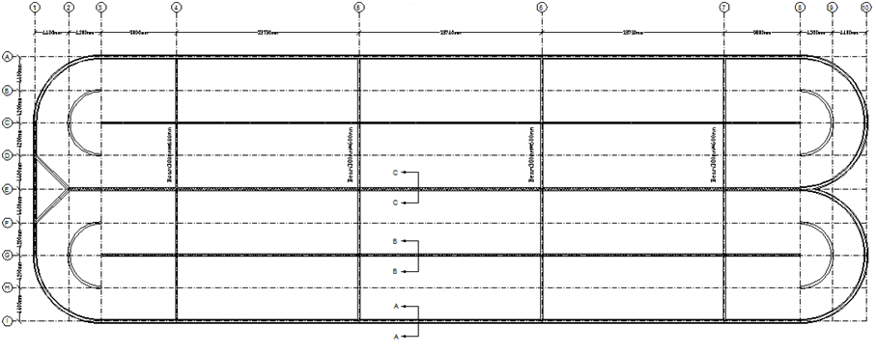
Structural Plan
Rectangular Tank 48

Slide 49
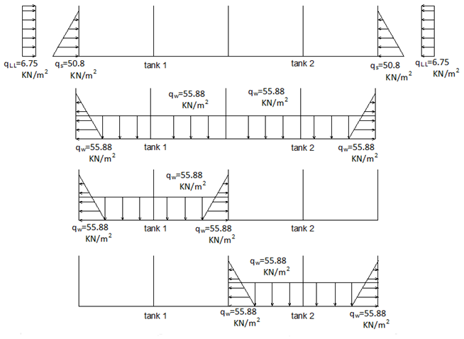
Load Cases in Rectangular Aeration Tank
Rectangular Tank 49

Slide 50
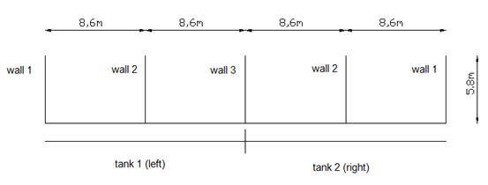
Rectangular Tank 50
Thickness of Wall 1 is non prismatic section =300 mm from top and 500 mm from bottom
Thickness of wall 2 = 300 mm
Thickness of Wall 3 = 400 mm

Slide 51
Walls Design
Rectangular Tank 51
Check thickness for:
Shear:
Tension :
Ft > Fc …… ok

Slide 52
Walls Design
Rectangular Tank 52
Moment:
,

Slide 53
Walls Design
Rectangular Tank 53
Calculation steps:
1- vertical Reinforcement due to water , soil pressure:
Mu design= Sd*M
Mu design → ρ → As=ρ×b× d
Check As > As min = 0.003/2×b× h

Slide 54
Walls Design
Rectangular Tank 54
2.Reinforcement in horizontal direction:
As total= As horizontal flexural + As for tension/2
Check As>As min = 0.005/2×b× h

Slide 55
Walls Design Results
Rectangular Tank 55
Table 14: final reinforcement in rectangular tank walls
Total horizontal reinforcement |  | Vertical reinforcement due to water pressure | Vertical reinforcement due to soil pressure | Walls
Middle wall | corners
1Φ25/125 | 1 Φ 25 / 90 | 1Φ 25 / 125 | 1Φ 25 / 150 | 1
1Φ 12 / 150 | 1Φ 12 / 150 | 1Φ 14 / 150 | ____ | 2
1Φ25 / 150 | 1Φ25 / 150 | 1Φ 25 / 125 mm | ____ | 3

Slide 56
Base Design
Rectangular Tank 56
The base thickness is 500 mm
Check thickness:
Shear
Tension
moment
Reinforcement for flexure and tension
In long direction
In short direction

Slide 57
Base Design
Rectangular Tank 57
Reinforcement in long/short direction:
Mu design= Sd*M
Mu design → ρ → As=ρ×b× d
As total= As horizontal flexural + As for tension/2
Check As total > As min = 0.005/2×b× h

Slide 58
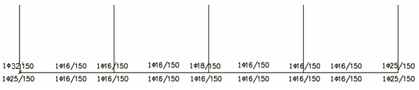
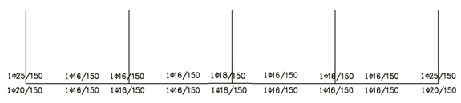
Base Design Results
Rectangular Tank 58
Reinforcement on section between the beams in short direction.
Reinforcement on section between the beams in long direction.

Slide 59
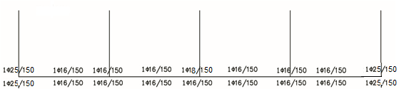
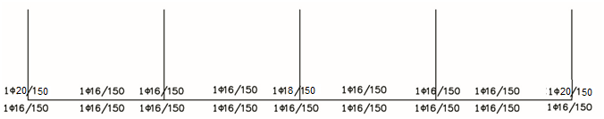
Base Design Results
Rectangular Tank 59
Reinforcement around the beams in short direction
Reinforcement around the beams in long direction

Slide 60
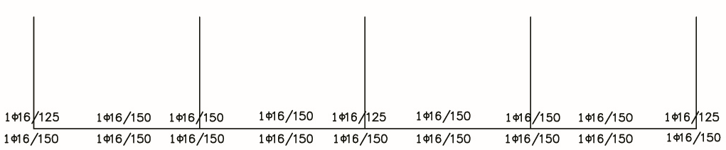
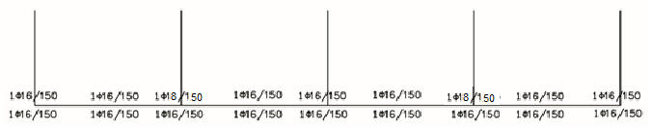
Base Design Results
Rectangular Tank 60
Reinforcement near the arcs at the end of the tank in short direction
Reinforcement near the arcs at the end of the tank in long direction

Slide 61
Comparing
Rectangular Tank 61
By modeling a frame on sap2000 program as a section in the middle of the tank shows the walls and the base, and after comparing between the results from the 3D model and from the frame for designing the base and the walls , we conclude that the results are very close to each other , so we can use the frame for the design of base and walls instead of 3D model .

Slide 62
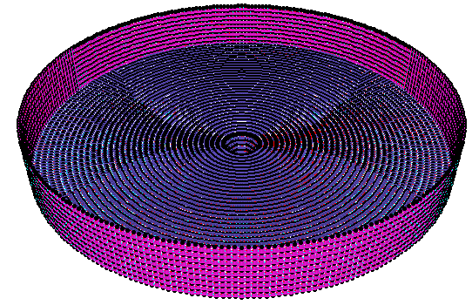
The Design of Final Settling Circular Tank
Circular Tank 62

Slide 63
General Description
Circular Tank 63
The area of tank is approximately 1019 m².
The clear height of settling tank is varies from 4.5m near the perimeter to 8.37m near the center.
The diameter of the tank is 36 m.

Slide 64
Materials
Circular Tank 64
Reinforced concrete for buildings: 35N/mm², f'c = 28 N/ mm²
Deformed high tensile steel bars shall have minimum yield stress of 420 N/mm², conforming to ASTM A615-Grade 60
The unit weights of materials that used are shown in the following figure.
Table 15: unit weights of materials .
25 KN/m³ | Reinforced concrete
23 KN/m³ | Plain concrete
78.5 KN/m³ | Reinforcing steel

Slide 65
Loads
Circular Tank 65
Table 16: loads in circular tank
13.5 KN/m² | Live Load (from vehicles)
55.88 KN/m² | Maximum Lateral Water Pressure at the Base of the Walls
20 KN at each to span | Mechanical Load

Slide 66
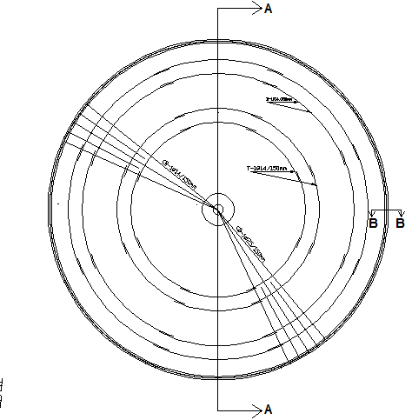
Structural Plan
Circular Tank 66

Slide 67
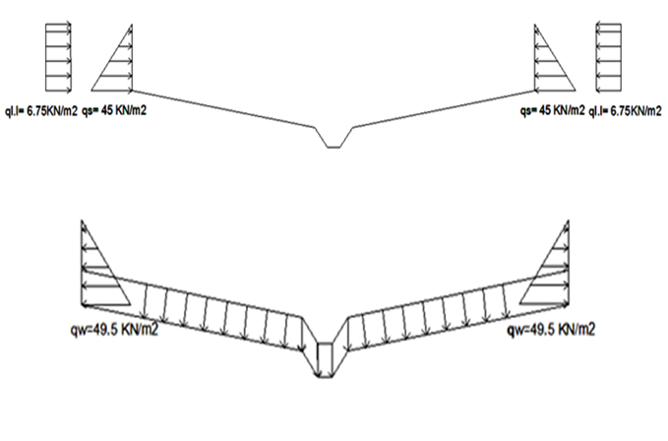
The load cases
Circular Tank 67

Slide 68
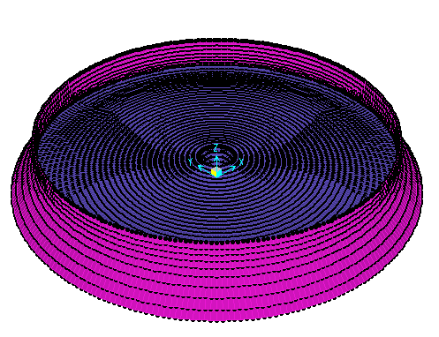
Verification of Structural Analysis
Circular Tank 68
A) Compatibility: the structure achieves compatibility in deformations.

Slide 69
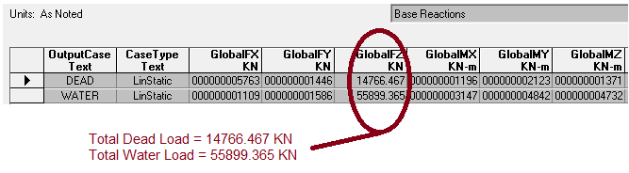
Verification of Structural Analysis
Circular Tank 69
B) Equilibrium
Total DL = 14632.3 KN.
Total wL=50386.05 KN
The results of Dead load and water load from SAP
% of error in D.L = 0.9 %
% of error in water load = 10.9 %

Slide 70
Verification of Structural Analysis
Circular Tank 70
C) Stress strain relationship check:.
Maximum moment occur at 0.5H=12.12 KN.m/m
Maximum moment in the wall from SAP=19.2 KN.m/m
% of error = 58%
Maximum shear V= 70.6 KN
Maximum shear in the wall from SAP=64.28 KN /m
% of error = 8.9 %

Slide 71
Verification of Structural Analysis
Circular Tank 71
The previous error is very large that’s related to the assumption of the fixed base but actually the base is 0.4 m and the wall is 0.35m therefore it is not fixed.

Slide 72
Wall Design
Circular Tank 72
Check thickness:
Shear
Tension
Moment
Reinforcement for flexure and tension
Vertical Reinforcement due to soil pressure:
Vertical Reinforcement due to water pressure
horizontal Reinforcement due to soil pressure:
horizontal Reinforcement due to water pressure

Slide 73
Wall Design Results
Circular Tank 73
Table 17: final reinforcement in circular tank walls
Notes | Reinforcement due to water pressure | Reinforcement due soil pressure | Reinforcement direction
Due to moment | 1ɸ12 /150 mm | 1ɸ14/150 mm | Vertical
Due to tension | 1ɸ18 /150 mm | 1ɸ18 /150 mm | horizontal

Slide 74
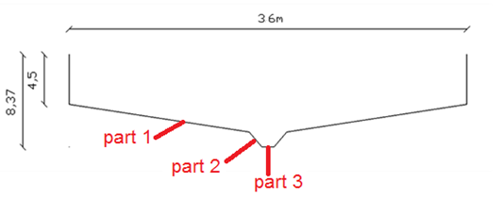
Base Design Results
Circular Tank 74

Slide 75
Base Design Results
Circular Tank 75
Table 18: final reinforcement in circular tank base
Use in part 3 | Use in part 2 | Use in part 1
1Φ25/150 mm | 1Φ25/150 mm | 1Φ14/150 mm | top reinforcement in 11 direction
1Φ25/150 mm | 1Φ25/150 mm | 1Φ14/150 mm | bottom reinforcement in 11 direction
1Φ32/150 mm | 1Φ32/150 mm | 1Φ25/150 mm | top reinforcement in 22 direction
1Φ25/150 mm | 1Φ25/150 mm | 1Φ14/150 mm | bottom reinforcement in 22 direction

