Slide 1
An - Najah national university
Civil engineering department
Graduation project (part 2)
Construction project management
(Time Management)
Prepared by:
Maram kiwan
Maha Samman
Safa’ Hasan
Reem Daryh
Amal Naser
Supervisor:
Eng. Hussein Abu Zant

Slide 2
Time Management
Time management is a critically important skill for any successful project manager.
Time management:
- Reduces stress.
- Increases productivity.
- Achieves larger profits for the owner of business.

Slide 3
Methods of Project Time Management
1- Break it down into number of tasks that have to be performed .
2- Assign duration to each tasks.
3- allocate the required resources to each tasks.
4- determine predecessor and successors.
5- tracking (monitoring & evaluation).

Slide 4
Case Study
- Taxes Departments at Nablus-Mall, it’s execution period is too short (60 days).
- Owner : Need to receive the project, because the site was rented to the offices of taxes departments.
- Contractor: seeks to execute it with minimal time in order to avoid liquidated damages.

Slide 5
Objectives:
The objective of this project is to make a good management for the time of construction projects, beside create systematic procedures to enable the contractor to deliver the project on time to avoid liquidated damages.
Assumptions
The main idea of the assumption that the time management leads to avoid liquidated damages.

Slide 6
Work Procedures:
1- definition of the problem (tight time caused potential
delay).
2- determination causes of delays.
2- Suggestion countermeasures to avoid the delay.
3- Gathering information about all activities with the available resources.
4- determination the time needed by using Primavera Program.

Slide 7
Causes of delay :
There are two kinds of causes of delay in construction projects:
1- Internal causes: include the causes arising from four parties:
2- External causes:
Owner
contractor
consultant

Slide 8
CONTRACTOR’S
RESPONSIBILITY
1- shortage of material ,
labor, equipments and tools on site.
2- financial problems.
3- poor site management.
4- construction mistakes and defective work (due to poor skills and experience).
CONSULTANT’S
RESPONSIBILITY
1- Absence of consultant’s site staff .
2- lack of experience of the consultant’s staff.
3- Incomplete documents.

Slide 9
Owner’s
Responsibility
1- lack of working knowledge.
2- Slowness in making decisions.
3- Contract modification(replacement, or addition of new work).
3- financial problems (delayed payment and economic problems).

Slide 10
Another causing
1- inspection .
2- subcontractor’s delay .
3- Poor weather site and economic conditions.
4- changes in laws and regulations.
5- Transportation delays.
6- External work due to Public agencies.

Slide 11

Questionnaire Design and Analysis

Slide 12
Results from Questionnaire
It is clear from the analysis that the financial problems is the most common and the main reason of delay in construction projects.

Slide 13
Countermeasures
In order to prevent and control delays in the construction projects, the following points can be recommended by all parties.

Slide 14

Scheduling By Primavera

Slide 15
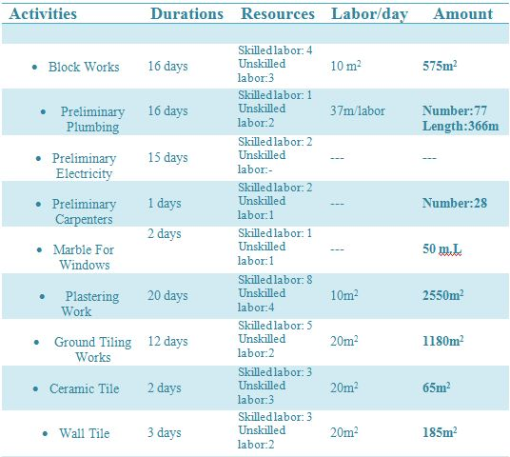
Table of activities ( Before crashing )

Slide 16
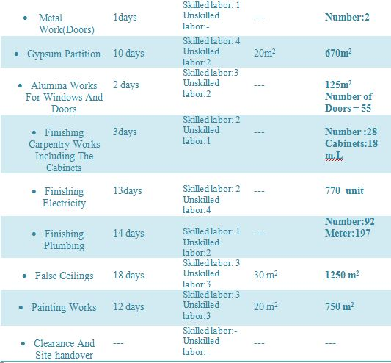

Slide 17
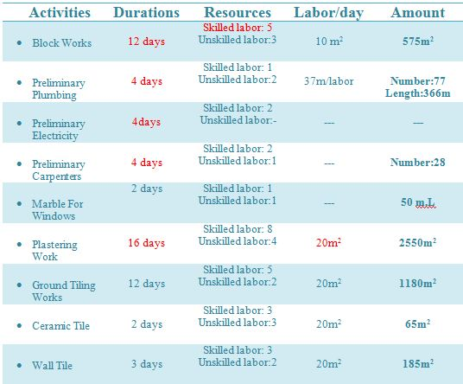
Table of activities ( After crashing )

Slide 18
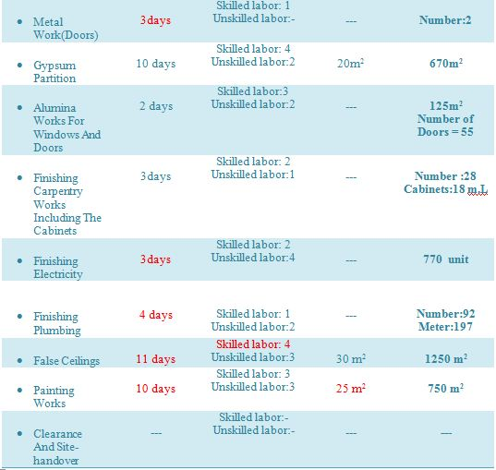

Slide 19
Conclusion
In this case the activities processed a usual manner a delay will occur, so liquidated damages will imposed upon the contractor.
Therefore a well management should be performed in order to execute the project with a minimal time.
Professional management recognizes positive issues related to all stakeholders especially for contractors.

Slide 20
Suggested solutions to achieve Minimum time
1- Parallel Activities.
2- Increment of resources.
3- Part time.
4- Not off days of Fridays .
5- Good management (available resources on time, good coordination between all involved parties) .
6- Decrease lag.

Slide 21
Recommendations
1- Select the right person as the project manager.
2- Make sure that the project is timely managed.
3- The human resources (labors) should be also taken into consideration since they are form the main resource that affects productivity.

