Slide 1
An-Najah National University Faculty of Engineering Civil Engineering Department Graduation Project Hydraulic Study and Water Distribution Network and Sewer Design for Zawata Village
Prepared By
Abeer Mohammed Ala' Snober
Suhad Dwaikat Wajeha Ma'ani
Submitted to
Dr. Amal Al-hudhud

Slide 2
Introduction
Water distribution network is necessary in order to facilitate the process of providing consumers with clean water and quantity that suit their needs and control the quality of this water because the presence of this network ensure unpolluted water and access to consumers with best quality.

Slide 3
Objectives
Analyze and study the existing network.
Redesign the existing network by using EPANET.
Design sewer network.

Slide 4
Study area
Zawata is a Palestinian village from west bank villages followed to Nablus city. Its name derived from Zuada word that is mean food and living. It is located to the North West of the Nablus city, about 6 km away, connected through a local road with the main road Nablus – Tulkarm, local road length is 1.1 km. Zawata was built over a hill rising from the sea 520 m with a total land area about 3483 donum Surrounding zawata lands the villages of Beit wazan, Beit Iba, northern Assira, Naqou

Slide 5
Study motivations
Zawata village is suffering from many problems as the following:-
The water network is old established in 1982, made of iron, rusty and corroded.
The water network not covers all the village.
The loser percent of water network is high.
Water demand and consumption are increasing rapidly. This is due to the increase in the population growth, rising of living standard.

Slide 6
* Not actively exploitation of water spring in winter despite the abundance of water in it. Open irrigation channels feed from water spring have a loser percent of water. * The sewer system not covers all the village. * The village has a reservoir not used since the construction of it; it is old and steel reinforcement exposure to the air.

Slide 7
Analysis of the existing water supply network using EPA NET program
EPANET program
Running hydraulic and water quality simulations.
Viewing the results in variety of formats which include color-coded network maps, data tables, time series .
Input data :
pipes→ID , Diameter ,length ,roughness.
Nodes→ID, Elevation , Demand .

Slide 8
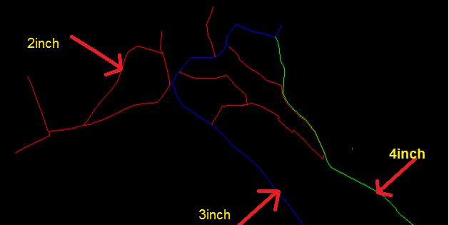
water distribution system had been designed since 1982 with diameter ranging between (2 – 4) inches pipeline materials are steel The main water sources supplying is Nablus municipality.

Slide 9
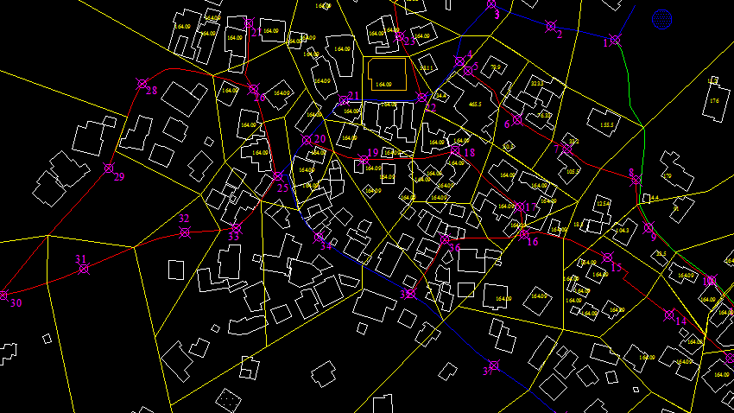
Preparing data
Junction :
1-Elevation → contour maps
2- Base demand=consumption/1-losses
consumption=68.5 L/C/d
Losses=30% Demand=98L/c/d
Demand for each node=density*area *base demand
Density=# of population /total area =.054 person /m²

Slide 10
Existing steady state .
According to the pressure there is no negative pressure , the highest pressure was 193.4 m and the lowest pressure was 133 m.

Slide 11
According to the velocity, the results were within the range (0.2-3) m/sec ,there is no velocity above 3 m²/sec but there are velocities below .2 m/sec in some pipes.

Slide 12
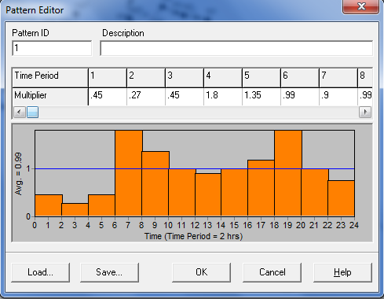
Transient state in the existing condition
In this case the base demand is steady state case ,except the time pattern. In this study , the pattern time step was set to 2 hours . This will cause demands to change at 12 different times of the day.

Slide 13
In this case, there is no negative pressure and the max is 191.44m.
Some of pipes velocity is below of .2m/sec

Slide 14
Network design
This design to make the pressure and the velocity of the existing network with the standard criteria and to complete it to cover all the village.

Slide 15
Network layout
To complete the old network:
By using AutoCAD program
Drawing lines in the streets represent pipes
Drawing points which represent junctions
Divide the village into areas (polygons)
B. By using Epanet program
Drawing junctions
Drawing pipes

Slide 16
EPANET input data requirements
For pipes length, diameter, roughness(c=150).
For junctions elevation, demand

Slide 17
Future population
The population growth rate according to the Palestinian Central Bureau of Statistics (PCBS) are assumed to be 3.2% for the year 2007.
The population growth rate by calculations = 3.1%
By taking growth rate (i = 3.1%), design period (n =24 year) and (P₂₀₁₀ =1988) person, then the future population of Zawata village up to 2035 will be
Pf = Pp * (1+i) ⁿ
P₂₀₃₅ = P₂₀₁₀ * (1+.031) ²⁵ → P₂₀₃₅ = 4265 person.

Slide 18
Future demand for nodes (l/s)
Demand in the crowded areas
Future demand for each node (l/s)= = [future demand (l/c/d) * Density (person/m²)*area of houses served by the node (m²)]/ (24 * 60 * 60)
2. Demand in not crowded areas
multiplied it is existing demand by future factor
Future factor = *
Future factor = 3.08994898
3. Demand for new nodes

Slide 19
Conclusion
From the output results we notice that the future velocities in all pipes are acceptable since; they had values within the permissible limits (.2 – 3) m/s.
All the nodes have a pressure head greater than the minimum standard limit (20m).
All the nodes have pressure lower than the maximum permissible head (100m) except few nodes that is more than the maximum value.

Slide 20
Recommendation
In order to prevent high pressure in low-lying areas, usual practice is to interconnect some pipes with pressure reducing valves.
To prevent negative pressure occur in the network, we must put a pump to the R3 to give a head pressure = 40 m.
The Existing reservoir needs lot of maintenance.

Slide 21
Problem
The existing network in Zawata is new but not serves all the village.
sewer system serve 75% of population, while 25% depends on the cesspits

Slide 22
Methodology
1. Drawing network using AutoCAD
Manholes
Line
polygon

Slide 23
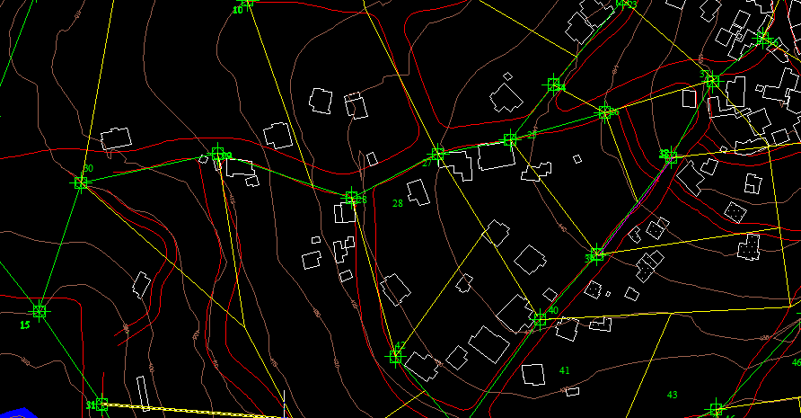
Network layout

Slide 24
2. taking some information from the map in AutoCAD
Number of person in each polygon.
Length of the pipe.
Elevation of each manholes.
3. Using Excel sheet to design
Calculate maximum hourly flow
Slope
Velocity(use manning)

Slide 25
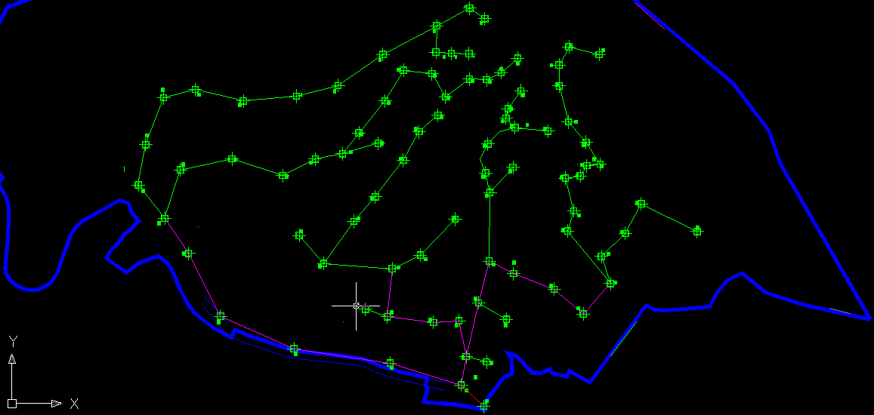
Layout of the design network

Slide 26
THE END
THANKS FOR YOUR ATTENTION

