Slide 1
Causes Of Contractors’ Failure In West Bank
Prepared by :
Abd elhay Tanbouz
Jehad Ayoub
Mohammed Qushtom
Yousef Assaf

Slide 2
Presentation Outline
Introduction
Objective of the project
Research Methodology
Questionnaire
Data analysis
Results & conclusion
Recommendations

Slide 3
INTRODUCTION
The construction industry is one of the main sectors of the Palestinian economy. It is the tool through which a society achieves its goals of urban and rural development. However, it is becoming more complex because the complexity of the construction process itself and the large number of parties involved including clients, users, designers, regulators, contractors, suppliers and others.

Slide 4
objectives
The main objective of this project is to understand the reasons behind failure of contractors and identify the most important factors contributing to their failure. This project will be in two main parts.

Slide 5
Project Failure
A project is considered a failure when it has not delivered what was required, in line with expectations. There are many definitions of failure mentioned in literatures.
According to Dun and Bradstreet
According to Storey
According to Watson & Everett

Slide 6
Research Methodology
Research Strategy
There are two types of research strategies, namely quantitative research and qualitative research.
Quantitative
Qualitative

Slide 7
Questionnaire

Slide 8
Name of organization : …………………………………………………
2. Major type of work involved :
Building Roads € Water and Sewage € Electro mechanics.
3. Respondents designation :
€ Owner of organization € Project manager € Contractor € Secretary
4. Relevant working experience (Years):
1-3 € 3-5 € 5-10 € > 10
5. Average of project executed per year($):
Less than 1 million €1-2 million € 2-3 million € More than million
6. No. of constant employees:
€ Less than 10 €10-15 €15-20 €more than 20

Slide 9
The followings are causes for contractors failure in West Bank. We need to choose one of the number from 1 to 5.
The numbers represent :
1 → Strongly agree
2 → Agree
3 → Neutral
4 → Disagree
5 → Strongly disagree

Slide 10
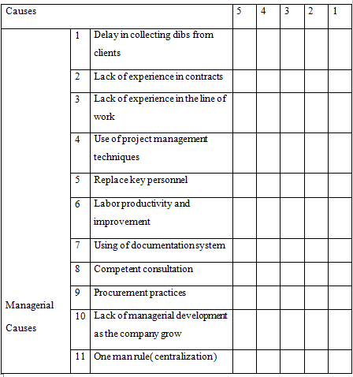

Slide 11
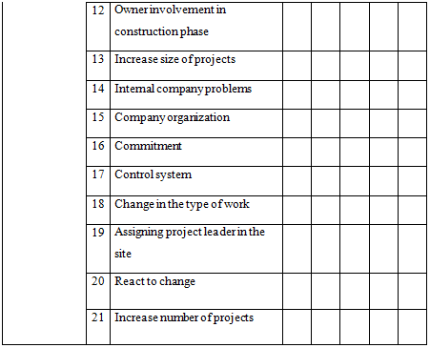

Slide 12
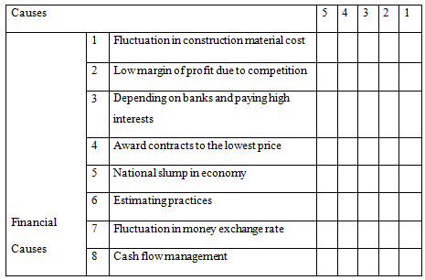

Slide 13
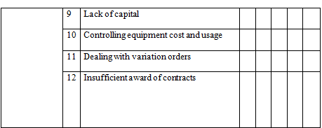

Slide 14
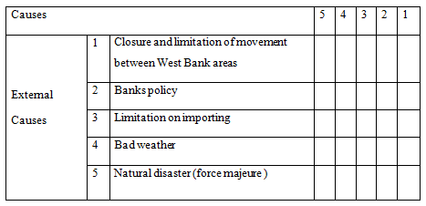

Slide 15
Questionnaire Strategy
Our sample size did not need to apply statistical laws because the sample is less than 30 -our sample was 26. However, if the sample is greater than 30, we must apply the statistical laws.

Slide 16
The questionnaires was distributed through 7 contractors companies classified second class in Nablus and Tulkarem (4 in Nablus and 3 in Tulkarem ) .
The questionnaires was distributed through 14 consulting office in Nablus , and Tulkarem .
( 10 in Nablus , 4 in Tulkarem )
The questionnaires was distributed through 5 owners ( 3 in Nablus , and 2 in Tulkarem ).

Slide 17
Data analysis
The data collected were analyzed using (SPSS-17) to provide answers to the questions of the study. Means, frequencies, standard deviations two independent sample T-test , One Way ANOVA test and post hoc test .

Slide 18
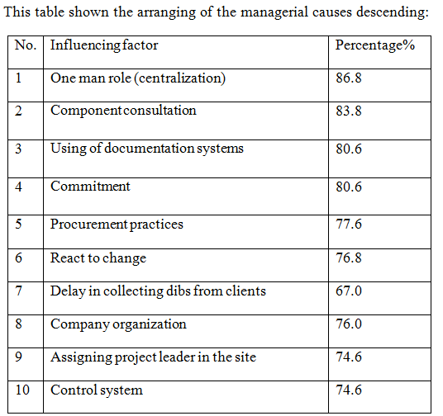
Results, Discussion & Conclusion

Slide 19
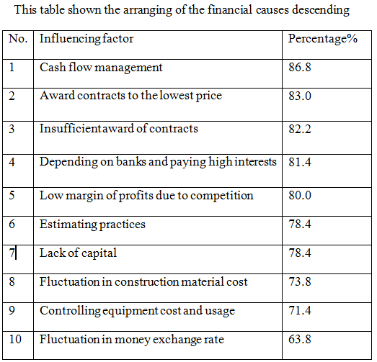

Slide 20
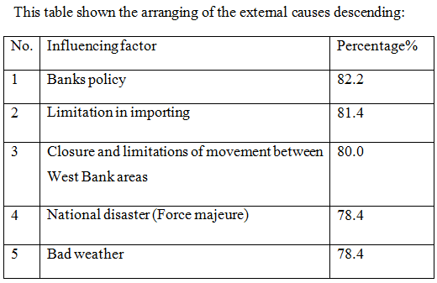

Slide 21
Recommendations
After we analyzed the results and explained the reasons for the failure, we can now make some recommendations that can help contractors, in the future to overcome the problems of failure.

Slide 22
Recommendations
* Contractors should improve the practices of
calculating the project cost.
* Contractor should appreciate the importance of having skilful project leader .
* Contractor should not neglect any of the owner requests.
* It is recommended that contractor should evaluate risk involved with each type of contract before entering into a contractual agreement with the owner.

Slide 23
Recommendations
* It is recommended that contractors should use information systems to manage the cash flow effectively and analyze the investments’ opportunities.
* The Contractor shall be obliged to pay the due installments on time, and he shall receive payments from the Owner in the allotted time.
* the contractor must try to avoid relying on the banks for funding and not to resort to banks.
* about limitation of importing , this issue remains out of control.

Slide 24


