Slide 1
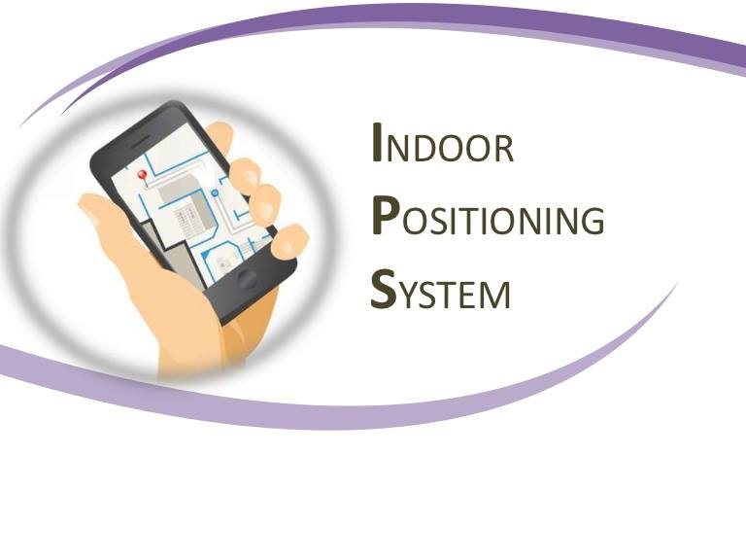
Prepared by: Narjes Shams
Zahraa Ayaseh
Supervised by: Dr.Saed Tarapiah

Slide 2
Outline
Introduction
Standards
Project General Idea and Methodology
Project Implementation
Results and Discussion
Conclusions and Going on Work

Slide 3
Introduction
  Concept of Indoor Positioning Systems
An indoor positioning system (IPS) is a system to locate objects or people inside a building using radio waves, magnetic fields, acoustic signals, or other sensory information collected by mobile devices.
IPS systems use different technologies, including distance measurement to nearby anchor nodes (nodes with known positions, e.g, Wi-Fi access points ( used in our project) .

Slide 4
  Motivations
Following the achievements of satellite‐based location services in outdoor applications the challenge has shifted to the provision of such services for the indoor environment. However, the ability to locate objects and people indoors remains a substantial challenge, forming the major bottleneck preventing seamless positioning in all environments.

Slide 5
  Aims and Objectives
The aim of the project is to locate objects or people inside a building using Wi-Fi network and collected data by using mobile devices.
Knowledge of power for each point, which is obtained from A.P by using AL Ghurair IPS application.
This project will help to locate object easily through the network due to the availability of these networks in all indoor places.

Slide 6
Standards
IEEE 802.11:
IEEE 802.11 refers to the set of standards that define communication for wireless LANs (wireless local area network, or WLANs) .
The technology behind 802.11 is branded to consumers as Wi-Fi.

Slide 7
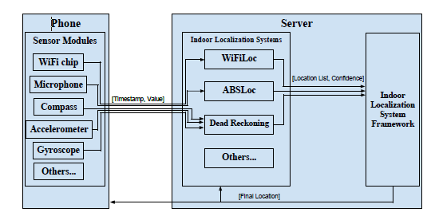
Project General Idea

Slide 8
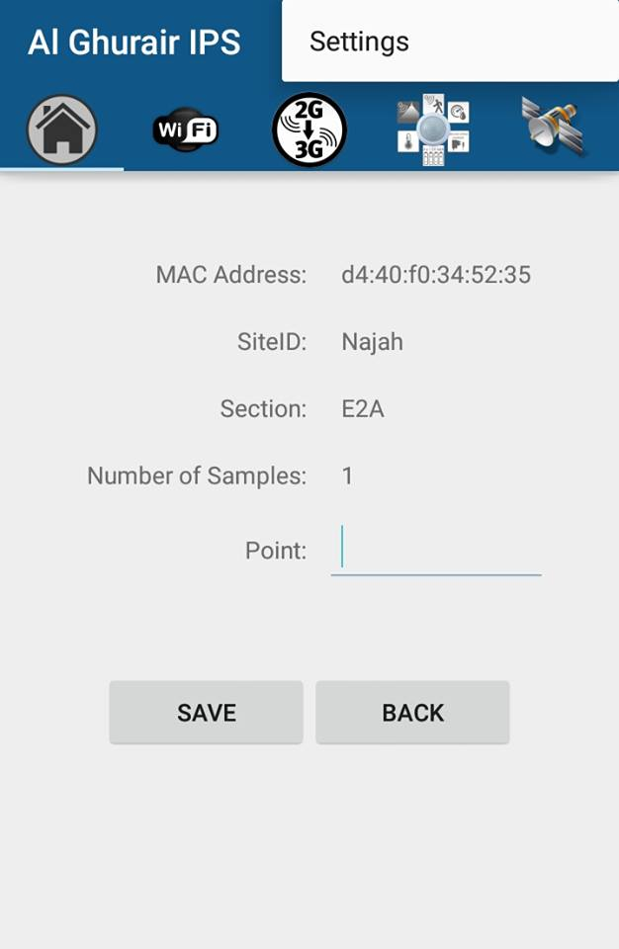
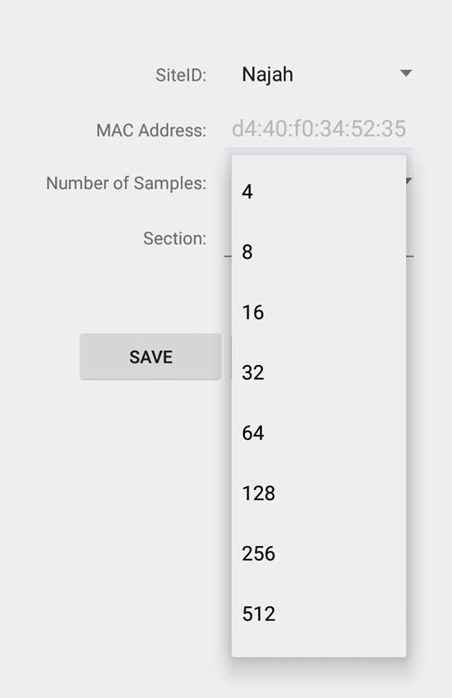
Methodology
Programs and software
AL Ghurair IPS application

Slide 9
AL Ghurair IPS application
.Write the name of siteID such as Najah.1
2.Write the name of section that works it such as E2A.
3.Choose the number of samples that used it for example 4,8,32,64,128.
4.Write the name or numbers of point that take it power value, finally press save.
5.The data save on the server for this application.

Slide 10
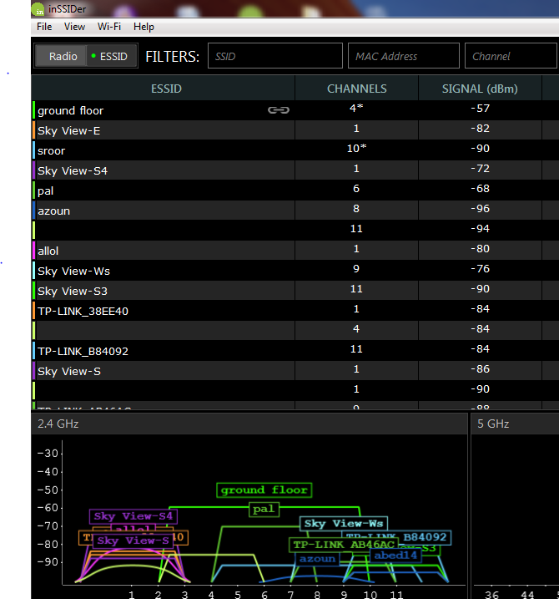
InSSIDer4
This program also to measure the power ( dB ) for each point but this program installed on Laptops , to know how accurate the values derived from Al Ghurair IPS application.

Slide 11
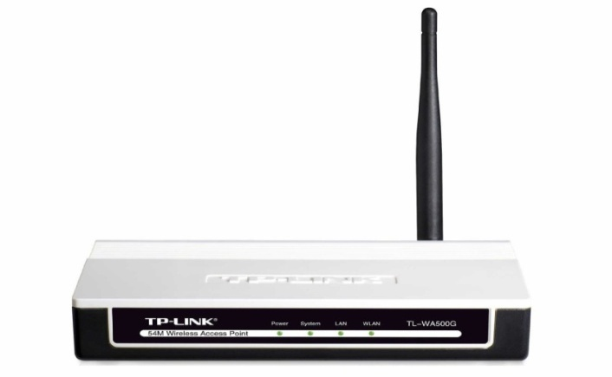
Project Implementation
TP-Link TL-WA500G
Wireless G speed up to 54Mbps, good for surfing the internet, email and online chat extended Range delivers 4 times the range of the traditional 11g products.

Slide 12
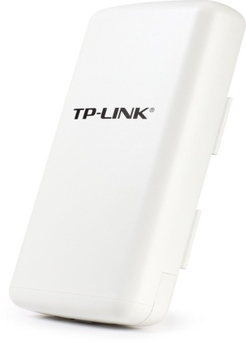
TP-LINK TL-WA7210N
High Power Outdoor Wireless, 2.4GHz 150Mbps, Dedicated power amplifier and low noise amplifier improve radio performance
Up to 500mw power for longer distance transmission.

Slide 13
Plane Map
Been working on the second floor of the college of Engineering, where he was put 8 A.P at the corners of the building, with the help of the scheme floor ,were taken 60 points in a symmetric way the distance between each point and the other 64cm, and by using AL Ghurair IPS application has been taking the values at every point,and it supposed to each point record 8 values that you get from 8 A.P.

Slide 14
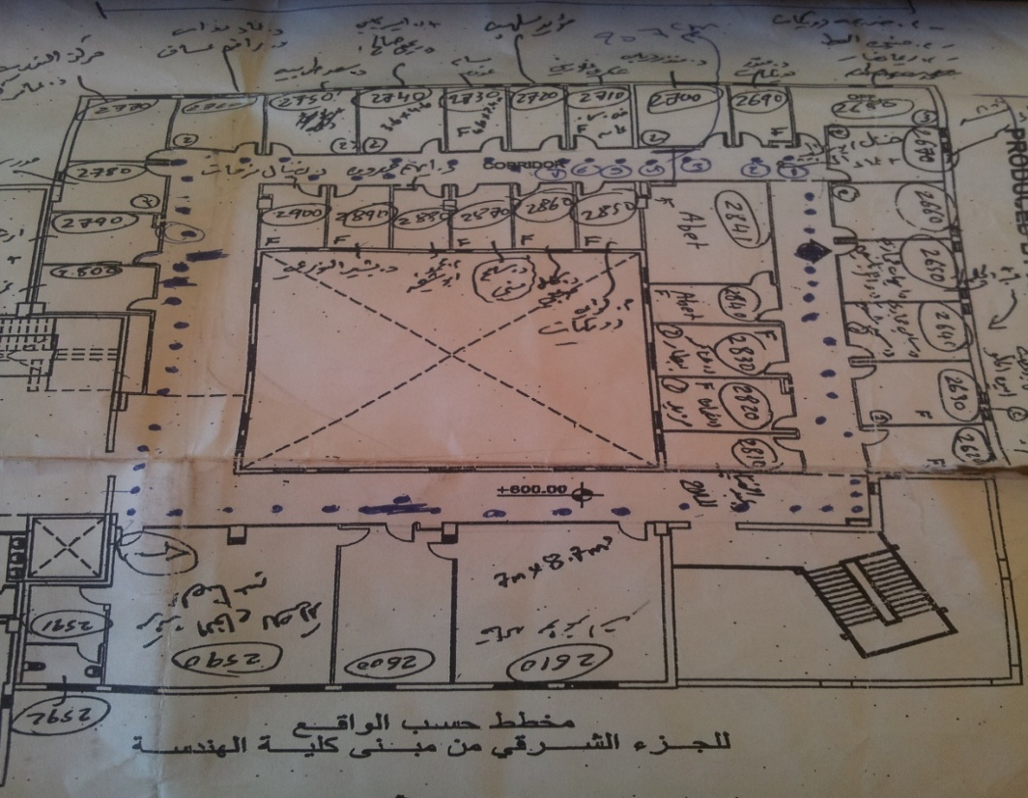
the eastern part of the Faculty of engineering building

Slide 15
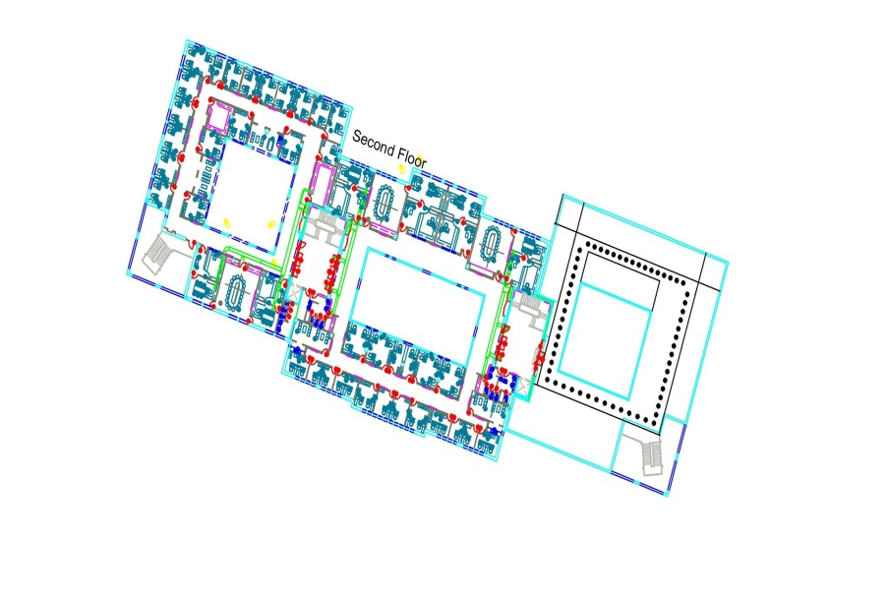
ArcGIS Program
By using ArcGIS program (Special software engineering Urban Planning), we know the coordinate for each specific points .

Slide 16
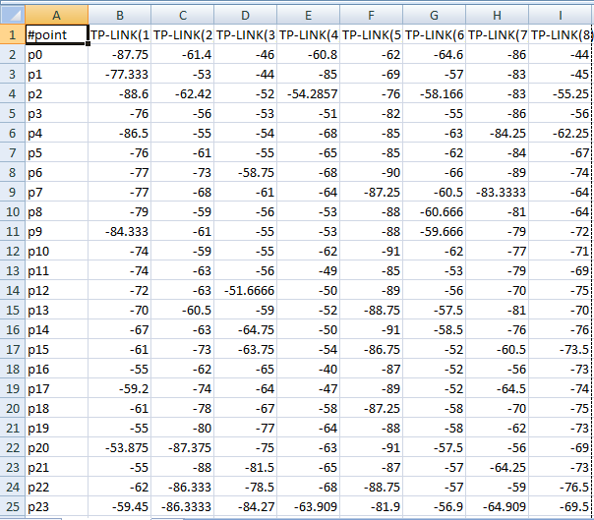
Results and Discussion
data that were obtained from AL Ghurair IPS application at 32 numbers of sample.

Slide 17
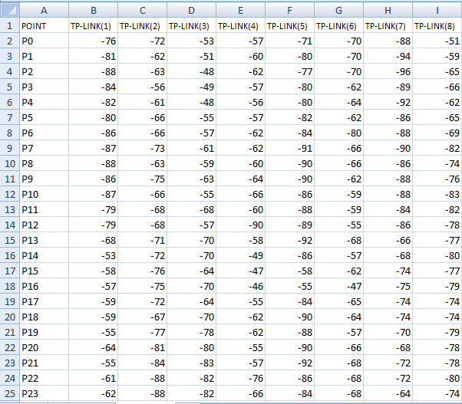
data that were obtained from InSSIDer4 program
NOTE: it is possible to note that the values that were taken from both applications fairly close to each other and that means we reach a correct and logical results.

Slide 18
Power vs distance at reference point

Slide 19
Select Random Points
After we take 60 points in symmetric way, and know the coordinate of each 60 point, the next step is take a random point in the same floor and measuring power by using the same application that used previously, , the aims of this operation to determine the location of the random point based on his power.

Slide 20
Conclusions and Going on work
To increase the accuracy of finding your location , this IPS system is suitable . And we can use it instead of satellites because IPS relies on nearby nodes. And IPS can be entirely local to your Smartphone or other navigation devices.
Wireless combined with other technologies Such as optical (e.g., IR), inertial, dc electromagnetic and ultrasonic for indoor location is another trend. How to combine these technologies into a practical system is a topic of sensor.
How to deploy sensors to improve the positioning accuracy, how to finish deploying wireless positioning system in a short time, especially for emergency responder application is also worth considering.

Slide 21
Thanks

