Slide 1
Graduation Project II Redesigning Adsorption Methanol-Activated Carbon Solar Cooling system
Supervisor : Dr.Mohammed Al Sayyed
AbdulRaheem Dmiadi
Imad Alawneh
Raed Zedan
Abdul malik Saffarini

Slide 2
Contents
Introduction
Refrigeration
Adsorption Refrigeration
Project Design
Results & Discussion
Conclusion
Recommendations

Slide 3
INTRODUCTION
In many countries in the world, large countities of vegetables, meat, milk, fish,..etc. Are lost annually due to poor storage conditions and facilities.
However, the world is still suffering from the problem of the large energy consumption, especially from refrigerators and air conditioners. In addition, there is the problem of rural areas, where it’s difficult & very costly to connect these areas with electricity.
This is will lead us to realize how much important the cooling technique in our lives.
Therefore, it became very necessary to look for a new technology that enable us to solve the these problems.
To solve these problems, we need to make a device that enable us to take advantage of the sun as a renewable source of energy. This device will give us the cooling effect we need, without any energy consumption.

Slide 4
INTRODUCTION (CONT’)
The objectives of this project are:
1- Investigate the solar energy cooling systems and applications.
3- Improve the design and performance of the solar refrigeration system and make it works almost without maintenance requirements and can be used in remote areas to store food and medicine.

Slide 5
Refrigeration Main Types
Def: Cooling is simply the process of reducing the temperature of a space or product for purposes of either comfort or preservation
Main Types:
Vapour-Compression Refrigeration
refrigeration system uses five components to perform the vapor compression cycle: an evaporator, a compressor, a condenser, a flow control, and interconnecting piping. Application: refrigerators, air conditioners.
Adsorption Refrigeration
Refrigeration system uses solar collectors, condenser and evaporator. And, some chemical substances, called adsorbent & adsorbate (working pairs )

Slide 6
Adsorption Refrigeration Introduction
An adsorption heat pump can be thought of as utilising a chemical rather than a mechanical compressor and is driven by heat rather than mechanical work.
The operation of adsorption heat pumps and refrigerators is based on the ability of porous solids (the adsorbent) to adsorb vapour (the adsorbate or refrigerant) when at low temperature and to desorb it when heated.
The system is comprised of two linked containers, one of them contains solid adsorbent (termed generator), and the other is the combined evaporator and condenser or receiver in which the refrigerant is evaporated and condensed.

Slide 7
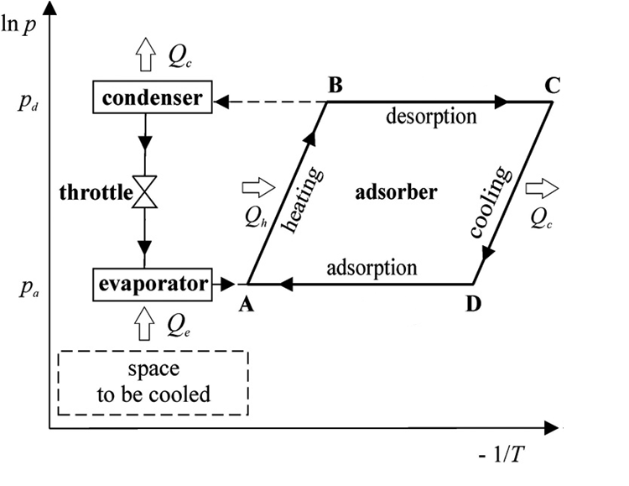
Adsorption Refrigeration How the System works

Slide 8
Adsorption Refrigeration Adsorbent-Adsorbate
Work of an adsorption cooling device depends heavily on the adsorbent-adsorbate working pair. An adsorbent must have the ability to adsorb large quantities of an adsorbate at low temperatures and to effective desorption when temperature rises. Its properties should not change with age and use.
The adsorbate or refrigerant should have the following properties:
Evaporation temperature below 0°c.
Small molecular size to enable it to be adsorbed into the adsorbent.
High latent heat of vaporization and low specific volume.
Thermally stable with the adsorbent at the cycle operating temperature ranges.
Low saturation pressures (above atmospheric) at normal operating temperature.

Slide 9
Adsorption Refrigeration Adsorbent-Adsorbate (con’t)
The important considerations influencing the choice of a suitable adsorbent are:
Adsorption of large amount of the adsorbate under low temperature conditions.
Desorption of most of the adsorbate when exposed to thermal energy.
Possession of high latent heat of adsorption compared to sensible heat.
No deterioration with age or use.
Low cost and widely available.

Slide 10
Project Design INTRODUCTION
Our graduation project is a new design of a solar adsorption project, we take an old project and redesign it to improve its design and increase its efficiency.
The old design was bigger, useless, and has low efficiency. Moreover to make a feedback about the project characteristics, including design, refrigerant, and working pairs. We need a device or a mechanism that allow us to make a comparison between the amount of refrigerant used in a cooling process and the cooling heat that generated from the process. This is will allow us in the future to have a feedback and as a result we will know where is the problem so we can fix it. And also after a feedback we can improve the design of our project.

Slide 11
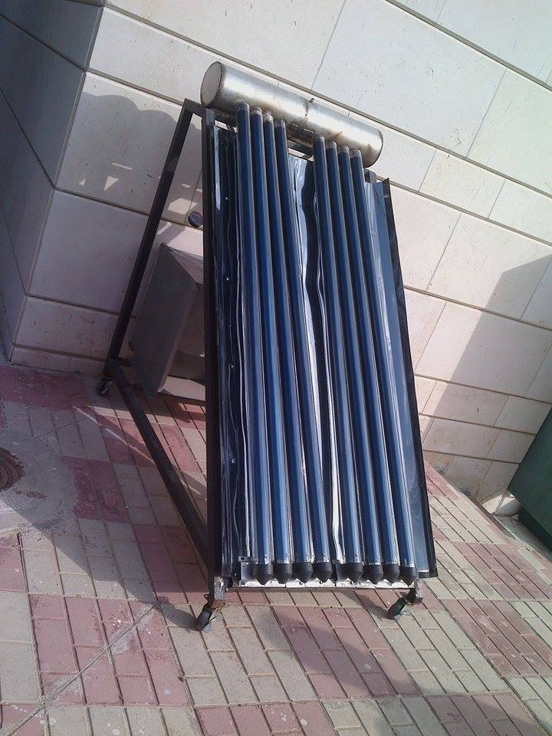
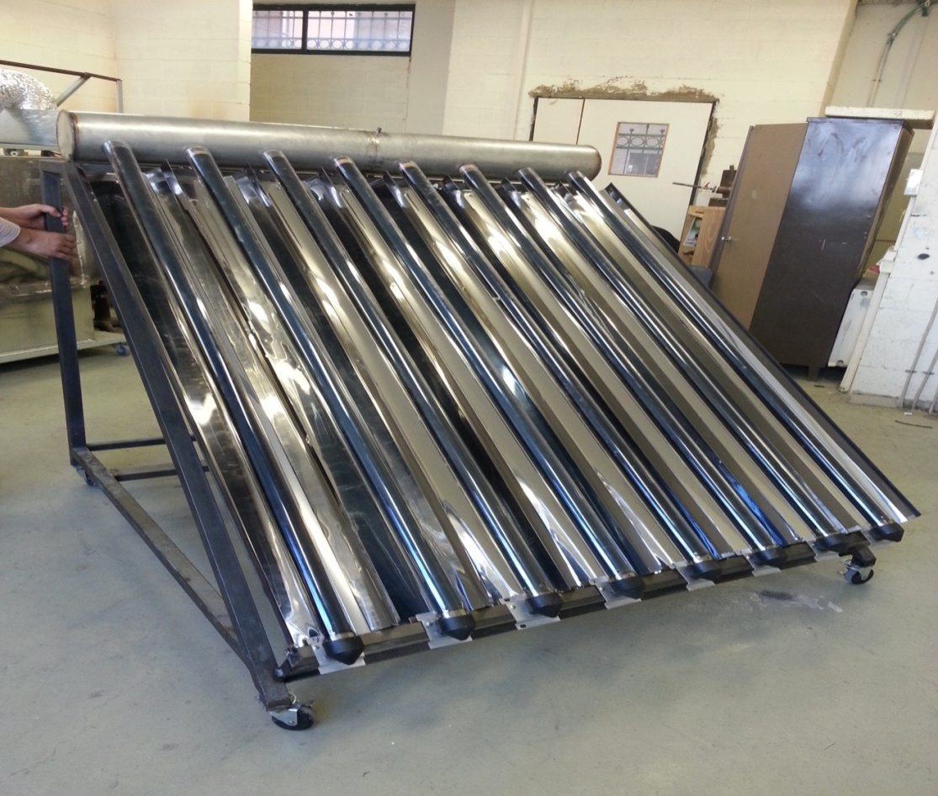
Project Design Components
To design a solar adsorption cooling system, the main components for the project that we need are, the solar bed (behave like a generator), solar collector, the condenser, and the evaporator. After having these components, we designed the system and build it to be as shown
After
Before

Slide 12
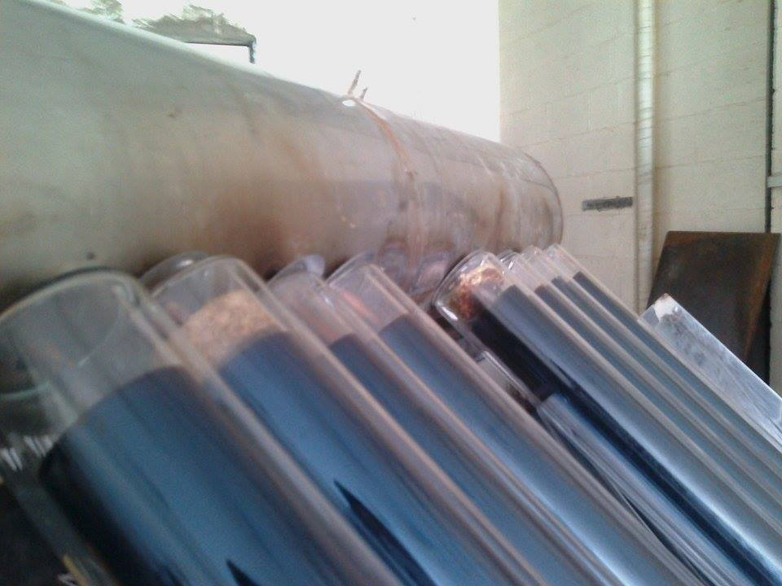
Project Design Components
Solar Collectors
Our project runs with 8 evacuated tubes, Each tube provides an average power of 40.3 watt. The evacuated tube is shown

Slide 13
Project Design Components
Adsorbent bed
Adsorbent bed or the generator is a stainless steel pipe with 12.5 cm (5 inch) diameter and 0.8 m in length. It contains the adsorbent (activated carbon) and it has holes to connect with both the manifold and the bulb of the evacuated tube which is the heat source for activated carbon .As shown

Slide 14
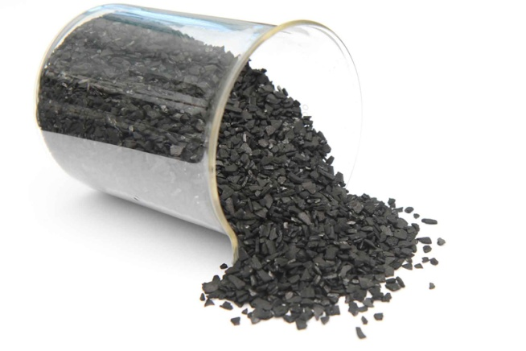
Project Design Components
Activated Carbon
The activated carbon is the adsorbent in the adsorption system, and its location is in the adsorbent bed. We use a 9.5 kg of activated carbon in the project. The activated carbon as shown

Slide 15
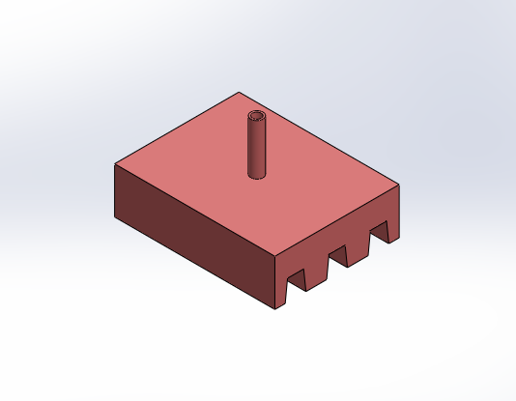
Project Design Components
Evaporator
We improve the design of the old evaporator and replace it by a new one, with a suitable volume that allow the condensed methanol to be stored on it. The old design of the evaporator was a series of four trapezoidal cells shown

Slide 16
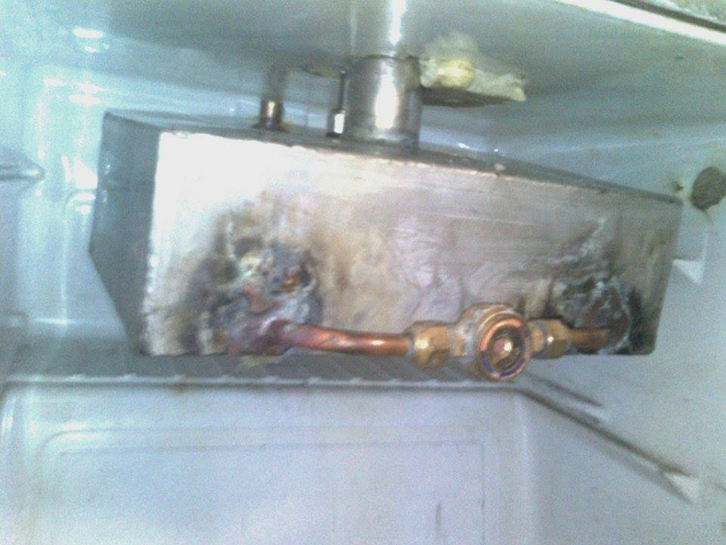
Project Design Components - Evaporator
The new design of the evaporator as shown is a rectangular stainless steel box. the dimensions of the evaporator is 220×320×100 mm³ . we redesign the evaporator and make it rectangular without a trapezoidal cells in order to make the process of measuring the level of methanol inside the evaporator much easier, because in the old design and due to the trapezoidal cells, the level of the methanol might be different in the cells, in other word, one cell might have an amount of methanol more than another cell, so that will cause a problem in measuring the level inside the evaporator.

Slide 17
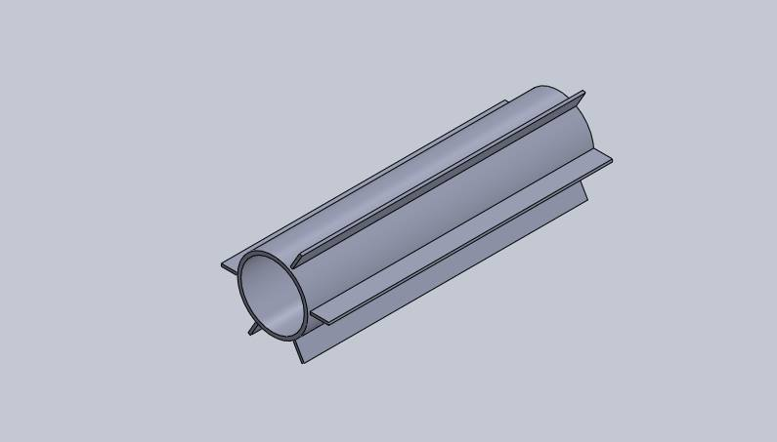
Project Design Components
Condenser
A well designed condenser is needed to reject the desorption heat. To facilitate the cooling of the condenser, stainless steel tubes with four fins were designed and permitted to have an exchange area with the ambiance of 0.015 m².As shown

Slide 18
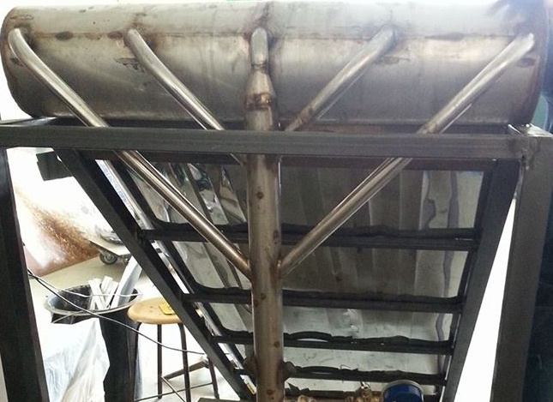
Project Design Components
Manifold
The adsorbent bed, the condenser and the evaporator were connected to each other by using a stainless steel pipes with a diameter of 1.25 inch called manifold. The manifold allows the activated carbon to desorbs and adsorbs the methanol vapour as shown

Slide 19
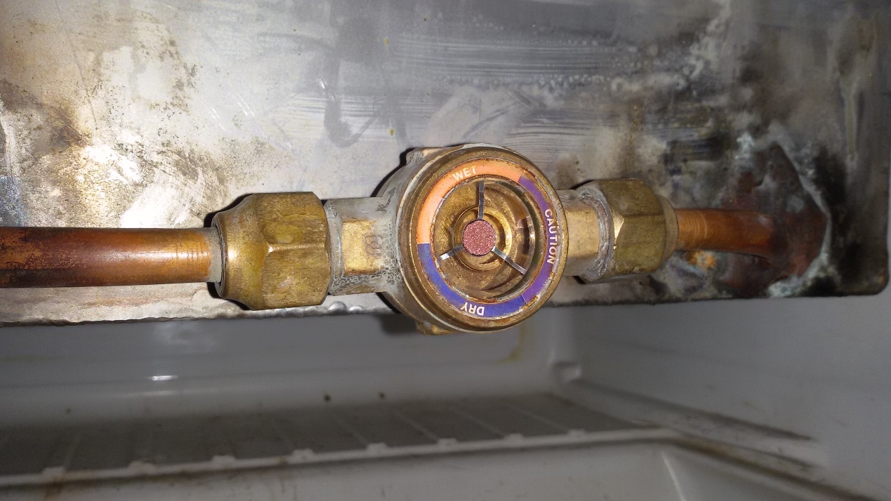
Project Design Components
Level Measuring device
In order to have a feedback about the project performance, we need a device that allow us to know the level of the liquid of refrigerant inside the evaporator.
So, we use a watch glass level sensor as shown, which is connected directly with the evaporator, where the liquid collected.

Slide 20
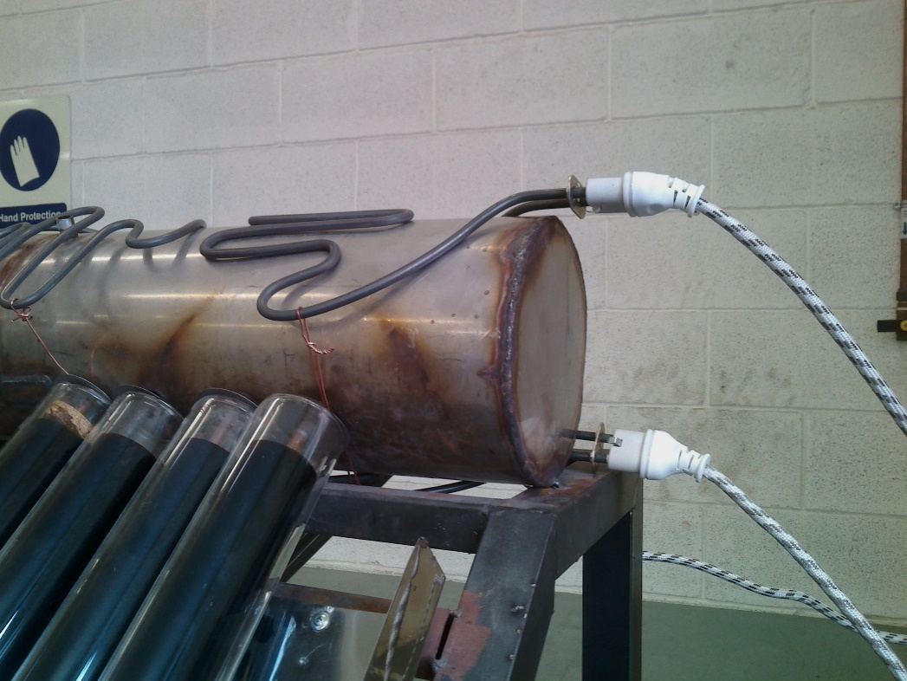
Results & Discussion Introduction
Because of the non-expected climate change, the sun become useless. So, we use another source of heat, in order to generate a high temp inside the adsorbent bed of the project.
We use an electrical heaters as shown ,to simulate the solar.

Slide 21
Results & Discussion Electric Heaters Power
Four heaters have been used to generate the heat to the system, each one of them was connected separately.
Every heater has a power of 1400 watt (manufacturer details).
And from four heaters, 5600 watt of heat will be gained.

Slide 22
Results & Discussion Change in Pressure gauge
The project was tested under two processes, the process of heating, and the process of cooling. During the heating process using electric heaters, as the temperature of the adsorbent bed increase, the pressure inside the system increase.
And during the cooling process, as the temperature inside the bed decrease, the pressure decrease.
So, when the temperature of the bed reaches the room temperature, the methanol starts to evaporate, and the activated carbon starts to adsorb the evaporated methanol, so the cooling process starts.

Slide 23
Results & Discussion Analyzing Experimental Data
Results of four hours heating
The cycle of heating began at a bed temperature of 22.7 °C, evaporator temperature of 23.6 °C .
Heating ended at a bed temperature of 239.1 °C, evaporator temperature of 27.4 °C.

Slide 24
Results & Discussion Analyzing Experimental Data-Results of four hours heating

Slide 25
Results & Discussion Analyzing Experimental Data
Results of Cooling
The cycle of cooling began at a bed temperature of 73.2 °C, evaporator temperature of 26 °C , and water temprature of 24.6 °C
Cooling ended at a bed temperature of 25.3°C, evaporator temperature of 11.6°C, and water temprature of 10.9 °C.

Slide 26
Results & Discussion Analyzing Experimental Data-Results of Cooling

Slide 27
Results & Discussion Analyzing Experimental Data
Coefficient of Performance
Calculating the COP
Q = C*m*ΔT
Where: Q: heat loss from water (in joule). c:specific heat of water = 4.18 kJ/kg.K. m: mass of water = 15 kg ( as tested).
ΔT: temperature difference of water from the beginning of adsorption to the end of adsorption (in K).
Qwater=4.18*15*[(24.9 – 10.9) + 273] = 17994.9kJ
Qheaters =1400*4*0.3*3600*4/1000 = 24192 kJ
COP= Qwater/Qheaters
COP= 17994.9/24192 = 0.74

Slide 28
Conclusion
In this project, the solar energy cooling system was investigated. We design and conduct a solar refrigerator that uses the activated carbon – methanol as a working pair in the project, the methanol as a refrigerant.
Unfortunately, project was tested through October and November which means, the weather wasn’t in the desired condition. The sun was useless, and insufficient to evaporate the amount of methanol inside the adsorbent bed. As a result, we used electric heaters to conduct the experiment.
From the result, it concludes that, with the new design, the project works very well with a high COP. And by comparing the COP of the new design with the COP for the old design, it will conclude that, the new design is smaller and more efficient, and it’s promising to give the idea that an adsorption system with this new design characteristics’ can compete to be the future of refrigeration systems.
Pervious COP estimation = 0.45 New COP estimation = 0.74

Slide 29
Recommendations
According to our problem, we can say that increasing the amount of heat absorbed by the solar collector, and increasing the heat transfer between the metallic plates and the adsorbent, and enhancing the system solar collectors, will improve the performance of the system.
Moreover, running the system under a suitable environmental condition may improve the performance of the system.
A well designed level measurement device to give an accurate information about the level of refrigerant inside the evaporator.
An accurate calculations will lead to use the appropriate amount of methanol according to the amount of activated carbon used in the system, if an appropriate amount of methanol used in the system that will improve the performance of the system.
Any increase in the amount of methanol used in the system will decrease the performance of the system.

Slide 30
Thank you ^__^

