Slide 1

IMPLEMENTATION OF A DIGITAL COMMUNUCATION SYSTEM
Data File
Source Coder
Encryption System
Channel FEC coder
AWGN Channel
Steganography System
Murad S. Qasim & Mohammad Hamid
Dr. Allam Mousa

Slide 2
Introduction
The implementation of the digital communication system is important for the study, analysis, test and development of the performance of the system.
The topics that are considered
Source coding
FECC
AES
Data File
Source Coder
Encryption System
Channel FEC coder
AWGN Channel
Steganography System

Slide 3
Source Coding
1
Burrows–Wheeler Compressor

Slide 4
Source Coding
The data compression or source coding is the process of encoding information using fewer bits (or other information-bearing units) than a non-encoded representation
It Aims at removing the redundancy until limit defined as entropy through the using of specific encoding schemes that are shown below
Lossless Source Coding Algorithms
Entropy Encoding
Huffman Coding
Shannon-Fano
Dictionary coders
Lempel-Ziv Algorithms
Arithmetic coding
Golomb coding
Other Encoding Algorithms
Data deduplication
Run-length encoding
Context mixing
Dynamic Markov Compression
Burrows–Wheeler Algorithm

Slide 5
Information & Entropy
Average information of a source is measured in bits per Symbol and defined as the source ENTROPY denoted as (H)
In order to implement source coding techniques, the files have to be analyzed by measuring its Size & Entropy in bits per symbol , the results are obtained for different samples of :
Text Files
TIF Images (Tagged Image File)
JPG Images
Speech Files
# | size Bytes | Entropy
1 | 1.14 k | 4.1486
2 | 30.5k | 4.179
3 | 56.9k | 4.155
4 | 79.6k | 4.157
5 | 183k | 4.1626
# | Size Bytes | Entropy
1 | 2.25M | 6.555
2 | 2.26M | 7.74
3 | 28.8M | 7.85
4 | 264K | 7.57
5 | 510K | 6.63
# | Image size Mb | Entropy
1 | 4.82 | 7.9177
2 | 3.41 | 7.7087
3 | 0.091 | 7.6722
4 | 0.838 | 7.311
# | File size bytes | Entropy
1 | 286K | 13.0752
2 | 160.6K | 13.1137
3 | 59K | 13.24
4 | 78.7K | 14.11
5 | 61K | 12.8
9 | 23K | 12.56

Slide 6
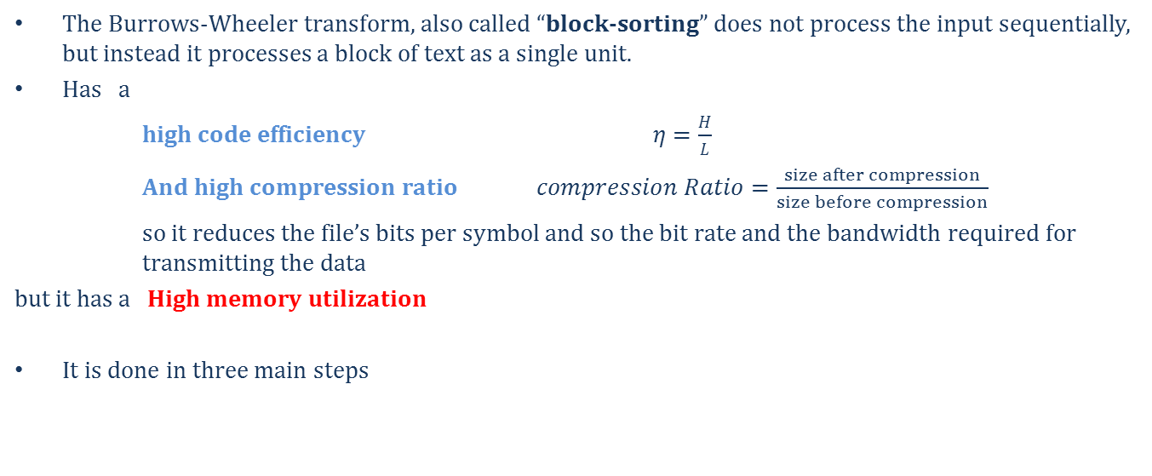
The Burrows-Wheeler Algorithm
Source Coding Example
The Burrows-Wheeler transform, also called “block-sorting” does not process the input sequentially, but instead it processes a block of text as a single unit.
Has a
high code efficiency $η=\frac{H}{L}$
And high compression ratio $compression Ratio=\frac{size after compression}{size before compression}$
so it reduces the file’s bits per symbol and so the bit rate and the bandwidth required for transmitting the data
but it has a High memory utilization
It is done in three main steps
BWT
MTF
Entropy Coding

Slide 7
The Burrows-Wheeler Transform
The input text, which is treated as a string S of N characters
Starting with input data as a one block S of N=14
S =
m | o | h | a | m | m | a | d | & | m | u | r | a | d
This string has an Entropy of 2.753 bit/symbol
One cycle shift at the step
first step is to create an N x N matrix M by using the input string S as the first row and rotating (cyclic shifting) the string N-1 times
d | m | o | h | a | m | m | a | d | & | m | u | r | a
m | o | h | a | m | m | a | d | & | m | u | r | a | d
d | m | o | h | a | m | m | a | d | & | m | u | r | a
second step is to sort the Matrix M lexicographically by rows. At least one of the rows of the newly created M’
a | d | m | o | h | a | m | m | a | d | & | m | u | r
r | a | d | m | o | h | a | m | m | a | d | & | m | u
.
.
.
.
.
.
.
.

Slide 8
L
lexically ordered rows
last step is to take the last characters of each row (from top to bottom) and write it in a separate string L.
This transform produces a short distance text that is suitable for MTF according to Burrows & Wheeler
&muradmohammad
ad&muradmohamm
admohammad&mur
ammad&muradmoh
d&muradmohamma
dmohammad&mura
hammad&muradmo
mad&muradmoham
mmad&muradmoha
mohammad&murad
muradmohammad&
ohammad&muradm
radmohammad&mu
uradmohammad&m
The Output
of the
transform
The Primary Index is 10

Slide 9
Move-To-Front Transform
Global Structure Transform
Move-to-Front encoding, is a scheme that makes a list of all possible symbols and modifies it at every cycle (moving one symbol, the last one used).
The advantages are that allows fast encoding and decoding, and requires only one pass over the data to be compressed
The combination of BWT & MTF reduces the file Entropy to approx. 20% for large files
The transform starts by initializing the dictionary of the source symbols and starts the process of search and move to front
The local BW- transformed file is Globalized by MTF to be Huffman Encoded

Slide 10
BWT Output
MTF Dynamic Dictionary
output
0 | 1 | 2 | 3 | 4 | 5 | 6 | 7
Find the symbol location
dmrhaaomad&mum
& | a | d | h | m | o | r | u
Move to front
Take the index
2
dmrhaaomad&mum
d | & | a | h | m | o | r | u
4
dmrhaaomad&mum
m | d | & | a | h | o | r | u
6
dmrhaaomad&mum
r | m | d | & | a | h | o | u
5
dmrhaaomad&mum
h | r | m | d | & | a | o | u
5
dmrhaaomad&mum
a | h | r | m | d | & | o | u
0
.
.
.
.
.
.
.
.
.
.
.
.
.
.

Slide 11
The process continues for all symbols (14 steps ) and the output is
24655064256371
To Huffman coding
Final dictionary arrangement that is needed to decoding
& | a | d | h | m | o | r | u
To store as MTF Dic.
After applying the Huffman coding (Basic Entropy Encoder )
The final code is the Huffman coder output
$$01101010 11110001 10010011 11100011 00100000$$
This code has av. Code len. of 2.857 bit/symbol
And a size of 5 bytes
The a compression ratio of 2.8 i.e. the output size is 35% of the original

Slide 12

Source Coding Comparison for Real Data Files
File name | Size Before [Bytes] | BWT [Bytes] | Huffman [Bytes] | Run- Length [Bytes] | RAR [Bytes] | Average code Length for Huffman [Bits/symbol] | Average code Length for BWT [Bits/symbol] | Entropy Of the source [Bits/symbol]
File 1 | 1k | 0.532k | 0.664 k | 1.53 k | 0.47 k | 4.40 | 2.94 | 4.38
File 2 | 1.36 k | 0.787k | 0.874 k | 2.67 k | 0.77 k | 4.40 | 3.59 | 4.38
File 3 | 3.66 k | 1.96 k | 2.40 k | 7.16 k | 1.88 k | 4.89 | 3.74 | 4.85
File 4 | 4.12k | 1.95 k | 2.62 k | 7.72 k | 1.82 k | 4.75 | 3.27 | 4.72
File 5 | 6.08 k | 2.92 k | 4.05 k | 11.9 k | 2.82 k | 5.09 | 3.5 | 5.05
File 6 | 12.7 k | 5.02 k | 7.21 k | 25 k | 4.87 k | 4.41 | 2.97 | 4.39
File 7 | 16.0 k | 6.02 k | 9.14 k | 31.5 k | 5.85 k | 4.46 | 2.85 | 4.44
File 8 | 18.1 k | 6.75 k | 10.2 k | 35.6 k | 6.72 k | 4.45 | 2.85 | 4.43
Reference
Limited by
Entropy Reduction is obvious

Slide 13
Data security
2
Encryption
Embedding

Slide 14
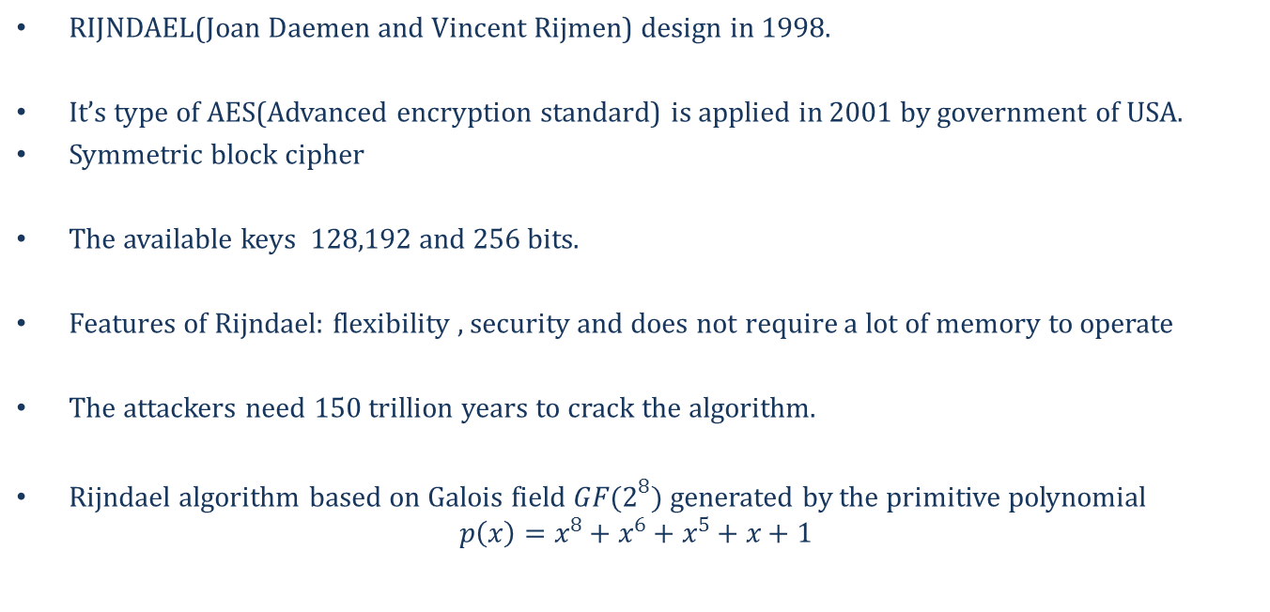
Rijndael algorithm
RIJNDAEL(Joan Daemen and Vincent Rijmen) design in 1998.
It’s type of AES(Advanced encryption standard) is applied in 2001 by government of USA.
Symmetric block cipher
The available keys 128,192 and 256 bits.
Features of Rijndael: flexibility , security and does not require a lot of memory to operate
The attackers need 150 trillion years to crack the algorithm.
Rijndael algorithm based on Galois field $GF(2^{8})$ generated by the primitive polynomial
$$p\left(x\right)=x^{8}+x^{6}+x^{5}+x+1$$

Slide 15
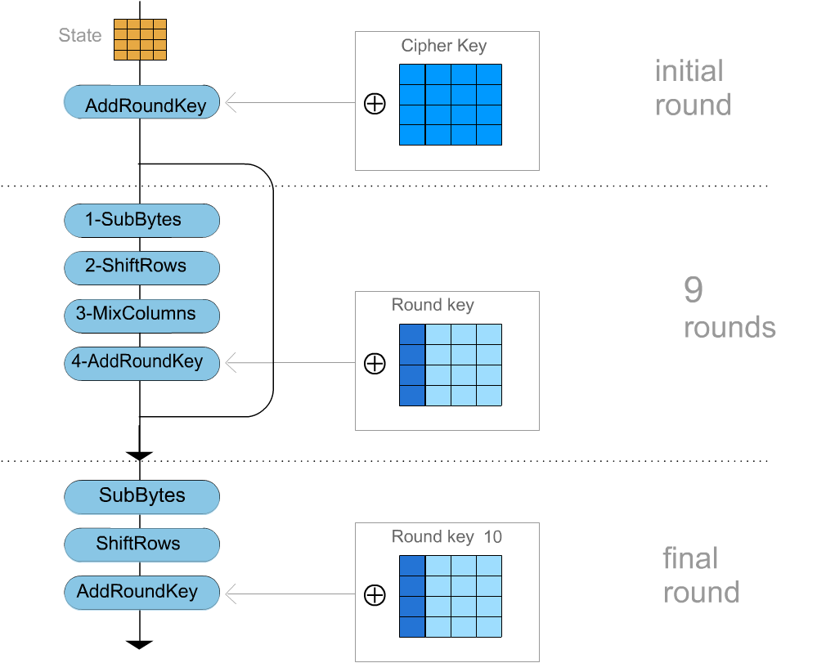
Flow chart of Rijndael encryption
* $\text{In} \text{decryption} \text{that} \text{need} \text{to} \text{inverse} \text{all} \text{transformations} \text{and} \text{exactly} \text{inverse} \text{the} \text{flow} \text{chart}\text{. }$

Slide 16



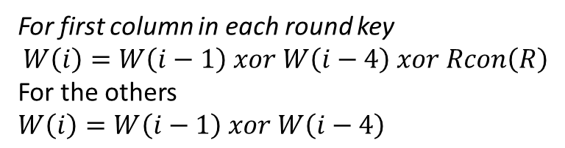


Key schedule
$$initial round key$$
$$round key(1)$$
$$final round key$$
2B | 28 | AB | 09 | A0 | 88 | 23 | 2A
7E | AE | F7 | CF | FA | 54 | A3 | 6C
15 | D2 | 15 | 4F | FE | 2C | 39 | 76
16 | A6 | 88 | 3C | 17 | B1 | 39 | 05
D0 | C9 | E1 | B6
14 | EE | 3F | 63
F9 | 25 | 0C | 0C
A8 | 89 | C8 | A6
$$……………………$$
$$Rcon$$
For first column in each round key
$$W\left(i\right)=W\left(i−1\right) xor W\left(i−4\right) xor Rcon\left(R\right)$$
For the others
$$W\left(i\right)=W\left(i−1\right) xor W\left(i−4\right)$$
01 | 02 | 04 | 08 | 10 | 20 | 40 | 80 | 1B | 36
00 | 00 | 00 | 00 | 00 | 00 | 00 | 00 | 00 | 00
00 | 00 | 00 | 00 | 00 | 00 | 00 | 00 | 00 | 00
00 | 00 | 00 | 00 | 00 | 00 | 00 | 00 | 00 | 00

Slide 17
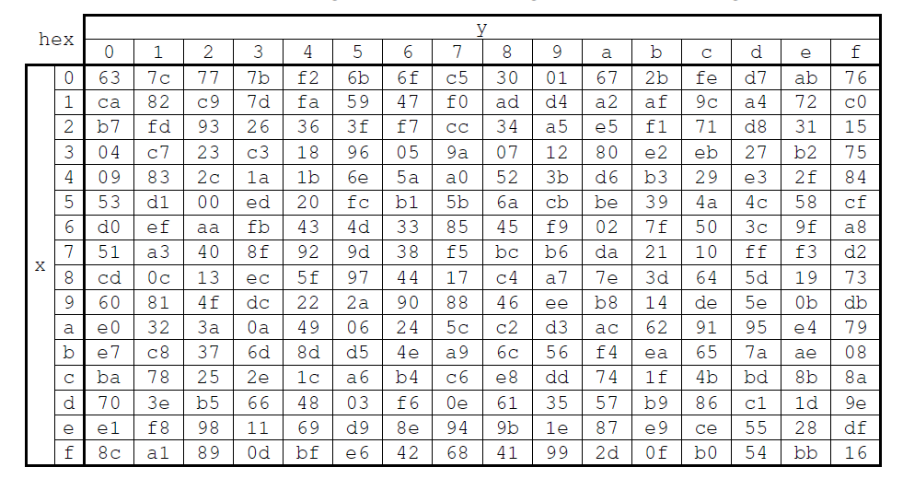



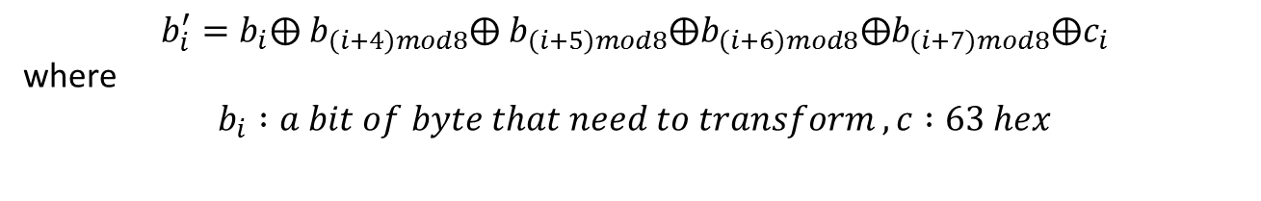
SUB BYTES
Encryption process
$$Transformation :$$
$$before s−box$$
$$after s−box$$
19 | A0 | 9A | E9
3D | F4 | C6 | F8
E3 | E2 | 8D | 48
BE | 2B | 2A | 08
D4 | E0 | B8 | 1E
27 | BF | B4 | 41
11 | 98 | 5D | 52
AE | F1 | EF | 30
$$b_{i}^{′}=b_{i}⨁{ b}_{\left(i+4\right)mod8}⨁ b_{\left(i+5\right)mod8}⨁b_{\left(i+6\right)mod8}⨁b_{\left(i+7\right)mod8}⨁c_{i}$$
where
$$b_{i} :a bit of byte that need to transform , c :63 hex$$

Slide 18
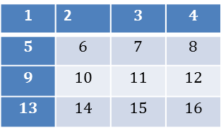
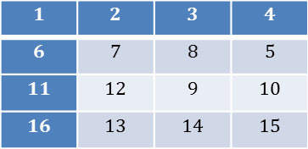
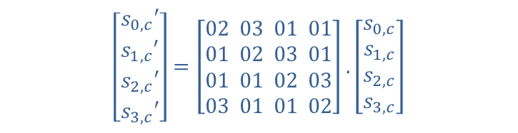
Shift Rows
1 | 2 | $$3$$ | $$4$$
$$5$$ | $$6$$ | $$7$$ | $$8$$
$$9$$ | $$10$$ | $$11$$ | $$12$$
$$13$$ | $$14$$ | $$15$$ | $$16$$
$$1$$ | $$2$$ | $$3$$ | $$4$$
$$6$$ | $$7$$ | $$8$$ | $$5$$
$$11$$ | $$12$$ | $$9$$ | $$10$$
$$16$$ | $$13$$ | $$14$$ | $$15$$
Mix columns
$$\left[\begin{aligned}s_{0,c}′ \\ s_{1,c}′ \\ s_{2,c}′ \\ s_{3,c}′\end{aligned}\right]=\left[\begin{aligned}02 03 01 01 \\ 01 02 03 01 \\ 01 01 02 03 \\ 03 01 01 02\end{aligned}\right].\left[\begin{aligned}s_{0,c} \\ s_{1,c} \\ s_{2,c} \\ s_{3,c}\end{aligned}\right]$$

Slide 19
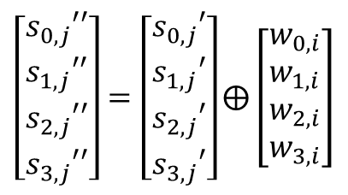
Add round key
The most important process in the Advanced Encryption Standard (AES).Its take one by one column form one block and form the desired round key.
$$\left[\begin{aligned}s_{0,j}′′ \\ s_{1,j}′′ \\ s_{2,j}′′ \\ s_{3,j}′′\end{aligned}\right]=\left[\begin{aligned}s_{0,j}′ \\ s_{1,j}′ \\ s_{2,j}′ \\ s_{3,j}′\end{aligned}\right]⨁\left[\begin{aligned}w_{0,i} \\ w_{1,i} \\ w_{2,i} \\ w_{3,i}\end{aligned}\right]$$
$$s_{0,j}^{′′}=s_{0,j}′ ⨁ w_{0,i}$$
$$s_{1,j}^{′′}=s_{1,j}′ ⨁ w_{1,i}$$
$$s_{2,j}^{′′}=s_{2,j}′ ⨁ w_{2,i}$$
$$s_{3,j}^{′′}=s_{0,j}′ ⨁ w_{3,i}$$

Slide 20
Embedding
Its optional second layer of security.
It makes an effort to hide the fact that the encrypted data even exists, so not drawing attention to it.
In our implementation we embedded the encrypted data (from Rijndael) in a RGB bitmap indexed image (carrier source ) which is a high security level.
Each symbol in the carrier source represented by a set of 8 binary digits , the least significant digit (bit) is replaced with the encrypted data without obvious distortion to the source due to its nature (the effect of the LSB is neglected)

Slide 21
Implemented Embedding System
Carrier Source
Carrier source
+
Secret information
Embedding Algorithm
LSBE
Encrypted Data
Decoding Key

Slide 22


Embedding System Application with AES
To increase the data security and protection steganography is used to conceal the encrypted data within another carrier data file
Input Data Implementation of a digital communication System
AES cipher key 2B 7E 15 16 28 AE D2 A6 AB F7 15 88 09 CF 4F 3C _{HEX}
Encrypted Data §¦<]­C£SøfsÕúeíþGØÇD¢)VsÌ ×ÔºÉõu}÷k¸³>BðG¹To
The steganography generated key 200 _{HEX}
Original source file
The Embedded source

Slide 23
Channel coding
3
FEC BCH(15,5,7)

Slide 24
Forward Error Correction
Block BCH Encoder
Channel coding or error control coding is a part of a Digital communication system used to detect the errors in the data and correct it using redundant bits added to the original data
The added redundancy should be acceptable in terms of the Channel Capacity
This class of codes is highly flexible, allowing control over block length and acceptable error thresholds, it can be designed to a given specification and mathematical constrains
The primary advantage of BCH codes is the ease of decoding, by algebraic method known as syndrome decoding which Allows Faster error detection and correction.
A block FEC codes which are extensively used in communication systems and computer storage devices (Reed-Solomon)

Slide 25
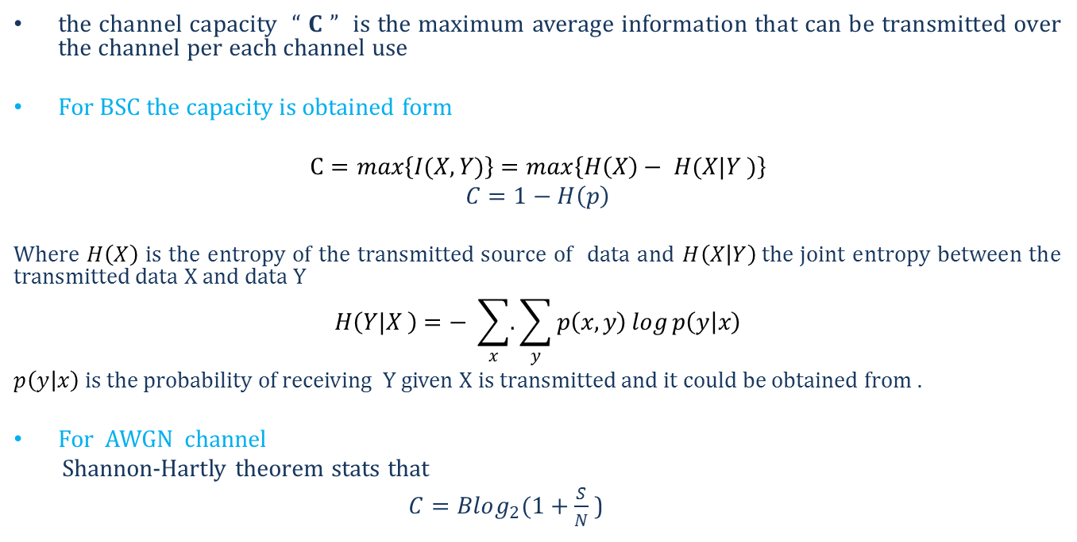
Channel Capacity
the channel capacity “ C ” is the maximum average information that can be transmitted over the channel per each channel use
For BSC the capacity is obtained form
$$C=max\left\{I(X,Y)\right\}=max\left\{H\left(X\right)− H(X|Y )\right\}$$
$$C=1−H\left(p\right)$$
Where $H\left(X\right)$ is the entropy of the transmitted source of data and $H\left(X | Y\right)$the joint entropy between the transmitted data X and data Y
$$H\left(Y|X \right)=− \sum_{x}^{ }{.}\sum_{y}^{ }{p\left(x, y\right)\log{p\left(y | x\right)}}$$
$p\left(y | x\right)$ is the probability of receiving Y given X is transmitted and it could be obtained from .
For AWGN channel
Shannon-Hartly theorem stats that
$C=Blog_{2}(1+\frac{S}{N}$ )

Slide 26
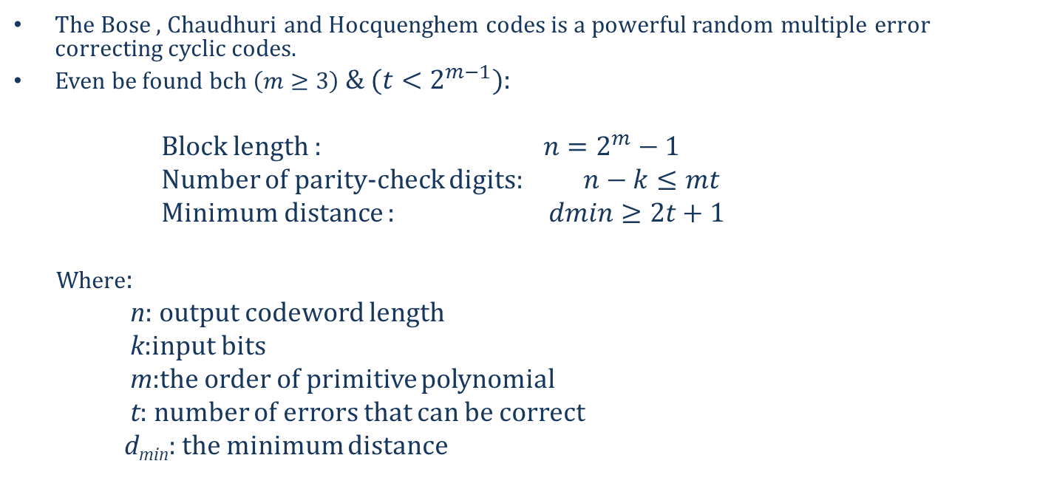
Block coding
BCH code
The Bose , Chaudhuri and Hocquenghem codes is a powerful random multiple error correcting cyclic codes.
Even be found bch$\left(m≥3\right)$ & $(t<2^{m−1})$:
Block length : $n=2^{m}−1$
Number of parity-check digits: $n−k≤mt$
Minimum distance : $dmin≥2t+1$
Where:
n: output codeword length
k:input bits
m:the order of primitive polynomial
t: number of errors that can be correct
d_{min}: the minimum distance

Slide 27
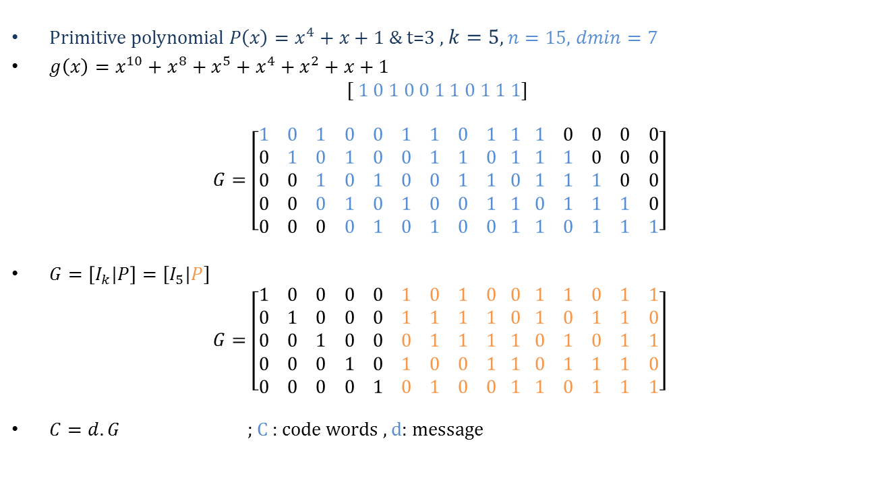
BCH(15,5,7)
Generation matrix & data Encoding
Primitive polynomial $P\left(x\right)=x^{4}+x+1$ & t=3 , $k=5$, $n=15,$ $dmin=7$
${g\left(x\right)=x^{10}+x^{8}+x^{5}+x}^{4}+x^{2}+x+1$
$$[ 1 0 1 0 0 1 1 0 1 1 1]$$
$$G=\left[\begin{aligned}1 0 1 0 0 1 1 0 1 1 1 0 0 0 0 \\ 0 1 0 1 0 0 1 1 0 1 1 1 0 0 0 \\ 0 0 1 0 1 0 0 1 1 0 1 1 1 0 0 \\ 0 0 0 1 0 1 0 0 1 1 0 1 1 1 0 \\ 0 0 0 0 1 0 1 0 0 1 1 0 1 1 1\end{aligned}\right]$$
$G=\left[I_{k}|P\right]=[I_{5}|P]$
$$G=\left[\begin{aligned}1 0 0 0 0 1 0 1 0 0 1 1 0 1 1 \\ 0 1 0 0 0 1 1 1 1 0 1 0 1 1 0 \\ 0 0 1 0 0 0 1 1 1 1 0 1 0 1 1 \\ 0 0 0 1 0 1 0 0 1 1 0 1 1 1 0 \\ 0 0 0 0 1 0 1 0 0 1 1 0 1 1 1\end{aligned}\right]$$
$C=d.G$ ; C : code words , d: message

Slide 28
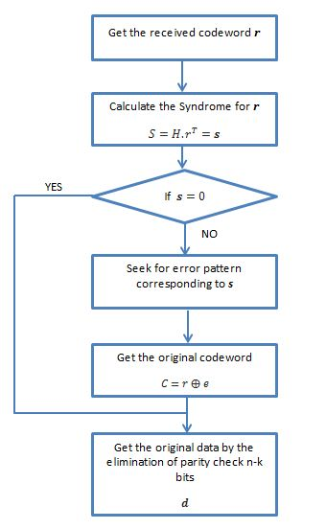
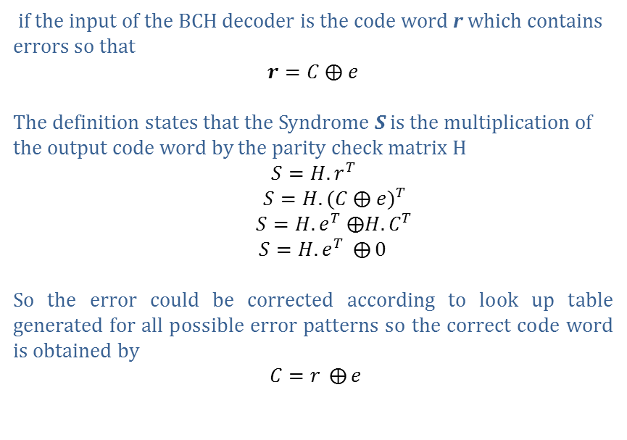
Decoding BCH (syndrome decoding)
For any BCH code word
$$H.C^{T}=0$$
if the input of the BCH decoder is the code word r which contains errors so that
$$r=C ⨁ e$$
The definition states that the Syndrome S is the multiplication of the output code word by the parity check matrix H
$$S=H.r^{T}$$
$S=H.{(C ⨁ e)}^{T}$
$S=H.e^{T} ⨁H.C^{T}$
$S=H.e^{T} ⨁{0}$
So the error could be corrected according to look up table generated for all possible error patterns so the correct code word is obtained by
$C=r ⨁{e}$

Slide 29
Performance of BCH(15,5,7)
Theoretical and practical
Performance over AWGN
channel for BCH(15,5,7)
The comparison between coded
and non-coded signal is shown
it shows better performance for
the coded signal at the higher
Eb/N0 levels

