Slide 1
Hyperactive Kids
Software Graduation Project
Supervisor: Dr. Luai Malhis
Prepared by: Sora Abu Nasser
Ansam Soliman

Slide 3
Outlets
Introduction about ADHD
Signs of ADHD
Diagnosis for ADHD
Design
Challenges
Future work
Conclusion

Slide 4
Motivation
Help those children who have this disease.
Develop an application to help parents analyze his/her kid’s health.
Easy communication between parents, doctors and specialists.

Slide 5
ADHD
ADHD stands for a condition called attention deficit hyperactivity disorder.
Kids with ADHD have problems paying attention and sitting still in their seats.
They can do things without thinking about the results.
This can cause problems like getting hurt.

Slide 6
ADHD Signs
Sometimes child acts as if she/he is driven by
a motor.
Child talk a lot, even when she/he has nothing much to say.
In class or at home, child blurts out answers to questions before they are fully asked.
It's very difficult for child to stay focused on homework or other tasks.

Slide 7
ADHD Signs
Rarely completes an activity before moving to the next activity.
Frequently loses things like homework and personal belongings.
Frequently forgets to do things.
Child makes careless mistakes.

Slide 8
Making the ADD / ADHD diagnosis
Pass thorough medical and family history.
Order or conduct a general physical and/or neurological exam.
Observe your child at play or school.
Use psychological tests in order to measure IQ and social and emotional adjustment.

Slide 9
Resources

Slide 10
Login screen

Slide 11
Registration screen

Slide 12
Home screen

Slide 13
Modes screen

Slide 14
Add kid screen

Slide 15
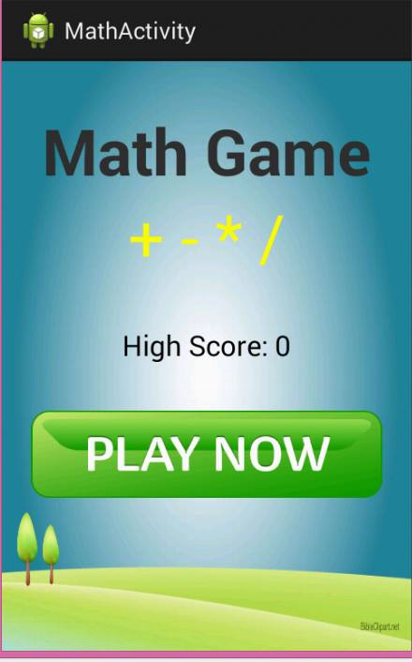
Math game
In this game, we choose equations
and answers randomly.
The score of the game
calculated depends on game’s
time and how many equations
the kid solve in specific time.

Slide 16
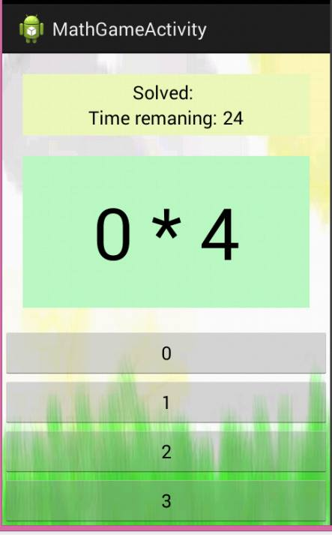
Math game

Slide 17
Bubble shooter game
The main purpose of the game is shooting bubbles.
If the player connects at least three bubbles of the same color to each other, they are removed from the top and the player receives points.
Points earned by the player allow him to go to the higher levels. The difficulty of the game increases with each level.

Slide 18
Bubble shooter

Slide 19
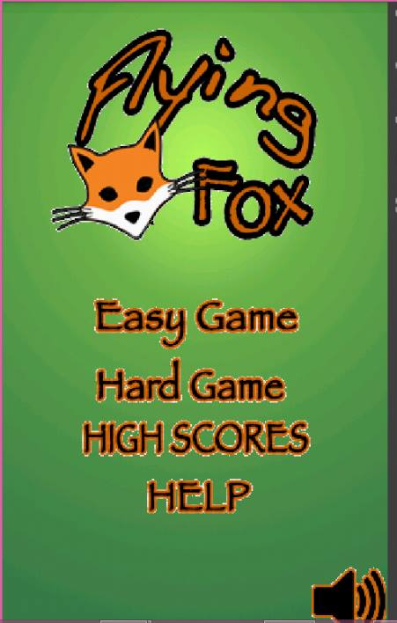
Flying fox game
The fox is the main moving object in
the game.
Fox continuously jumps during the
game and moves left or right based on
accelerometer events.

Slide 20
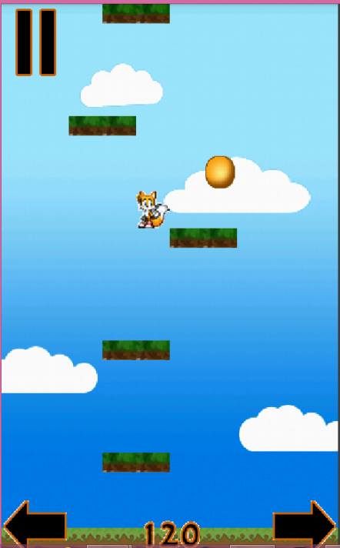
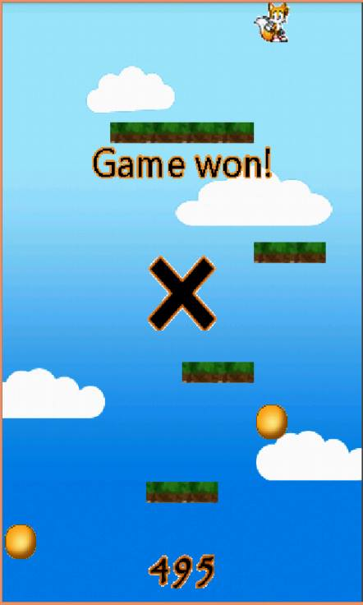
Flying fox game

Slide 21
Our website

Slide 22
Login page

Slide 23
Registration page

Slide 24
Contact page

Slide 25
Result page

Slide 26
Result page

Slide 27
Logout page

Slide 28
Challenges
Time.
Building games.
Analyze the ADHD and know all the important factors

Slide 29
Future work
Build more games.
Make a special page in our website for doctors to help patients.
Put the games on server and allow parents to download them on their devices.
Make the games operate on our website not only on application.

Slide 30
Conclusion
Finally, we hope that we do our best effort to help those kids with ADHD.

