Slide 1



Graduation Project
Prepared By :
Lama Asmah Amani Mashaqi
Presented To:
Dr. Reyad Abdel- Kareem
Eng. Emad Al-Qasem
Eng. Yaser Al-Jaedee
An-Najah National University

Slide 2

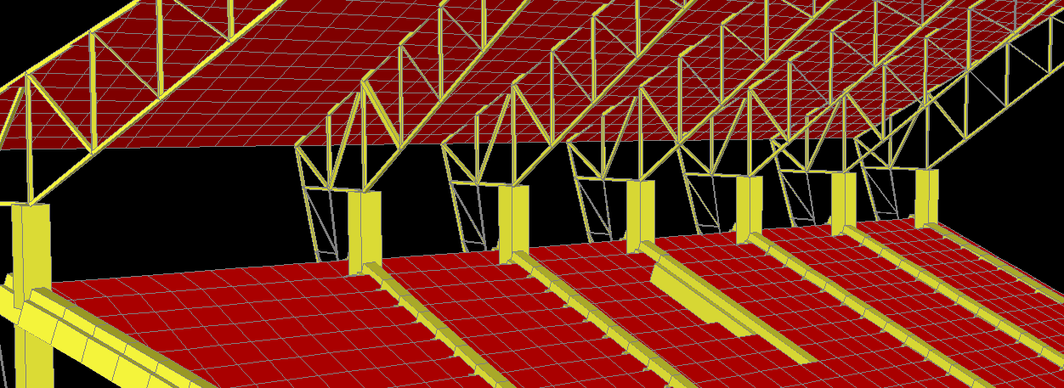

Hebron Stadium
An-Najah National University
Faculty of Engineering
2011-2012

Slide 3
This project consists of six basic chapters:-
1
Introduction
2
Slab Beam design
3
Truss Design
4
Column Design
5
Footings and Stair’s Design
6
Three Dimensional Structural Analysis and Design
:

Slide 4
1. General Description :
*Geography: The building will be constructed in Hebron with a total area of (2758.6m²).
*Geology: the project is expected to be constructed on hard limestone soil with bearing capacity = 2.5 kg/cm².
*Structural description: The building has approximately a uniform grid with spans which are constructed as one-way solid slab system.
*Architecture description: The project is consisting of single symmetry area around the playground

Slide 5
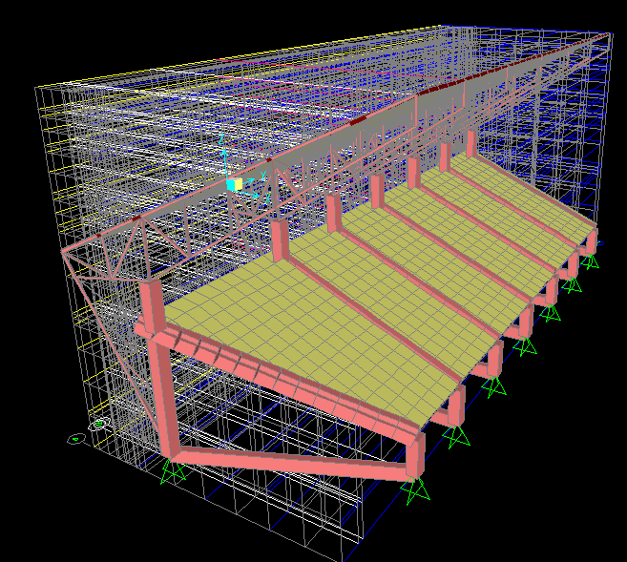

Slide 6
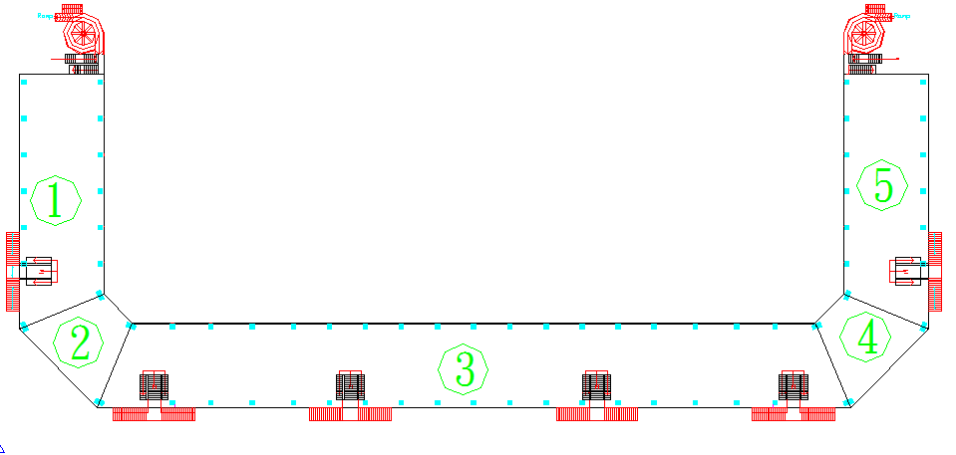
Architecture plan

Slide 7
2. Materials:
*Reinforced concrete:
concrete compressive strength f_{c}=28MPa
Modulus of elasticity E_{c} = 2.49*10⁴ MPa
*Steel:
Yield stress in steel bars and stirrups=420MPa
Minimum yield stress in steel members=344.7 MPa
Minimum tensile stress in steel members=448.2 MPa

Slide 8
3. Design Code:
The structures are designed using practice , codes and specifications that control the design process and variables.
The following codes and standards are used in this study:
*ACI-318-2008 :
*ACI-350-2008
*IBC- AISC360-05 LRDF-2006

Slide 9
4. Loadings:
5. Load combinations:
1. Non-Sway loads
**Dead loads:
**Live loads:
2. Sway Loads:
**Wind loads:
truss | 0.5 KN
Concrete slab | 0.5 KN
Wu =envelop of all the load cases below:
Wu= 1.4 D.L
Wu= 1.2 D.L + 1.6 L.L
Wu=1.2 D.L +1.6 W.L + 1.0 L.L
Wu=0.9 D.L +1.6 W.L
truss | 0.5 KN
Concrete slab | 3 KN
truss | 0.5 KN

Slide 10
6. Outline of Analysis and Design:
Analysis and design is performed for 3 representative frames Interior , Exterior and Inclined
The structural analysis needed to:
1. determine the external reactions at the supports
2.determaine the internal forces like moments, shear, and normal forces
Theses internal member forces are used to design the cross section of elements.

Slide 11
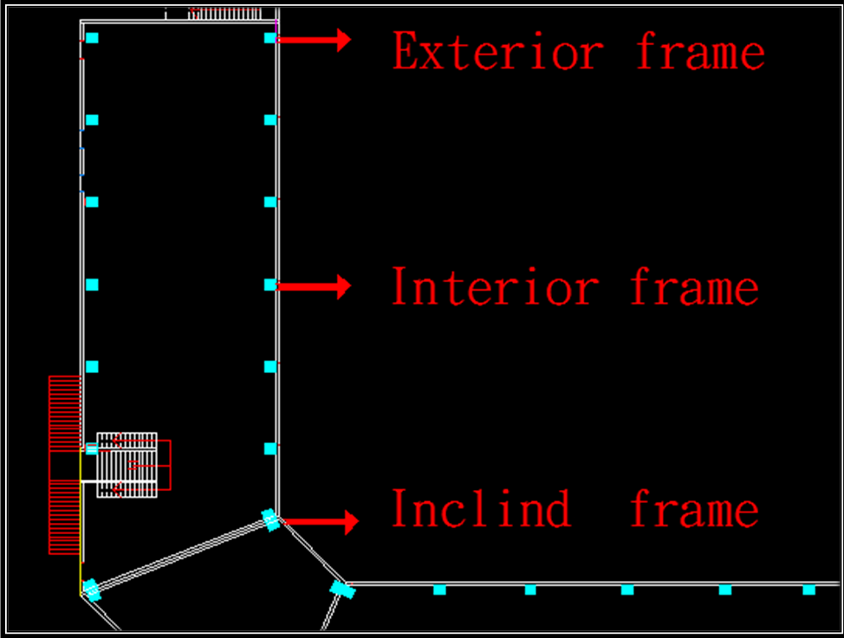

Slide 12
Concrete Design

Slide 13
Slab design:
One way solid slab (pre-casted).
 | Slab thickness | Flexure design (+M) | Flexure design (- M) | Shear design
Interior slab | 30 cm | 4Ø14 | 4Ø14 | 1Ø10/100 mm
Exterior slab | 30 cm | 4Ø14 | 4Ø14 | 1Ø10/100 mm
Inclined Slab (the longest span | 40 cm | 12Ø14 | 5Ø14 | 1Ø10/150 mm

Slide 14
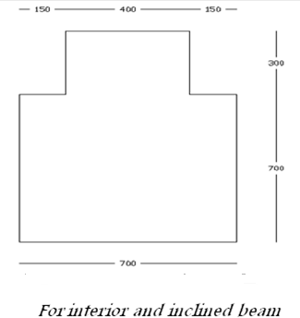
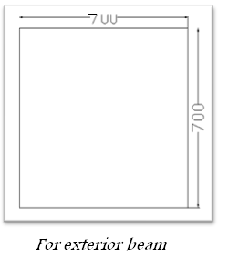
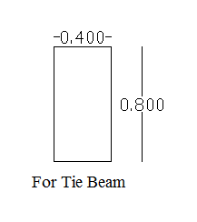
Beam design:
 | Flexure design (+M) | Flexure design (-M) | Shear design
Interior Beam | 14Ø25 | 3Ø25 | 1Ø10/150mm
Exterior Beam | 15Ø25 | 3Ø25 | 1Ø10/250mm
Inclined Beam | 13Ø25 | 3Ø25 | 1Ø10/200mm
Tie Beam | 2Ø25 | 3Ø25 | 1Ø10/350mm

Slide 15
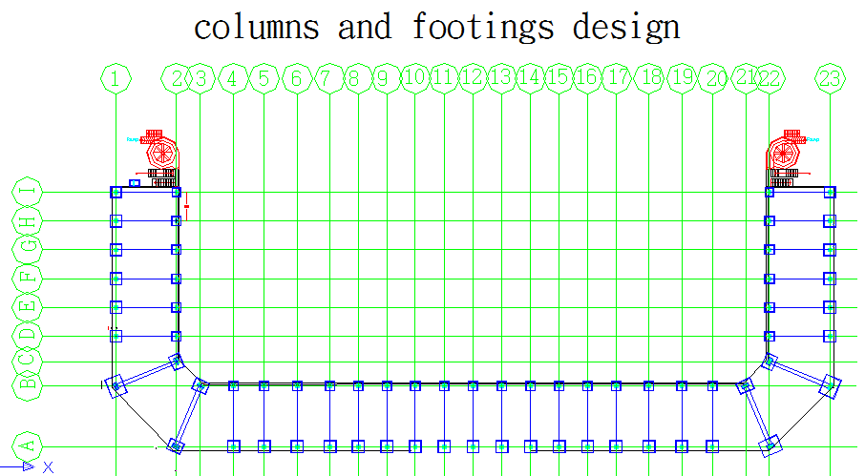

Slide 16
Columns and Footings Design:
Column, Footing Group | Footing number
(C1), (F1) | D2,E2,F2,G2,H2 B4,B5,B6,B7,B8,B9,B10,B11,B12,B13,B14,B15,B16, B17,B18,B19,B20 D22,E22,F22,G22,H22
(C2),(F2) | D1,E1,F1,G1,H1, A4,A5,A6,A7,A8,A9,A10,A11,A12,A13,A14,A15,A16, A17, A18 A19, A20 D23,E23,F23,G23,H23
(C3),(F3) | I2,122
(C4),(F4) | I1,I23
(C5),(F5) | C2,B3,B21,C22
(C6),(F6) | A2,B1,A22,B23
Table :Classification of the Columns and the Footings.

Slide 17
Column Design:
In this project square columns are used. And these columns can carry axial load and moment.
Short and long columns (un-braced).
Dimension=70*70 cm
column | Flexure design | Shear design
Interior 2.25m (C1) | 10 Ø25 | 1Ø10/250
Interior 10m (C2) | 20Ø36 | 1Ø10/250
Exterior 2.25m (C3) | 10 Ø25 | 1Ø10/250
Exterior 10m (C4) | 20Ø30 | 1Ø10/250
Inclined 2.25m (C5) | 10 Ø25 | 1Ø10/250
Inclined 10m (C6) | 20Ø30 | 1Ø10/250

Slide 18
Footings Design:
Footings which used in this project can be classified into the following types :-
Footing Name | Areas(m) | As(in each direction)
Interior 2.25m (F1) | 1.7*1.7*0.3 | 4Ø14
Interior 10m (F2) | 2.2*2.2* 0.3 | 6Ø14
Exterior 2.25m (F3) | 1.5 ,1.5 ,0.3 | 4Ø14
Exterior 10m (F4) | 2 ,2 ,0.3 | 5Ø14
Inclined 2.25m (F5) | 2.1 ,2.8,0.3 | 4Ø14
Inclined 10m (F6) | 3 ,3.7 ,0.52 | 6Ø14
*Single footing :
Squire footings---interior and exterior frame
Rectangular footings ---inclined
frame
*Wall footing.

Slide 19
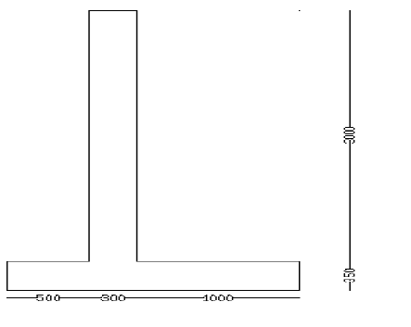
Ø=30
γ =18 KN/m²
Fc=28 MPa
q all=250KN/m²
Retaining wall:
 | Dim (m) | As main (mm² ) | As (mm² )
Wall | 3*0.3 | 1Ø16/250mm | 1Ø16/300mm
Toe | 1*0.35 | 1Ø16/250mm | 1Ø12/300mm
Heel | 0.5*0.35 | 1Ø16/250mm | 1Ø12/300mm
*Wall footing

Slide 20
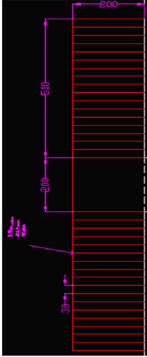
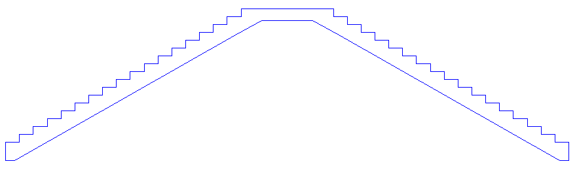
Stair Design:
Angle of inclination of stairs:
è = tan ⁻¹ = 30.96 accepted (preferred range 20-30 degree)
h _{min} = 0.25 m (table 9.5.a one end continues slab)
SDL=3KN/m²
LL=5 KN/m²
Weight of stairs =1.81KN/m²

Slide 21
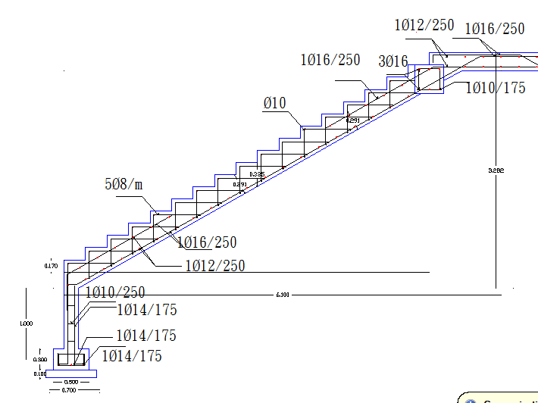
Stair’s Reinforcement
With its footing
Stair’s Reinforcement

Slide 22
Steel Design:

Slide 23
Control points in Truss Design:
1.Angle:
its preferred to be <30 to drain water .
*an angle of (Ø=26.6) was suitable .
2. Deflection :less than both of
* (L.L ONLY)
Accepted Δ L=L*1000/360
* (D.L+ L.L)
Accepted Δ D + l=L*1000/240
CHAMBURING

Slide 24
3. Sections:
Double symmetry sections.
min weight.
item | Tube | pipe
Dead weight (KN) | 90.30 | 93.332
Table : Weight comparison of the truss using different types of double symmetry sections (tube and pipe)

Slide 25
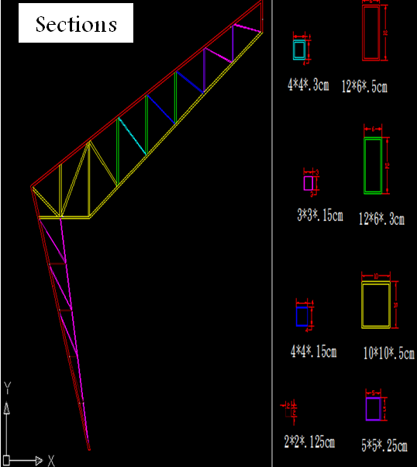

Slide 26
Design of members:
* Compression members:
If λ < 1.5
Inelastic region:
F_{cr} = (_{0.658} ^{Fy/Fe}) F_{y}
If λ > 1.5
Elastic region:
F_{cr} = 0.877 *Fe
Ø Pn = Ø*F_{cr}*Ag
* Tension members:
Yeild:
Ø_{t} Pn=
Fracture:
Ø_{t} Pn=
* Zero force members:
r min of section ≥L /300

Slide 27
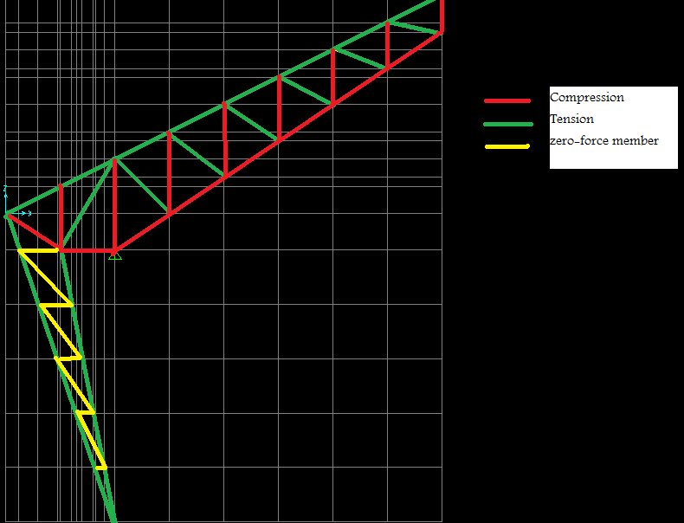

Slide 28
Weld connection:
ØRn=0.75* Fw*0.707*a*L _{w}
The required length of weld =
Table 3.4: Multipliers to determine the effective length of the weld (β)
IF Lw/a<100 | β | 1
IF 100<Lw/a<300 | β | =1.2-0.002* Lw/a
IF Lw/a>300 | β | 0.6

Slide 29
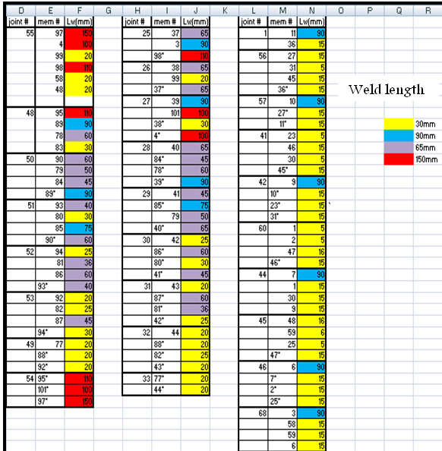

Slide 30
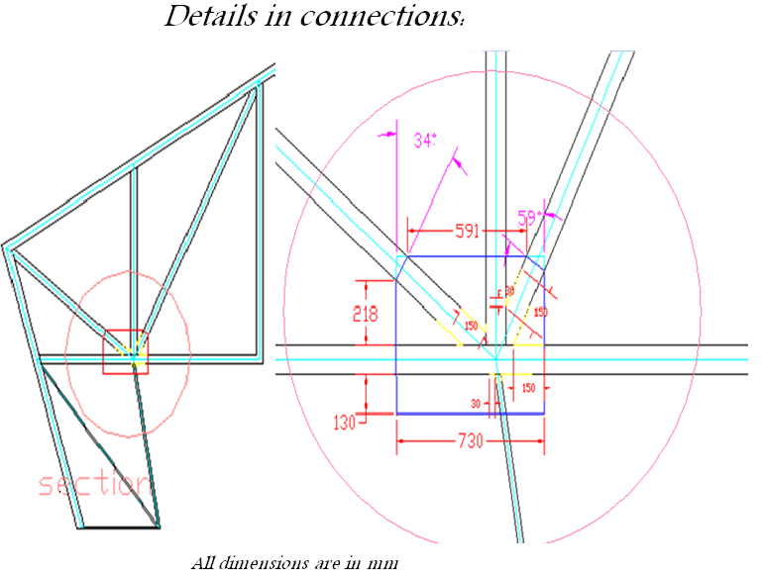

Slide 31
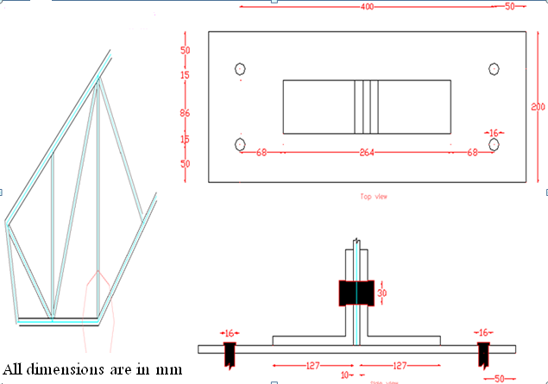

Slide 32
7. Three Dimensional Structural Analysis and Design
Three dimensional analyses for the stadium have two objectives:
making the three dimensional model gives meaning to what is done previously in this project since the main concept of design and analysis of the frames is the tributary area in load distribution .
2. It is vital to trust the two dimensional work, and to have full, good and clear view about the design differences between them.

Slide 33
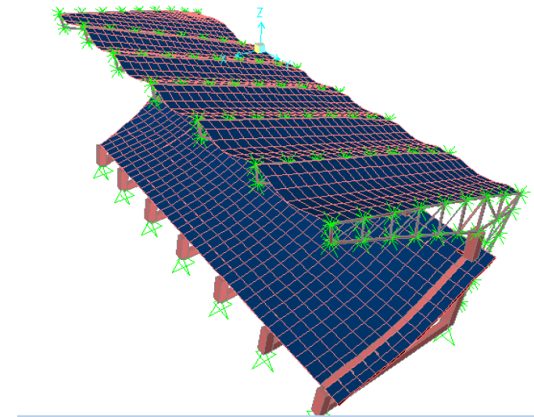
8. Checks for Three Dimensional Model:
1. Compatibility :

Slide 34
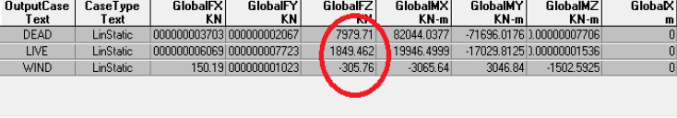
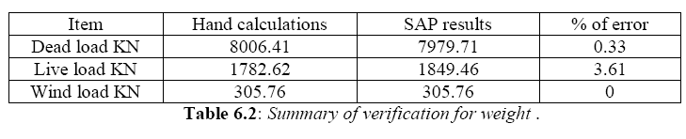
2.Equilibrium:

Slide 35
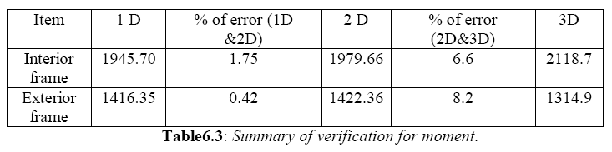
3. Stress strain relationship:

Slide 36
Thank you FOR YOUR attention

