Slide 1


Health Band
Mohammad Diab
Bashar Jodeh
Supervisors:
Dr. Sufyan Samara
Dr. Hanal Abuzant

Slide 2
Agenda
Introduction.
Problem.
Solution overview.
Signal Processing.
Blood pressure.
Calculations and Equations.
Chips & Technologies.
Future work.

Slide 3
Introduction
What is Health Band?
Our project is a medical watch made for athletes and patients to help them to show some information about their body temperature, heart rate, their walking/running speed, calories that they lost while walking, the distance they covered, current time and date.

Slide 4

Problem
Patients and old people
They need small device to show them some information about their health status such as heart rate and body temperature during day.
They need a system to record these data to be as reference for their doctors and mentors.

Slide 5

Problem (Con’t)
Athletes
They need a hand watch to show them information about their body and health status such as walking/running speed during ,distance they covered and calories that they lost while walking/training.

Slide 6
Solution
Our solution is an hardware integrated with software :
Mobile Application (Windows Phone App).
Watch Device.

Slide 7

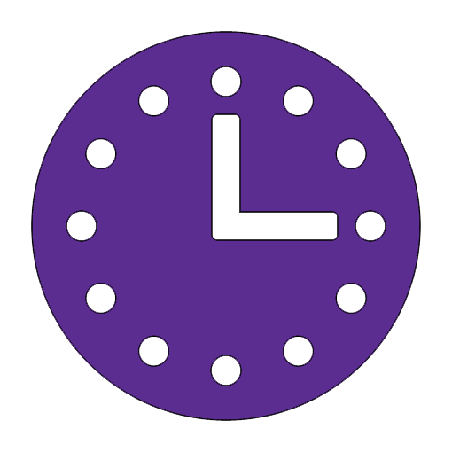
Solution (Device)
Consists of a tape that is connected around the hand with LCD screen, microcontroller and some electronic sensors.
Features:
Provide the user to show :
Body Temperature | Heart Rate | Distance Covered
Running Speed | Calories Lost | Timer / Time

Slide 8
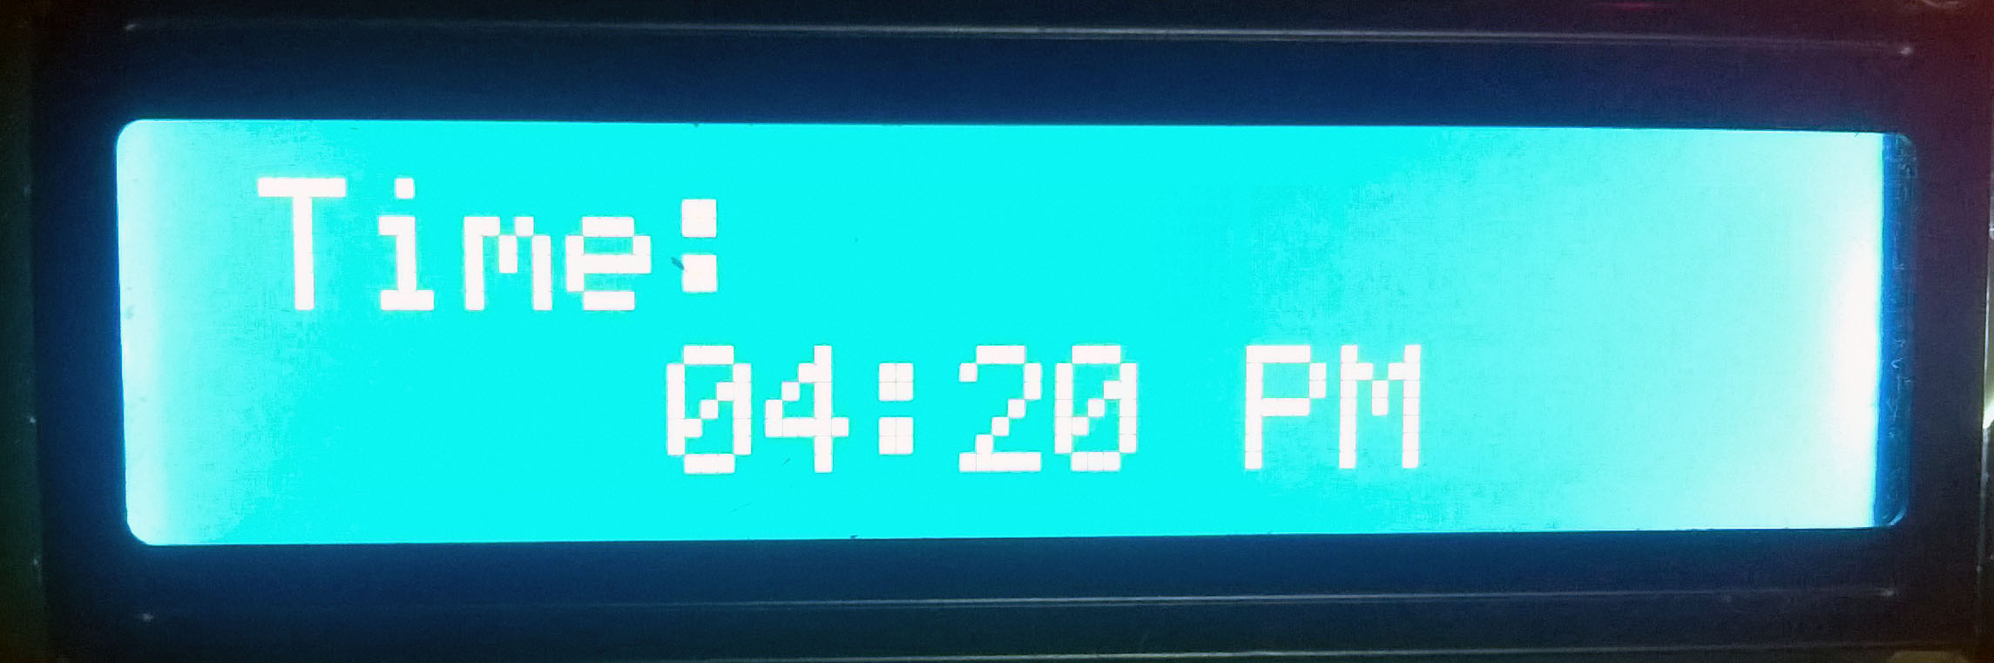
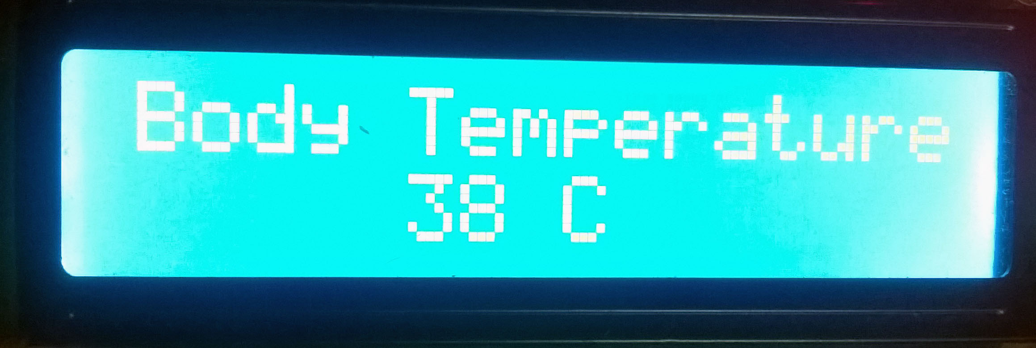
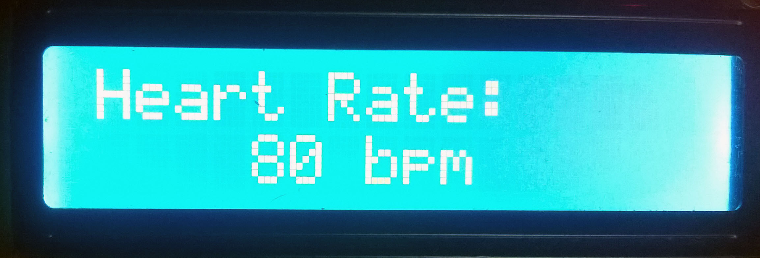
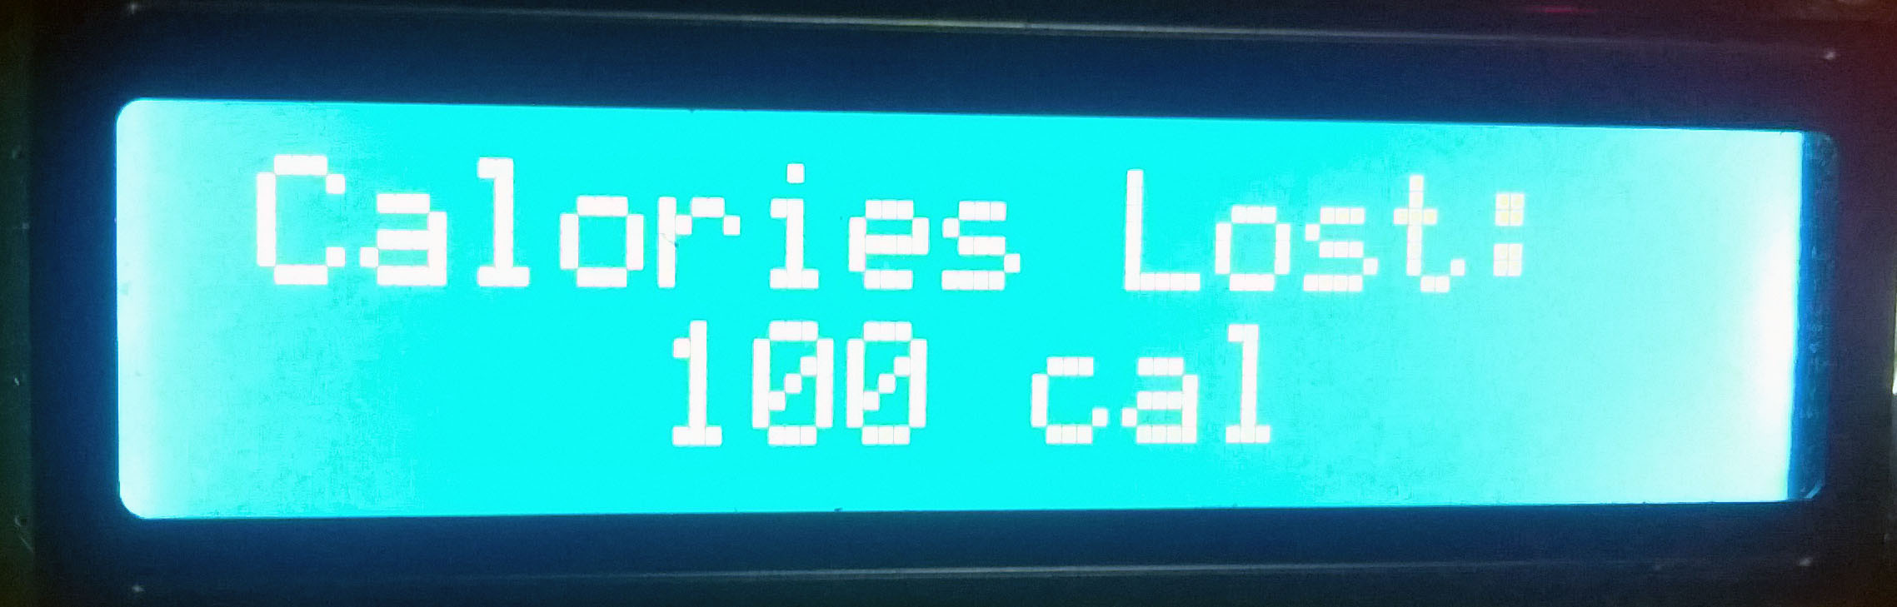
Solution (Device Con’t)

Slide 9
Solution (Device Con’t)

Slide 10
Solution (Mobile Application)
Have four main screen:
Main Screen: it helps user to see the data that receiving from Bluetooth .
Profile Screen: its allow to user to enter his body information such as weight in kg, gender , age and height .
Goals Page :it allows athletes to enter their goals before starting the training.
Report Screen: it allow to user to see the useful analytic data such as max temperature, min temperature, max hart rate, max hart rate

Slide 11
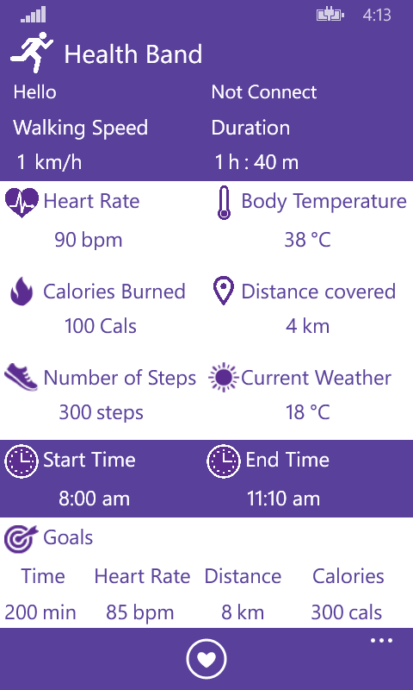
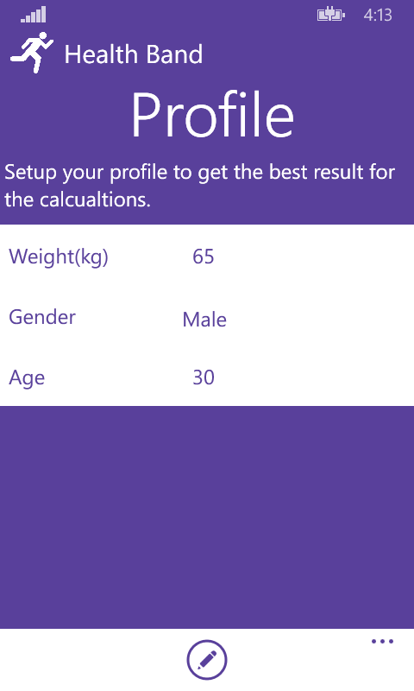
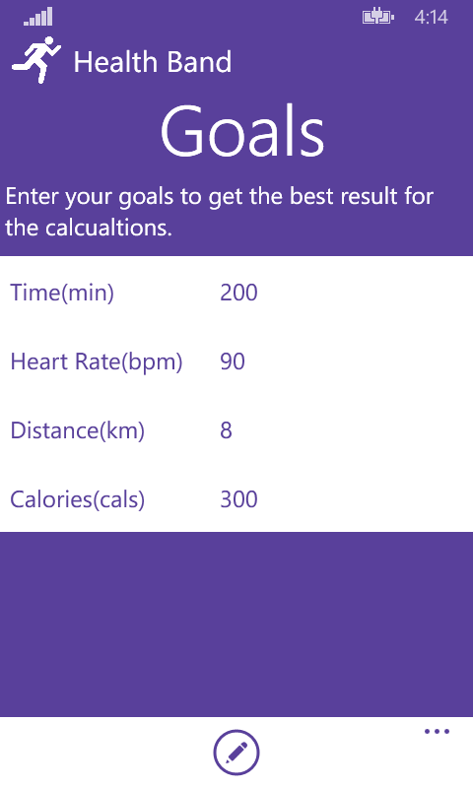
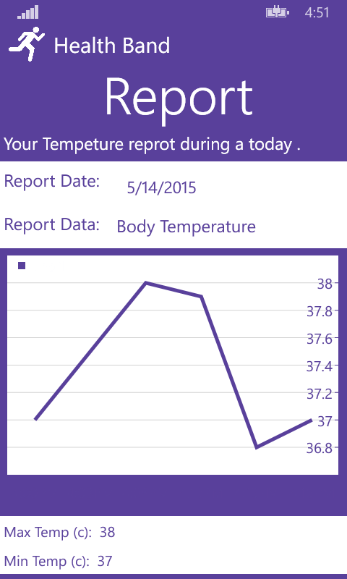
Solution (Mobile Application Con’t)
Main Screen
Profile Page
Goal Screen
Report Page

Slide 12
Solution (Mobile Application Con’t)
Features in Mobile Application:
Provide the device useful data by using the mobile sensors such as location sensor for make calculate for distance covered.
Provide user expert system, to help him to track his status.
Make the calculation that related of calories burned and steps count.
Make management and reporting for data.

Slide 13
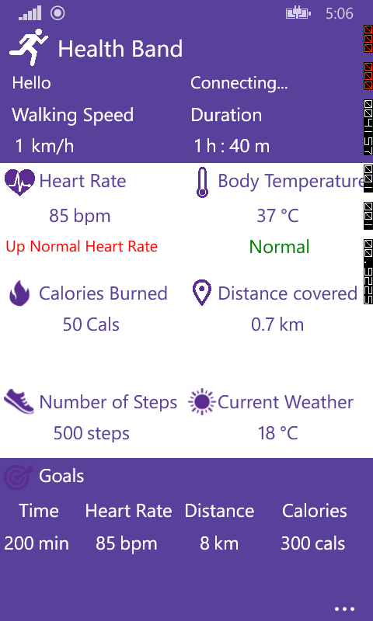
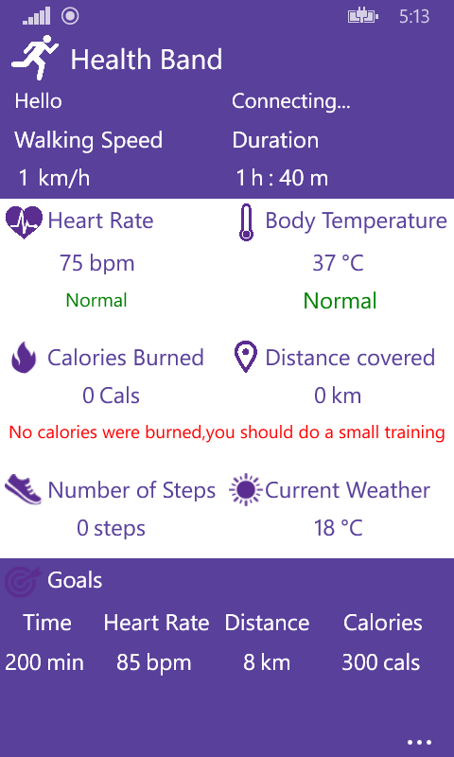
Expert System Example

Slide 14
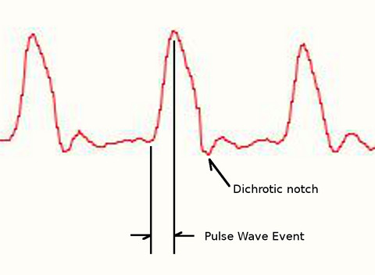
Signal Processing:
Pulse Sensor:
Averaging on 10 reads of output.
IBI (Inter-Beat-Interval) time between beats about 500 ms.
Comparison between the output value
(BPM) and the output value from another
device called Blood Pressure Monitor.

Slide 15
Signal Processing:
Temperature Sensor
we measured the surround temperature by using thermometer, after that we made a calculation on the output signal.
Output Temperature = Output Value * 0.4464
Item | Before | After
0 | 56 | 25
1 | 64 | 28.5
2 | 65 | 29
3 | 66 | 29.5
4 | 66 | 29.5
5 | 65 | 29

Slide 16
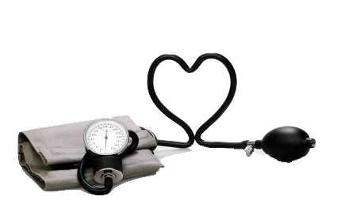
Blood pressure
Blood pressure is a is the pressure exerted by circulating blood upon the walls of blood vessels and is one of the principal vital signs.
The first (or top) number is your systolic blood pressure. It is the highest level your blood pressure reaches when your heart beats.
The second (or bottom) number is your diastolic blood pressure. It is the lowest level your blood pressure reaches as your heart relaxes between beats.

Slide 17
Calculations and Equations
  Calories burned:
Weight(kg)
Heart Rate = 60 – 120
Time in minutes.
Calories Burned =
[(Age x 0.2017) + (Weight x 0.1988) + (Heart Rate x 0.6309) — 55.0969] x Time / 4.184.

Slide 18
Calculations and Equations(con’t)
  Steps :
Stride length = 415 * Height (cm)
Convert to stride length from Centimeters to Kilometer
Stride length (km) = Stride length (cm) / (100,000)
Number of steps= Distance / Stride length (km)

Slide 19
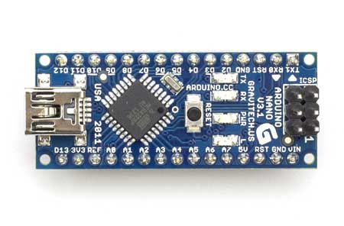
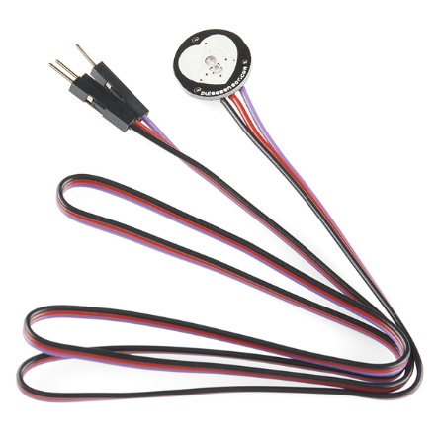
Chips & Technologies
Chips
    Microcontroller (Arduino Nano board).
    Pulse Sensor.
    Temperature Sensor .
    16x2 Character LCD .
    Bluetooth Module.

Slide 20



Chips & Technologies
Technologies
    Windows Phone 8 SDK for mobile application.
    SQLite Database (mobile application).
    Arduino Studio.
    Proteus for build a circuit.

Slide 21
Future Work
Add ability to health band to measure the blood pressure.
Adding more features for expert system in mobile application.
Decrease the device size.
Add folding screen that support touch technology.

Slide 22


