Slide 1
Robot Hand
Presented By:
Fuad Amira.
Reem Salous.
Supervisors:
Dr. Raed Al Qadi.
Dr. Ashraf Armoush.

Slide 2
Problem ☹
Humans can not have direct contact with everything
Many materials can cause harm to the human body.
Toxins
Radioactive materials

Slide 3
Solution ☺
In our project we tried to solve the mentioned problem.
We design a robot hand that is similar to the human hand.
The hand can be controlled by a glove that captures the movement of the user’s hand.
The hand the glove communicate over a wireless channel.

Slide 4
Three phases of our project
We managed to build our project in three different stages.
Building the mechanical part of the hand.
The control glove
Communication between hand and glove.

Slide 5
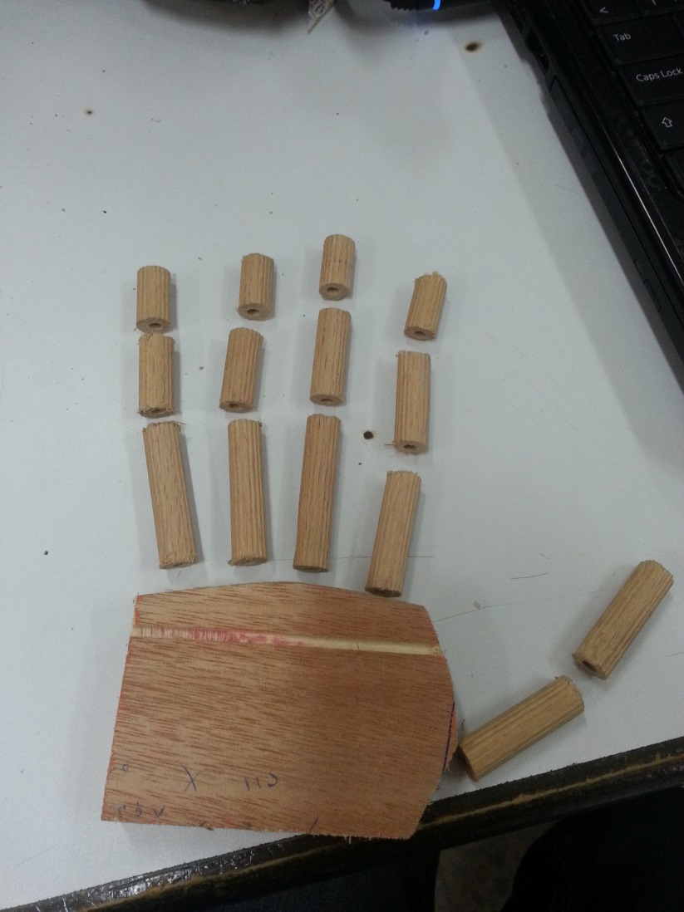
1. The mechanical part.
We used wood for building the hand.
We cut the wood in to small pieces to build the “bones” of the fingers

Slide 6
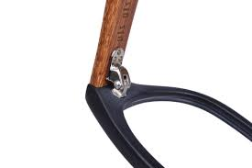
The mechanical part
We used sunglasses’ hinges to connect the small parts of wood to build the joints
Then we placed an elastic material to the back of each finger to build the tendons.

Slide 7
Mechanical part cont’d
Finally, we installed servo motors on to the arm.
Then we attached a servo to each finger using a string.

Slide 8
Why servo motors?
The elastic band will try to pull the finger back.
Normal DC and stepper motors don’t have the enough torque to hold the finger.
Luckily, servo motors are provided with gears that make them able to provide a strong torque.

Slide 9
2. The control glove
To build our control unit we used a normal glove.
We attached flex sensors to each finger of the glove.
The flexes detect the motion of the user’s hand and send it to a microcontroller.

Slide 10
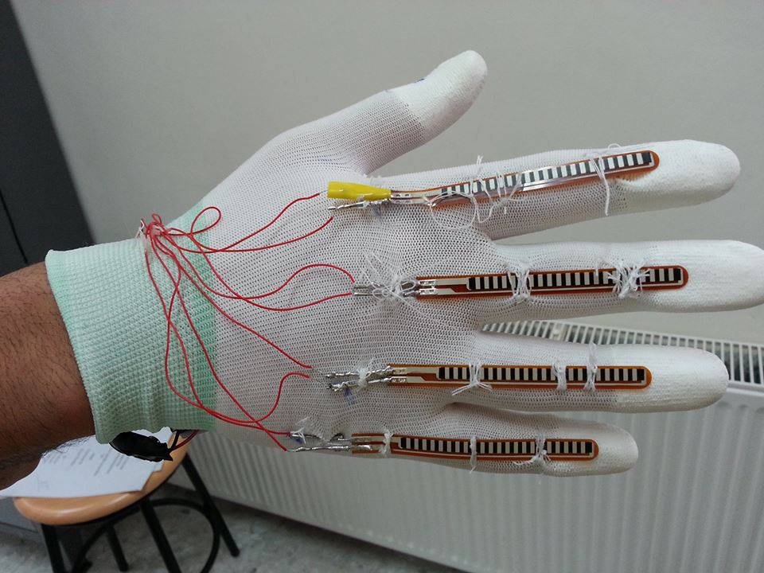
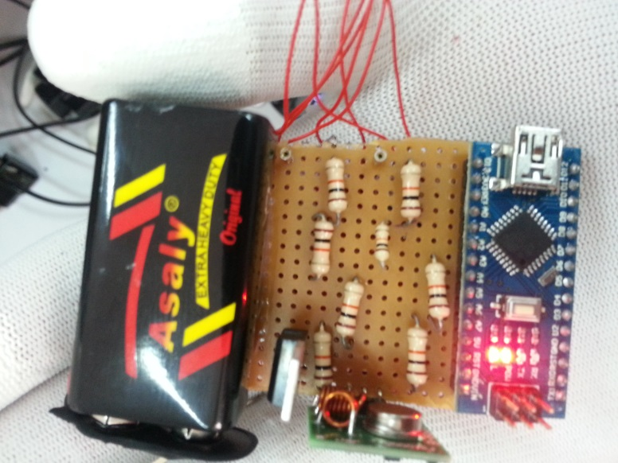
The Glove

Slide 11
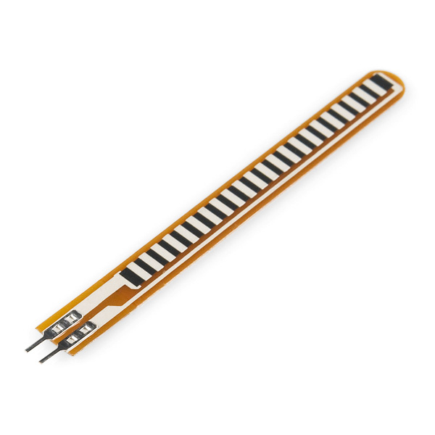
Flex sensors
Flex sensors are sensors that change in resistance depending on the amount of bend.

Slide 12
The Communication
We used a wireless module to build a communication channel between the control unit and the hand.
By using a wireless communication module, the hand and the glove can be at different locations

Slide 13
Communication cont’d
We used RF 433MHz sender receiver module.
The microcontroller at the glove side prepares the data and sends it through the RF sender.
The microcontroller at the receiver side receives the data and generates commands to the servos.

Slide 14
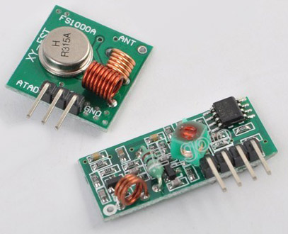
Communication cont’d
An Arduino library was used to implement the communication protocol.
Max distance between the sender and receiver can reach 50m.

Slide 15
Future work.
For the future work we will try to design the whole arm of the robot and we will try providing the user with arm sensors and an accelerometer to capture the movement of the user’s arm

Slide 16
Demo

Slide 17
Thank you :D :D

