Slide 1
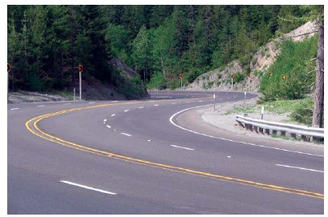
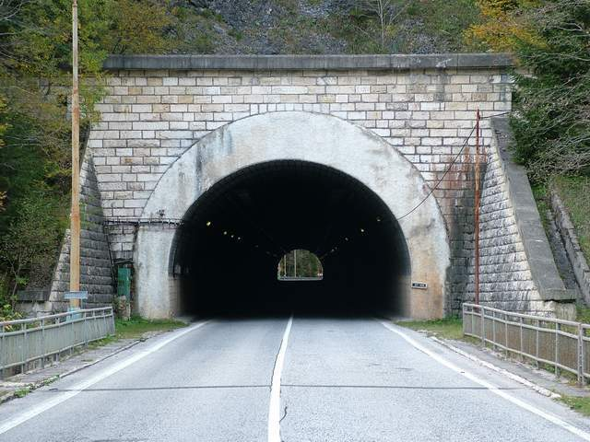

Slide 2

An – Najah National University
Faculty of Engineering
Civil Engineering Department
Pavement Design For Bizzarya – Deir Sharaf highway
Prepared by: Akram Awwad
Zafer hasson
Supervisor : Dr. Sami Hijjawi
2012

Slide 3
Project outline:
Project description,
Highway problems,
Soil properties,
Traffic data,
Traffic analysis,
Flexible pavement layers,
Rigid pavement design,
Rigid pavement execution,
Slope stability problem, And
Budget evaluation.

Slide 4
Project description

Slide 5
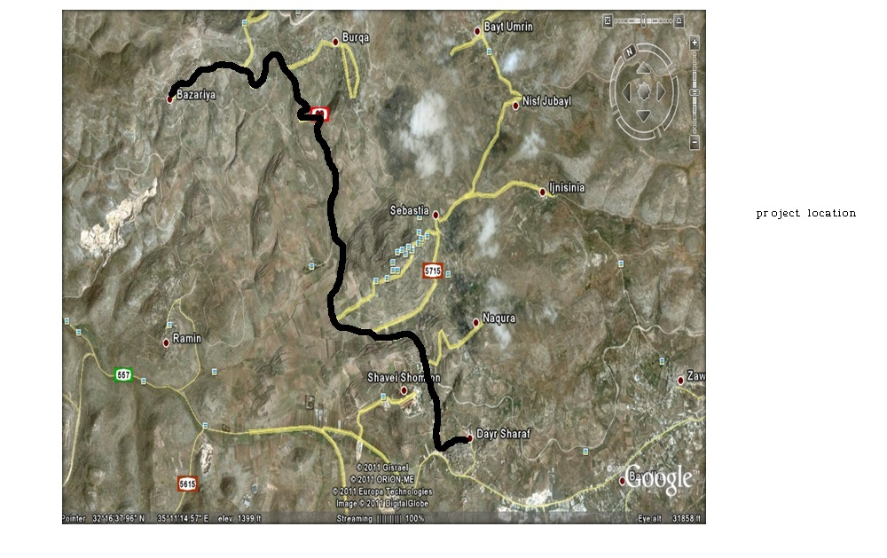

Slide 6
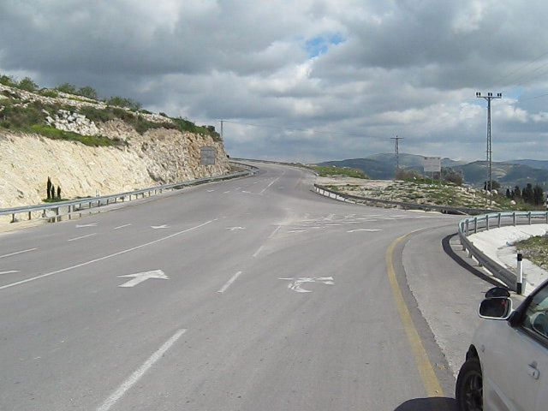
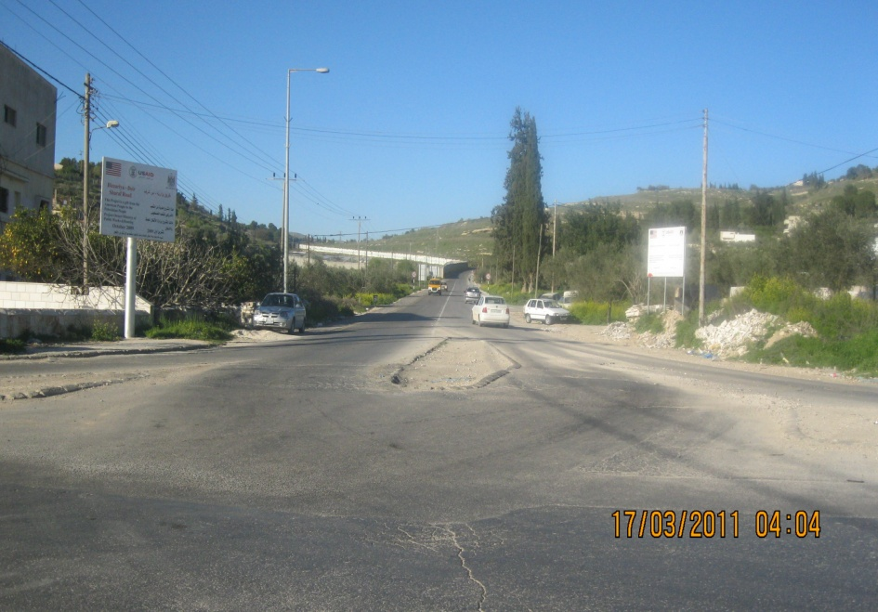
Bizzarya inter section at the end of the highway
Deir – Sharaf intersection

Slide 7
Highway Problems
Cracks in pavement
Slope stability
Drainage
Geometric problems
Others…

Slide 8
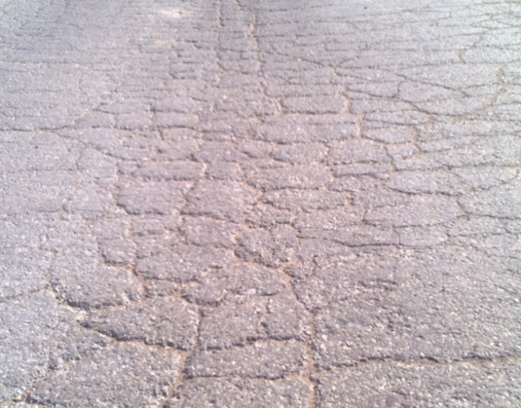
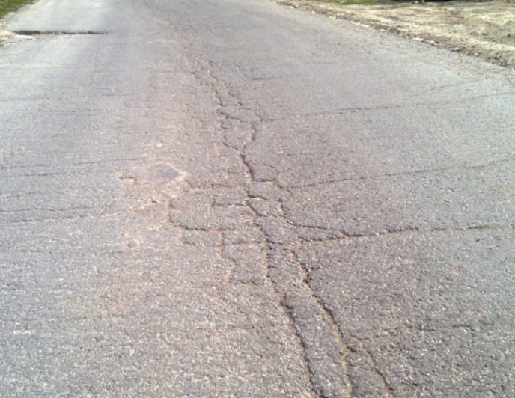
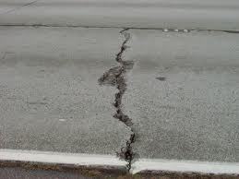
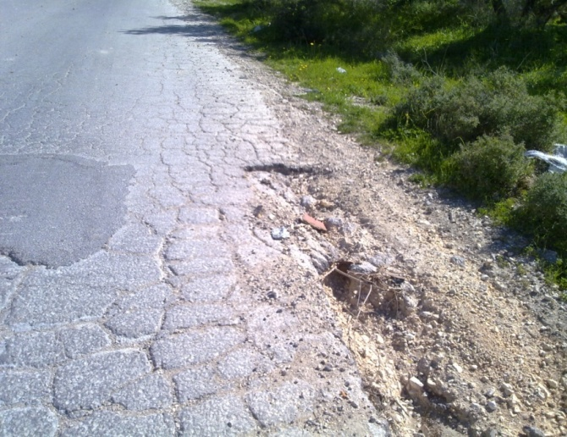
Alligator Cracking
Pavement cracks
Longitudinal cracking
Transverse crack
Edge crack

Slide 9
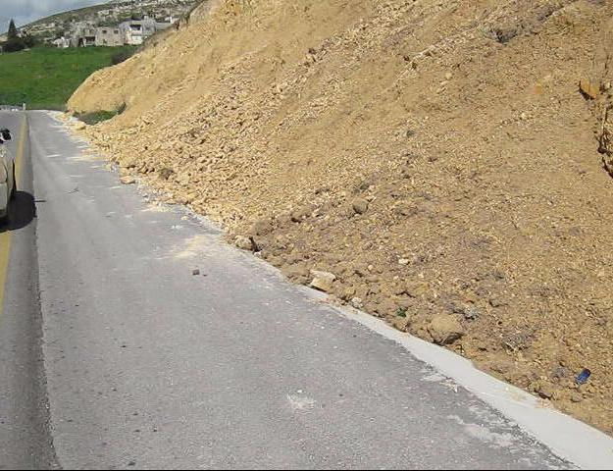
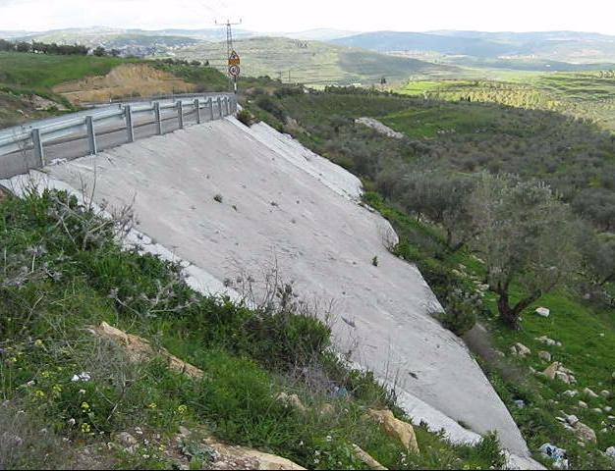
Slope stability problems
Unstable cut area
Slope stability – Burqa village

Slide 10
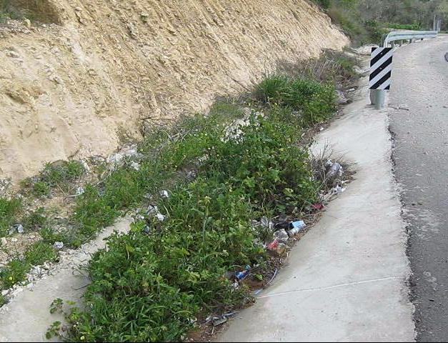
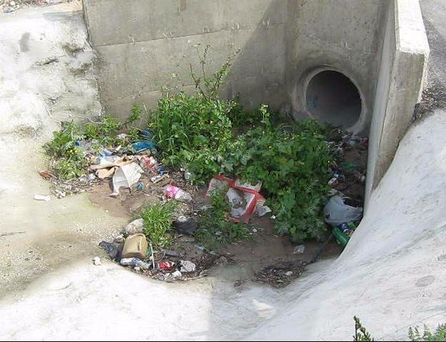
Closed ditch
Drainage problems
Closed culvert

Slide 11
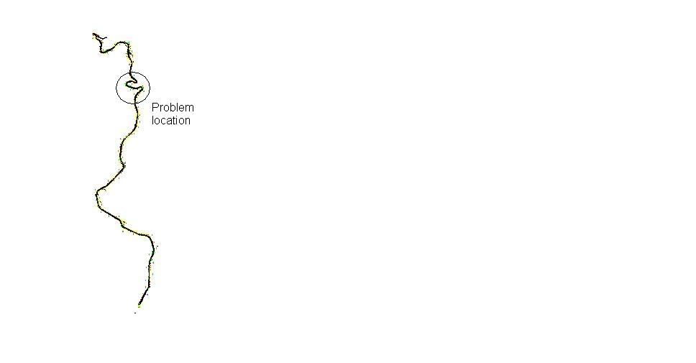
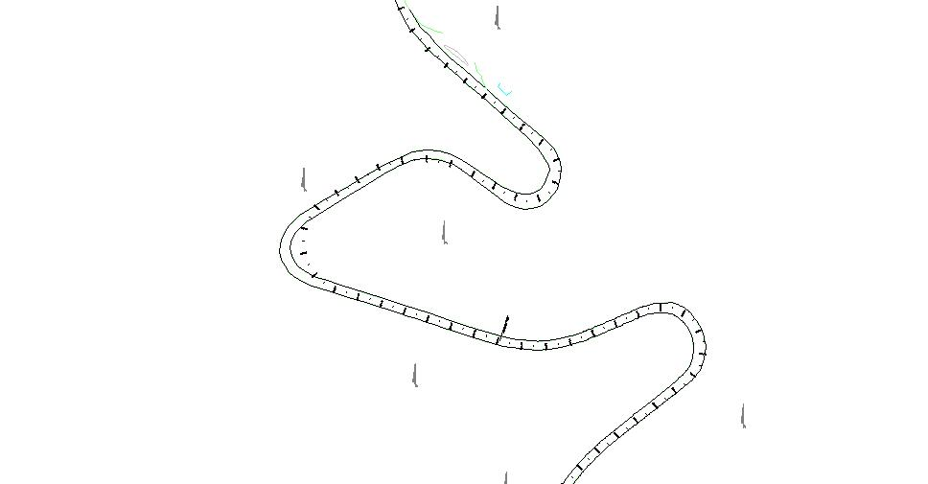
Geometric problems

Slide 12
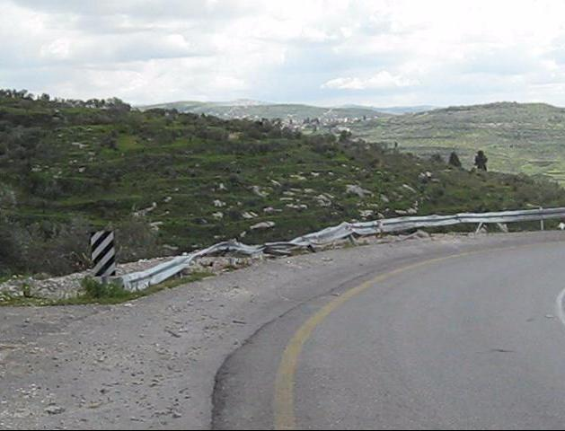
Damaged barrier

Slide 13
Soil description
Station | Soil description
0+000 | Soft formation of grayish marlstone
0+150 | Soft formation of grayish marlstone
0+450 | Selected fill materials
0+800 | Light brown silty clay with little boulders and organic matters
1+250 | Yellowish brown silty clay
1+800 | Yellowish formation of soft marlstone
2+100 | Yellowish formation of soft marlstone
2+450 | Soft formation of yellowish marlstone
2+720 | Soft formation of yellowish marlstone
3+320 | Light brown silty clay with little bounders and organic matters
3+650 | Light brown silty clay with little bounders and organic matters
4+100 | Light brown silty clay with little bounders and organic matters
4+350 | Light brown silty clay
4+650 | Yellowish formation of soft marlstone
5+100 | White formation of medium hard marlstone
5+510 | Light brown silty clay mixed with very hard chert
6+500 | Light brown silty clay with little bounders and organic matters
7+000 | Light brown silty clay with little bounders and organic matters
7+500 | Light brown silty clay with little bounders and organic matters
8+000 | Light brown silty clay with little bounders and organic matters
8+200 | Light brown silty clay with very little boulders

Slide 14
Traffic data
24 – hours count , An – najah national university , 2000
Not used in calculations.
12 – hours count, First Option Company, Ramallah, Palestine
26/8/2008, 12 – Hours counting:
Peak hour (15:00 – 16:00)
Peak hour volume (PHV) = 242 Veh.
27/8/2008, 12 – Hours counting:
Peak hour (8:00 – 9:00)
Peak hour volume (PHV) = 265 Veh.
4 – Hours counting (7:00am-9:00am & 3:00pm-5:00pm) performed in Wednesday 16/3/2011 on Bizzarya – Deir Sharaf road for two directions counted every 15 min. this counting obtained by (Ring Road Graduation project 2011, students; Mohammad Assrawi, Odai Salahat, Nidal Abu Aisheh)

Slide 15
Traffic analysis
Percent of 4 – hours count to 12 – hours = 37%
Percent of 12 – day hours to the 24 - hours traffic = 85%
Percent of 4 – hours to 24 – hours traffic = 0.37 * 0.85 = 30%
Expansion factor = (total day traffic / particular hour traffic) = 1/0.30 = 3.3

Slide 16
Pavement design

Slide 17
Segments for design…
Segment | Station (m) |  | Segment length (m) | CBR %
 | From | To
1 | 0+000 | 1+250 | 1,250 | 8
2 | 1+250 | 4+650 | 3,400 | 6
3 | 4+650 | 5+100 | 450 | 45
4 | 5+100 | 8+200 | 3,100 | 3

Slide 18
Flexible pavement layers
Segment | Sub – Grade CBR | Station (m) |  | Depths (cm)
 |  | From | To | Asphalt | Base course | Sub - base
1 | 8 | 0+000 | 1+250 | 7 | 20 | 15
2 | 6 | 1+250 | 4+650 | 7 | 20 | 15
3 | 45 | 4+650 | 5+100 | 7 | 30 | ----
4 | 3 | 5+100 | 8+200 | 7 | 25 | 30

Slide 19
Rigid pavement design
Thicknesses
Segment | Sub – Grade CBR | Station (m) |  | Depths (cm)
 |  | From | To | Concrete | Sub - base
1 | 8 | 0+000 | 1+250 | 15 | 25
2 | 6 | 1+250 | 4+650 | 15 | 30
3 | 45 | 4+650 | 5+100 | 15 | 15
4 | 3 | 5+100 | 8+200 | 15 | 30
Reinforcement
Segment | Steel location | Diameter and spacing | Number of bars/piece
All segments | Long. Temperature steel | 1ф8 /15 cm | 24
 | Trans. Temperature steel | 1ф8 /30 cm | 40
 | Dowel Bars | 1ф32 / 30 cm | 12
 | Tying Bars | 1ф20 / 90 cm | 14

Slide 20
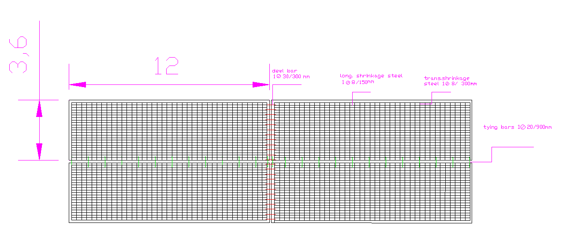
Reinforcement distribution

Slide 21
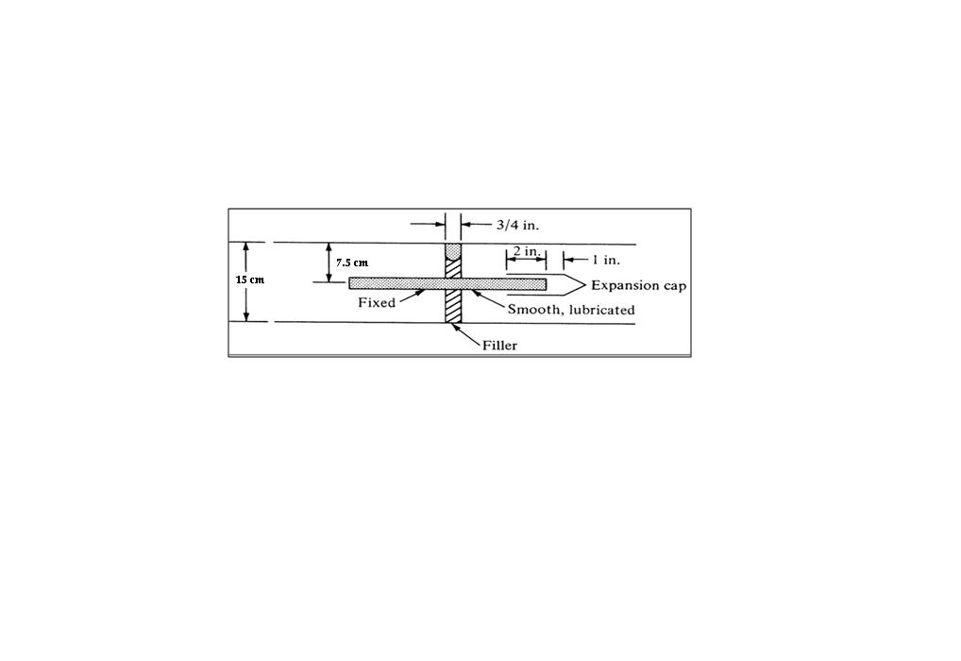
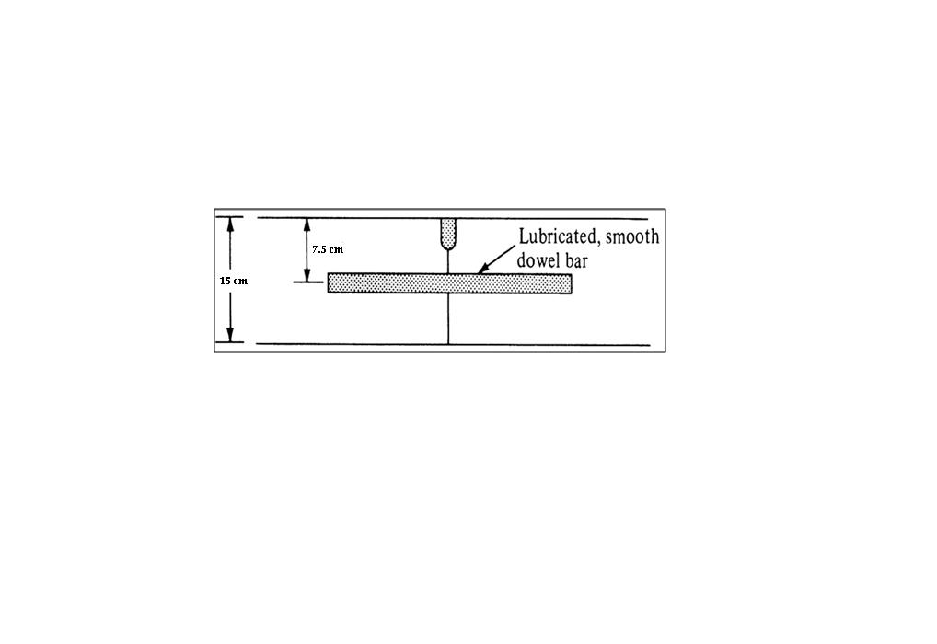
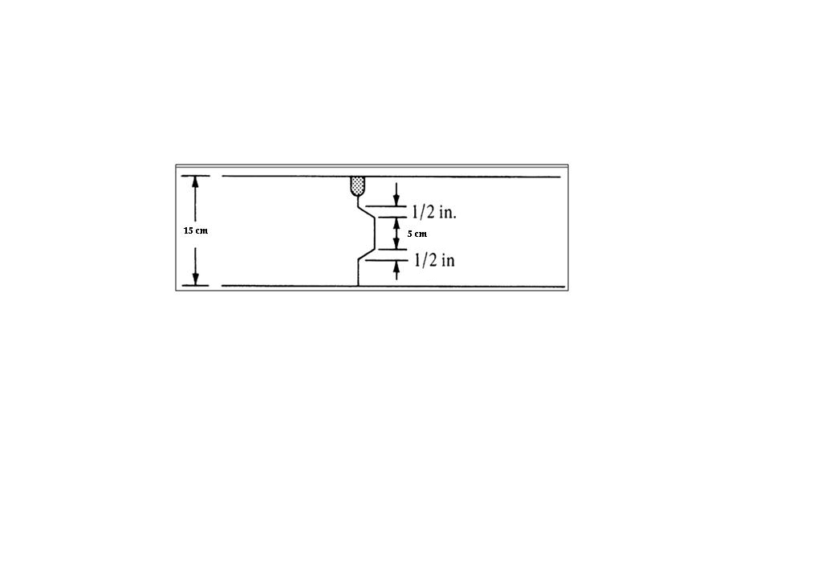
Joints design
Expansion joint design
Contraction joint design
Hinge joint design

Slide 22
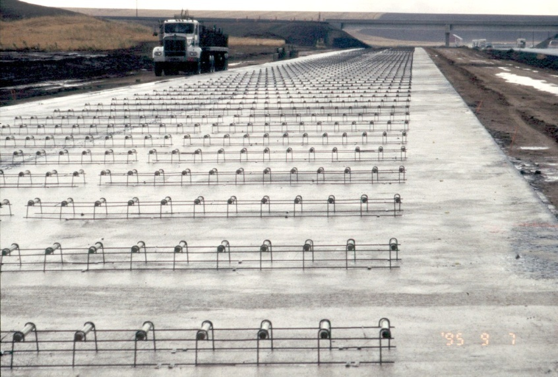
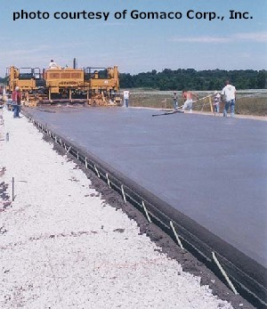
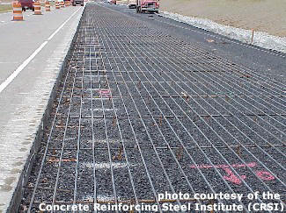
Dowel bars
Rigid pavement execution
Tying bars
Shrinkage steel

Slide 23
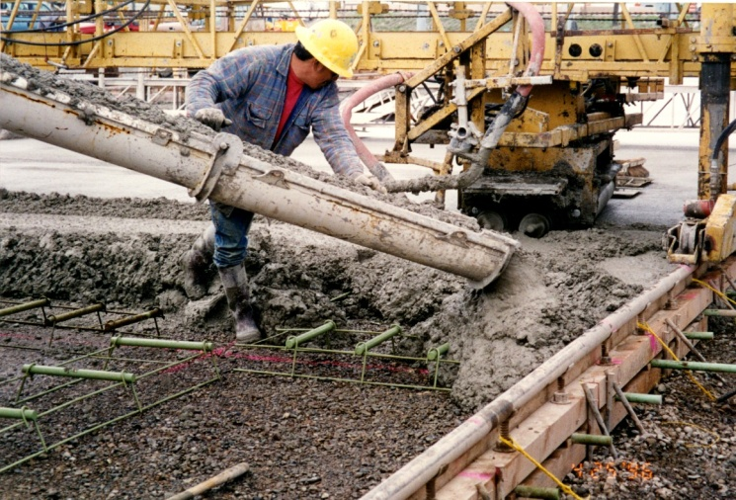
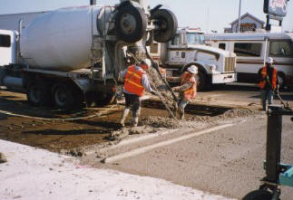
Concrete placement

Slide 24
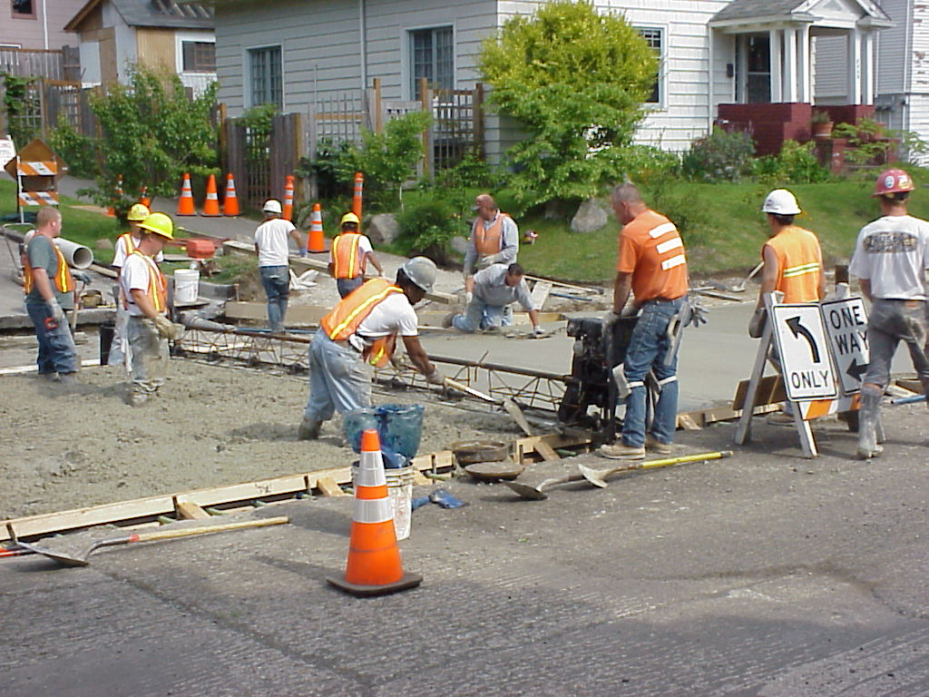
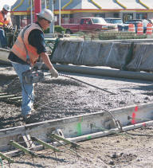
Vibrating

Slide 25
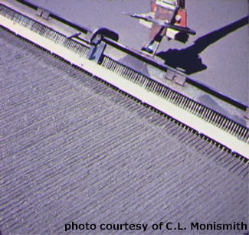
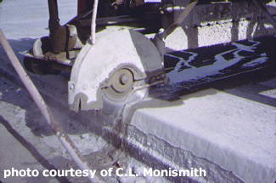
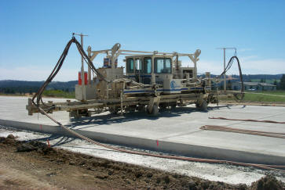
Finishing and sawing

Slide 26
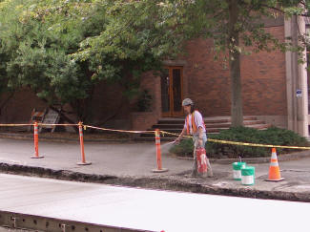
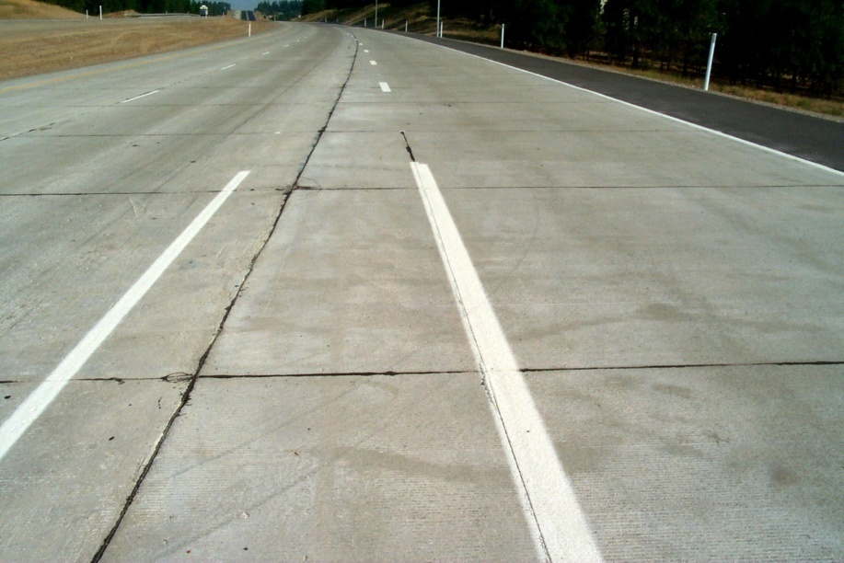
Concrete and joints sealing

Slide 27
Slope stability

Slide 28
Burqa intersection located In segment 4 at stations (from 5+100 to 8+200) and the type of soil as the following table
No. | Station (m) | Depth (m) |  | Description | W (%) | Finer sieve #200 (%) | PI | MDD (g/cm³) | O.M.C (%) | CBR (%)
 |  | From | To
14 | 5+100 | 0.25 | 1.60 | White formation of medium hard marlstone | 8.5 | 17.0 | 2.50 | 1.810 | 7.4 | 45
15 | 5+510 | 0.25 | 2.00 | Light brown silty clay mixed with very hard chert | 9.4 | 27.3 | 26.50 | 1.937 | 7.4 | 10
16 | 6+500 | 0.25 | 2.00 | Light brown silty clay with little boulders and organic matters | 14.3 | 46.0 | 12.50 | 1.900 | 14.2 | 15
17 | 7+000 | 0.25 | 2.00 | Light brown silty clay with little boulders and organic matters | 14.5 | 78.0 | 12.50 | 1.642 | 15.5 | 3
18 | 7+500 | 0.25 | 2.00 | Light brown silty clay with little boulders and organic matters | 14 | 81.0 | 12.70 | 1.638 | 15.0 | 3
19 | 8+000 | 0.25 | 2.00 | Light brown silty clay with little boulders and organic matters | 14.3 | 80.0 | 12.20 | 1.645 | 15.3 | 3
20 | 8+200 | 0.37 | 2.00 | Light brown silty clay with very little boulders | 22 | 90.0 | 22.00 | 1.635 | 23.5 | 2

Slide 29
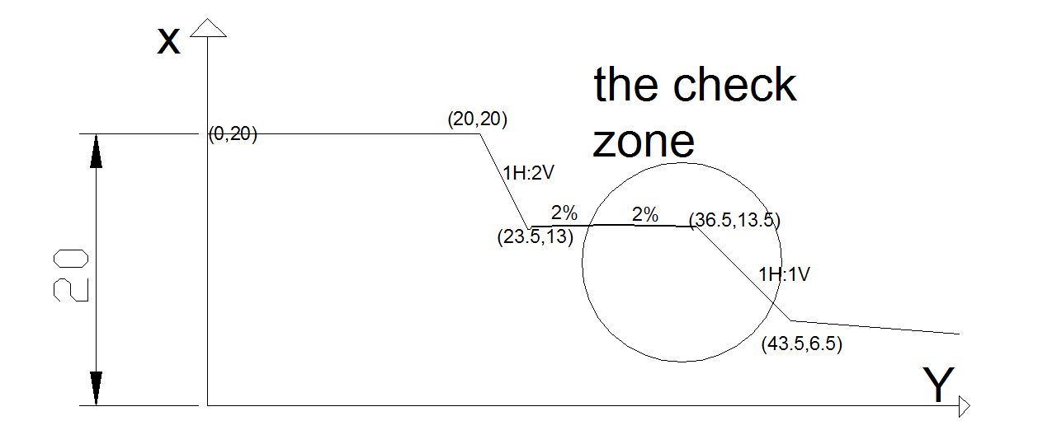
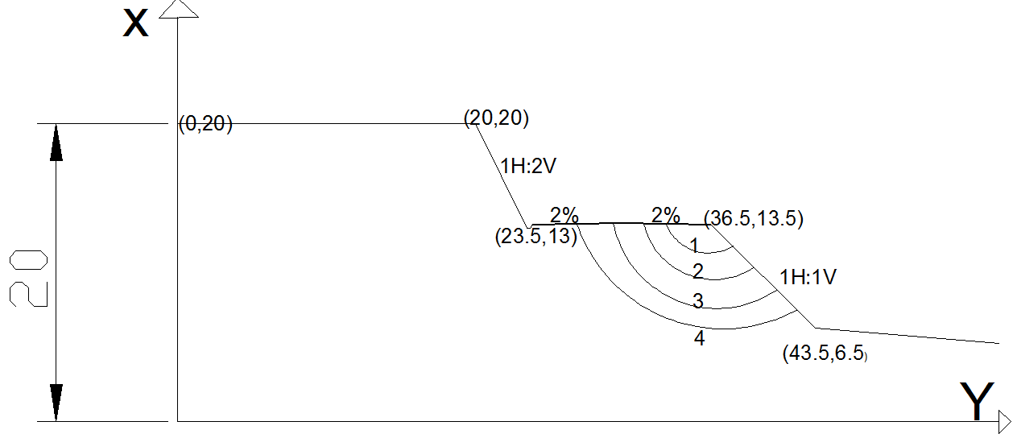

Slide 30
Factor of safety = 1.67 > 1.5 … OK

Slide 31
In general , the lands beside the Burqa intersection is agricultural , so the soil is weak and can be absorbed the water in winter season ,then it will collapse. So the lab. Test (Tri – axial unconfined test ) gives the following data:
Cohesive (c in KN/m²) | Phi ( in degrees) | Unit weight (ɣ in KN/m³)
35 | 8 | 18
And the load traffic = 20 KN/m²

Slide 32
Budget evaluation

Slide 33
Rigid pavement cost estimation
Material type | Quantity | unit | Unit cost (NIS) | Cost (NIS)
Concrete | 8856 | M³ | 320 | 2,833,920
Sub – base coarse | 17708 | M³ | 30 | 531,240
Steel φ 32 | 103.689 | Ton | 3500 | 362,912
Steel φ 20 | 23.627 | Ton | 3500 | 82,695
Steel φ 8 | 233.301 | Ton | 3500 | 816,554
Base coarse | 656 | M³ | 50 | 32,800
Total cost (NIS) |  |  |  | 4,660,121
Flexible pavement cost estimation
Cost (NIS) | Unit cost (NIS) | Unit | Quantity | Material type
3,306,400 | 800 | M³ | 4133 | Asphalt
722,650 | 50 | M³ | 14453 | Base course
390,600 | 30 | M³ | 13020 | Sub – base coarse
4,419,650 | Total cost (NIS)

Slide 34
Conclusion:
Flexible pavement is cheaper than rigid pavement, also rigid pavement execution needs high initial investment cost, however it can last for 50 years compared with 25 years in flexible.
Slope stability near Burqa is a critical case because safety factor equals 1.671 and its close to the critical value of 1.5, so suitable solution should be prepared in future such as soil nailing or boulders above rock layers.

Slide 35
Thank you for your attention

