Slide 1
Selat al-daher water distribution network
Prepared By :
Mohammad Waleed Abu Diak
Anas Wasef Ali

Slide 2
Objective
* Analyze and Redesign the existing
water distribution network in
Selat Al-Daher to be valid for
the next 30 years

Slide 3
Project Description
* Site Selection
* Have a contour and water network maps
* Data Collection
* Analysis the existing water network
* Solve the problems

Slide 4
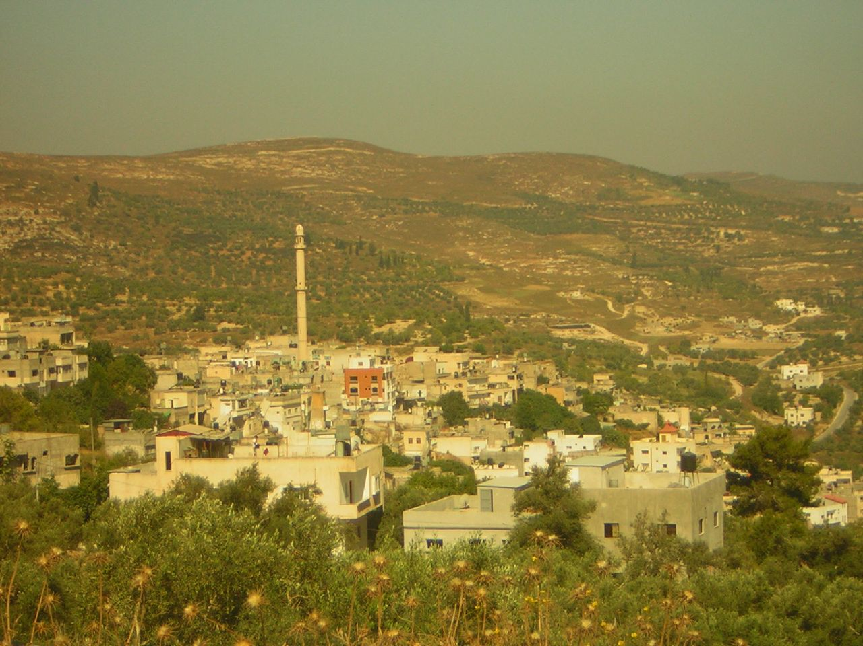
Study Area
Selat Al-Daher
* Located 14 km south of Jenin
* Current population is 6900 capita
51% males and 49% females
* The Average height of the town is 400 m
* Surrounded by Al-Attara,
Al-Fandaqomia, Burqa And Bezarya

Slide 5
Precipitation rates
Temperature rates

Slide 6
Questionnaire Analysis
* Family Size is 7 persons per family
* Average daily consumption is 69 l/c/day
*Average daily demand is 106 l/c/day

Slide 7
Education

Slide 8
Monthly Income

Slide 9
Farms Percentage

Slide 10
Existing Water Distribution
Network
* The source of water is Mekarot
* Losses in the network equal to 35 %
taken from minisipilaty
* No As-Built plan for the network

Slide 11
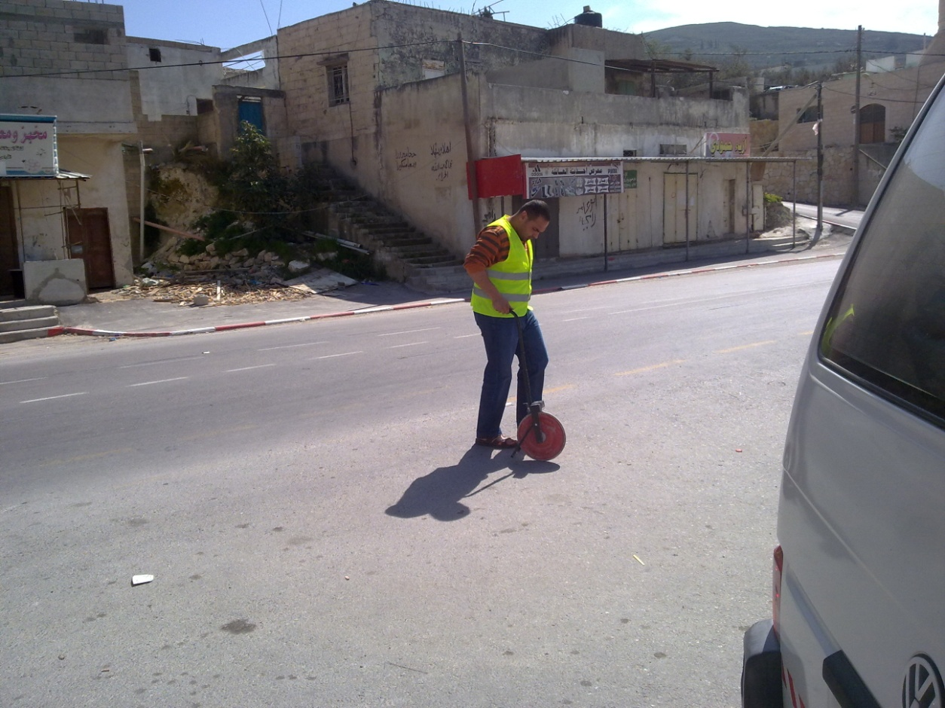

Slide 12
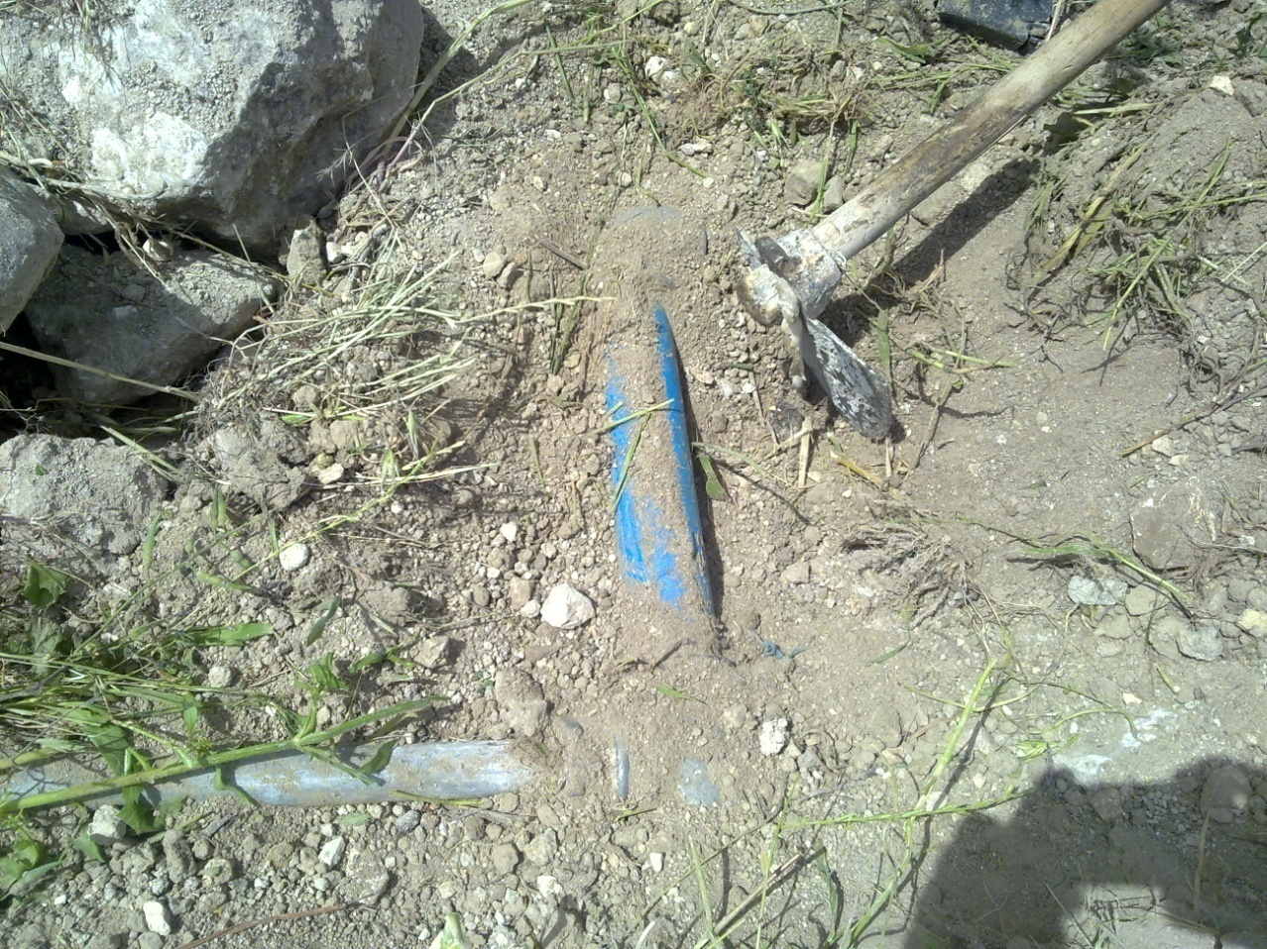

Slide 13
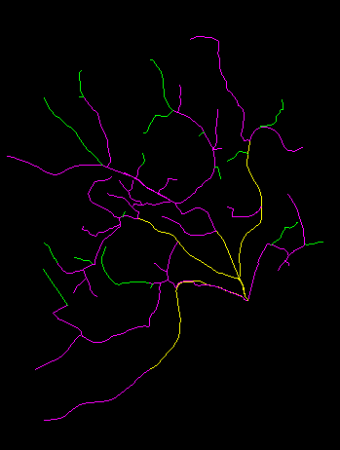

Slide 14
Epanet Analysis for
Existing Network
* 6 main water supply pipes
Presented with two reservoirs
* Only one pump
* Demand pattern equal to 5
* Many Problems discovered

Slide 15

Future Design
* Design Period is 30 years
* Population Equation is $P_{f}=P_{p}{(1+i)}^{n}$
* Growth Rate is 1.836%
* Population at 2041 is 11909 capita
* Steel Pipes used with 110 HW coefficient

Slide 16
* Assumed value of consumption
is 120 l/c/day
* Physical Losses in the network is 15%
* Future Demand is 141 l/c/day
* Future demand factor is 2.294

Slide 17
Design Constraints
* Velocity Limit 0.1 – 3 m/sec
* Pressure Limit 30 – 160 m

Slide 18
Future Epanet Run
* Two Runs, Before and after
Redesign the network

Slide 19
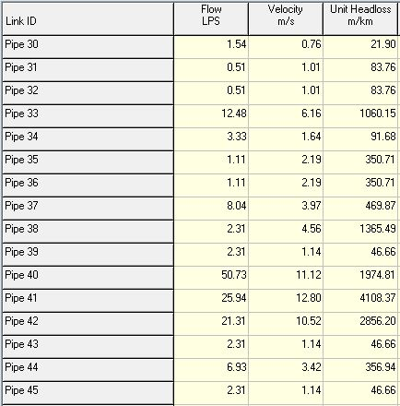
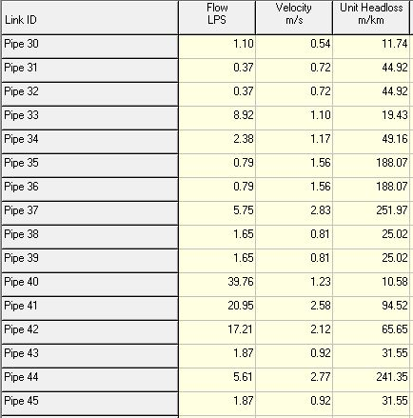
Before
After

Slide 20
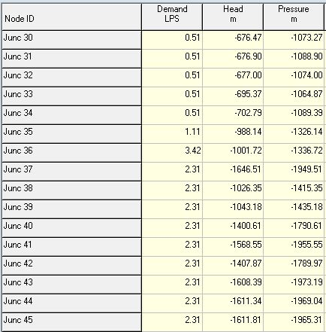
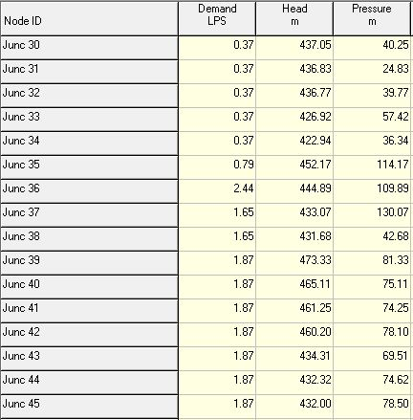
Before
After

Slide 21
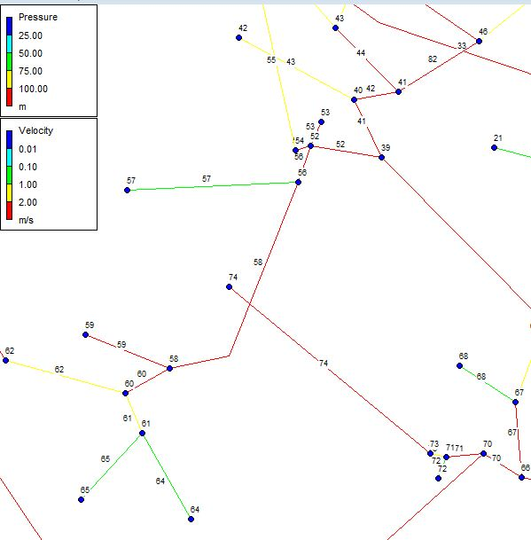

Slide 22
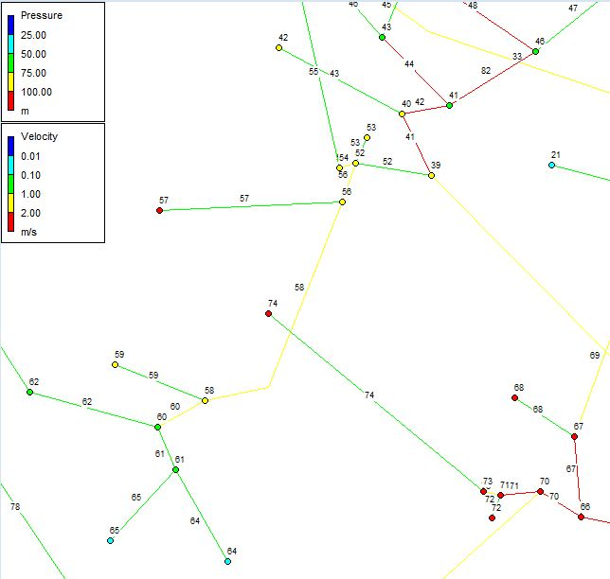

Slide 23
Results and recommendations
* Min Velocity is 0.18 m/sec
* Max velocity is 2.95 m/sec
* Min Pressure is 9.88 m
* Max pressure is 171.23 m
* PRV recommended to be used in two links

Slide 24
Cost of the Project
Total Cost for each diameter size
Cost($) | Cost($/m) | Pipes length | Diameter
25004 | 28 | 893 | 2
78948 | 45 | 1754.4 | 3
91665.6 | 52 | 1762.8 | 4
59828.8 | 61 | 980.8 | 6
58603.6 | 76 | 771.1 | 8
314050 |  | 6162.1 | Total

Slide 25

Thank you so much

