Slide 1
Inter- City Public Transport System for Nablus

Slide 2
Introduction
Nablus is the largest city in the West Bank after Jerusalem.
150,000 inhabitants live in Nablus .
Nablus has the largest university in the West Bank with around 20,000 students.

Slide 3
Many businesses have either moved from or have been established outside Nablus.
Three complexes were constructed to serve the inter-city public transportation in Nablus City.

Slide 4
Current Problems
Congestion
Delay
Safety
Pollution
Time waste and fuel consumption
Economic view

Slide 5
Objectives
To improve the current traffic system in order to create a new system that connect the internal and external movements through the city.
Applicable solution to solve the current problems for at least 20 years.

Slide 6
Data Collection Composition
Maps
Photos
Traffic counts
Average headway
Routes specification
Number of spaces

Slide 7
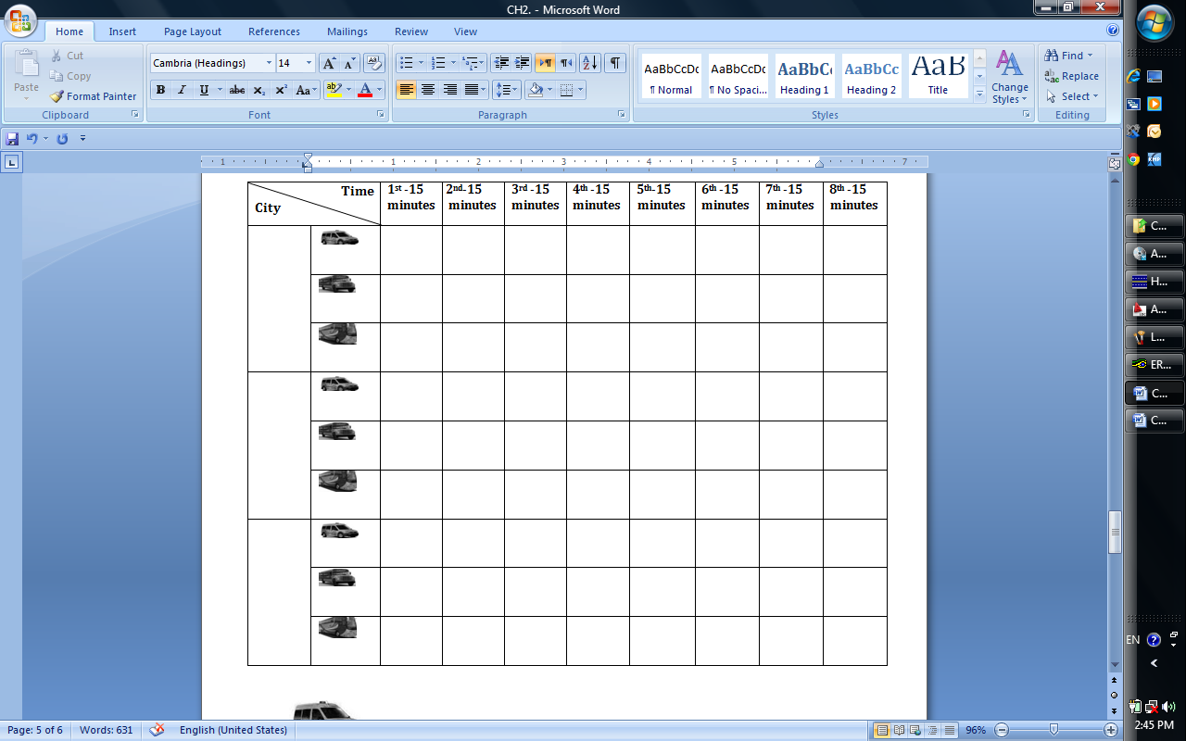
Table 2.1: Data collection form

Slide 8
Table 3.1: Total number of vehicles entering and leaving the complexes over two hours period
Public transport complex | Representative day (Monday, Tuesday) |  | Peak day (Thursday)
 | Inbound | Outbound | Inbound | Outbound
Western complex serves cities | 190 | 148 | 204 | 248
Western complex serves villages | 265 | 271 | 260 | 306
Eastern complex | 336 | 399 | 392 | 466

Slide 9
Table 3.2: Total number of registered vehicles and parking spaces
Public-transport complex | Number of available parking spaces | Number of registered vehicles
Western complex serves cities | 19 | 391
Western complex serves villages | 39 | 146
Eastern complex | 31 | 334

Slide 10
Solutions
Reallocation of the public transport complexes away from the CBD.
Providing an internal transport system .

Slide 11
Reallocation the complexes
Two separate public transport complexes at the two outskirts of the city.
Two available land spaces each is around 17 donums.

Slide 12
to estimate the number of passengers during the project period. The following relationship was used:
F = P (1+ i ) ^n

Slide 13
The project has a design period of 20 years.
An assumed value of 1.5% is considered as Passenger’s growth rate.
1900 passengers/hr is the current maximum number of passengers(271 veh/hr)

Slide 14
Total area of 4.6 dunoms is required as parking spaces and circulation area for vehicles in the new western public transport complex.
Only 3.2 dunoms required for the eastern complex.

Slide 15
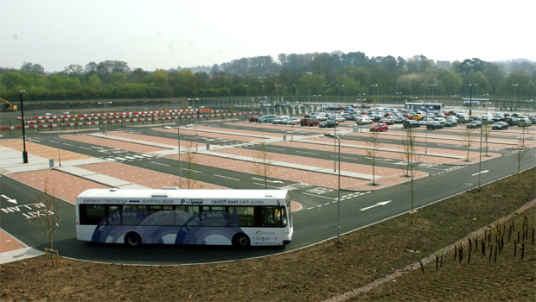
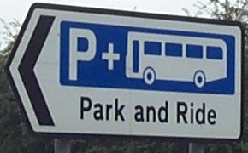
Remaining area can be used as vehicles storage, private cars parking “ park and ride” ,coffee shops and restaurants, shopping centers, waiting hall, etc

Slide 16
Internal Public Transport System
Connect between the suggested locations of the public transport complexes.
Cover the needs of the city.
Several options can be suggested as internal transport system .

Slide 17
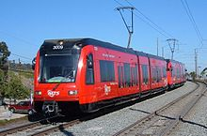
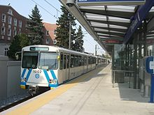
International Systems of Internal Public Transportation
Light Rail System

Slide 18
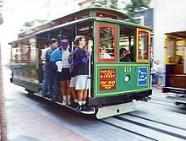
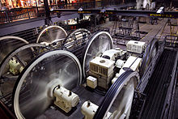
Cable Cars System: either traditional or modern

Slide 19
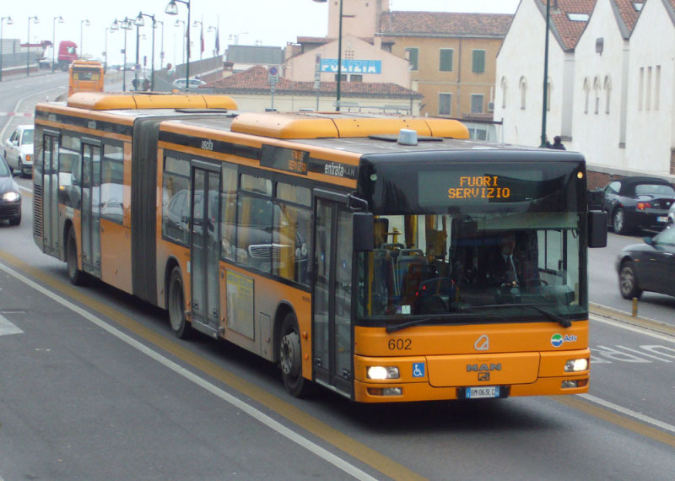
Bus Rapid Transit : provide faster than an ordinary bus line

Slide 20
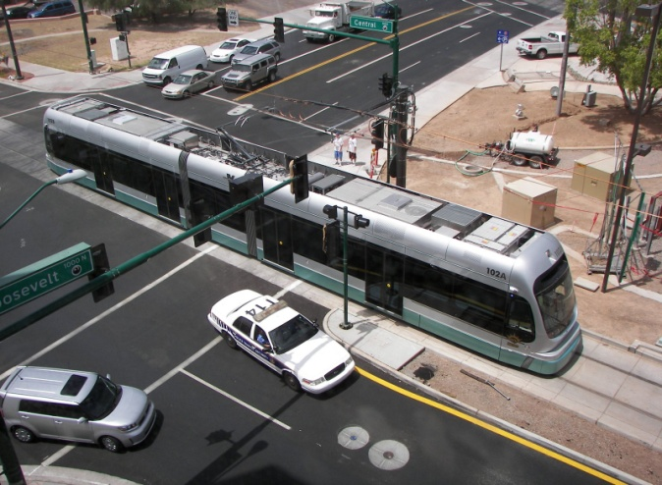
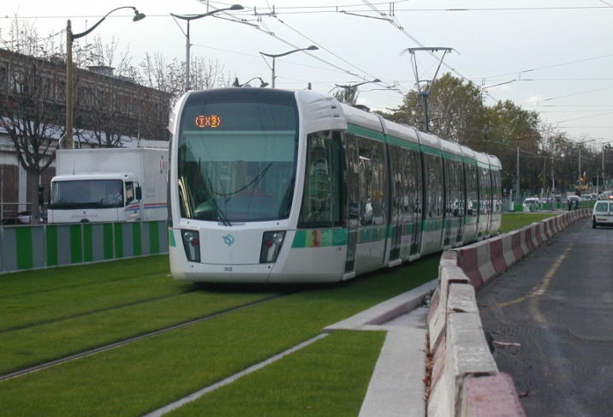
Trams

Slide 21
Why Tram?
Provide higher capacity service than buses.
Load faster that other type of vehicles.
Trams’ stops are easily accessible
Right-of-way are narrower than for buses.

Slide 22
Can adapt to the number of passengers .
Can be driven from either end.
Create less pollution than the vehicles using rubber tires.
Efficient and operating costs are low.

Slide 23
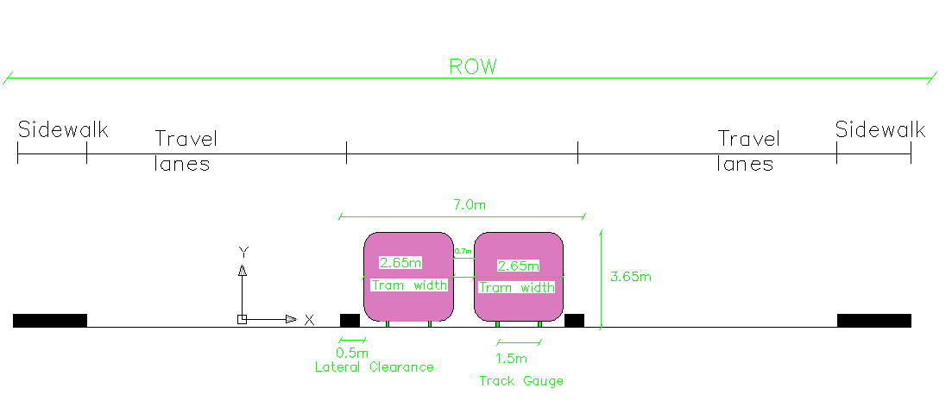
Distance reserved by trams from each street along tram path is around 7 meters except when the two track separate at Faisal street. The distance will be 4 meters.

Slide 24
Street | Width | Remaining width after tram construction for each direction | Comments
Al-Ziot Street | 20-25 | 7-9 | -
Jamal abd Al-Naser Street | 30 | 11.5 | -
Faisal Street at the separation of the track | 20 | 13 | -
Faisal Street after the two tracks meet again (around 500m long) | 15 | 4 | Widening is required
Haifa Street | 30 | 11.5 | -

Slide 25
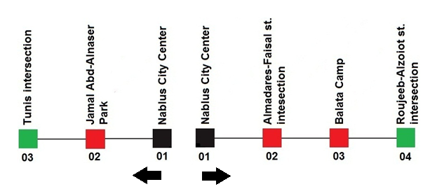
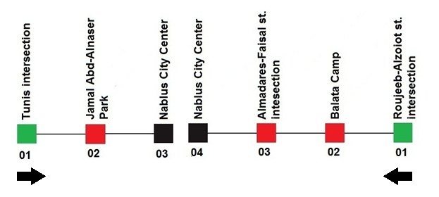
Map shows the trams routes served during the day hours

Slide 26
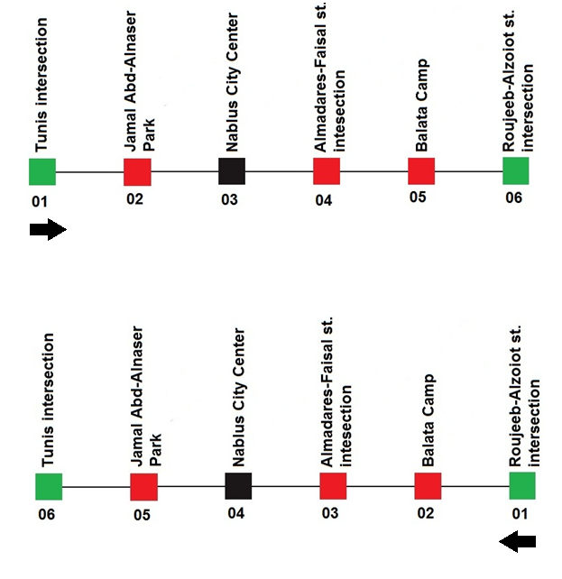
Routes served by two trams during night hours

Slide 27
Capacity of the tram was calculated based on the following assumptions
Tram will carry 60% of the whole number of passengers. The other 40% may not need to use the tram to go into or out of the city center.

Slide 28
Two trams will serve each public transport complex.
Each tram needs an estimated time of 30 minutes to complete one round (including stops).

Slide 29
The two trams serving one route will be separated by 15 minutes.
Most common vehicle is currently the shared-taxi which carries 7 passengers
Annual growth rate of 1.5% for passenger demand.

Slide 30
Average number of passengers using tram/15min | Number of passengers using tram/hr | Number of passengers/hr | Number of veh/hr | Number of years
285 | 1138 | 1897 | 271 | 0
330 | 1321 | 2202 | 315 | 10
383 | 1533 | 2555 | 365 | 20
445 | 1779 | 2965 | 424 | 30
516 | 2065 | 3441 | 492 | 40
599 | 2396 | 3994 | 571 | 50
695 | 2781 | 4635 | 662 | 60

Slide 32
For a design period of 20 years the tram required to carry 383 every 30 minutes.
Tram of 400 capacity will be efficient to serve the city such as the tram in Stockholm.
25% of daily trips to Balata Camp and Al-Ain Camp will be replaced by the tram.

Slide 33
Route | Number of trips per hour
Balata refugee camp | 240
Ain Beit Al-ma’ camp | 115

Slide 34
Faisal street is considered as a multilane highway .
LOS for Faisal street was calculated by using HCS2000 program (Highway Capacity Software)

Slide 35
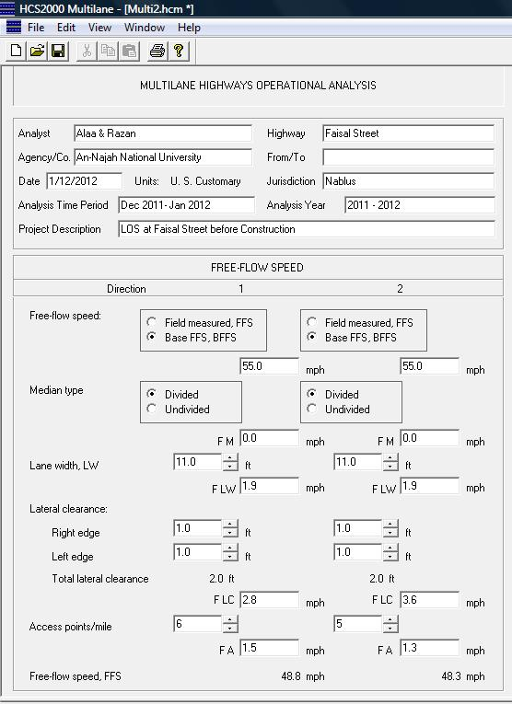
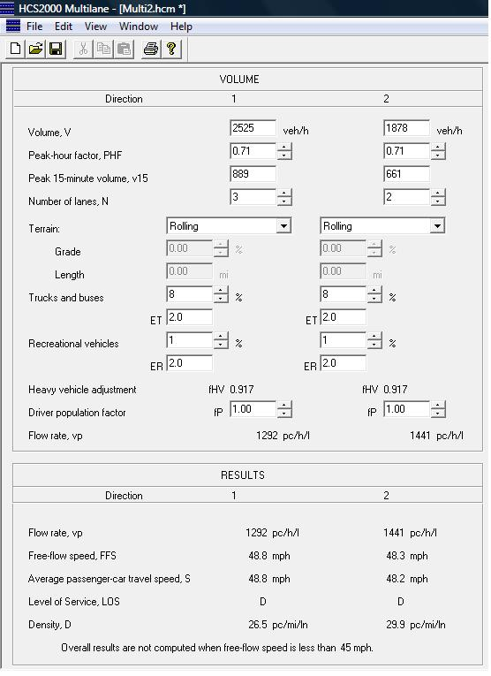

Slide 37
The current Level of service for Faisal street is D which is resulted from the high volume of traffic along the street.
The provision of tram along Faisal Street will improve the LOS to become C.

Slide 38
Project Constraints
The studied project will serve for 20 years.
Available budget.
Tram transit system feasibility.

Slide 39
Bus rapid transit can be considered as an alternative transportation system for the near future.
The BRT will follow the same route designed for the tram.

Slide 40
Recommendations
Study the impact of the tram on the overall movement of traffic along and crossing the tram path at intersection.
Provide a preemption system at intersections controlled by signals to give priority for the tram path.

Slide 41
Conduct a feasibility study for the suggested system to take into consideration capital and operating costs of the tram system, estimated impact on the overall traffic operation for the network impacted by the tram, etc.

Slide 42
Consider overpass for tram at intersection with major location in the CBD area.
Study for the suggested tunnel of pedestrians that will connect the main station at Al- Watani Hospital with the CBD area.

Slide 43
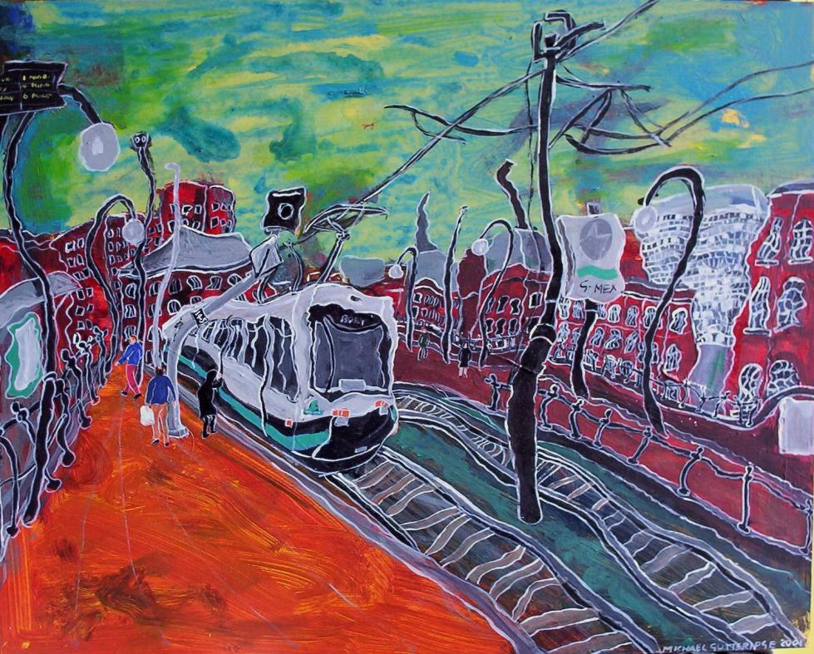
THE END

