Slide 1

An-Najah National University
Civil Engineering Department
Hydrological System of Dead Sea
Dead Sea-Red Sea Project
Submitted By: Masa Wasfi Salous
Supervisor: Dr. Hafez Shaheen

Slide 2
Objectives
Make a water budget for the Dead Sea
properties and characteristics of the Dead Sea
Determine the water resource and the losses, and calculate its volume
Present the Dead- Red canal as a solution of the problem
Elaborate some of hydraulic, environmental, social and political aspects related to the Dead-Red Canal

Slide 3
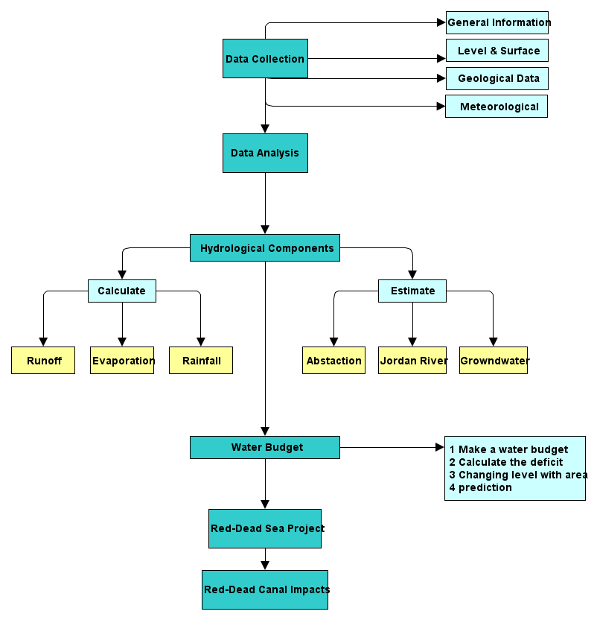
Methodology

Slide 4
Dead Sea
Dead Sea is a closed salt lake bordered by Jordan from east and Palestine from west and it is a part of the geomorphologic depression
It is situated in the deepest part of the Jordan Rift Valley and considered to be the lowest elevation point, and the deepest hyper saline lake in the world.
It is about 423 m deep below the sea level, and about 600 Km long.
Dead Sea catchment area is about 40000 km ^2 in distributed in six countries.
The mountains area are closed the Dead Sea by high mountain walls from east and west.

Slide 5
Dead Sea
Physical & Chemical Characteristics
Dead Sea has a unique chemical composition
high salinity water,33.7% salinity. ten times larger than the other seas
Its density is about 1.22gm/cm³
DS contains a large group of salts and minarets which use in important economic uses.

Slide 6
Climate
The Dead Sea is described as a hot climate, arid region and sunny skies.
In summer the average temperature is about 37.7°C, while it is about 19.2 °C during winter.
High evaporation (2200mm/yr) compare to rainfall about (100 mm/yr)

Slide 7
Level and surface
from the 1960s to 1980s the decreasing of DS level was uniform and it was about 40 cm per year. From 1980s to 2005 the falling was increase to 80 cm per year. After that, the drop increased to reach 1 m or little more

Slide 8
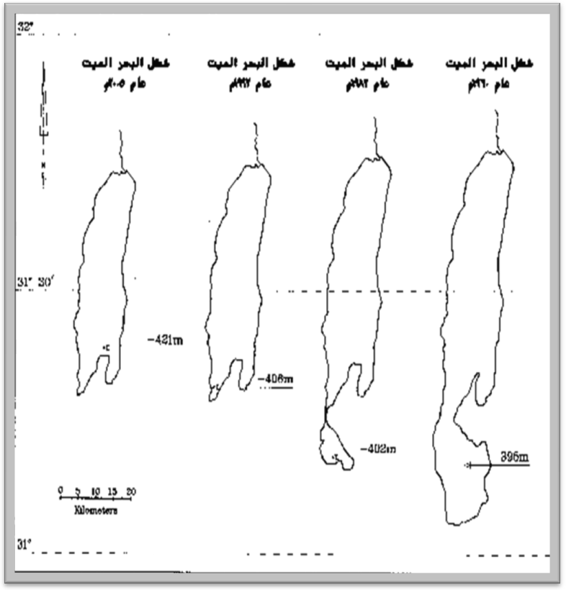
Level and surface

Slide 9
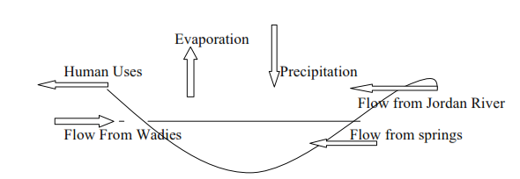
Dead Sea water budget
Hydrologic Model

Slide 10
Water Budget
Inflow
outflow
Direct rainfall
Flow of Jordan river
Runoff from wadies
Groundwater & springs
Evaporation
Abstraction and withdrawing by human

Slide 11
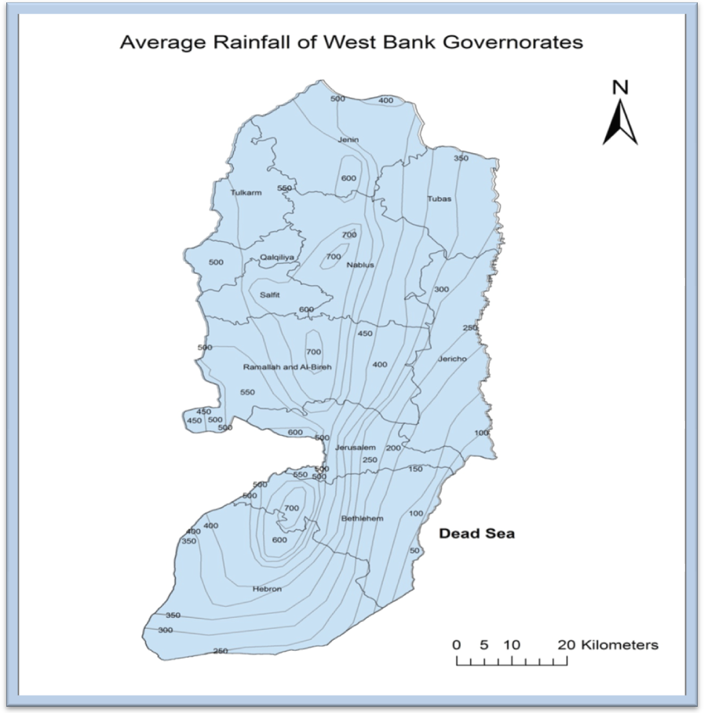
precipitation
Define
Dead Sea

Slide 12
Precipitation
Jericho city from 1995-2010 is about 136.38 mm/year.
North Dead Sea is about 100 mm/year
South Dead Sea is about 60 mm/year
Mid Dead Sea is about 80 mm/year
Arithmetic mean method is used= 94.1 mm/ year
Average area = 704 km²
The annual amount of rainfall on the Dead Sea = Annual Average rainfall (mean value) * Dead Sea Area.
94.1 mm * 704 = 66.25 MCM/year.

Slide 13
Jordan River
Main resource that fed Dead Sea
Originate in the mountains of eastern Lebanon
The main sources of the river water are the Hasbani River, the Banyas River, the Dan River, and the Yarmouk River

Slide 14
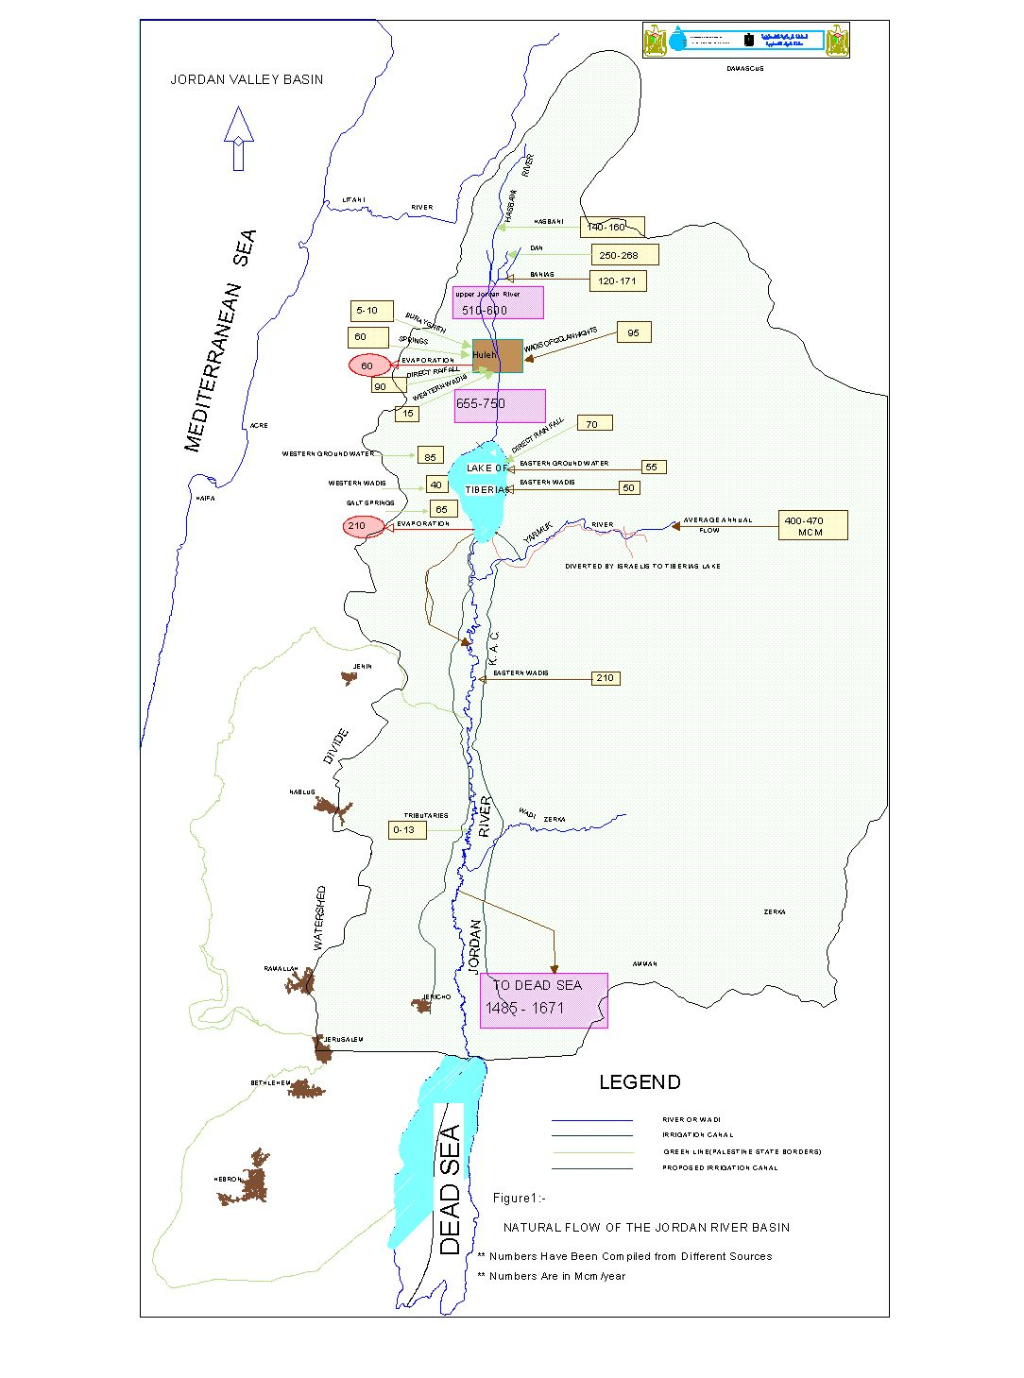
Without utilization

Slide 15
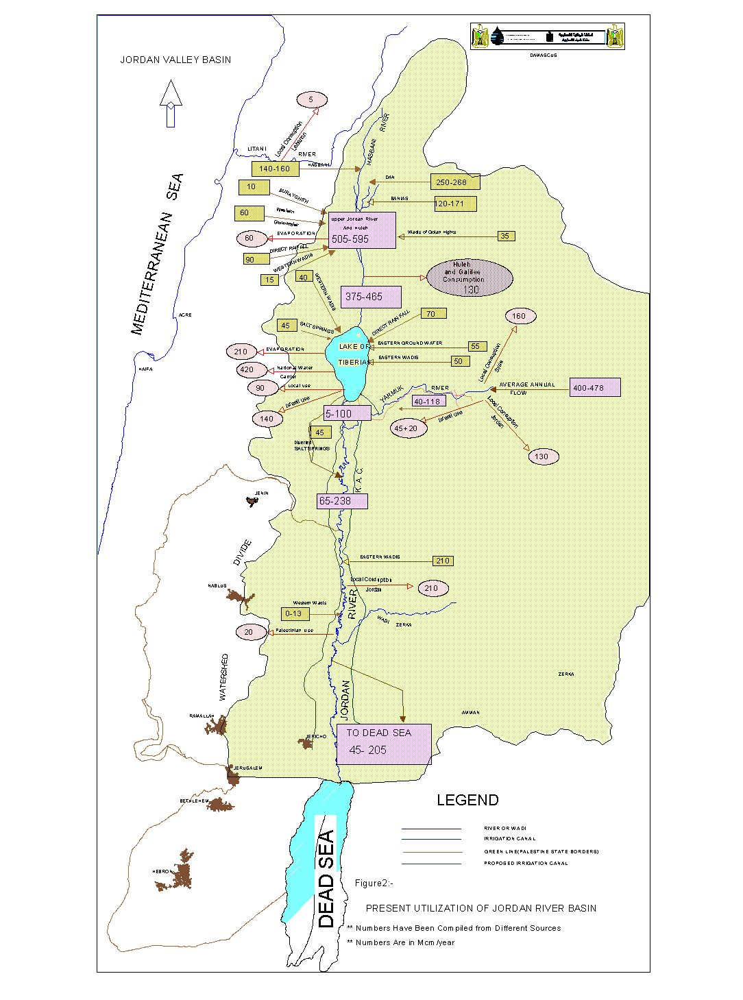
With utilization

Slide 16
Jordan river flow

Slide 17
Consumption of Jordan River

Slide 18
Groundwater & Springs
Groundwater is the water that occurs in the tiny spaces (called pores or voids) between the underground soil particles or in the fractured rocks
Groundwater is a resource that supply the Dead Sea with water. And it is about 125- 172 million m³ per year leak about 90-100 million m³ to the Dead Sea

Slide 19
Dead Sea springs

Slide 20
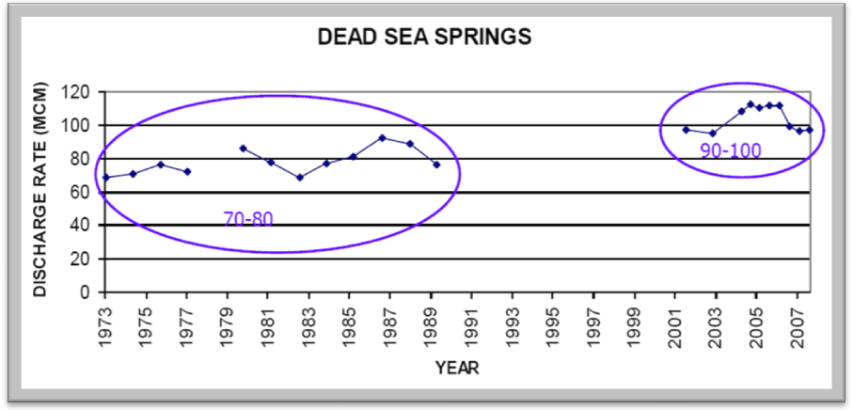

Slide 21
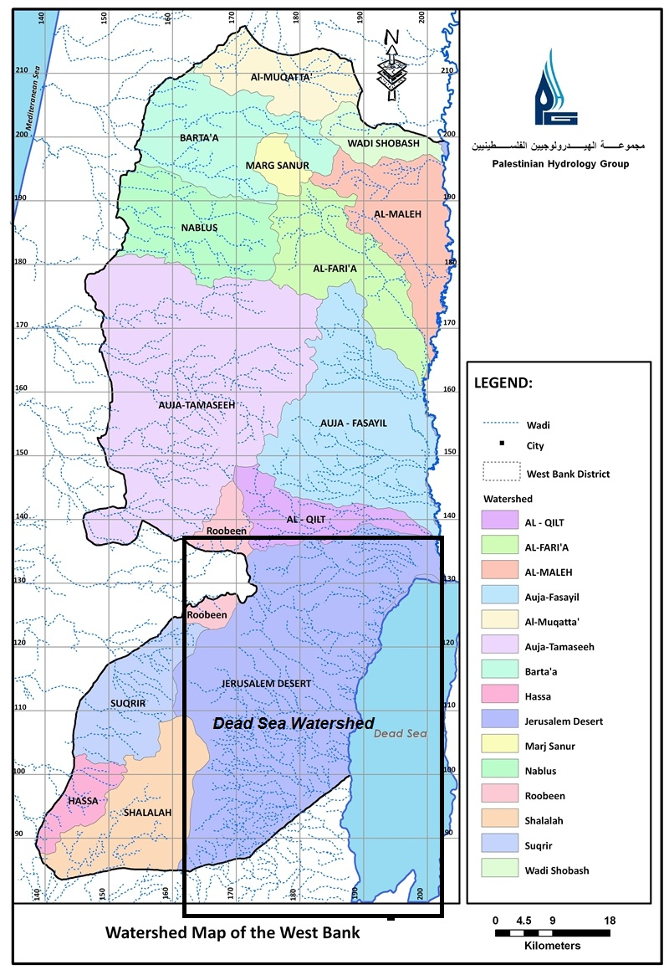
Runoff
Area
Northern area = 1449.197 km²
Southern area = 488.770 km²

Slide 22
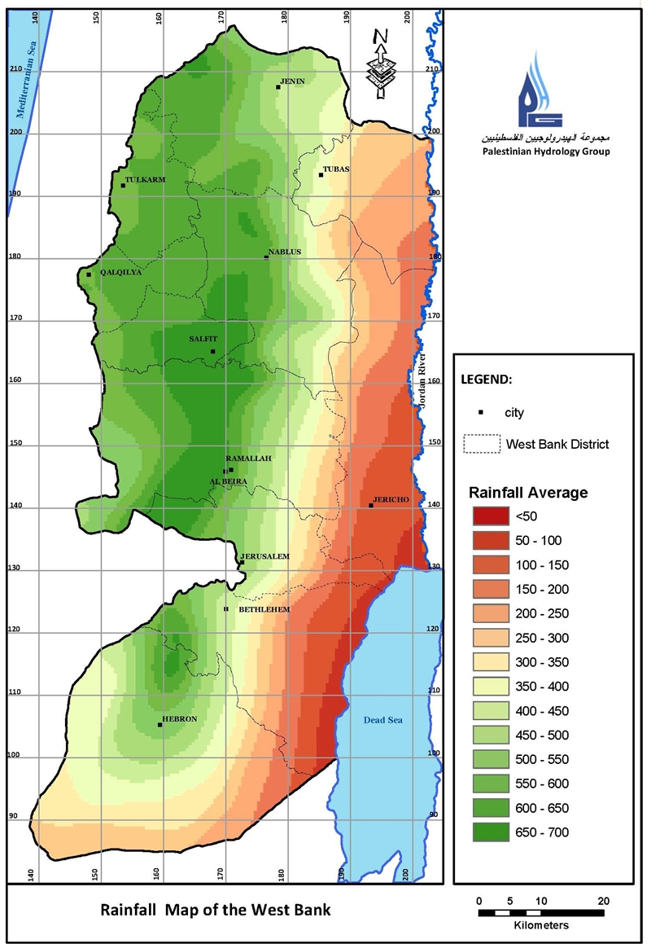
Runoff
Rainfall
Northern area 240 mm/yr
Southern area 100 mm/yr
Rainfall volume= area *average rainfall depth
=347.8 MCM for northern area
= 48 .88 MCM for southern area

Slide 23
Runoff
Coefficient
Take into consider the following characteristics :
Elevation and slops
West bank districts
Geology
Land use
Soil characteristics
By average Weighted method the average runoff coefficient is .296

Slide 24
Runoff
Runoff volume (west side)= rainfall volume * coefficient = 117 MCM/yr
The volume of western runoff is about 117 MCM/yr. And the volume of eastern runoff is 1.4 times:
117 *1.4= 164 MCM.
Total runoff from both side = 281 MCM/yr

Slide 25
Evaporation
Define
Annual volume of potential evaporation on the Dead Sea equal:
Annual Average evaporation * Average Dead Sea Area.
2106.6 mm * 704 km² =1483 Million Cubic meter/year.
Actual evaporation = .7 * potential evaporation
.7* 1483 = 1038 MCM actual evaporation from the Dead Sea.

Slide 26
Abstraction
Industrial abstraction is the second loss
because of Dead Sea`s important components, neighbor countries exploit its water for industrial uses and other uses
200 MCM/yr

Slide 27
Water Budget
Output MCM/yr | 1238
Min Input MCM/yr | 483
Max Input MCM/yr | 653
Max deficit MCM/yr | 755
Min deficit MCM/yr | 585

Slide 28

Change in volume
1990-2000= 545.43 MCM/yr
2000-2010 = 686.8 MCM/yr

Slide 29
Prediction
Level prediction
Area prediction
drop in each year is about 0.8918 m. And it is expected that in 2105 the elevation will reach -507.439 m below sea level
The Dead Sea will decline by 6.57 km² per year
it is expected that in 2105 the Dead Sea will disappear, if it continues that way

Slide 30
Dead Sea- Red Sea project
In order to avoid the drought happens, the Dead Sea- Red Sea project has been proposed.
This project will employ the idea of transferring water from the RD to the DS by the water conveyance system.
The area of the project extends from Aqaba or Eilat to Dead Sea crossing through Jordan and/or Palestine.

Slide 31
Red Sea-Dead Sea Concerns
Positive impacts
Negative impacts
Risk of groundwater contamination:
Re-establishment of stratification in the DS
Dead Sea Mineral Concentration
Dust and Noise
Biological growth of living organisms in the sea and the canal
Precipitation Of The Chemicals In The Sea
Impact On Soil
Coral Reefs Destruction In The Gulf Of Aqaba
Threats To Natural Habitat Of Animals And Plants
potential earthquake
Impact on the climate:
Restore the Dead Sea level and halt the decline in the level
Provide new source for potable water
Desalination of Sea water
Cheep hydro-electric energy
Improving life quality
Salt Deposition Prevention

Slide 32
Applying the project will affective severely the political aspects on Palestinian boundaries and rights.
It will also enhance the power of Israeli occupation in middle east, especially in Palestine.

Slide 33
Thank you

