Slide 1
The Optimization of Solid Waste Collection (SWC) in Nablus City
An-Najah National University
Group Members:
Alaa Rabi
Diana Arman
Rasmyia Khudair
Walaa Amer
Supervisor: Dr. Ramiz Assaf
Co. Supervisor: Dr. Yahya Saleh

Slide 2
Content
Project Description
Introduction
Literature Review
Mathematical Model
Solving the Mathematical Model
Result and Analysis
Conclusion and Recommendation

Slide 3
Project Description
Our study was aimed to formulating mathematical model for the councils' solid waste management system. The model used to find the best vehicle route in order to minimize the total travelled distance which result in minimizing the total cost and time.

Slide 4
Introduction

Slide 5
Motivation for choosing this idea
Triggers
population growth
urban sprawl
different type of human activities
So
we must find the best method to manage solid waste system which consist of collection, transportation and disposal
Cause
generation of huge amounts of solid waste worldwide.
If accumulated
Lead to
deterioration of urban environment
environment pollution
health problems

Slide 6
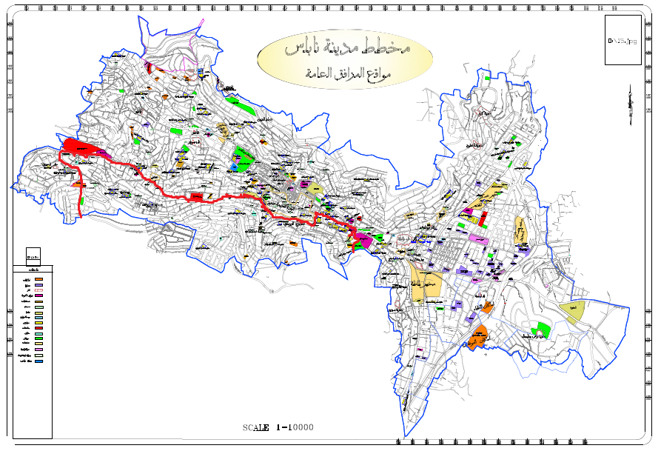
Solid Waste Management System in Nablus City

Slide 7
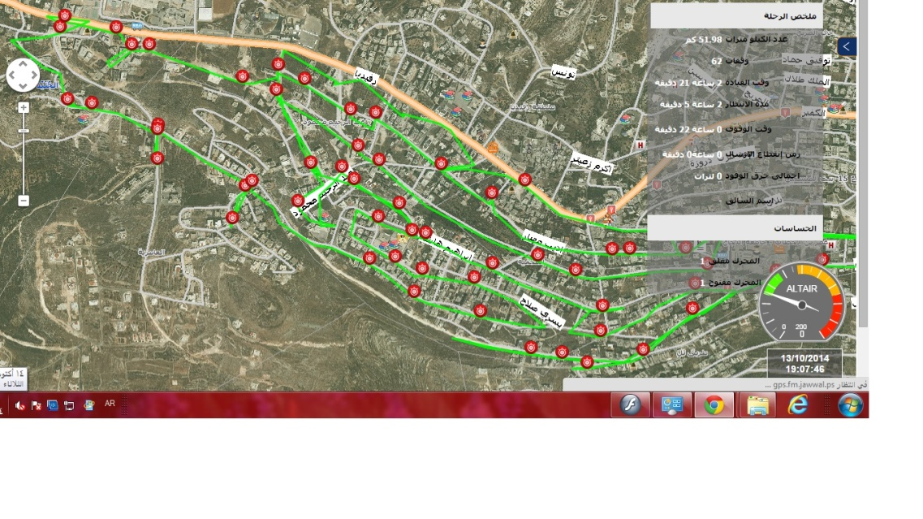
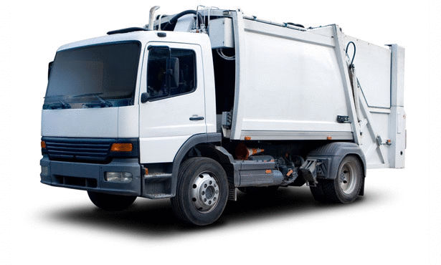
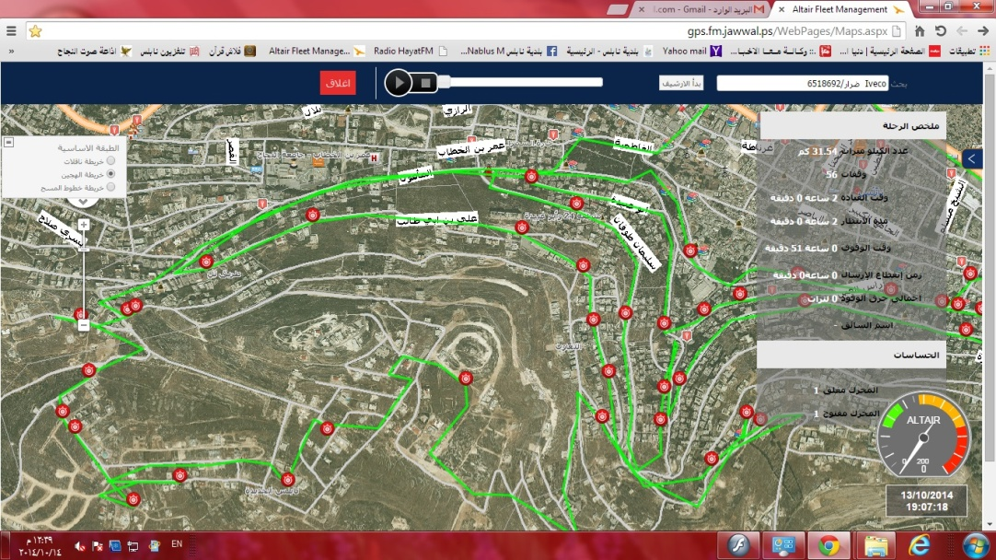
Joint Service Council for Solid Waste Management in Nablus City
Capacity =11 ton
Capacity =11 ton

Slide 8
Problem Statement
The council suffers from the lack of areal plan for collection transfer station, dumpsters locations and vehicles route. The existing system is based on experience, which lead to high consumption of the council revenues. Also, the council has only one transfer station to accommodate all generated waste. This causes a higher transportation costs, thus our project addressed this by finding the best vehicle route.

Slide 9
Research Objectives
develop a mathematical model for capacitated vehicle routing problem
analyze and solve mathematical model
minimizes the total traveled distance for collection waste
Determine the best route for each vehicle

Slide 10
Literature Review

Slide 11
Reviewed Literature
Solid Waste Management in Gaza Strip Problems and Solutions.
Solid waste: generation, handling, treatment and disposal Web site.
Solid Waste Management:A Local Challenge With Global Impacts Web site.
Solving Real-World Vehicle Routing Problems Using MILP and PGreedy Heuristics.
A Robust Optimization Approach for the Capacitated Vehicle Routing Problem with Demand Uncertainty.
Modeling and Solving the Capacitated Vehicle Routing Problem on Trees.
Optimization of Municipal Solid Waste Management System. University of Dar es Salaam.
A Tutorial Guide to Mixed-Integer Programming Models and Solution Techniques.
Optimizing Routing of Municipal Solid Waste Collection Vehciles in Deir El-Balah – Gaza Strip.
Vehicle Routing Problem.
Clarke & Wright's Savings Algorithm.
Solving the Vehicle Routing Problem with Genetic Algorithm and Simulated Annealing.
The Simulated Annealing Algorithm.
Improving Dorm Room Assignments Using Simulated Annealing.
Ant Colony Optimization.
Ant Colony Optimization for Capacitated Vehicle Routing Problem.
Ant colony Optimization Algorithms : Introduction and BeyondAnt colony Optimization Algorithms.
An Optimization Algorithm for the Capacitated Vehicle Routing Problem Based on Ant Colony System.
The VRP Web site.
Solving the Capacitated Vehicle Routing with a Genetic Algorithm.
evolutionary algorithm for vehicle routing.
Applying Genetic Algorithm for Capacitated Vehicle Routing Problem.
Application of Dynamic Graph for the fasest Route search in a Transport Network.
Advanced Route Planning in Transportation Networks.
Application of Dijkstra Algorithm in Logistics Distribution Lines.
A Comparative Study of Vehicles Routing Algorithms for Route Planning in Smart Cities.
Evaluation of Shortest Paths in Road Network.
Dijkstra’s shortest path algorithm Web site.
Dijkstra's Algorithm.
Towards a Multilevel Ant Colony Optimization.
VRP Algorithms for Decision Support Systems to Evaluate Collaborative Urban Freight Transport Systems.
Solving the Vehicle Routing Problem with Genetic Algorithm and Simulated Annealing.
Comparing the Performance of Genetic Algorithm and Ant Colony Optimization Algorithm for Mobile Robot Path Planning in the Dynamic Environments with Different Complexities.
Comparison of TSP Algorithms.
Creating a genetic algorithm for beginners.
GENETIC ALGORITHMS Web Site.
Genetic Algorithms, Tournament Selection, and the Effects of Noise.
Analysis of the impact of parameters values on the Genetic Algorithm for TSP.
A Comparative Study between the Nearest Neighbor and Genetic Algorithms: A revisit to the Traveling Salesman Problem.
Genetic Algorithm Performance with Different Selection Strategies in Solving TSP.

Slide 12
Capacitated Vehicle Routing Problem
(CVRP)
Vehicle Routing Problem (VRP)
Mixed Integer Programming(MIP)
Solid Waste Collection
(SWC)
Solid Waste Management System
(SWMS)
Heuristic Algorithms

Slide 13
Solid Waste Management System (SWMS)
solid waste management
storage and collection
transportation
disposal

Slide 14
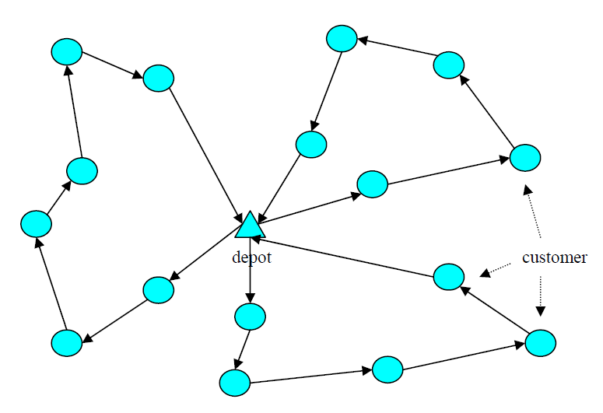
Vehicle Routing Problem (VRP)
Typical input for the VRP
An output for the VRP

Slide 15
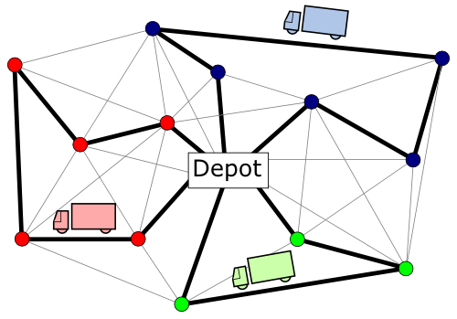
Capacitated Vehicle Routing Problem (CVRP)
CVRP one of the type of VRP where each vehicle has the uniform capacity and each customer has a certain demand.

Slide 16
Mixed Integer Programming(MIP)
Mixed integer programming model (MIP) is a variation of a linear programming model where some of the variable are restricted to take real and some are integers, or at least one variable is an integer, It may have a binary variable which used to identify if any entity is active or not by being assigned 1 or 0 respectively.

Slide 17
Heuristic Algorithms
Heuristic Algorithms
Saving Algorithm
Ant Colony Algorithm
Genetic Algorithm
Dijkstra’s Algorithm
Nearest Neighbor Algorithm
Simulated Annealing

Slide 18
The quality of solution
The speed of solution
Comparison between heuristic algorithms

Slide 19
Nearest Neighbor Algorithm

Slide 20
Genetic Algorithm

Slide 21
Parameter of Genetic algorithm
Crossover rate.
Mutation rate .
Population size.
Selection.
Tournament selection (Tournament size)
Roulette wheel selection.
Rank selection (Selective Pressure)
Encoding.
Crossover.
Single point crossover.
Two point crossover.
Uniform crossover.
Termination Condition.
Reach specified number of generation .
Reach optimal solution.
Reach specified time.

Slide 22
Best value of the Parameter
From previous studies we found the best values for these parameters:
Parameters | Value
Population size | 1000
Mutation rate | 0.01
Selection | Rank selection
Crossover | Single point
Encoding | Permutation
Termination Condition | Number of generation

Slide 23
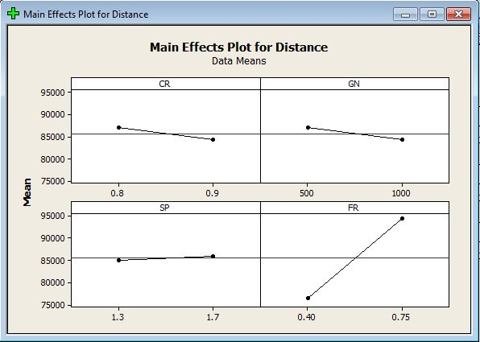
Best value of the Parameter
Other parameters, we made design of experiment by using Minitab to figure out the best values.

Slide 24
Best value of the Parameter
Parameters | Value
Crossover rate | 0.9
No. of generation | 1000
Selective Pressure | 1.3

Slide 25
Mathematical Model

Slide 26
Model Assumptions
Transportation cost and time is proportional to the distance traveled by the vehicles.
Each dumpster contains the same amount which is equal to the 67% of the its capacity
The vehicle traveled with constant speed.
The service time to discharge each dumpster is the same.
There is no traffic jam
Each vehicle makes two trips
Each node contain only one dumpster.
Number of vehicles is constant.

Slide 27
Parameters
27

Slide 28
Decision Variables

Slide 29
Objective Function
The objective function of the model calculates the sum of travelled distance by the vehicles (TTD). Therefore, the aim of the model is to minimize(TTD) . Assume each vehicle make two trip to complete discharging all dumpsters.
schematic diagram of trip 1

Slide 30
schematic diagram of trip 2

Slide 31
The total travelled distance by each vehicle is the sum of the distance travelled in trip one and trip two as follows:
The total travelled distance by two vehicle can be expressed as:
Model objective is to minimize (TTD)

Slide 32
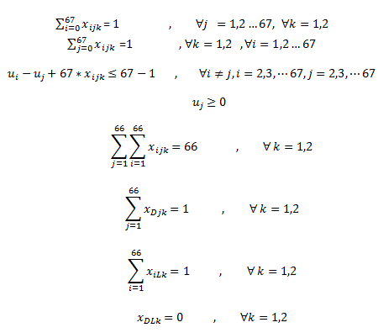
Constraints
Trip One Constraints:

Slide 33
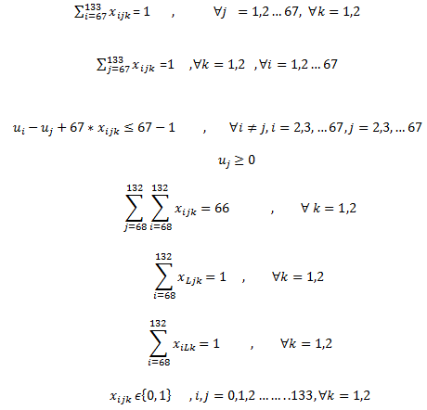
Trip two constraints:

Slide 34
Solving the Mathematical Model

Slide 35
CVRP solver

Slide 36
Result And Analysis

Slide 37
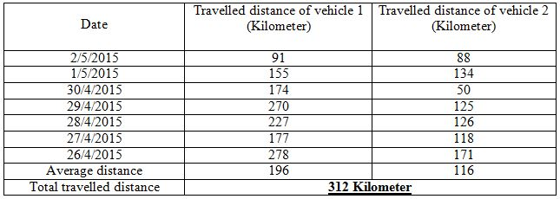
Current Route
There is no a certain route accredited by the municipality.

Slide 38
Improved Route
Vehicle1 | Vehicle 2
Depot | Depot
C203 | C1
C202 | C2
C201 | C11
C200 | C12
C211 | C216
C210 | C218
C209 | C219
C208 | C217
C207 | C222
C233 | C220
C234 | C199
C235 | C221
C236 | C48
C237 | C49
C232 | C45
C231 | C46
C230 | C47
C229 | C43
C228 | C44
C227 | C42
C226 | C41
C225 | C40
C224 | C66
C223 | C65
C204 | C7
C205 | C6
C206 | C4
C198 | C5
C94 | C8
C95 | C9
C109 | C13
C108 | C14
C107 | C15
C105 | C16
C96 | C17
C97 | C18
C98 | C19
C104 | C20
C103 | C23
C193 | C21
C83 | C22
C84 | C24
C82 | C246
C81 | C248
C86 | C249
C87 | C250
C88 | C251
C89 | C252
C78 | C54
C79 | C55
C80 | C53
C122 | C57
C121 | C52
C120 | C56
C118 | C50
C119 | C51
C186 | C28
C185 | C27
C127 | C30
C128 | C29
C129 | C25
C131 | C26
C132 | C32
C168 | C31
C195 | C34
C196 | C33
C214 | C0
Transfer Station | Transfer Station
C212 | C39
C191 | C35
C136 | C36
C140 | C37
C144 | C38
C147 | C73
C148 | C64
C149 | C63
C150 | C62
C151 | C61
C152 | C60
C156 | C59
C155 | C69
C101 | C282
C102 | C281
C161 | C279
C160 | C277
C159 | C276

Slide 39
 | C158 | C278
 | C100 | C272
 | C99 | C271
 | C157 | C270
 | C153 | C269
 | C154 | C268
 | C162 | C257
 | C163 | C256
 | C165 | C255
 | C166 | C254
 | C167 | C253
 | C190 | C261
 | C189 | C262
 | C188 | C260
 | C173 | C263
 | C172 | C259
 | C174 | C258
 | C178 | C267
 | C179 | C264
 | C180 | C58
 | C187 | C265
 | C123 | C266
 | C124 | C245
 | C125 | C244
 | C126 | C243
 | C183 | C242
 | C182 | C241
 | C181 | C240
 | C177 | C239
 | C176 | C238
 | C175 | C110
 | C171 | C111
 | C170 | C112
 | C137 | C247
 | C138 | C113
 | C139 | C114
 | C135 | C116
 | C134 | C115
 | C133 | C117
 | C169 | C77
 | C194 | C76
 | C192 | C75
 | C106 | C74
 | C197 | C275
 | C93 | C273
 | C92 | C274
 | C91 | C280
 | C85 | C67
 | C213 | C10
 | TS | TS
 | Depot | C3
 |  | C164
 |  | C143
 |  | C142
 |  | C141
 |  | C146
 |  | C145
 |  | C71
 |  | C70
 |  | C72
 |  | C68
 |  | TS
 |  | Depot
Total Distance | 33602.338 | 71141.4025
Total Travelled Distance | 104743.74 =105 Km

Slide 40
Comparison Between Current Route and Our Improved Route
Price of a liter solar | 6.3 NIS
Km consumption of liters solar | 74% of liter solar
 | Current route | Improved route
Total travelled distance (Km) | 312 | 105
Total fuel consumption(liter) | 312*0.74=280.88 | 105*0.74=77.7
Total fuel cost (NIS) | 280.88*6.3=1769.54 | 77.7*6.3=489.51
Amount of reduced cost (NIS) | 1769.544 - 489.51=1280.034

Slide 41
Conclusion
and Recommendation

Slide 42
Conclusion
There are many things that must be improved in the municipality in order to reduce costs and increase profits.

Slide 43
Recommendation
Put a real plan of solid waste collection.
Oblige the driver to follow the best order of the dumpsters that find it by CVRP solver.
Make technological innovation such as:
using an sensor on each dumpster to evaluate the filling ratio.
use CVRP solver software to find the best order of the dumpsters.

Slide 44
Thank you

