Slide 1
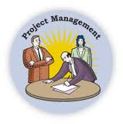
An-Najah National University
Civil Engineering Department
Management engineering prepared by : Mariam Al-Qarow
Hala Harb
Amani Saleh
Submitted to: Dr. Barraq Jumaa
Welcome to our presentation

Slide 2

What is a Project? is a work effort made over period of time to create a unique product, or a service. & because it has a start and a finish, it is also called a temporary effort or endeavor.

Slide 3
* Project Lifecycle from the beginning of the project to the end ,its go through steps such:
1- defining the project objectives
2- Planning the work to achieve those objectives
3- performing the work
4- monitoring and controlling all those steps carefully
5-closing the project after receiving product acceptance.

Slide 4
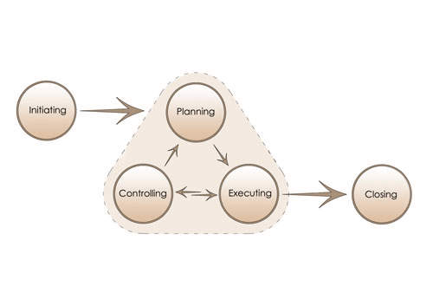

Slide 5
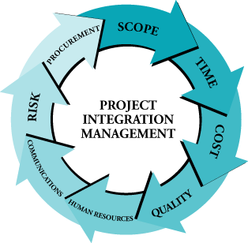
* Project management
Its the usage of knowledge, skills, and tools to manage a project from start to finish with the goal of meeting the project requirements, and its divided to main 9 issues which are :

Slide 6
1-Managing scope : it includes the processes required to ensure that the project includes all the work required to complete the project successfully
2- Managing Time : The project schedule is the organization of all project activities by time and by their logical dependencies and each with a start date and a finish date.

Slide 7
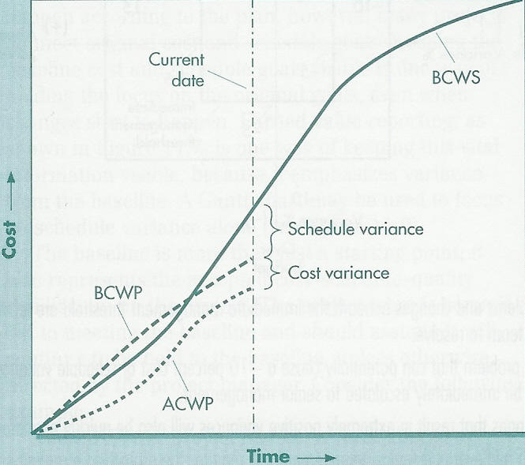
3-Managing Cost : includes the processes involved in planning, estimating, budgeting, and controlling costs so that the project can be completed within the approved budget

Slide 8

4-Managing Human Resources: processes required to coordinate the human resources on a project, such processes include those needed to plan, obtain, orient, assign, and release staff over the life of the project.

Slide 9

5- Managing Risk : identification and treatment of these risks. Its objective is to add maximum sustainable value to all the activities of the organization
6-Managing Quality : "Quality" refers to the ability of product to satisfy both stated and implied needs requirements

Slide 10
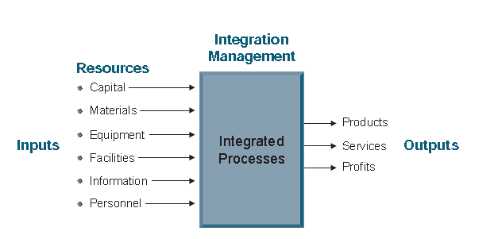
7-Managing Integration:
The need for integration in project management becomes evident in situations where individual processes interact, and the picture below samurais the whole process

Slide 11
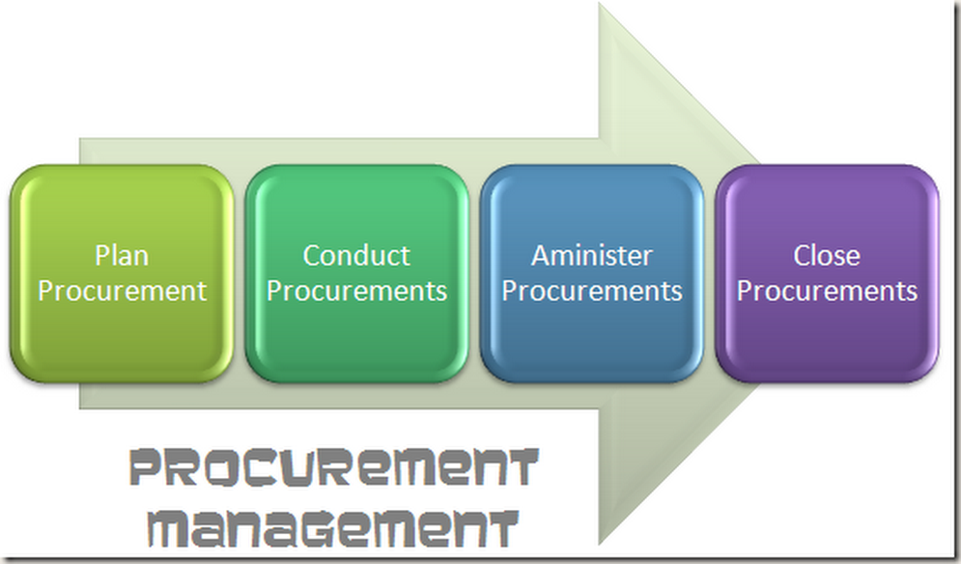
8-Managing Communication : Any project requires good communications to manage day-to-day activities and ensure success of the project
9- Procurement managing:
includes the processes required to acquire goods and services from outside the performing organization.

Slide 12
Case study
Part two
Short Description al-moqata’a locates in Tulkarem city
Total area of the building equal 4265.93 m² and consist of five floor contain kitchen ,reception and dormitory.

Slide 13
Description | Unit
No. of floor | NO. | 5
Basement floor area | m² | 840.6
Ground floor area | m² | 842.62
1st floor area | m² | 834.83
2nd floor area | m² | 831.07
3rd floor area | m² | 831.07
Stair area | m² | 85.73

Slide 14

Objective
The purpose of our study is to obtain the final cost, and duration for al-moqata’a building and information are shown below .

Slide 15
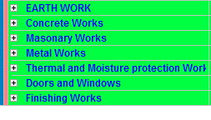
1-WBS

Slide 16
2- Quantity and duration for each activity
Example: internal plastering for the (basement floor)
Qty. = 1700 m²
Duration =
Qty / productivity
( 3 mason = 120 m²/d)
= 1700 / 120
= 13 day

Slide 17
3-Total cost
description | unit | Qty. | Unit price(NIS) | Tot.(NIS)
Internal plastering | M² | 1700 | 29 | 49300

Slide 18
4- check design using sap
D.L= 0.5 ton/m2
L.L= 0.6 ton/m2
The design appear to be ok

Slide 19
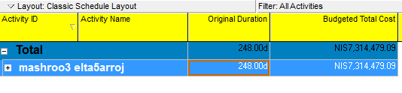
5- Analysis of the project using primavera 6.1
Calendar: 6day work/ week

Slide 20
6- Result
Total project cost = 7314479 NIS
Profit = 30% from total cost
Project duration 248 work day

Slide 21
Earned value analysis
= 7318479 - 8167433
= -848954 NIS
CPI = BCWP / ACWP
= 7318479/8167433
= 0.89 < 1 ➔ over budget

Slide 22
Thank you ☺

