Slide 1
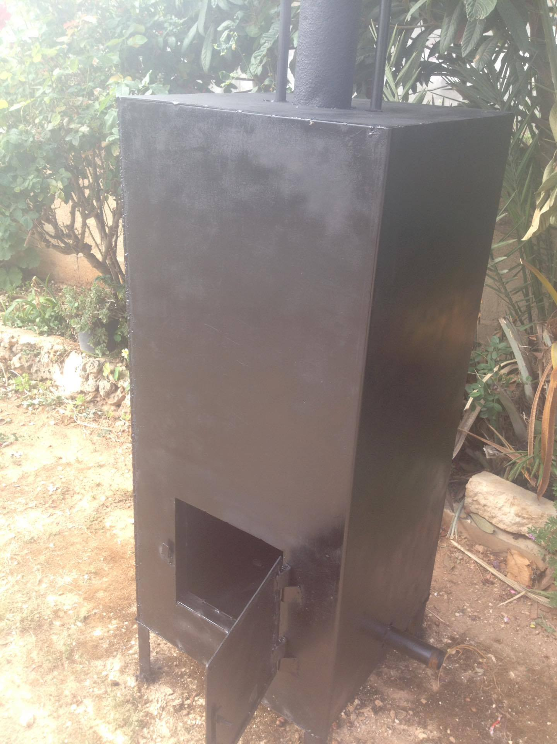
Waste to energy furnace and heat transfer analysis
Students :
Amjad Abu Baker
Ameel Bne Bhamsa
Hassan Owais
Ibrahim Al-rube
Supervisor:
Eng. Luqman Herzallah

Slide 2
Contents
Introduction
Methodology
Practical work
Result and analysis
Discussion
Conclusion & recommendation

Slide 3
Introduction
Waste to energy process
Is the process of generating energy in the form of electricity and or heat from the waste combustion.
Waste to energy furnace
is the place at which treatment and combustion of the waste occur.

Slide 4
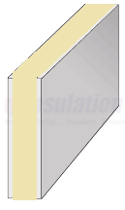
Introduction
Furnace was built with diameter (0.58*0.58*0.64) m
It was built by using two steel layers with thickness 3 mm, separated by Rockwell layer with thickness.
Mass flow rate of the waste is 0.12 kg/s.

Slide 5
Zonal method
It’s mathematical procedure used to analyze complex and realistic radiative heat transfer problems.
It’s basically used when the temperature of surfaces are unknown.
it gives heat transfer interchange area between surfaces and zones.

Slide 6
Zones of the furnace
Zone 1: the ground of the furnace.
Zone 2: the walls surround combustion area.
Zone 3: the walls surround gas area.
Zone 4: the ceiling of the furnace.
Zone 5: combustion zone, the zone at which combustion occurs.
Zone 6: gas zone, the zone at which evaporator located which shown in figure

Slide 7
Methodology
LHV & air needed
Chimney design
Zones temperature
Evaporator design

Slide 8
Waste composition

Slide 9
Lower heating value (LHV)
The lower heating value extracted from the combustion of composition is 1500.4 KJ/Kg
The mass flow rate of waste =0.12kg/s
Heat =$\sum{LHV∗{\dot{m}}_{waste}}$=1500.4*0.12=180 kw

Slide 10
Air needed
The stoichiometric combustion of the waste is based on the following three equation:
$C_{x}H_{y}+a(O_{2}+3.76N_{2})→$ ${b CO}_{2}$+$C H_{2}O+dN_{2}$
To grantee complete combustion 20% excess air is considered.
The amount of air needed = 0.45$\frac{m^{3}}{s}$

Slide 11
Flue gases composition

Slide 12
Zones temperature
Zonal method
Surface to surface total interchange area
Gas to surface total interchange area
Gas to gas total interchange area
$∅_{i,ext}$=$∅_{i,rad}$+$∅_{i,conv}$+$∅_{i,loss}$
∅_(𝑖,𝑒𝑥𝑡)=∅_(𝑖,𝑟𝑎𝑑)+∅_(𝑖,𝑐𝑜𝑛𝑣)+∅_(𝑖,𝑙𝑜𝑠𝑠)

Slide 13
Zones temperature
The temperature of zones as following :
Zones | Temp (K)
Zone 1 | 904.1
Zone 3 | 936.6
Zone 4 | 937.4
Zone 5 | 947.5
Zone 6 | 944.1

Slide 14
Evaporator Design

Slide 15
Chimney design
Q chimney =56045.6 w
Chimney design
${\dot{m}}_{g}$(kg/s) | 0.0825
V(m$/s)$ | 7
$A_{c}{(m}^{2}$) | 0.012
D(m) | 0.1236

Slide 16
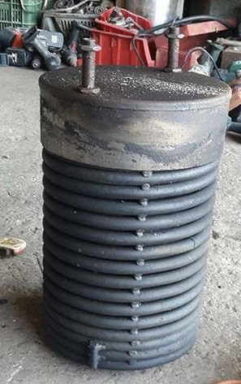
Practical Work

Slide 17
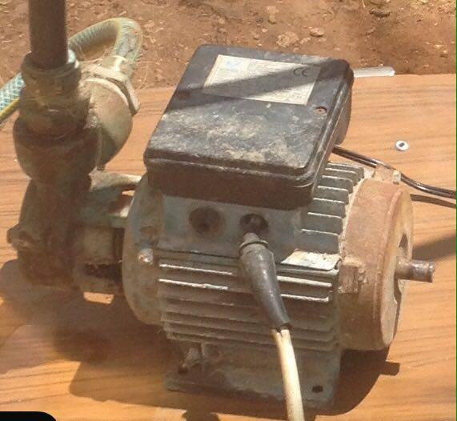
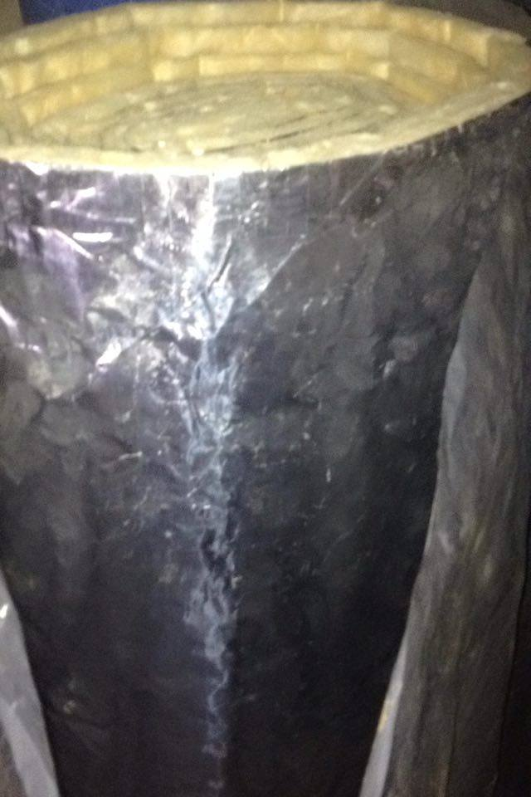
Practical Work

Slide 18
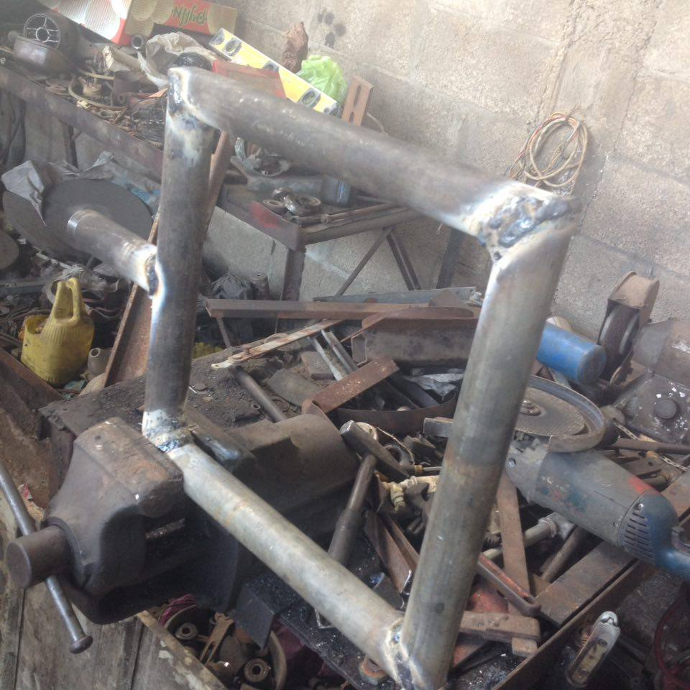
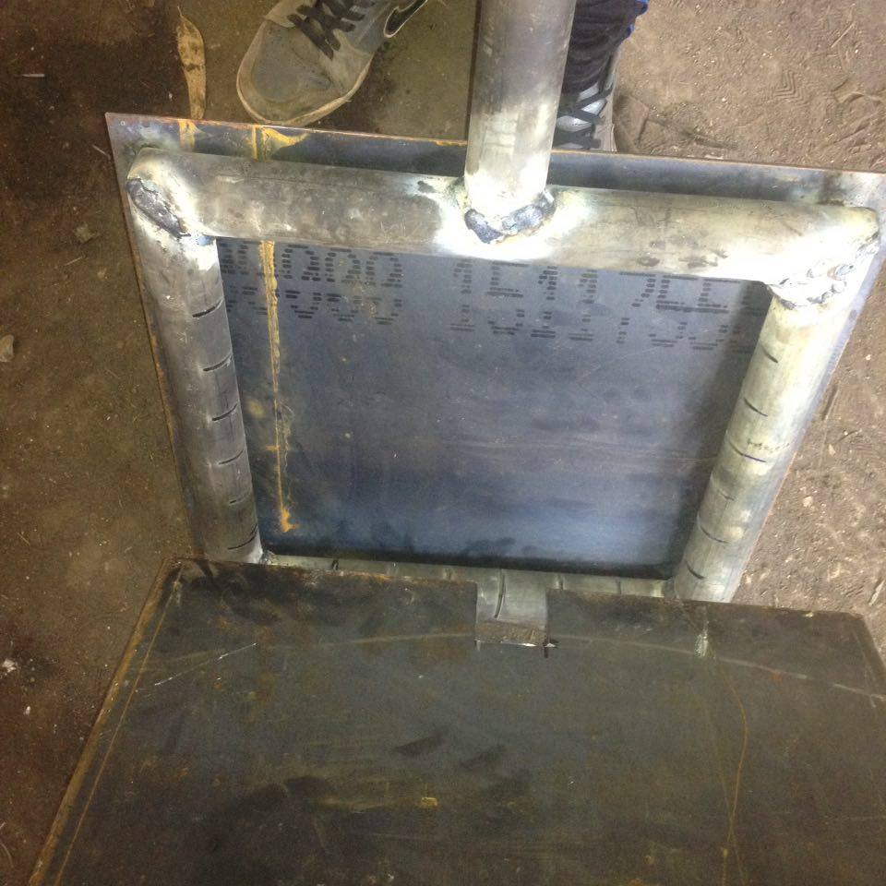
Practical Work

Slide 19
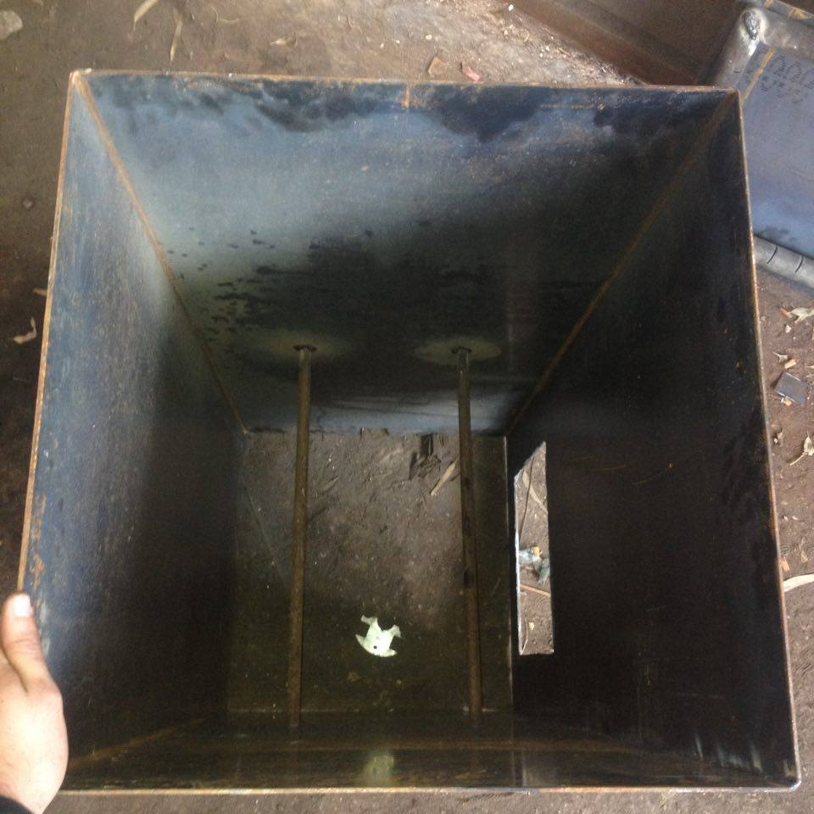
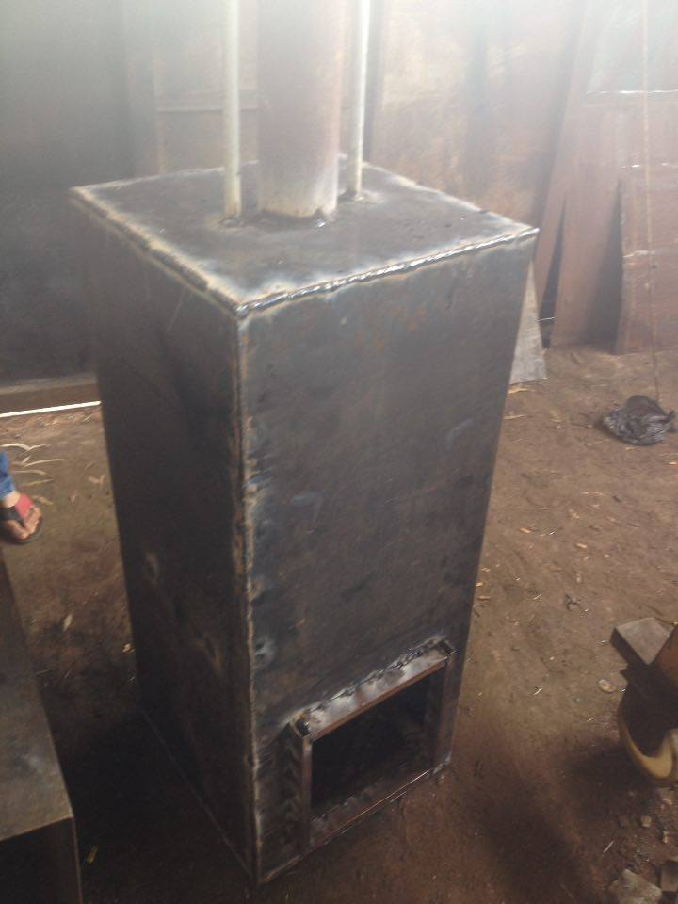
Practical Work

Slide 20
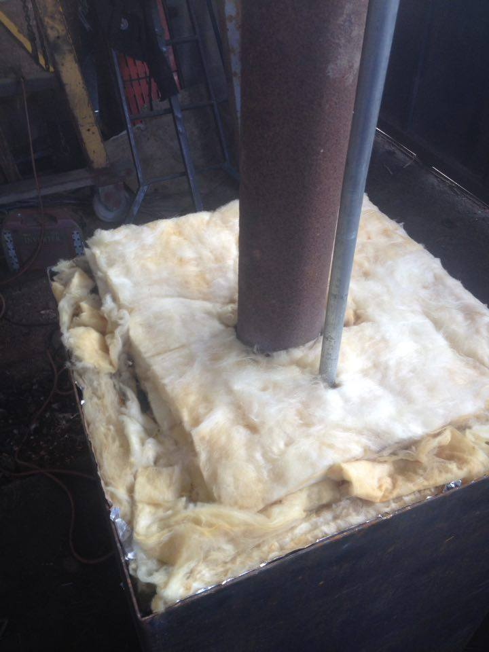
Practical Work

Slide 21
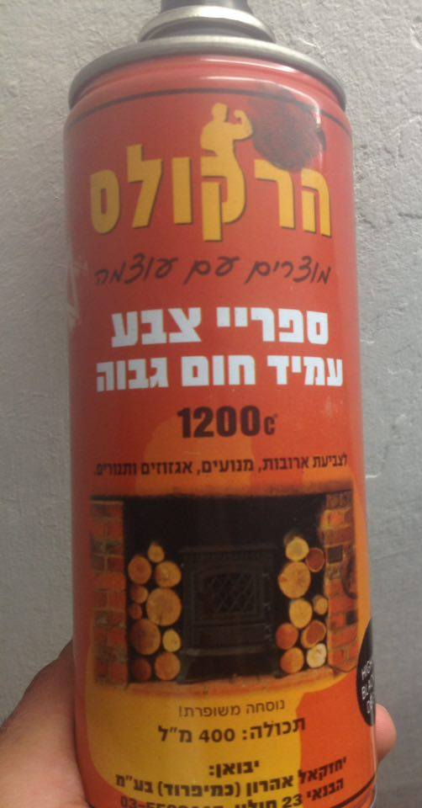
Practical Work

Slide 22
Result and analysis
Theoretical volume flow rate of water =0.11 L/s
Measured volume flow rate of water =0.07 L/s
T=250$℃ ,P=4bar→Superheated steam$.
$h=2970{KJ}/{kg}$, $S=7.4{KJ }/{kg.K}$
which is sufficient for steam turbine uses.

Slide 23
Discussion
According to the insulation system used:
$↑heat losses →↓heat flux →↓\text{flow} \text{rate} \text{of} \text{water}$
For this reason the flow rate of water decreasing experimentally
Due to this reason the error appear

Slide 24
Recommendation
Modifying the insulation system (thermal brick and cement)
Using preheater for inlet water
Using calorimeter to increase steam quality

Slide 25
Cost
Items | Cost(NIS)
Steel | 600
Rock wool | 180
Evaporator | 100
Welding | 500
Fan | 100
Transportation | 150
Miscellaneous | 250
Total | 1880

