Slide 1
Graduation Project Seminar
Prepared By :
Walaa Hattab Fayrooz Tayah
Supervisor :
Dr. Samer Arandi

Slide 2
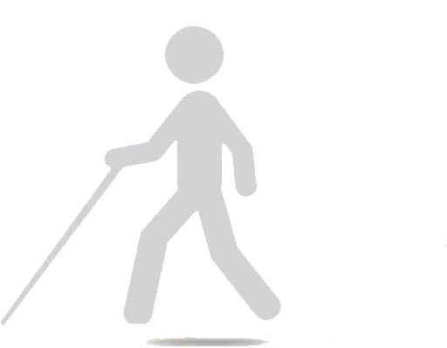
Outline
Motivation, objectives.
Feature Highlights.
Implementation.
Problems.
Future Work.

Slide 3
Outline
Motivation, objectives.
Feature Highlights.
Implementation.
Problems.
Future Work.

Slide 4
Motivation
High percentage of the visually impaired world-wide and in Palestine.
Problems faced by visually impaired people :
Can’t walk easily on their own.
Suffer from obstacles.
Difficult to reach a certain place.

Slide 5
Objectives
Our proposed system helping the visually impaired person to:
Avoid any obstacles in his way.
Find the cane if it is lost.
Go to a specific place safely.
Helping the ordinary people to recognize visually impaired people in the dark.
Notes:
Warning the visually impaired person of any obstacles in his way.
Helping the visually impaired person to find the cane if it is lost.
Helping the visually impaired people to go to a specific place safely.
Helping the ordinary people to recognize visually impaired people in the dark.

Slide 6
Outline
Motivation, objectives.
Feature Highlights.
Implementation.
Problems.
Future Work.

Slide 7
Feature Highlights – Current solutions
Require permanent Human Help
Animal Help
Other devices to help
Traditional White cane
Notes:
1-Dependence on a Person to lead…
But a person is not always there..
2-But an animal is not always there,
Or cannot be admitted everywhere..
3-Current designs are very limited…
4-Heavy, Hard to carry around, Expensive and in many cases not practical…

Slide 8
Feature Highlights – Our Proposed Solution
Obstacles avoidance
Simple Navigation System
Cane Locater

Slide 9
Outline
Motivation, objectives.
Feature Highlights.
Implementation.
Problems.
Future Work.

Slide 10
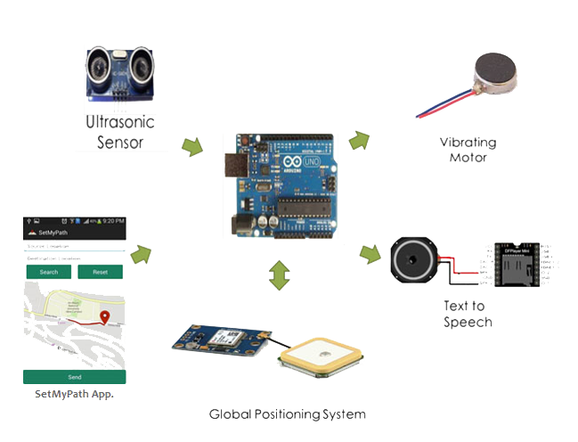
Components

Slide 11
Implementation - Obstacles avoidance
Warning the visually impaired person of any obstacles in his way.
Obstacle detection system is designed by using ultrasonic sensors.
Obstacle detection system designed in two mode:
Indoor obstacle detection system.
Outdoor obstacle detection system .

Slide 12
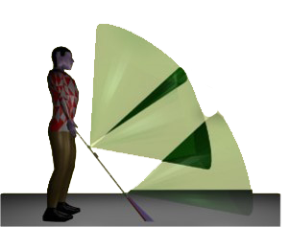
Implementation - Obstacles avoidance
Indoor obstacle detection.
Detect low obstacles.
Detect the objects that are as far as 1 meter away.
Auditory feedback.
Outdoor obstacle detection.
Detect mid-height obstacles.
Detect an object at a maximum distance of 2.5 meters.
Vibratory feedback.

Slide 13
Implementation - Cane Locater
Helping the visually impaired person to find the cane if it is lost.
Two circuits sender and receiver.
Follow the buzzer sound to locate the cane.

Slide 14
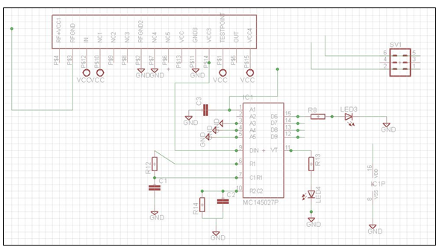
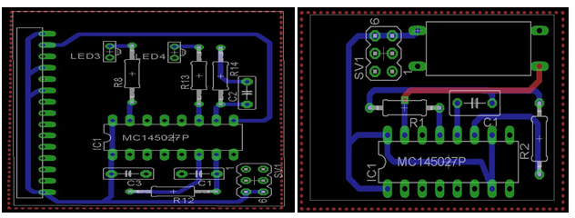
Implementation - Cane Locater
System Tool
Software tool
Design the schematics of both transmitter and receiver circuits in
EAGLE CAD .
Convert these schematics into PCB.

Slide 15
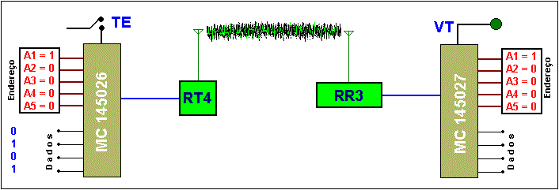
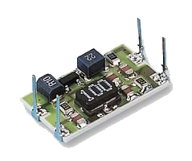
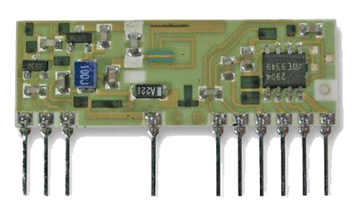
Implementation - Cane Locater
System Tool
Hardware tools
Used RT4 and RR3 modules and other components to build the transmitter and receiver circuits.

Slide 16
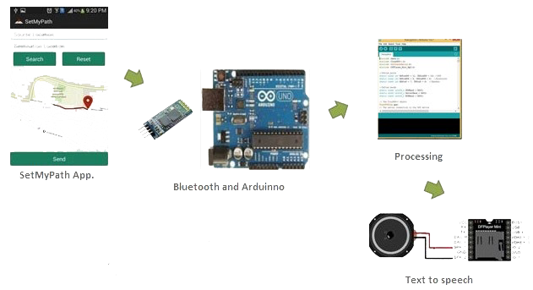
Implementation - Simple Navigation System
Helping the visually impaired people to go to a specific place safely.
Designed by using android application, Bluetooth module, TTS and GPS module.

Slide 17
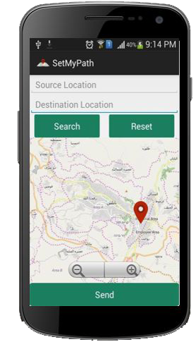
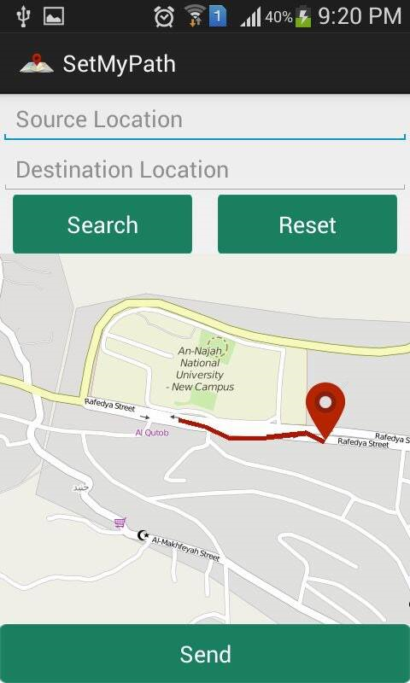
Simple Navigation System
Set the path
Set the desired path.
Send the coordinates to the arduino.
The navigation start through auditory feedback.

Slide 18
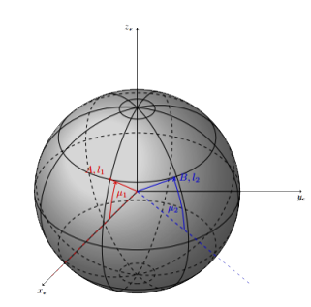
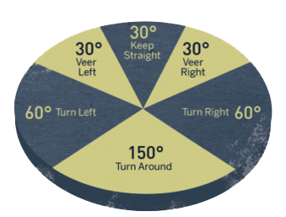
Simple Navigation System
Way-point technique
A GPS receiver can obtain coordinates of the current location.
Way-points technique to obtain For direction and distance towards a destination.
Notes:
//Explain the algorithm in this slide …

Slide 19
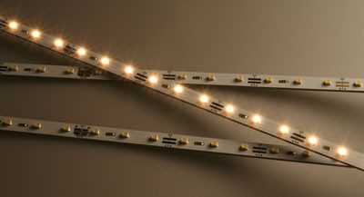
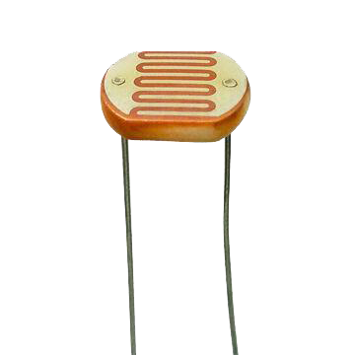
Implementation – Last feature
Helping the ordinary people to recognize visually impaired people in the dark.
Led indicator system is designed by using LDR sensor “Light Dependent Resistor”.

Slide 20
Outline
Motivation, objectives.
Feature Highlights.
Implementation.
Problems.
Future Work.
.

Slide 21
Problems Faced and their Solutions
Design with multiple sensors gave slow feedback.
Designed with only 2 ultra sonic sensors.
Dealing with RF transmitter and receiver circuits because it's more sensitive.
Using Eagle CAD program to design PCB for the circuits.
The GPS take a time to work and give result.
Solve it partially by coding.
The size of component must fit with the size of the cane.
Try to distribute the components along the cane.

Slide 22
Outline
Motivation, objectives.
Feature Highlights.
Implementation.
Problems.
Future Work.

Slide 23
Future work
Increase the accuracy of the obstacle detection.
Improve the navigation system by using speech recognition application to be more appropriate to visually impaired person.
Improve the accuracy of the navigation system algorithm.

Slide 24
Questions?
Thank you ☺

