Slide 1
Civil Engineering Department
An-Najah National University
Soil Improvement and Ground Modification
Graduation Project
Prepared By:
Noor Eshtayeh
Waed Awwad
Neveen Abu-Alrub
Rawan Hijawe
Supervised By: Dr. Isam Jardaneh

Slide 2
Content
Definition of soil improvement
Purpose of soil improvement
Method of soil improvement
Soil Improvement using Fly Ash
Soil Improvement using Cement
Recommendations and Conclusions
Notes:
Definition of soil improvement.
soil improvement technique(s) to improve the properties and parameters of different local soil type that will have problems when building foundations or other ground structures.
Purpose of soil improvement:
1-Reduce the settlement of structures .
2-Improve the shear strength of soil and thus increase the bearing capacity of shallow foundations .
3-Increase the factor of safety against possible slope failure of embankment and earth dams .
4-Reduce the shrinkage and swelling of soils .

Slide 3
Definition of soil improvement.
Soil improvement is technique(s) to improve the properties and parameters of different local soil type that will have problems when building foundations or other ground structures.

Slide 4
Purpose of soil improvement.
Reduce the settlement of structures .
Improve the shear strength of soil and thus increase the bearing capacity of shallow foundations .
Increase the factor of safety against possible slope failure of embankment and earth dams .
Reduce the shrinkage and swelling of soils .

Slide 5
Method of soil improvement
Ground Reinforcement
Ground Improvement
Ground Treatment

Slide 6
In this project two ground treatment techniques were adopted which are Fly Ash stabilization and Cement stabilization .
These techniques applied on a clay soil form Al-jalama site near Jenin city.

Slide 7
Soil Improvement using Fly Ash.
Fly ash is a by-product of the pulverized coal combustion process.
The addition rate depends on :
the nature of the soil
the characteristics of the fly ash
the strength desired
Notes:
Fly ash is a by-product of the pulverized coal combustion process usually associated with electric power-generating plants.
The primary reason fly ash is used in soil stabilization applications is to improve the compressive and shearing strength of soils. The compressive strength of fly ash treated soils is dependent on:
In-place soil properties
Delay time
Moisture content at time of compaction
Fly ash addition ratio

Slide 8
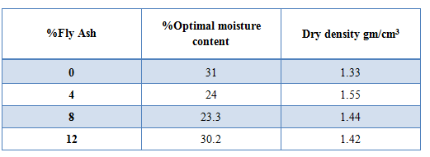
Soil Improvement using Fly Ash.
the following table shows the results of stander proctor test of soil at adding different percentages of Fly Ash.
Notes:
Several laboratory tests were done on soil samples with its original state and with adding different percentages of Fly Ash. The tests done were Standard Proctor, Unconfined Compression, Liquid Limit and Plastic Limit.

Slide 9
Soil Improvement using Fly Ash.

Slide 10
Soil Improvement using Fly Ash.
The results of unconfined compressive strength test of different percentages of Fly Ash in soil .

Slide 11
Soil Improvement using Fly Ash.

Slide 12
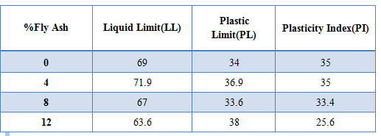
Soil Improvement using Fly Ash.
Liquid Limit, Plastic Limit and Plasticity Index Results of different percentages of Fly Ash in soil.

Slide 13
Soil Improvement using Fly Ash.

Slide 14
Soil Improvement using Fly Ash.

Slide 15
Soil Improvement using Fly Ash.
Recommendations:
The recommended percent of fly ash to be added to the silty clay soil is greater than 12%.
Notes:
After reviewing the various laboratory tests regarding adding different percentages of fly ash to the silty clay soil

Slide 16
Soil Improvement using Cement
Is done by mixing soil and Portland cement with water and compacting the mix to attain a strong material.
During soil cement stabilization the following factors are affecting:
Type of soil.
Quantity of cement.
Quantity of water.

Slide 17
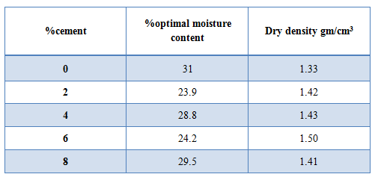
Soil Improvement using Cement
Results of stander proctor test of soil at adding different percentages of cement.

Slide 18
Soil Improvement using Cement

Slide 19
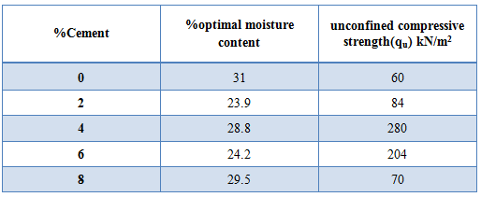
Soil Improvement using Cement
Results of unconfined compressive strength test of different percentages of cement in soil.

Slide 20
Soil Improvement using Cement

Slide 21
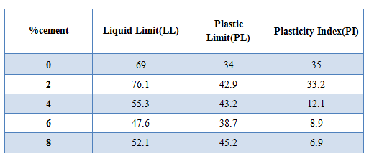
Soil Improvement using Cement
Liquid Limit, Plastic Limit and Plasticity Index Results of different percentages of cement in soil.

Slide 22
Soil Improvement using Cement

Slide 23
Soil Improvement using Cement

Slide 24
Soil Improvement using Cement
In general, the recommended percent of cement to be added to the silty clay soil is around 6%.
Notes:
The reason to minimize the percent of cement add to silty clay is the economical reason. Since the cost of cement is high, the percent of cement should be kept as low as possible. In this case the recommended percent of cement is 6%.

