Slide 1

An-Najah National University Civil Engineering Department Graduation project Hydraulic analysis & Redesign of Al-Masaken & Old Askar Camp Water Supply Network Submitted by: Leen Masri Duaa Dweikat Supervisor: Dr. Anan Jayossi 2012

Slide 2
project main objectives
This project aims to analyze the water distribution
network of Al–Masaken and Old Askar Camp Area .
Modify or redesign the network in order to meet
the area citizens' water requirements in accordance
with population growth until 2040.

Slide 3
Study Area
Al-Masaken AlShaabeya and Old Askar Camp are
located in the eastern part of Nablus city.
It’s population is about 25082 persons.
It’s area is about 884.534 donums.
It’s supplied with water directly from Al-Baddan
well.

Slide 4
Questionnaire analysis
Questionnaires covers 42 families which were
chosen randomly.
It was divided into two categories:
General information about the inhabitants.
Information about water network

Slide 5
The Questionnaire (cont’)
The figure below shows the relationship between the family income and average consumption.

Slide 6
The Questionnaire (Cont.)
The figure below shows that houses that have gardens consume water more than the houses that don’t have ones.
Most of people don’t complain of water quality in Al-Masaken El-Sha’abya and Old Askar Camp as shown in the figure below.

Slide 7
EPANET
EPANET program is one of the networks modeling software that performs extended period simulation of hydraulic and water quality behavior within pressurized pipe networks.
The program tracks the flow of water in each pipe ,the pressure at each node, the height at water in each
tank or reservoir.

Slide 8
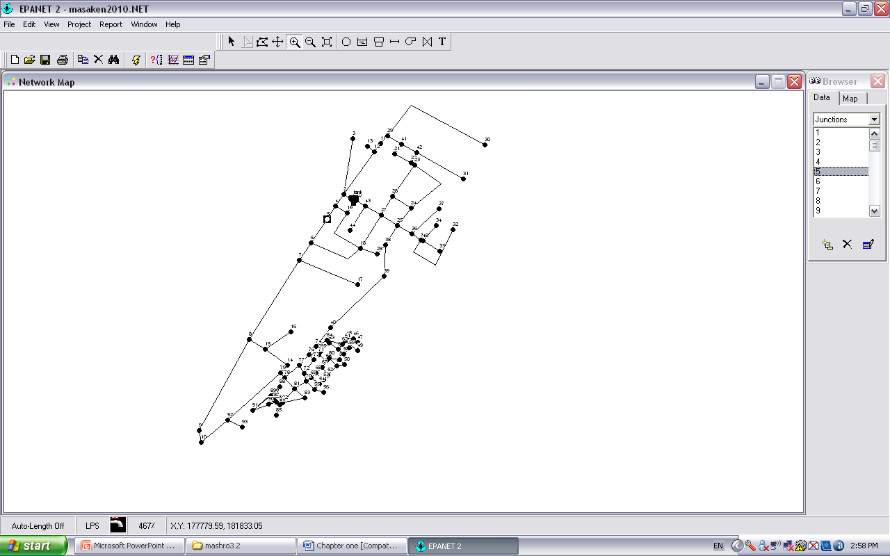
EPANET Network

Slide 9
Existing water network description
The Existing water network has 121 pipes with different diameters (2, 3, 4, 6, 8, 10, 12) inch of Polyethylene and polypropylene pipe.
It has 93 nodes with different elevations.
Existing water network gets water directly from Al-Badan Well through the main link which has a pressure of 7.5 bar.
It has a continuous rate of pumping .

Slide 10
EPANET- Input Data
A group of tables were prepared to be used in
EPANET program to simulate the network.
Here are samples of this tables:
This table represent nodes characteristic:
Node number | Elevation(m)
1 | 499.5
2 | 506.3
3 | 520
4 | 507.7
5 | 511
6 | 515
7 | 519

Slide 11
EPANET –Input Data (cont.)
Pipe characteristic table:
Pipe ID | from | to | Length (m) | Diameter (in) | C
1 | Tank | 1 | 10 | 16 | 140
101 | 1 | 2 | 51 | 12 | 140
102 | 2 | 3 | 315 | 4 | 140
103 | 2 | 4 | 64 | 10 | 140
104 | 4 | 5 | 78 | 10 | 140
105 | 5 | 6 | 148 | 8 | 140

Slide 12
EPANET-Input Data (Cont.)
Demand for each node table:
Node number | Area served by each node | Total Area (m²) | Population | Demand (L/d)
1 | A7 /10 + A10 /7 | 7860.31 | 223 | 23660.3
2 | A7 /10+ A10 /7+A18 /4 | 14207.91 | 403 | 42758.3
3 | A18 /4 | 6347.6 | 180 | 19098
4 | A10 /7 | 4565.85 | 129 | 13686.9
5 | A10 /7 | 4565.85 | 129 | 13686.9
6 | A10 /7+A11 /7 | 13166.35 | 373 | 39575.3
Assuming that our study area has a uniform density which equal to .02835 c/m² according to this equation:
Density = Total population/ total area
The study area is divided into small areas and each node gets part of area that serves it. As show in the table.

Slide 13
EPANET-Input Data
Population served by each node calculated from multiplying the Area served by that node by the Density.
Consumption per capita day is (75.23 L/c.d)
UFW% equals to 29.1%
Demand per capita days equal to 106.1 L/c.d
Using this equation :
Demand = consumption / (1- UFW%)
Node's demand was found by multiplying demand per capita-day by pop. served at each node

Slide 14
EPANET - Output Data
the main elements of the EPANET output that have been used to analyze and redesign the network was the pressure at each node & the velocity in each pipe.
This project’s criteria was “20-70 m” pressure
“0.1-3 m/s” velocity

Slide 15
EPANET-Output Data(cont.)
EPANET present Node results
EPANET present Link results
Node ID | Demand (LPS) | Head (m) | Pressure (m)
1 | 0.55 | 585.63 | 86.13
2 | 0.99 | 585.43 | 79.13
3 | 0.44 | 585.41 | 65.41
4 | 0.32 | 585.33 | 77.63
5 | 0.32 | 585.25 | 74.25
6 | 0.92 | 584.81 | 69.81
7 | 1.45 | 584.59 | 65.59
Link ID | Flow (LPS) | Velocity (m/s) | Unit head loss(m/km)
101 | 83.21 | 1.18 | 3.99
102 | 0.44 | 0.06 | 0.05
103 | 30.49 | 0.62 | 1.51
104 | 24.71 | 0.5 | 1.02
105 | 24.40 | 0.78 | 2.96
106 | 20.58 | 0.66 | 2.16
107 | 17.68 | 0.56 | 1.63

Slide 16
EPANET Output (cont.)
Pressure of nodes : there is no negative pressure and all values are above 20 m.
Velocity of pipe :velocities range between (0.01-2) m/s this means that there are values less than 0.1m/s. Low values of velocity results from large pipe’s diameter and dead ends.

Slide 17
Future water network

Slide 18
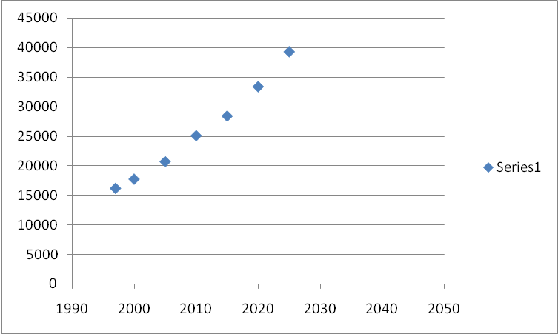
Population forecast
The future population in 2040 is about 50000c according to this curve:
Population forecast
It can also be calculated based on this equation:
Pf=Pp (1+i)^n
The growth rate for ALMasaken is (3.2%)
And for Old Askar Camp is around zero (0.5%).

Slide 19
Future Demand Estimation
*
The future demand was considered to be 141 L/c.d
according to this equation:
demand = Future consumption / (1- physical losses)
Future consumption is 120 L/c.d. While Physical
losses is 15 % .
To estimate the future water demand for each node, the
existing demand was multiplied by a factor that is
calculated as follows:
Factor = (population 2040/population 2010) * (demand
2040/demand 2010)
= 2.65

Slide 20
EPANET - Input Data
Here ‘s a sample for the future demand calculation which will be used in EPANET ‘s future input value:
Future demand for each node
Node number | Demand 2010 (L/d) | demand 2040 (L/d)
1 | 23660.3 | 62699.8
2 | 42758.3 | 113309.5
3 | 19098 | 50609.7
4 | 13686.9 | 36270.3
5 | 13686.9 | 36270.3
6 | 39575.3 | 104874.5

Slide 21
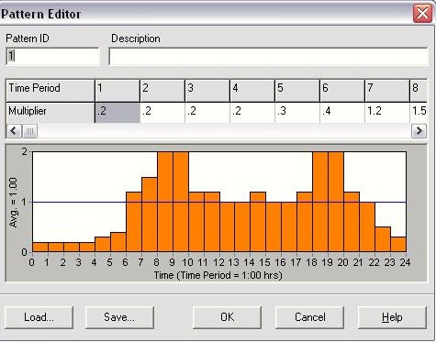
EPANET - Input Data
Due to continuous pumping the following pattern was used:
Demand Pattern

Slide 22
EPANET-Output Data
Pressure of nodes : there is no negative pressure and all values are above 20 m.
Velocity of pipe : velocity values are within the range of (.01-4.17) m/s that means we should change diameter of the pipes in order to have velocities within the range of (.1-3) m/s

Slide 23
Modification
Modification has been made to meet the future requirements :
Pipe diameter changes
Pipe ID | Old diameter(mm) | New diameter (mm)
1 | 300 | 400
101 | 300 | 400
112 | 250 | 300
128 | 250 | 300
144 | 200 | 250
146 | 100 | 150
147 | 100 | 150
211 | 200 | 300
218 | 75 | 100

Slide 24
EPANET - Output Data
Node Results for the year 2040
Link Results for the year 2040
Node ID | Demand (LPS) | Head (m) | Pressure (m)
1 | 1.45 | 585.09 | 85.58
2 | 2.62 | 584.78 | 78.48
3 | 1.17 | 584.68 | 64.68
4 | 0.84 | 584.27 | 76.57
5 | 0.84 | 583.84 | 72.84
Link ID | Flow (LPS) | Velocity (m/s) | Unit Headloss (m/km)
101 | 220.51 | 1.75 | 5.97
102 | 1.17 | 0.15 | 0.31
103 | 75.09 | 1.53 | 8.01
104 | 61.36 | 1.25 | 5.51
105 | 60.52 | 1.93 | 15.93

Slide 25
Cost
Here’s a sample of table that summarizes the cost
calculation for the pipes:
Cost calculations for the pipes
Pipe ID | Length (m) | Diameter (in) | Cost ($)/m | Cost ($)
1 | 10 | 16 | 140 | 1400
101 | 51 | 16 | 140 | 7140
102 | 315 | 4 | 53 | 16695
103 | 64 | 10 | 94 | 6016
104 | 78 | 10 | 94 | 7332
105 | 148 | 8 | 76 | 11248
106 | 105 | 8 | 76 | 7980
We can see that the approximate cost for the pipes only is about 783090 $.

Slide 26
Thank you for your attention

