Slide 1
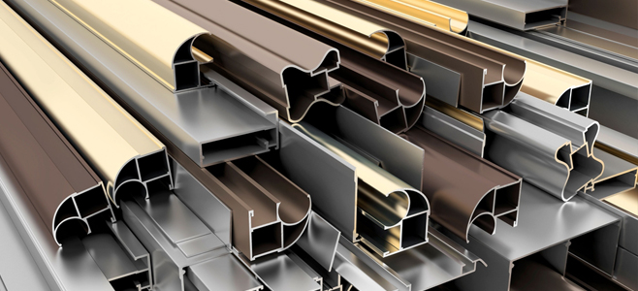
Using of Aluminum Powder Coating Waste
As
a Construction Material
Graduation Project 2
Prepared by:
Dyala Sharaf
Farah Johar
Supervised by:
Dr. Sami Hijjawi

Slide 2
Table of contents:
Experimental Part.
Data Collection and Analysis.
Conclusions and Recommendations.

Slide 3
Experimental Part
Trial mixes of Concrete using the powder material.
Making concrete according to the mix design used which is 1:2:4 .
For strength requirements, select the water to cement ratio by weight (w/c) = 0.7
Sand replacement with certain proportions of powder ( 3%, 5%, 10% and 15% ) and keeping cement, coarse aggregate, and water as fixed materials.

Slide 4
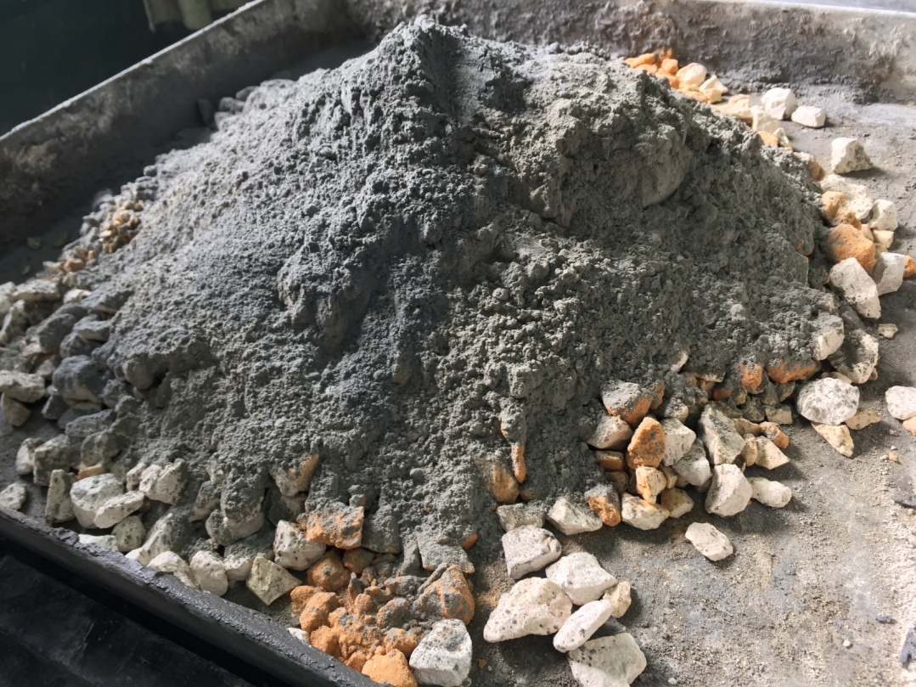
Powder

Slide 5
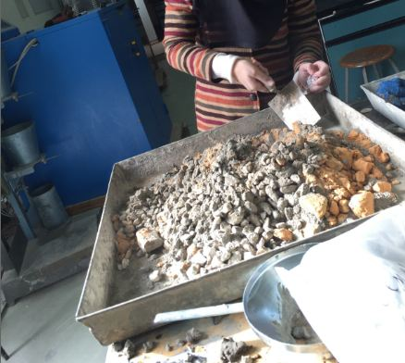
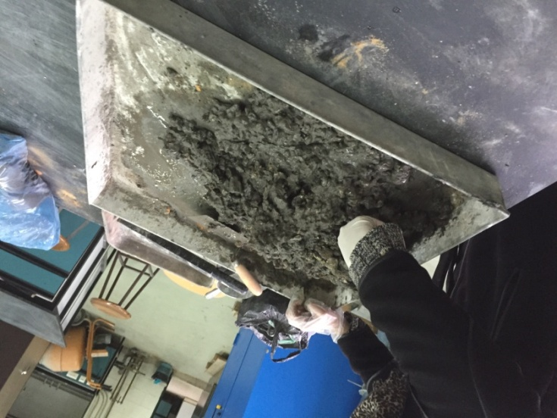
1
2
3

Slide 6
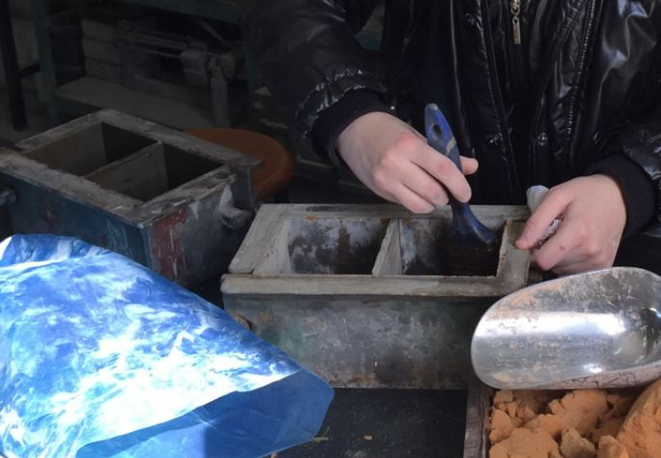
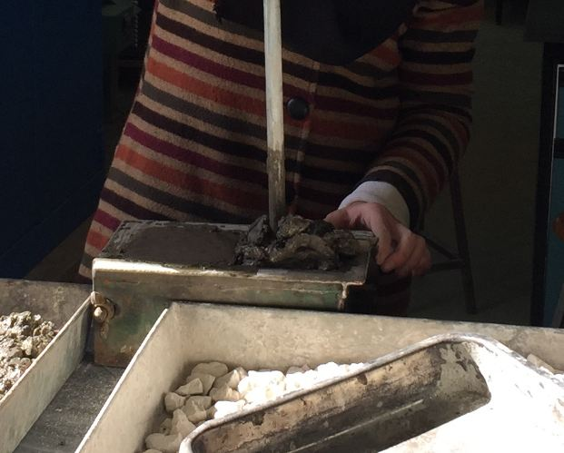
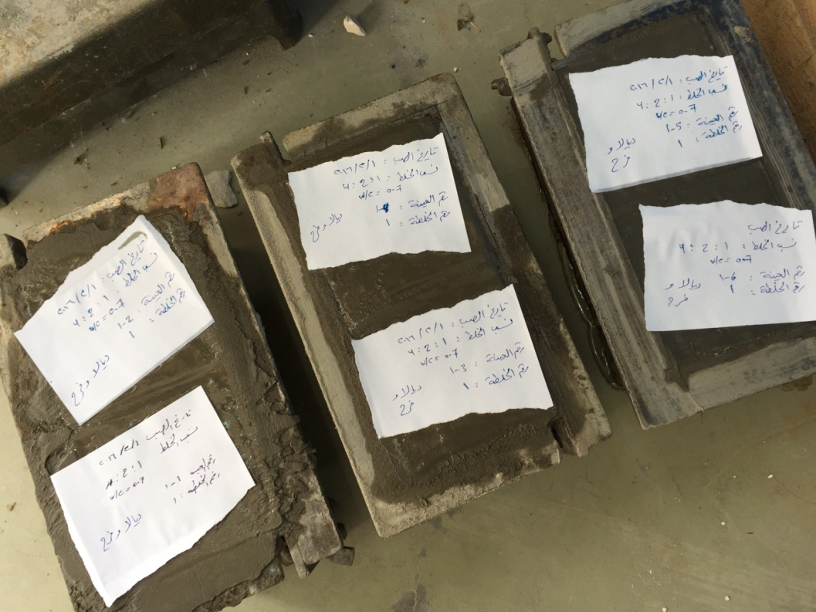
4
5
6

Slide 7
Slump Test
is an empirical test that measures workability of fresh concrete, It is performed to check consistency of freshly made concrete.
Five classes of slump are designed:
Very dry mixes (0 _ 25) mm.
Low workability mixes (25_ 40) mm.
Medium Workability mixes (50_ 90) mm.
High Workability mixes > 100 mm.

Slide 8
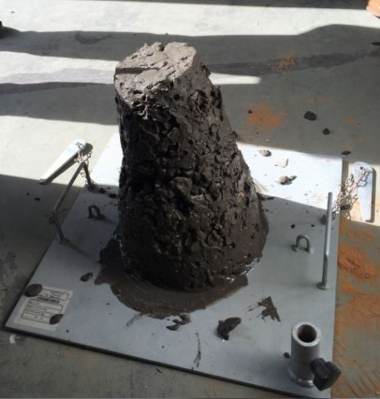
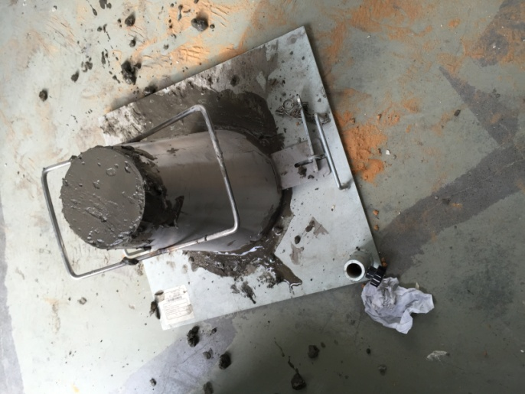

Slide 9
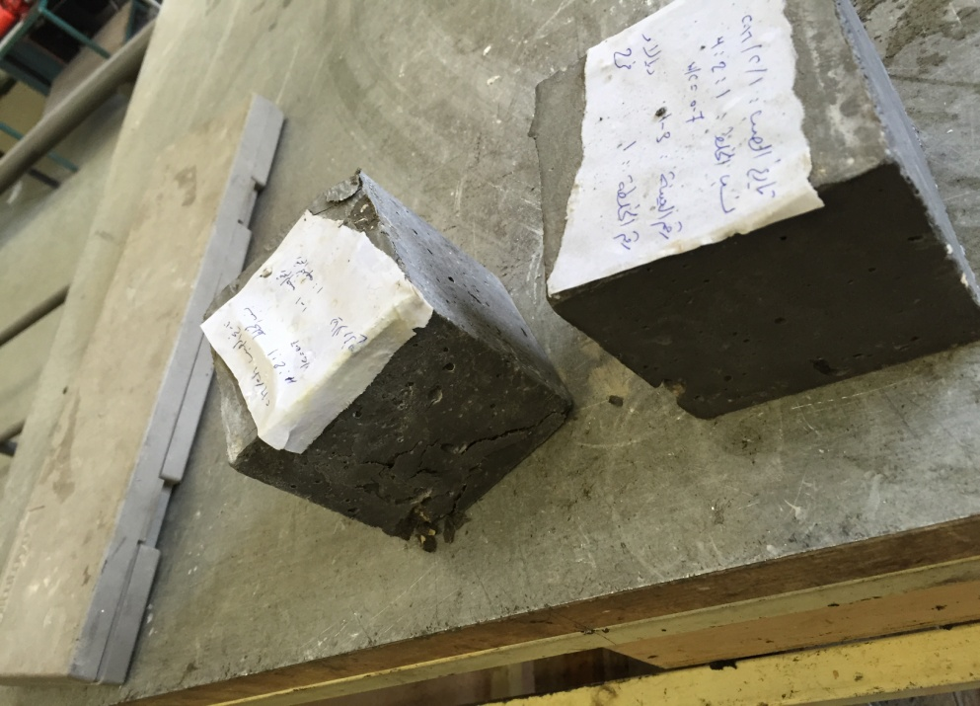
Compression Test
A test is conducted to determine the compressive
strength of concrete or its ability to resist a crushing
force. This test is performed to check powder effect on concrete strength.
For each mix, three cubes are tested after 7 days, and three are tested after 28 days.

Slide 10
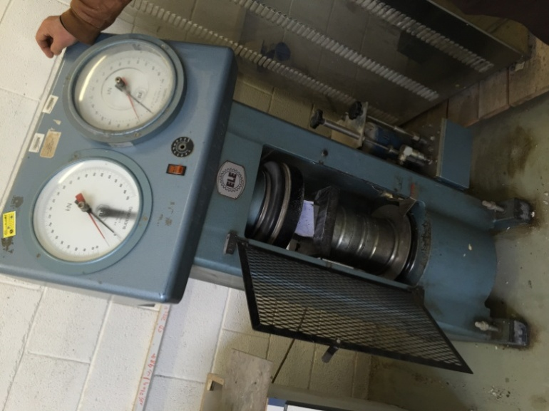
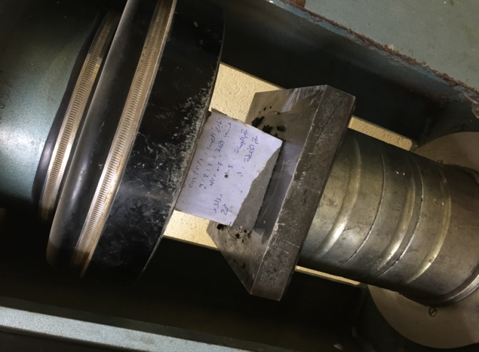

Slide 11
Using the powder as a soil improvement additive material.
Doing tests on a clayey soil to improve it’s properties such as :Liquid limit and plastic limit with different percentages of powder (0 %, 3 %, 5 %, 10 %, 15 % and 25 %).
Liquid limit : is the water content at which the behavior of a clayey soil changes from plastic to liquid.
Plastic limit : is the water content at which the behavior of a clayey soil changes from solid to plastic.

Slide 12
Plasticity Index (PI) : is equal to the difference
between liquid limit and plastic limit of a soil. It is an
important parameter used in classifying fine-grained
soil.
Low plasticity index is indicative to have high
Organic matter in soil, which is preferable.
Ranges of PI and their indications:
(0-3) - Non plastic
(3-15) - Slightly plastic
(15-30) - Medium plastic
>30 - Highly plastic

Slide 13
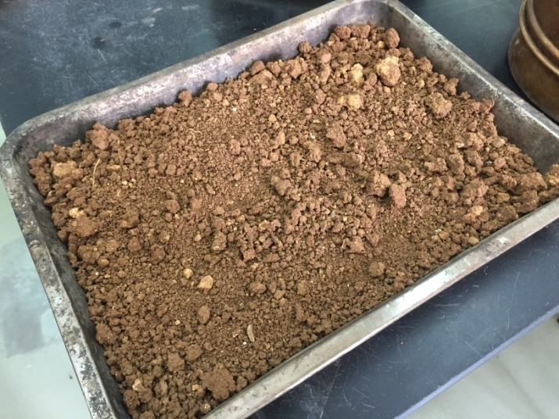
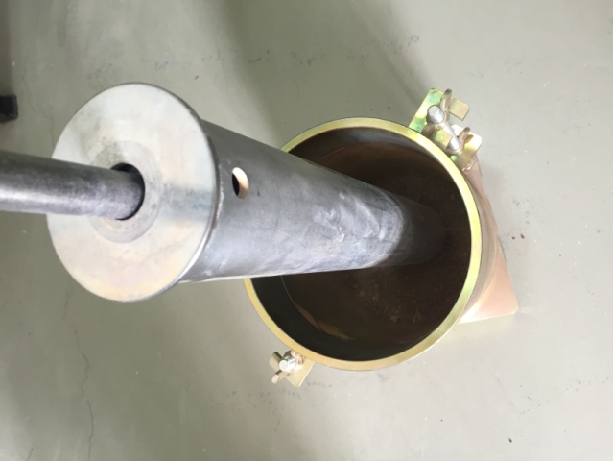
1
2
3

Slide 14
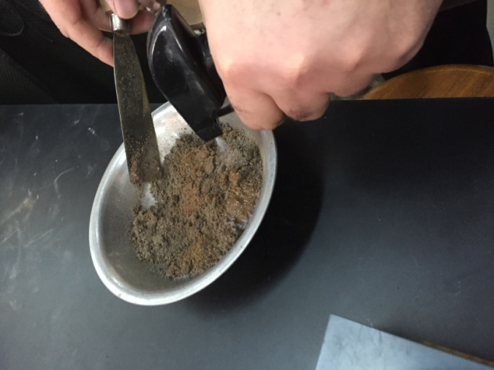
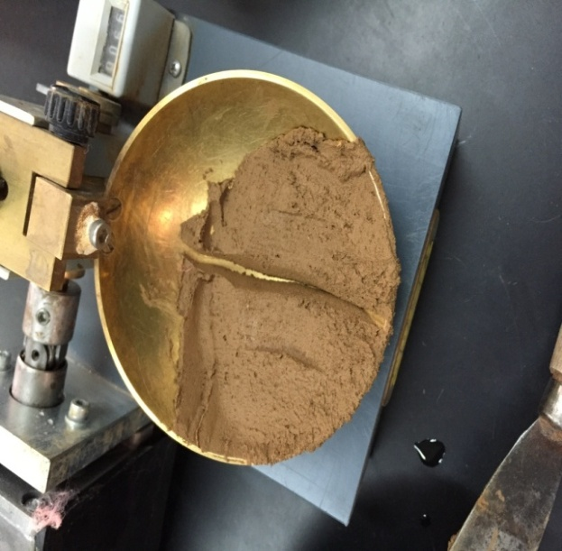
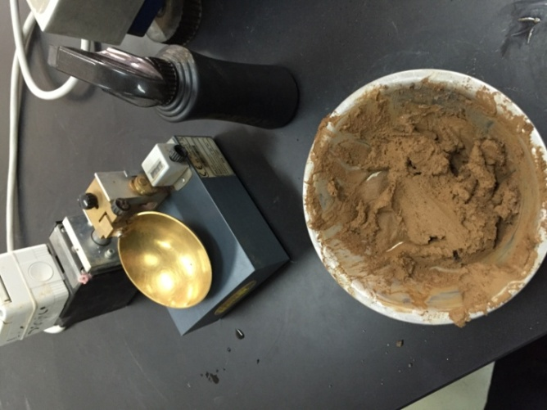
4
6
5

Slide 15
Trial mixes of concrete pipes using the powder material.
A visit was conducted to The Palestinian Concrete
Products Co. (PCP) to identify Concrete pipes, manholes
and its production.
The PCP Company has performed Compressive
Strength test on Manholes and Concrete pipes’ mix
with addition of powder coating.

Slide 16
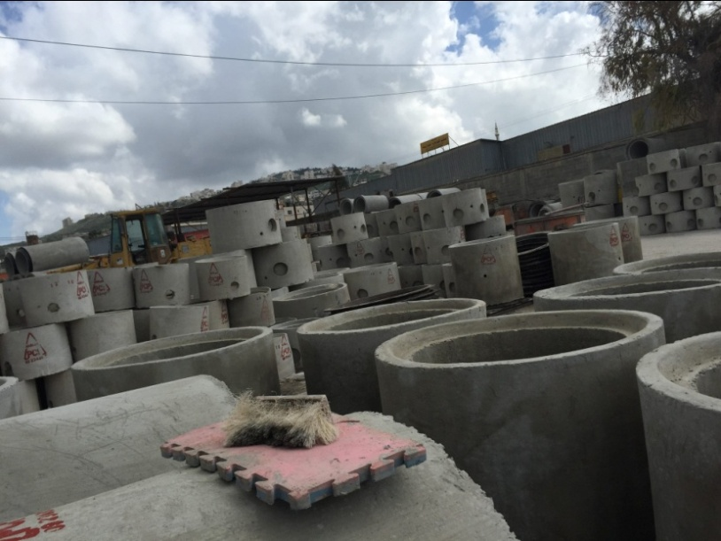
The results were as follows:
Required concrete strength : Manholes B300.
“Manholes’ mix with addition of Powder coating”
Avg. Compressive strength (Kg/cm² ) :
after 3 days =367.5
after 7 days =414.5
after 28 days=533.5

Slide 17
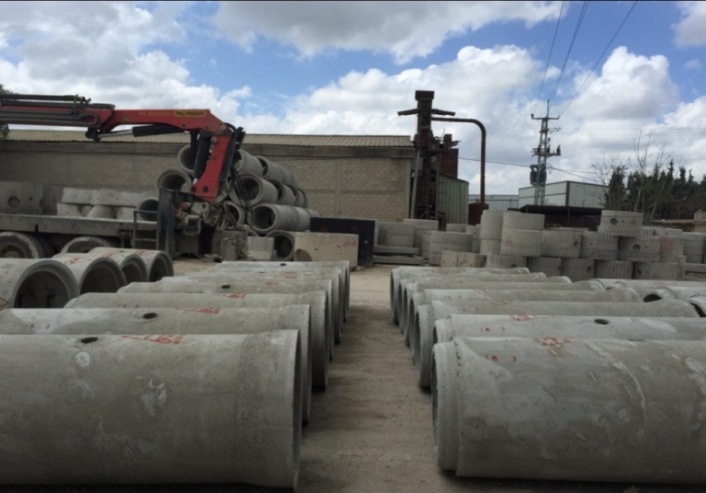
Required concrete type: Concrete Pipes.
“Manholes’ mix without addition of Powder coating”
Avg. Compressive strength after 3 days = 287.5 Kg/cm²
“Manholes’ mix with addition of Powder Coating”
Avg. Compressive Strength after 3 days = 324.5 Kg/cm²

Slide 18
Data Collection and Analysis
For slump test measurement:
Mix. No | Slump (mm)
1 | 30
2 | 40
3 | 60
4 | 40
5 | 15

Slide 19
Simple chart of values:

Slide 20
For Compressive Strength measurement.
Obtaining the strength after 7 days in MPa (average values):

Slide 21
Obtaining the strength after 28 days in MPa (average values):
16
21.8
10.8
20.4

Slide 22
For liquid limit and plastic limit measurements.
32.5
23
14.7
15.6
14
9.1

Slide 23
When the value of plasticity index decrease, the properties of clayey soil will improve.
The graph shows that PI decreases while adding powder , but when adding 25 % the value increases but it still less than if there was no powder.
Which means powder has a positive effect on the clayey soil.

Slide 24
Conclusions and Recommendations
After visiting factories and doing tests on concrete and clayey soil containing powder coating, the following conclusions can be made:
Aluminum Powder coating has a little effect on concrete mixes, so adding a percent of not more than 5% of powder as a replacement of fine aggregate will be optimum; since it increases workability of concrete and makes a little increase in compressive strength.

Slide 25
Powder has a strong influence on clayey soils; since it decreases plasticity index of the soil and therefore increases the strength of soil, which indicates that the durability of the soil will increase.
Powder has a perfect effect on the strength of concrete pipes since its addition increases the compressive strength of the pipes.

Slide 26
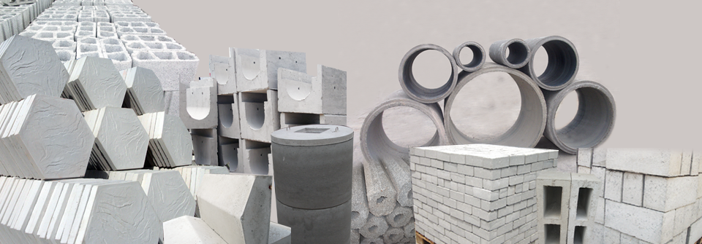
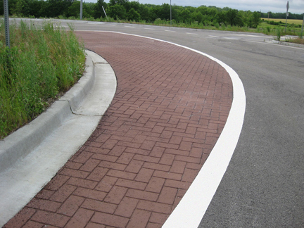
it is recommended to carry out additional set of tests to study the effect of using the aluminum powder coating on the physical and mechanical properties of more kinds of construction materials manufactured in the local market, such as cement tile, concrete block, curbstone,
block for paving, etc.

Slide 27
Questions ?
Presented by:
Dyala Sharaf
Farah Johar

