Slide 1
An-Najah National University Faculty of Engineering Industrial Engineering Department Graduation Project 1 Situational assessment for pharmaceutical sector in Nablus City Supervisor: Eng. Suleiman Daifi Prepared by: Aseel Ismael Saja Younis Sali Baba Tamara Qanadilo

Slide 2
Problem statement
The pharmaceutical sector is considered as one of the most important services in our country; since any problem in it could cause illness, suffering or death!
So we want to identify the factors affecting the efficiency of the output of this sector.

Slide 3
Suggested solution
Design a questionnaire
Distribute the questionnaire
Analyze data

Slide 4
Project objectives
increase pharmacists’ job satisfaction
create a better informed sector
enhance the cooperation between the pharmacists and other stakeholders

Slide 5
Implementation methodology
Methodology
brain-storming meetings were started, Interview with an expert pharmacist was held
Discuss the content of the questionnaire with the supervisor and head of Pharmaceutical Association
workshops may hold with the Pharmaceutical Association to discuss the results and try to find out possible solutions
distributing the questionnaire to Nablus’s pharmacies
recommendations for the developmental planning

Slide 6
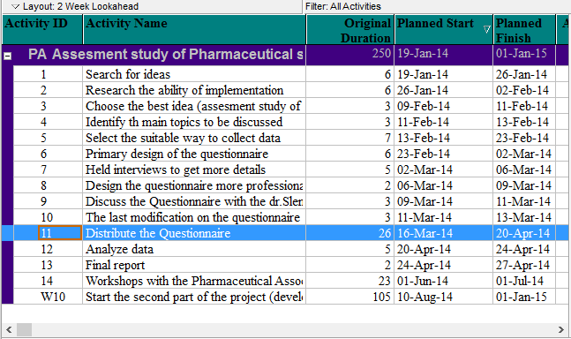
Implementation methodology
Work plan

Slide 7
Scope of work
Our project will be implemented for Nablus city pharmacies, including suburbs and camps, to improve the current situation at those areas .

Slide 8
Literature review

Slide 9
Literature review
Previous assessment Studies of the Pharmaceutical Sector
Previous Questionnaire Design Studies

Slide 10
Previous assessment Studies of the Pharmaceutical Sector
Assessment study of the pharmaceutical sector in India, it’s the main objective is to reducing the effects of high cost drugs while maintaining drugs quality.
They must give more drug quality because they affect the success of the pharmaceutical sector and gain more customer satisfaction

Slide 11
Another study was an assessment of the pharmaceutical sector in Ethiopia;
-- It aims to discover strengths and weaknesses in the pharmaceutical sector.
-- Give recommendations to improve.
-- Increase the availability of drugs.
-- Develop storage conditions in health departments.

Slide 12
According to article written by Dr. Thomas to design a good questionnaire can be divided into 5 elements :
PREVIOUS QUESTIONNAIRE DESIGN STUDIES.
design the question sequence
select the question type for each question
determine the questions to be asked,
Identify Objectives of the project
identify the type of questionnaire

Slide 13
And according to an article written by Wai-Ching Leung To write good questions we have to follow these rules
write Introduction explaining the goal of the questionnaire
writing the questions in a good sequence
start with closed format questions
Write sentences shortly
Leave enough space to record the answers
Use simple and direct language
questions must be clear and easy to understand

Slide 14
Project Implementation

Slide 15
Methodology
Questionnaire Design
Field Work
Data Entry and Cleaning

Slide 16
Questionnaire Design
Stakeholder Analysis
Revising and Finalizing the Questionnaire
Developing the Question

Slide 17
Stakeholder Analysis
Pharmacy
Doctors
Patients
Insurance companies
Pharmaceutical Association
Pharmaceutical Companies
Ministry of Health
University
Other Pharmacist
Dealing with Expired Drugs

Slide 18
Questionnaire Design
Stakeholder Analysis
Revising and Finalizing the Questionnaire
Developing the Question

Slide 19
Developing the Questions
Questions
Closed
Yes/No
1-5
Open

Slide 20
Questionnaire Design
Stakeholder Analysis
Revising and Finalizing the Questionnaire
Developing the Question

Slide 21
Revising and Finalizing the Questions
Revising and finalizing the questionnaire with our project supervisor
Revising with the Chairman of the pharmaceutical Subcommittee in Nablus City and apply the needed modification
Get the Approval from the Chairman of the pharmaceutical Subcommittee in Nablus City

Slide 22
Methodology
Questionnaire Design
Field Work
Data Entry and Cleaning

Slide 23
Methodology
Questionnaire Design
Field Work
Data Entry and Cleaning

Slide 24
QUESTIONNAIRE
Analysis

Slide 25
Relationship between Pharmacist and Doctors
Weaknesses
Strengths
Scientific names
prescriptions
Existing medicines in the Palestinian market
Certain pharmaceutical products companies
Certain pharmacies
Drugs' doses
Communicate with doctors

Slide 26
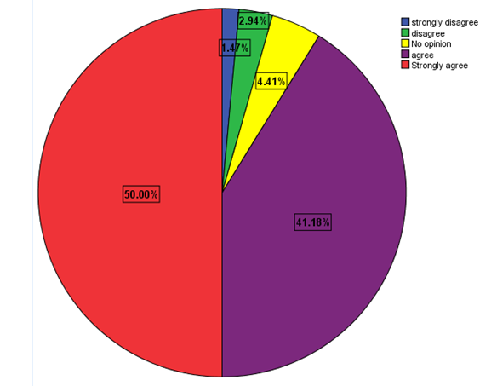
The highest percentage of weaknesses was for doctors who insist writing drugs from a certain pharmaceutical products companies, see the following chart

Slide 27
Relationship between Pharmacist and Pharmaceutical Companies
Weaknesses
Strengths
Companies don’t restore and act with expired medicines
Providing imported needed medicines
Prices of local medicines
promotion representatives/the salesman
They don’t pay for the quantities of medicines that are expired
Providing local needed medicines
Prices of imported medicines
Reasonable offers/payments
easy to communicate with
delivering ordered medicines on the right time

Slide 28
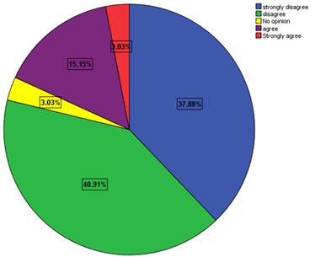
The highest percentage of weaknesses was for if the pharmaceutical products companies pay for the pharmacist for the quantities of medicines that are expired, see the following chart

Slide 29
how pharmacists usually deals with expired medicines

Slide 30
Relationship between Pharmacist and Insurance companies
Weaknesses
Strengths
choosing/dealing with pharmacies isn't through the association
don't pay their dues in two months or less
cooperation/ low service performance
medicines lists are not well identified/generalized
insurance companies don't deal with all pharmacies
Prefer dealing with most insurance companies
easy to communicate with
electronic system
pharmaceutical association monitors the insurance companies and their commitment of laws

Slide 31
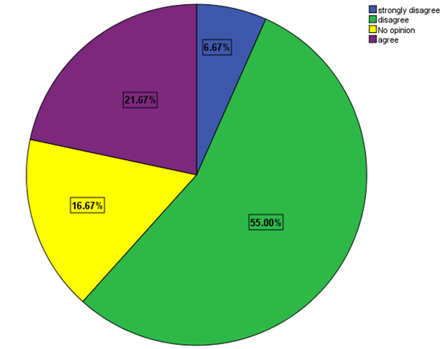
The highest percentage of weaknesses was for if insurance companies are considered to be fast and offer all of the pharmacists’ requirements , see the following chart

Slide 32
Relationship between Pharmacist and pharmaceutical Association
Weaknesses
Strengths
financial dues are beyond the ability of the pharmacists
doesn't held regular meetings
didn't make a big effort in standardizing the prices
linking the social solidarity to obtain the license of practicing
doesn't provide the latest available technological facilities
has a responsible employee to keep in contact with them
corporates with the ministry of health
enhances the relationships between pharmacies and insurance companies
organizes Fridays' shifts fairly

Slide 33
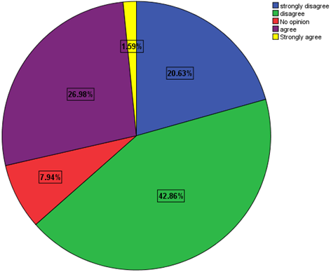
The highest percentage of weaknesses was for if the pharmaceutical association held regular meetings, to discuss pharmacists’ problems and find solutions, see the following chart

Slide 34
Relationship between Pharmacist and patients
Weaknesses
Strengths
patients care about medicines’ prices
some patients ask to buy part of the medicines in the prescription
addiction to a particular type of medicines
fabrication of unreal drugs prescriptions
pharmacists give enough time to explain how to use the medicines to the patients
patients pay attention to know how to use the medicine
Availability of special equipment in the pharmacy to prepare some medical prescription

Slide 35
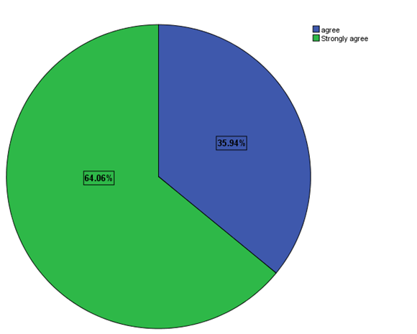
The highest percentage of weaknesses was for if patients compare medicines’ prices in more than one pharmacy to choose the lowest price, see the following chart

Slide 36
Relationship between Pharmacist and the ministry of health
Weaknesses
Strengths
procedures established to obtain a license to set up a Pharmacy are complex
The cost of license is high
the penal system isn't valid for all without exception
doesn't monitor standardizing the prices of medicines
takes samples of drugs periodically to make sure that they meet specification
health inspectors visit pharmacies periodically
monitors smuggled and stolen medicines
monitors the process of getting rid of the hazardous expired medicines

Slide 37
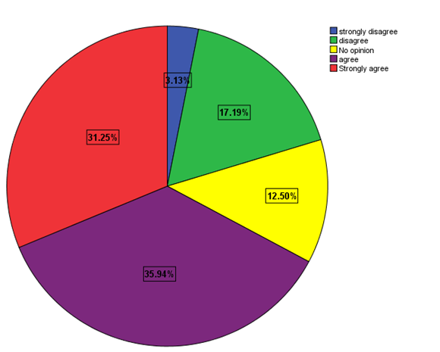
The highest percentage of weaknesses was for if the cost of license needed to establish a pharmacy is considered high, see the following chart

Slide 38
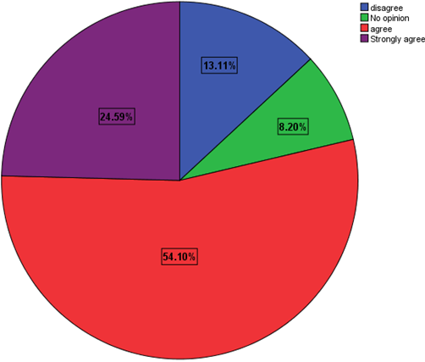
Relationship Between Pharmacists and University
If there is a different between what the student
learns at university and what he applies

Slide 40
Conclusion

