Slide 1
Variation Orders
By: 1.majed bushnaq 2.mahmoud battat
3.ibrahim obaidi 4.medhat athamneh
Under supervision of Eng.Reema Nassar

Slide 2
OUTLINE:
Part one of the research
Questionnaire
Case study
Analysis and conclusion
Recommendation

Slide 3
Part one of the research:
Research background
Variation orders definition
Causes of variation orders
Effects of variation orders
Variation orders in FIDIC and World Bank
Previous studies
Research Methodology

Slide 4
Definition of variation order
Is an alteration to the scope of works in a construction contract in the form of an addition, substitution or omission from the original scope of works.
Variations may include:
Alterations to the design.
Alterations to quantities.
Alterations to quality.
Alterations to working conditions.
Alterations to the sequence of work.

Slide 5
QUESTIONNAIRE
Understand the attributes of a well-designed questionnaire.
Adopt a framework for developing questionnaires.

Slide 6
Questionnaire Design:
Questionnaires have been usually used in order to find out facts, opinions and views.
All the information that could help in achieving the study objectives were collected, reviewed, and formalized to be appropriate for the study survey.

Slide 7
Preliminary decisions in questionnaire design:
Decide the information required.
Define the target respondents.
Put questions into a meaningful order and format.
Pre-test the questionnaire.
Develop the final survey form

Slide 8
Questionnaire Content:
The questionnaire design was composed of three parts to accomplish the aim of the research, as follows:
1. The first group contained general information about the companies consists from seven questions.
2. The second part contained information about industry characteristics of variation orders.

Slide 9
Questionnaire Content:
3. The third part: Identify the causes, effects and controls of the variation orders :
Group (1) potential causes : Causes related to the owner ;contains six choices, causes related to the design consultant; contains thirteen choices and other causes; contains six choices
Group (2) effects of variations ; contains seven choices.
Group (3) controls of variations ;contains twelve choices.

Slide 10
Pilot Study
The piloting process conducted by interviewing three experts.
we were asked to review the questionnaire and make some modifications
. In general, experts agreed that the questionnaire is suitable to achieve the goals of the study.
some modifications have been done on important comments.

Slide 11
Limitation of the Research:
The research have merged between areas of the north, represented by the city of Nablus and the south represented by Hebron
to get the most accurate answers and Studies on this topic ,survey was limited to contracting and consulting companies that are classified as first degrees , which have a valid registration in Palestinian contractor union PCU. And Engineers Association.

Slide 12
CASE STUDY:
Case study description:
Project: construction, completion and maintenance of Al Rehiyeh Secondary Girls School, Al Rehiyeh village, Hebron city, owned by Ministry of Education and Higher Education, designed and supervised by Arab Engineers company , contractor was Abulfilat construction cooperation .

Slide 13
CASE STUDY:
A substitution variation order in the form of unforeseen terrain conditions of bearing capacity of the soil after requesting and reviewing the results and following the recommendations of geotechnical inspection report for the school site

Slide 14
CASE STUDY:
the variation order was to substitute the selected sub base fill of 60cm and base course layer of 1m under the footings in the original project drawings with rubble concrete layer of 40cm thickness.

Slide 15
Tracking the conducted procedure:
The consultant requested the contractor to prepare a geotechnical inspection report for the site providing description of site condition and geotechnical recommendations relating to the allowable bearing pressure and footing construction.
Contractor requested the building center company to prepare the report
After reviewing the report results and recommendation the consultant decided to perform the variation order

Slide 16
Tracking the conducted procedure:
Consultant ordered the contractor to prepare the needed bill of quantities of earth works before and after modification.
Consultant revised the contractor rates and compared it with the original bill of quantities of the contract and made the necessary correction on them and adopted them.
Consultant sent a notice to the owner clearing the VO and the deducted price from the items of concern.
Owner approved the VO and all parties signed on VO documents.
The VO was performed.

Slide 17
CONCLUSION
The most preferred contracting system for both contractors and consultants was the traditional "design-bid- build" contracts for less variation orders or better type for overcoming.
Most of consultants and contractors said that the delay caused by variation orders as a percent from the original schedule was from 0-10%.
Majority of consultants agreed that the amount of variation orders as a percent from the contract value was from 0-10%, where contractors considered its limited up to 5%.

Slide 18
CONCLUSION
Contractors said that; the main originator of variation orders are the consultants where consultants referred the responsibility to the owner.
The ten most important factors that contribute to the occurrence of variation orders in construction projects in Palestine are :
1) Owner’s financial problems
2) Change of scope by owner . 3) Design complexity.
4) Change in design. 5) lack of coordination.
6) Weather conditions. 7) Unforeseen problems.
8) Errors in design.
9) Change in economic conditions.
10) Conflicts between contract documents.

Slide 19
CONCLUSION:
The five most important effects of variation orders in construction projects in Palestine are;
1) overhead expenses increase.
2) Completion schedule delay .
3) Project cost increase.
4) Delay in payment.
5) Productivity degradation.

Slide 20
The five most effective control techniques of variation orders in our study area came as following;
1) The designer must be familiar with all regulations .
2) No contradiction between contract documents.
3) Items in BOQ must be obvious .
4) Written approvals and documentation .
5) Owner’s involvement during construction.

Slide 21
CONCLUSION:
Value additions of variation orders: a very important point we concluded at a late stage of our project was; nothing wrong with variation orders as long as they were initiated for project improvement purposes. There should not be any damage of relationships between parties to the contract following the occurrence of variation orders; the presence of a variation clause is an indication of flexibility of contract arrangements in order to accommodate changes to solve problems arising within the project.

Slide 22
RECCOMENDATION
Adoption of DBB:
most effective and comfortable as results of respondents opinions have shown.

Slide 23
Minimizing potential variations and subsequent claims
Concise drawings, BOQs, specifications.
Comprehensive project brief ,supported by stakeholders.
Legislative requirements
Identifying risks.
co-ordinated designs

Slide 24
Minimizing potential variations and subsequent claims
Unambiguous and explicit.
Contractor's rates
Planning
Completeness of the design .
Time allocated to the pre-contract.

Slide 25
Minimizing potential variations and subsequent claims
Clear brief
Forecast .
Co-ordination.
Communication.
experienced , dedicated supervisor.
Budgetary considerations .

Slide 26
Suggested road map to manage V.Os in the construction projects:
1. Project Initiation Stage: - Preparation of clear project brief and conducting of credible feasibility study.
2. Project Planning Stage: - project design, project scheduling, contract documentation and cost estimation.
3. Project Execution Stage: - Identify the contract requirements, identify the potential variation and create a potential variation order file, evaluation of PVO, execution of VO and documentation of VO.
4. Project Closure Stage: - Production of as-built drawings, project completion reports and lessons learned log.

Slide 27
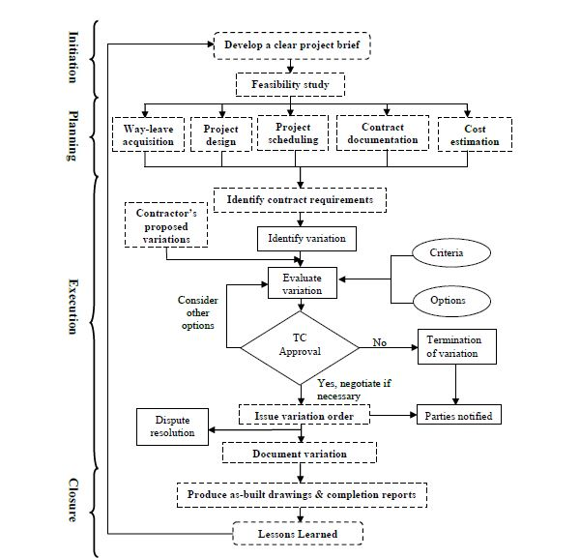

Slide 28
Thank you

