Slide 1


Towards a Smart City:
GEO-Apps Utilization in Al-Zababdeh town – Palestine

Slide 2
Prepared by:-
Shatha Mohammad Hashem Zeid Al Kilani
Abdul-Rahman Majed Naji Nasser
Batool Nasem Noeman Isayed
Jumanah Shaheen Mahmoud
Ibrahim Baker Ibrahim Abu Hijleh
Under supervision of: Dr. Abdelhaleem Khader

Slide 3
Outline
Introduction
Objective
Geo form
Elevation profile
Web app
Smart water Distribution network
Mobile app

Slide 4
Introduction
Day by day - urban populations grow largely and researchers have also predicted that approximately 75% of the world population will live in cities by the year 2050.
As a result of these predictions, the decisions makers and planners in the city start thinking of creating a new concept for organizing and facilitating city life that is labeled " smart city “ .

Slide 5
What is the “smart city “ ?
There is no specific definition for smart city in the world yet, it means “different things for different people “.
In general, smart city is a development region which has high progress in economic, political and cultural fields.

Slide 6
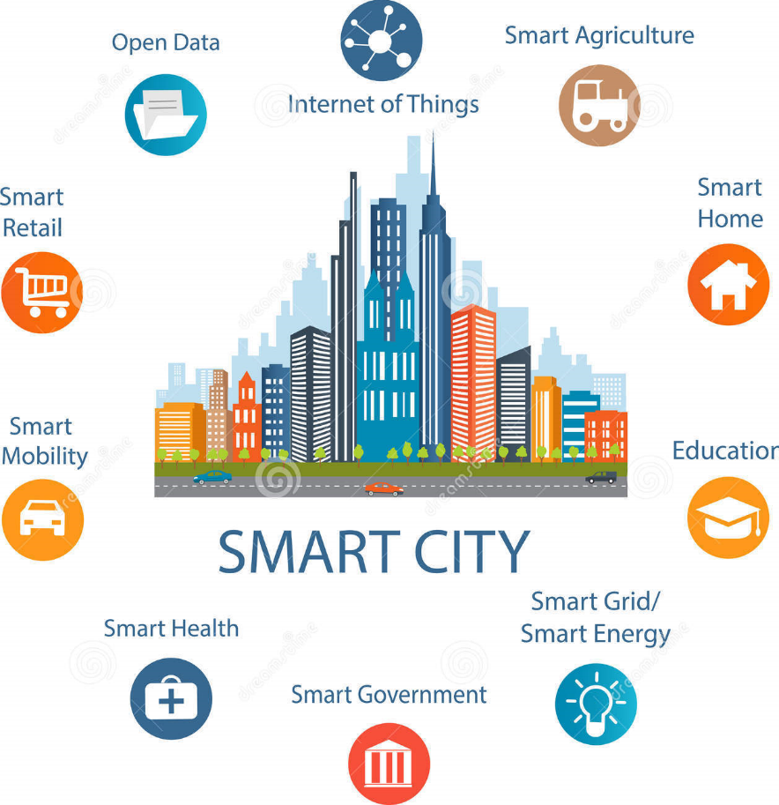

Slide 7
As a result of usefulness of applying smart cities technology in some countries of the world, we as a researchers applied one side of this technology (Geo app) in Al-Zababdeh town by using ESRI website to solve environment problems.

Slide 8
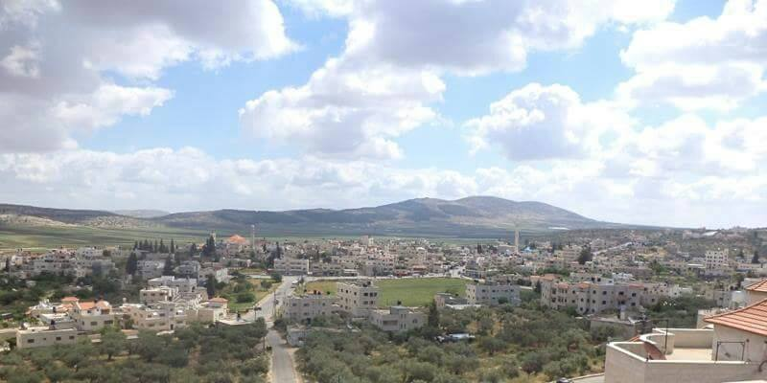
Study area about Al-Zababdeh

Slide 9
Study area about Al-Zababdeh
Location
The town of al-Zababdeh is located in the governorate of Jenin, 15 km to the south-east of the northern west bank.
Topography
About half of Al - Zababdeh area is flat and the other half is mountainous, the average elevation is 314m for this town.

Slide 10
Study area about Al-Zababdeh
Social-Economic Situation
The population of Al -Zababdeh town is distributed between Christians and Muslims.
There are many quarries in the town that considers an incomes source for many citizens.
As a result of close location of the town from the Arab American University, this helps in establishing many buildings for resident students and this in turn improves economic status
Most of the people in the town working in the public, private and agricultural sectors.

Slide 11
Objectives
The main objective of any smart city is represented by using technology in the field of traffic, agricultural, transportation and communications so as to create a high quality.
In an attempt of solving some environmental problems in our country by applying some of Geo application.

Slide 12
Based on the benefits we want to deliver to the municipality to achieve the desired goals we have applied these five application:-
1- Geo form
2- Elevation profile
3- Web app
4- Smart water Distribution network
5- Mobile app

Slide 13
Geo Form

Slide 14
Geo form definition
The Geo Form is a newest and configurable web mapping application template of form-based data editing for a feature service through the web browser.
This application allows users to enter data through a form instead of a map’s pop-up, and this is leveraging the power of the Web Map and editable Feature Services.
It enable users to add points to a feature service via a form.
This is perfect for users who want to encourage customers or members of the public to self-serve with reporting without the need for custom development.

Slide 15
Geo form advantages
All collected data is stored in a standard format, a feature class is shared across ArcGIS Online – as the data is submitted.
Data are stored in the cloud. Hard drive crashes don’t erase your data.
Data can be entered from a desktop or mobile device with equal ease which means it would be easy to keep in touch with data.
The data can be viewed and analyzed in ArcGIS for Desktop or with an ArcGIS Online Organization account (using the “Perform Analysis” tools).

Slide 16
Geo form features
Multiple layer support.
Point, line and polygon features.
Ease of enter and editing data to the form.

Slide 17
Al-Zababdeh geo form
We use this service to create an application about Al-Zababdeh town to help the group of students in Urban Planning Engineering Department at An-Najah university to collect social data about people in Zababdeh, this application help them to collect data easily without any need to go to the field and it will conserve time and money.
The questions aims to collect social data about people like range of age of people, what the type of jobs, age of building, number of floors and department at each house and another social questions that help to improve the town conditions.

Slide 18
Al-Zababdeh geo form
We create 5 Geo application with same questions but with different map, each map show part of the town (North, South, East, and West and center part of the town).
We share the links on social media to facilitate citizens' access to the links.

Slide 19
Al-Zababdeh geo form links
Center part
Western part
Eastern part
Northern part
Southern part

Slide 20
Elevation Profile app

Slide 21
Elevation profile app definition
These tool help to generate an elevation profile for existing road in the map or for lines drawn using the measure tool.

Slide 22
Elevation profile app advantages
The main purposes of elevation profile is to give a profile between points which is very important in Transportation Engineering since it helps at excavation process in road construction (cut and fill calculation).

Slide 23
Elevation profile app features
The elevation profile give us several useful information about the drawing line like:-
Distance of any point in the line from the start point.
Elevation of any point from the mean sea level.
Elevation from the start point.
Max and Min elevation in the line.
Elevation of the start and end point.
Change in elevation between the start and end point.

Slide 24
Al-Zababdeh elevation profile app
We developed Al-Zababdeh elevation profile as a simple map which can be use by any user.
The application provide several base map to use.

Slide 25
Al-Zababdeh elevation profile app link
Al-Zababdeh elevation profile

Slide 26
Social Web App

Slide 27
Web app definition
Web App Builder for ArcGIS provides a foundation for building web applications in ArcGIS that run anywhere, on any device, without writing a single line of code.
Web app can be created by author a web map in ArcGIS Online using the Smart Mapping tools and layers from the Living Atlas of the World and Esri demographic data.
Living Atlas of the World and Esri demographic data is a drive for Esri which contains several information about areas and countries that we can use in web app to show the information on map in a simple useful way.

Slide 28
Web app features
We can modify the data in the event of any change.
We can turn off the filters pre-set in the map.
Facilitate the process of obtaining information about places through the map instead of using paperwork

Slide 29
Web app features
building this app depending on amount of information about the area that we interested , this information include maps, information about population, and information about the thing that we want like health, education, spending … etc.

Slide 30
Significance of the work
Since there are no existing layers about Palestinian area at Living Atlas of the World and Esri demographic data because of the policies of the Israeli occupation so we use GIS shape files in our application.
We prepared GIS shape files about the four area at Al-Zababdeh With help of urban planning Engineering students at Al-Najah University and we upload these shape files as layers on the map.

Slide 31
Significance of the work
Each of this layer contain social information like (religion of people in each house, number of floor in each building, construction material of building, use of building, years of construction, area of building).

Slide 32
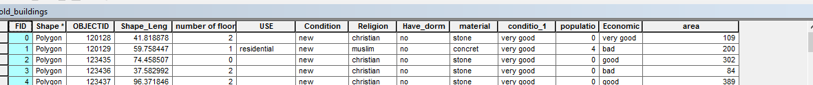
Significance of the work
Layers information for web app

Slide 33
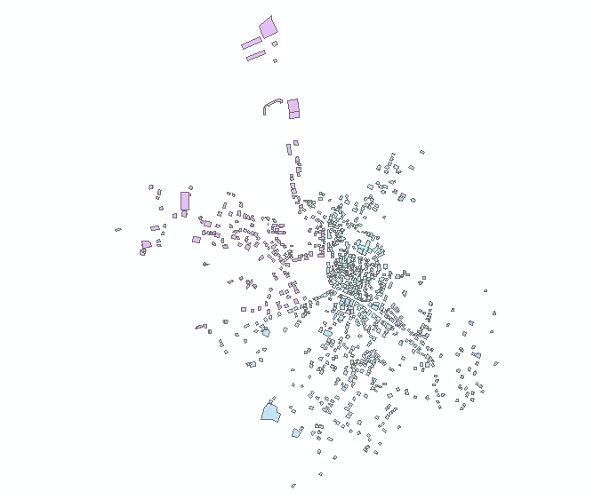
Significance of the work
The distribution of building as obtained from GIS software shown in the next figure:-

Slide 34
Al-Zababdeh social web app link
Al-Zababdeh social web app

Slide 35
Al-Zababdeh
Mobile app

Slide 36
Mobile app definition
Most people used the mobile applications for gaming and browsing internet, little people used a national programmers, we will built an application depends on a specified data base, and it is installed directly on the mobile.
Native apps are created for a specific platform and installed directly on to a device.
With AppStudio, we can convert our web maps into beautiful, consumer-friendly mobile apps (for Android, iOS, Windows, Mac OS X, and Linux) and publish them to popular app stores.

Slide 37
Mobile app features
Our application aims to improve the connection between people and Al – Zababdeh municipality in a smart form with using the principle of GIS (connect the data with location).
people can use the app to take photo of any engineering problem and enter data about the problem then the app will automatically specifies the location of the taken photo.
The photo, data and location will directly transform to a web site that the municipality engineer can see the problem sent on a web map with entered information.

Slide 38
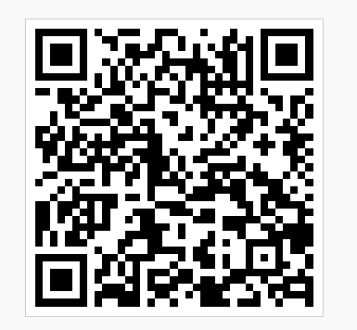
How we can get the app
We can upload our app to app store and Google play if we have a license to do that, then people can download the app on their smart phone and use it for free.
But before upload the app the people can use the app if they have an account on Arc GIS only, then they should download Appstudio app on their device to be able to use this feature, people should scan the Qr code of the app to download it on Appstudio app.

Slide 39
Mobile app map
After uploading the photo by citizens, the report will uploaded to a certain web map so the municipality engineer can see the problem sent on a web map with entered information.
The flag at the map means there is a report of a problem upload by user in this location, when press on the flag a box will appear and show the enters information and the photo of the problem.
After repair the problem, the municipality engineer can delete the problem from the map.

Slide 40
Mobile app map
In addition the map provided some other features like direction tools are provided to the map, from this tools we can select tow position and the map will measure the direction and time needed to reach the problem for example if the first point is the municipality building and the second point is the problem location we can measure the direction to problem location and time needed.

Slide 41
Mobile app map link
Mobile app map

Slide 42
SMART WATER DISTRIBUTION NETWORK

Slide 43
Smart water distribution network definition
A smart water distribution network aims to provide a simple and smart network viewed on a web page with information about the elements of the network.
The network consist of these elements:-
1- Pipes
2- Valves
3- House meters
4-Municipality meters

Slide 44
Smart water distribution network features
smart water distribution network help engineers to preview the network easily by pressing at each element then the information about this element will appear.
Ability to modify and add information on the network.
Facilitate analysis processes on the network.

Slide 45
Significance of the work
We get the designed network from Al-Zababdeh municipality as AutoCAD file and we get also the information about the element as softcopy from Al-Zababdeh municipality then we draw the network on GIS software and then we enter the data of each element and allocate the coordination of the network to match on the map at Al-Zababdeh town.

Slide 46
Significance of the work
The information we enter on GIS software as a shape file are:-
1- Roads network.
2- Pipes network: each pipe contains these information’s (material,
label, length, diameter and date of construction).
3- Valves : (label of valve).
4- House meters: (label of each meters).
5- Municipality meters: (label of each meters).

Slide 47
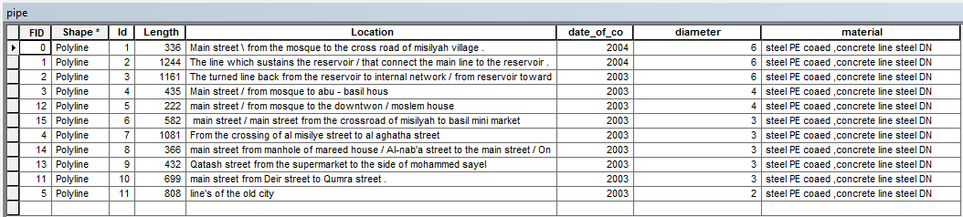
Significance of the work
The table below show the network contents:-
Contents of water network

Slide 48
Additional features to the network
In addition, we create a layer helps engineer to read the elevation at any point. There is another layer contain a properties and types of soil which help if there is an infiltration on pipe we can know what is the properties of soil that infiltrate to the pipe.

Slide 49
Smart water distribution network link
Smart water network

Slide 50
References
https://www.quora.com/
https://blogs.esri.com/
Department of engineering at Al-Zababdeh municipality.

Slide 51


