Slide 1
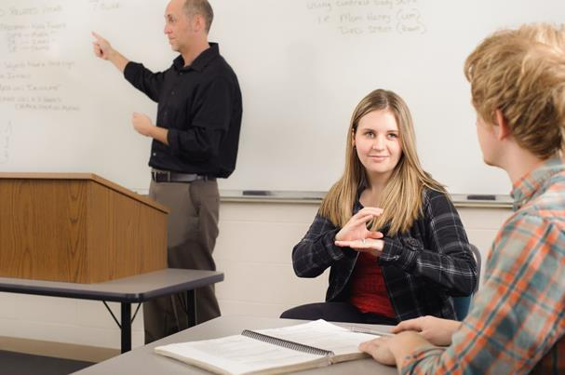
Sign For Me
Prepared by:
Wala’ Hamad Khayrieh Homran
Supervisor:
Dr.Raed Al-Qadi

Slide 2
Outline:
What is Sign For Me?
Motivation, Objective and Main idea.
Application modes.
Programming techniques.
Future work.

Slide 3
What is Sign For Me?
It’s an Android application that targets hearing impaired people.
It provides 5 sub applications which support Arabic Language.
It converts normal people voice and written text to animated Sign Language.

Slide 4
Motivation
The high percentage of hearing impaired people in Palestine
Helping hearing impaired people to keep up with group real time conversation .

Slide 5
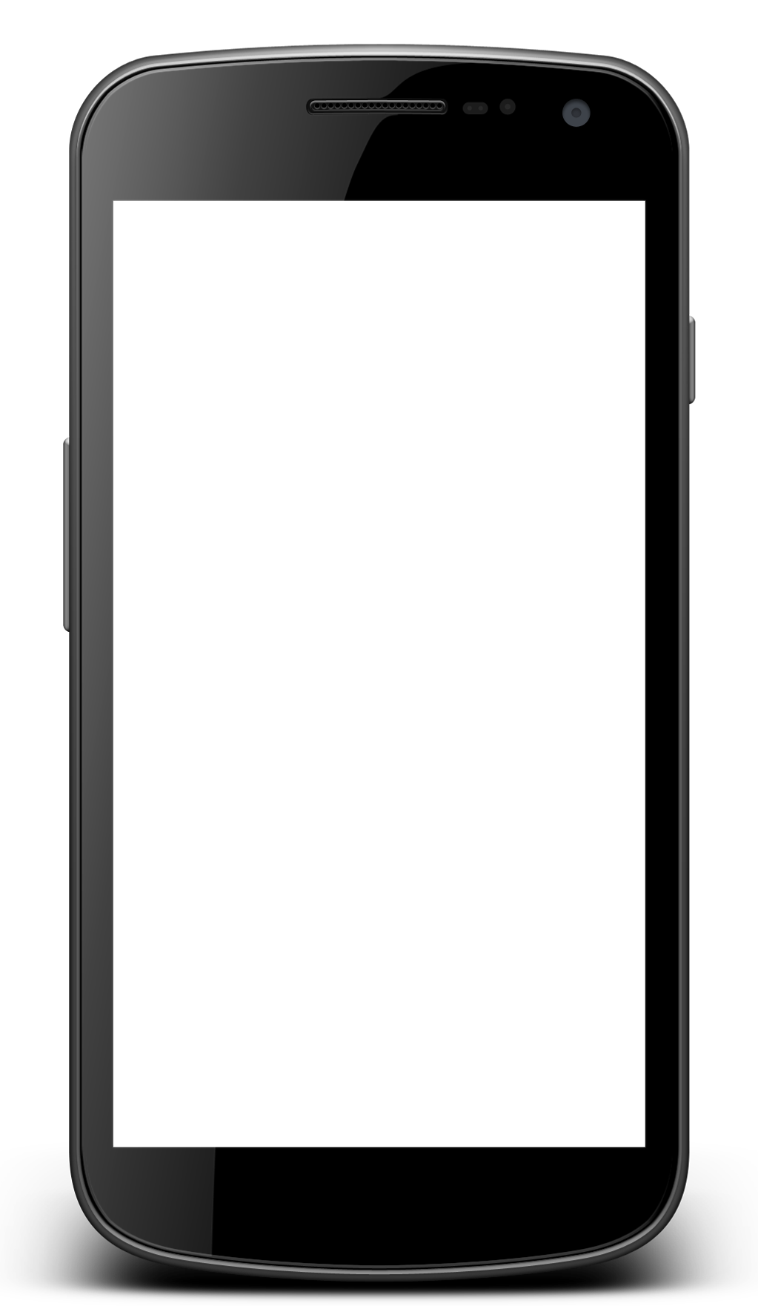
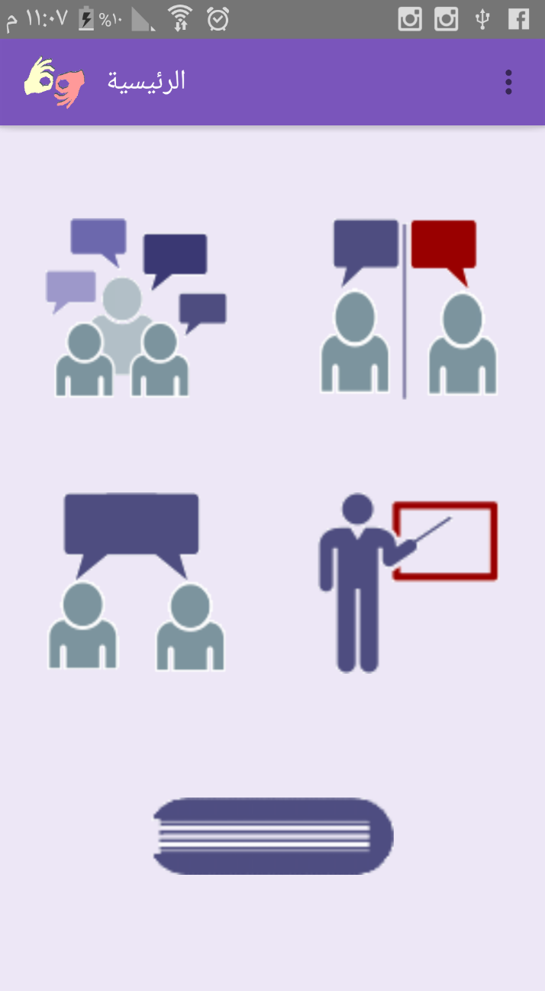
Application Modes
Friend Chat Mode
Group Conversation Mode
Single Device Mode
Training Mode
Dictionary Mode

Slide 6
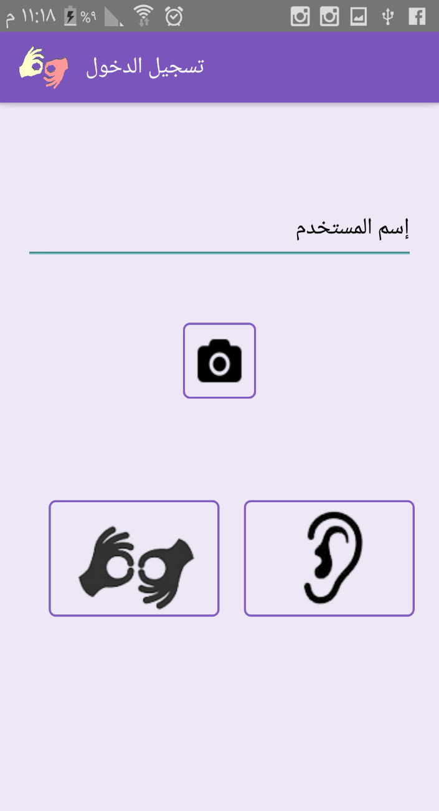
Group Conversation Mode
Two types of users:
Hearing impaired users.
Normal hearing users.

Slide 7
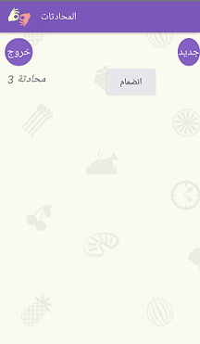
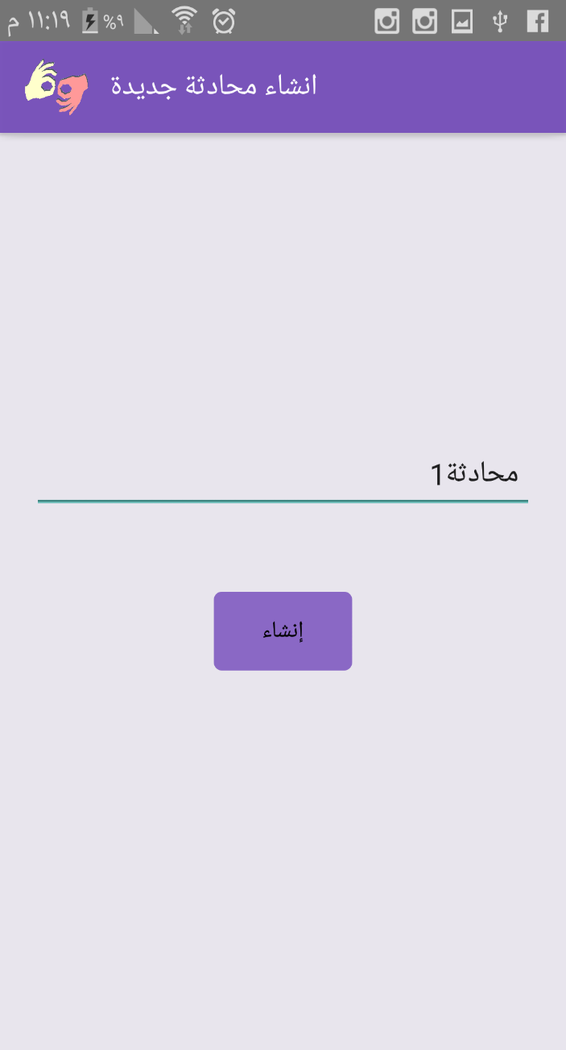
Group Conversation Mode
Deaf user
Creating new conversation.
Joining existing conversation.

Slide 8
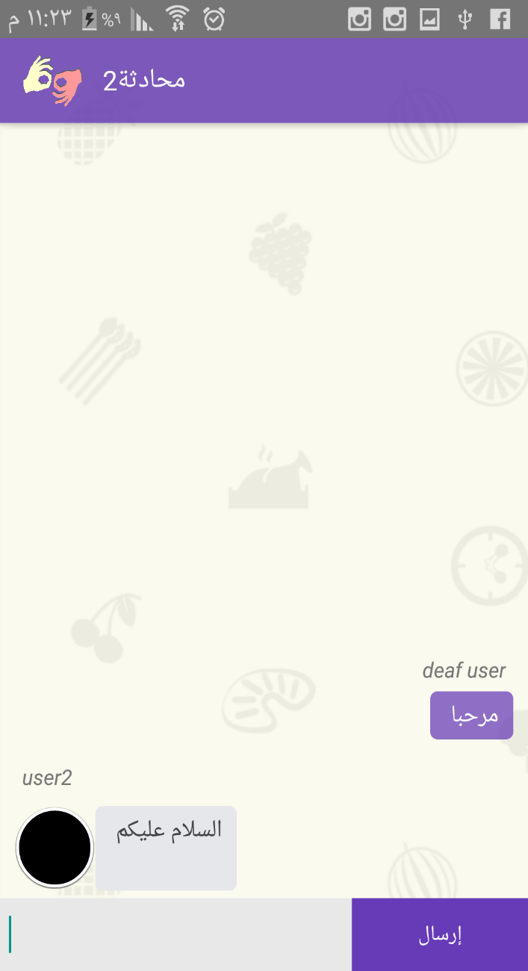
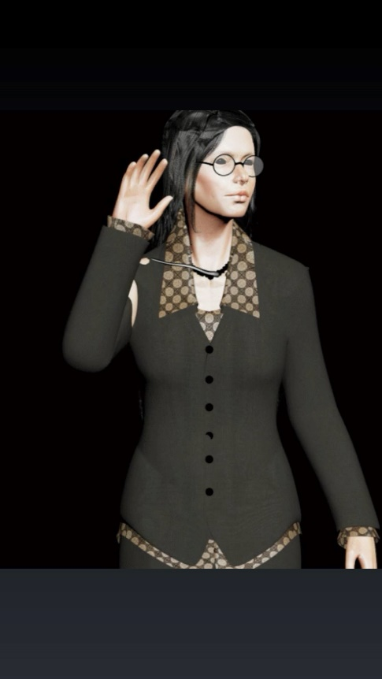
Group Conversation Mode
Deaf user
Sending Message to conversation.
Translate received messages to Sign Language.

Slide 9
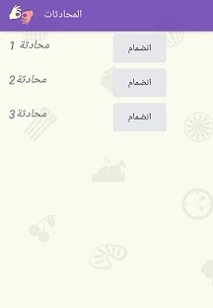
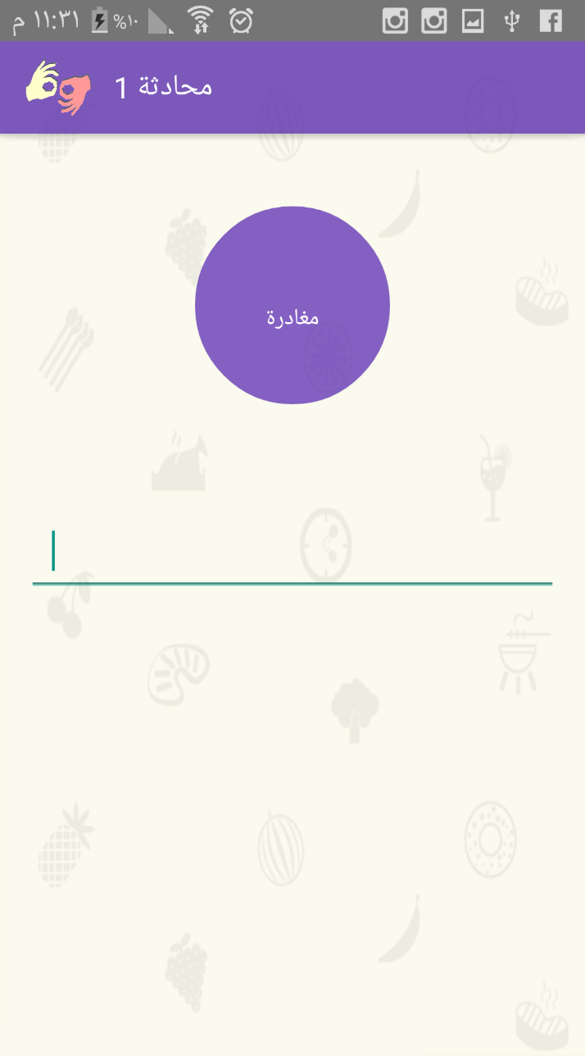
Group Conversation Mode
Hearing user
Joining existing conversation.
Application Handle the spoken text voice.

Slide 10
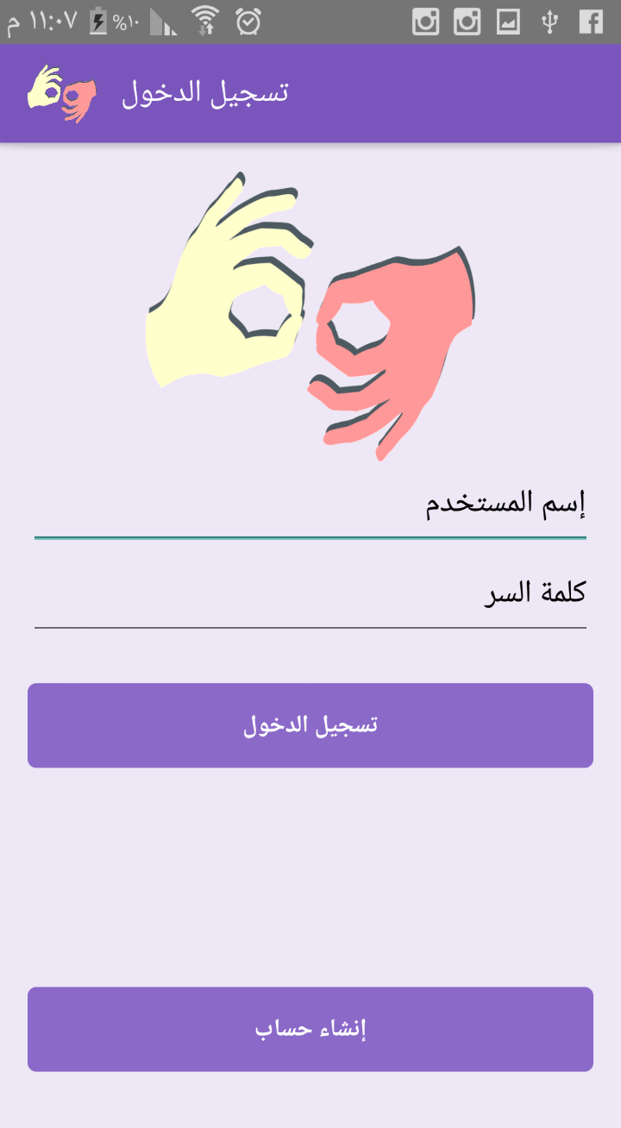
Friend Chatting Mode
Login to existing user account.

Slide 11
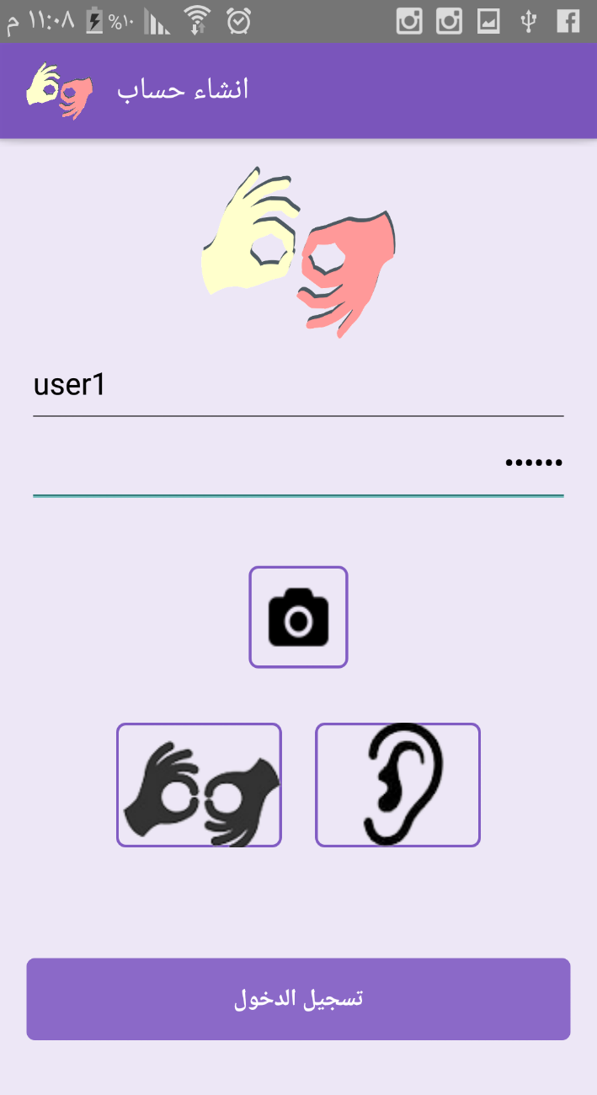
Friend Chatting Mode
Create new account as:
Deaf user.
Hearing user.

Slide 12
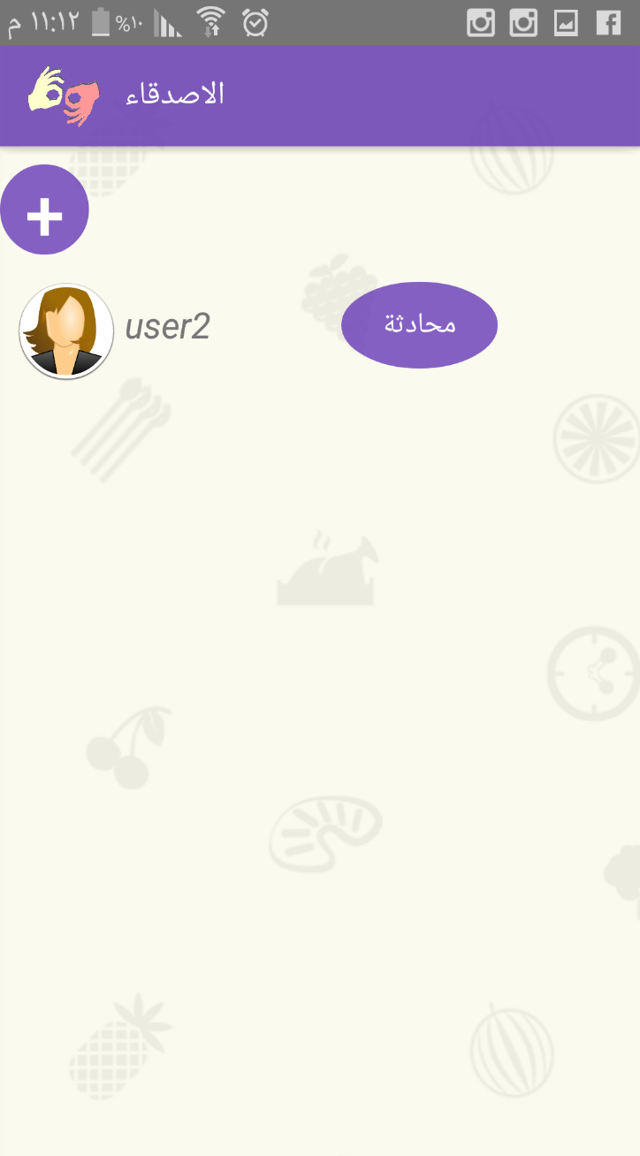
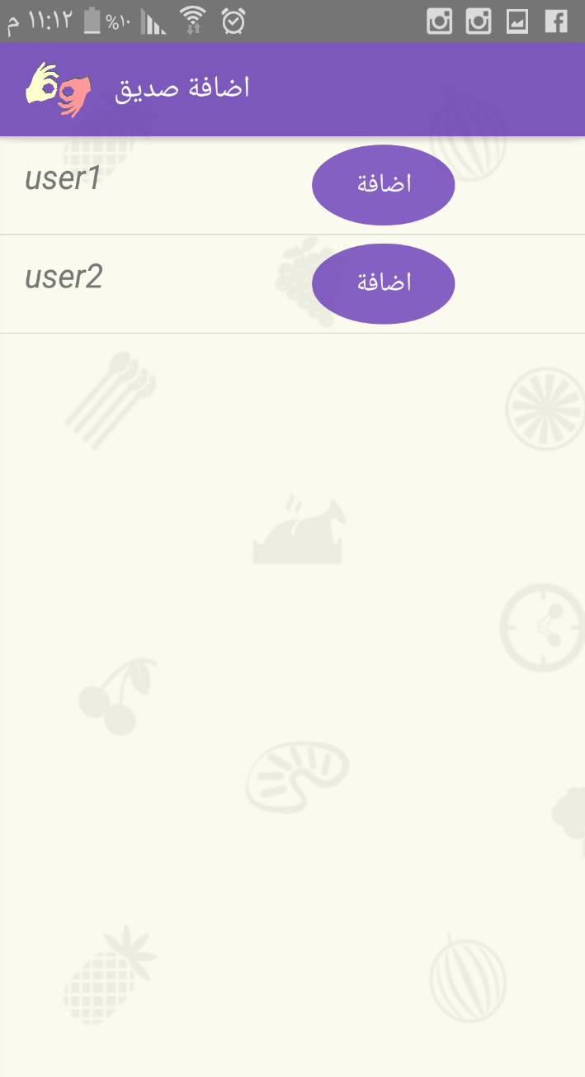
Friend Chatting Mode
Chatting with friend.
Adding new friend.

Slide 13
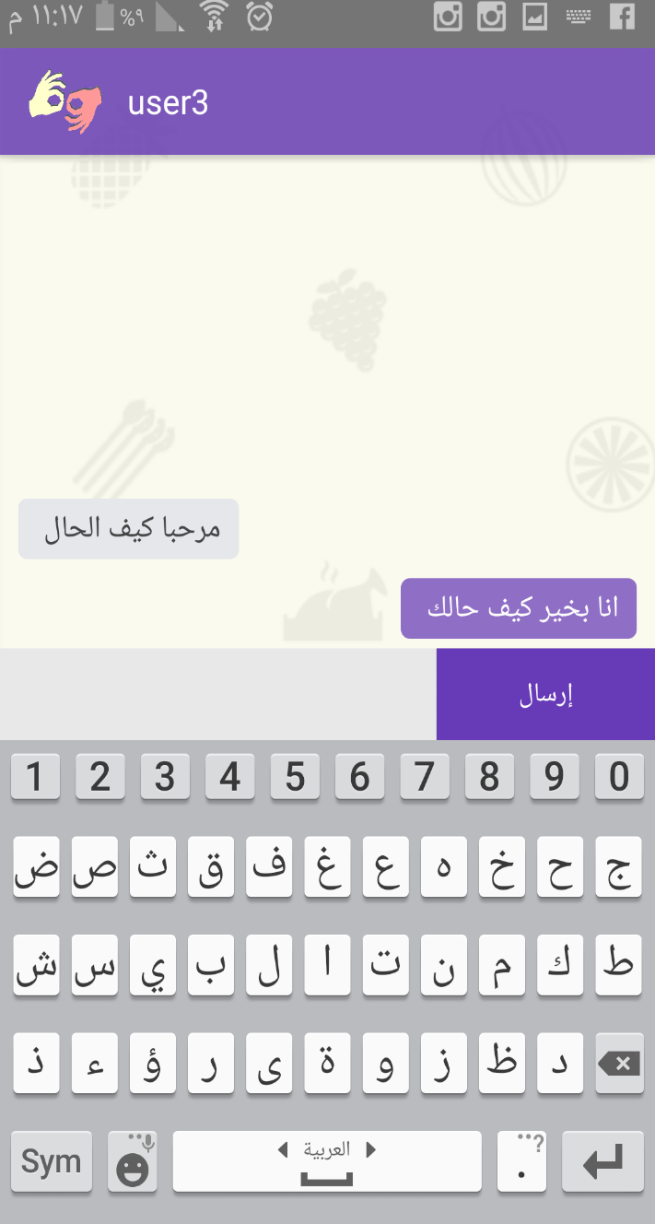
Friend Chatting Mode
History of all previous messages.
For Deaf user, convert received messages to Sign Language.

Slide 14
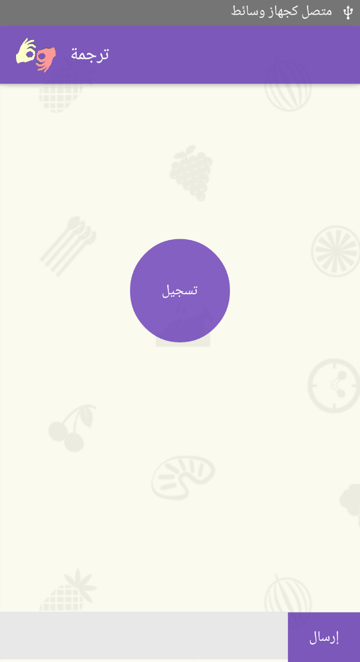
Single Device Mode
Facilitate peer to peer conversation between deaf and hearing person.

Slide 15
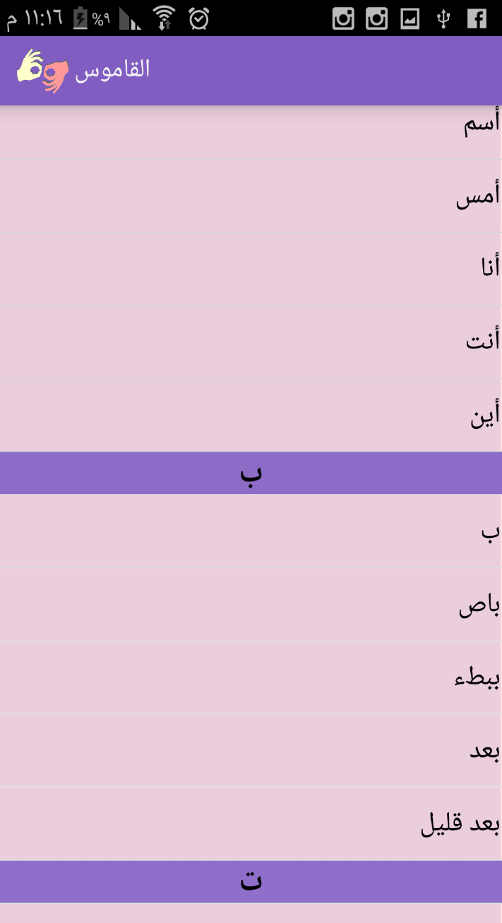
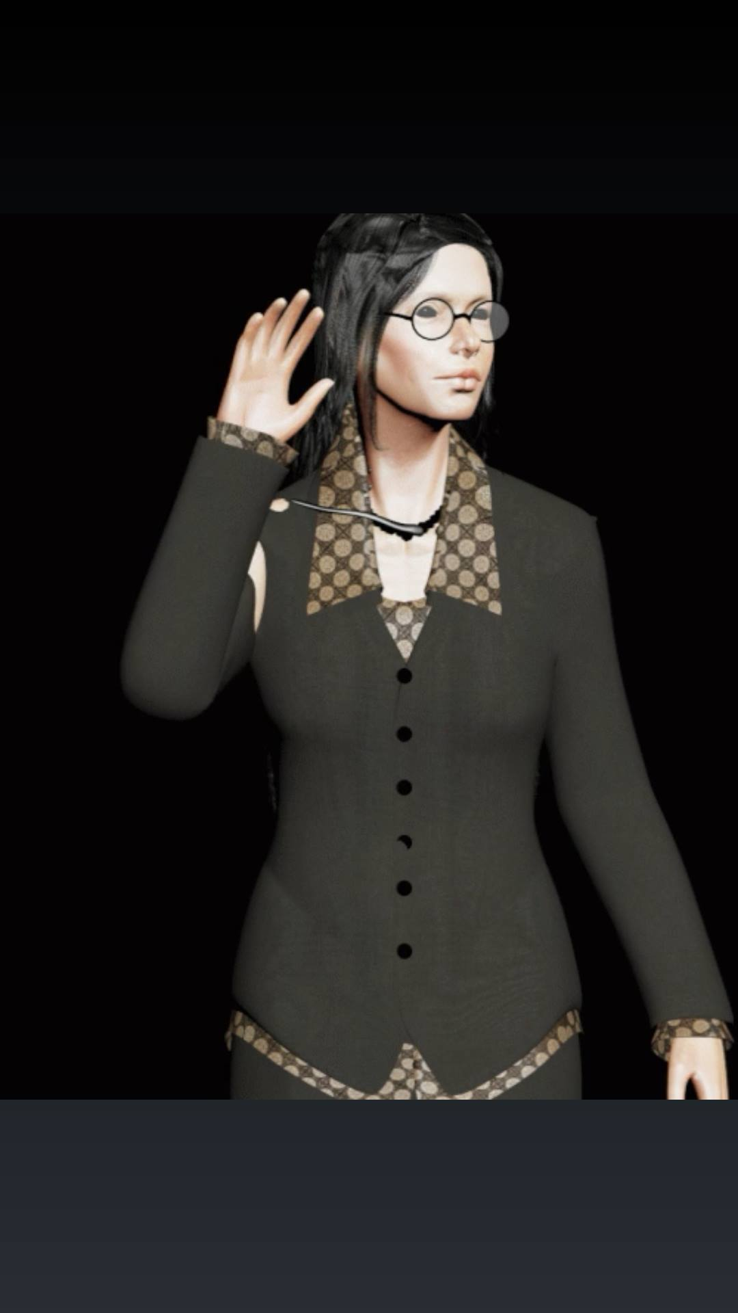
Sign Dictionary Mode
Arabic Language words – Sign Language Dictionary

Slide 16
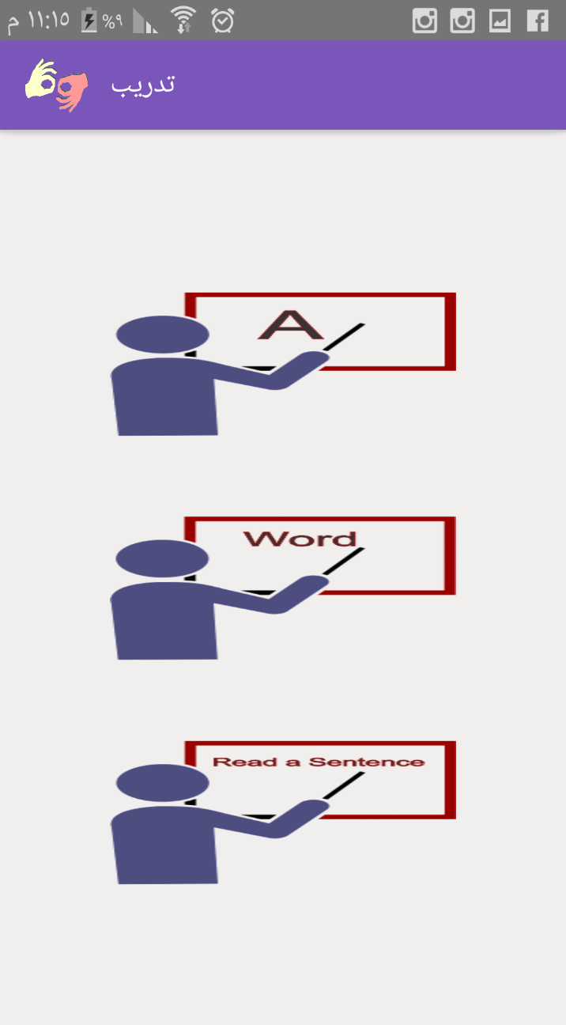
Sign Language Training
Easy level (Alphabetic characters and numbers ).
Medium level (Word).
Hard level (Statement).

Slide 17
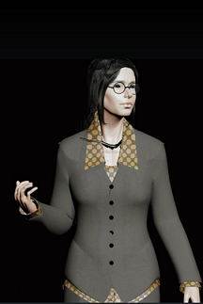
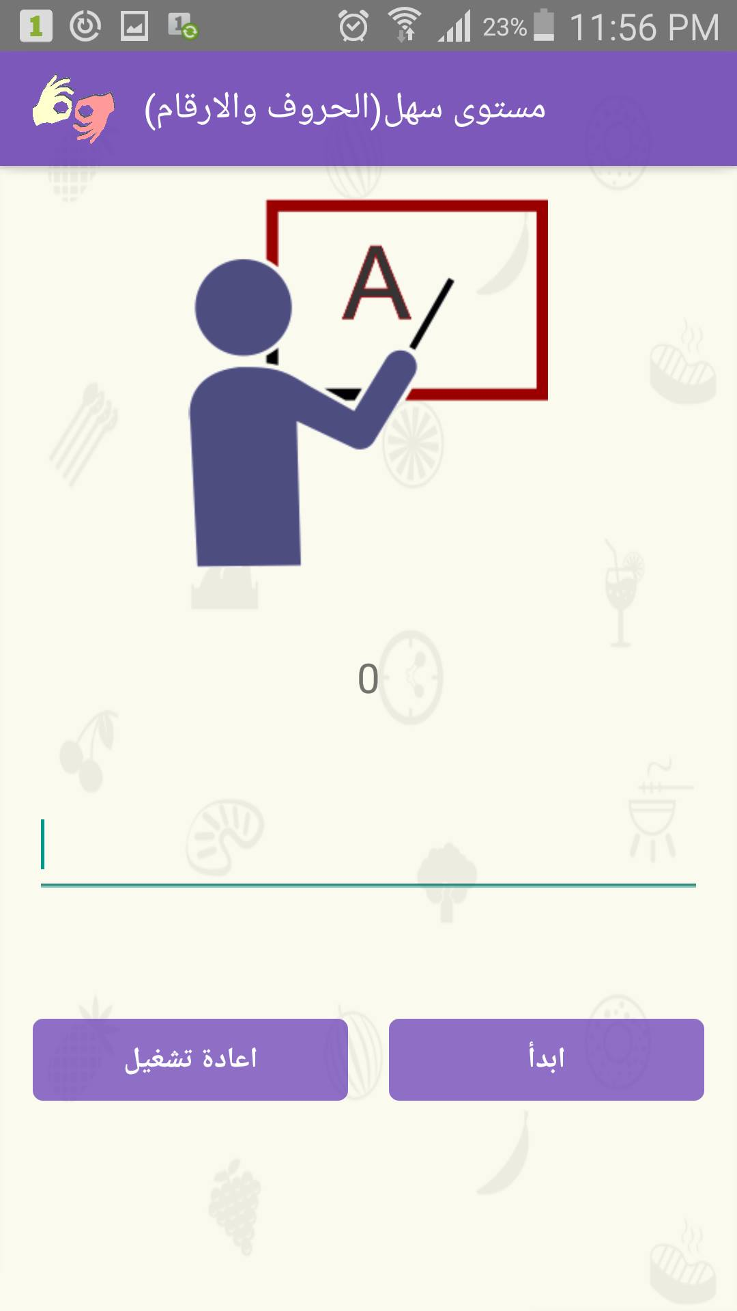
Sign Language Training

Slide 18
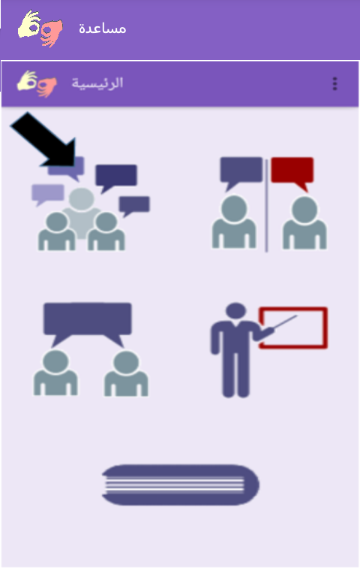
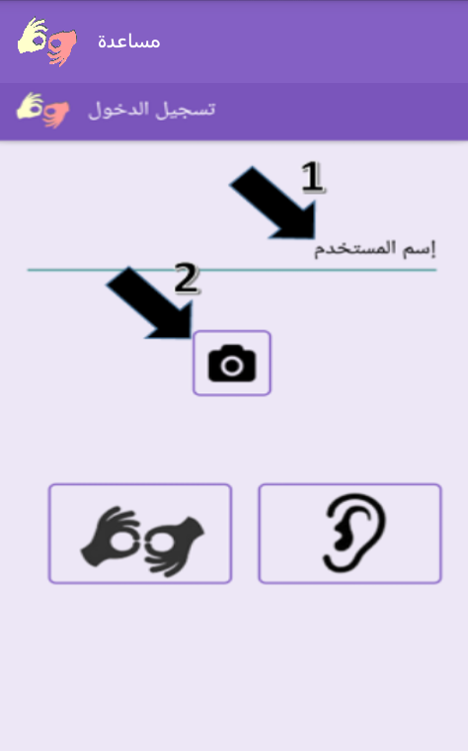
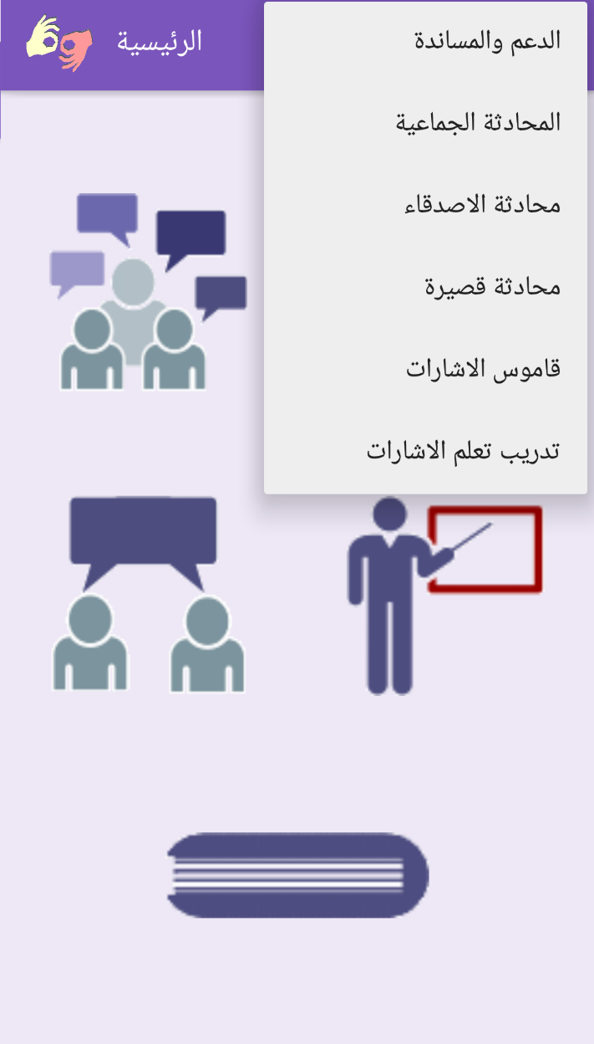
Help

Slide 19
Techniques

Slide 20
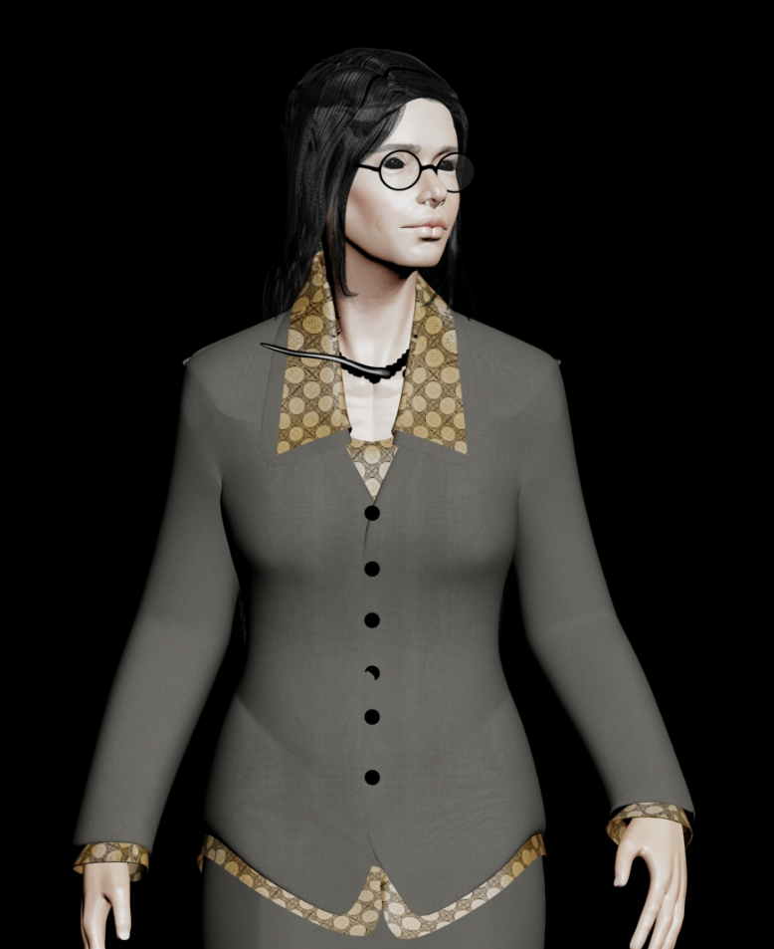
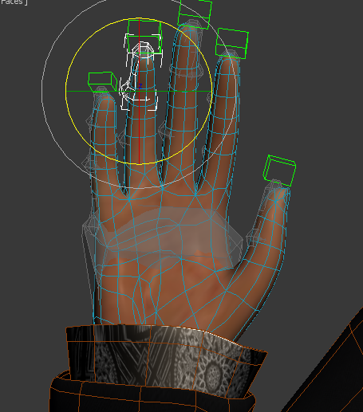
3D Model
Use existing 3D model to make the Sign Language movements.

Slide 21
Dragon SDK
We use Speech To Text Dragon SDK.
We use Text To Speech Dragon SDK .
Dragon SDK :
it’s support Arabic Language.
it’s not free.
it’s give you up to 20,000 transaction only free.

Slide 22
Arabic Text Analysis
There is no POS (Part Of Speech) library that supports Arabic Language.
We write simple Arabic Text Processing algorithm to explain our application idea.

Slide 23
Future Work
Improving this project and supporting the largest number of Sign Language words.
Developing a technology to facilitate converting sign language to spoken text and integrating with our project.

Slide 24
Demo

Slide 25
Thank you
Questions ??

