Slide 1

An-Najah National University
Faculty Of Engineering
Civil Engineering Department
DESIGN OF WATER & WASTEWATER NETWORK FOR SHWAIKA VILLAGE
Prepared By :
Anas S. Awwad
Amr A. Sleebi
Ahmed N. Hamdan
Supervision of Dr. Sameer Shadeed

Slide 2
Outline:
Objectives of the project.
Significance of the work.
Study area.
Methodology.
Modeling and design.
Results and conclusions.

Slide 3
Objectives
Design efficient water distribution network (WDN) for SHWAIKA village.
Design wastewater collection network(WWCN) for SHWAIKA village.

Slide 4
Significance of the work
To supply water at an adequate pressure and flow.
To transport sewage through SHWAIKA VILLAGE to sewage treatment plants.
To have an economic design as possible for both networks.

Slide 5
Study area

Slide 6
Data Collection:
Contour, Houses, roads, Boundary, aerial photo and amount of consumption water for each consumer,… etc. manhole, conduits, road contour and outfall for the village.

Slide 7

Area and land use:
The present population is 16,400 persons.
The area is approximately 6932 donum Which include agriculture lands 800 donum and buildings is 412 donum.
Shwaika village is a flat land, The ground surface in the village varies from 100 m to 450 m (A.M.S.L) (where the water tank is located).

Slide 8
Water Resources and Water Supply:
Almsnawy well which established at 2001 with depth 125 m and it is supply village with water by (188 cm/hr).
Almal'ab (established at 1973), the depth of well is 155 m and it is supply village with water by (190 cm/hr).
Althahra tank which has a volume 550 cm and this tank get water from Almsnawy and Almal'ab wells by the pump station.

Slide 9
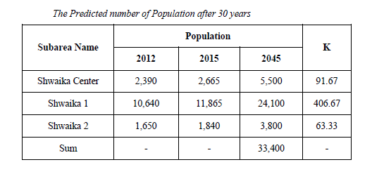
Population Prediction:

Slide 10
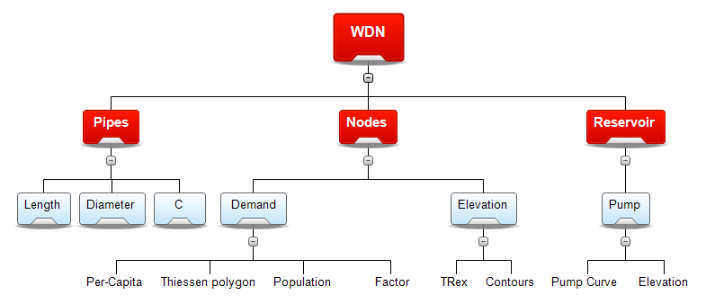

Slide 11
WDN
Design constraints:
Pressure at junction between (20-100) m.H₂O.
Velocity in pipe (0.3-3.0) m/s.

Slide 12
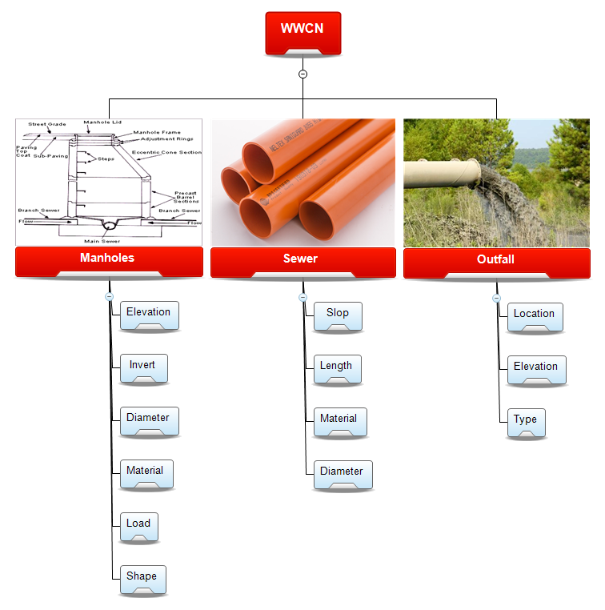

Slide 13
Location & Connecting Manhole
Before starting the design we should consider that the manholes must be located at the roads networks wherever there is:
An intersection.
Change in slop.
Change in direction.
Maximum distance of (30-50) m.

Slide 14
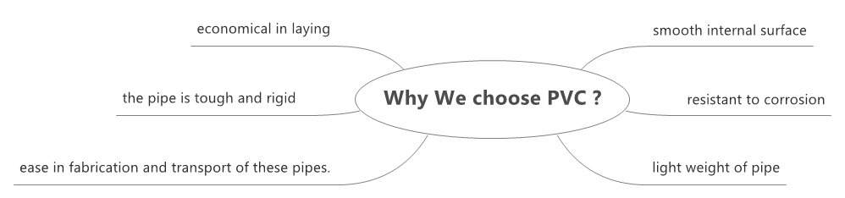

Slide 15
Design constraints:
Partial full flow conditions 80 %
Cover depth [0.6 - 5.0] m
Slope [1 - 10] %
Velocity [0.6 - 3.0] m/s

Slide 16
MODELING AND DESIGN

Slide 17
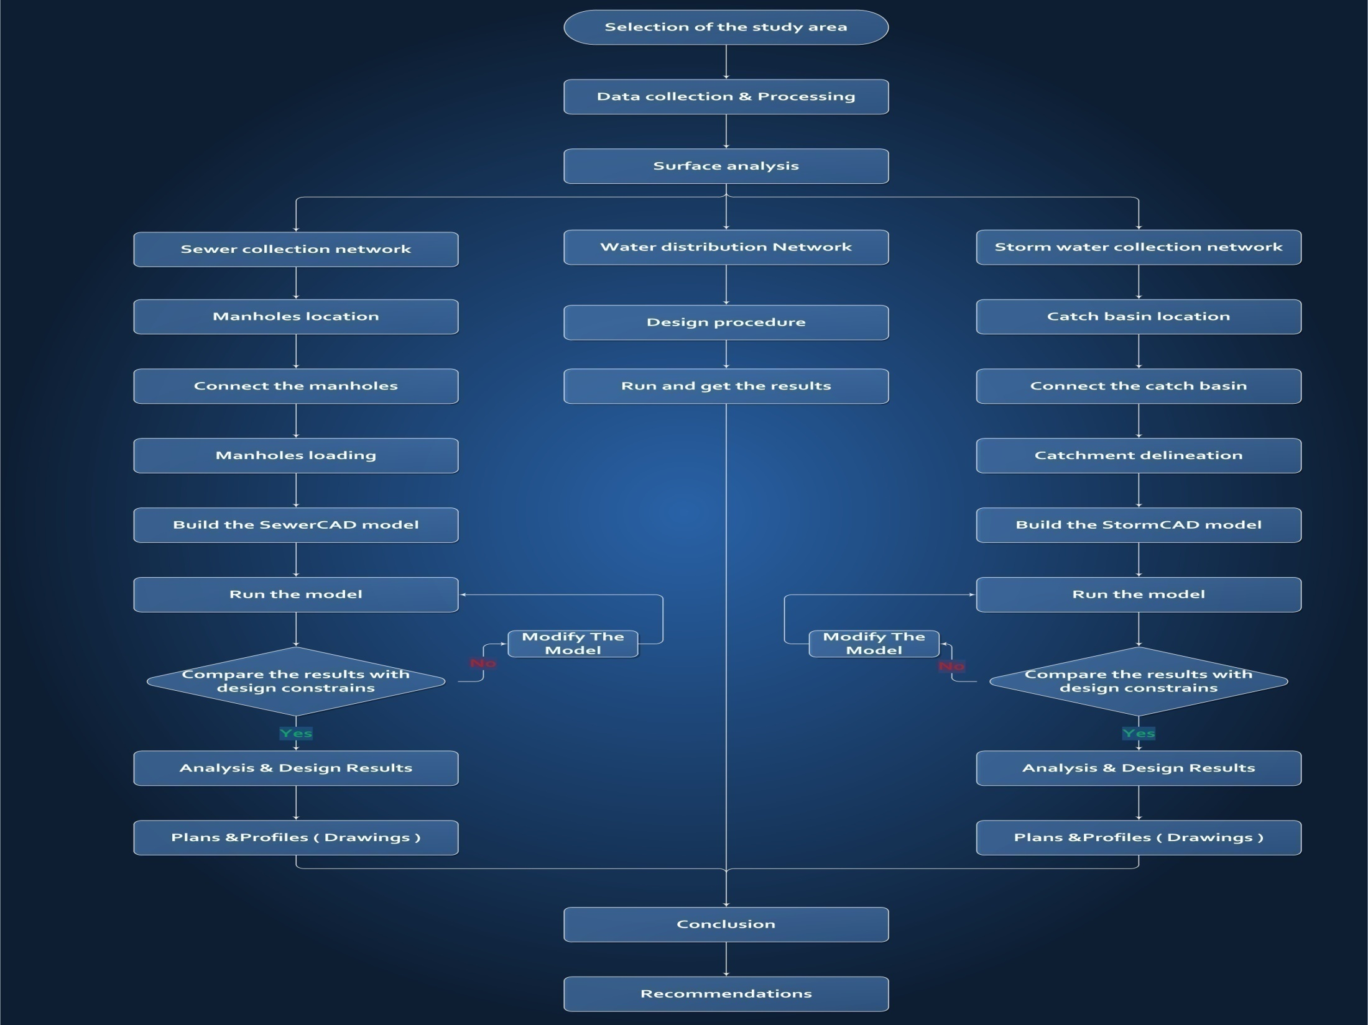
Methodology

Slide 18
WDN
Firstly, we will divide this village to three regions because we have different population density which are:
Shwaika 1
Shwaika Center
Shwaika 2

Slide 19
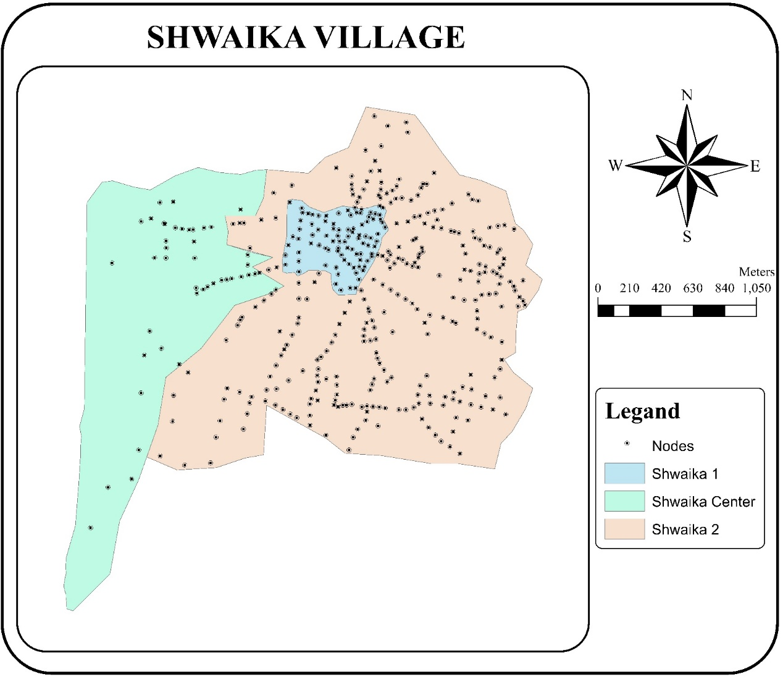

Slide 20
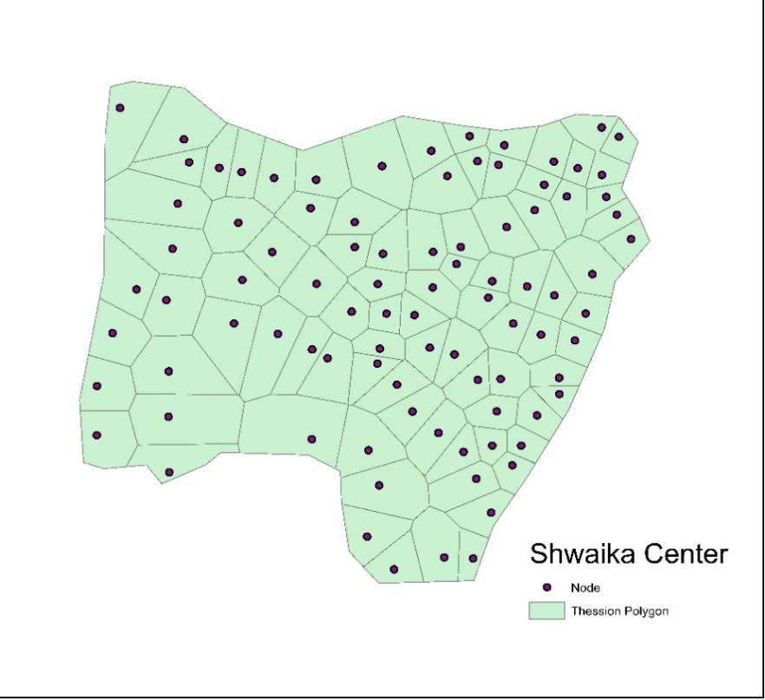
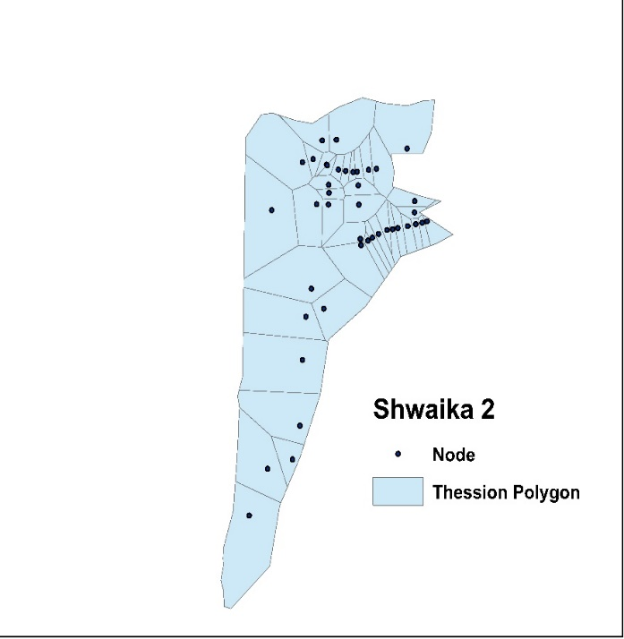
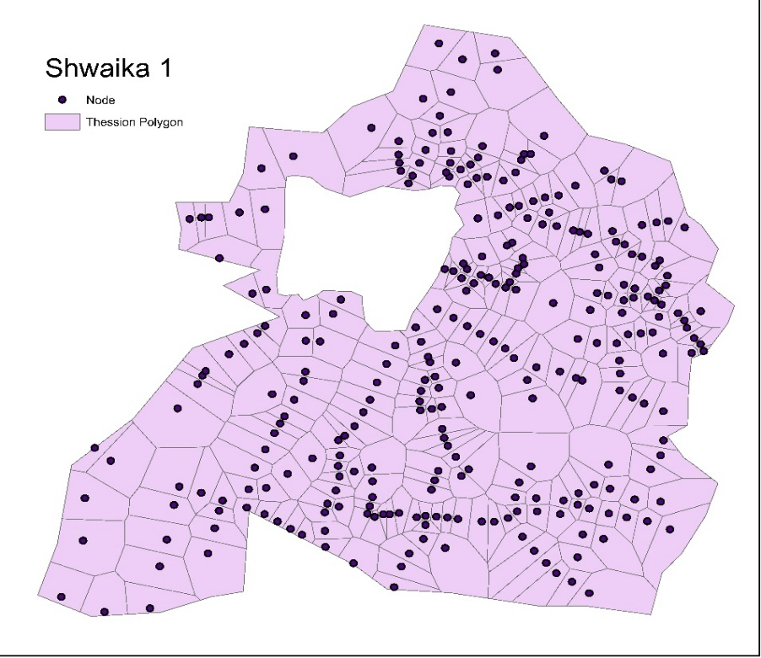

Secondly, The load on each region calculate by:
$Shwika 1,load =$ $5423 m^{3}/day$
$Shwika 2,load =$ $855 m^{3}/day$
$$Shwika Center,load =1238 m^{3}/day$$

Slide 21
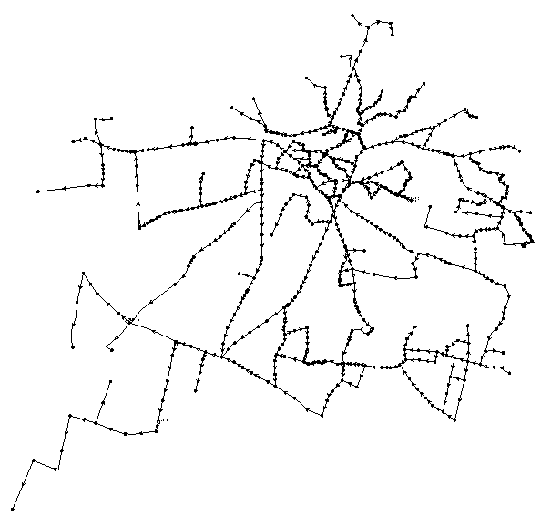

Slide 22
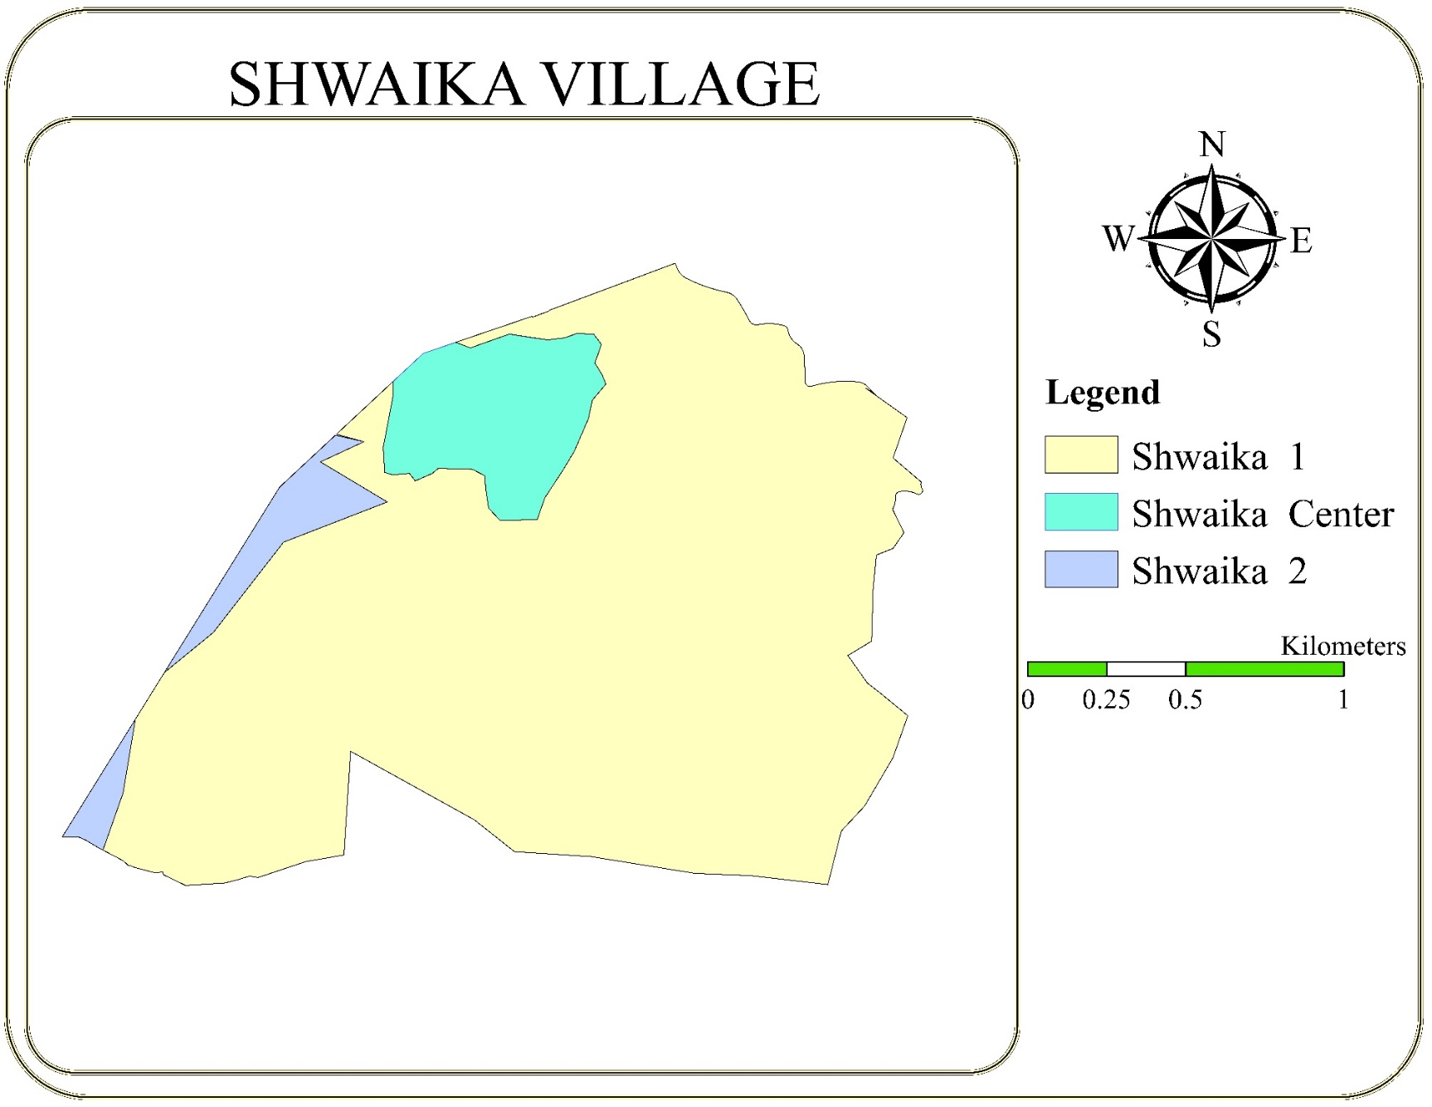
WWCN

Slide 23
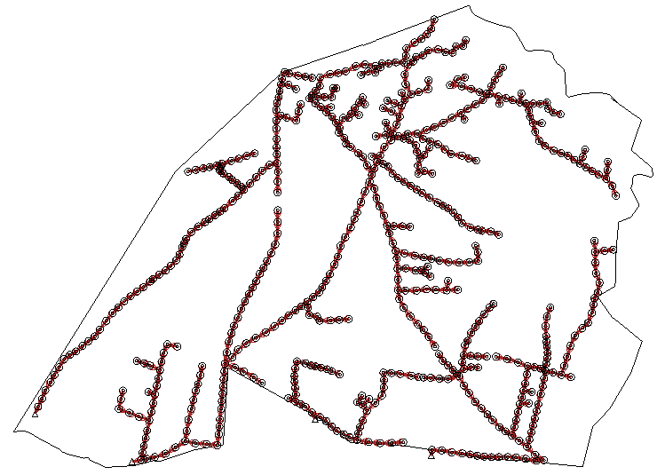

Slide 24
Loads on manholes
The loads on the manholes must be calculated based on the number of the houses that are connected to each manhole, but this going to need a lot of data that are missing, so we calculate the load as we are going to explain.

Slide 25
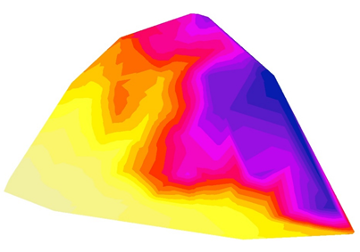
Export Manholes and conduit from SewerCAD
Create Digital Elevation Model (DEM)

Slide 26
Preparation of manholes and conduits
Excavate Manholes and conduits
Find the catch basin catchments

Slide 27
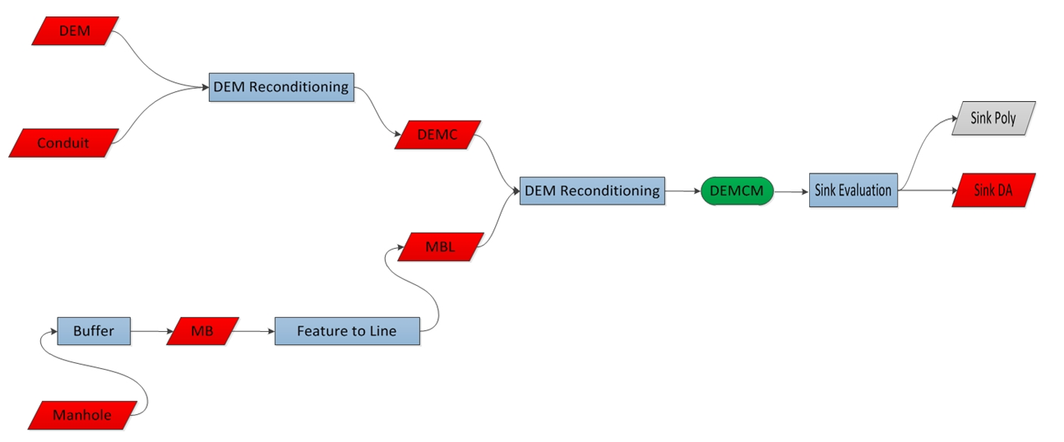

Slide 28
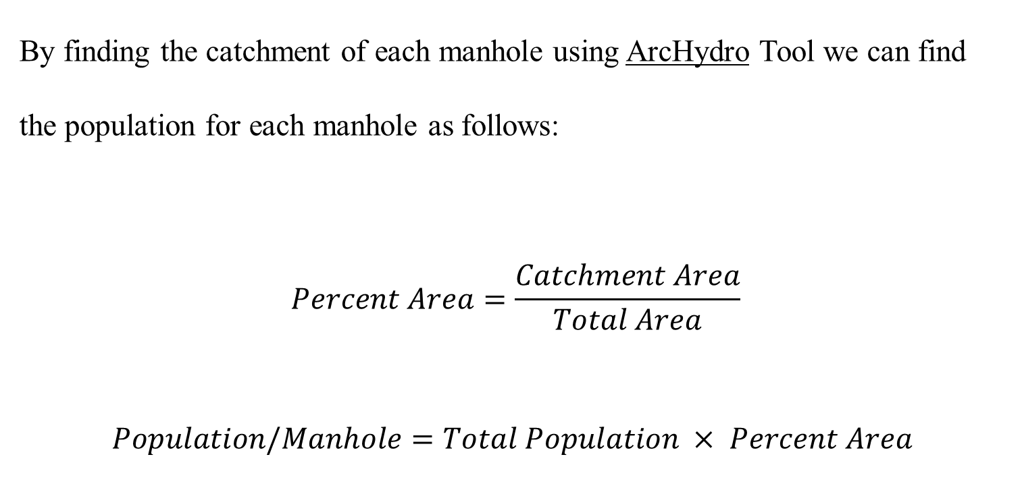
By finding the catchment of each manhole using ArcHydro Tool we can find the population for each manhole as follows:
$$Percent Area=\frac{Catchment Area}{Total Area}$$
$$Population/Manhole=Total Population × Percent Area$$

Slide 29
Results And Discussion

Slide 30
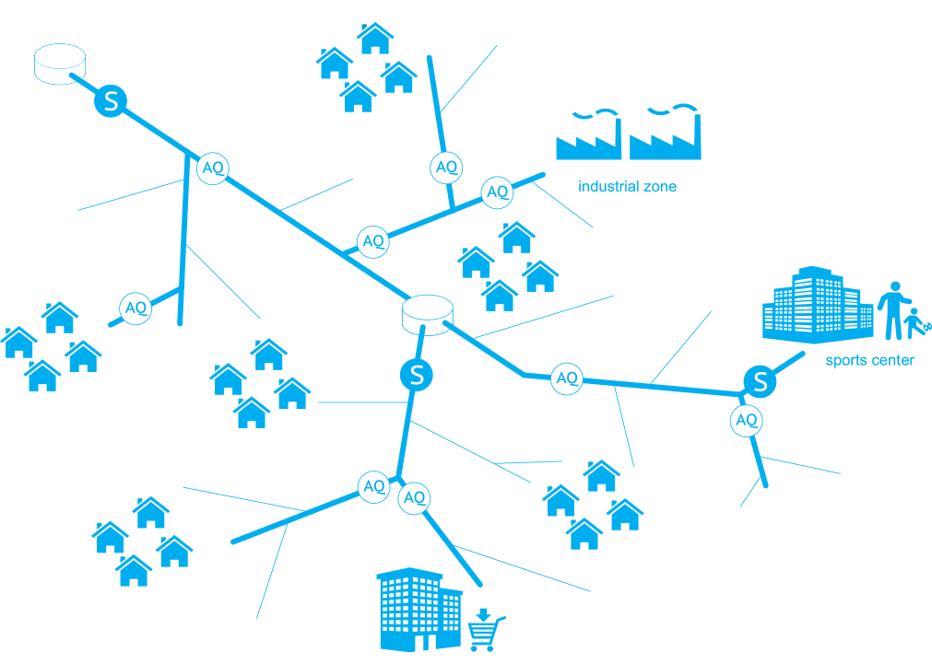
WDN

Slide 31
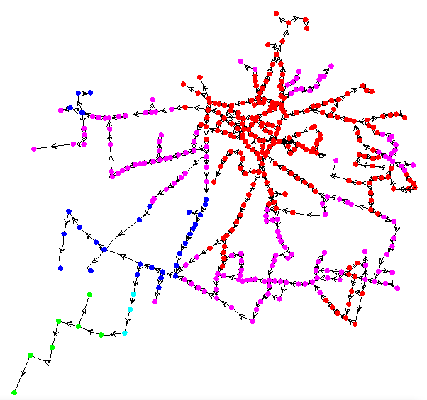
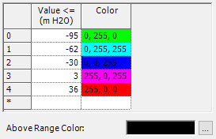
Pressure (m H2O)

Slide 32
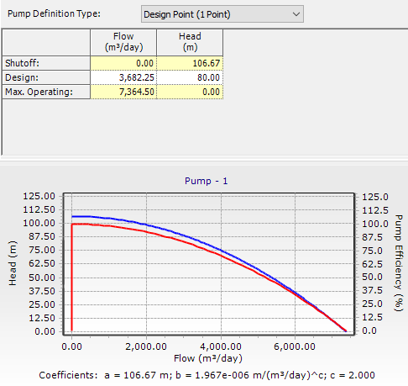

So we want to solve this problem by add pumps to increase the pressure with acceptable limits.
Five pumps were added to the water network with the following characteristics:

Slide 35
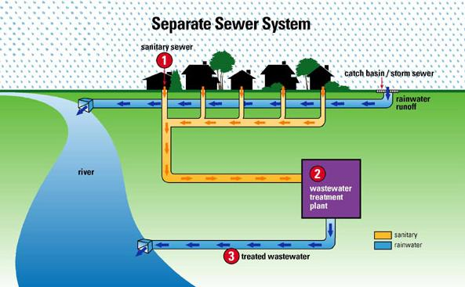
WWCN

Slide 36
Velocity (m/s)

Slide 37
Slope (%)

Slide 38
Cover (m)

Slide 39
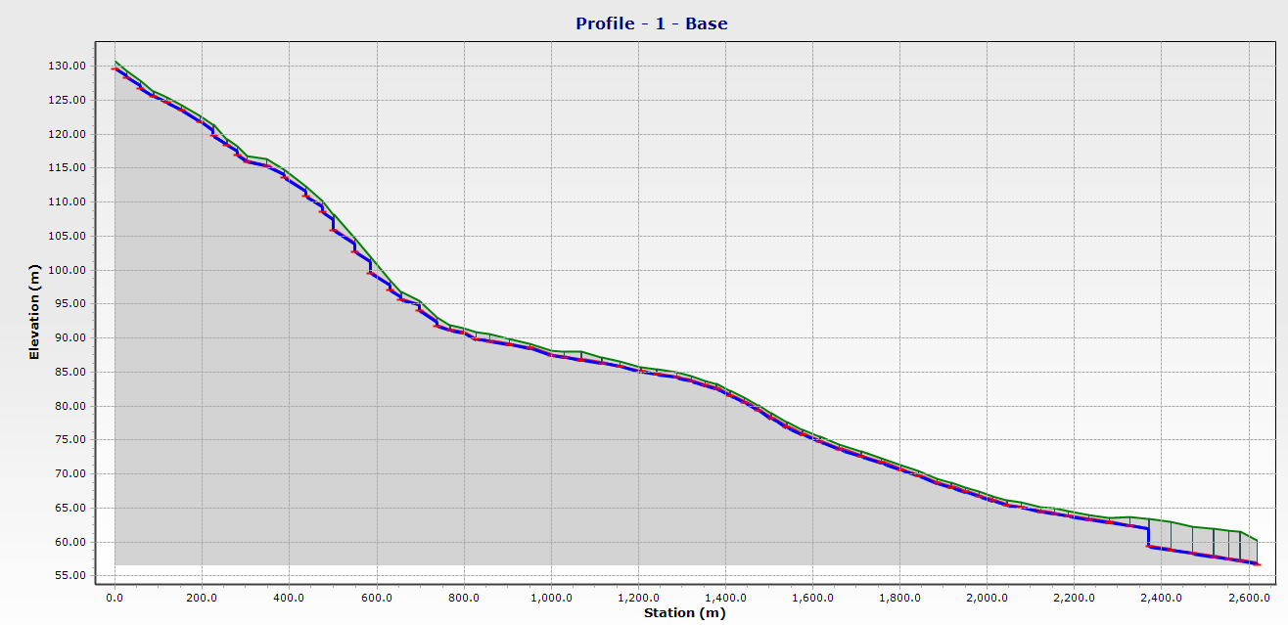
Profile

Slide 40
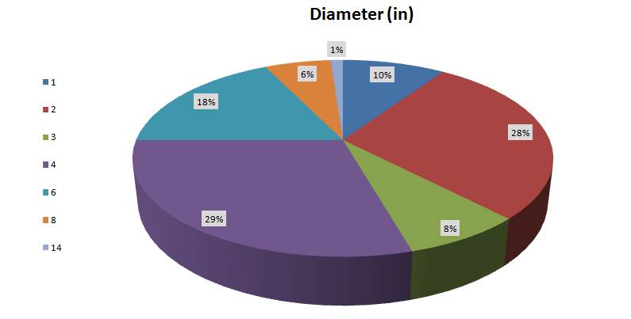
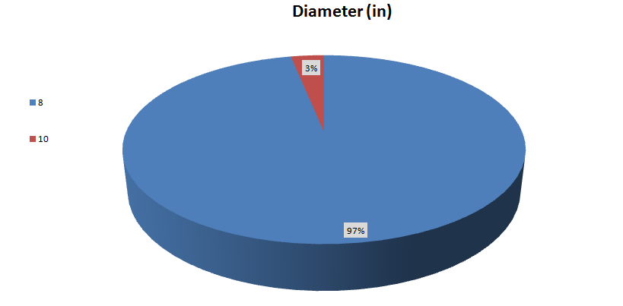

Conclusions
After the end of design process we got the following conclusions:
The majority percentages of water pipes are 2 and 4 inch.
The sewer material is PVC because it's easy to site.
Most sewer network conduits diameters are 8 inch.
ArcHydro tools save a lot of time in calculates loads.

Slide 41
Recommendations
A periodic maintenance should be done and the damaged parts should be replaced.
If possible treatment plant is considered as a feasible project.
Suitable space between water pipes and wastewater pipes must be achieved (water pipes must be above wastewater pipes).

Slide 42


