Slide 1
Economic Feasibility of an Ergonomically Designed Computerized Classroom at An-Najah National University
Prepared By: Amjad Hajyousef Areen Abu Kishek Julia Thaher Heba Asmar Mohammed Qasrawi
Presented To: Dr. Ayham Jaaron Dr. Saida Affouni Dr. Ahmad Ramahi

Slide 2
Outline
Objectives of the work
Previous work
Classroom Components
Feasibility study
Recommendations

Slide 3
Objectives of the work
There are two objectives for this project :
Find the optimal design for the E-Learning Classrooms.
Study the economic feasibility of such transformation.

Slide 4
Previous Work
Flexible Layout Vs Fixed Layout
Lighting Distribution
Lighting System

Slide 5
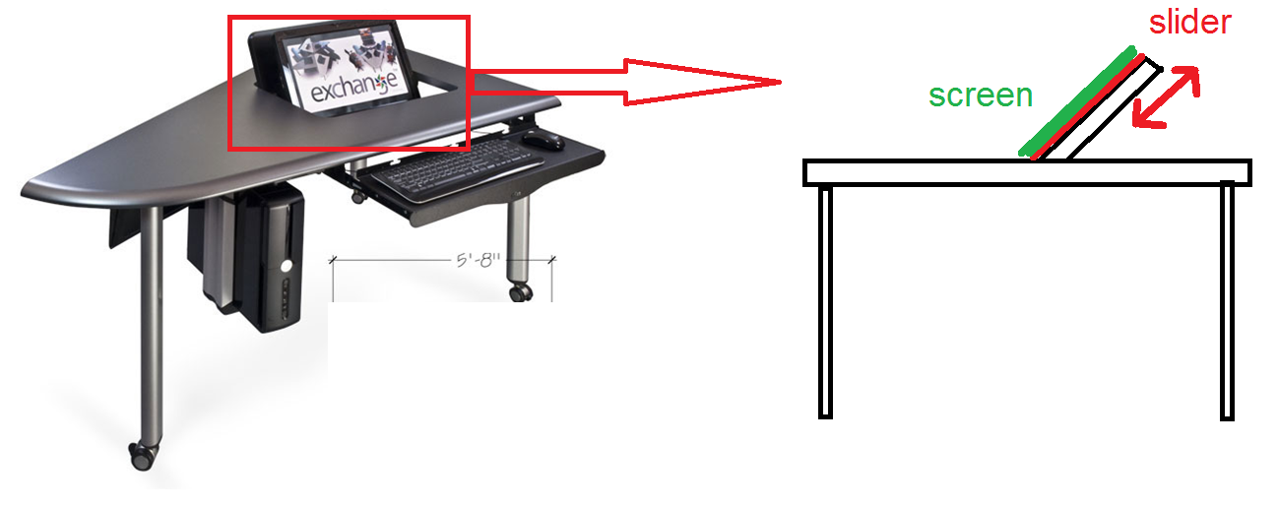
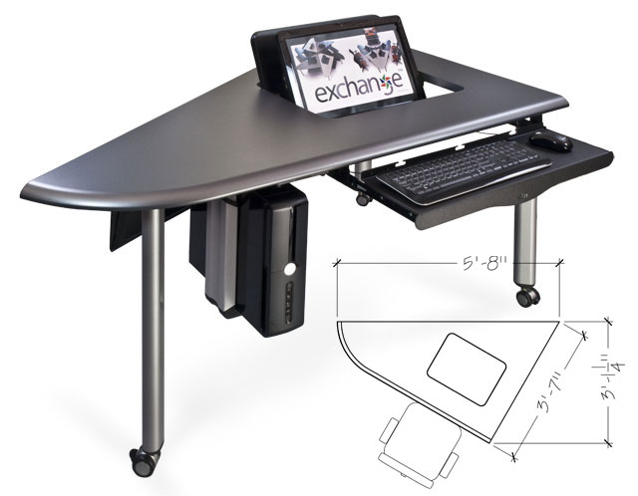
Classroom components - Desks

Slide 6
Prototype

Slide 7
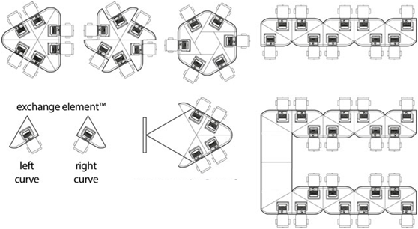
Classroom components - Layout
Flexible layout

Slide 8
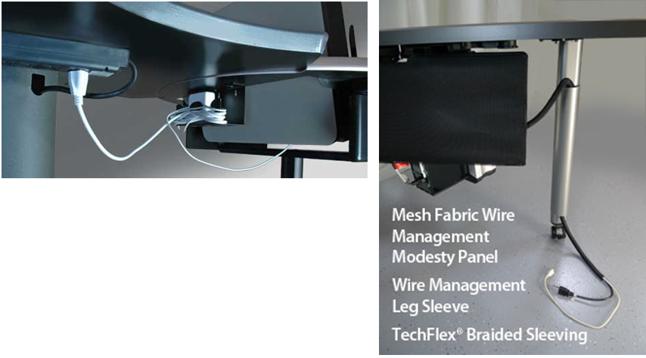
Classroom components - Electricity connections
All connections will be inside the tables

Slide 9
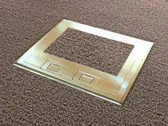
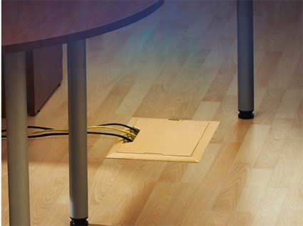
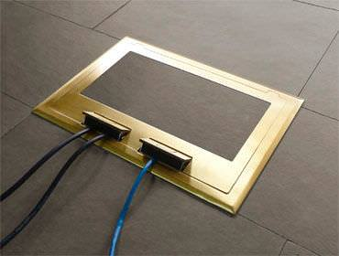
Classroom components - Electricity connections
Built-in Floor electrical box

Slide 10
Classroom components - Lighting
Both of them are suitable for computerized classrooms, but the first one was chosen since it prevents the glare in two directions
Luminaire type | Photo
florescent lamps with squared micro prism
florescent with Rectangular micro prism

Slide 11
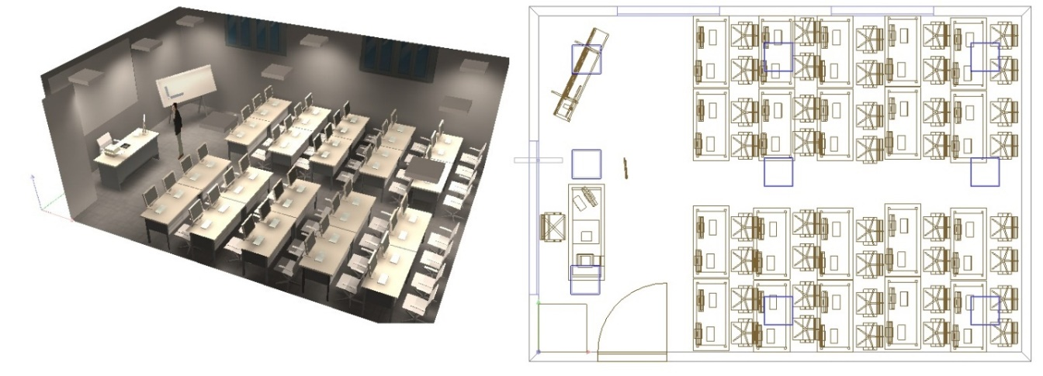
Lighting distribution and glare
The following Layout for the lighting Distribution was designed using Dialux Lighting Simulation software

Slide 12
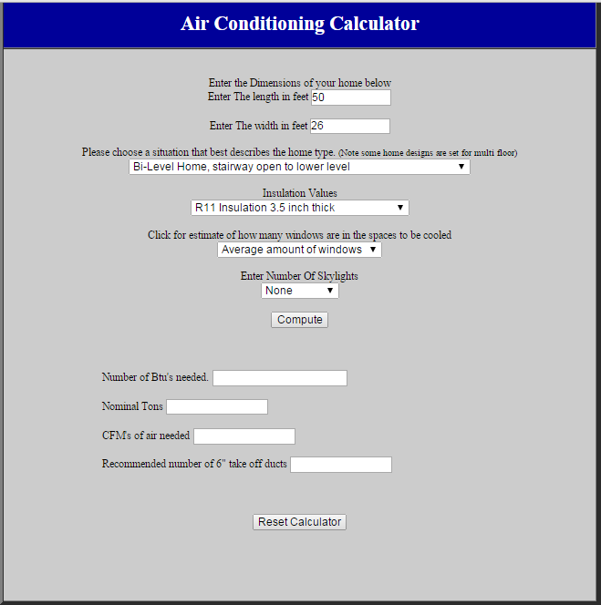
Classroom components - Air conditioner
The following programmed was used to determine the optimal air conditioner size
10%

Slide 13
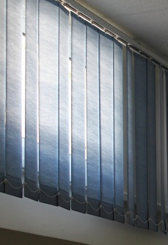
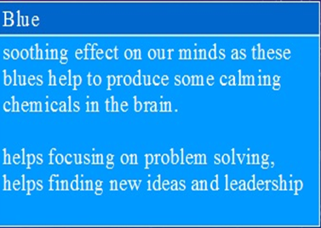
Classroom components - Colors

Slide 14
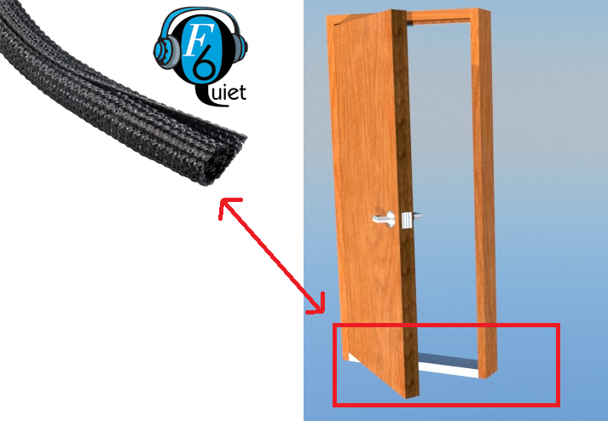
Classroom components – Noise Prevention
Flexo F6 Quiet

Slide 15
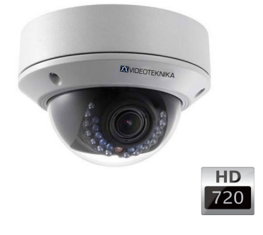
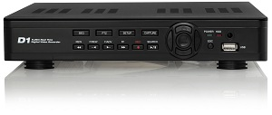
Classroom components - Cameras
VD6257 Dome security Camera
VD6257 Dome DVR Device

Slide 16
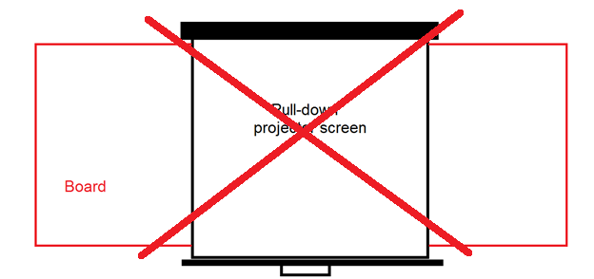
Classroom components - Board and Multimedia system
White board Vs Smart board
No projector screen
Speakers

Slide 17
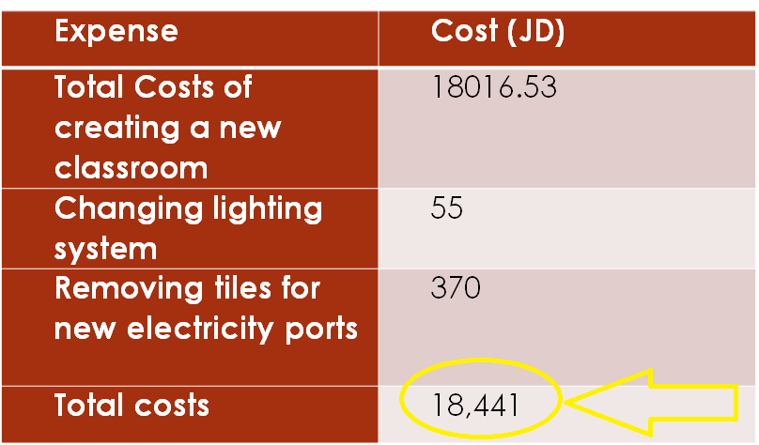
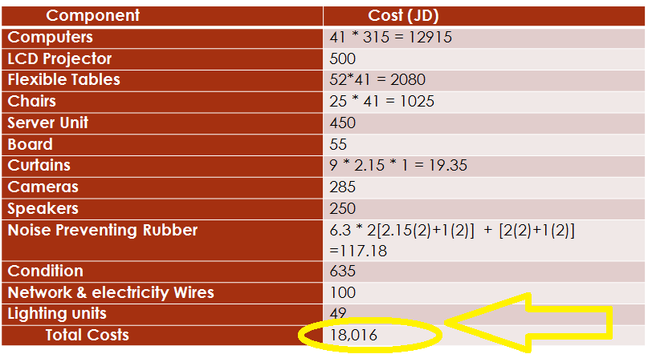
Feasibility Study
Costs for creating a new computerized classroom
Expense | Cost (JD)
Total Costs of creating a new classroom | 18016.53
Changing lighting system | 55
Removing tiles for new electricity ports | 370
Total costs | 18,441
Component | Cost (JD)
Computers | 41 * 315 = 12915
LCD Projector | 500
Flexible Tables | 52*41 = 2080
Chairs | 25 * 41 = 1025
Server Unit | 450
Board | 55
Curtains | 9 * 2.15 * 1 = 19.35
Cameras | 285
Speakers | 250
Noise Preventing Rubber | 6.3 * 2[2.15(2)+1(2)] + [2(2)+1(2)] =117.18
Condition | 635
Network & electricity Wires | 100
Lighting units | 49
Total Costs | 18,016

Slide 18
Feasibility Study – Creating New classroom
$Depreciation\backslash Year=\frac{Buying Price−Salvage Value}{Expected life}$
$Depreciation$ is calculated for electric components of classroom with expected life of 4 years.
Component | Depreciation/year
Computers | $=\frac{10250−0}{4}$=2562.5
LCD Projector | $=\frac{500−50}{4}$=112.5
Cameras | $=\frac{285−28.5}{4}$=64.1
Speakers | $=\frac{250−0}{4}$=62.5
Condition | $=\frac{635−63.5}{4}$=142.8
Total Depreciation/year | $$2908$$
Component | Amount (JD)
Initial cost | 18,016*(A/P,3%,4) = 4847
Depreciation / year | 2908
Maintenance / year | 200
Computers electricity consumption / year | 240
Air conditioner electricity consumption/year | 60
Total costs / year | 8255

Slide 19
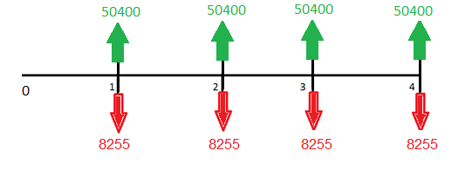
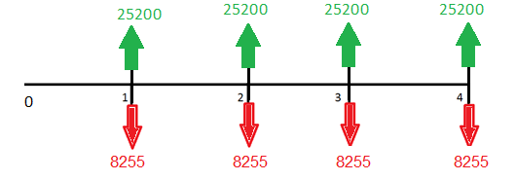
Feasibility Study – Creating New classroom
Total income from 40 students / year = 126,000 JD
Assuming the universities' overhead = 80%
Net profit/year = 126000 * (100 – 80)% = 25200 JD
Benefit/cost ratio = 305 % Payback Period = 1.07 Year = 387 Day.
Now Assuming the universities' overhead = 60% Gives
Net profit/year = 126000 * (100 – 60)% = 50400 JD
Benefit/cost ratio = 611% Payback Period = 0.43 Year=157 Day.

Slide 20
Feasibility Study Results
 | Initial cost | Running costs/year | B/C % (overhead 60%) | Payback period (Overhead 60%)
Creating a new classroom | 18,016 | 8255 | 611 % | 0.43
Converting an existing classroom to a computerized one | 18,441 | 8370 | 603 % | 0.45

Slide 21
Recommendation
The main benefit of the project is to have a better education facilities and keeping up with the technological evolution
we cannot determine if the costs of the project is sufficient for the university since we don’t know how bad the university needs to improve the learning system.

Slide 22
Thanks For Listening
Questions

