Slide 1

An-Najah National University
Building Engineering Department
Cultural Palace
Presented by:
Nour Nidal Samaro
Fa’eqa Sameh Halbouni
Yasmen Mohamed Amer
Supervisor:
Dr. Monther Dwaikat

Slide 2


Outline:
    Introduction.
  Architectural Design.
  Structural Design.
  Acoustical & Lighting Design.
  Environmental Design.
  Electrical & Mechanical Design.
  Safety Design.
  Cost estimation

Slide 3

Introduction

Slide 4
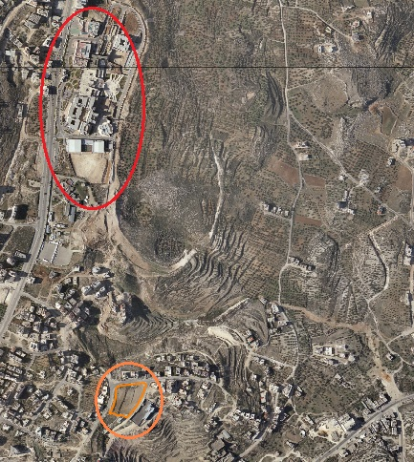
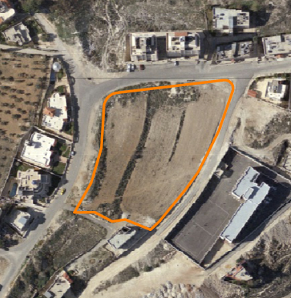
Introduction :
N

Slide 5
Architectural
Design

Slide 6
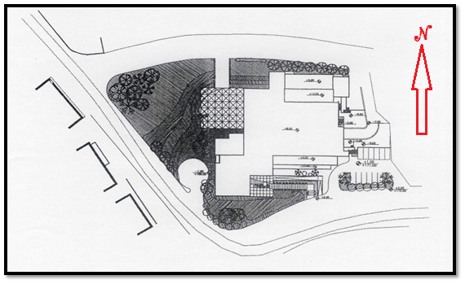
ARCHITECTURAL DESIGN
The proposed design
The Proposed Site

Slide 7
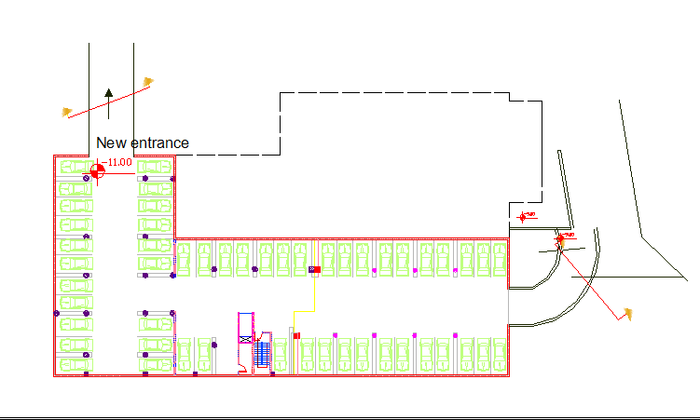
ARCHITECTURAL DESIGN
Architectural changes

Slide 8
Structural
Design

Slide 9
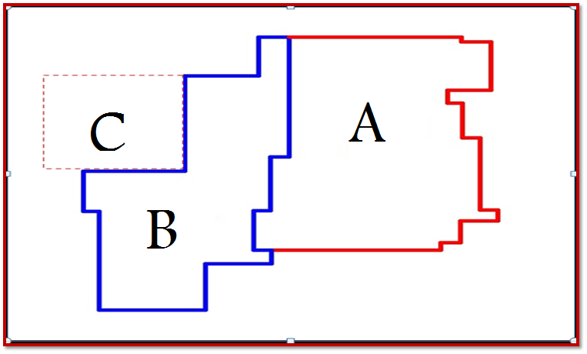
STRUCTURAL DESIGN
Blocks
The project consists of Two blocks and a steel truss.
C

Slide 10
STRUCTURAL DESIGN
Design Codes
ACI -318-08 for reinforced concrete structural design.
UBC -97 for earthquake load computations.
ASCE for load computations.
AISC 2010 for designing steel and composite systems.

Slide 11
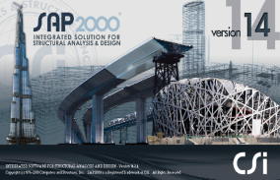
STRUCTURAL DESIGN
Block A
Slab thickness for the floors = 32cm
Loads:
  Superimposed dead load = 2.5kN/m²
  Live load = 7 kN/m²
Beam dimension column dimension
C1 (80*80) | 50 *52
( C2 (40*50 | 80*62
( C3 (D60 | 80*104
C4 (D70) | 70*52
C5 (60*60) | 52*100
 | Composite beams 140*80

Slide 12
STRUCTURAL DESIGN
Seismic Load
By using response spectra method the input data as in the following table.
0.4 | C_{v}
0.28 | C_{a}
1 | I
4.2 | R

Slide 13
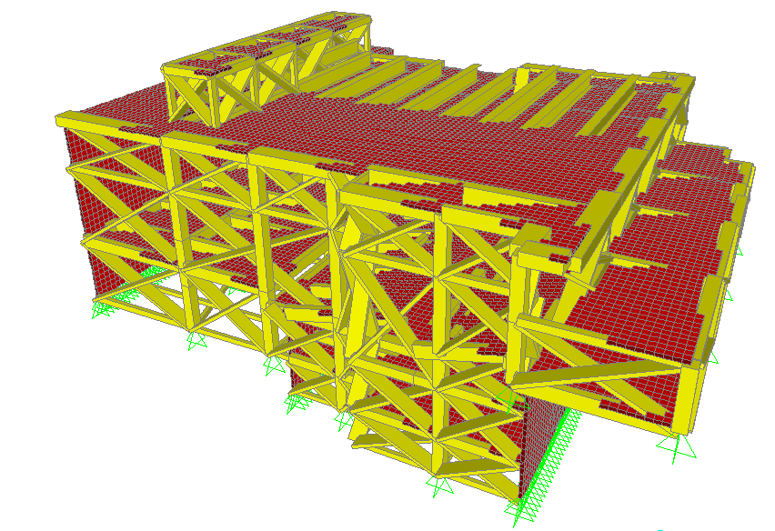
STRUCTURAL DESIGN
Block A Model
Five floors.
First and second floor one way ribbed slab with dropped beams.
Fifth floor one way solid slab with composite beams.

Slide 14
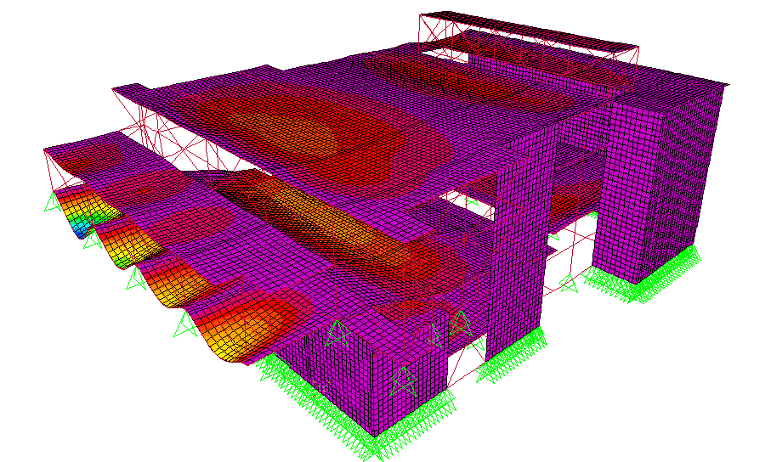
STRUCTURAL DESIGN
SAP Model Validation for Block A
Compatibility check

Slide 15
STRUCTURAL DESIGN
Model Validation for Block A
Equilibrium check
Check <5% | % of error | From SAP (kN) | Manual Calculation (kN) | load
<5% It is OK | 0.9% | 65308 | 64680 | Total dead load
<5% It is OK | 0.7% | 22961 | 22800 | Total live load

Slide 16
STRUCTURAL DESIGN
Model Validation for Block A
Internal forces check
% of difference | SAP Moment (kN.m) | Manual Moment (kN.m) | Structural element
4% | 687 | 712 | Slab
3% | 799 | 766 | beam
% of difference | SAP Load (kN) | Manual Load (kN) | Structural element
4.7% | 425 | 446 | column

Slide 17
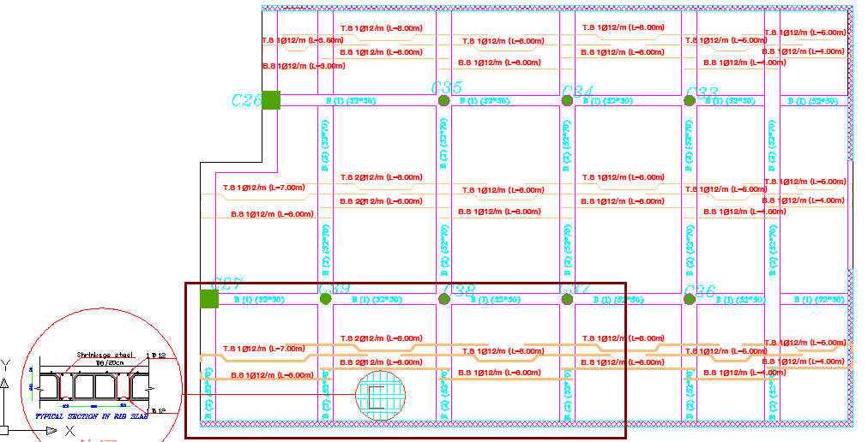
STRUCTURAL DESIGN
Design for Slab(One way rib slab)

Slide 18
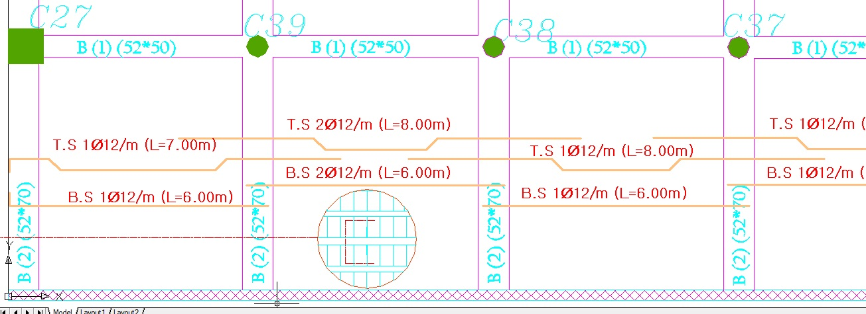
STRUCTURAL DESIGN
Design for Slab(One way rib slab)
Section A-A

Slide 19
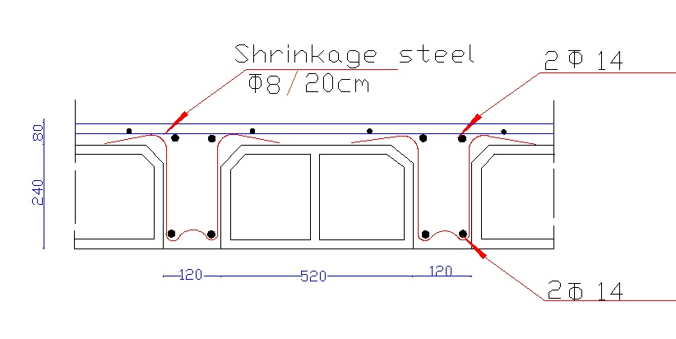
STRUCTURAL DESIGN
Design for Slab(One way rib slab)
Section A-A

Slide 21
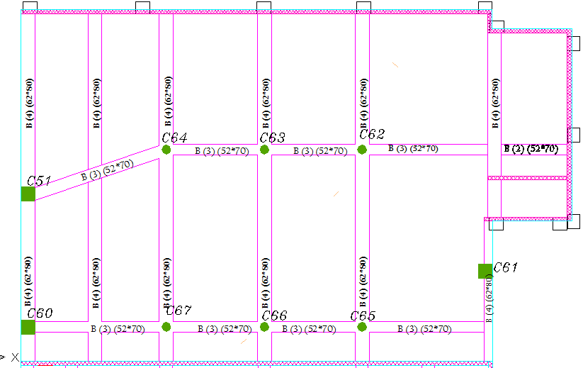
STRUCTURAL DESIGN
Beams and Columns name

Slide 22
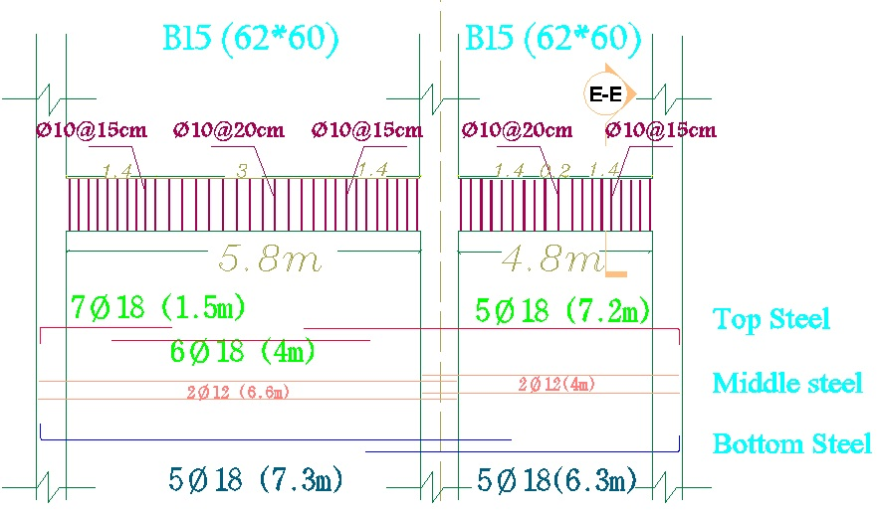
STRUCTURAL DESIGN
Concrete Beam Detail

Slide 23
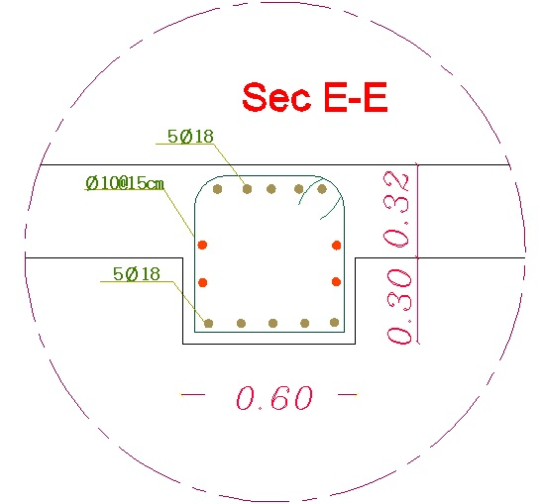
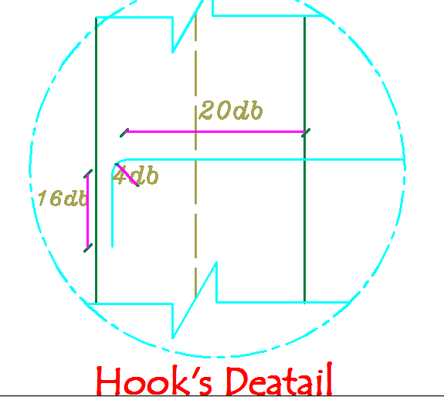
STRUCTURAL DESIGN
Hook‘s Detail & Detail of Cross Section in Concrete Beam

Slide 24
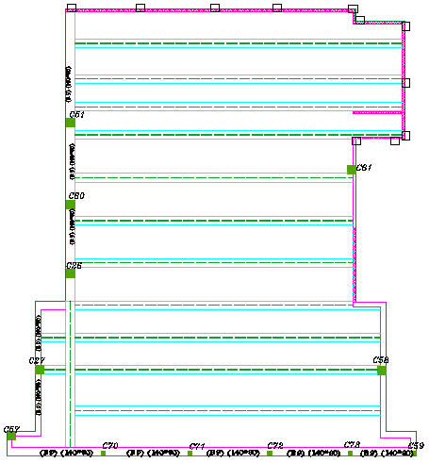
STRUCTURAL DESIGN
Layout of the composite Beams

Slide 25
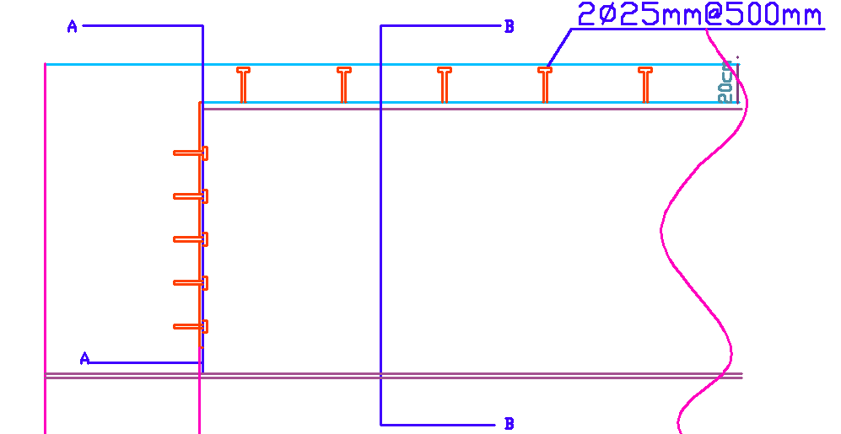
STRUCTURAL DESIGN
Composite Beam Detail
Longitudinal Section in Composite Beam

Slide 26
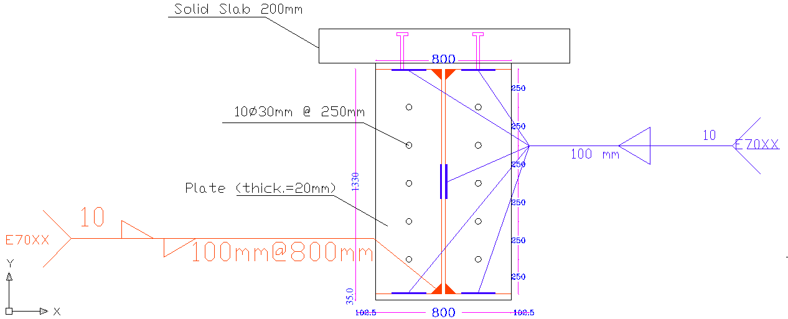
STRUCTURAL DESIGN
Composite Beam Detail (Cross Section)

Slide 27
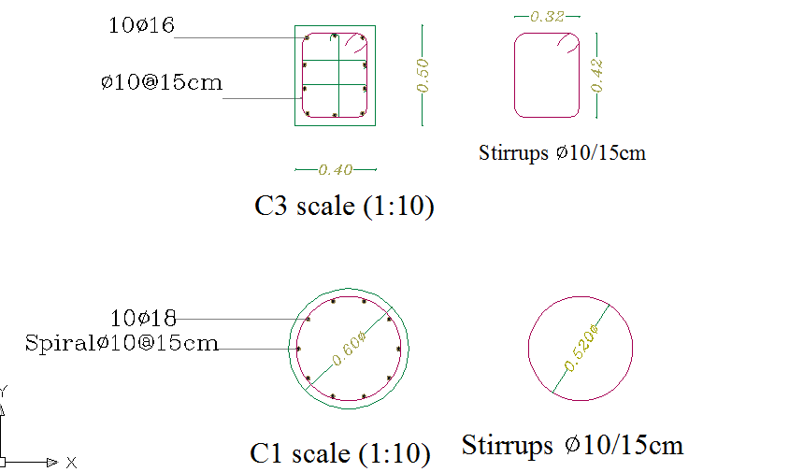
STRUCTURAL DESIGN
Cross Section in Column

Slide 28
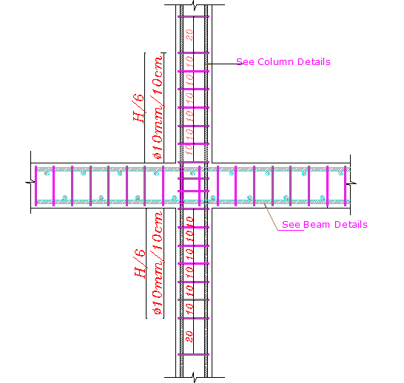
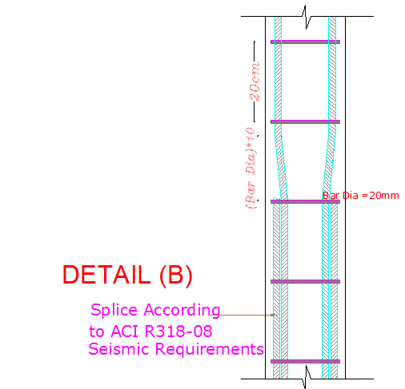
STRUCTURAL DESIGN
Column Detail

Slide 29
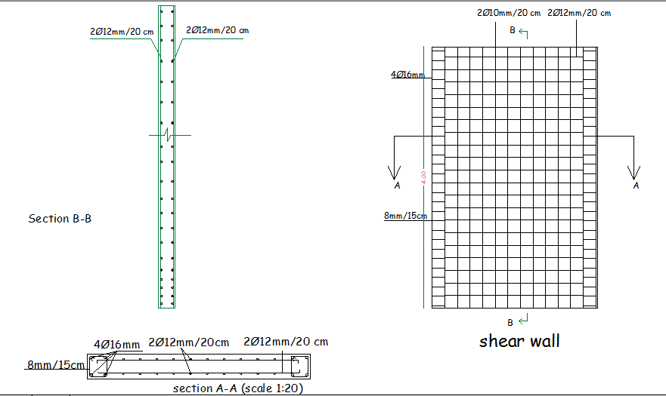
STRUCTURAL DESIGN
Shear Wall Detail

Slide 30
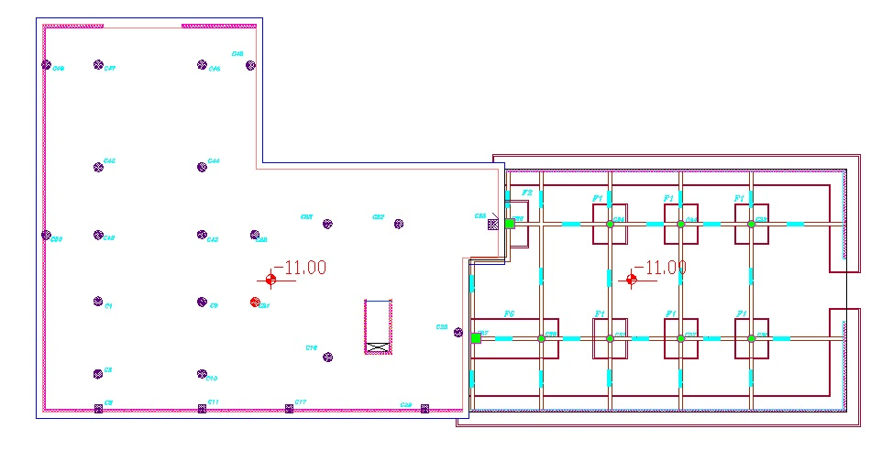
STRUCTURAL DESIGN
Lay out footing in the building

Slide 31
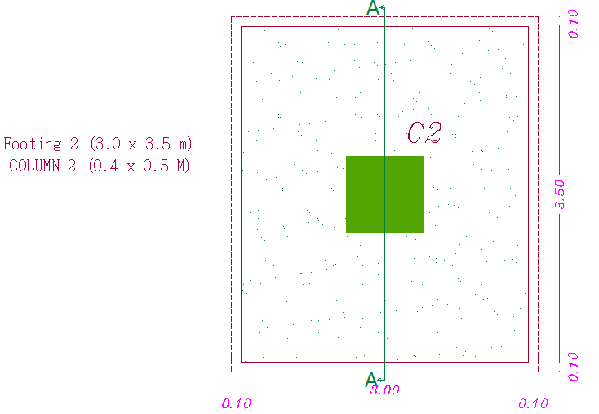
STRUCTURAL DESIGN
Single Footing Detail

Slide 32
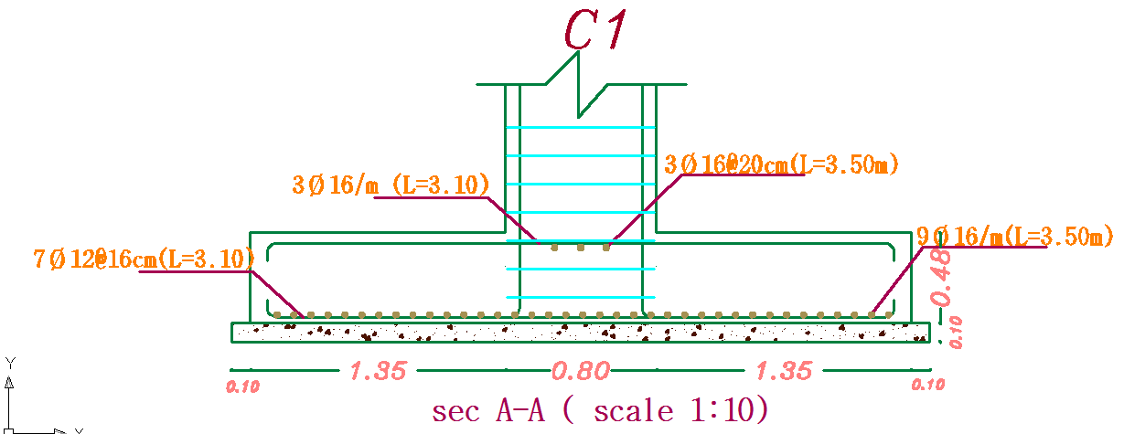
STRUCTURAL DESIGN
Single Footing Detail

Slide 33
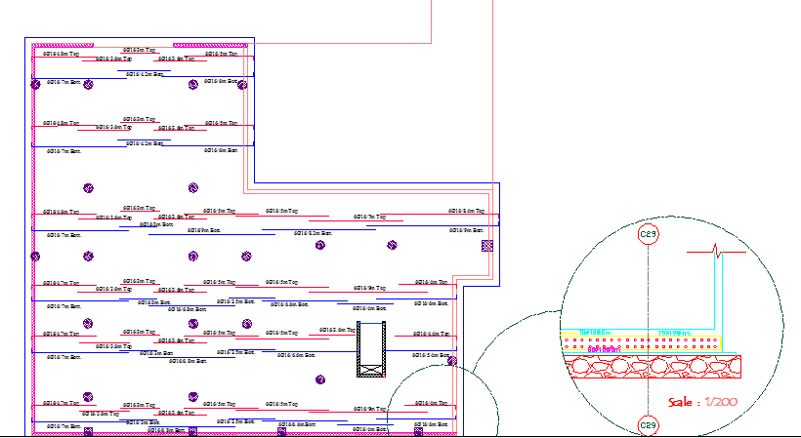
STRUCTURAL DESIGN
Design for Mat Foundation

Slide 34
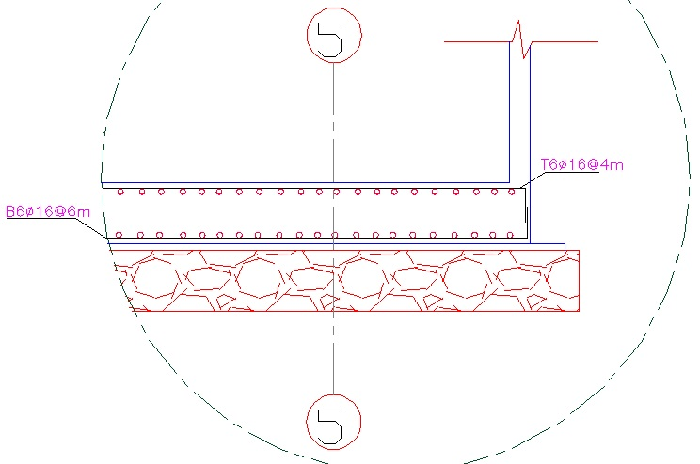
STRUCTURAL DESIGN
Section in Mat foundation

Slide 35
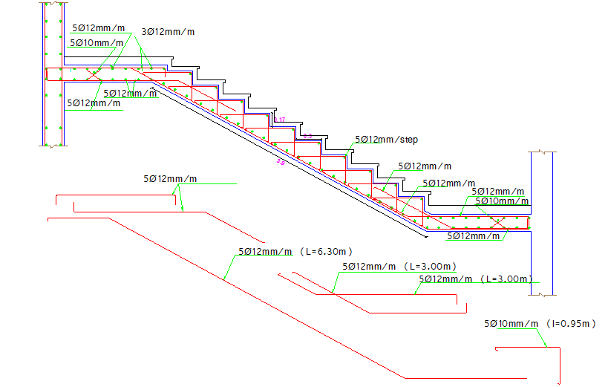
STRUCTURAL DESIGN
Stairs Detail

Slide 36
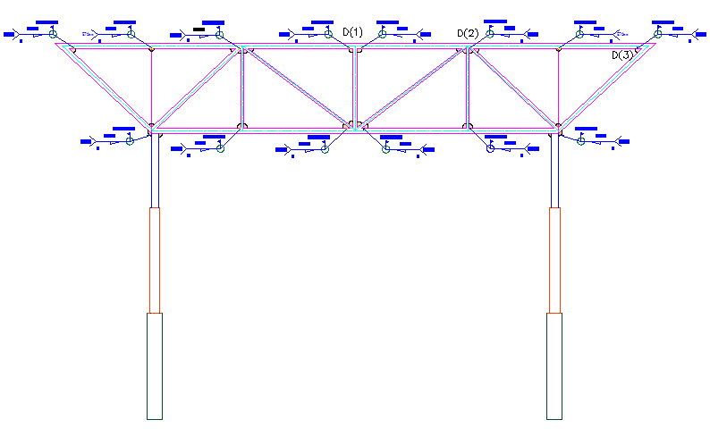
STRUCTURAL DESIGN
Steel Detail

Slide 37
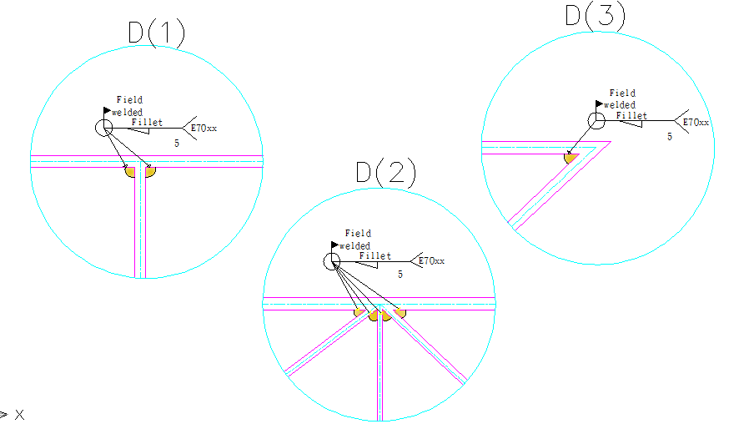
STRUCTURAL DESIGN
Steel Details
Steel -Truss Connection

Slide 38
Acoustical
& Lighting
Design

Slide 39
ACOUSTICAL DESIGN
Recommendated | Calculated
( Rt60= (1-1.5 | Rt60= 1.1
Position | Material
side wall | wood
back wall | Glass
Floor | Carpet
Ceiling | Metal deck(75mm)
Side wall | Fiber glass board (50mm)

Slide 40

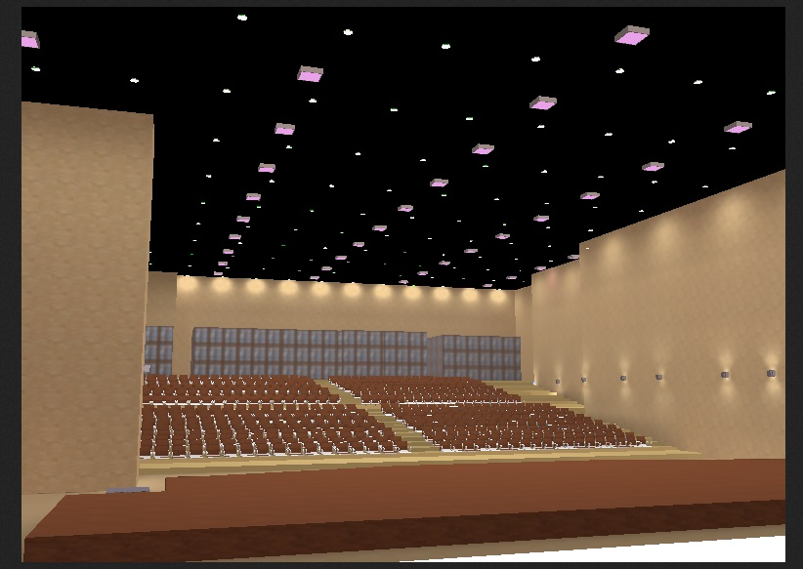
LIGHTING DESIGN
The Result for the Auditorium:

Slide 41
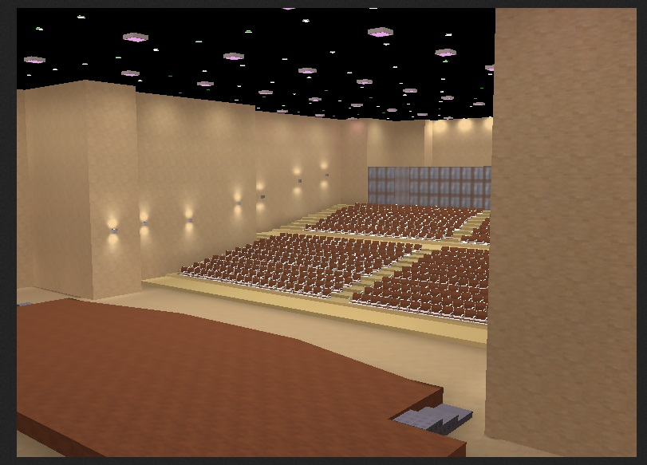
LIGHTING DESIGN
The Result for the Auditorium:

Slide 42
Environmental
Design

Slide 43
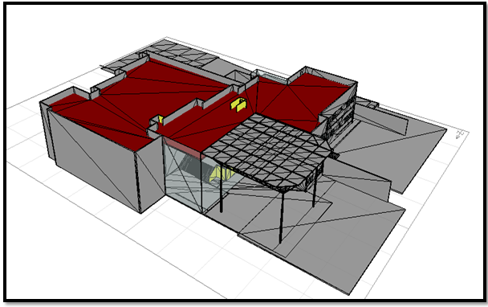
ENVIRONMENTAL DESIGN using ECOTECT
ECOTECT Program was used to:
  Analyze sun movement and natural lighting.
  Calculate the solar gain.
  Calculate heating and cooling loads.

Slide 44
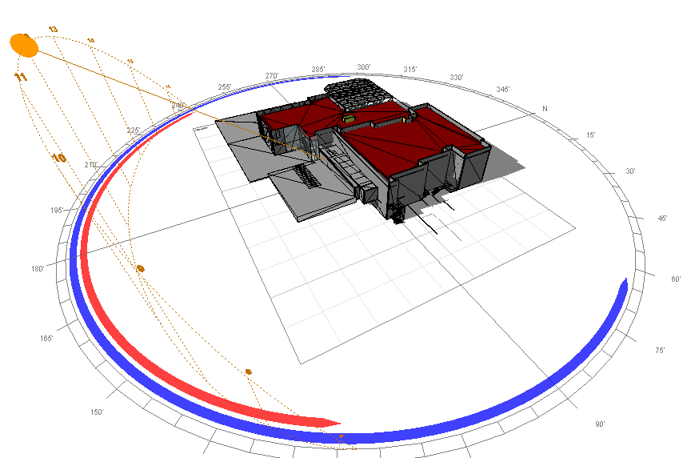
ENVIRONMENTAL DESIGN
The Sun Path
The Sun Path in Winter in January

Slide 45
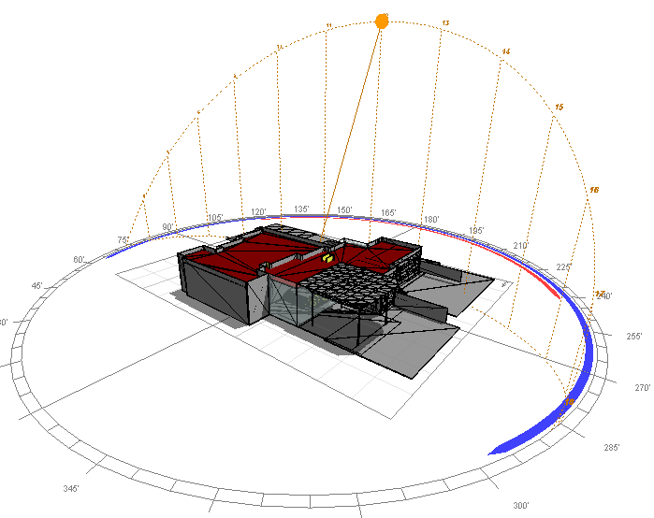
ENVIRONMENTAL DESIGN
The Sun Path
The Sun Path in Summer in July

Slide 46
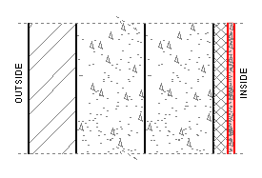
ENVIRONMENTAL DESIGN
Section Used for External Wall
Layers from outside to inside:
Layers | Width (cm) | Conductivity
Stone | 7 | 2.6
Concrete | 10 | 0.75
Lightweight Hollow Block | 15 | 0.76
Polystyrene | 2.5 | 0.03
Plaster | 2 | 0.52
U-Value = 0.75 w/m².k

Slide 47
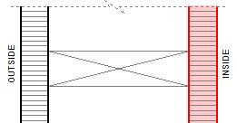
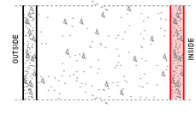
ENVIRONMENTAL DESIGN
Internal Wall (Partition)
Layers from outside to inside:
Layers | Width (cm) | Conductivity
Plaster | 2 | 0.43
Lightweight Block, Perlite-Filled | 10 | 0.17
Plaster | 2 | 0.43
U-Value = 0.5w/m².k
Shear Wall
Layers | Width (cm) | Conductivity
Plaster | 1 | 0.52
Concrete | 25 | 0.75
Plaster | 1 | 0.52
U-Value = 1.1w/m².k

Slide 48
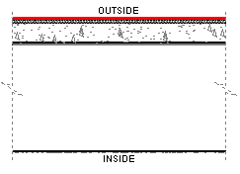
ENVIRONMENTAL DESIGN
Auditorium floor:
Layers from outside to inside:
Layers | Width (cm) | Conductivity
Carpet | 2 | 0.48 both
Rubber band | 2
Concrete | 20 | 0.75
Wood wool | 5 | 0.81
Air Gap | 60 | 5.56
False ceiling | 1 | 0.06
U-Value = 0.45w/m².k

Slide 49
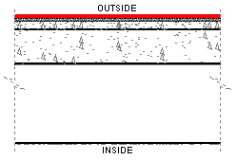
ENVIRONMENTAL DESIGN
Section Used
Floors in block B
Layers from outside to inside:
Layers | Width (cm) | Conductivity
Tile | 1 | 0.19
Sand | 2 | 1.74
Ribbed Slab | 32 | 0.6
Polystyrene | 2.5 | 0.03
Air Gap | 60 | 5.56
False ceiling | 1 | 0.06
U-Value = 1.1w/m².k

Slide 50
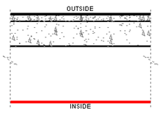
ENVIRONMENTAL DESIGN
For roof
Layers from outside to inside:
Layers | Width (cm) | Conductivity
Asphalt | 2 | 1.2
Ribbed Slab | 32 | 0.6
Polystyrene | 2.5 | 0.03
Air Gap | 60 | 5.56
False ceiling | 1 | 0.06
U-Value = 0.77w/m².k

Slide 51
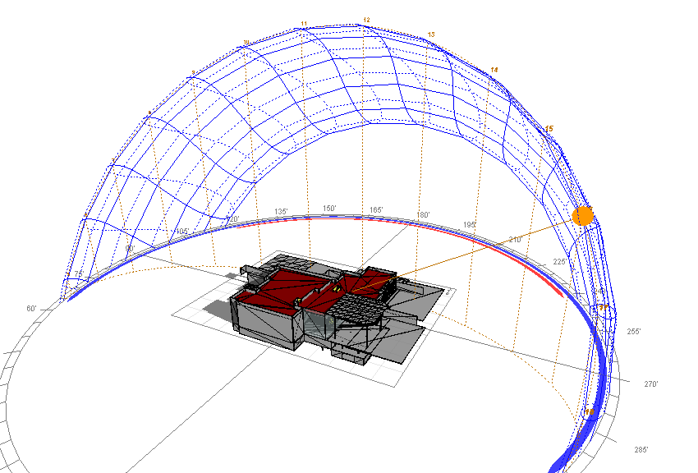
ENVIRONMENTAL DESIGN
The Sun Path
Sun path after 4 PM:

Slide 52
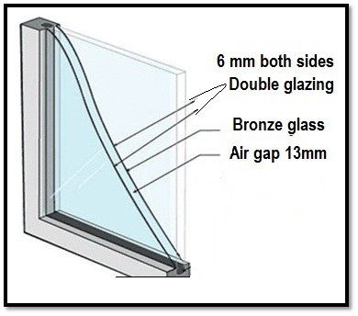
ENVIRONMENTAL DESIGN
Double glazed, Tinted glass:
U-Value = 2.66w/m².k
Notes:
Double glazing type was used in the western side. This type of glazing was used to minimize the heat gains on summer and the heat losses in winter.

Slide 53
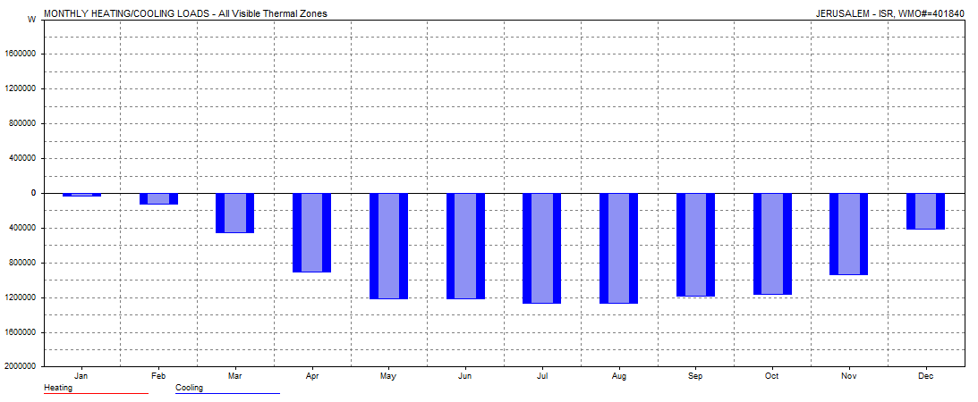
ENVIRONMENTAL DESIGN
Cooling load in auditorium
There’s NO HEATING load due to the occupancy
Max Cooling load at 15:00 on 21 August = 331KW =
94 T.R for an area =1150 m²
Notes:
Monthly Cooling Load for the Auditorium

Slide 54
Electrical
& Mechanical
Design

Slide 55
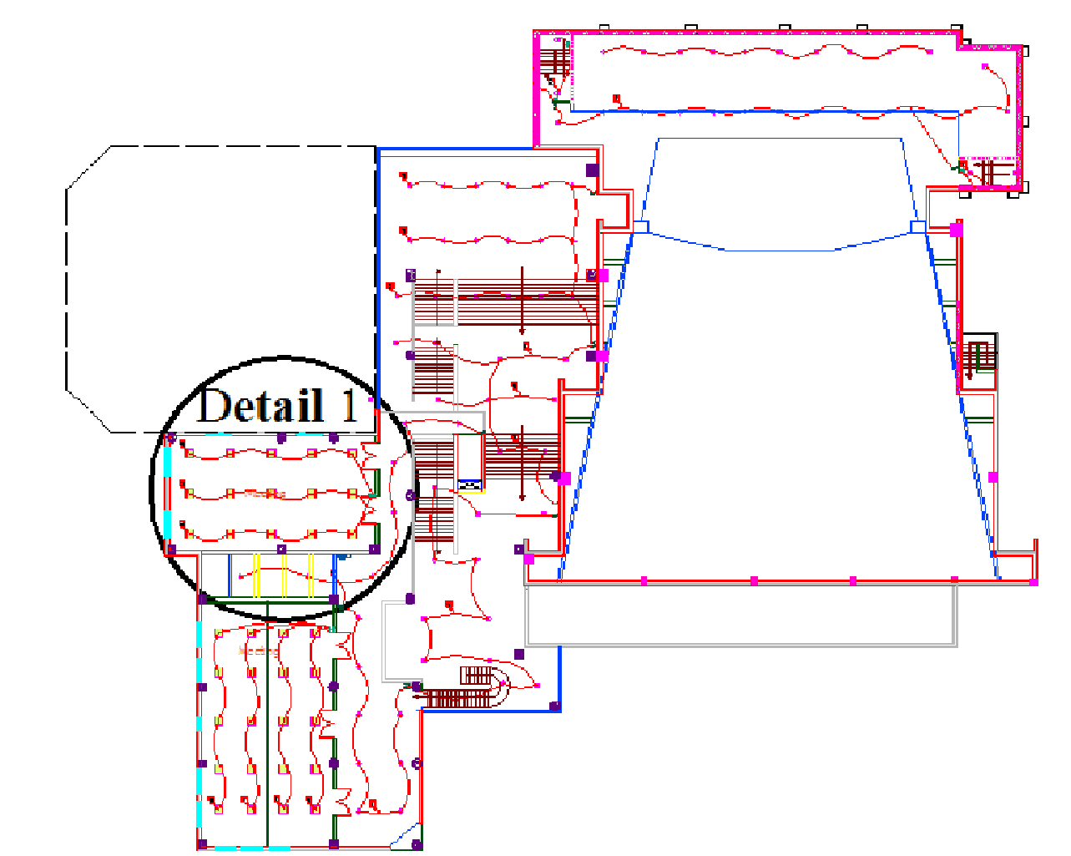
Electrical Design
Distribution of lighting in first floor

Slide 56
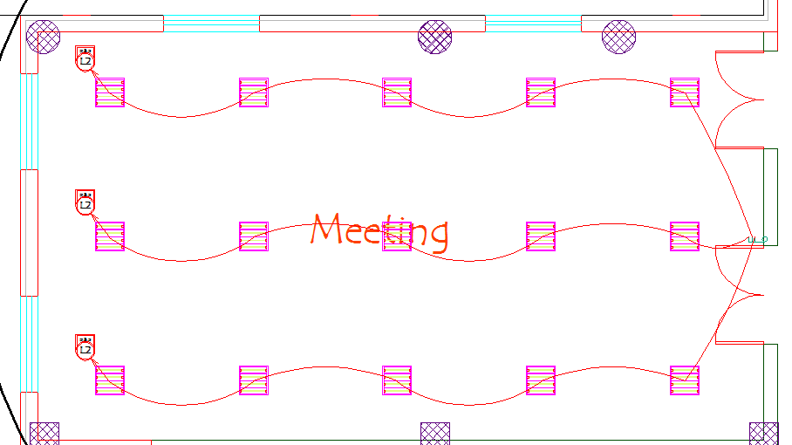
ELECTRICAL DESIGN
Distribution of lighting in first floor (Detail 1)
Detail 1

Slide 57
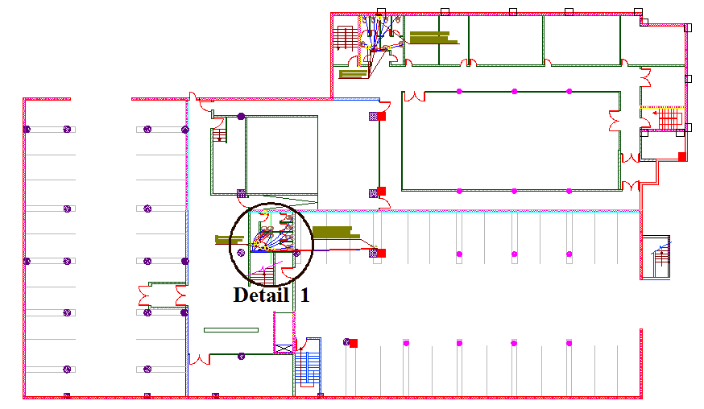
MECHANICAL DESIGN
Water System for Second Basement

Slide 58
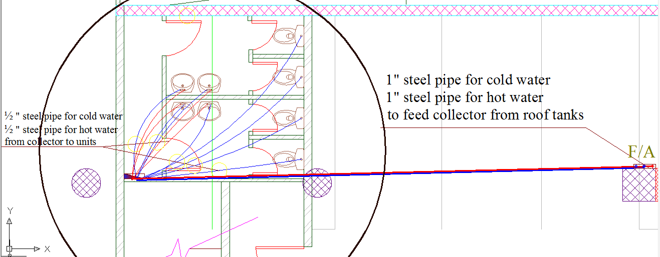
MECHANICAL DESIGN
Water System for Second Basement (Detail 1)
Detail 1

Slide 59
Safety Design

Slide 60
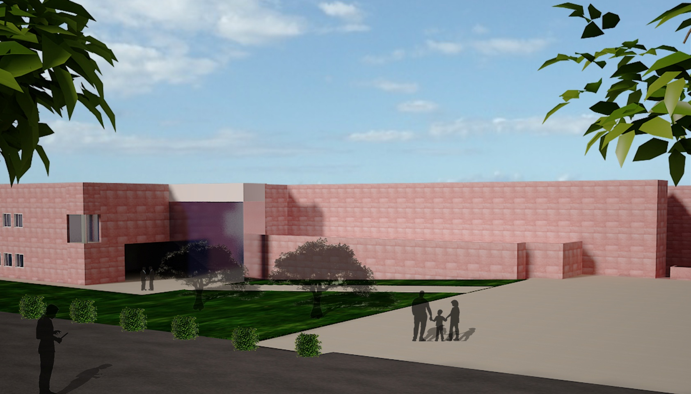
SAFETY DESIGN
Safety for People with Special Needs:
Ramp

Slide 61
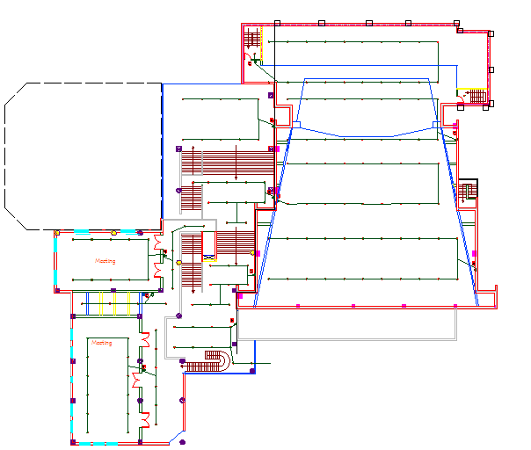
Safety DESIGN
Distribution of Fire Alarm -First floor
Notes:
(heat detector)

Slide 62

Safety Design
Fire System For Basement 2

Slide 63

Safety Design
Fire System For Basement 1

Slide 64
Cost
Estimation

Slide 65
Cost estimation
Cost ( $) | Activity
1500 | Mobilization
388846.15 | Earth work
636186.35 | Steel
189911.7 | Form work
624289.25 | Concrete work
1467218.6 | Finishing
481192.8 | Mechanical
320795.2 | Electrical
4109940 | Total
The cost of 1m² = 600$

Slide 66


Slide 67

Safety Design
Detail 1

Slide 68
Area of floors
Area | Floor
1350 m² | Basement 3
1970 m² | Basement 2
840 m² | Basement 1
1030 m² | Ground floor
470 m² | First floor
1150 m² | Auditorium

