Slide 1
Water Resource Management in Tulkarm Governorate
Prepared By:
Diana Khalid AL-Tayyah
Hala Bilal Takrori

Slide 2
Objectives
Study the existing water situation for Tulkarm Governorate.
Estimate the Future Water Demand.
Suggest new water resources to cover the water Gap for the next 20 years

Slide 3
Study Area

Slide 4
Cont.
The total number of localities is 34
The total population is 163,000

Slide 5
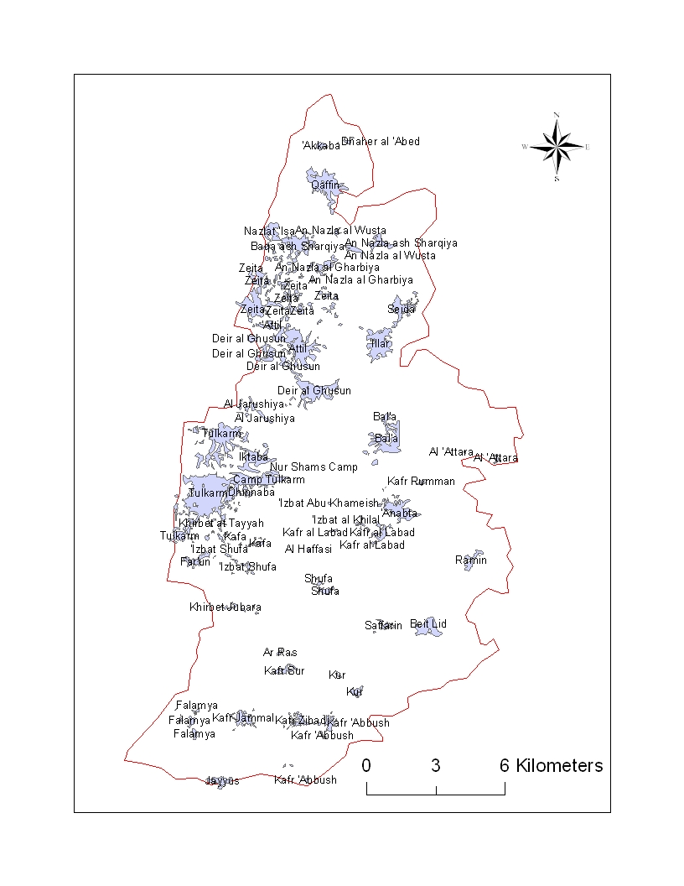

Slide 6
Study Area
Land use
Topography
Climate
Rainfall rate

Slide 7
Water situation
The total number of localities is 34
The total number of served localities is 24
The total number of un-served localities is 10
Total existing water supply is around 7.1Mcm/yr.
The average water demand is 126L/C/day

Slide 8
Future Population
The population growth rates are assumed to be:
3% for years 2007-2010
2.5% for years 2010-2020
2% for years 2020-2030
The total Future population will be around 244,000 by year 2030

Slide 9
Future Demand
Assumptions:
The water consumption rate will be 100L/c/day.
The increase per year of consumption is 2L/c/day

Slide 10
Cont.
The existing consumption rate of un-served rural areas is 35L/c/day
The losses in the networks due to leakage, wrong readings in meters and illegal consumption are assumed to decrease.

Slide 11
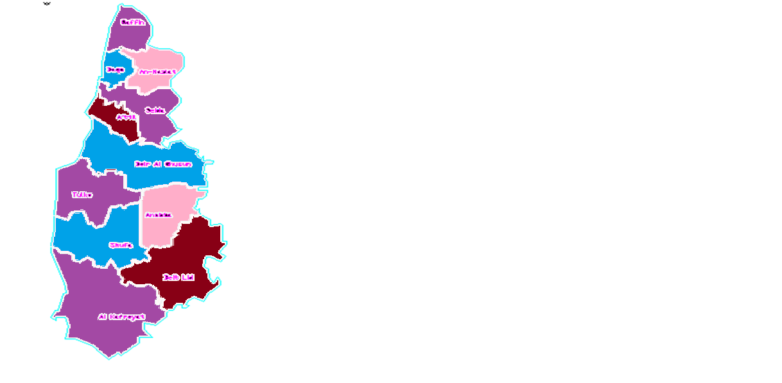
clusters

Slide 12
Existing and Future Population
Cluster Number | Cluster Name | Existing Population ( 2007 ) | Future Population (2030)
1 | Qaffin | 8,546 | 13,504
2 | Baqa | 6,377 | 7,862
3 | An-Nazlat | 2,766 | 4,362
4 | Seida | 9,037 | 14,235
5 | A’ttil | 11,783 | 18,580
6 | Deir Al-Ghusun | 15,895 | 25,065
7 | Tulkarm | 70,445 | 96,084
8 | Anabta | 11,300 | 17,819
9 | Shufa | 5,802 | 9,149
10 | Beit Lid | 7,492 | 11,814
11 | Al-kafreyat | 6,816 | 10,393
Total |  | 156, 259 | 228,866

Slide 13
Existing Water Supply
Cluster Number | Cluster Name | Existing Supply (m³/year) | Existing Supply (Mcm/year)
1 | Qaffin | 336,070 | 0.336
2 | Baqa | Un-served | Un-served
3 | An-Nazlat | 65,000 | 0.065
4 | Seida | Un-served | Un-served
5 | A’ttil | 595,317 | 0.60
6 | Deir Al-Ghusun | 675,611 | 0.676
7 | Tulkarm | 4,357,278 | 4.357
8 | Anabta | 398,688 | 0.40
9 | Shufa | 202,080 | 0.202
10 | Beit Lid | 217,446 | 0.217
11 | Al-kafreyat | 288,469 | 0.288
Total |  | 7,135,959 | 7.14

Slide 14
Future Water Demand
Cluster Number | Cluster Name | Future Water Demand (Mcm/year)
 |  | 2010 | 2020 | 2030
1 | Qaffin | 0.56 | 0.78 | 0.975
2 | Baqa | 0.156 | 0.31 | 0.365
3 | An-Nazlat | 0.152 | 0.23 | 0.28
4 | Seida | 0.35 | 0.69 | 0.81
5 | A’ttil | 0.78 | 1.07 | 1.34
6 | Deir Al-Ghusun | 1.03 | 1.45 | 1.80
7 | Tulkarm | 4.68 | 6.47 | 8.05
8 | Anabta | 0.74 | 1.01 | 1.26
9 | Shufa | 0.36 | 0.50 | 0.614
10 | Beit Lid | 0.47 | 0.67 | 0.826
11 | Al-kafreyat | 0.43 | 0.58 | 0.732
Total |  | 9.708 | 13.76 | 17.052

Slide 15
Future Water Gap
Cluster Number | Cluster Name | Future Water Gap (Mcm/year)
 |  | 2010 | 2020 | 2030
1 | Qaffin | 0.224 | 0.444 | 0.639
2 | Baqa | 0.156 | 0.31 | 0.365
3 | An-Nazlat | 0.087 | 0.165 | 0.215
4 | Seida | 0.35 | 0.69 | 0.81
5 | A’ttil | 0.185 | 0.475 | 0.745
6 | Deir Al-Ghusun | 0.354 | 0.774 | 1.124
7 | Tulkarm | 0.323 | 2.11 | 3.69
8 | Anabta | 0.341 | 0.61 | 0.86
9 | Shufa | 0.158 | 0.298 | 0.412
10 | Beit Lid | 0.253 | 0.453 | 0.609
11 | Al-kafreyat | 0.142 | 0.292 | 0.444
Total |  | 2.489 | 6.525 | 9.913

Slide 16
New and additional water resources
Water Harvesting
Rehabilitation of existing water networks
Water demand management
Ground water wells

Slide 17
Water Harvesting
Cluster Number | Cluster Name | Existing Population (2007) | Future Population (2030) | Total Number of Buildings | Cistern Volume
 |  |  |  |  | (m³/year) | (Mcm/year)
1 | Qaffin | 8,546 | 13,504 | 1,543 | 204,806.98 | 0.205
2 | Baqa | 6,377 | 7,862 | 1,199 | 124,169.546 | 0.124
3 | An-Nzlat | 2,766 | 4,362 | 532 | 70,473.2668 | 0.070
4 | Seida | 9,037 | 14,235 | 1,258 | 166,453.571 | 0.166
5 | A’ttil | 11,783 | 18580 | 2,178 | 288,487.496 | 0.288
6 | Deir Al-Ghusun | 15,895 | 25,065 | 2,929 | 387,976.869 | 0.388
7 | Tulkarm | 70,445 | 96,084 | 9,501 | 1,088,552.82 | 1.089
8 | Anabta | 11,300 | 17,819 | 2,207 | 292,338.829 | 0.292
9 | Shufa | 5,802 | 9,149 | 1,081 | 143,186.108 | 0.143
10 | Beit Lid | 7,492 | 11,814 | 1,472 | 194,978.306 | 0.195
11 | Al-Kafreyat | 6,816 | 10,393 | 1,487 | 190,459.044 | 0.190
Total |  | 156,259 | 228,867 |  | 3,151,882.84 | 3.152

Slide 18
Rehabilitation of existing water networks
Cluster Number | Cluster Name | Existing water Amounts (m³) | Difference in Losses (%) | Saved Water Amounts
 |  |  |  | (m³ / year) | (Mcm/ year)
1 | Qaffin | 336,070 | 10 | 33,607 | 0.034
2 | Baqa | Un-served | 10 | 0 | 0
3 | An-Nzlat | 65,000 | 10 | 6,500.0 | 0.007
4 | Seida | Un served | 10 | 0 | 0
5 | A’ttil | 595,317 | 10 | 59,531.7 | 0.06
6 | Deir Al-Ghusun | 675,611 | 10 | 67,561.1 | 0.068
7 | Tulkarm | 4,357,278 | 10 | 435,727.8 | 0.435
8 | Anabta | 398,688 | 10 | 39,868.8 | 0.04
9 | Shufa | 202,080 | 10 | 20,208 | 0.02
10 | Beit Lid | 217,446 | 10 | 21,744.6 | 0.022
11 | Al-Kafreyat | 288,469 | 10 | 28,846.9 | 0.029
Total |  | 7,135,959 |  | 713,596 | 0.715

Slide 19
Demand management is the purposeful and beneficial manipulation of the level and timing of water usage

Slide 20
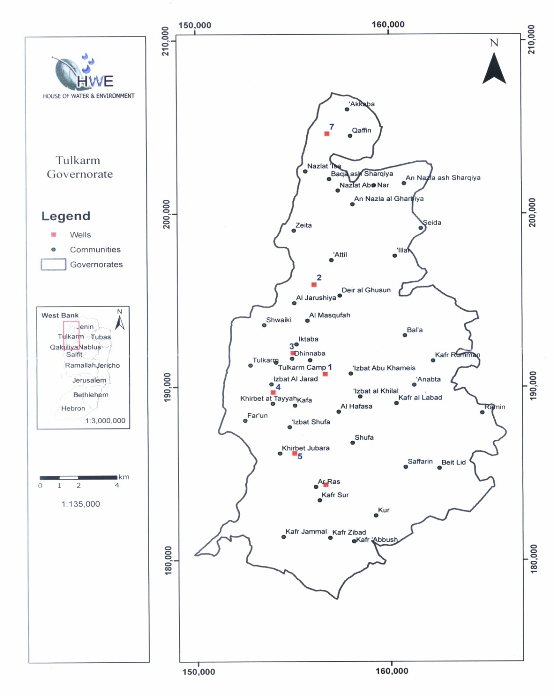
Ground Water Wells

Slide 21
Proposed Future Projects
Package # | Description | Total cost ( million $)
1 | A ground water well,2 reservoirs, 2conveyance lines, and one pump | 3.14
2 | A ground water well, one reservoir, one conveyance line and one pump | 2.02
3 | A ground water well,2 reservoirs, 2conveyance lines and one pump | 2.58
4 | A ground water well, one reservoir, one conveyance line and one pump | 1.98
5 | A ground water well, one reservoir, one conveyance line and one pump | 1.98
6 | A ground water well, one reservoir, one conveyance line and one pump | 2.39
7 | A ground water well, one reservoir, one conveyance line and one pump | 2.44
8 | A ground water well, one reservoir, one conveyance line and one pump | 1.98
9 | A ground water well, one reservoir, one conveyance line and one pump | 2.39
10 | A ground water well, one reservoir, one conveyance line and one pump | 1.93

Slide 22
The total Investment equals 22.83 million $

Slide 23
Based on the previous packages, the fheaded iollowing cash flow shows the nvestment to implement the plan

Slide 24
Based on the packages above we can conclude the following:
The total investment cost is considered to be around 22.83 million $ which approximately equals 90 million NIS.
The average investment per year equals around 1,000,000 $/year.
The average investment per capita per year equals around 4.1 $/capita /year.
Maintenance cost per capita equals around 7.4 NIS.

Slide 25
Thank you for your Listening

