Slide 1

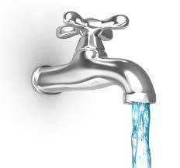
Evaluation and Redesign of Beit Dajan Water Distribution Network
Prepared by:
Tahreer Mayyaleh
Nibal Thabet
Amani Beiram
Supervisor:
Dr. Sameer Shadeed

Slide 2
Content
Introduction
Objectives
Study Area
Methodology
Principles of WDN Analysis
Analysis of Existing and redesigned WDN
Discussion and Conclusion
Recommendation

Slide 3
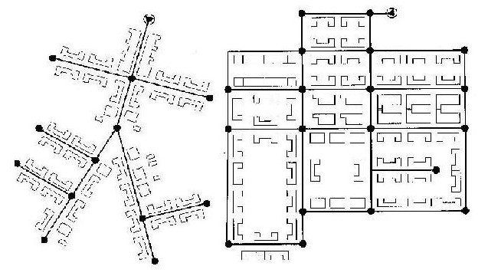
Introduction
A water distribution system consists of network of pipes, reservoirs, pumps, valves, and other hydraulic elements. Its purpose is to supply good quality water to customers within specific pressure levels under various demand conditions.

Slide 4
Objectives
Assess the existing WDN (e.g adequacy, velocity, pressure, etc).
Provide new design for parts of the existing WDN to overcome the existing problems if any and to satisfy water needs for the future expansion in the village.

Slide 5
Study Area
Geography and Topography
Population
Water Situation

Slide 6
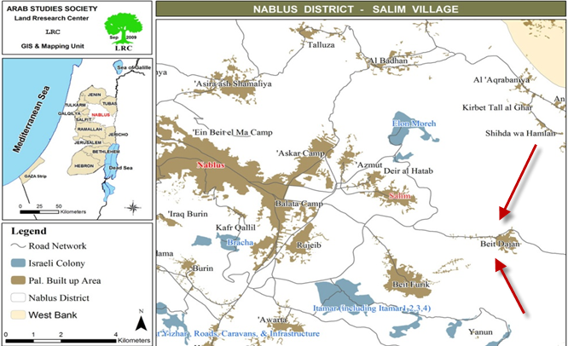
Geography and Topography
Location:
Beit Dajan is a Palestinian
village in the Nablus
Governorate in the
north central West Bank,
located 10 km to the east
of Nablus city.

Slide 7

Population
Total population for Beit Dajan village is about
3,834 inhabitants
There are more than 613 buildings in the village with about 740 housing units. The average family members is about 5 persons.

Slide 8
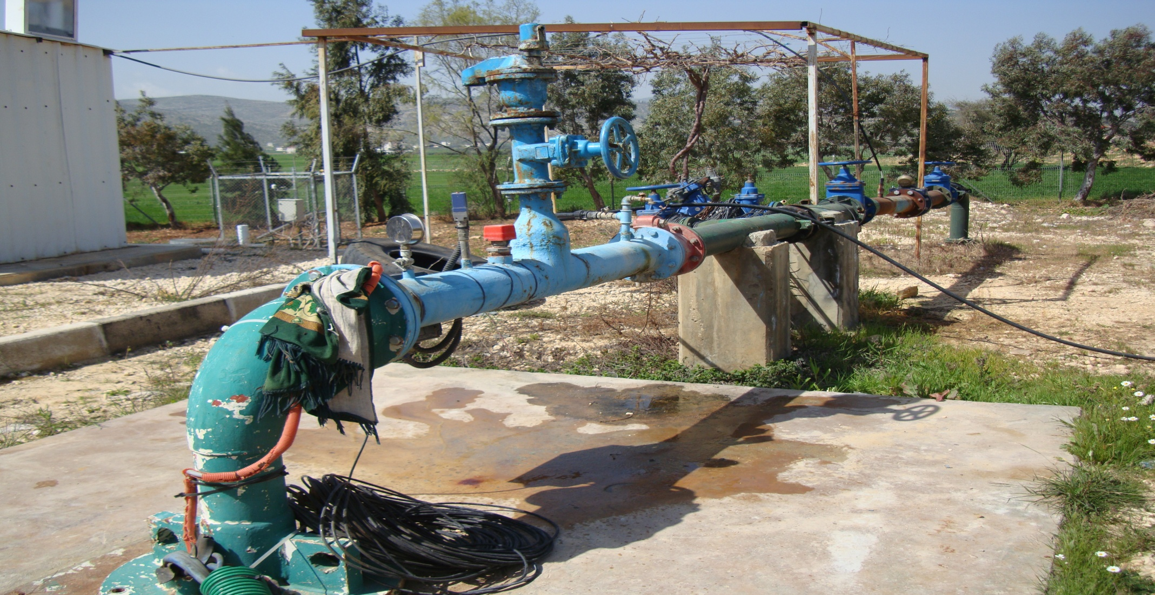
Water Situation
Beit Dajan Well: Beit Dajan Village depends for drinking water supply mainly on a well constructed on 2003 and called Beit Dajan Well. It is located to the west of the village in between Beit Dajan and Beit Furik close to Beit Dajan-Nablus main road.
It’s povided Beit Dajan and Beit Furik villages with drinking water produced at 65 m³/hour

Slide 9
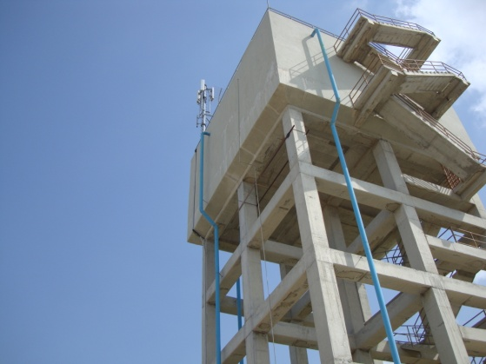
Beit Dajan Water tank
Water from the well is continuously pumped to a concrete elevated tank, with a capacity of around 500 m³ constructed in 2008 at the highest point in the village.
Water from the reservoir is then distributed to all houses in the village, by gravity, through a network constructed in 2009.

Slide 10
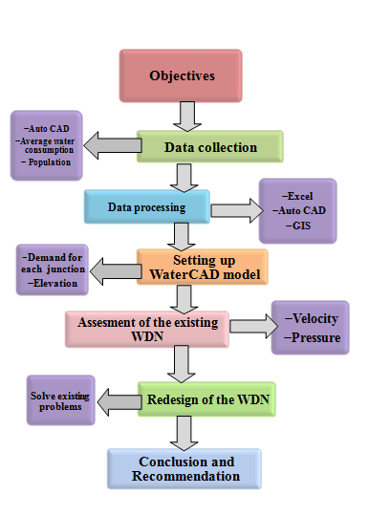
Methodology

Slide 11
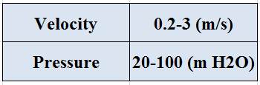
Design Criteria for Pressure and Velocity

Slide 12
Principles of WDN Analysis
1. Continuity: The algebraic sum of the flow rates in the pipes meeting at node together with any external flows is zero. ΣDemand=0
2. Energy conservation: For all paths around closed loops, the accumulated energy loss including local losses minus any energy gain or heads generated by pumps must be zero. Σhf=0

Slide 13
Energy equation
(P₁/_{ᵞ}) +(V²₁/2g) + Z₁=(P₂/_{ᵞ}) +(V²₂/2g) + Z₂+ h_{L}
Hazen- William equation
H_{f} = 162.5( Q/C)^{1.852} D^{-4.87} L

Slide 14
Demand on Nodes
Demand/node = N_{A} x P_{D} x W_{d} x PF
Where:
N_{A}: Node Area of Estimated Theisen Polygon Method ( m²)
P_{D}: Demand Population Density (c\m²)
W_{d}: Water Demand Rate (L\c.d)
PF: 1.5

Slide 15
Thiessen Polygon
the area of each node was calculated using Thiessen Polygon method
The total area of the built-up area from Thiessen Polygon equals to 2701879 m²

Slide 16
Future population
P_{f} = P_{P}(1+r)^{n}
Where:
Pf : Future population.
PP : Present population.
r : growth rate.
n : number of years to be designed.
Here it was used to be as followed
P_{f} = 3834(1+3.2%)³⁰ = 9306 capita

Slide 17
Population density
Population density = P_{f} /total area
= 9306/ 2701879 = 3.4x10 ⁻³ c/m²
Water Consumption
According to (PWA, 2010) In Nablus the average daily water consumption rate was approximately 85 l/c/d.
Water demand was calculated as 120 /c.d instead of 85 l\c.d because of losses. (losses = 25% according to PWA)
Wd = Wc /(1-losses)
= 85/(1-0.25) = 113 l/c.d
Wc = 120 L/c.d was considered

Slide 18
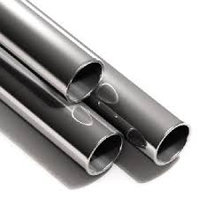
Diameters of The Existing WDN
2 in
3 in
4 in
6 in
8 in
The Pipes
made from HDPE

Slide 19
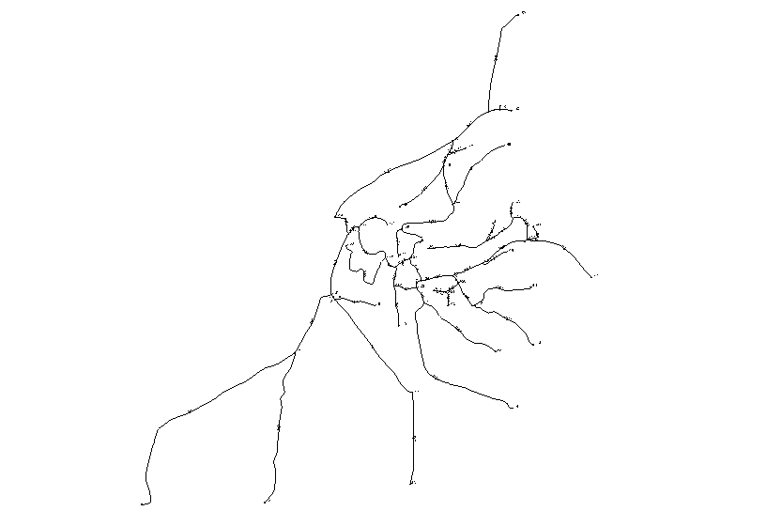
WDN setting up on WaterCAD

Slide 20
Analysis of Existing WDN
Case 1 : Steady State
The flow rate is constant all over the day.
Case 2 : Transient State
The flow rate is not constant and varies during the day.

Slide 21
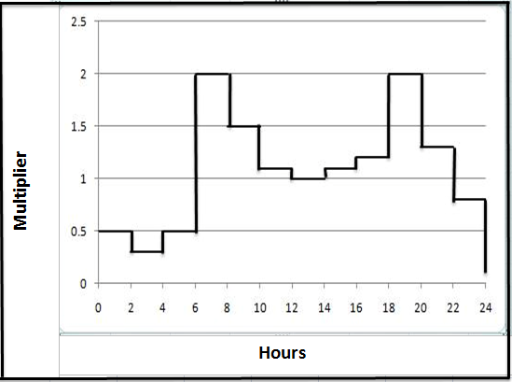
Consumption pattern

Slide 22
Analysis of Existing WDN
At steady state
Max. Pressure= 130 m H2O
Min. Pressure= 10.1 m H2O

Slide 23
At steady state
Max. velocity= 1.46 m/s
Min. velocity= 0.01 m/s

Slide 24
At Transient State(6:00)
Max. Pressure= 125 m H2O
Min. Pressure= 4 m H2O

Slide 25
At Transient State(6:00)
Max. velocity= 2.95m/s
Min. velocity= 0.02 m/s

Slide 26
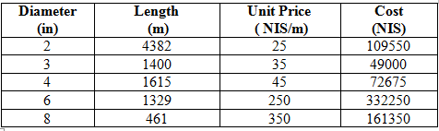

Cost of existing WDN
TOTAL COST=724825 NIS

Slide 27
WDN after Redesign
At Steady State
Max. Pressure= 127 m H2O
Min. Pressure= 9 m H2O

Slide 28
At Steady State
Max. velocity= 1.48 m/s
Min. velocity= 0.01 m/s

Slide 29
At Transient State(6:00)
Max. Pressure= 113 m H2O
Min. Pressure= 5 m H2O

Slide 30
At Transient State(6:00)
Max. velocity= 2.95m/s
Min. velocity= 0.02 m/s

Slide 31
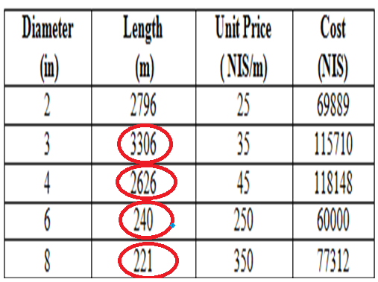

Cost of WDN after Redesign
TOTAL COST= 441058 NIS

Slide 32
Discussion and Conclusion
For Existing WDN:
The existing WDN was capable to command the present demand places on it, since the pressure head in the WDN is within the acceptable limits.
The nodal pressure is good, since it is in the acceptable range of (20-100m) except a few nodes above 100m and that dose not cause a problem because HDPE pipes can carry up to 550 m of pressure.

Slide 33
There were about 42% of pipes with low velocity (< 0.2 m/s) that is due to large diameters of pipes compared within it's demand be served.

Slide 34
For Redesign WDN:
Modifying of some pipe diameters in order to increase the velocity. But low velocity problem still found in some pipes due to dead ends.
The pressure acceptable within the range also except some nodes over 100 m.
In a comparison with the existing WDN cost, About 300000 NIS can be saved .

Slide 35

Recommendation
Need to choose the best diameters that make the WDN more economical within the hydraulics limitations.

Slide 36


