Slide 1

Novel TH M-ary PPM Technique
Supervisor:
Dr. Ahmed Masri
Prepared by:
1. Aya Hamarsheh
2. Safaa Hamdan
2013/2014

Slide 2

Outline
Create understanding about TH M-ary PPM
TH M-ary PPM Applications
Conventional TH M-ary PPM (C-PPM)
Novel TH M-ary PPM (N-PPM)
Simulation and Results
SWOT analysis
Conclusion and Recommendations

Slide 3
Our Contribution
Propose and analysis a novel improvement for TH M-ary PPM technique with main target of improving the overall system performance under interference dominated system

Slide 4
TH M-ary PPM Applications
RF (Radio Frequency) communications
Used in optical communication
Used in UWB (which uses common control channels in cognitive radio networks).

Slide 5
Create Understanding About Conventional TH M-ary PPM (C-PPM)

Slide 6
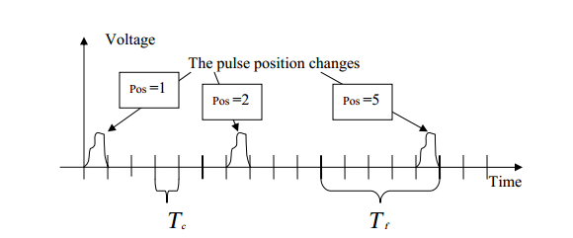
TH M-ary PPM
TH M-ary PPM is a modulation technique that is used to transmit binary data (symbols), each symbol is represented by a pulse of duration of 2 ns sent over a train of pulses in a random location determined by Time Hopping Code.

Slide 7
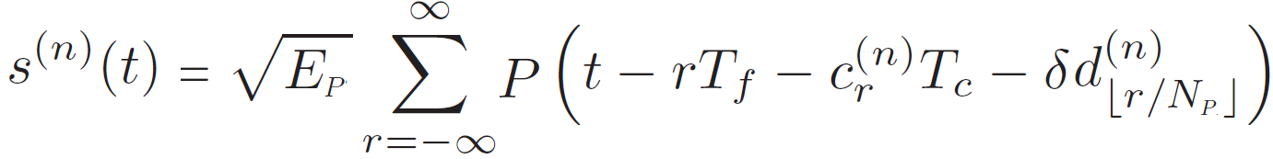
Conventional TH M-ary PPM (C-PPM)
E_{p} : Energy transmitted for each pulse
P(t): The reference pulse with duration T_{p}
T_{f} : Frame Duration
C_{r} : Time Hopping Code
T_{c} : Chip Duration
d : The transmitted symbol
δ : The modulation index

Slide 8
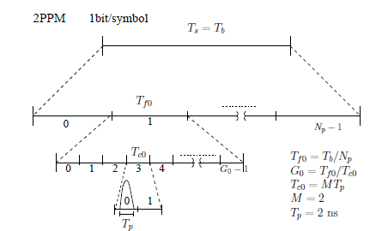
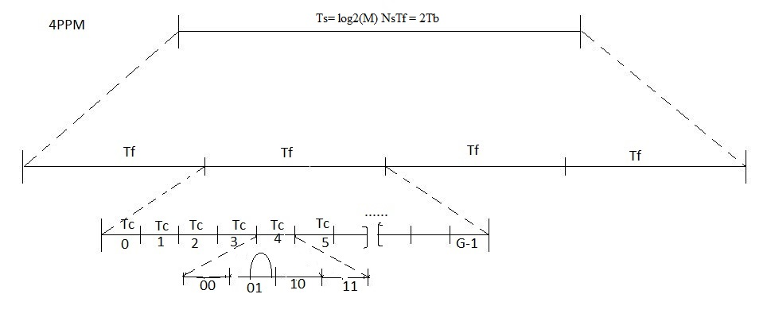
Conventional TH M-ary PPM (C-PPM)

Slide 9
Conventional TH M-ary PPM (C-PPM)
Disadvantages of (C-PPM)
  As we go to higher modulation order the symbol duration increases while bit duration remains constant which means constant data rate for 2PPM or 16PPM .
  As a result the total interference probability will remain the same
  Our target: Minimizing the total system interference
  Our task: Is to minimize packet duration, thus the total system interference will be reduced.

Slide 10
Propose Novel TH M-ary PPM (N-PPM) Technique

Slide 11
Novel TH M-ary PPM (N-PPM)
  Our target: Minimizing the total system interference
  Our task: Is to minimize packet duration, thus the total system interference will be reduced as we go for higher order modulation.
  Our Proposal: we will squeeze “compress” the data within the same symbol duration as we go for higher order modulation

Slide 12
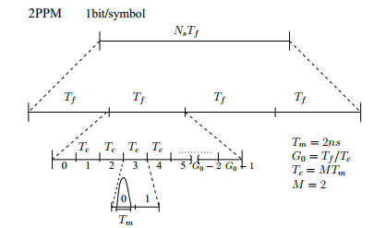
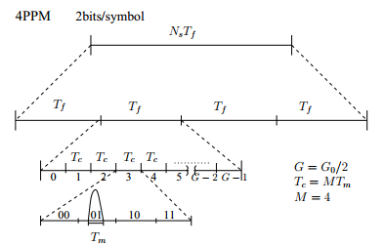
Novel TH M-ary PPM (N-PPM)

Slide 13
Novel TH M-ary PPM (N-PPM)
Advantages:
Data rate is going higher as we go for higher order modulation (Packet duration is shorter):
    E.g; 2PPM → 1Mbps → 1bit/Sym → T_{b} = 1 µs
    4PPM → 2Mbps → 2bit/Sym → T_{b} = 0.5 µs
    8PPM → 3Mbps → 3bit/Sym → T_{b} = 0.33 µs
    16PPM → 4Mbps → 4bit/Sym → T_{b} = 0.25 µs
Best works in interference dominated systems.

Slide 14
Simulation Parameters
This type of modulation is often used in UWB that use a transmitted signal of Bandwidth of 500 MHz as recommended by the Federal Communications Commission (FCC), which makes the energy pulse equal to -41.3 dBm/MHz.
The ALOHA Access Protocol
Was used to avoid the need for synchronization.

Slide 15
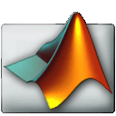
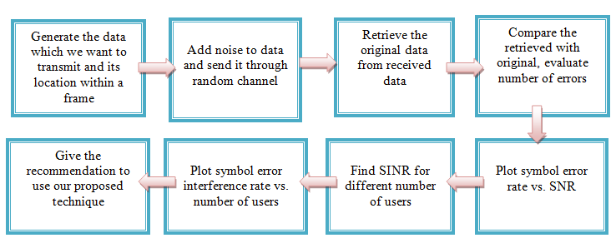
Simulation

Slide 16
Simulation Results

Slide 17
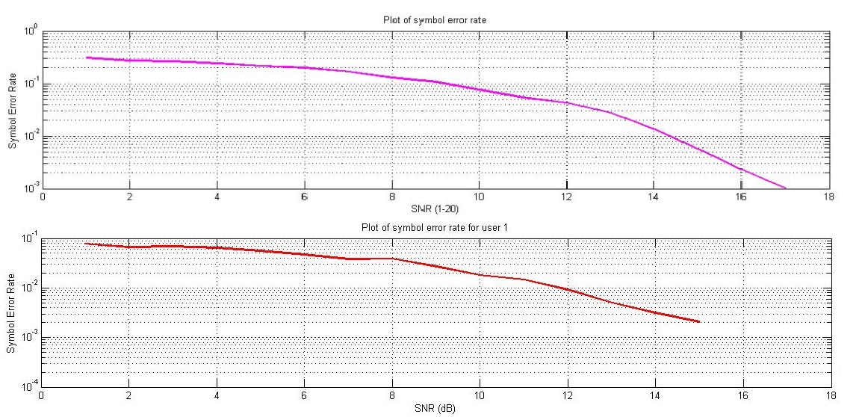
SER for C-2PPM (above) and N-2PPM (below)

Slide 18
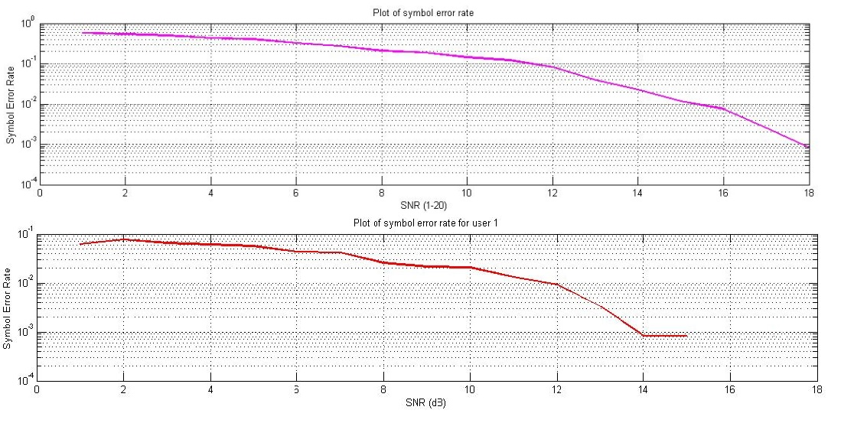
SER for C-16PPM (above) and N-16PPM (below)

Slide 19
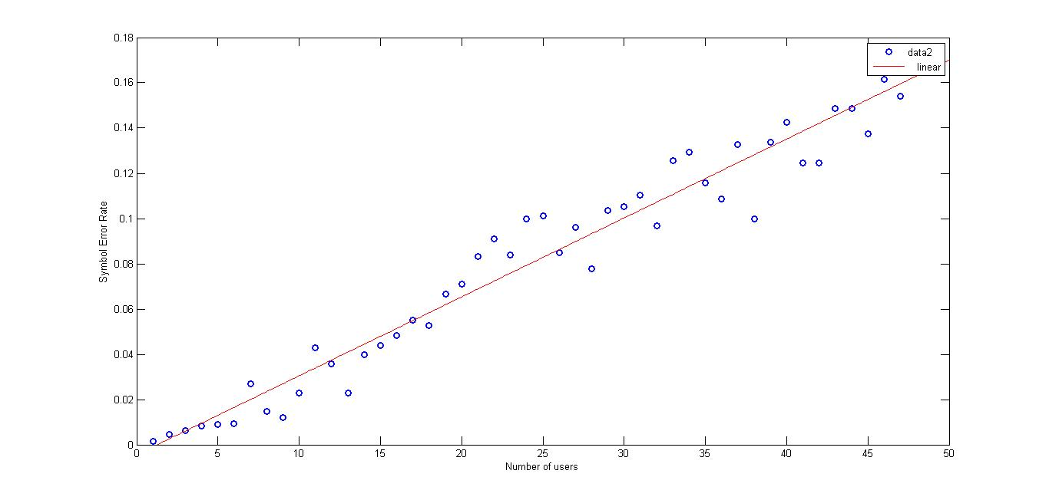
SER for C-2PPM due to noise & interference

Slide 20
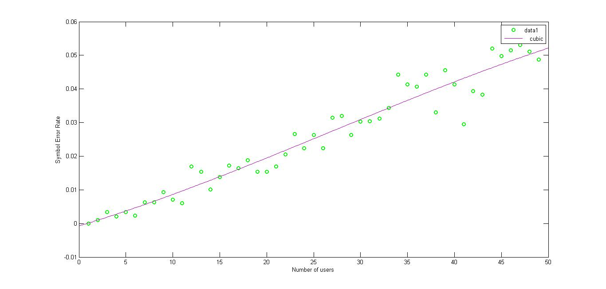
SER for N-2PPM due to noise & interference

Slide 21
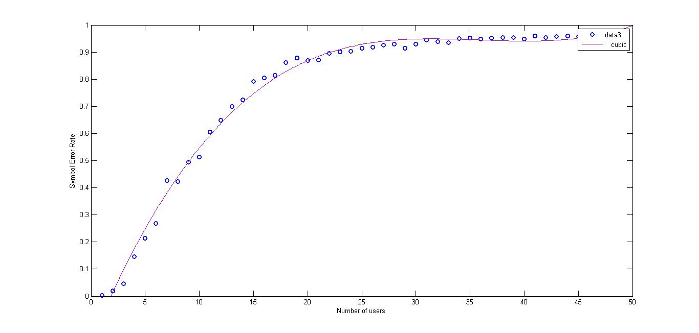
SER for C-16PPM due to noise & interference

Slide 22
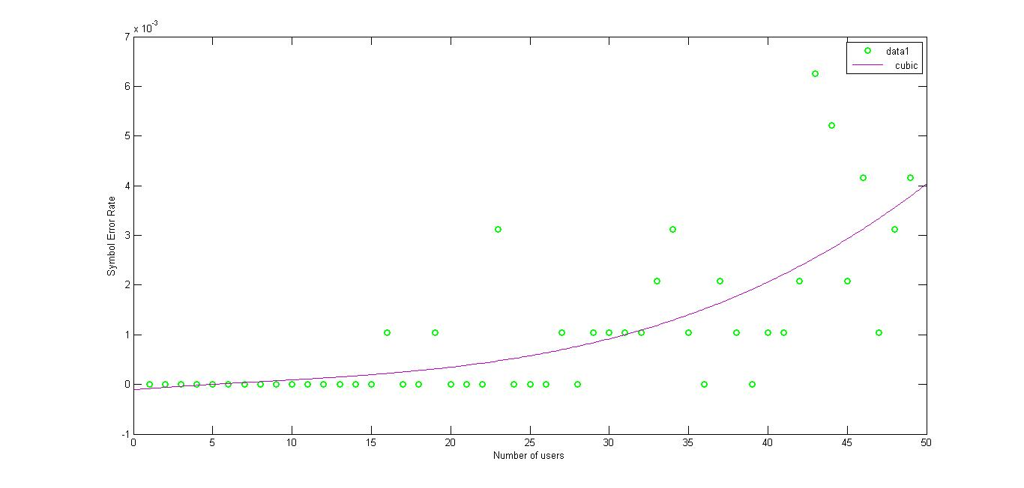
SER for N-16PPM due to noise & interference

Slide 23
Poisson Arrival
Poisson arrival is a function that generates random number depends on a rate parameter called “lambda”.
as lambda increase, the delay for each user to access the channel decrease, this will increase the total system interference.
In our simulation we used lambda= 0.05, 0.85 and 2

Slide 24
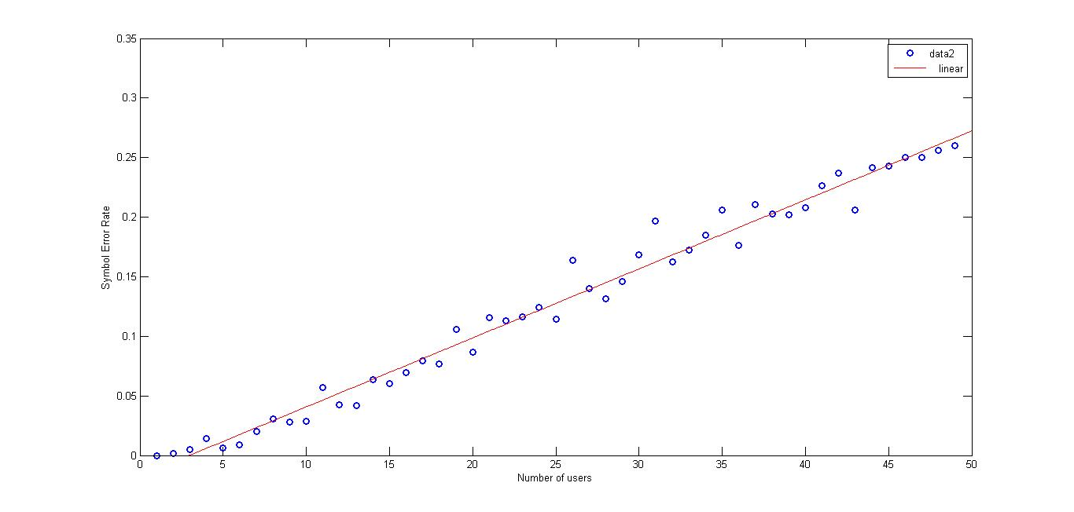
Lamda =0.05 (C-PPM)

Slide 25
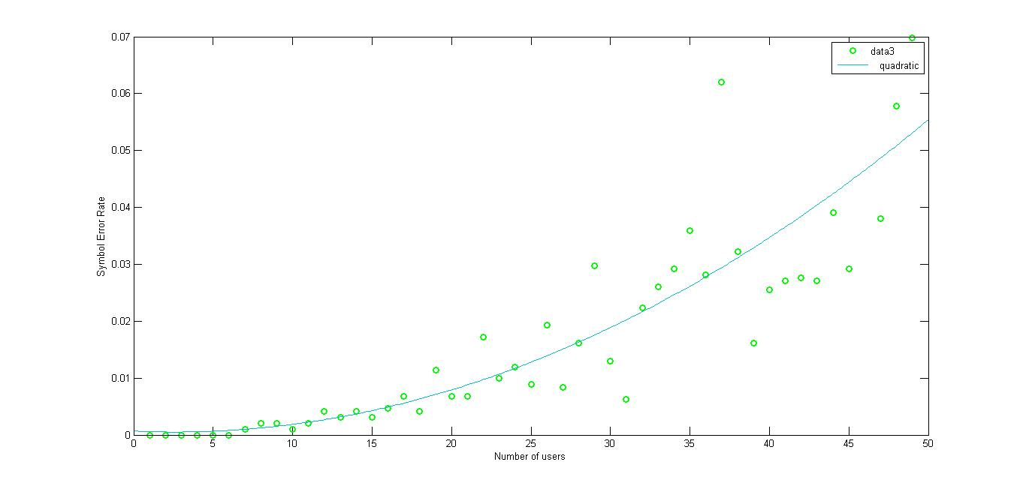
Lamda =0.05 (N-PPM)

Slide 26
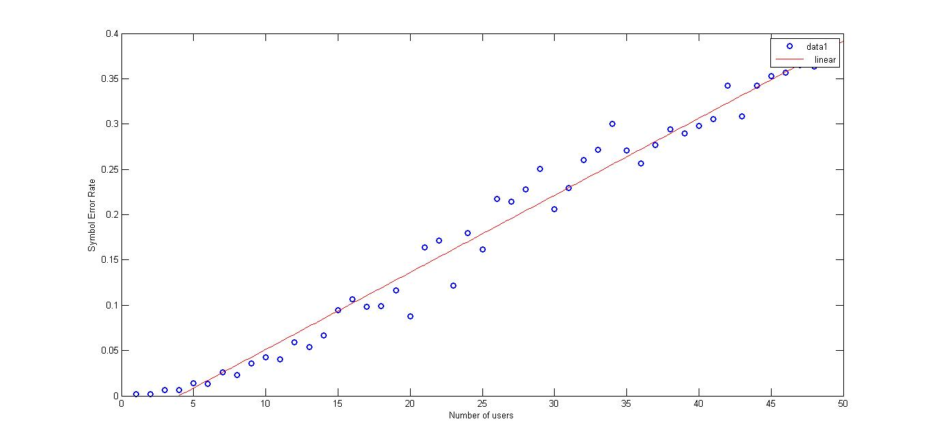
Lamda =0.85 (C-PPM)

Slide 27
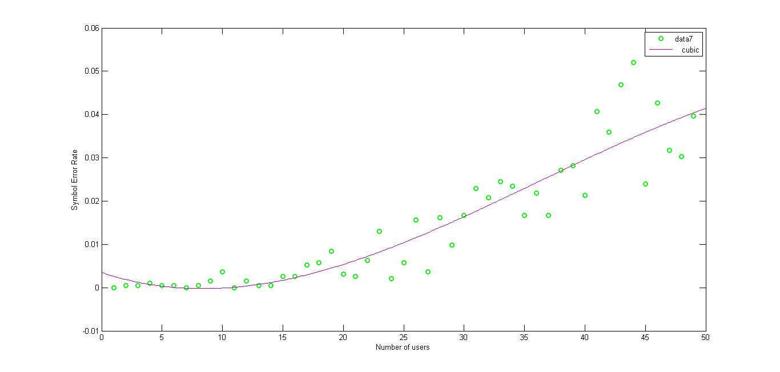
Lamda =0.85 (N-PPM)

Slide 28
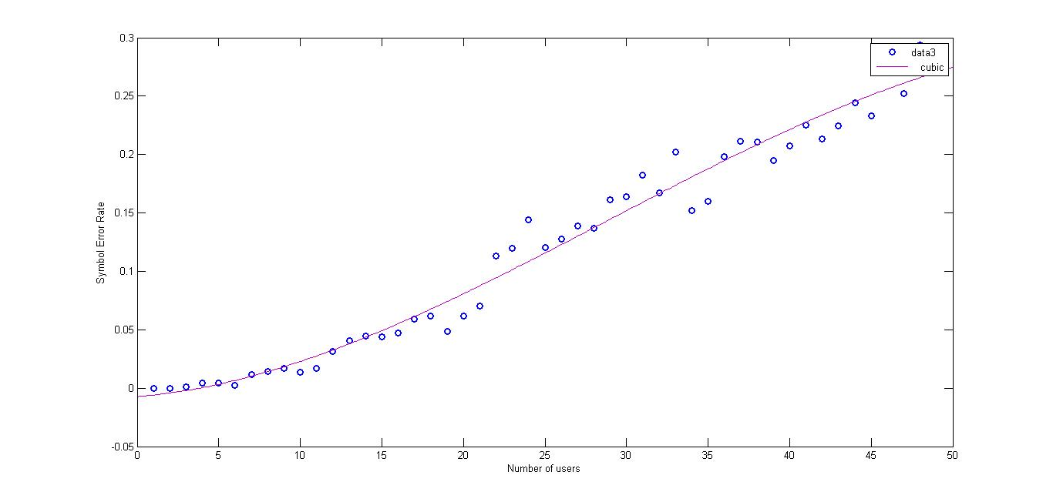
Lamda =2 (C-PPM)

Slide 29
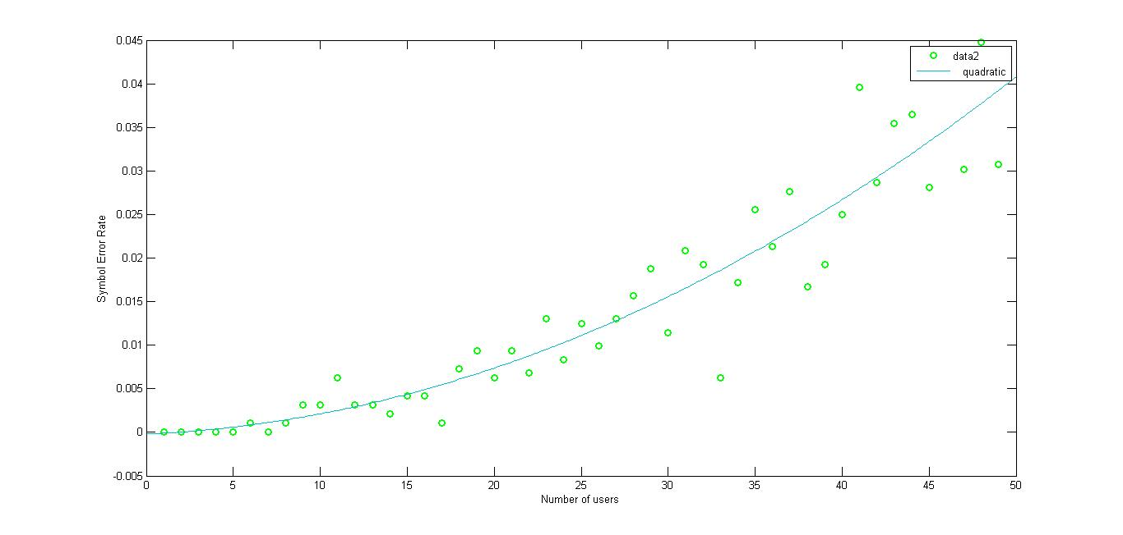
Lamda = 2 (N-PPM)

Slide 30
SWOT Analysis
SWOT
* Provide high data rates
* Immunity to high interference
* Used in UWB
* Compatible with optical fiber properties
* It only works for 2, 4, 8 and 16PPM
* Adopting this new method in many applications
* Fastens the spread of using UWB, which is considered to have potentially low complexity and low equipment cost
* This method is still under research

Slide 31
Conclusion
As a results of our simulation we conclude that our proposed method is more robust against multi-user interference.
Our recommendations
We strongly recommend that our proposed method to be implemented in reality and then compare the results of it with the simulated ones from one side and with the C-PPM from the other side

Slide 32
Future Work
As our proposed technique is novel, we are in the process of publishing our results in a high impact scientific journal

Slide 33


